Slide 1
0
Applesoft's Loaded Dice
The Truth About Randomness on the Apple II, Then and Now
Jeff Robison · VCF Midwest 21 2026
Notes:
Name and title. Fifteen seconds. No bio slide.
Worth considering: boot the machine cold, PRINT RND(1), reboot, same number. Do it three times before this slide. Then everything after is explaining something they already watched.

Slide 2
The Problem
1
PRINT RND(1)
.973136996
Notes:
Most of this room knows what a PRNG is. Keep it short.
The amber box is the part that has to land. Slide 4 depends on it.

Slide 3
What a random number generator is
2
Truly random
Pseudo-random
Comes from something physical. A die. Thermal noise. You can't compute it.
A formula. You give it a starting number. It does math on that number and hands back an answer. The answer becomes the next starting number.
Entropy is the key to sufficient randomness and unpatterned results.
Notes:
Most of this room knows what a PRNG is. Keep it short.
The amber box is the part that has to land. Slide 4 depends on it.

Slide 4
Integer BASIC, 1977
3
Woz wrote a generator at $EF4E
Built-in Seed
Known period with limited range
No Floating point
Sufficiently random
There's a counter at $4E and $4F that goes up while the monitor sits waiting for a keypress. Integer BASIC reads it.
Sander-Cederlof, Apple Assembly Line, August 1981.
Notes:
Say out loud that $4E/$4F is not a jiffy clock. That's a Commodore term. The Apple II has no timer doing this.
Don't make the regression argument yet. Just show what worked.

Slide 5
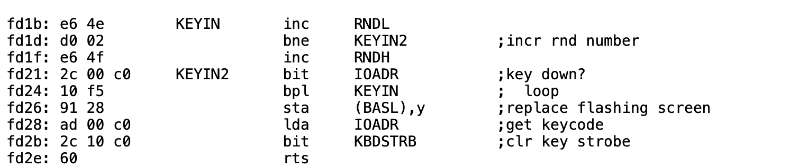
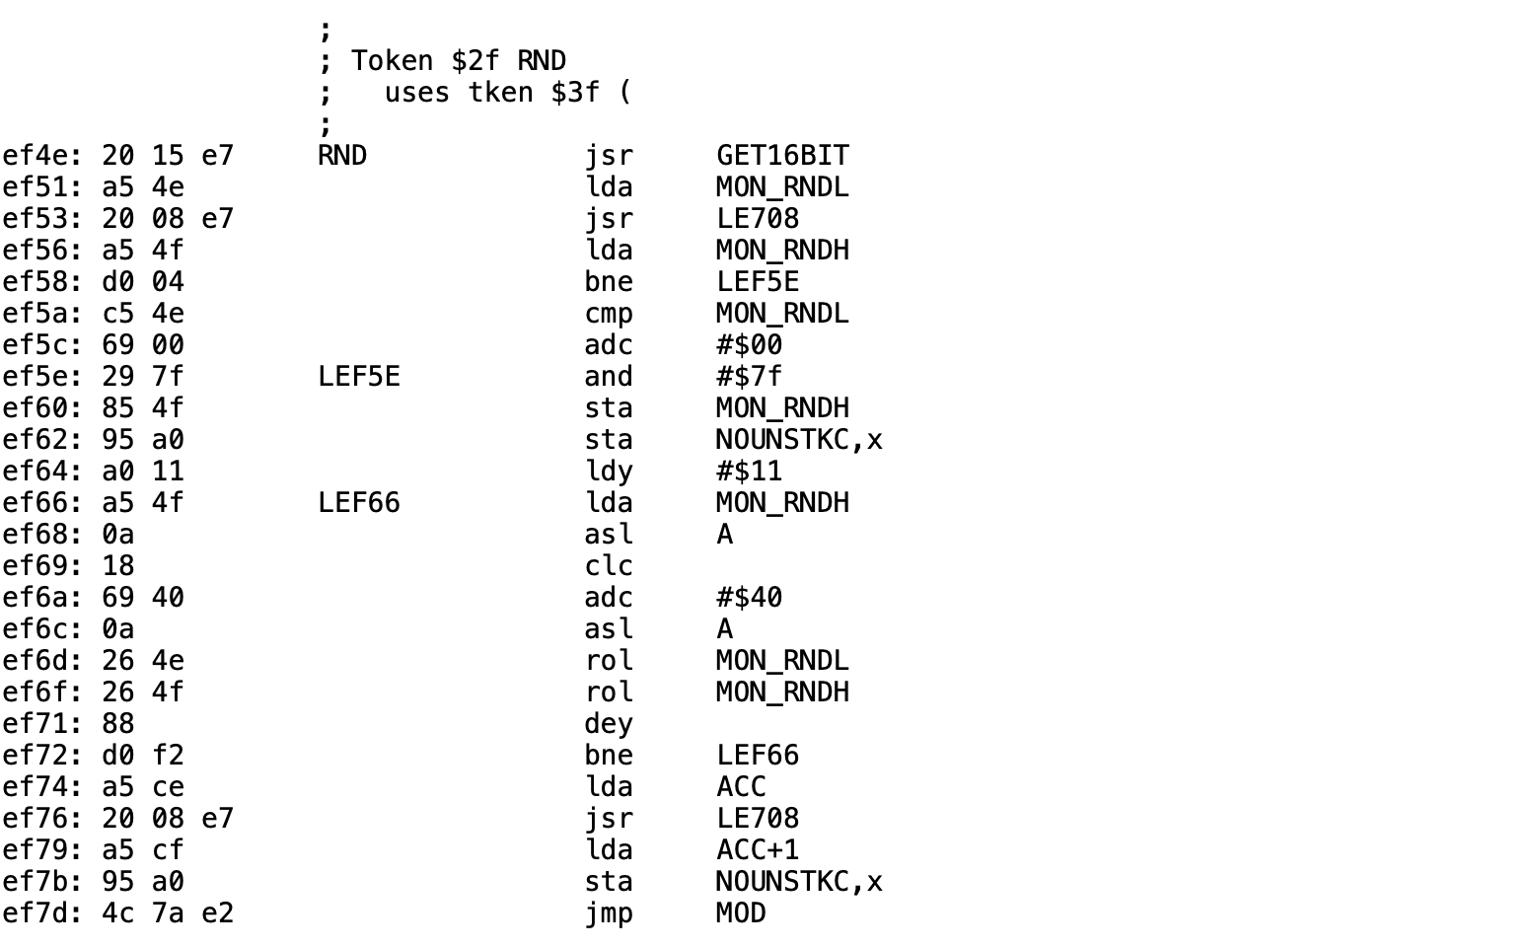
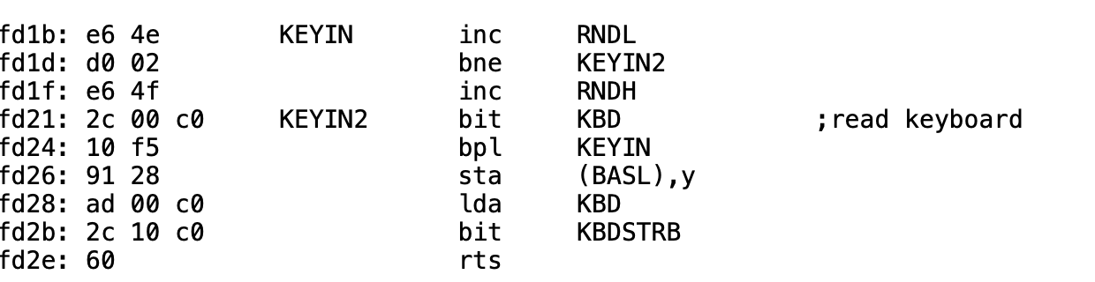
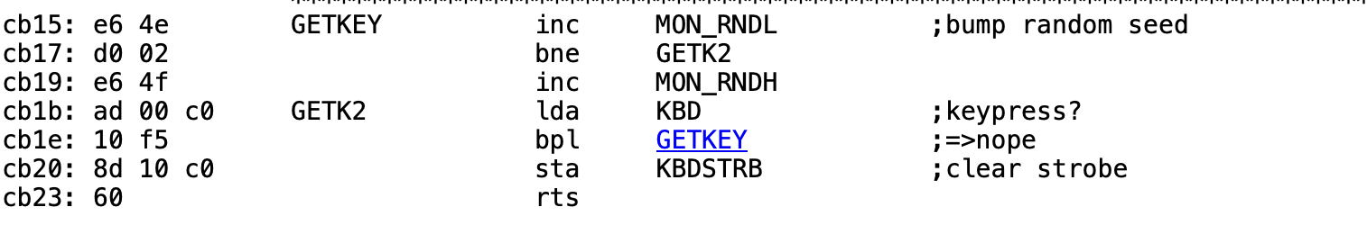
Built-in Entropy Source
4
Present in some form in all Apple II ROMs
Integer BASIC, at $EF4E
https://6502disassembly.com/a2-rom/OrigF8ROM.html
$4E/$4F
https://6502disassembly.com/a2-rom/AutoF8ROM.html
https://6502disassembly.com/a2-rom/IIc_16kb.html
https://6502disassembly.com/a2-rom/Unenh_IIe_80col.html
Notes:
Walk the left side first. Point at the bne going back to KEYIN. That's the whole entropy source.
The counter gets bumped before the keyboard is read, every pass. It's a loop count, not a keystroke count. Sit there two seconds and it's gone round tens of thousands of times.
Then the right side: the second thing Integer BASIC's RND does is read $4E.
Sources: 6502disassembly.com/a2-rom/OrigF8ROM.html and IntegerBASIC.html. Worth mentioning that Woz wrote Integer BASIC with no assembler, so there is no original source, only hand-written pages in a binder. The disassembly is Paul Santa-Maria's work, converted by Andy McFadden.

Slide 6
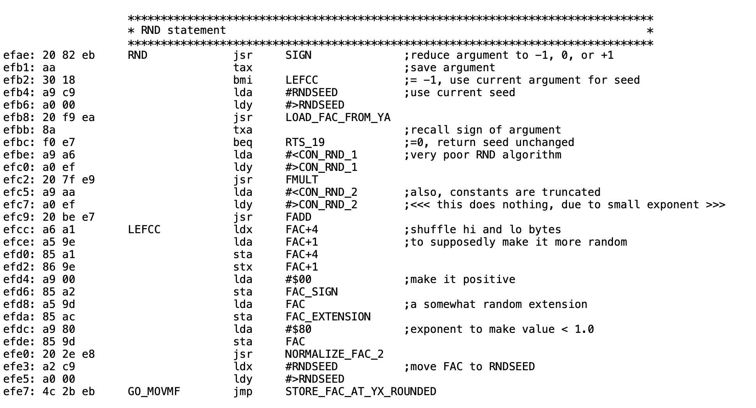
Applesoft, 1978
5
Applesoft relies on different seed
However, the seed for Integer BASIC remains.
What it does
Takes the seed at $C9, multiplies, adds, swaps two bytes around, forces the result under 1, writes it back to $C9.
Notes:
This is the whole thing. Twenty-six instructions.
Point at the top: the seed comes from $C9, which got a fixed value out of ROM at boot. Point at the bottom: the answer goes back to $C9. Nothing else feeds it.
If someone wants the source, this is McFadden's disassembly at 6502disassembly.com.

Slide 7

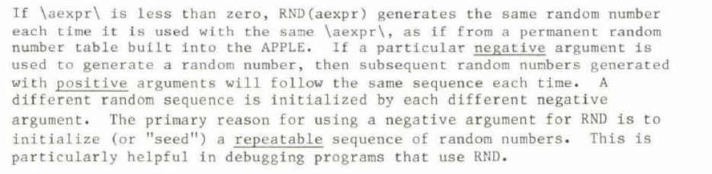
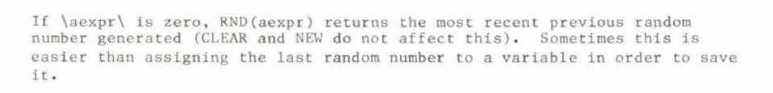
Applesoft Manual, 1978
5
RND(n)
RND(-n)
RND(0)
Notes:
This is the whole thing. Twenty-six instructions.
Point at the top: the seed comes from $C9, which got a fixed value out of ROM at boot. Point at the bottom: the answer goes back to $C9. Nothing else feeds it.
If someone wants the source, this is McFadden's disassembly at 6502disassembly.com.

Slide 8
Sources
7
Kaner & Vokey, 1982
First published account. Dr. Kaner sent me the paper directly.
Call A.P.P.L.E., Jan 1983
“RND is Fatally Flawed.”
Sander-Cederlof, AAL May 1984
Found the startup bug. The seed copy is off by one.
Aldridge 1987, Gleason 1988
Behavior Research Methods. ERIC EJ372427.
Empson, GS WorldView 1999
Built Moore's LFSR for the Apple II.
Notes:
Four decades of people finding the same thing and working around it one program at a time.
The 202 figure is measured, from the paper, on real Applesoft. Better than any secondhand claim about Commodore.

Slide 9
Two Part Solution
9
LC_Loader.bin
Enables language card write mode while keeping ROM readable
Copies $D000-$FFFF (all of Applesoft and the monitor ROM) from ROM to LC RAM
Writes the patch code into the LC at $F5CB. (may impact HFIND, supposedly unused by AppleSoft.)
Writes JMP $F5CB at $EFAE in the LC copy
Switches the language card to read mode
Patch_lc.bin
1. Preserves negative and zero RND() functionality while relying on the KEYIN counter present in the ROM.
Notes:
Somebody will say just seed it first. Say it yourself before they do, and agree with it for new code.
Then: you can't edit software you didn't write, the failure is silent so only people who already know can fix it, and this machine used to do it automatically.

Slide 10
Try it yourself
Jeff Robison · VCF Midwest 21 2026
Notes:
Link and QR. Nothing else.
Questions to expect: does the C64 have this too (yes, same Microsoft code, but Commodore wired RND(0) to hardware timers and gave people TI). Why not replace the generator (speed, no space, and RND(-n) has to keep working). What's at $F5CB (HFIND, answer it straight).

