Slide 1
AES and the Shift Drive
Sean Newell

Slide 2
[ Demo ]

Slide 3
Why Bother Trying?
Learn (apply knowledge)
Free MATLAB license from MathWorks
Trip to AES in NYC
Win money / MATLAB 4 LYF

Slide 4
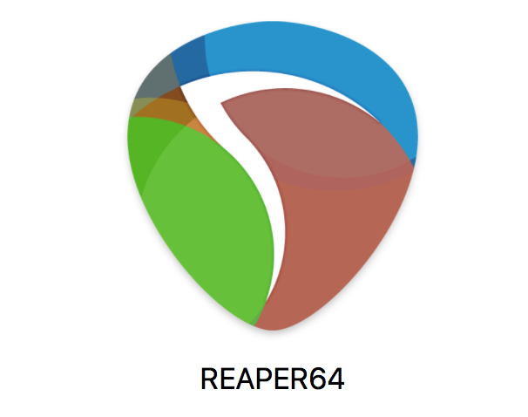
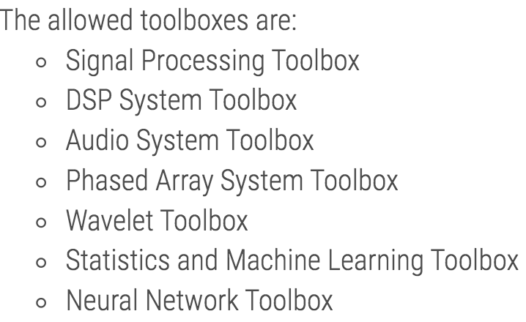
Tools/Reqs
Free MATLAB license and toolboxes
DAW for testing (Reaper is clutch)
Rules / Must have student membership
Use a team?

Slide 5
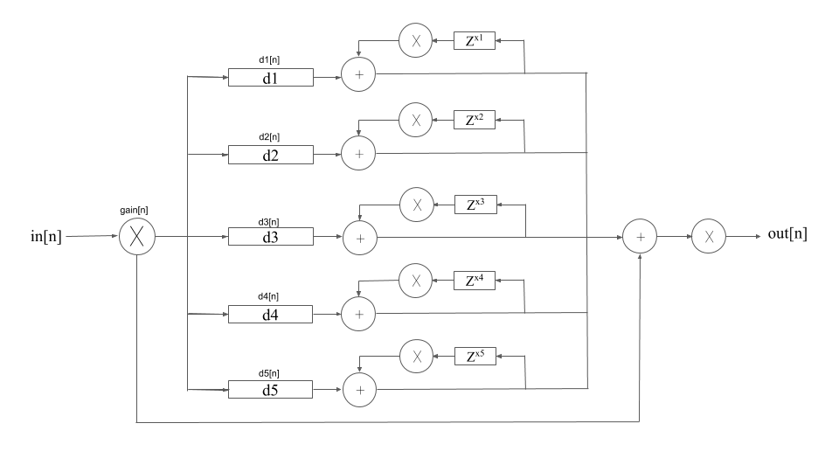
What I created

Slide 6
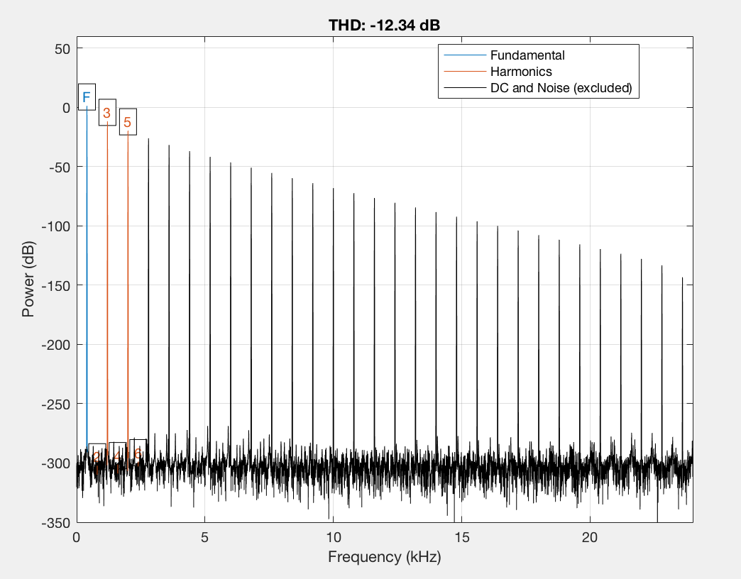
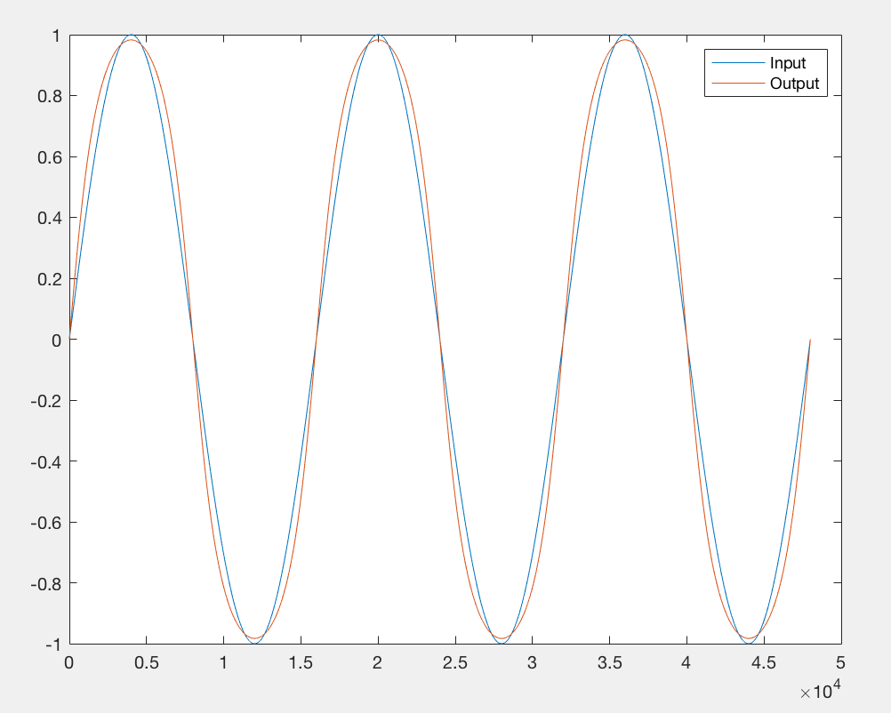
What I created
d1

Slide 7
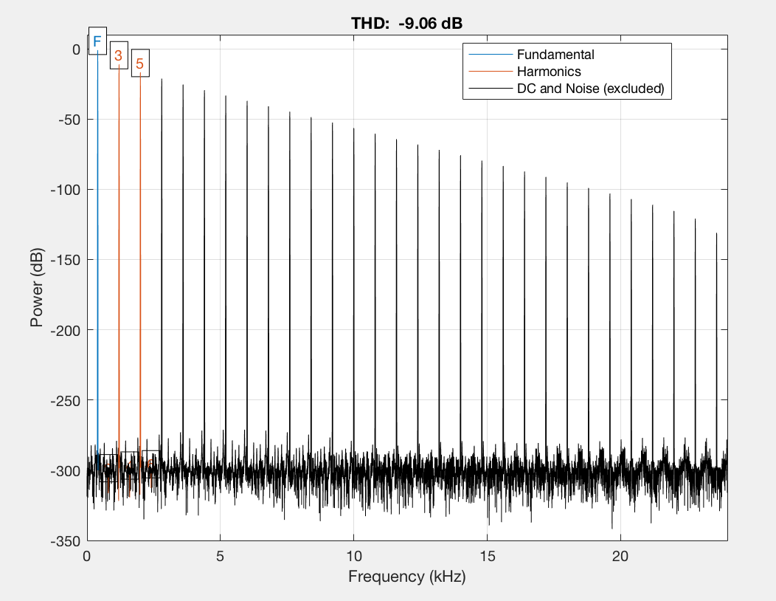
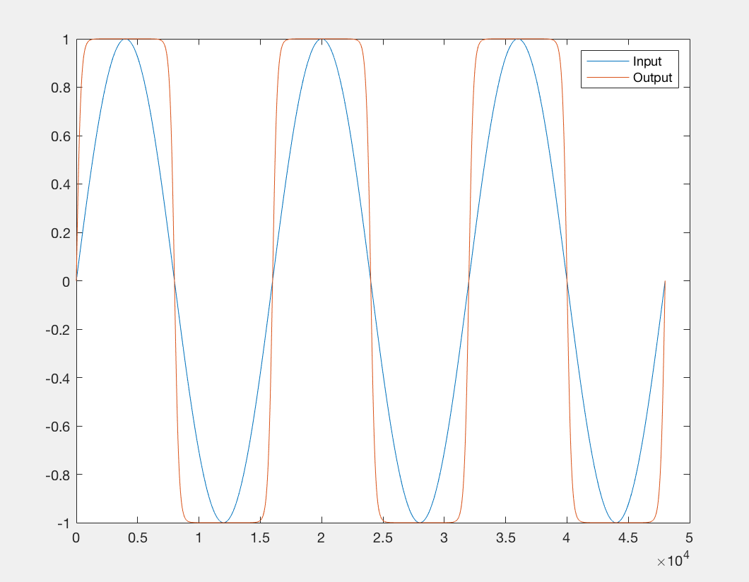
What I created
d2

Slide 8
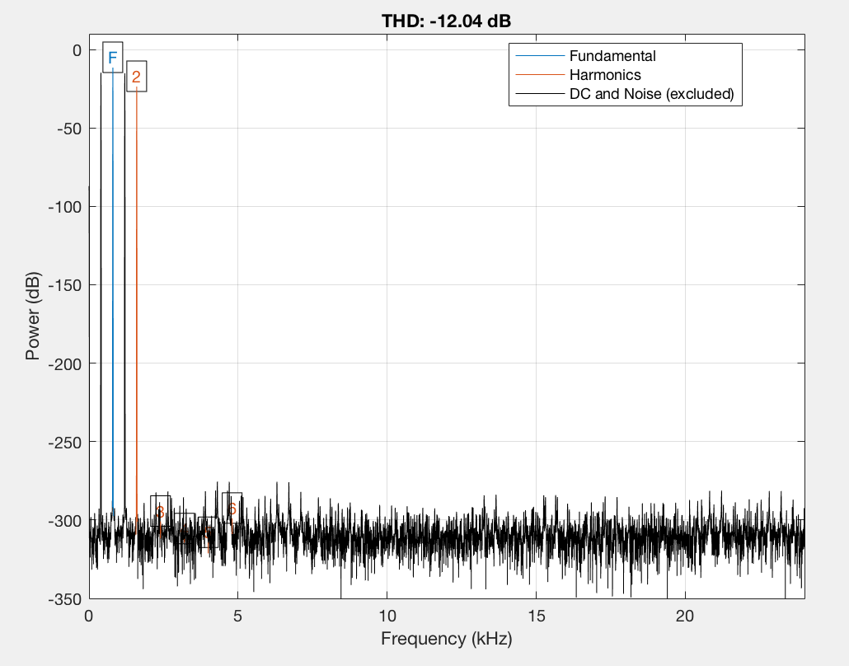
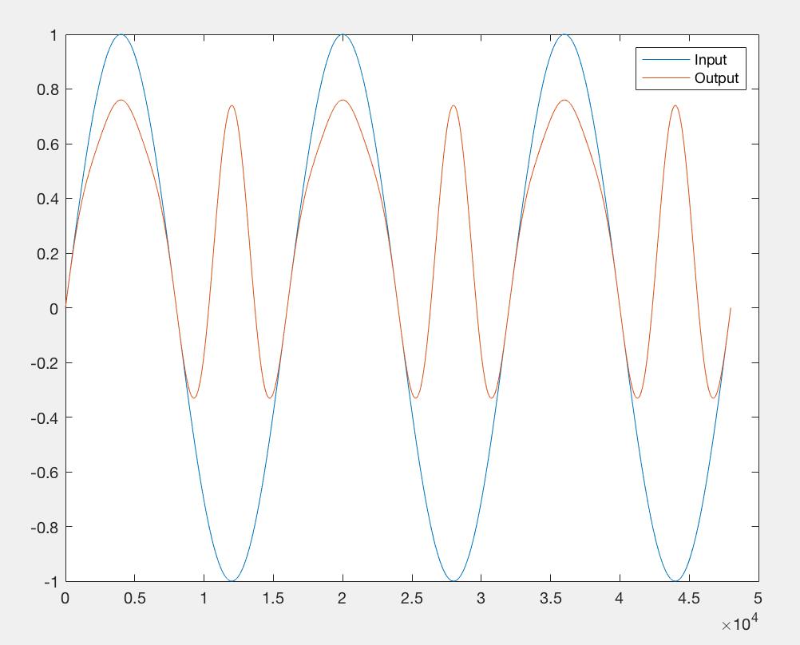
What I created
d3

Slide 9
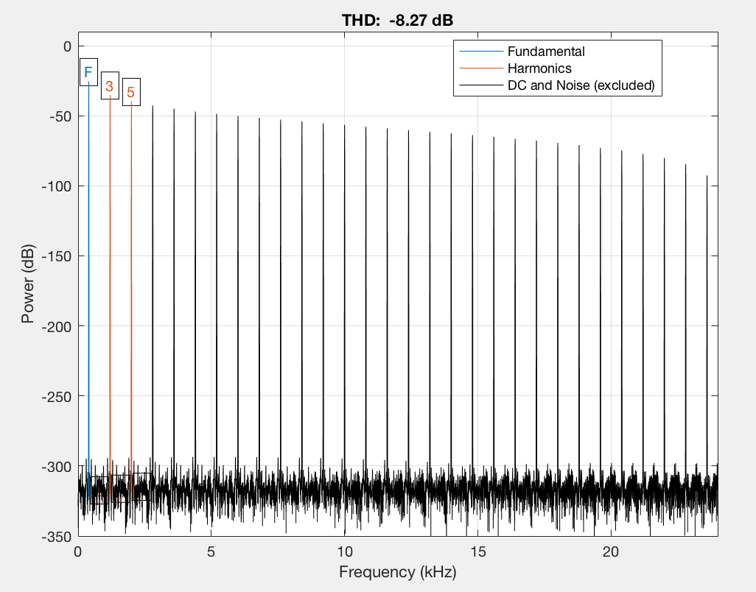
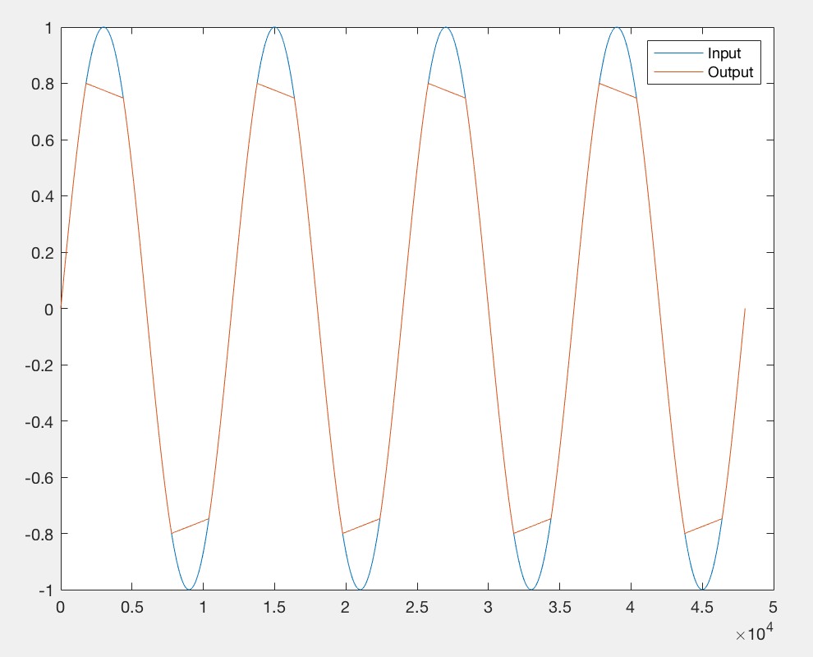
What I created
tc

Slide 10
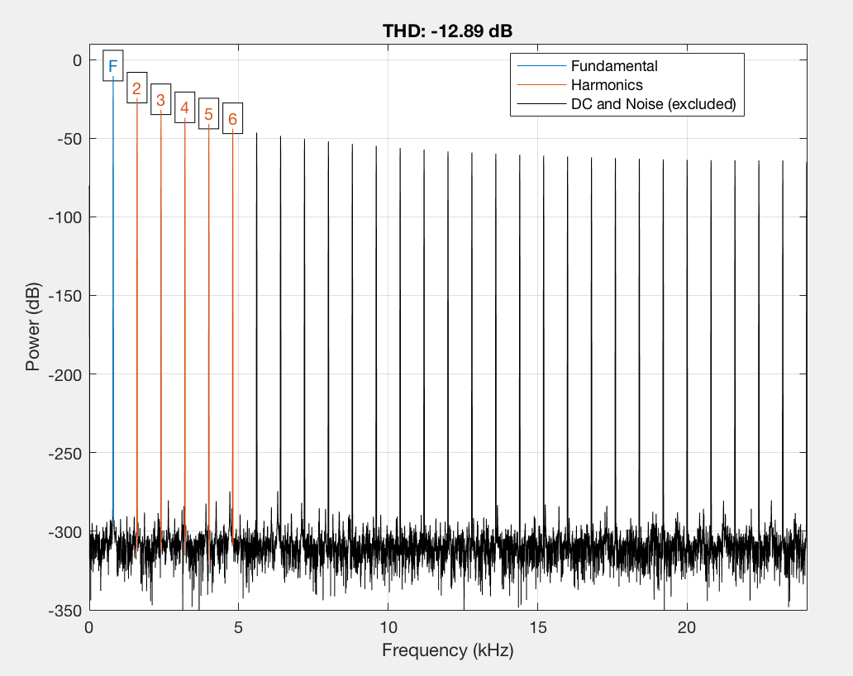
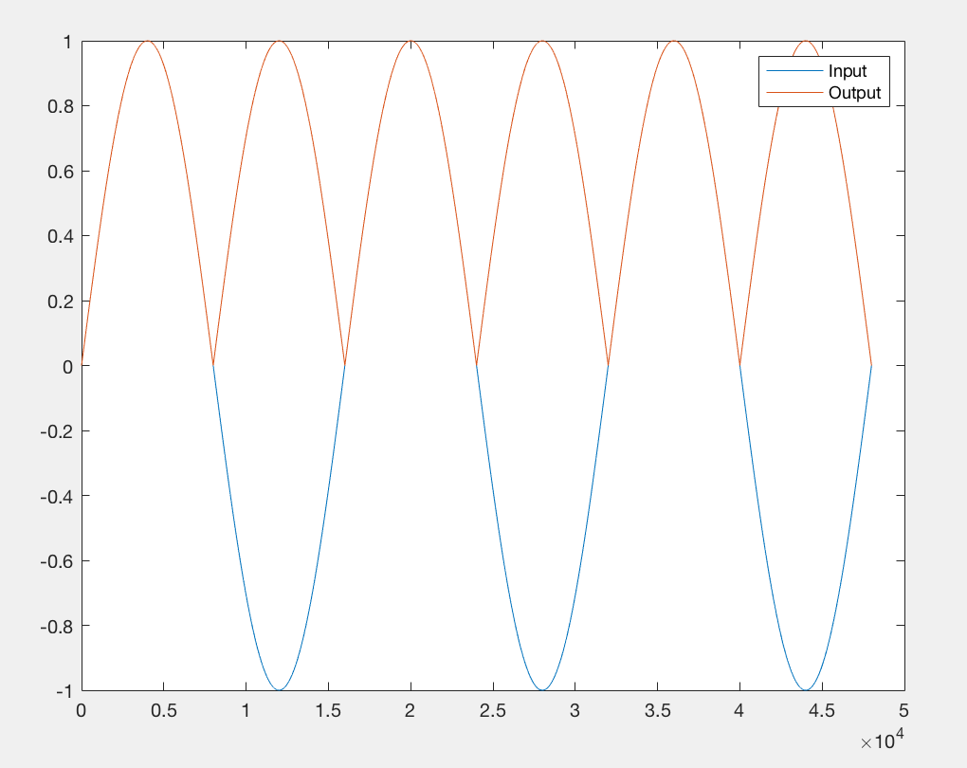
What I created
fwr

Slide 11
Object Oriented Programming (OOP)
Class
Inheritance: Basing a class off of another; the class will inherit all the properties from the other
Object1
Object2
Object3
F1
F2
F3
F1
F2
F3
F1
F2
F3

Slide 12
How I created it
[ code example ]

Slide 13
[ Questions ]

Slide 14
Find This Presentation Online
GitHub:
Username: seannewell
Repo: November-Meet-Up
Link: https://github.com/seannewell/November-Meet-Up

