Slide 1
CELL-TYPE ANNOTATION
Aging Adipose Atlas: 3-Month + 16-Month
WT Mouse Cell-Type Annotation
Marker-gene + differential-expression annotation on a 518,332-cell combined atlas, validated against PanSci's original labels
Sean / YY, Chih-Hao Lee · Lab Meeting · August 19, 2026
Notes:
Hi everyone. Today I'll walk through the aging atlas we built from 3-month and 16-month WT mouse adipose tissue — the focus is our own cell-type annotation, and at the end I'll validate it against PanSci's original labels. This should take about 5 to 10 minutes.

Slide 2
02
Motivation
• Aging is a key biological variable. Adipose tissue composition and cell states change with age, but most single-cell atlases only annotate one timepoint at a time.
• We built one combined atlas spanning both ages. 3-month and 16-month WT mice, 3 tissues, processed together end-to-end (518,332 cells) so cell populations can be compared directly across age within a single, consistently-processed dataset.
• The real question: does an independent marker-gene + differential-expression annotation pipeline agree with PanSci's own cell-type labels, cluster by cluster, across this combined aging dataset?
2
Notes:
Starting with motivation. Aging is a central variable in adipose biology, but most single-cell atlases only annotate a single timepoint. We processed 3-month and 16-month WT mice together in one pipeline, 518,332 cells total, so cell populations can be compared directly across age under the same standard. The core question: does our own marker-gene plus differential-expression annotation pipeline agree with PanSci's original labels, cluster by cluster?

Slide 3
03
Experimental Design
• Dataset: mouse adipose tissue — BAT, iWAT, gWAT, WT only, 3-month + 16-month, 518,332 cells total (3-month: 297,137 · 16-month: 221,195)
• Batch design: Harmony integration uses tissue as the only batch key — age is deliberately kept as a biological signal, not removed as a technical batch effect
• Annotation strategy: marker-gene scoring → Wilcoxon differential-expression cross-check → targeted sub-clustering wherever a cluster's identity was ambiguous
• Validation: cross-tabulate our final labels against PanSci's own main_cell_type annotation for the same cells
3
Notes:
The dataset covers three adipose tissues — brown, subcutaneous, and visceral — WT genotype only, 3-month plus 16-month, 518,332 cells total. One key design choice: Harmony integration only uses tissue as the batch key, not age, because age is the biological signal we want to observe, not a technical batch effect to remove. Annotation starts with marker-gene scoring, cross-checked with differential expression, and any ambiguous cluster gets further sub-clustering. Finally we cross-tabulate our results against PanSci's own original labels.

Slide 4
04
Annotation Pipeline
1 QC filter
2 Doublet removal
3 Normalize + scale
Remove low-quality cells/genes; WT + age filtering applied before doublet detection
Scrublet, batched per mouse
normalize_total, log1p, top variable genes (batch = tissue), z-score scaling
4 PCA + Harmony
5 Leiden clustering
6 Cell-type annotation
50 PCs → batch-corrected on tissue only — age preserved as biological signal
Cluster the integrated, batch-corrected embedding
Marker scoring + DE validation + sub-clustering for ambiguous clusters
4
Notes:
All six steps run on the same combined 3-month + 16-month WT dataset — one consistent script, not separate runs per age group.
Step 1, QC filter: we remove low-quality cells and genes (WT and age filtering is applied here too, before doublet detection — that way we never waste time running Scrublet on cells we'd discard anyway).
Step 2, doublet removal: Scrublet runs per mouse (batched by animal ID, not pooled, since doublet rates can differ mouse to mouse).
Step 3, normalize + scale: normalization, HVG selection, and scaling all use tissue as the batch key (not age — age is the biological signal we want to keep, not remove).
Step 4, PCA + Harmony: PCA down to 50 components, then Harmony integration (same batch key, tissue only, for the same reason — age has to survive this correction so it can still be compared afterward).
Step 5, Leiden clustering: we cluster the integrated, batch-corrected embedding.
Step 6, cell-type annotation: marker scoring plus differential-expression validation — any cluster without one clean matching signal gets sub-clustered further, which is exactly how the rare types on the next slide were found.

Slide 5
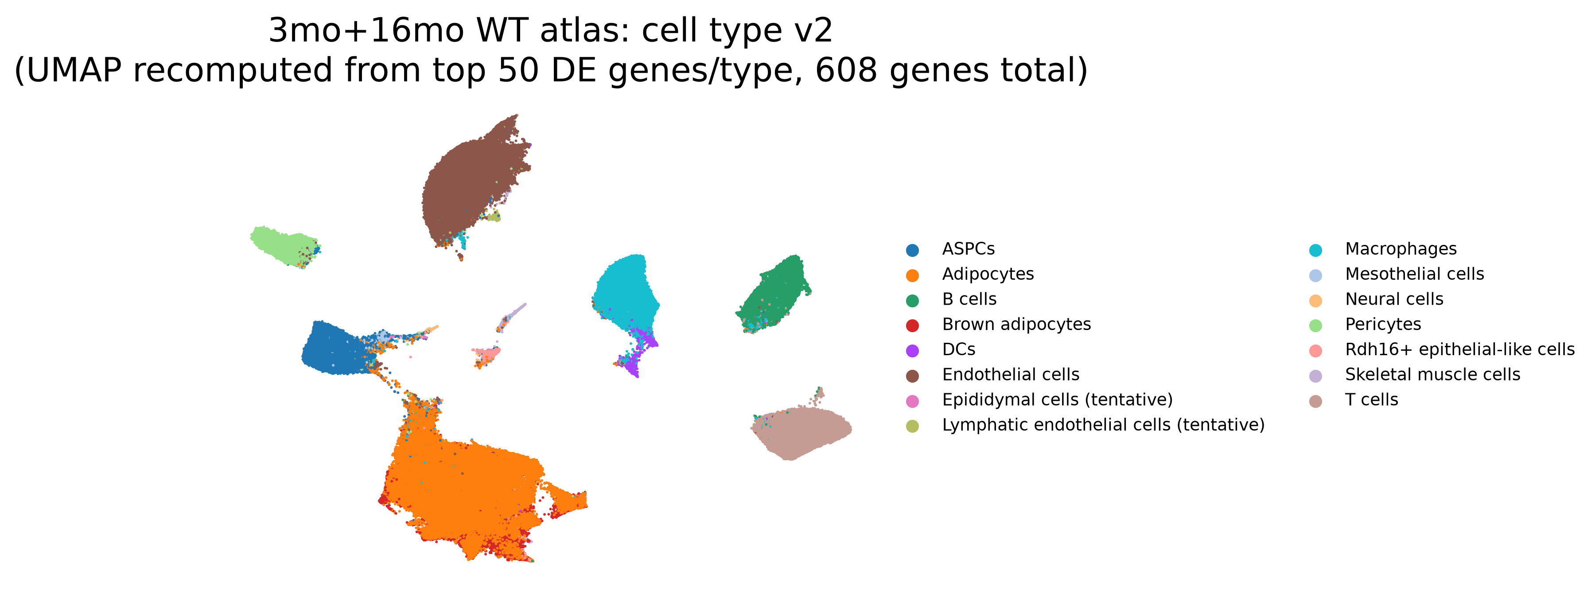
05
Results: Final Cell-Type Annotation
• 15 cell types identified across 518,332 cells
• 5 new types resolved only through sub-clustering: Rdh16+ epithelial-like cells, Neural cells, Mesothelial cells, Epididymal cells (tentative), Lymphatic endothelial cells (tentative)
• Independent validation: embedding recomputed using each type's top 50 marker genes (608 genes total) still separates all 15 types cleanly
5
Notes:
This is the final cell-type annotation — 15 cell types across 518,332 cells. Five of them are rare populations that the cluster-level pass couldn't resolve on its own; they only emerged through targeted sub-clustering: Rdh16+ epithelial-like cells, neural cells, mesothelial cells, epididymal cells, and lymphatic endothelial cells — the last two are still marked tentative since their signal is weaker. This UMAP also carries an extra check: instead of using the original HVG space, the embedding was recomputed using only each type's top 50 differentially-expressed marker genes — 608 genes total — and it still separates all 15 types cleanly, showing those markers alone are enough to support this clustering result.

Slide 6
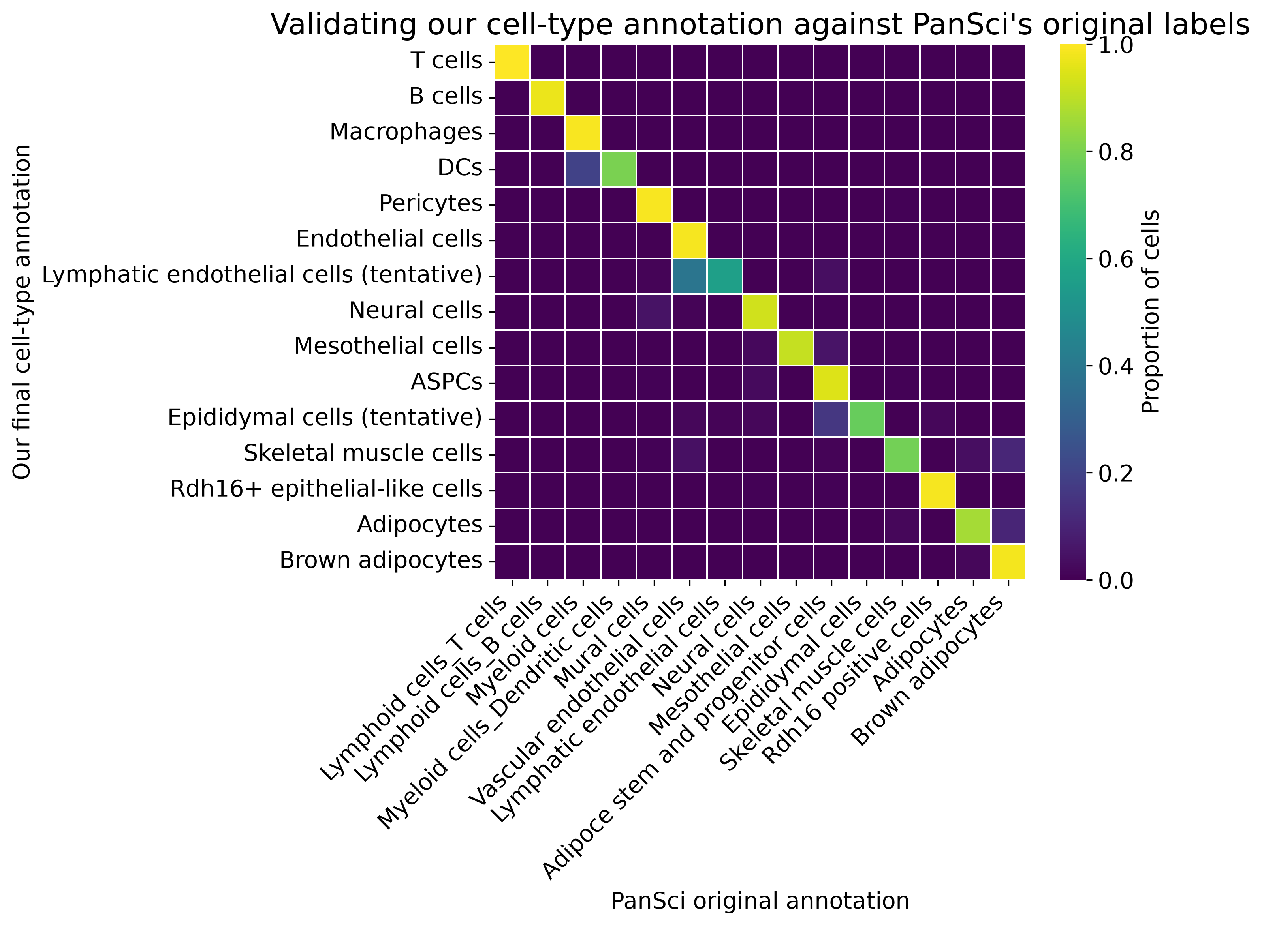
06
Results: Validation Against PanSci's Labels
• Clean diagonal — our independent annotation converges with PanSci's own cell-type calls
• 11 / 15 types exceed 85% concordance with PanSci's original labels
• Remaining 4 are genuinely rare populations, resolved via sub-clustering and documented as tentative
6
Notes:
This is the similarity matrix — the x-axis is PanSci's original labels, the y-axis is our final annotation, and brighter yellow means a higher proportion. The diagonal is very clean, which means our independently-derived annotation largely agrees with PanSci's own labels. 11 out of 15 types exceed 85% concordance with PanSci. The remaining 4 — DCs, skeletal muscle cells, epididymal cells, and lymphatic endothelial cells — are genuinely rare populations that only came out through sub-clustering; the last two are still marked tentative since their signal is weaker. We honestly document that their signal isn't as clean, rather than treating it as an unfinished analysis.

Slide 7
07
Key Takeaways
Concordance | Match rate | Cell types
≥ 95% | 97 – 100% | T cells, Macrophages, Pericytes, Endothelial cells, Rdh16+ epithelial-like cells, Brown adipocytes, B cells
85 – 95% | 87 – 95% | ASPCs, Neural cells, Mesothelial cells, Adipocytes
Rare / tentative (sub-clustering resolved) | 56 – 80% | DCs, Skeletal muscle cells, Epididymal cells (tentative), Lymphatic endothelial cells (tentative)
7
Notes:
To summarize in three tiers. Tier one: 7 types match PanSci at 95% or above — T cells, Macrophages, Pericytes, very clean signal. Tier two is 85 to 95%, covering ASPCs, neural cells, mesothelial cells, and adipocytes. Tier three is the genuinely rare, noisier group of 4 — DCs, skeletal muscle cells, and two tentative populations: epididymal cells and lymphatic endothelial cells — all of which only surfaced through extra sub-clustering. They sit at 56 to 80% concordance, but their destination is clearly documented.

Slide 8
08
Next Steps
• This talk: building and validating the 3-month + 16-month WT aging atlas — cell-type annotation only
• Next: poster presentation (10 minutes), building on this report together with the July 31 preprocessing-benchmark talk
8
Notes:
This talk covered building the aging atlas and validating our cell-type annotation. The next step is to turn this into a poster, a 10-minute presentation combining this report with the July 31 preprocessing-benchmark talk.

Slide 9
Thank You
Notes:
Thank you — that's the report. Happy to take questions.

