Slide 1
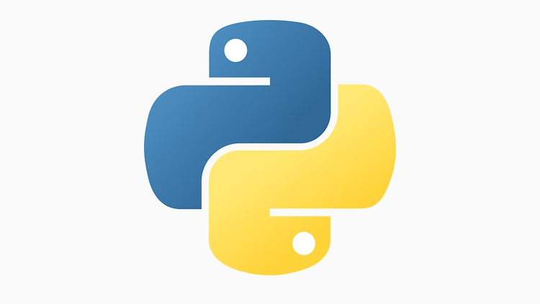
Python Bootcamp
Sean Morrison

Slide 2
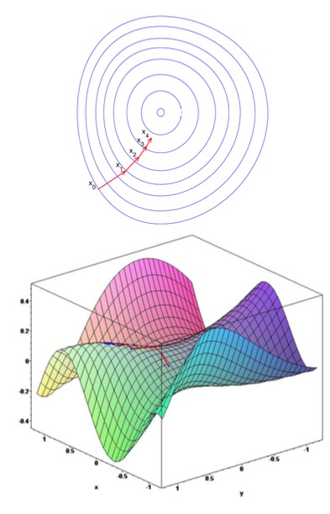
Topics
What is Python?
Why use Python?
Installing Python and using the Spyder IDE
Programming basics, Python 101
Worked example: quadrotor simulation

Slide 3


What is Python?
Interpreted programming language;
Aims for simplicity, readability.
Invented in 1991; has since become the fastest growing language.
Runs on a virtual machine – as long as you have the VM installed, you can run python on any operating system.

Slide 4

Why Use Python?
Easy to learn, easy to read.
“Productive” language. Can implement code quickly.
Many open-source libraries; scientific and numerical packages (numpy, scipy).
Pip package manager makes installing and using libraries easy.
Ubiquitous; can easily share code repositories or Jupyter Notebooks with others.
HPC – Python is installed by default on *nix-like operating systems.

Slide 5
Why Use Python?
Excellent glue language. Do fast computation in C/C++, and call from Python.
Virtual environments make code development very easy.
Machine learning is built on Python (supplanting R in some cases).
Major software often includes support for Python scripting (ROS, Excel, MATLAB, etc.)
Programming is extraordinarily useful – can easily test concepts. If you can understand it, you can build it.

Slide 6
Installing Python
Go to https://www.anaconda.com/download/
Grab the Python 3.7 installation file for your OS and install it.
Open the anaconda prompt (Terminal for MacOS users), type the following, and hit Enter:
spyder
This will launch the Sypder IDE, where we can start coding!

Slide 7
Installing Python
Once you’ve launched Spyder, download python_workshop from the RMIT UAS Team Google Drive.
Unzip the folder to your desktop.
Navigate to the python_workshop folder in Spyder to make it your working directory.
This will let you play with and run the code examples provided with this workshop.
How to use Jupyter Notebooks:
Open a terminal and type jupyter notebook, hit Enter
Click on the notebook you would like to view.
To run a cell, press Shift+Enter

Slide 8

Our First Program
In the script window, type the following:
print(“Hello, world!”)
Save it and press the run button:
You should something like the following in your console:
See the example file hello_world.py

Slide 9
Variables
Hold information that we need.
Variables in Python are “duck-typed”.
Variable types: integer, float, double, boolean, list, dictionary, set, string.
Examples given in variables.py, and in the Variables jupyter notebook.

Slide 10
Variables
Some simple examples:
x = 1
y = 1
x + y = z
x = “Hello, ”
y = “my name is Boris.”
z = x+y
print(z)
Booleans are either True or False.

Slide 11
Variables
Python also has lists:
x = []
x.append(y)
x.insert(0,y)
List operations:
x = [1, 2, 3]
y = [4, 5, 6]
z = x+y
print(z)
print(len(z))
x = [[a],[b],[c]]

Slide 12
Variables
Dictionaries:
animals = {“cat”: x,
“dog”: y}
Can access using:
cat = animals[“cat”]
dog = animals[“dog”]
Very useful for storing or organizing variables.
Remember: lists are indexed from 0 onwards.

Slide 13
Variables
Can access elements of a list:
x = [1, 2, 3, 4, 5]
a = x[2]
print(a)
y = [[1, 2, 3],[4, 5, 6],[7, 8, 9]]
b = y[0][2]
print(b)

Slide 14
Variables
Can slice elements from a list or an array using [:] notation:
y = [[1, 2, 3],[4, 5, 6],[7, 8, 9]]
b = y[0][:]
print(b)
Note that the convention changes slightly between standard Python lists, and numpy arrays.
What happens if we do a[-1] for a 1D list a?

Slide 15
Variables
Typecasting – sometimes we need to tell the interpreter what type a variable is. As an example:
a = 10/5
Do we need “a” to be an integer or a float? If int, we have to typecast it:
a = int(10/5
If you do this to a non-integer, it will truncate it (drop the decimal values).
Sometimes need to do this for lists. For example:
for x, y in reversed(list(zip(xs, ys))):
print(x)
print(y)
If you are unsure of a variable’s type, you can use:
print(type(a))

Slide 16
Operations & Conditional Statements
We want to be able to modify variables.
These are typically standard mathematical operations.
Also includes logical comparisons and True/False statements.
See the file operations.py
See the Flow Control jupyter notebook

Slide 17
Operations
Standard mathematical operations: +, -, *, /
x = 5
y = (x+1) *5/3-7
z = x**2
Note that power operations in Python use **, not ^
Also many operations that can be imported from math:
from math import sin, cos, tan, sqrt, pi
x = sin(pi)+3*cos(pi)+tan(pi)-sqrt(2)

Slide 18
Operations
Can also do logical operations:
a = 1>0
b = not a
c = type(a) is str
print(a)
print(b)
print(c)
Remember: logical equality uses “==“. This is different to assignment, which uses the “=“ sign.

Slide 19
Conditional Statements
Motivation: use a logical operator to determine whether to execute a block of code:
if x >= y:
print(”x is greater than or equal to y”)
if not a and not b:
print(“both a and b are False”)
if a or b:
print(“either a or b is True”)
See conditional_statements.py

Slide 20
Loops
Motivation: often want to repeat operations without rewriting a lot of code. E.g. summing all numbers from 1 to n.
Loops are the bread and butter of most programs (i.e. the program you are using is running a while loop right now).
For loops will run for a set number of iterations, while loops require a termination condition.
See the file loop.py
See the Loops jupyter notebook

Slide 21
Loops
A for loop and a while loop:
y = 0
for x in range(1, 101):
y += x
running = True
n = 100
while running:
y -= n
n -= 1
if n == 0:
break
print(“y = ”, y)

Slide 22
Loops
Can also loop through lists:
numbers = [1, 2, 3]
for x in numbers:
print(x)
And in reversed order:
for x in reversed(numbers):
print(x)

Slide 23
Loops
What if we want to loop through a list and refer to the index?
numbers = [5, 4, 3, 2, 1]
for i, x in enumerate(numbers):
print(“i: {}, x: {}”.format(i, x))
What if we have several lists?
list_1, list_2 = [5, 4, 3, 2, 1], [10, 9, 8, 7, 6]
for x, y in zip(list_1, list_2):
print(“x: {}, y: {}”.format(x, y))

Slide 24
Loops
Finally, we have list comprehension – build lists rapidly using loops:
a = [x for x in range(5)]
Can also nest list comprehension:
a = [[x+y for x in range(3)] for y in range(3)]
Advantages: very fast since it leverages underlying C code (i.e. this is intended “Pythonic” syntax)

Slide 25
Functions
Motivation: wrap a block of code so that we can apply it repeatedly. Saves having to rewrite code!
Functions take zero or more inputs called arguments.
They can return a value, multiple values, or just do “something” without returning anything.
Functions can be recursive (advanced).
See the corresponding slide for examples.
See the Functions jupyter notebook

Slide 26
Functions
def x_squared(x):
return x**2
def calculate_lift(cd, rho, vel, area):
lift = cd * 0.5 * rho * vel**2 * area
return lift
def get_aircraft_velocity():
return aircraft.velocity
See simple_fns.py

Slide 27
Functions
Functions don’t have to take an argument:
def bark():
print(“woof”)
def plot_data():
data = aircraft.data
fig = plt.figure()
plt.plot(data.x, data.y)
plt.show()

Slide 28
Functions
See intermediate_fns.py
def simulation_step():
forces = calculate_forces()
dx_dt, dy_dt = calculate_accelerations(forces)
x += dx_dt*dt
y += dy_dt*dt
return x, y

Slide 29
Recursion
Functions can be self referential (i.e. they call themselves):
def fib(n):
if n == 0:
return 0
if n == 1:
return 1
else:
return fib(n-1)+fib(n-2)
Nice and short, but not always better. In this case, recursion is very inefficient.
See fib.py

Slide 30
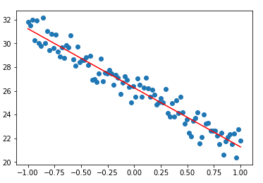
Nested functions
Can also nest functions. See optim.py
def optimize_f(theta, x, y_hat):
def cost(pred, targ):
loss = –0.5*(pred-targ)**2
grad = targ-pred
return sum(loss)/len(loss), grad
while True:
y = theta*x
loss, grad = cost(y, y_hat)
theta += sum(grad*x*alpha)/len(x)
if sum(grad)/len(grad) < thresh:
break

Slide 31
Lambda Functions
Lets you define a function on a single line.
f = lambda x: x**2
y = 5
print(f(y))
Can also nest lambda functions:
f = lambda x: (lambda y: sqrt(y)) (x**2)
y = 2
print(f(y))
See lambda_fns.py

Slide 32
Variable Arguments
Sometimes want to vary the number of arguments you pass to a function. Do this with *args and **kwargs.
def test_var_args(f_arg, *argv):
print "first normal arg:", f_arg
for arg in argv:
print "another arg through *argv :", arg
test_var_args('yasoob’, 'python’, 'eggs’, 'test')

Slide 33
Classes
Motivation: lets us reuse code! Allows code to be organized easily.
Classes are typically used to create objects that have certain properties.
They form the basis of Object Oriented Programming, and modules.
See the file classes.py for some working examples.
See the Classes jupyter notebook

Slide 34
Classes
class Dog:
def __init__(self, name, breed, height, weight, age):
self.name = name
self.breed = breed
self.height = height
self.weight = weight
self.age = age
def bark(self):
print(“woof”)
This is our dog class. It has a name, a breed, a height, a weight, and an age. Dogs also bark, so we’ve created a function for our dog called “bark”

Slide 35
Classes
How do we use classes? We initialize them like variables:
fido = Dog(“fido”, “labrador”, 0.45, 30, 7)
fido.bark()
This is called instantiation, and the object is called an instance.
Practical example: simulating multiple aircraft. Each vehicle has its own mass, inertia matrix, dimensions, etc.
What if we want to go more abstract? E.g. quadrotors and fixed wing aircraft are both aircraft. Can we create a more abstract object that encapsulates both?

Slide 36
Inheritance
Sometimes you want to add further structure to your code. E.g. cats and dogs are both pets. Can we define a “Pet” class, and then break it down into further specializations?
This is called inheritance. Classes can inherit from one or more other classes, which gives them access to the parent class’ functions.
Lets us extend the functionality of the base class while minimizing the amount of rewritten code.
Allows for easy instantiation of complex objects (factory methods).
See inheritance.py

Slide 37
Inheritance
Example, let’s say we want a generic pet class:
class Pet:
def __init__(self, name, species):
self.name = name
self.species = species
def print_name(self):
print(self.name)

Slide 38
Inheritance
Now we have a dog class that inherits from Pet. Not all pets bark, ony dogs do.
class Dog(Pet):
def __init__(self, name):
super(Dog, self).__init__(name, “Dog”)
def bark (self):
print(“Woof.”)

Slide 39
Inheritance
If you create a new instance of class Dog:
spike = Dog(“spike”, True)
fido = Pet(“fido”, “Dog”)
spike.print_name()
spike.bark()
fido.print_name()
fido.bark()
What happens when we try fido.bark()?

Slide 40
Inheritance
class First:
def __init__(self):
super(First, self).__init__()
print("first")
class Second:
def __init__(self):
super(Second, self).__init__()
print("second")
class Third(First, Second):
def __init__(self):
super(Third, self).__init__()
print("third")
This is an example of multiple inheritance: the class Third inherits from both First and Second. What will happen when we run this code?

Slide 41
Inheritance
What if we need to change a method in the parent class?
We override it in the child class:
class Dog(Pet):
def __init__(self, name):
super(Dog, self).__init__(name, “Dog”)
def print_name (self):
print(“This is the child class.”)

Slide 42
Modules and Libraries
A module contains methods and classes that can be imported into other code.
Motivation: easily port code between projects.
Until now we’ve been using single scripts, but more complex projects require more complex machinery. This is a good time to discuss __main__

Slide 43
Modules and Libraries
Importing code is fairly straightforward:
import os
import time
import numpy as np
from collections import namedtuple
from scipy import *
We can also import our own code from other files if they are in the same folder structure.
We can install modules into our environment with pip:
pip install numpy
This is typically done through the terminal prompt.

Slide 44
What is __main__?
Programs need to start somewhere.
Our scripts so far have just run from start to finish.
Other languages like Java include a main() function that the machine looks for to know where to start the program.
In python, we use:
def main()
do_stuff()
if __name__ == "__main__":
main()
If you have multiple scripts, one of them should include your main loop, and import the others as necessary. Your main script will generally include the snippet of code to the right.

Slide 45
Advanced Concepts
Decorators
Generators and yield
Error handling: if you get an error, your program will crash. In many cases (though not all) this is undesirable. Can prevent the program from crashing by using error handling – try/catch
Multithreading/parallel computing: if you have n independent calculations, which is faster?
Calculate one at a time for i = 1:n; or,
Do all n calculations at the same time?

Slide 46
NumPy and SciPy
Modules for scientific and numerical computing;
Similar to MATLAB, but free, and comes with the advantages of an object-oriented programming language;
Can combine with other modules to rapidly prototype and solve problems in optimization, machine learning, dynamics and control.
Disadvantages: no Simulink analog, no official support.
See the Numpy Jupyter Notebook

Slide 47
Project
Impossible to learn a language in a day – even covering all of a language’s features is difficult.
The best way to learn any language is to use it a lot.
Find a problem to solve, and attempt to solve it.
Today’s problem to solve: quadrotor simulation.
See handouts.
Make sure to use your cheat sheets!

