Slide 1
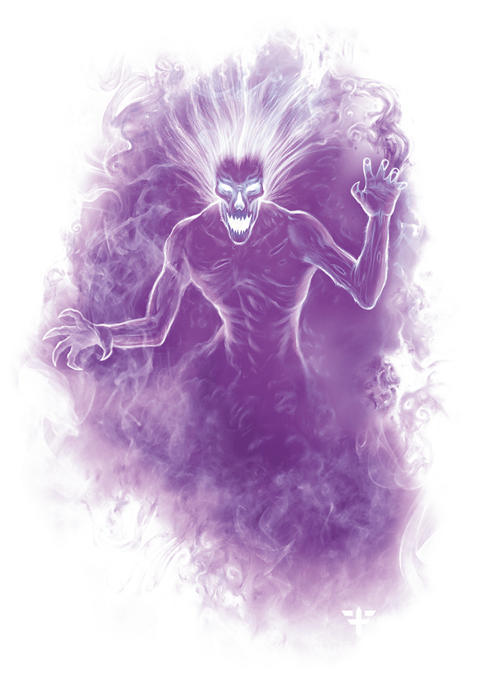
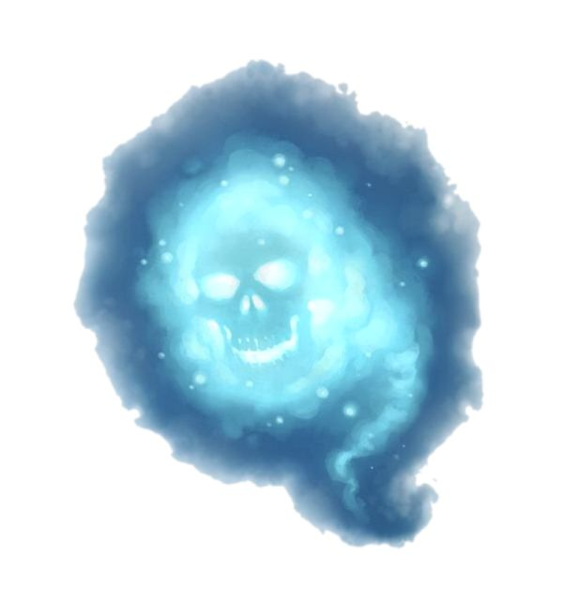
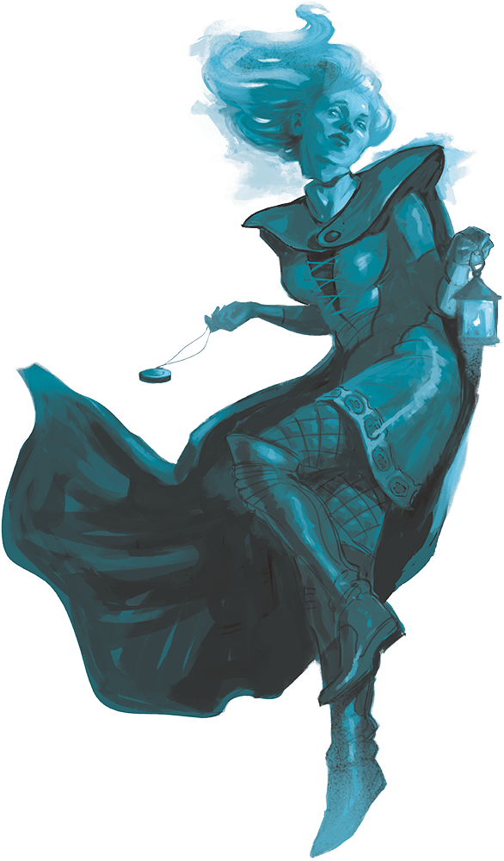
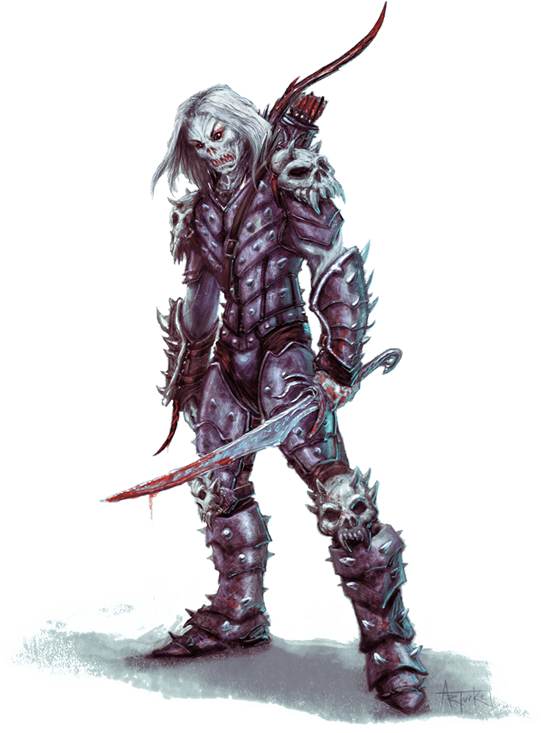
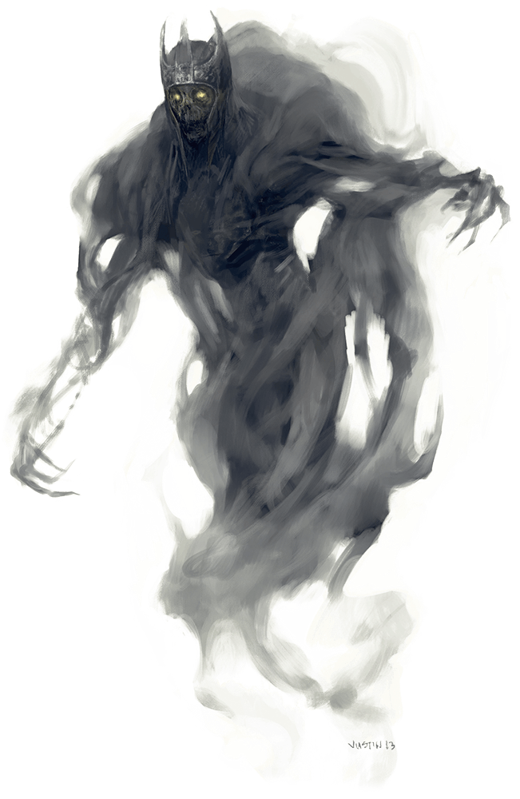
Tân Annwn
Will-o’-Wisp
Ysbryd
Ghost
Weddyn
Wight
Weddyn
Wight
Drychiolaeth
Specter

Slide 2
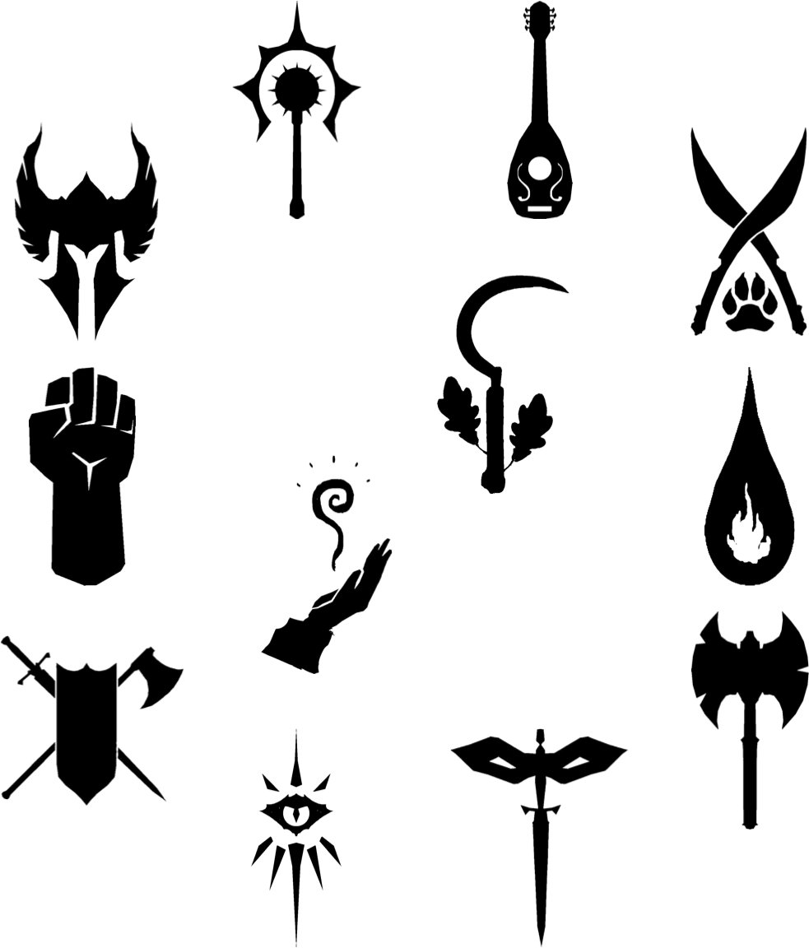
Clerig
Cleric
Bardd
Bard
Crwydryn
Ranger
Paladin
Paladin
Derwydd
Druid
Myfyrydd
Monk
Swynydd
Sorcerer
Dewin
Wizard
Gwylltyn
Barbarian
Ymladdydd
Fighter
Dyhiryn
Rogue
Llochesydd
Warlock

Slide 3
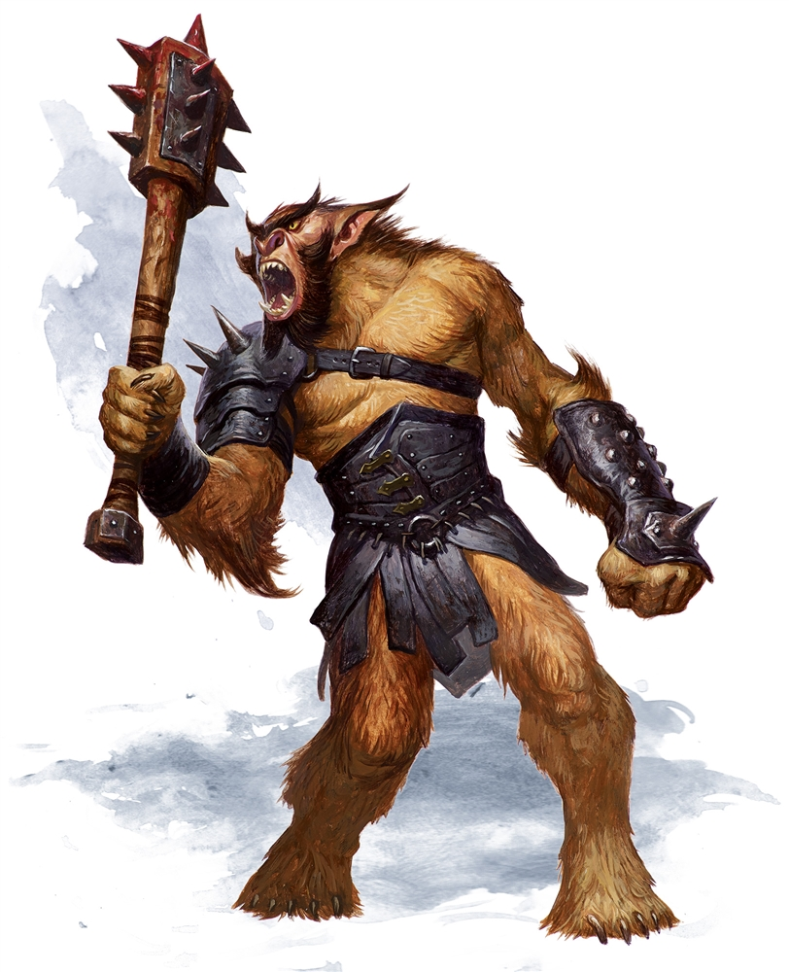
Bugbear =
“Bwgarth”
?
púki (devil)
Old Icelandic
puca (goblin)
Old English
Bwgan
(bad thing)
Middle Welsh
bocanách
(supernatural being)
Middle Irish
bugge
(scarecrow/beetle)
Middle English
bugbear
(frightening thing)
bwgan (scarecrow)
bwgwl (threat)
púca (spirit)
Modern Irish
bogey (spirit)
bwci-bo (spirit)
Puck (fairy)
bug (beetle)
Modern Welsh
Modern English

Slide 4
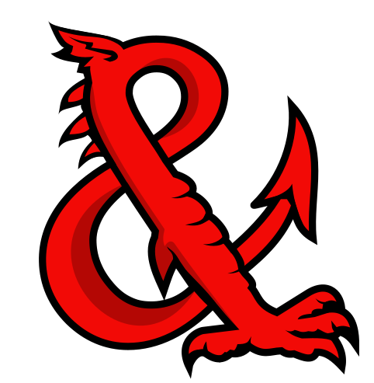
HP – Heini Presennol
AC – Anhawster Curo
DC – Dosbarth Caledrwydd
DM – Deddfmeistr

Slide 5
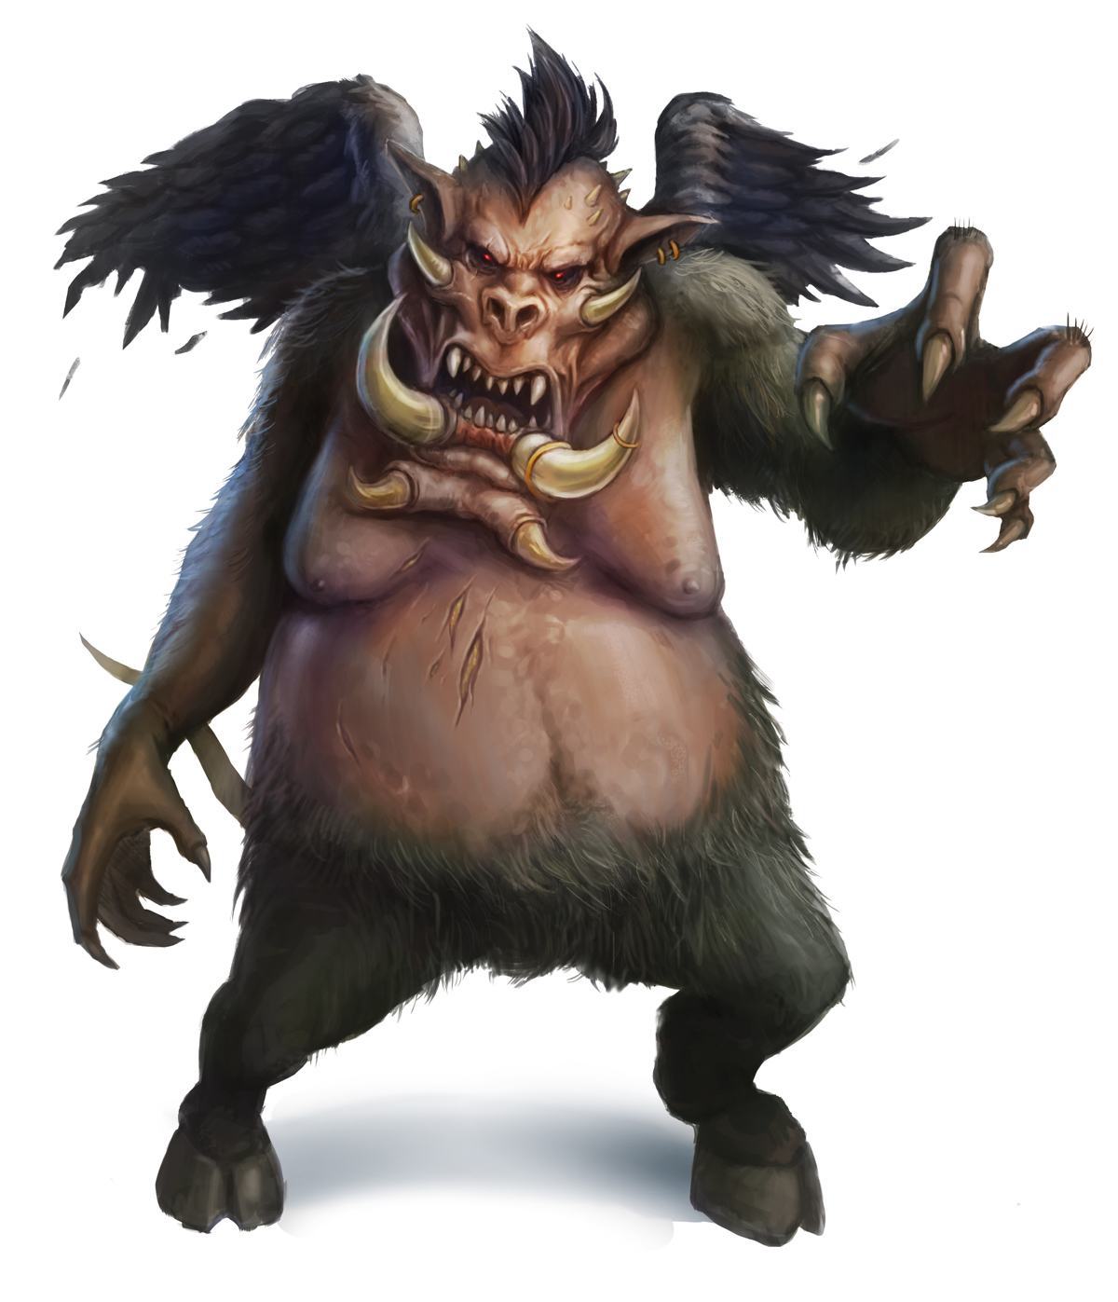
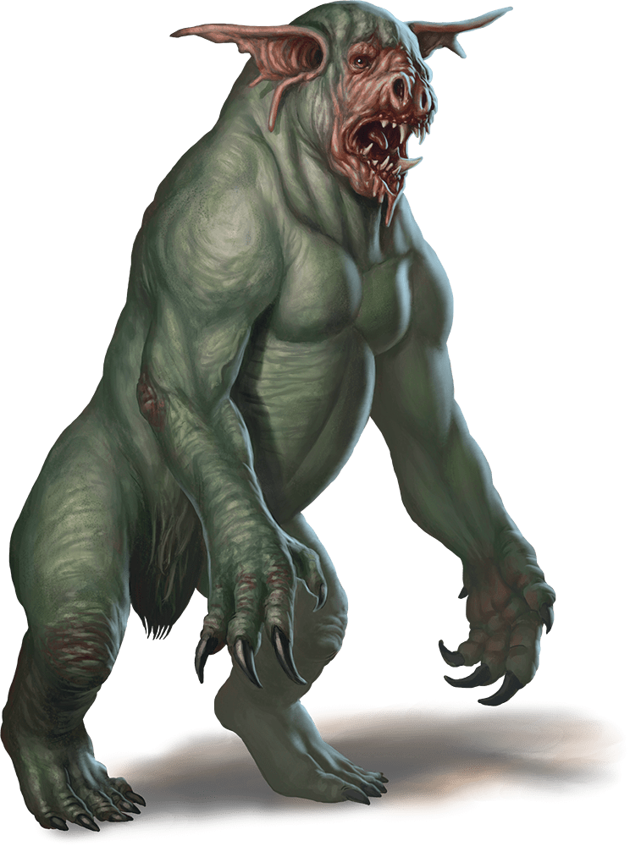
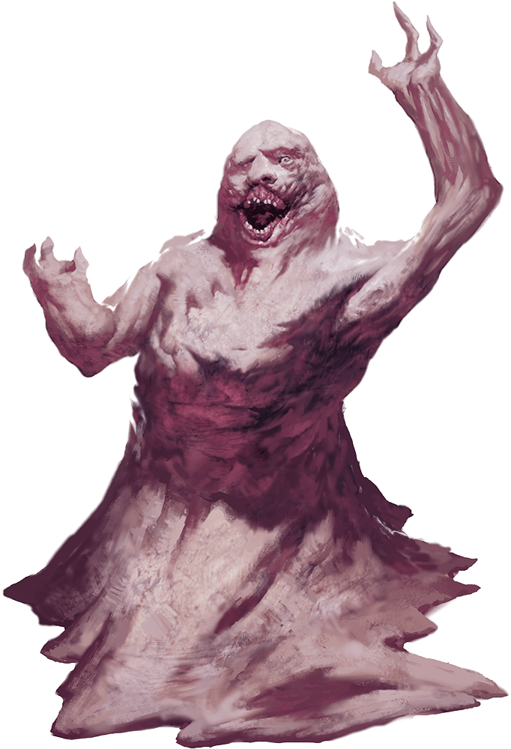
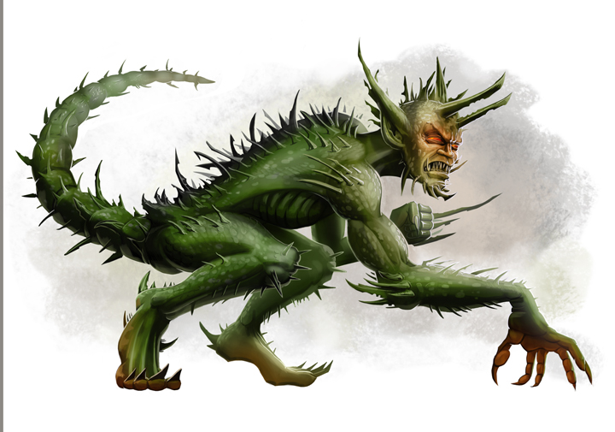
Cythreuliaid
(Demons)
Diafoliaid
(Devils)
Trochyn
(Dretch)
Baeddraul
(Nalfeshnee)
Isddiafol
(Lemure)
Diafol Adfachog
(Barbed Devil)
I also had to decide on words for various categories of monster, like demons and devils
(from immersion/drench)

Slide 6
There are established Welsh words for a surprising number of D&D monsters:
Flying Snake = Gwiber,
Cockatrice = Ceiliocsarff ,
Griffon = Edn Griff ,
Lamia = Llamia ,
Salamander = Pry y tân (‘fire worm’),
Wyvern = Gwyfryn ,
Basilisk = Y Fad Fawr (‘the big death’)
But I had to make some names up:
Ettercap (originally from ‘atter’ (poison) + ‘cop’ (spider)) = Gwenwyngop (poison + spider)
Owlbear (owl + bear) = Tylluarth (tylluan + arth)
Lich (fromOld English ‘lic’ (corpse))= Abaryn (Abar = corpse/corrupt + ‘one’)
Blink Dog (dog from the Fey) = Ci Annwn (dog from Annwn)
Bugbear = Bwgarth

