Slide 1
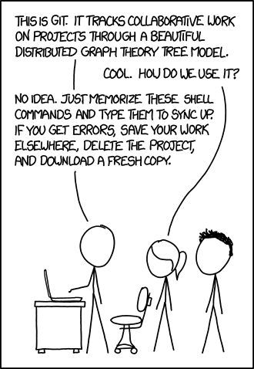
Tutorial on Git and Github
Have you:
Installed Git?
https://git-scm.com/book/en/v2/Getting-Started-Installing-Git
Installed a modern text editor?
Windows: Notepad ++
Mac: TextWrangler
Signed up for a GitHub account?
www.github.com

