Slide 1
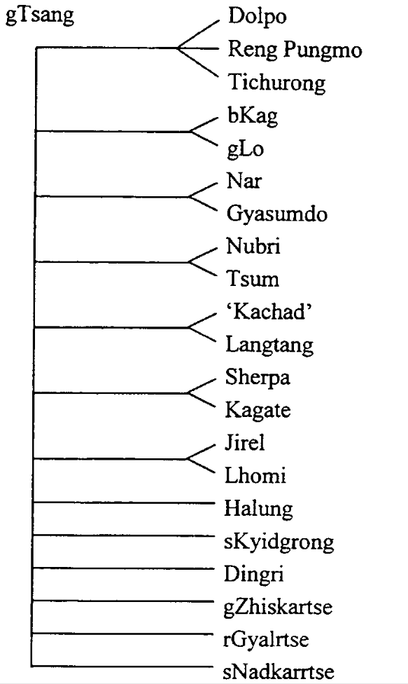

Slide 2
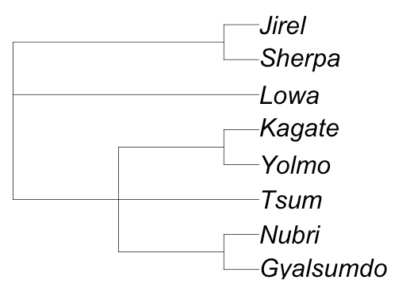
208 (68)
0
600 (41)
0
0
854 (81)
601 (60)
671 (70)
Need 313 items to get coverage of Jirel list
Other languages: Dolpo, Tichurong, Humla, Kyerung,, Lhomi, Mugom, Naaba, Walungge

Slide 3
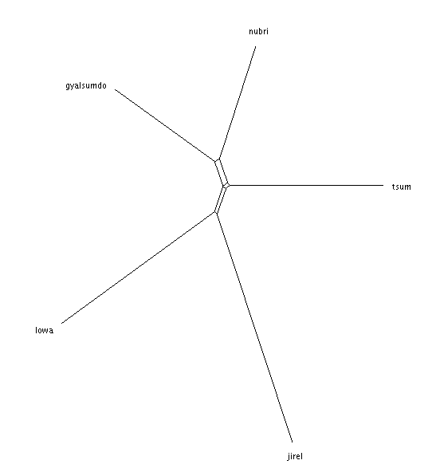
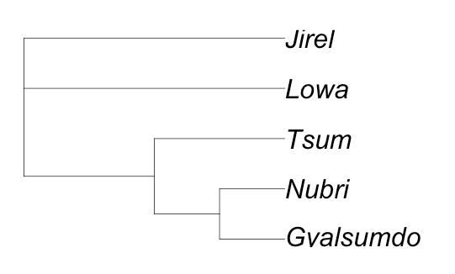
119 concepts

