Slide 1
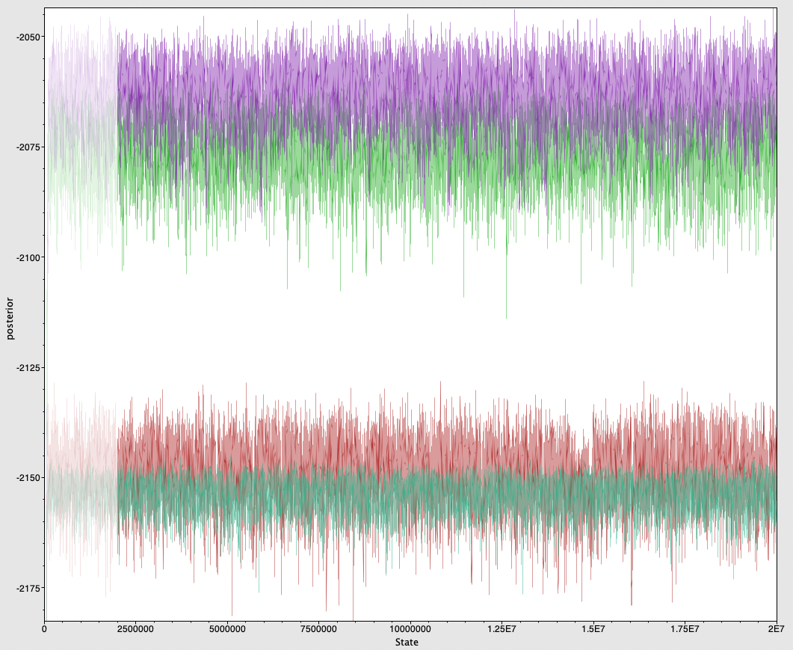
3 site models
2 site models
1 site model
Strict clock

