Slide 1
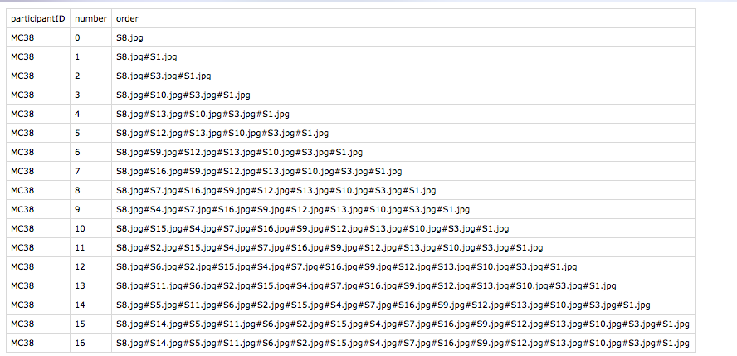
The storyOrder folder contains two types of file.
Files like this show the order of images in the first task. Each change to the storyline bar is tracked, so the last line should show the full order.
Files like this show the consent questions

Slide 2
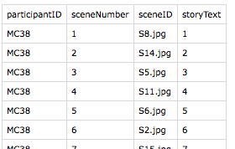
The “tellStoryOrder” folder has files like this. It tracks the story text for each image.
The “storyOrderMostImportant” folder has files like this. It tracks the final survey.

