Slide 2
You will now play a memory game
?

Slide 3
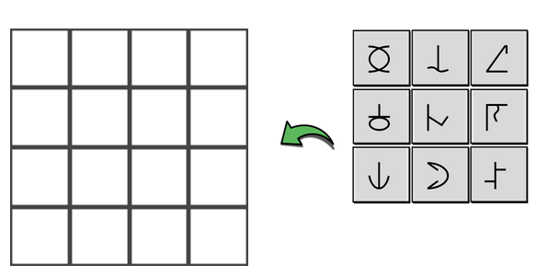





You will see 5 symbols in a grid:
?

Slide 4
Remember the symbols and their positions
?

Slide 5
You have 30 seconds to memorise them
?

Slide 6
Then you’ll see a blank grid and the symbols to the right.
?

Slide 7

Drag the symbols into the correct position.
?

Slide 8
You have 20 seconds to drag all the symbols!
?

Slide 9
If you make a mistake, drag a symbol to a new position
?

Slide 10
Or drag it off the board to delete it.
?

Slide 11

When the time is up, you’ll be told if you were correct
?

Slide 12
You will play 3 rounds of the game. Try to be as accurate as possible!
?

Slide 13
Get Ready!

