Slide 2
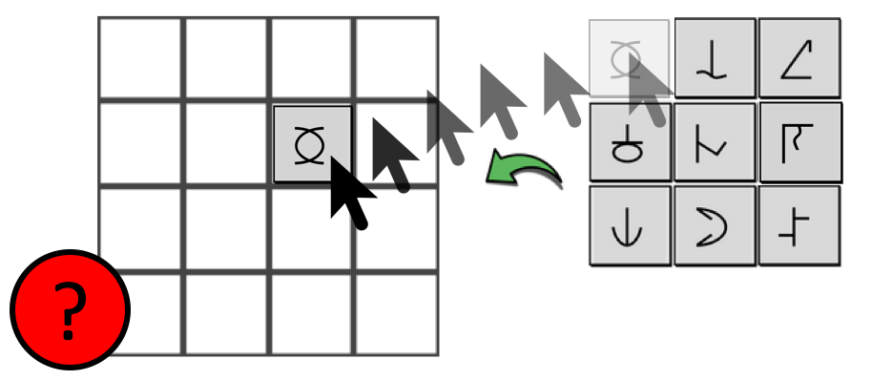
You will now play a memory game. You will see 5 symbols in a grid. Remember the symbols and their positions. You have 20 seconds to memorise them.
Then you’ll see a blank grid and the symbols to the right.
Drag the symbols into the correct position. You have 20 seconds to drag all the symbols!
If you make a mistake, drag a symbol to a new position or drag it off the board to delete it. When the time is up, you’ll be told if you were correct.
You will play 4 rounds of the game. Try to be as accurate as possible!

