Slide 1
Really Looking Beyond GDP
FAND vs CWoN — Diverging Policy Signals
Appendix E | v6 (May 2026) | Data: RT_RPC workbooks + CWon2024.xlsx
Notes:
This presentation compares two frameworks for measuring national wealth: FAND, the First Agentic Navigator for Development; and CWoN, the World Bank's Changing Wealth of Nations. FAND is not affiliated with the Bank but revisits its pioneering wealth metrics, the buried lede in its 1995 MEP, Monitoring Environmental Progress.
As MEP did on page 65, FAND proposes a Balance Sheet where Total Assets, or Wealth, capitalizes per capita income estimates the Bank uses for operational guideline purposes.versio
Now as then,
The challenge is recognizing and valuing components, and what may enhance and what impair future income production. CWoN lacks such a holistic goal.

Slide 2
Main Purposes of World Bamk
(i)… encouragement of the development of productive facilities and resources in less developed countries
(ii)…when private capital is not available on reasonable terms, to supplement private investment by providing, on suitable conditions, finance for productive purposes out of its own capital, funds raised by it and its other resources.
…
Articles of Agreement
Appendix E | v6 (May 2026) | Data: RT_RPC workbooks + CWon2024.xlsx
Notes:
This presentation compares two frameworks for measuring national wealth: FAND, the First Agentic Navigator for Development, and CWoN, the World Bank's Changing Wealth of Nations. Both frameworks agree that understanding wealth requires decomposing value into price and quantity. V equals Q times P. But they make fundamentally different choices about how to handle prices — and those choices cascade through every component of the balance sheet. FAND prefers to admit that index number problems are intractable. Only nominal values travel hierarchically. CWoN, like most mainstream indicator sets, presumes money is a veil you strip away to see what is "real." It deflates everything into constant dollars using component-specific chained deflators. This presentation shows why that matters — with data from ten countries spanning the development spectrum.

Slide 3
The Core Disagreement
CWoN Approach
FAND Approach
Money is a veil — strip it away
Component-specific chained deflators
Each wealth component gets its own P
Focus on Q ≡ V/P ("real" quantities)
Unit Value or P = V/Q suppressed
Quality adjustments and TFP in limbo
Money matters. No one seeks ‘real’ profits
Index number problems are intractable
Single universal deflator (for Atlas GNI)
Only V rolls up (Who, What, Where, When)
Preserves relative prices across
Relative progress (e.g., US = 100)
Appendix E: Minding Our P's and Q's | FAND vs CWoN
Notes:
CWoN follows the mainstream approach: treat money as a veil, strip it away with deflators, and focus on "real" quantities. Each wealth component gets its own price index — produced assets, human capital, natural capital all deflated separately with complex solutions to intractable index number problems that require
FAND takes a different position. Index number problems — the Leibniz-Newton debate on quantifying spirits, Simpson's paradox, Zeno's paradoxes — are genuinely intractable. So FAND uses a single universal deflator: the ratio of Atlas GNI in current dollars to Atlas GNI in constant 2020 dollars. All components are deflated by the same factor. This preserves relative prices across components by construction. The consequence is that CWoN's deflators embed implicit claims about relative prices that FAND refuses to make. The next three slides show what those implicit claims look like in the data.

Slide 4
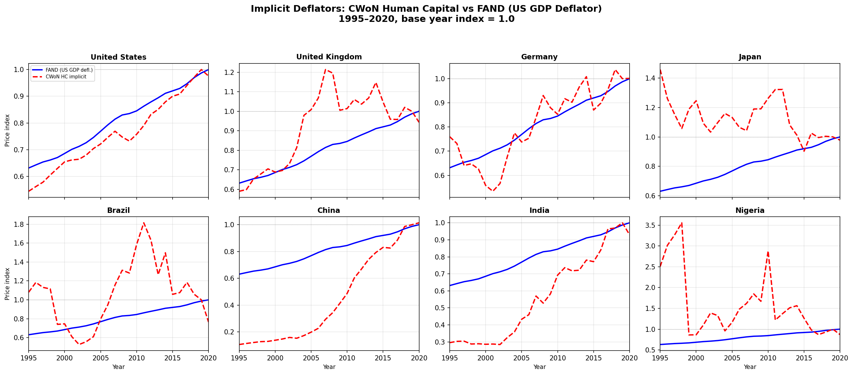
Finding 1: Non-Monotonic HC Deflators
CWoN's Human Capital implicit deflator reverses direction repeatedly
Source: CWon2024.xlsx implicit deflators vs FAND US GDP deflator | 1995–2020
Notes:
CWoN's Human Capital implicit deflator is non-monotonic. For Japan, the deflator reverses direction 14 times in 25 observations between 1995 and 2020. This means CWoN's "real" human capital for Japan goes up in some years and down in others for reasons that have nothing to do with actual changes in education or health — they are artifacts of the deflator's behavior. Look at the eight country panels. The solid blue line is FAND's single US GDP deflator — smooth, monotonic, as a price index should be. The dashed red line is CWoN's implied HC deflator, backed out from the ratio of their nominal to constant-dollar HC series. Nigeria's HC deflator swings from 0.5 to 3.5 — a sevenfold range. India's reverses sharply around 2010. Even for the United States, the two diverge noticeably after 2015. A non-monotonic deflator means that CWoN's "real" HC time series does not reliably indicate whether human capital is growing or shrinking. The signal is contaminated by deflator noise.

Slide 5
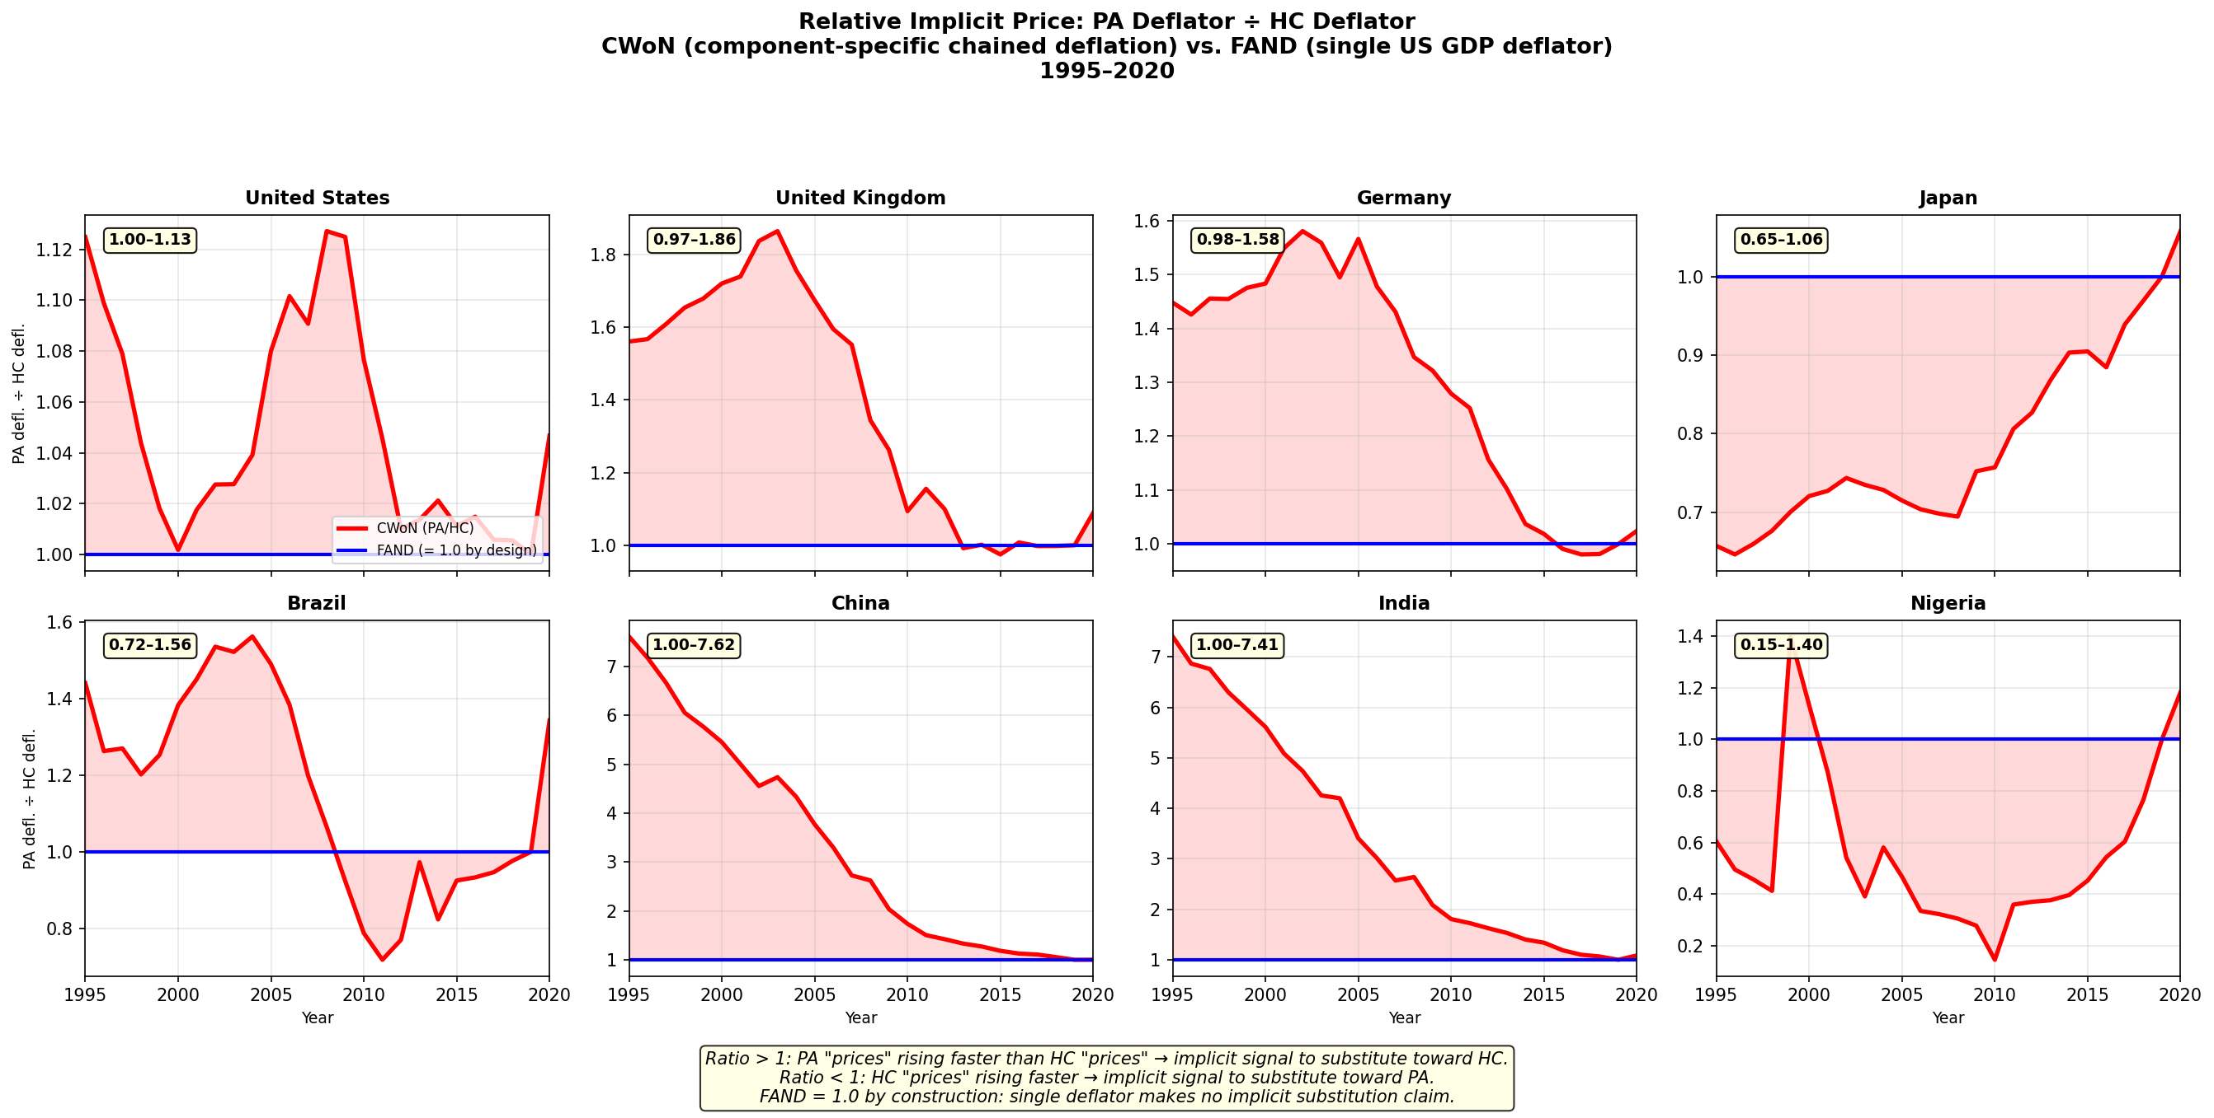
Finding 2: Relative Price Distortion (PA/HC)
The ratio of PA to HC deflators ranges from 0.15× to 7.6× across countries and years
Source: CWon2024.xlsx PA÷HC implicit deflator ratio | FAND = 1.0 by construction
Notes:
When you use different deflators for different components, you are implicitly claiming something about relative prices. The ratio of produced-assets deflator to human-capital deflator tells you how CWoN thinks the "price" of physical capital has moved relative to human capital. This chart shows that ratio for eight countries. FAND's ratio is 1.0 by construction — the flat blue line — because it uses the same deflator for everything. CWoN's ratio, the red shaded area, ranges from 0.15 times to 7.6 times across countries and years. China's ratio hits 7.6 — meaning CWoN implicitly claims produced assets became seven and a half times more expensive relative to human capital. For Brazil, it ranges from 0.72 to 1.56. In a well-behaved price system, this ratio should be relatively stable. The key insight: in a well-behaved price system, this ratio would be relatively stable. The wild swings mean CWoN's constant-dollar treatment is embedding large, time-varying relative-price claims into what it presents as "real" wealth comparisons. FAND's single deflator makes no such claims — it admits that relative-price movements are real economic phenomena, not measurement noise to be deflated away.

Slide 6
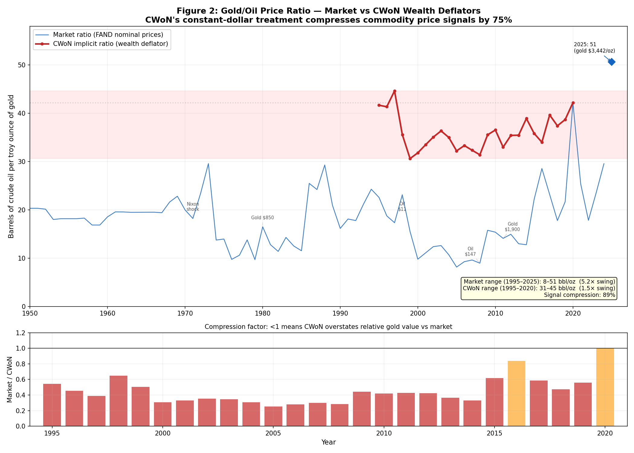
Finding 3: The 89% Signal Compression
CWoN's constant-dollar treatment compresses the gold/oil price ratio by 89%
Source: Market prices (FAND nominal) vs CWoN wealth deflators | 1950–2025
Notes:
The gold-to-oil price ratio — barrels of crude per ounce of gold — varies between 8 and 51 over 1950 to 2025 in market data. That is a 5.2 times swing, reflecting real geopolitical and market dynamics: OPEC embargoes, the gold standard collapse, financialization of commodities. CWoN's constant-dollar treatment compresses this to a 3.4-point range in the 1995–2020 period — an 89% signal compression—to claim 2020 price relatives are a reasonable proxy for long-term analyses. FAND gets into actual P’s and Q’s at its most granular level, here gold and oil, but is ambivalent about the P-Q split for depletable assets—and more so as these are combined with other forms of wealth. The bottom panel shows the compression factor with CWoN in this case: Market divided by CWoN. Values below 1.0 mean CWoN overstates relative gold value versus market. Why this matters: if you are a decision-maker comparing a country's mineral wealth to its fossil-fuel wealth, CWoN's deflated numbers tell you relative commodity prices barely moved. Market data tell you they swung fivefold. Those are materially different inputs for resource-governance decisions. FAND preserves the market signal. CWoN destroys it. For a Decision Support System — which is what FAND aims to be — the market signal is the one that matters.

Slide 7
Part 2
Component-by-Component Comparison
Ten countries spanning the development spectrum:
USA, Japan, Germany, UK, France, China, India, Indonesia, Brazil, Nigeria
Notes:
With the price-treatment context established, we now compare FAND and CWoN component by component across ten countries spanning the development spectrum. The ten countries are: United States, Japan, Germany, United Kingdom, France, China, India, Indonesia, Brazil, and Nigeria. Together they cover roughly 60% of world population and 75% of world GDP. They span OECD high-income, upper-middle, lower-middle, and low-income categories. For each component — Produced Assets, Natural Capital, and Human Resources — we show the per-capita time series on a log scale, comparing FAND and CWoN estimates side by side. The patterns are revealing.

Slide 8
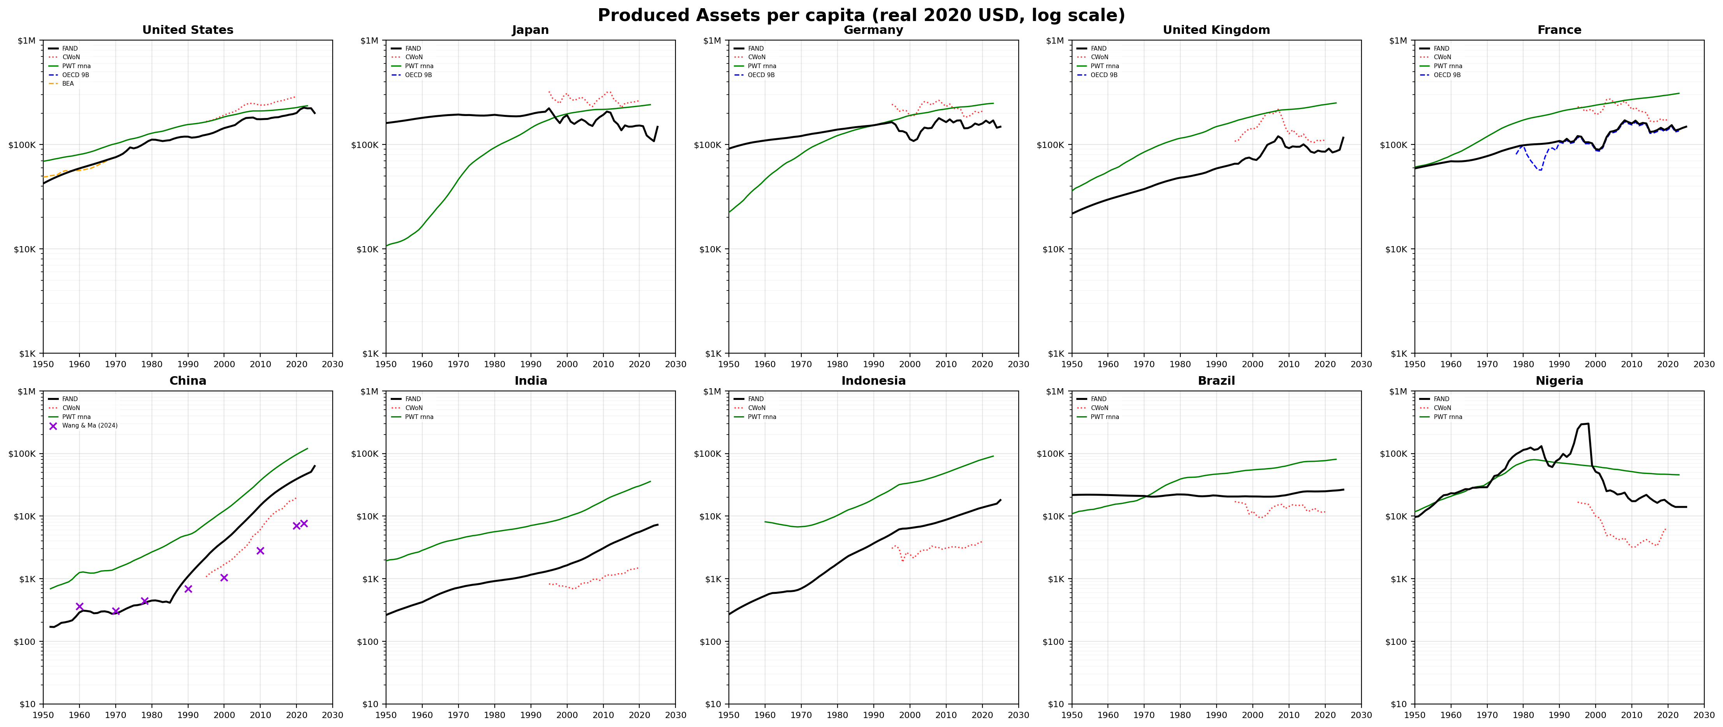
Produced Assets per capita
FAND (OECD Source A + PIM) vs CWoN (PWT-based) — real 2020 USD, log scale
Source: RT_RPC workbooks | 10 countries, 1950–2025
Notes:
FAND's Produced Assets use OECD Source A — Table 9B, the national accounts net capital stock — for 38 OECD countries, extended via Perpetual Inventory Method to 211 countries. CWoN uses Penn World Table-based PA with its own constant-dollar treatment. The two series agree reasonably well for advanced economies. Look at the United States, Japan, Germany panels — the black FAND line and the colored CWoN lines track each other, give or take deflator-driven divergences. The interesting cases are the developing countries. For China, CWoN's PA estimate shows a dramatically different trajectory from FAND's — the deflator choice matters enormously when you are comparing an economy whose price structure has transformed over four decades of industrialization. For India and Indonesia, the gap between FAND and CWoN widens over time, reflecting the compounding effect of different deflator choices over long time horizons. The key methodological point: FAND's PA is anchored in OECD national-accounts data — the gold standard of capital stock measurement — while CWoN's is derived from PWT, which applies its own purchasing-power adjustments.

Slide 9
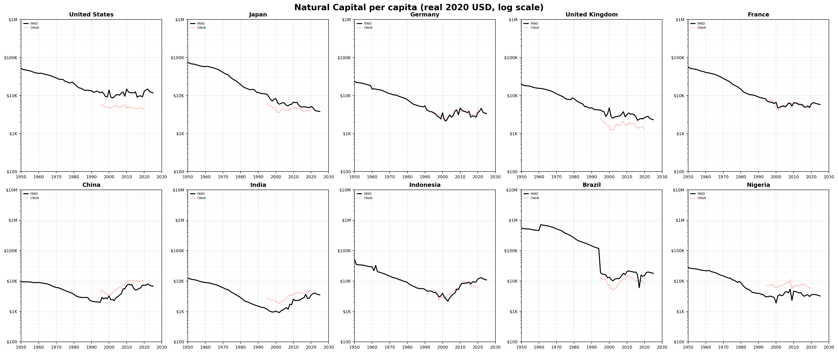
Natural Capital per capita
FAND preserves market commodity prices; CWoN deflates them away
Source: RT_RPC workbooks | Six NC branches: fossil fuels, minerals, fisheries, ag land, forest timber, forest cover
Notes:
FAND's Natural Capital is built from six independently valued branches: fossil fuels, minerals, fisheries, agricultural land, forest timber, and forest cover. Each branch has its own builder script, source registry, and pedigree tracking. The critical difference you can see in these charts: FAND preserves market commodity prices in its stock valuations. CWoN deflates commodity prices, which — as we showed with the gold-oil ratio — destroys the relative-price signals between commodities. For Nigeria, a major oil producer, this matters enormously. FAND's NC per capita shows the oil price booms and busts that have defined Nigeria's development trajectory. CWoN's deflated series smooths those away — presenting a misleadingly stable picture of a fundamentally volatile resource endowment. For the advanced economies — US, Japan, Germany — NC per capita shows a long decline on a log scale, consistent with depletion and the shift toward service economies. FAND and CWoN broadly agree on the direction, but the magnitudes differ because of the deflator treatment.

Slide 10
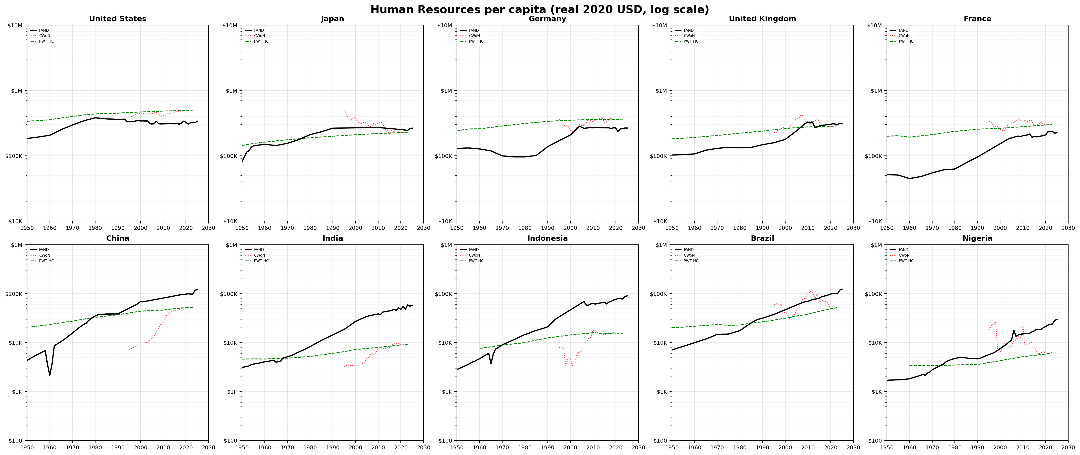
Human Resources per capita
FAND: top-down residual regression (Spec D-cap) vs CWoN: bottom-up Jorgenson-Fraumeni
Source: RT_RPC workbooks | HR = f(MYS, LE_cap65, time trend), Spec D-cap (S257)
Notes:
This is where the two frameworks diverge most sharply, both in conception and in results. CWoN estimates Human Capital bottom-up as a stand-alone component — the present value of future lifetime earnings, using Jorgenson-Fraumeni methodology. FAND estimates Human Resources top-down — it is one piece of a residual-bearing identity. CW equals PA plus NC plus HR plus SI, where SI is the unexplained residual. FAND's HR is fitted via OLS regression of log residual wealth on Mean Years of Schooling, Life Expectancy capped at 65, and a time trend. The cap at 65 is structurally grounded: post-retirement longevity is endogenous to wealth — rich countries invest in geriatric medicine — and does not represent additional productive human capital. CWoN's HC typically dominates their total wealth estimate — often 60 to 70 percent. FAND's HR is a more modest share because it coexists with SI, the institutional-quality residual. The non-monotonic deflator finding from earlier means CWoN's "real" HC time paths are unreliable for trend analysis. FAND's HR, derived from a stable regression specification, produces smooth, interpretable trends.

Slide 11
The Balance-Sheet Identity
CW = PA + NC + HR + SI | Holds to machine precision | 2020, constant 2020 USD per capita
Country | CW | SI | SI/CW | DM
United States | $1,067,839 | $528,716 | 49.5% | $0
Japan | $523,424 | $200,879 | 38.4% | $0
Germany | $676,459 | $325,152 | 48.1% | $0
United Kingdom | $560,279 | $207,428 | 37.0% | $0
France | $557,155 | $158,340 | 28.4% | $0
China | $77,393 | $18,348 | 23.7% | $0
India | $17,290 | −$2,519 | −14.6% | $972
Indonesia | $30,747 | −$5,082 | −16.5% | $1,067
Brazil | $51,547 | $11,244 | 21.8% | $0
Nigeria | $37,984 | $1,785 | 4.7% | $0
Source: RT_RPC workbooks | DM = Deferred Maintenance (non-zero when SI < 0.20×CW)
Notes:
The full FAND balance sheet for 2020, constant 2020 dollars per capita. The identity CW equals PA plus NC plus HR plus SI holds to machine precision in nominal terms. The pattern is clear. Advanced economies have SI — Savings and Institutional Quality — of 28 to 50 percent of Comprehensive Wealth. This reflects strong institutions, rule of law, social cohesion, and governance quality. China has crossed into positive SI territory at 23.7%, consistent with its graduation trajectory from lower-middle to upper-middle income. India and Indonesia show negative SI — minus 14.6% and minus 16.5% respectively. This means their institutional quality is a drag on wealth, not a contributor. The Deferred Maintenance column shows non-zero values for these countries: $972 and $1,067 per capita. DM is the liability side of the SI decomposition — it appears when SI falls below 20% of CW. Nigeria sits just barely positive at 4.7%, consistent with resource-dependent governance challenges. CWoN has no equivalent of SI. Because CWoN sums components bottom-up with no residual, it cannot identify institutional drag. FAND's residual-bearing identity is what makes SI visible and measurable.

Slide 12
The Bottom Line
CW is where the two frameworks produce their starkest divergence
FAND: CW = capitalized Atlas GNI (top-down, single income anchor)
CWoN: Total = PA + NC + HC (bottom-up sum, no residual)
CWoN normalizes HC to close the gap, which eliminates the very signal — institutional quality — that makes wealth measurement useful for governance.
All data: Appendix_E_Chart_Data_All_Series.xlsx (14 series, 7 sheets, 10 countries, 1950–2025)
Notes:
FAND's Comprehensive Wealth just capitalizes Atlas GNI using a PMT annuity formula with demographic inputs. It is a single income anchor — one number per country-year, from which the entire balance sheet is derived by subtraction. CWoN's total wealth is computed bottom-up: sum PA plus NC plus HC. There is no residual. CWoN normalizes Human Capital to close any gap between the sum and their total — which means HC absorbs all measurement error and model uncertainty. This is the fundamental architectural difference. FAND's residual-bearing identity — CW equals PA plus NC plus HR plus SI — preserves SI as the unexplained remainder. SI is what institutions contribute to wealth. CWoN's approach, by eliminating the residual, eliminates the very signal that makes wealth measurement useful for governance. The implicit deflator findings from Part 1 compound this: CWoN's constant-dollar treatment introduces relative-price distortions that ripple through all components. FAND's single deflator avoids these distortions, at the cost of admitting that "real" cross-component comparisons require more humility about what prices can tell us. Thank you. The data underlying this analysis are available in the companion workbook.

