Slide 1
Really Looking Beyond GDP
FAND vs CWoN — Diverging Policy Signals
Appendix E | v6 (May 2026) | Data: RT_RPC workbooks + CWon2024.xlsx
Notes:
This presentation compares two frameworks for measuring national wealth: FAND, the First Agentic Navigator for Development, and CWoN, the World Bank's Changing Wealth of Nations. agree that understanding wealth requires decomposing value into price and quantity. V equals Q times P. But they make fundamentally different choices about how to handle prices — and those choices cascade through every component of the balance sheet. FAND prefers to admit that index number problems are intractable. Only nominal values travel hierarchically. CWoN, like most mainstream indicator sets, presumes money is a veil you strip away to see what is "real." It deflates everything into constant dollars using component-specific chained deflators. This presentation shows why that matters — with data from ten countries spanning the development spectrum.

Slide 2
Main Purposes of World Bamk
(i)… encouragement of the development of productive facilities and resources in less developed countries
(ii)…when private capital is not available on reasonable terms, to supplement private investment by providing, on suitable conditions, finance for productive purposes out of its own capital, funds raised by it and its other resources.
…
Articles of Agreement
Appendix E | v6 (May 2026) | Data: RT_RPC workbooks + CWon2024.xlsx

Slide 3
The Core Disagreement
CWoN Approach
FAND Approach
Money is a veil — strip it away
Component-specific chained deflators
Each wealth component gets its own price index
Focus on Q ≡ V/P ("real" quantities)
Implicit relative-price claims embedded in deflators
Index number problems are intractable
Single universal deflator (Atlas GNI ratio)
All components deflated by the same factor
Only V travels hierarchically (Who, What, Where, When)
Preserves relative prices across components
Appendix E: Minding Our P's and Q's | FAND vs CWoN
Notes:
Both frameworks agree that meaningful comparisons across time and place require decomposing value into price and quantity. V equals Q times P. The disagreement is about what to do next. CWoN follows the mainstream approach: treat money as a veil, strip it away with deflators, and focus on "real" quantities. Each wealth component gets its own price index — produced assets, human capital, natural capital all deflated separately with component-specific chained deflators. FAND takes a different position. Index number problems — the Leibniz-Newton debate on quantifying spirits, Simpson's paradox, Zeno's paradoxes — are genuinely intractable. So FAND uses a single universal deflator: the ratio of Atlas GNI in current dollars to Atlas GNI in constant 2020 dollars. All components are deflated by the same factor. This treats relative prices across components as ‘real’ by construction. The consequence is that CWoN's deflators embed implicit claims about relative prices where FAND is ambivalent. The next three slides show what those implicit claims look like in the data.

Slide 4
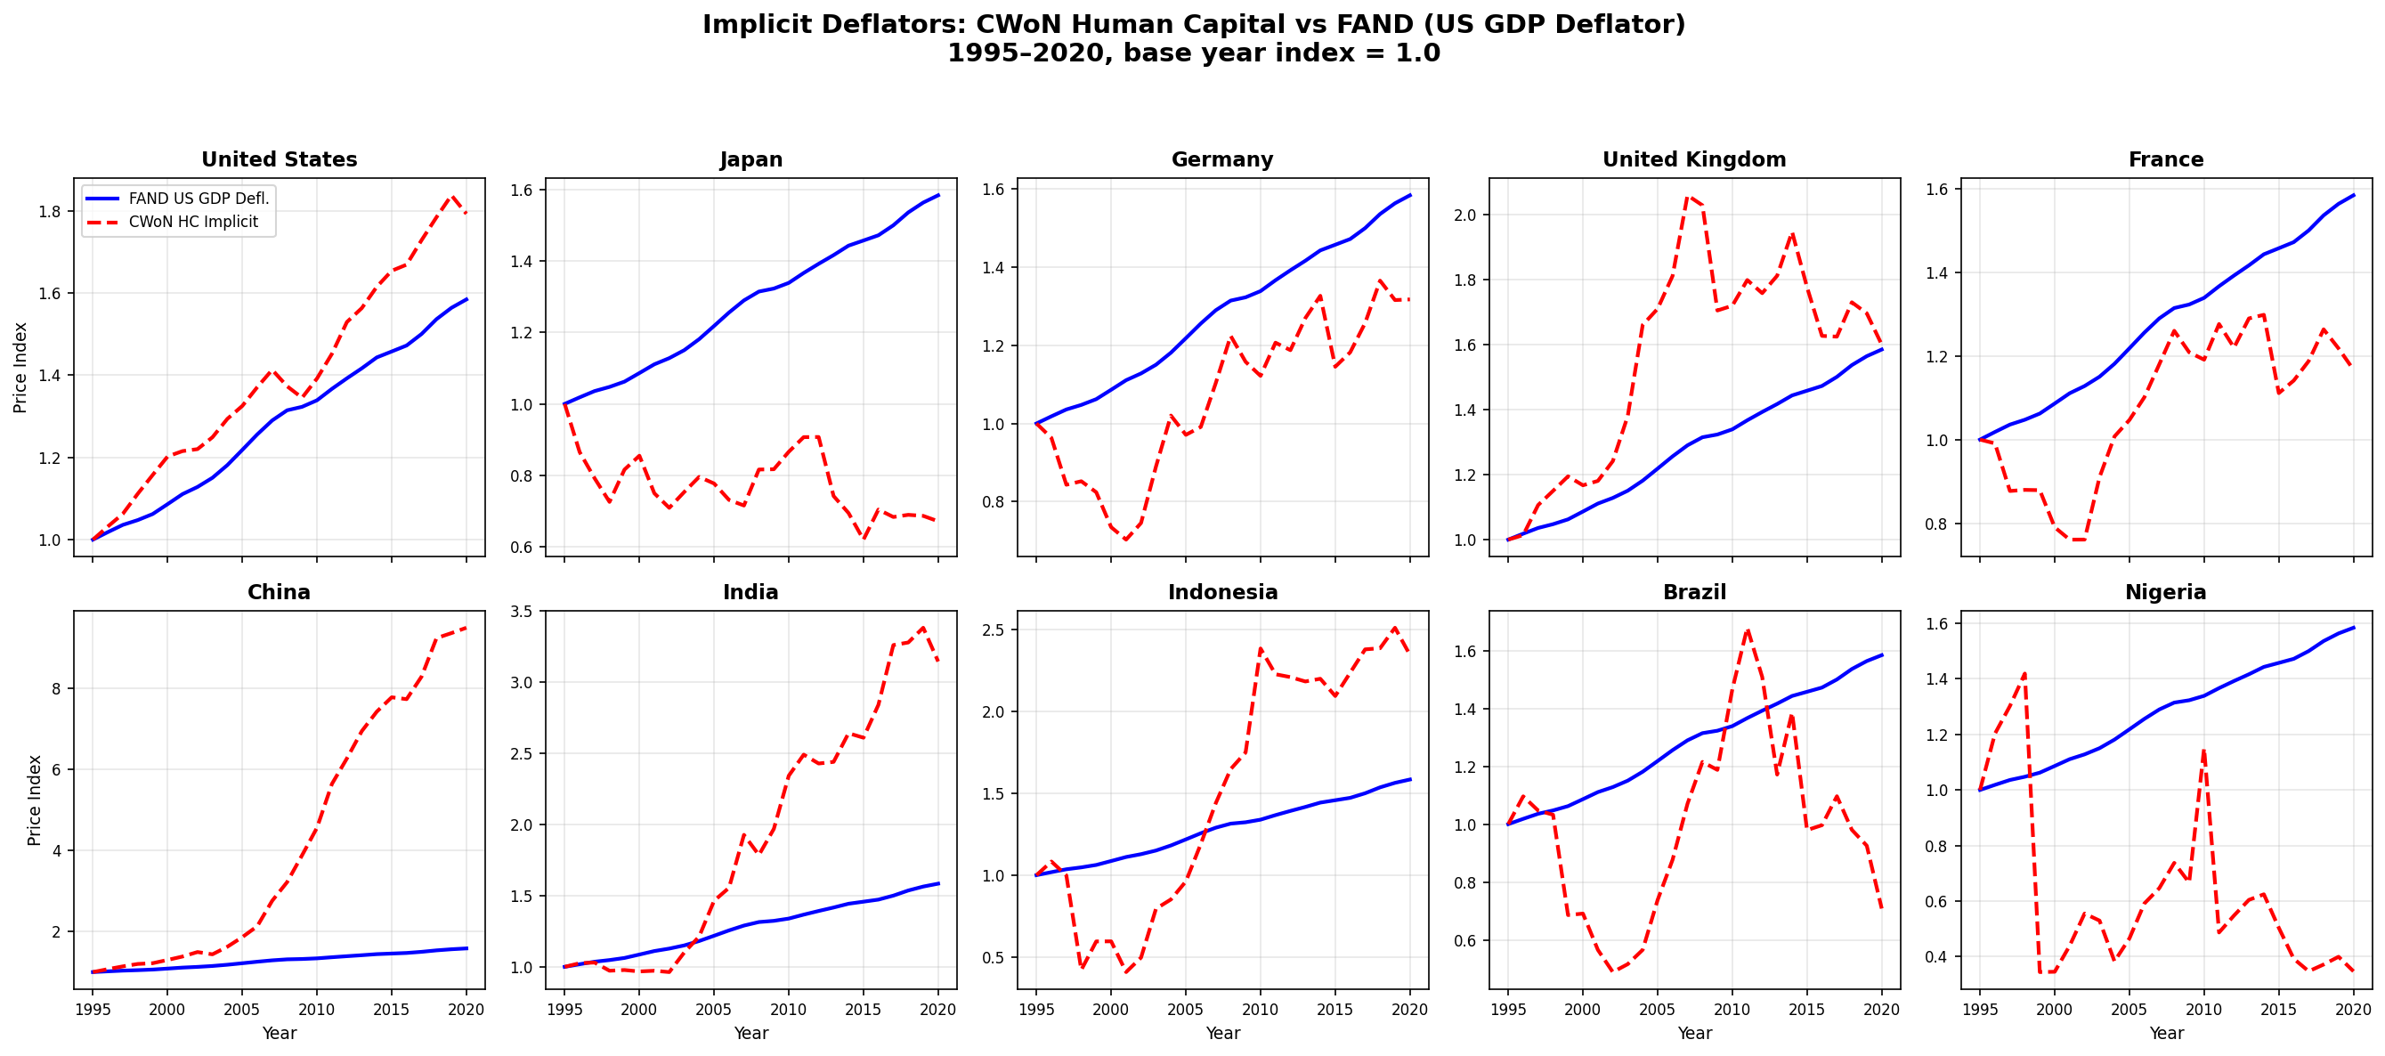
Finding 1: Non-Monotonic HC Deflators
CWoN's Human Capital implicit deflator reverses direction repeatedly — all 10 comparison countries
Source: CWon2024.xlsx implicit deflators vs FAND US GDP deflator | 1995–2020 | 10 countries
Notes:
CWoN's Human Capital implicit deflator is non-monotonic. For Japan, the deflator reverses direction 14 times in 25 observations between 1995 and 2020. This means CWoN's "real" human capital for Japan goes up in some years and down in others for reasons that have nothing to do with actual changes in education or health — they are artifacts of the deflator's behavior. Look at the ten country panels. The solid blue line is FAND's single US GDP deflator — smooth, monotonic, as a global price index should be. The dashed red line is CWoN's implied HC deflator, backed out from the ratio of their nominal to constant-dollar HC series. Nigeria's HC deflator swings from 0.5 to 3.5 — a sevenfold range. India's reverses sharply around 2010. Even for the United States, the two diverge noticeably after 2015. France’s HC deflator, while less dramatic than the developing-country cases, still shows reversals — rising through 2008, falling back, then recovering. Indonesia’s is strikingly non-monotonic, with a sharp spike around the 1997–98 Asian financial crisis followed by a prolonged decline through 2010. A non-monotonic deflator means that CWoN's "real" HC time series does not reliably indicate whether human capital is growing or shrinking. The signal is contaminated by deflator noise.

Slide 5
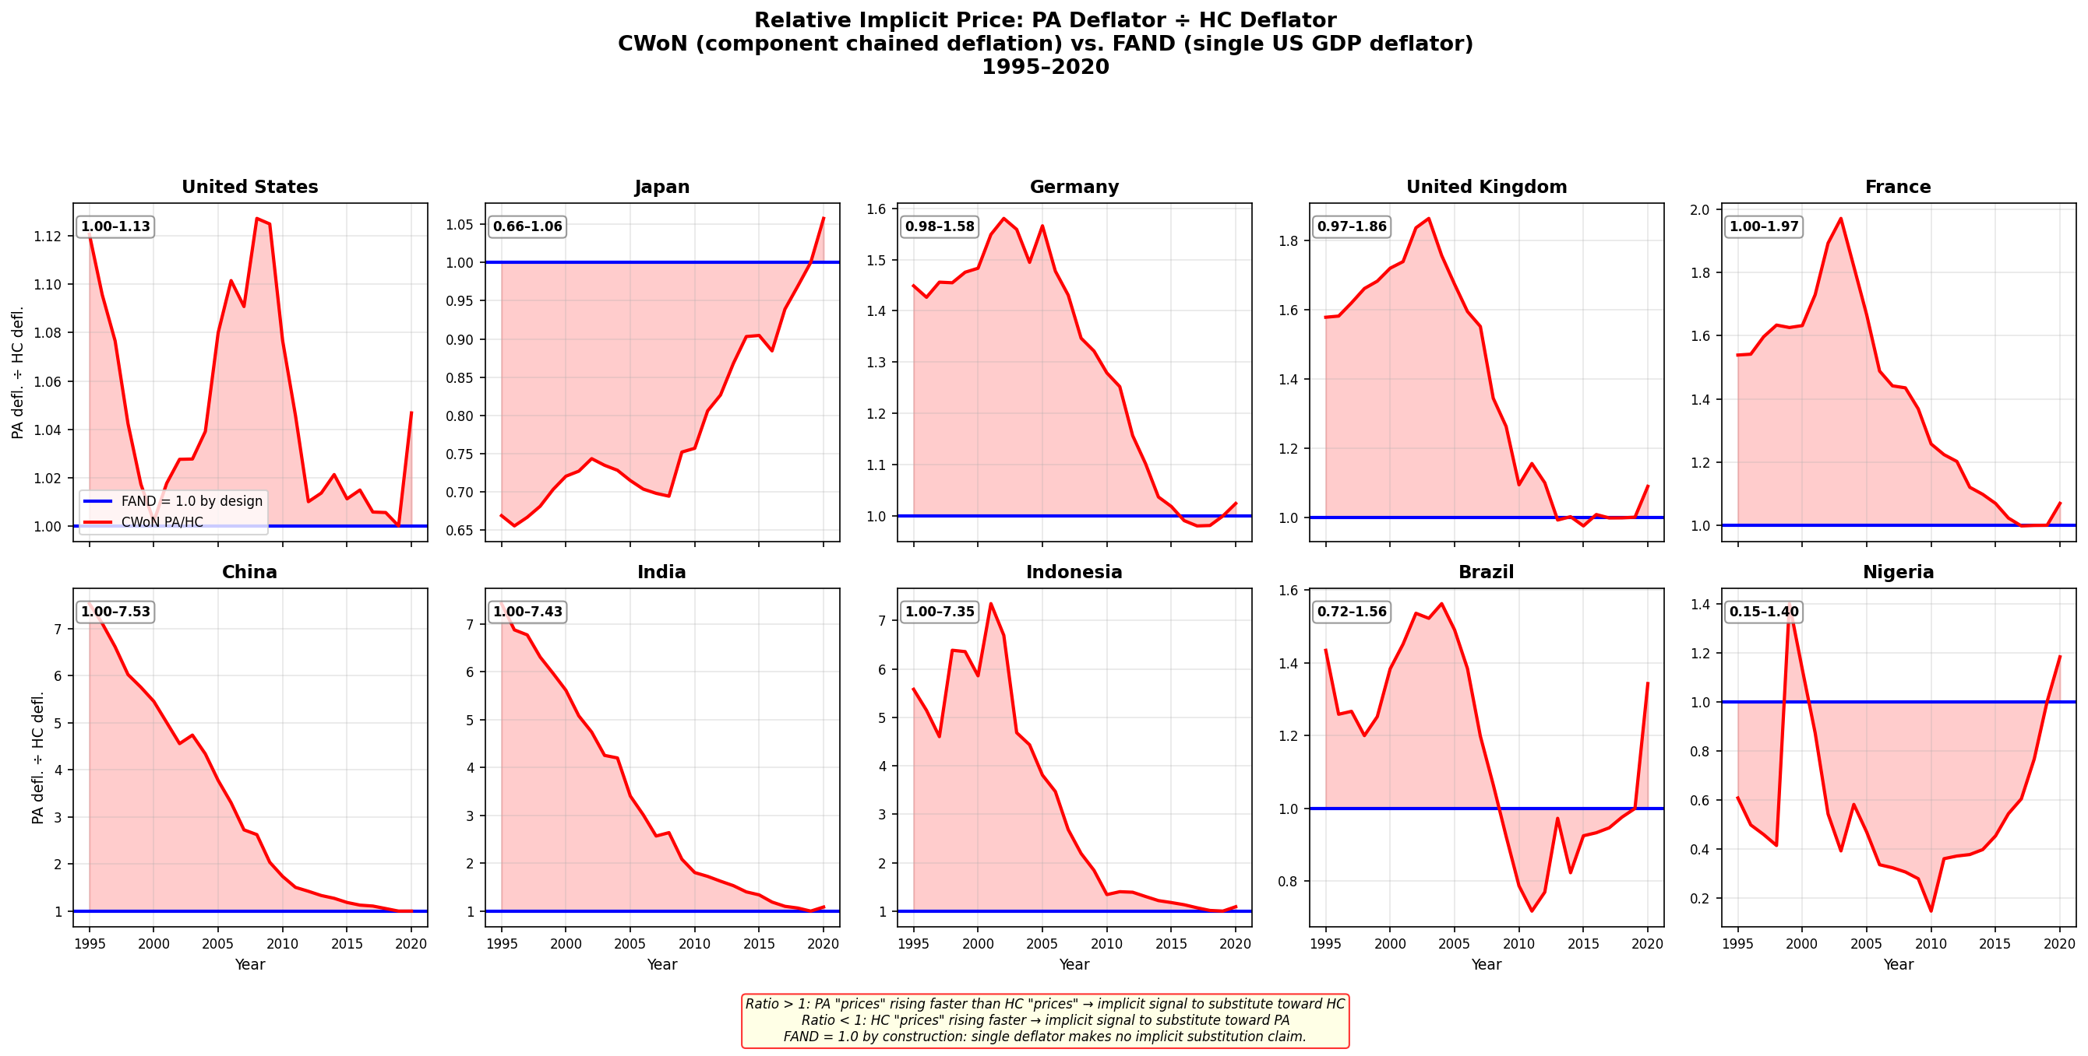
Finding 2: Relative Price Distortion (PA/HC)
PA÷HC deflator ratio ranges 0.15× to 7.5× across countries — all 10 comparison countries
Source: CWon2024.xlsx PA÷HC implicit deflator ratio | FAND = 1.0 by construction | 10 countries
Notes:
When you use different deflators for different components, you are implicitly claiming something about relative prices. The ratio of produced-assets deflator to human-capital deflator tells you how CWoN thinks the "price" of physical capital has moved relative to human capital. This chart shows that ratio for all ten comparison countries. FAND's ratio is 1.0 by construction — the flat blue line — because it uses the same deflator for everything. Again, relative price changes are real to FAND. CWoN's ratio, the red shaded area, ranges from 0.15 times to 7.5 times across countries and years. China's ratio hits 7.6 — meaning CWoN implicitly claims produced assets became seven and a half times more expensive relative to human capital. Indonesia shows a comparable 7.4 times, driven by the Asian financial crisis shock to its PA deflator. India reaches 7.4. For Brazil, it ranges from 0.72 to 1.56. France, at 1.00 to 1.97, shows that even an advanced OECD economy is not immune to the distortion. The key insight: in a well-behaved price system, this ratio would be relatively stable, evolving slowly. The wild swings mean CWoN's constant-dollar treatment is embedding large, time-varying relative-price claims into what it presents as "real" wealth comparisons. FAND's single deflator makes no such claims — it admits that relative-price movements are real economic phenomena, not measurement noise to be deflated away. The pattern is universal across all countries examined — the only variation is in magnitude.

Slide 6
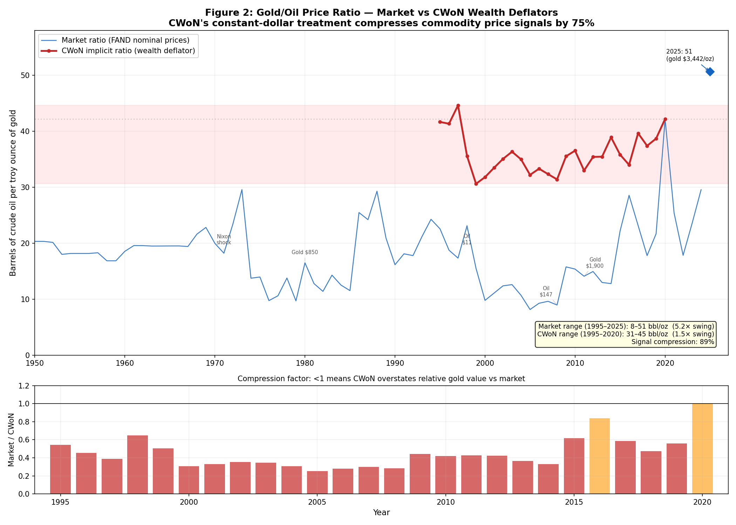
Finding 3: The 89% Signal Compression
CWoN's constant-dollar treatment compresses the gold/oil price ratio by 89%
Source: Market prices (FAND nominal) vs CWoN wealth deflators | 1950–2025
Notes:
The gold-to-oil price ratio — barrels of crude per ounce of gold — varies between 8 and 51 over 1950 to 2025 in market data. That is a 5.2 times swing, reflecting real geopolitical and market dynamics: OPEC embargoes, the gold standard collapse, financialization of commodities. CWoN's constant-dollar treatment compresses this to a 3.4-point range in the 1995–2020 period — an 89% signal compression. The bottom panel shows the compression factor: Market divided by CWoN. Values below 1.0 mean CWoN overstates relative gold value versus market. Why this matters: if you are a decision-maker comparing a country's mineral wealth to its fossil-fuel wealth, CWoN's deflated numbers tell you relative commodity prices barely moved. Market data tell you they swung fivefold. Those are materially different inputs for resource-governance decisions. FAND preserves the market signal. CWoN destroys it. For a Decision Support System — which is what FAND aims to be — the market signal is the one that matters.

Slide 7
Part 2
Component-by-Component Comparison
Ten countries spanning the development spectrum:
USA, Japan, Germany, UK, France, China, India, Indonesia, Brazil, Nigeria
Notes:
With the price-treatment context established, we now compare FAND and CWoN component by component across ten countries spanning the development spectrum. The ten countries are: United States, Japan, Germany, United Kingdom, France, China, India, Indonesia, Brazil, and Nigeria. Together they cover roughly 60% of world population and 75% of world GDP. They span OECD high-income, upper-middle, lower-middle, and low-income categories. For each component — Produced Assets, Natural Capital, Human Resources, and Comprehensive Wealth — we show the per-capita time series on a log scale, comparing FAND and CWoN estimates side by side.

Slide 8
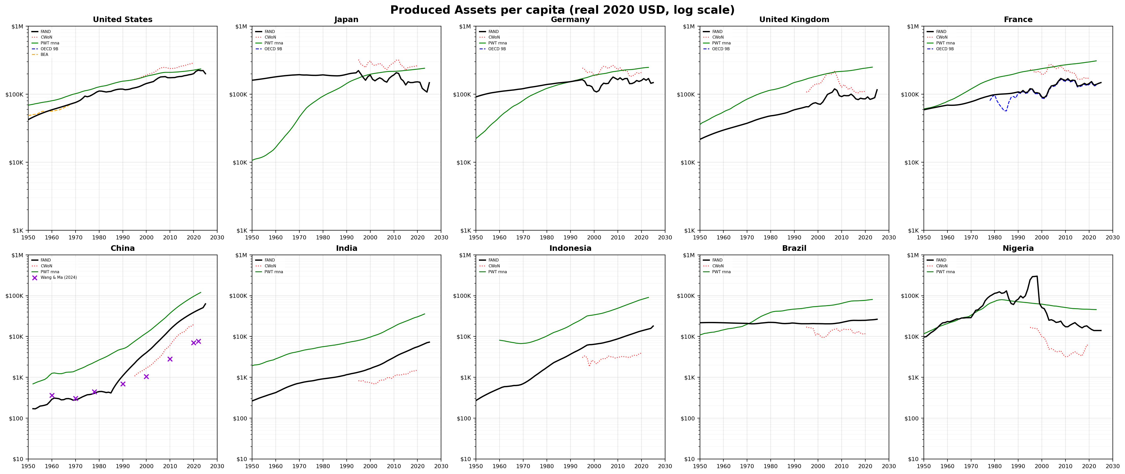
Produced Assets per capita
FAND (OECD Source A + PIM) vs CWoN (PWT-based) — real 2020 USD, log scale
Source: RT_RPC workbooks | 10 countries, 1950–2025
Notes:
FAND's Produced Assets use OECD Source A — Table 9B, the national accounts net capital stock — for 38 OECD countries, extended via Perpetual Inventory Method to 211 countries. CWoN uses Penn World Table-based PA with its own constant-dollar treatment. The two series agree reasonably well for advanced economies. The United States, Japan, and Germany panels show the FAND and CWoN lines tracking each other, give or take deflator-driven divergences. The interesting cases are the developing countries. For China, CWoN's PA estimate shows a dramatically different trajectory — the deflator choice matters enormously when comparing an economy whose price structure has transformed over four decades of industrialization. For India and Indonesia, the gap widens over time, reflecting the compounding effect of different deflator choices over long horizons. FAND's PA is anchored in OECD national-accounts data — the gold standard of capital stock measurement — while CWoN's is derived from Penn World Tables, which apply their own purchasing-power adjustments.
Most importantly, note that CWoN is above FAND for all advanced economies, and below for all developing economies. We will see the same for Human Resources, two slides from now. Almost the reverse holds for Natural Capital, in the next slide. This seems an artifact of CWoN’s detour into purchasing power parities for PA and HR but not NC.

Slide 9
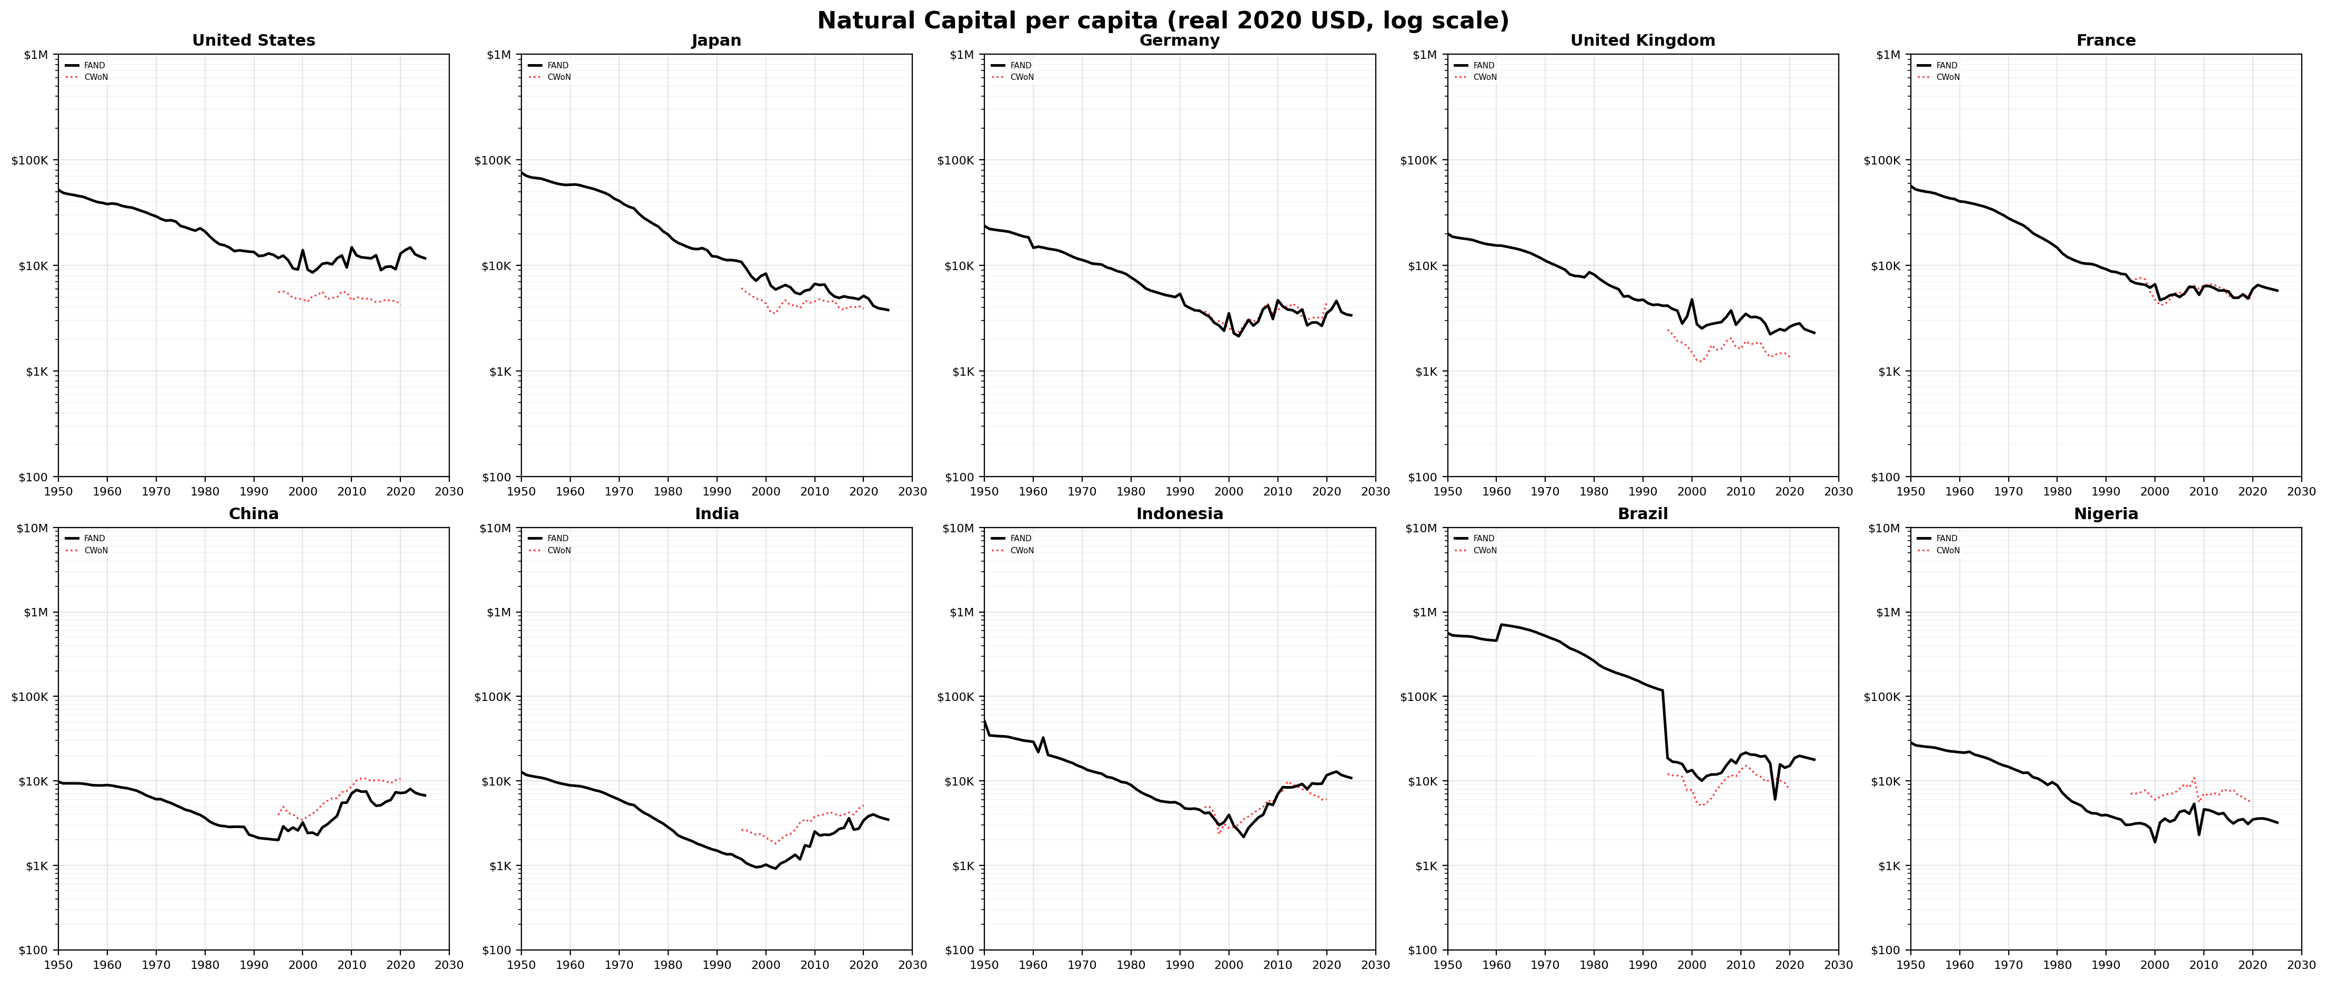
Natural Capital per capita
FAND preserves market commodity prices; CWoN deflates them away
Source: RT_RPC workbooks | Six NC branches: fossil fuels, minerals, fisheries, ag land, forest timber, forest cover
Notes:
FAND's Natural Capital is built from six independently valued branches: fossil fuels, minerals, fisheries, agricultural land, forest timber, and forest cover. Each branch has its own builder script, source registry, and pedigree tracking. The critical difference: FAND preserves market commodity prices in its stock valuations. CWoN both imagines nation-level rather than local severance costs (by capitalizing rents) and deflates commodity prices, which — as we showed with the gold-oil ratio — destroys the relative-price signals between commodities. FAND considers rent capitalization a last resort at national level, but essential Where actual severance happens. FAND’s rule-of-thumb for national decision-making harks back to the idea of a tithe: A place should not even consider severing depletable wealth if the local return is less than 10% of world market price. For depletable assets, rising scarcity should make that a floor, not a ceiling.
For Nigeria, a major oil producer, this matters enormously. FAND's NC per capita shows the oil price booms and busts that have defined Nigeria's development trajectory. CWoN's deflated series smooths those away — presenting a misleadingly stable picture of a fundamentally volatile resource endowment. For the advanced economies, NC per capita shows a long decline on a log scale, consistent with depletion and the shift toward service economies. FAND and CWoN broadly agree on the direction, but the magnitudes differ because of the deflator treatment. And CWoN’s limited time span masks the reality that depletable assets are—depleting. Rises imply commodity prices rising above global inflation, more than “discoveries.”

Slide 10
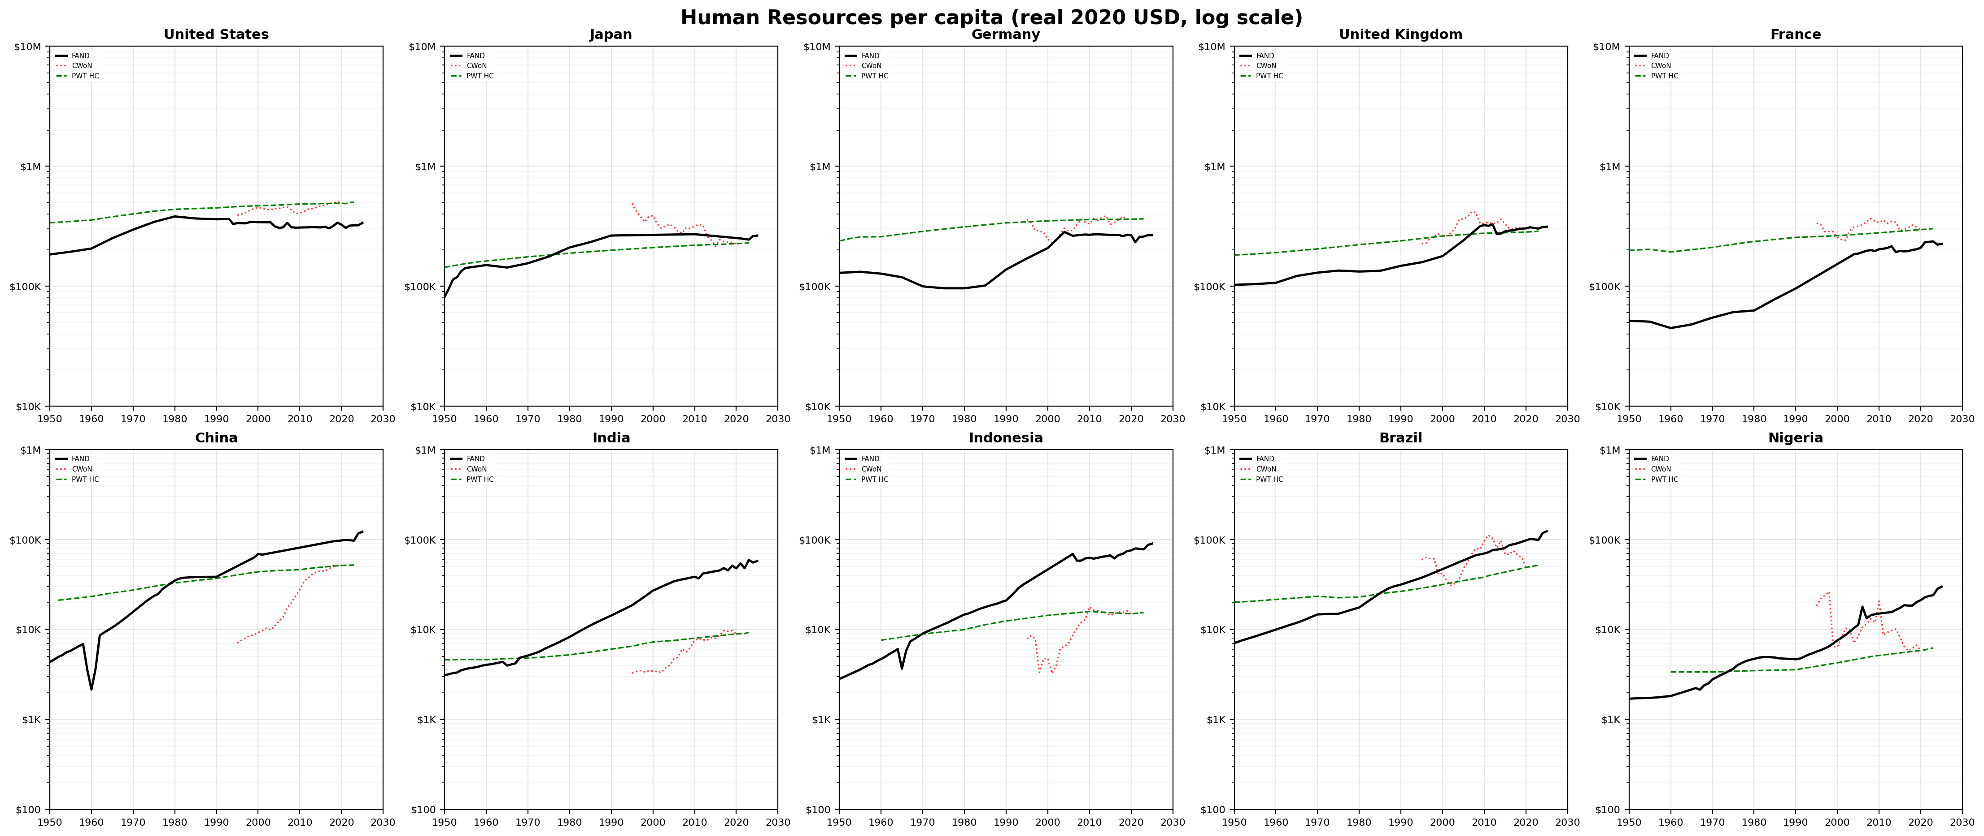
Human Resources per capita
FAND: top-down residual regression (Spec D-cap) vs CWoN: bottom-up Jorgenson-Fraumeni
Source: RT_RPC workbooks | HR = f(MYS, LE_cap65, time trend), Spec D-cap (S257)
Notes:
This is where the two frameworks diverge most sharply, both in conception and in results. CWoN estimates Human Capital bottom-up as a stand-alone component — the present value of future lifetime earnings, using Jorgenson-Fraumeni methodology. FAND estimates Human Resources top-down — it is one piece of a residual-bearing identity. CW equals PA plus NC plus HR plus SI, where SI is the unexplained residual. FAND's HR is fitted via OLS regression of log residual wealth on Mean Years of Schooling, Life Expectancy capped at 65, and a time trend. The cap at 65 is structurally grounded: post-retirement longevity is endogenous to wealth and does not represent additional productive human capital. CWoN's HC typically dominates their total wealth estimate — often 60 to 70 percent. FAND's HR is more modest because it coexists with SI, the institutional-quality residual. The non-monotonic deflator finding from earlier means CWoN's "real" HC time paths are unreliable for trend analysis. FAND's HR, derived from a stable regression specification, produces smooth, interpretable trends.

Slide 11
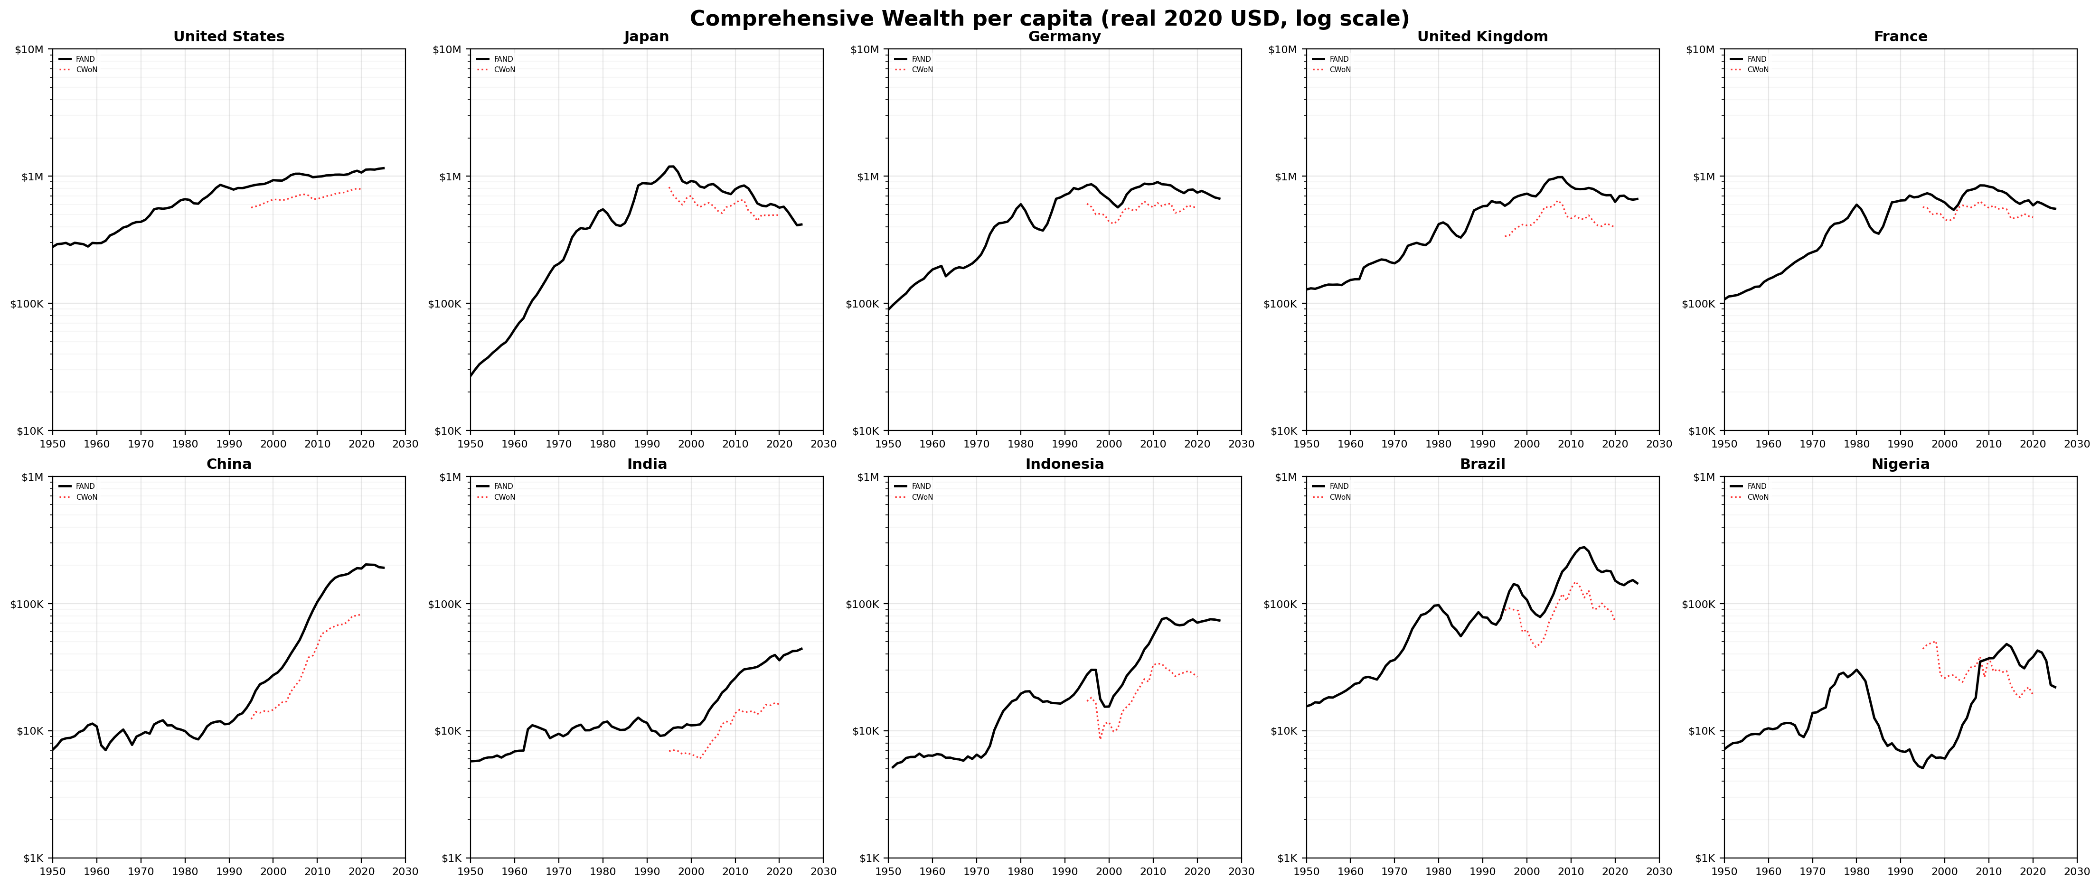
Comprehensive Wealth / Total Wealth (CW)
The starkest divergence — FAND top-down (capitalized Atlas GNI) vs CWoN bottom-up (PA+NC+HC, no residual)
[ Insert CW chart grid here — image7 from Appendix_E_v6.docx ]
Source: RT_RPC workbooks | 10 countries, 1950–2025
Notes:
CW is where the two frameworks produce their starkest divergence. FAND’s CommonWealth is computed top-down: capitalize Atlas GNI per capita using a PMT annuity formula with demographic inputs — working-age population share and average labor force age. It is a single income anchor: one number per country-year, from which the entire balance sheet is derived by subtraction. CWoN’s Comprehensive (Domestic) Wealth is computed bottom-up: sum PA plus NC plus HC. There is no residual, no room for Substantive Rights. CWoN normalizes Human Capital to close any gap between the component sum and their total wealth estimate. This means HC absorbs all measurement error and model uncertainty. This is the fundamental architectural difference. FAND's residual-bearing identity — CW equals PA plus NC plus HR plus a residual SI — preserves an unexplained remainder. SI captures what institutions contribute to wealth: governance quality, rule of law, social cohesion. CWoN's approach, by eliminating the residual through HC normalization, eliminates the very signal that makes wealth measurement useful for governance.
The implicit deflator findings from Part 1 compound this: CWoN's constant-dollar treatment introduces relative-price distortions that ripple through all components. FAND's single deflator avoids these distortions, at the cost of admitting that "real" cross-component comparisons require more humility about what prices can tell us.
While beyond this presentation to detail, FAND recognizes the residual may be negative and that is a meaningful signal. FAND stipulates a minimum asset component, essentially a stock counterpart of total factor productivity, must exist for an economy to function. Below that threshold, FAND infers deferred maintenance of social infrastructure. It also converts that into a risk premium for accessing international capital markets.

Slide 12
What This Means
1
Prices matter more than you think
Component-specific deflators embed implicit relative-price claims. CWoN's PA/HC deflator ratio swings 0.15×–7.5×. FAND's = 1.0 by construction.
2
The residual is the signal
CWoN normalizes HC to close the identity, absorbing all error into the one component you'd most want to trust. FAND preserves SI — institutional quality — as a measurable quantity.
3
Market prices are decision inputs
89% signal compression on the gold/oil ratio means CWoN presents a misleadingly stable picture to resource-governance decision-makers.
Data: Appendix_E_Chart_Data_All_Series.xlsx (14 series, 7 sheets, 10 countries, 1950–2025)
Notes:
Three takeaways from this analysis. First, prices matter more than most mainstream databases admit. When CWoN uses component-specific deflators, it is implicitly claiming that relative prices between physical and human capital swing by factors of 7 or more. FAND's single deflator makes no such claims. This is not a minor methodological footnote — it determines whether your "real" wealth time series goes up or down in any given year. Second, the residual is the signal. CWoN normalizes Human Capital to close its identity, which means HC absorbs all measurement error and model uncertainty. FAND's architecture preserves SI — Savings and Institutional Quality — as a measurable residual. SI is what institutions contribute to wealth. It is the most policy-relevant metric in the framework, because it captures what governance can change in the medium term. A framework that eliminates the residual eliminates the most actionable information. Third, market prices are decision inputs. The 89% signal compression on the gold-to-oil ratio means CWoN presents a misleadingly stable picture of commodity wealth to the decision-makers who need that information most — resource-dependent countries deciding how to manage their natural endowments. All data underlying this analysis are available in the companion workbook. Thank you.

