Slide 1
Detection and Identification of Lung/Colon Cancer
Seanmark Paz, Jabali Shah, Yaakov Sternberg
University of San Diego
AAI-521: Applied Computer Vision for AI
Siamak Aram, PhD.
December 6, 2024

Slide 2
Objective
Dataset information
Model Training
Model Visualization
Member Contributions
Improvements
Agenda

Slide 3
Utilize the Lung and Colon Cancer Histopathological Images dataset on Kaggle to create a model capable of detecting benign or cancerous tissue
Use Grad-CAM to understand regions of input images that contribute most significantly to model predictions
Objectives

Slide 4
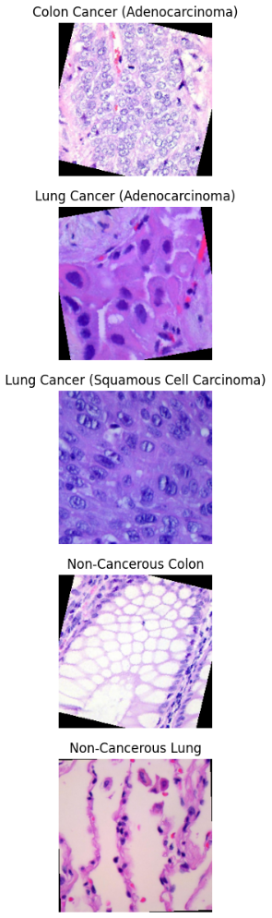
Dataset Information
Name: Lung and Colon Cancer Histopathological Images
URL: https://www.kaggle.com/datasets/andrewmvd/lung-and-colon-cancer-histopathological-images?resource=download
Content: 25,000 histopathological images with 5 classes (Lung benign tissue, Lung Adenocarcinoma, Lung squamous cell carcinoma, Colon adenocarcinoma, Colon benign tissue). All images are 768x768 pixel sized jpeg files. Images were generated from an original sample of HIPAA compliant and validated sources, consisting of 750 total images of lung tissue and 500 total images of colon tissue, augmented to 25,000 using the Augmentor package

Slide 5
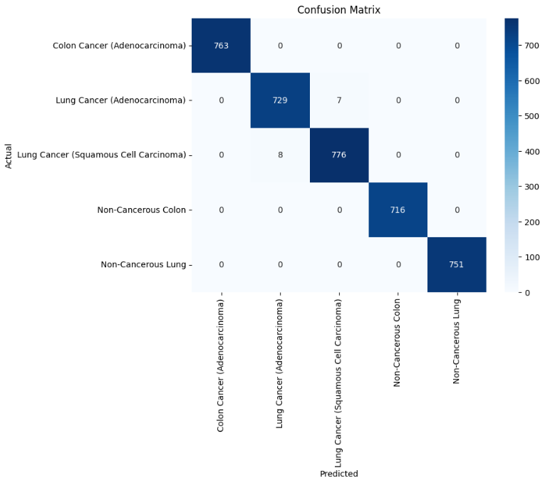
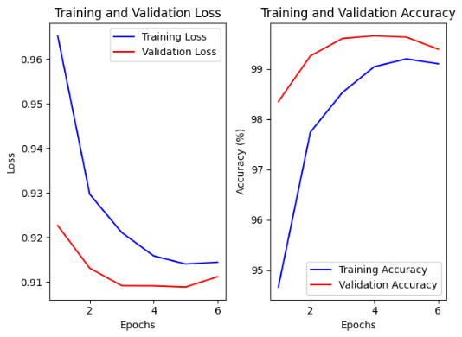
Model Training
Leveraged MobileNetV2 network as the backbone due to efficiency and strong performance on resource-constrained systems
Adapted model for classification of tissue by replacing original classification head with a custom classifier
Reached a validation accuracy of 99.65% during training
Precision, recall, and f1-score were all basically 1.00 during model evaluation except for a few predictions where the model confused the two types of lung cancer

Slide 6
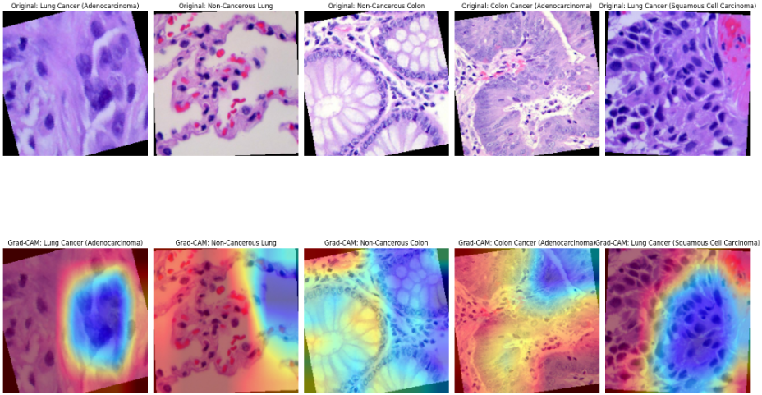
Model Visualization
Grad-CAM heatmap highlights areas of the image most relevant to the model’s decision on what category it belongs to
Hot colors (red, orange, yellow) indicate high focus
Cool colors (blue or absent heatmap) indicate areas with little to no focus

Slide 7
Member Contributions
Seanmark Paz | Jabali Shah | Yaakov Sternberg
Model Training/Visualization Slideshow/Presentation Report (Model Training/Visualization) |  | Wrote way too much code (experimenting with various models & metrics) Slideshow/Presentation Contributed to Report

Slide 8
Improvements
Using outside data to test the model, rather than just the generated images from the dataset
Increase the type of cancerous tissue that the model can identify, including tissue from other areas besides lung/colon
Incorporating pre-trained models like ResNet or EfficientNet and exploring ensemble learning techniques

Slide 9
Alternative approach: Data Preprocessing & Exploration
EDA:
  Classes: lung_n, lung_scc, lung_aca, colon_n, colon_aca
  Dataset had 25,000 evenly divided between the classes for 5,000 each
  Removed about 3,000 duplicates to avoid leakage
Preprocessing Steps:
  Label encoding
  Data augmentation techniques (rotation, zoom, brightness adjustment).
  Preprocessing: VGG16: preprocess_inpu, CNN: Rescaled by 1./255
  Stratified splitting into training (60%), validation (20%), and test (20%) sets.
  Generators: Created generators for each set

Slide 10
Model Architecture
Custom CNN
  Multiple Conv2D layers (ReLU activation)
  Batch Normalization, MaxPooling, Dropout layers
  Fully connected Dense layers
  Output: Softmax activation for multi-class classification
VGG16 Transfer Learning
  Base Model: Pre-trained VGG16 (ImageNet weights, frozen initially)
  Top Layers: Global Average Pooling, Dense (ReLU), Batch Norm, Dropout, Softmax
ResNet50 Transfer Learning
  Base Model: Pre-trained ResNet50 (ImageNet weights, frozen initially)
  Top Layers: Similar setup as VGG16

Slide 11
Training Strategy
Compilation
  Optimizer: Adam (1e-4 initial, 1e-5 for fine-tuning)
  Loss Function: Categorical Crossentropy
  Metrics: Accuracy, AUC, Precision, Recall
Callbacks
  Early Stopping (patience: 5 epochs)
  Model Checkpointing (best validation loss)
  ReduceLROnPlateau (learning rate reduction)
  TensorBoard (metric logging)
Training Phases
  Initial Training: Base models frozen
  Fine-Tuning: Unfreeze top layers, retrain with lower learning rate

Slide 12
Model Performance Results
Metric | CNN | VGG16 (Fine-Tuned) | ResNet50
Test Accuracy | 95.34% | 91.57% | 73.92%
Test AUC | 0.9971 | 0.9915 | 0.9492
Test Loss | 0.1215 | 0.2295 | 0.6034
Precision | 0.9542 | 0.9233 | 0.7713
Recall | 0.9530 | 0.9054 | 0.6954
F1 Score | 0.9534 | 0.9054 | 0.7259
Matthews Correlation Coefficient (MCC) | 0.9419 | 0.9054 | 0.6840
Log Loss | 0.1238 | 0.2295 | 0.6160

Slide 13
Model Performance Results
CNN:
Accuracy: 95.34%
AUC: 0.99
F1 Score: 0.95
MCC: 0.94
Log Loss: 0.12
VGG16 Fine-Tuned:
  Accuracy: 91.57%
  AUC: 0.99
  F1 Score: 0.90
  MCC: 0.90
  Log Loss: 0.22
ResNet50:
Accuracy: 73.92%
  AUC: 0.94
  F1 Score: 0.72
  MCC: 0.68
  Log Loss: 0.61

Slide 14
Key insights
CNN Dominates Performance:
  Highest accuracy (95.34%) and AUC (0.9971)
  Balanced precision and recall (0.9542 & 0.9530)
  Strong additional metrics (F1: 0.9534, MCC: 0.9419)
VGG16 Shows Strong Performance:
  Competitive accuracy (91.57%) and AUC (0.9915)
  High precision and recall (0.9233 & 0.9054)
  Robust F1 and MCC scores (0.9054, 0.9054)
  Potential for Improvement: Further fine-tuning can enhance performance
ResNet50 Underperforms:
  Lower accuracy (73.92%) and AUC (0.9492)
  Weaker precision and recall (0.7713 & 0.6954)
  Lower F1 and MCC (0.7259, 0.6840)
  Possible Issues: Model complexity or suitability for dataset

Slide 15
Recommendations:
Test models on additional datasets from other sources:
  To avoid any possibility of results being due to data leakage or easy dataset
More Pre-trained Models (InceptionV3, EfficientNet, etc.) and ensemble
Optimize Hyperparameter Tuning: learning rates, batch sizes, and optimizer settings
Data Augmentation: more sophisticated augmentation techniques to improve generalization
K-fold Cross-Validation: more robust validation (resource heavy)
Grad-CAM: Understand the models "thinking", I.E. what factors impact most.
VGG16: Determine into why it performed better in previous iterations (overfitting?)
ResNet50:
  Consider alternative architectures or different training configurations
  Investigate specific class performance issues

Slide 16
Thank you!

