Slide 1
Detection and Identification of Lung/Colon Cancer
Seanmark Paz, Jabali Shah, Yaakov Sternberg
University of San Diego
AAI-521: Applied Computer Vision for AI
Siamak Aram, PhD.
December 6, 2024

Slide 2
Agenda
Objective
Dataset information
Model Training
Model Visualization
Member Contributions
Improvements

Slide 3
Objectives
Utilize the Lung and Colon Cancer Histopathological Images dataset on Kaggle to create a model capable of detecting benign or cancerous tissue
Use Grad-CAM to understand regions of input images that contribute most significantly to model predictions

Slide 4
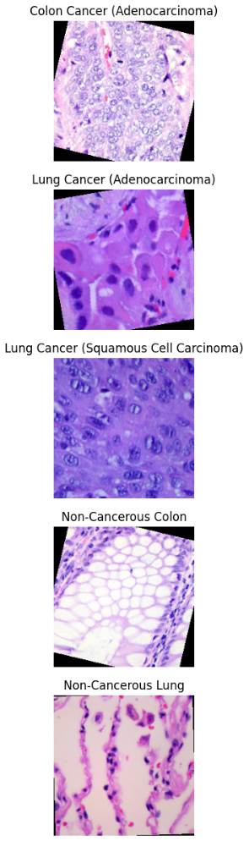
Dataset Information
Name: Lung and Colon Cancer Histopathological Images
URL: https://www.kaggle.com/datasets/andrewmvd/lung-and-colon-cancer-histopathological-images?resource=download
Content: 25,000 histopathological images with 5 classes (Lung benign tissue, Lung Adenocarcinoma, Lung squamous cell carcinoma, Colon adenocarcinoma, Colon benign tissue). All images are 768x768 pixel sized jpeg files. Images were generated from an original sample of HIPAA compliant and validated sources, consisting of 750 total images of lung tissue and 500 total images of colon tissue, augmented to 25,000 using the Augmentor package

Slide 5
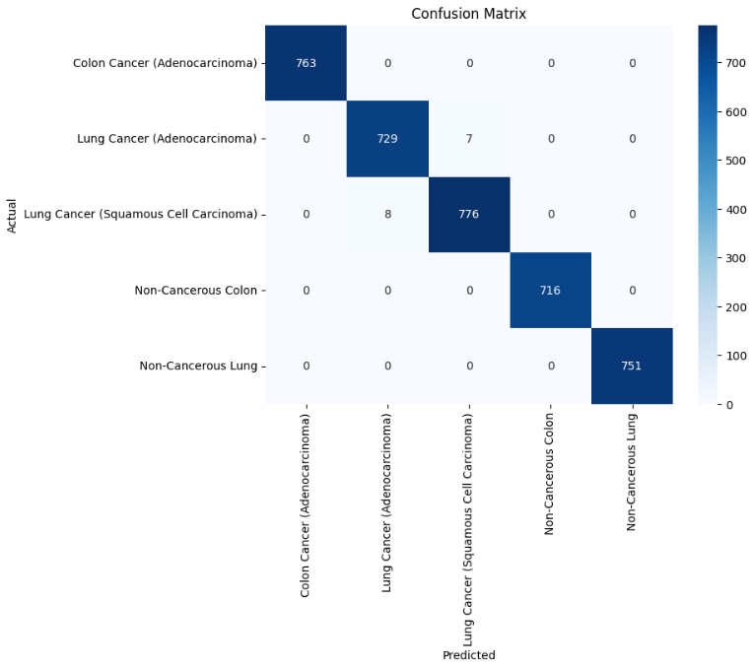
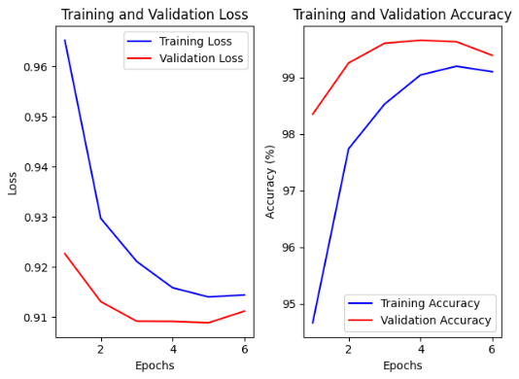
Model Training
Leveraged MobileNetV2 network as the backbone due to efficiency and strong performance on resource-constrained systems
Adapted model for classification of tissue by replacing original classification head with a custom classifier
Reached a validation accuracy of 99.65% during training
Precision, recall, and f1-score were all basically 1.00 during model evaluation except for a few predictions where the model confused the two types of lung cancer

Slide 6
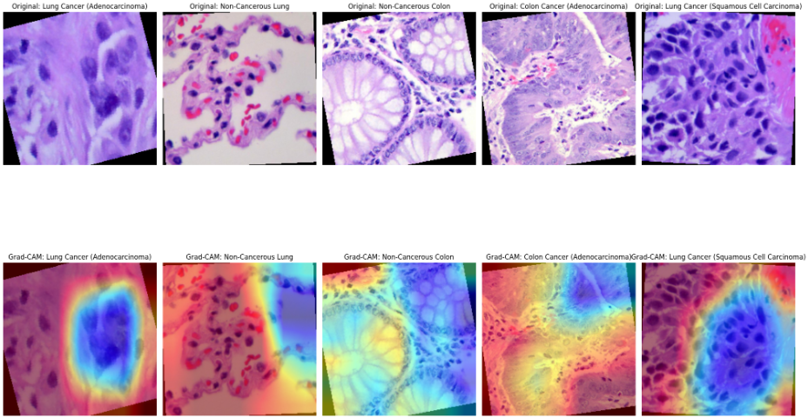
Model Visualization
Grad-CAM heatmap highlights areas of the image most relevant to the model’s decision on what category it belongs to
Hot colors (red, orange, yellow) indicate high focus
Cool colors (blue or absent heatmap) indicate areas with little to no focus

Slide 7
Model Training
Leveraged MobileNetV2 network as the backbone due to efficiency and strong performance on resource-constrained systems
Adapted model for classification of tissue by replacing original classification head with a custom classifier
Reached a validation accuracy of 99.65% during training
Precision, recall, and f1-score were all basically 1.00 during model evaluation except for a few predictions where the model confused the two types of lung cancer

Slide 8
Member Contributions
Seanmark Paz | Jabali Shah | Yaakov Sternberg
Model Training/Visualization Slideshow/Presentation Report (Model Training/Visualization)

Slide 9
Improvements
Using outside data to test the model, rather than just the generated images from the dataset
Increase the type of cancerous tissue that the model can identify, including tissue from other areas besides lung/colon

Slide 10
Thank you!

