Slide 1
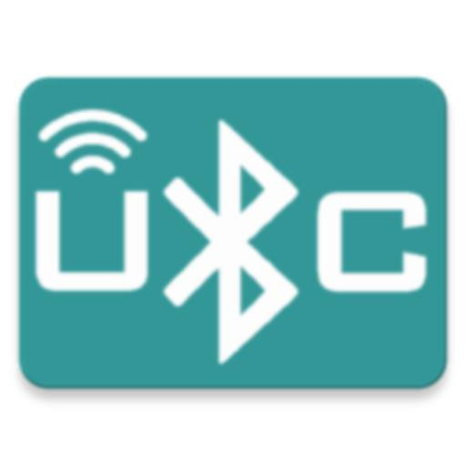
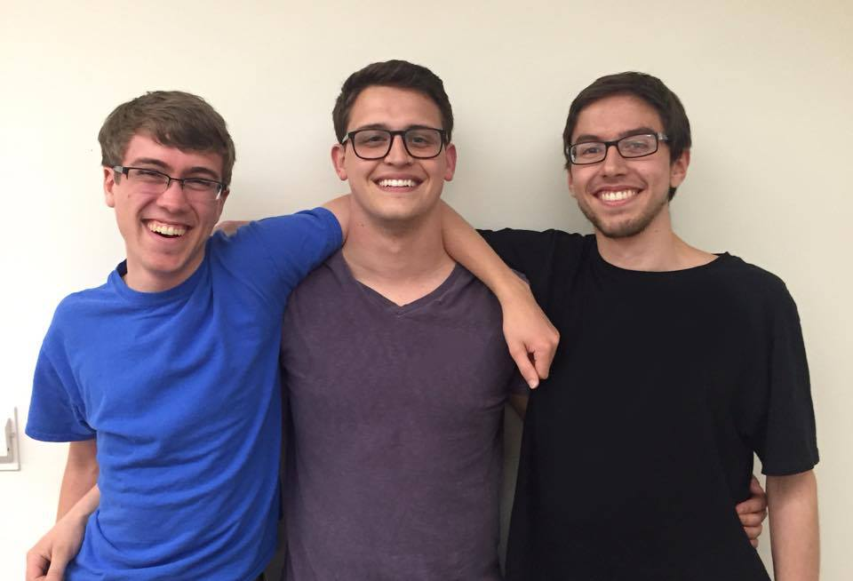
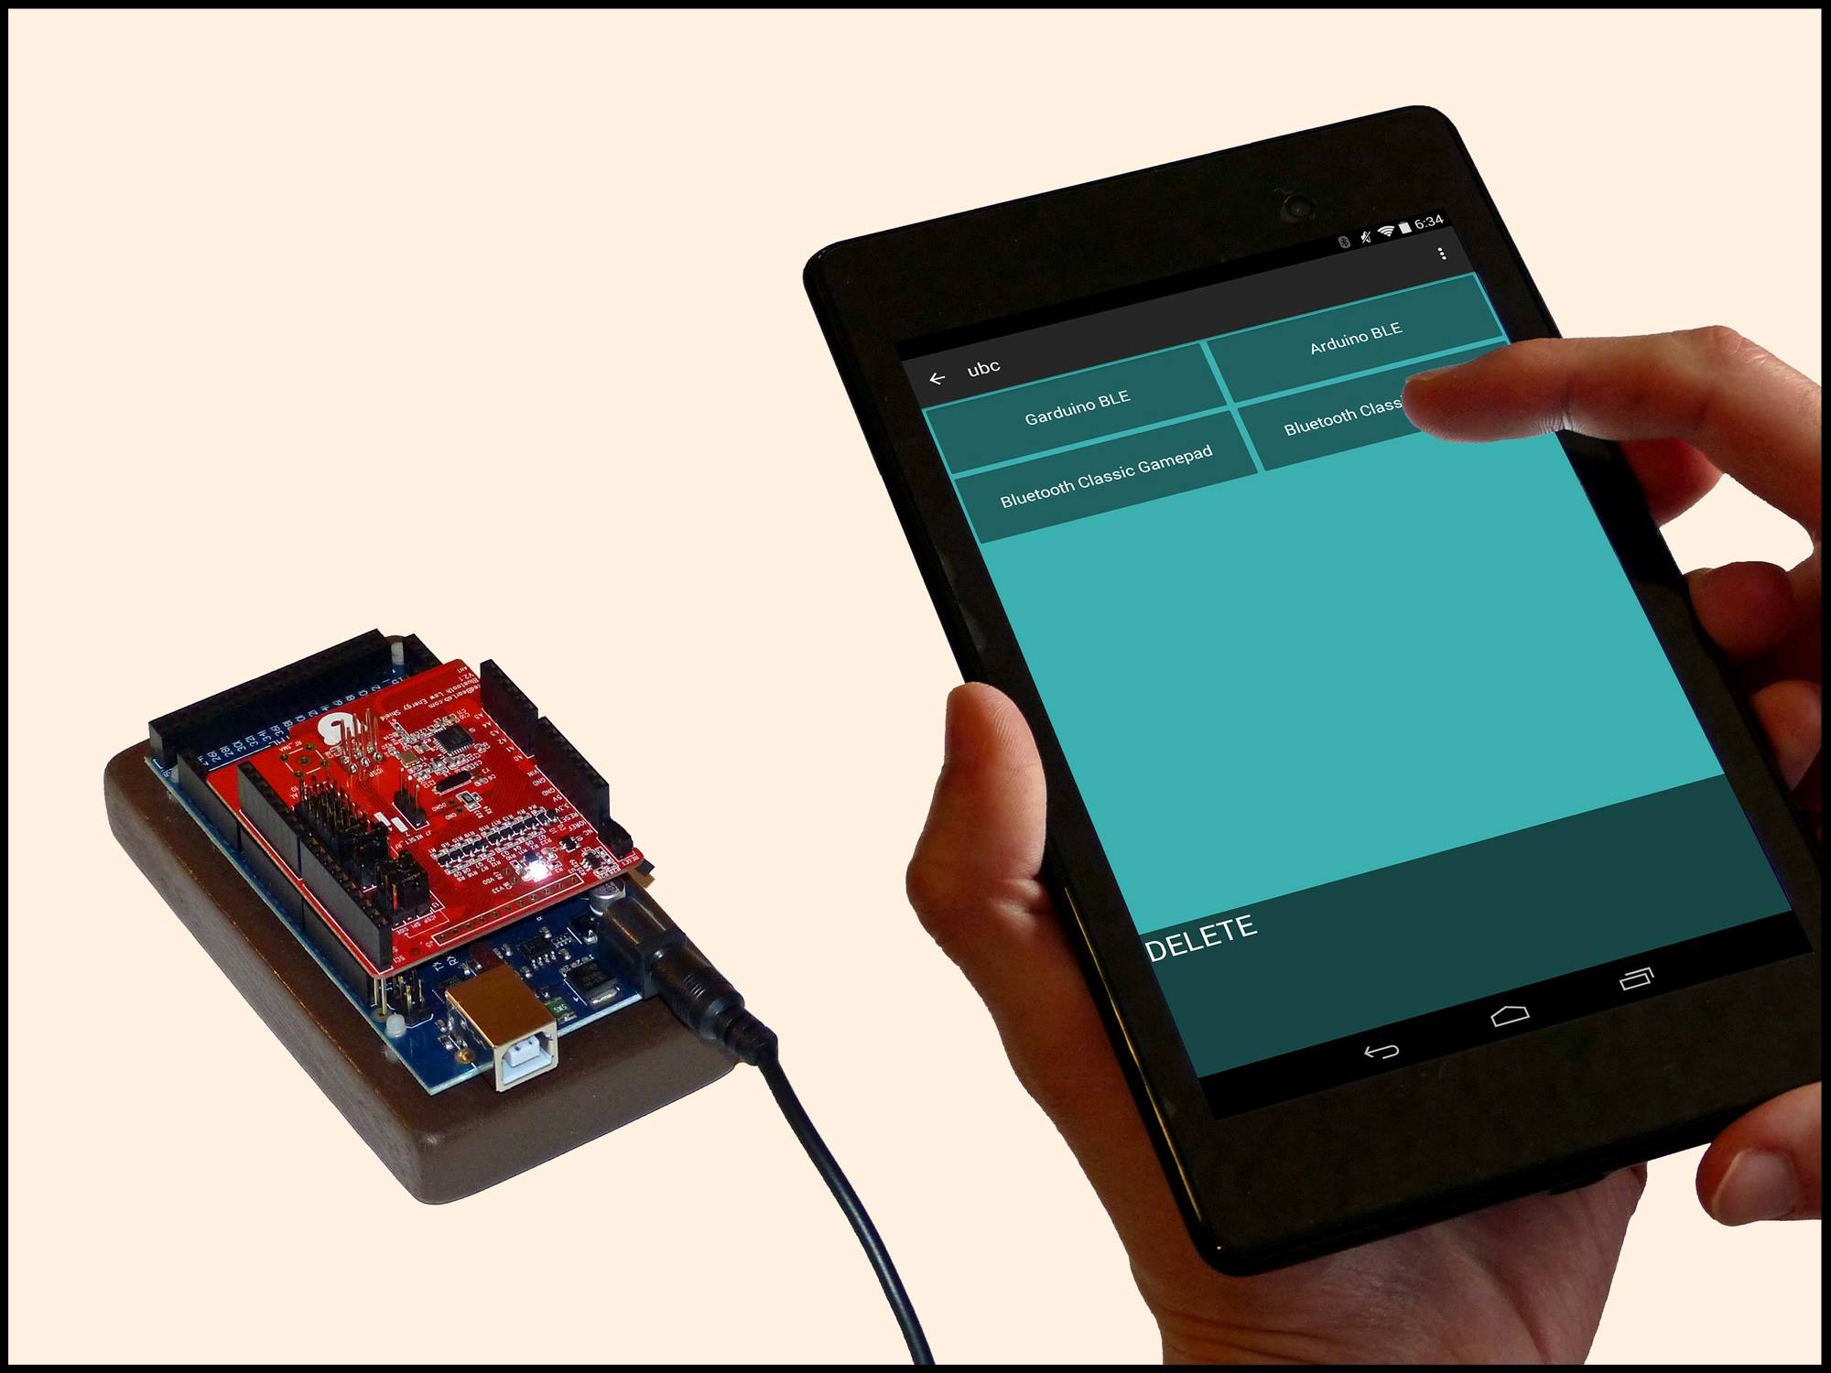
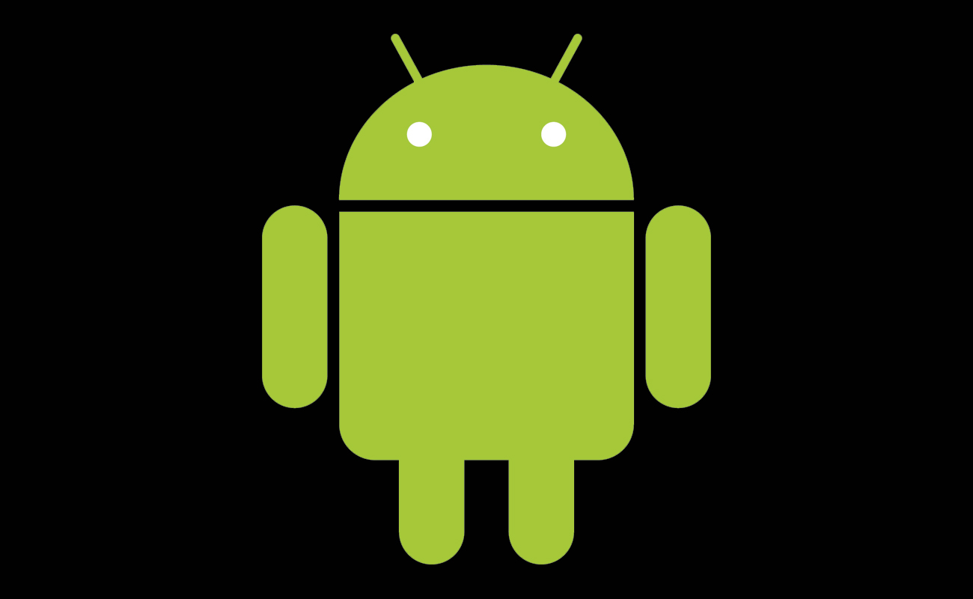
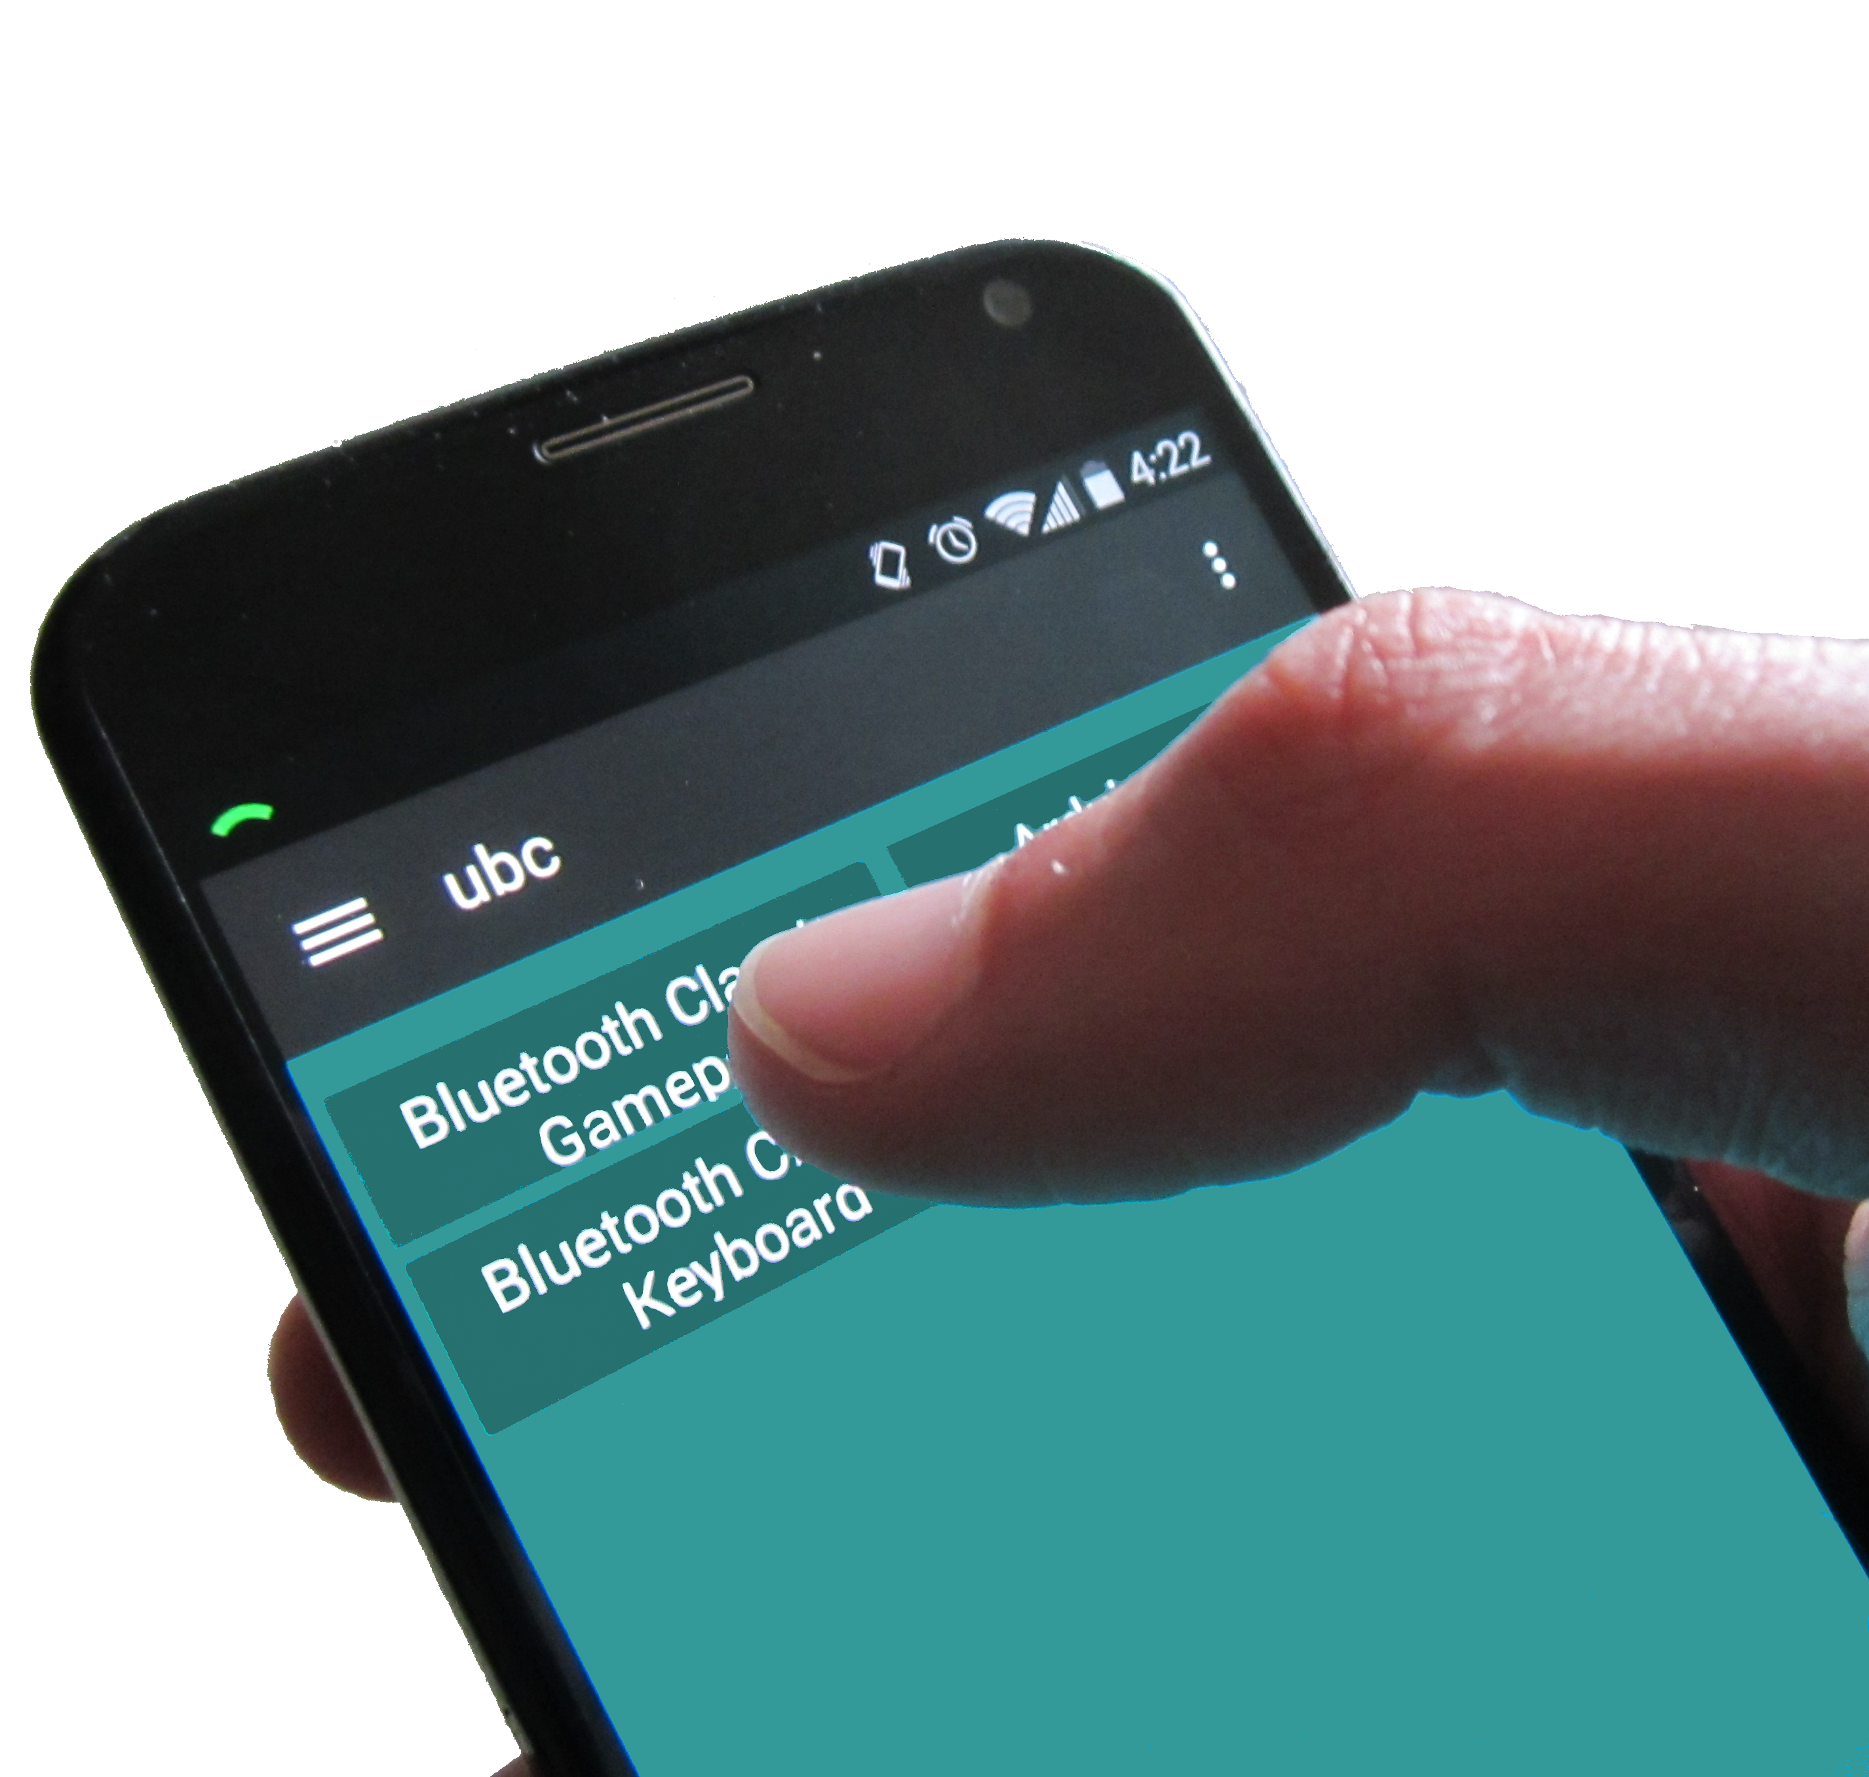
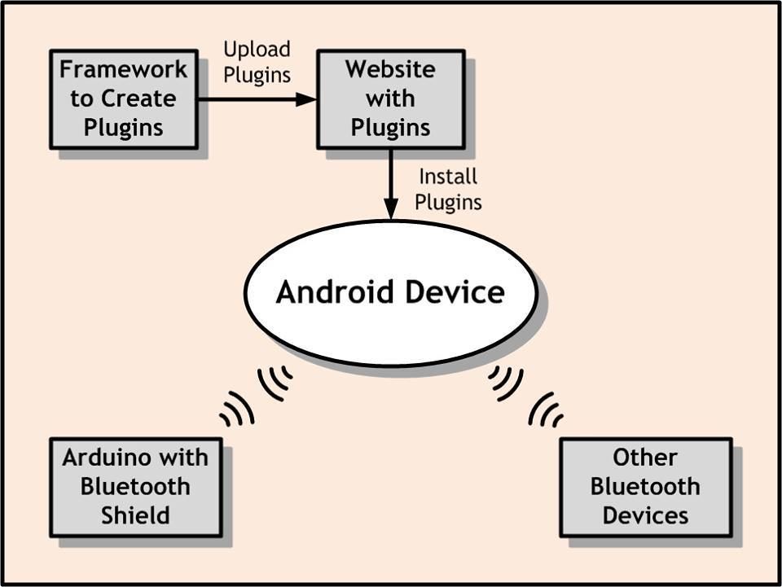
UBC (Universal Bluetooth Controller)
Doing the project
We learned about Bluetooth low energy and different profiles. The keyboard and the gamepad both used Bluetooth classic. The Arduino used BLE (Bluetooth low energy). We decided to use BLE because it was the most energy efficient method of Bluetooth communication.
We also learned the process of publishing an app to the google play store. We learned the hard way that we shouldn’t have a real email address hooked up to the google play store unless you enjoy getting spam.
For the plugin framework, we made each plugin into an .apk file which can be downloaded from the website. The main app can figure out which plugins are installed, and launch any of them.
Microcontroller
There is also an Electrical engineering part of this project. They were tasked with designing hardware that interfaces directly with our app. People can then modify this hardware and add functionality, like adding LEDs or pumps for watering plants (or serving water).
Control your devices with this Android app!
Project Description
We setup a framework to create plugins. After a user creates a plugin, we can then add support for said plugin in our app. We used our framework to develop some modules for a Bluetooth gamepad, keyboard, and Arduino.
When a user finishes a plugin, they can upload it to our app website. On this website, users can download and review submitted apps.
We chose Bluetooth low energy to minimize battery usage, and learn new technologies.
End Results
We successfully created a plugin framework, however, there are security concerns that would need to be addressed before anonymous users could contribute plugins. It would have been better if Google had an official plugin framework to use.
Bluetooth low energy is useful for conserving energy, although we have found that it is still buggy on various Android devices. It may have been better to use a Bluetooth classic shield for the Arduino.
Team members:
Sean Penney: penneys@onid.oregonstate.edu
Aaron Egger: eggera@onid.oregonstate.edu Paul Atkinson: atkinspa@onid.oregonstate.edu
Client:
Don Heer: heer@eecs.oregonstate.edu
Target Users
The main target users will be ECE students (or people familiar with electrical engineering) with limited programming and version control knowledge. The reason behind this is that the app will simplify the software part of controlling Bluetooth hardware, so that they can focus on setting up the hardware. Users will need an Android 4.3+ device that supports Bluetooth low energy.
Introduction and Background
This project is the brainchild of our mentor, Donald Heer, who plans to use this project in DIY applications around his home. This project was born out of his need for a convenient way to control multiple Bluetooth devices at once, including devices connected to the ECE Bluetooth box.
Don Heer wanted a framework to allow general users to control hardware through Bluetooth without having to program anything themselves. The idea was to have a base app that you install “plugins” for. Each of these plugins add some functionality to the app. For example, if you have an Arduino hooked up to a pump, you could download a plugin that will control the Arduino and pump the water. This way, Electrical students don’t have to worry about doing the programming themselves, they just have to worry about the hardware end of things.
We were interested in this project because we wanted more experience designing user interfaces and working with bluetooth devices in Android. Two of us had previous experience with Android programming, so we already had some base knowledge.
Notes:
If tri-fold mounting at SMS – make sure no text or image is in-between the two vertical guide lines; this space will be cut away. To view the vertical guide lines: Select “View” from the main menu, select “Guides” from the pull down menu, and lastly select “Static Guides”.

