Slide 1
Using Bioinformatic Algorithms to Analyze the Politics of Form in Modernist Urdu Poetry
A. Sean Pue
(@seanpue; Github: seanpue; pue@msu.edu)
Tracy K. Teal (@tkteal)
C. Titus Brown (@ctitusbrown)
DH2015
June 31, 2015
Code: https://github.com/seanpue/dh2015

Slide 2
Code
Code: https://github.com/seanpue/dh2015
Graphics: https://github.com/seanpue/dh2015/blob/master/Graphics.ipynb

Slide 3
Talk Layout
Research Problem
In a field dominated by literary history and studies of semantic meaning, how to incorporate other formal qualities, including sound, in analysis of Urdu poetry
Motivated choice to analyze the meter of Urdu poetry, both classical and free verse
Method
Working with graph-based algorithms developed in conjunction with bioinformaticians
Results
Application to the modernist poetry of Sana Ullah Dar ‘Miraji’ (1912–49) reveals abstractions from two metrical systems, one Perso-Arabic and one Indic
Conclusion
Further applications and research possibilities

Slide 4
Why Digital Analysis for Urdu?
Motivated by the strong and recurrent discourse about ‘sound’ in modern Urdu poetry
Urdu as a language involves:
Perso-Arabic vocabulary and forms (ghazal, masnavi, etc.)
Indic (“Hindi”) vocabulary and forms
Relation of meter to community
Possibilities of providing experiential or graphical “proof” to prose assertions

Slide 5
Urdu Meter
The meters are quantitative (not qualitative), based on length rather than stress
Units involve “short” and “long” vowels
Metrical units are not necessarily syllables
E.g. Raaj → = - (raa j) [where = is long, - is short]
Flexibility
Long vowels can be shortened at the end of words
Metrical units can span words
There are particular word-based anomalies/flexibilities
Notes:
Note =,-

Slide 6
Urdu Prosody
Descriptions in Urdu from Persian (Farsi) and earlier Arabic prosody, as following a particular pattern (dates back to al-Khalil of Basra (718 CE)
Describe metrical feet using text where certain vowels are “moving” or “silent,” e. g.
fāʿilātun = - = = فاعلاتن
fāʿilun = - = فاعلن
faʿūlan - = = فعولن
Meters named using primary metrical “wheels” and different sorts of modifications to them
Meter is referred to as a baḥr (“ocean”)

Slide 7
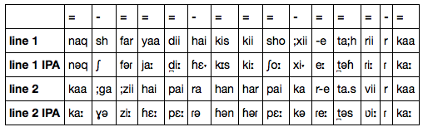
Metrical Examples
نقش فریادی ہے کس کی سوخی تحریر کا کاغذی ہے پیرہن ہر پیکر تصویر کا

Slide 8
Computational Problem
How to computationally scan Urdu poetry in a scalable and effective way?

Slide 9
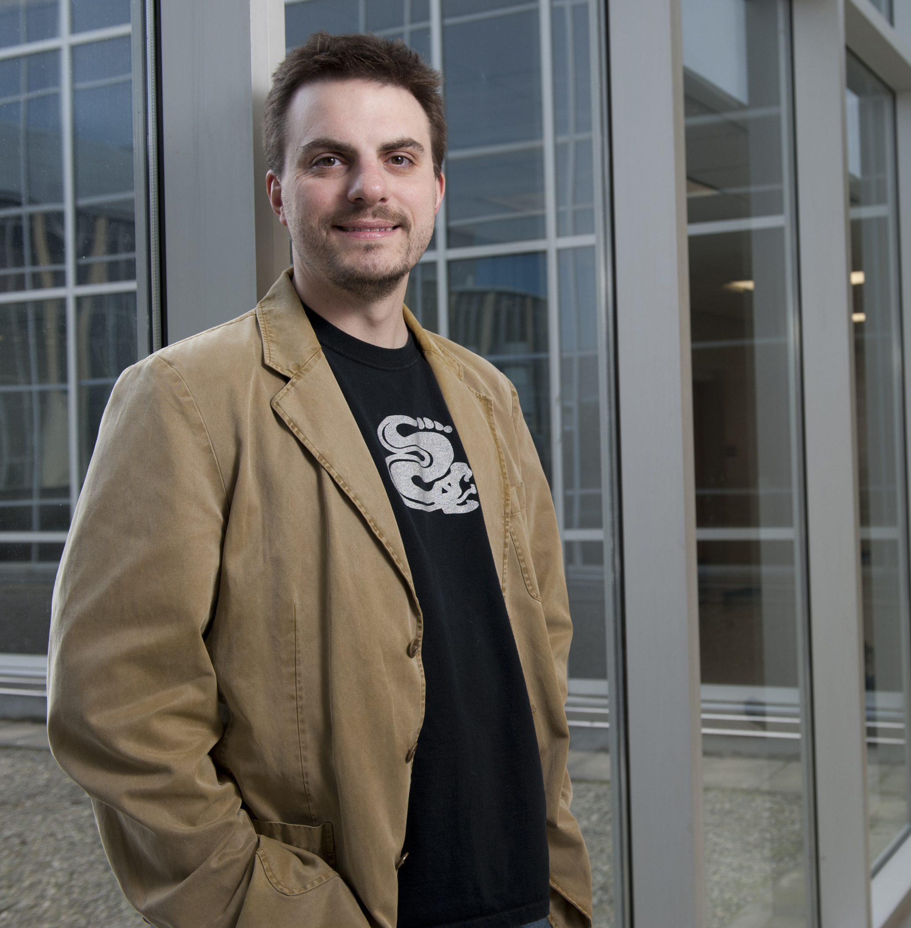
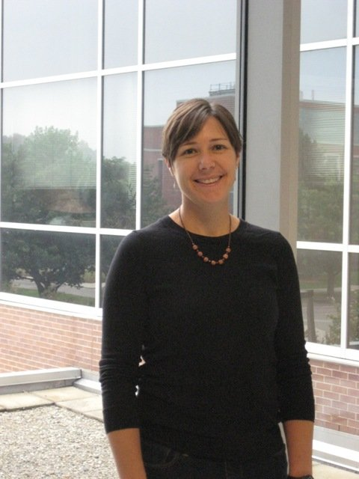
Collaborators
C. Titus Brown (@ctitusbrown)
“developmental biology, next-gen sequence analysis, metagenomics, and software engineering.”
Tracy K. Teal (@tracykteal)
“Microbial ecologist, bioinformatician, collector of soils. OpenScience and tab-complete advocate.”

Slide 10

Transfer of sequences that encode information
The Central Dogma of Molecular Biology
DNA
AAGGAATCATATGGATAC
Urdu
Replication
DNA
AAGGAATCATATGGATAC
Transliteration
ranj se ;xuugar hu))aa insaa;n
Transcription
Metrical
components
RNA
AAGGAAUCAUAUGGAUAC
csccbcvbcvcscbcscvbsccvn
Parsing
RNA
codons
Group
components
csc c bcv bcv csc bcs cv sc cvn
AAG GAA UCA UAU GGA UAC
Translation
Protein
KESTGT
Scansion
=-==/=-==/=-==

Slide 11
Representations of sequences
Markov chain
A mathematical system that undergoes transitions from one state to another, between a finite or countable number of possible states
eat
tasty
ham
I
like
green
butterflies
winged
Find the best transition state trajectory

Slide 12
Meters as Graphs
Nodes represent metrical units
(oval = is long, short – is circle); red is end position
Edges contain constraints, disallowing invalid combinations
Example: = - = = / = - = = / = - = (-)

Slide 13
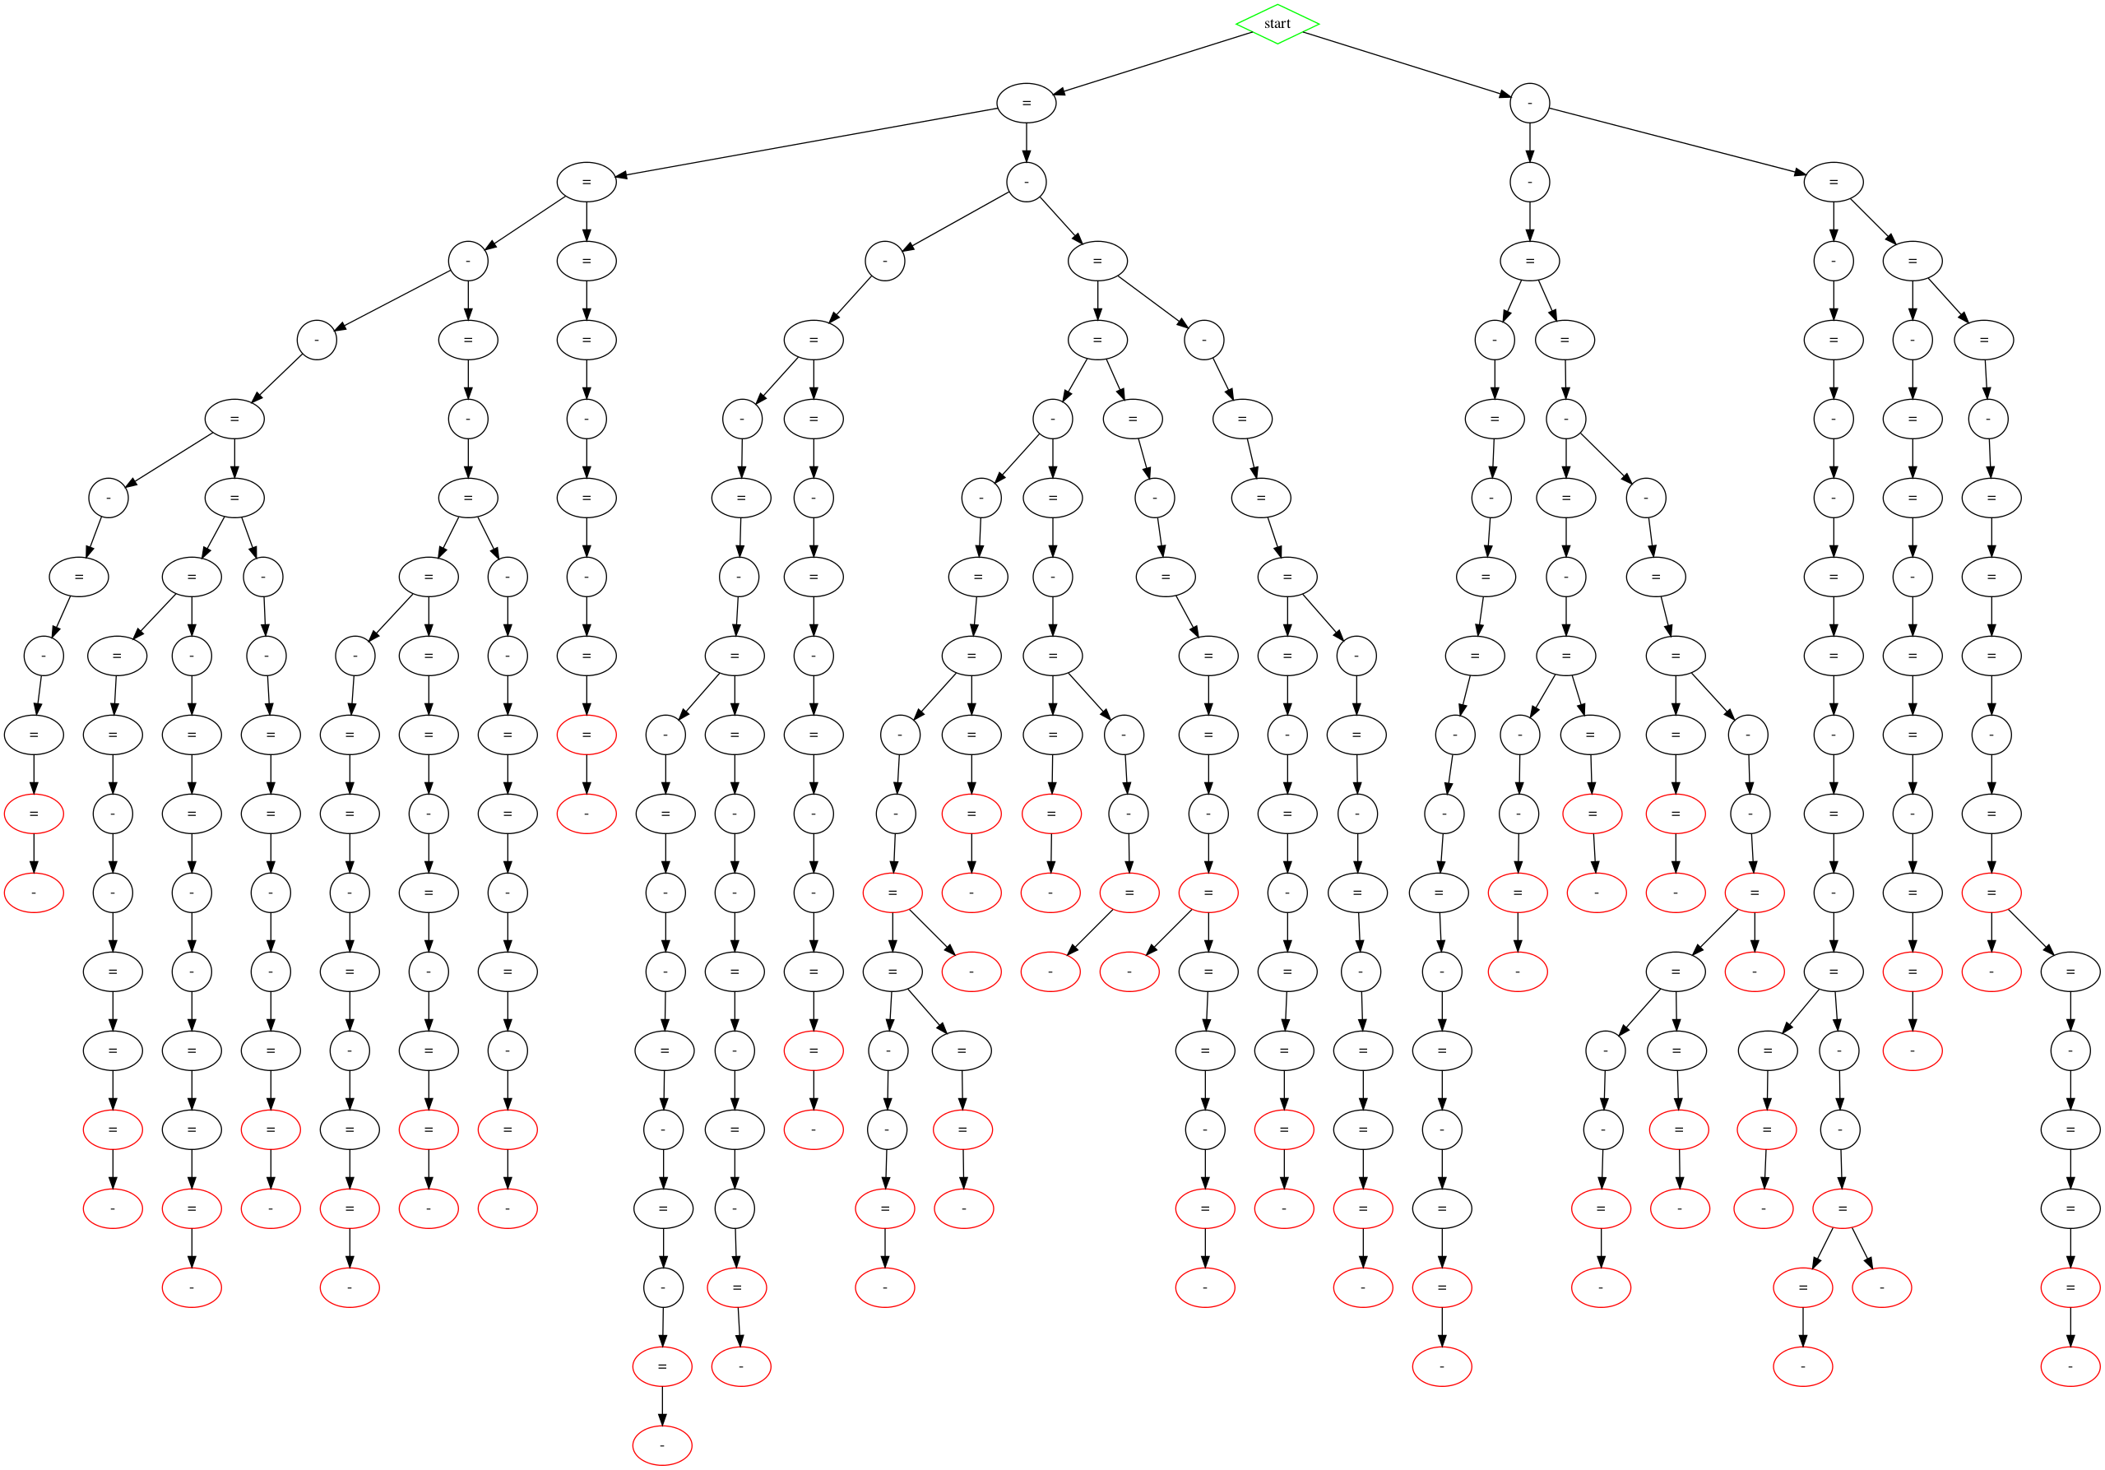
“Classical” meters of Mirza Ghalib (d. 1869)

Slide 14
Transformation of “Classical” to “Free” Verse

Slide 15
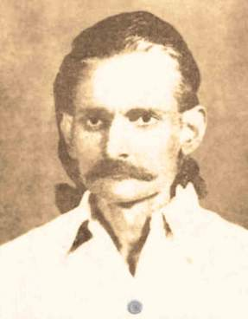
Sana Ullah Dar Miraji (1912-49)
Miraji ki nazmen, 1944
Claims to embrace a past that is not Indo-Muslim
Drawn to ancient India, gopis, Krishna
Heart focused on Hindu Indian past, eyes focused on the world around him
Extraordinary legacy for modern and contemporary Urdu poets, as a poet of Hindustani (before Hindi and Urdu were separated)

Slide 16
Prosody of Miraji ki nazmen 1
(–⏑–– /)+ –⏑–(⏑) {1 Poem}
[⏑–– /]+ ⏑–(⏑){1 Poem}
[⏑–⏑ / –– ]+ {6 poems}
[⏑––– /]+ {3 poems}
[⏑–– / ]+ {3 poems}
––⏑/ (⏑––⏑)+/ ⏑–– {1 poem}
–⏑–– / (⏑⏑–– /)+ [⏑⏑– | ––](⏑) {11 Poems}
[–⏑– /]+ (⏑) {3 poems}
[⏑–⏑– /]+ {1 poem}
All abstractions from ghazal (Perso-Arabic) meters

Slide 17
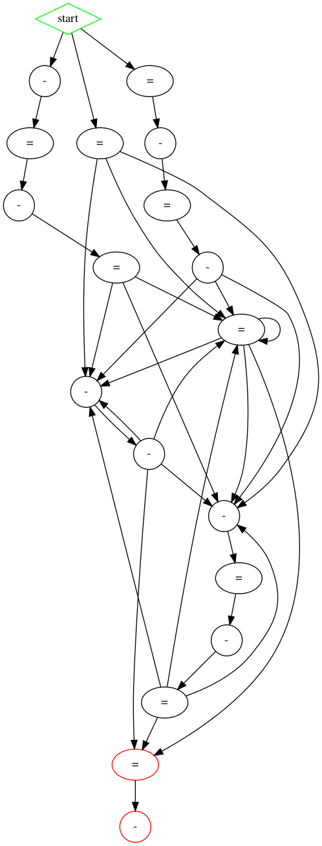

Prosody of Miraji ki nazmen, 2
However, a separate metrical pattern in 18 poems that does not follow Perso-Arabic meters, but is based on total count of metrical units, usually following a pattern of:
= [ = | - - ] = (-)
With other variants:
= - = [= | - - ] = (-)
= [= | - = - = ] = (-)
Closer to the mātrik chhand (mora-based meters of Hindi); though uses the metrical-unit rules of Urdu
Also a few adaptations of Braj Bhasha (early Hindi) forms as well

Slide 18
Closest parallel in Mir’s “Hindi Meter”
Mir Taqi Mir (1722-1810)
Earlier examples as well:
ʿAlī Ādil Shāh II ‘Shāhī’ (r. 1656-1672, Bijapur)
Mīr Muḥammad Jaʿfr ‘Zaṭallī (1659?-1713?, Haryana and Delhi)
Shāh ʿImād-ud Dīn Qalandar Phulvārvī (1654-1712)

Slide 19
Secondary Metrical System
Does not align easily with the Perso-Arabic prosody, but has a larger presence in the modernist Urdu canon, as well as arguably the classical as well
A different sort of aahang (melody) to what gets canonized as the separately “Perso-Arabic”/Muslim metrical system of Urdu
Points to the common musical/rhythmic understanding of Hindi and Urdu

Slide 20
Possibilities for Computational Analysis
1. A model of how poem should sound in meter, that can be visualized in different ways.

Slide 21
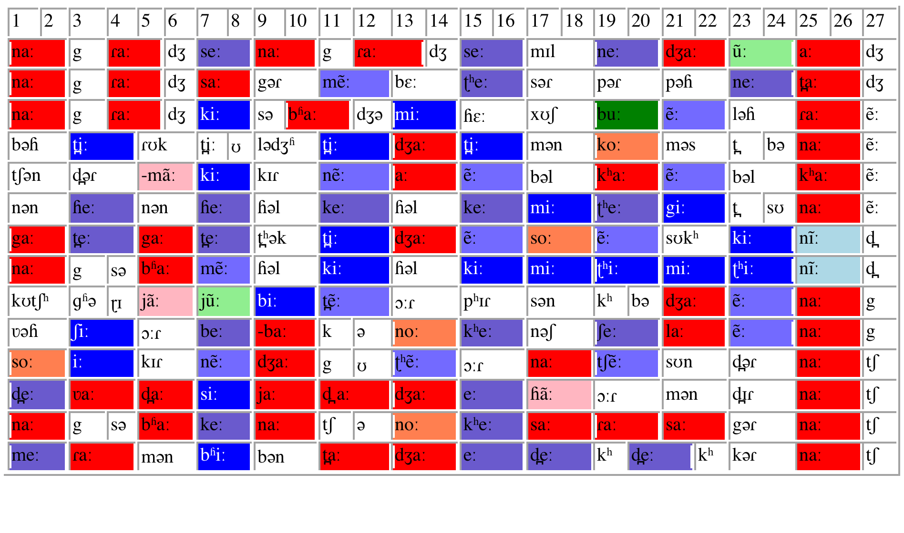
Possibilities for Computational Analysis
1. A model of how poem should sound in meter, that can be visualized in different ways.

Slide 22
Possibilities
1. A model of how poem should sound in meter, that can be visualized in different ways.
2. Correlation with performance.
Determining role of stress, which remains elusive.
3. Discerning patterns in sound, comparison across languages and in relation to music.
4. On a macro level, mapping of the evolution of poetic forms, including free verse, across languages.
5. Cultural heritage preservation—making annotated texts and performances available and open to new discoveries, both scholarly and creative.

