Slide 1
Taxonomy of Work
End goal: connect real labour-market evidence to business decisions
Public Job Postings
Evidence comes from real postings;
standards (O*NET, ESCO) are the reference frame.
Tasks + Skills
Task / Skill Taxonomies
Task-Skill Mapping
Business Initiative -> Tasks -> Skills
IE7945 Workforce Analytics capstone x Workhuman - Taxonomy of Work
1

Slide 2
A reproducible shared workforce-data foundation
Sprint 1
5,595
5,497
4,029
raw postings
canonical postings
unique postings
O*NET 31.0
1,016 occupations | 18,838 tasks
ESCO v1.2.1
3,039 occupations | 13,939 skills
DuckDB
one shared database
Shared data contract
one posting_id for both teams
EDA notebook
executed from the DB
Automated pipeline
21/21 acceptance checks
IE7945 Workforce Analytics capstone x Workhuman - Taxonomy of Work
2

Slide 3
How the data fits together
Job postings = empirical evidence | O*NET & ESCO = reference standards
NYC Open Data Jobs
2,795 raw
TASKS
O*NET 31.0
18,838 tasks
Canonical Job Corpus
5,497 postings
Arbeitnow API
2,800 raw
posting_id
SKILLS
ESCO v1.2.1
13,939 skills
Every downstream artefact (task, skill, mapping) joins back to the same posting_id and to a preserved,
checksummed raw record - so both teams work on identical evidence.
IE7945 Workforce Analytics capstone x Workhuman - Taxonomy of Work
3

Slide 4
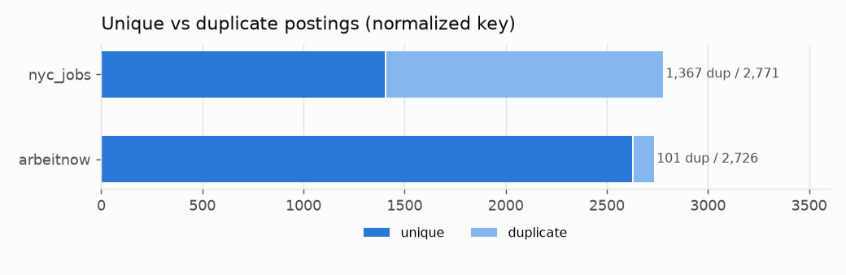
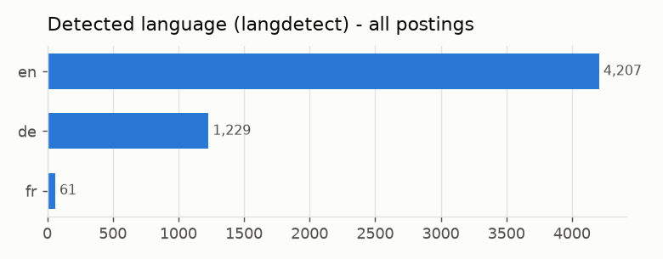
What EDA taught us
Corpus quality and representation must be measured before taxonomy construction
26.7%
overall duplicates
49.3%
NYC duplicates
(internal + external re-posts)
76.5%
English
22.4%
German
0%
industry available
from current sources
IE7945 Workforce Analytics capstone x Workhuman - Taxonomy of Work
4

Slide 5
Independent development now; integration without rework later
Shared data contract v1.0 (docs/data_contract.md)
posting_id
TASK TEAM
posting_id -> atomic tasks
source + source_job_id
LATER
posting_id
tasks <-> skills
raw record (preserved)
SKILL TEAM
posting_id -> atomic skills
normalized fields
(NULL = not available)
Rules: UTF-8, ISO-8601 dates, ISO language codes, source-provided vs *_derived fields, duplicates flagged not deleted.
IE7945 Workforce Analytics capstone x Workhuman - Taxonomy of Work
5

Slide 6
Advanced prototype direction
Model disagreement as a quality signal - not an LLM answer as ground truth
REAL POSTING (deterministic sample, section detection)
COMPLETED
COMPLETED = built and tested end to end on a 4-posting smoke test.
IN PROGRESS = 200-posting experiment paused mid-run; responses cached, results not yet validated.
No experiment metrics are shown until the run completes.
Gemini + Groq independent extraction (cached, schema-validated)
IN PROGRESS
Evidence-preserving gates (verbatim span must exist in posting)
COMPLETED
Task / skill statements + cross-model agreement
IN PROGRESS
O*NET / ESCO candidate alignment
NEXT
Human review where models disagree
NEXT
IE7945 Workforce Analytics capstone x Workhuman - Taxonomy of Work
6

Slide 7
Collaboration path
One shared foundation feeds both teams; the joint work reuses their outputs
SHARED FOUNDATION
canonical corpus | posting IDs
data contract | O*NET + ESCO
TASK TEAM
responsibilities -> tasks -> clusters
-> O*NET evaluation
SKILL TEAM
requirements -> skills -> clusters
-> ESCO evaluation
JOINT
task-skill mapping
initiative -> tasks -> skills
IE7945 Workforce Analytics capstone x Workhuman - Taxonomy of Work
7

Slide 8
Foundation complete; moving from data acquisition to evidence extraction
Current status
DONE
IN PROGRESS
NEXT
- Corpus (NYC + Arbeitnow)
- O*NET 31.0 loaded
- ESCO v1.2.1 loaded
- DuckDB database
- Shared data contract
- EDA notebook
- Reproducible pipeline (21/21)
- Gemini/Groq provider layer - built, live-tested
- Deterministic 200-posting sample - built
- Section detection + evidence gates - built, tested
- Dual-model extraction run - paused (cached)
- Empty gold-100 set + annotation guidelines - drafted
- Finish evidence-based extraction prototype
- Gemini/Groq disagreement experiment
- Human-labelled 100-posting set
- O*NET/ESCO candidate matching
- Embeddings/clustering (next sprint)
- Joint task-skill integration later
IE7945 Workforce Analytics capstone x Workhuman - Taxonomy of Work
8

