Slide 1

Tea Time on Jupiter – A Serena Story by Sean Reed
For these slides..
  The left side of the slide will have:
    Page number
    Whether the image should be one page or a two page spread
    An image description
    My commentary/additional notes
  The right side of the slide will have:
    Dialogue (if any)
    The manuscript text

Slide 2
Image Description
Dialogue and Manuscript Text
Page 1, on RHS (LHS blank)
Serena's MOM outside the door to Serena's room. Door is closed.
MOM has just knocked vigorously on the door
Mom is puzzled that Serena says she's up. Has never happened before in the history of the world
Serena is off, words are through the door
Mom: Serena, time for breakfast.
Serena: I'm already up!
Serena: I really am up, Mom. Honest.

Slide 3
Image Description
Dialogue and Manuscript Text
Spread, Pages 2-3
Serena really is up!
In fact, she is sitting on her bed in outer space in a close orbit of Jupiter.
The huge, full disk of the multicolored planet looms large in the background. The Great Red Spot is visible.
Two Galilean Moons (Europa and Callisto) and their shadows are visible near Jupiter's surface
Serena: I'll be down in a minute, Mom

Slide 4
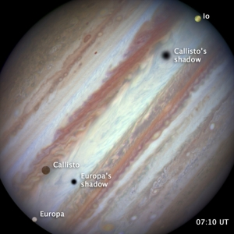
Image Description (Continued from previous page)
The space around Jupiter is jam packed with activity, and view is both jarring and spectacular. Serena is taking it all in
Note: for the large moons and their shadows, this is what I have in mind for the image:

Slide 5
Image Description
Dialogue and Manuscript Text
Spread, Pages 4-5
Serena (now out of her imagination and back on Earth!) slides down the stairs in her pajamas to get breakfast.
Mom and Dad are both in breakfast nook, food in front of them, waiting.
Dad: Serena, the food is getting cold...
Serena: I'm coming down right now, Dad...

Slide 6
Image Description (continued from previous page)
Serena passes several framed family pictures along the stairs:
  Mom and Dad's wedding
  Serena when she just got home from the hospital
  Serena at a dance recital.
Also visible: identical photo to the one that Serena left on the Moon

Slide 7
Image Description
Dialogue and Manuscript Text
Spread, pages 6-7
Breakfast has been over for a little while, everyone's done.
Dad heading to the door about to go out for his morning walk/jog. Sweatsuit jacket now on, zipping it up.
Dad: We're doing Jupiter during tea time today, right?
Serena: Yep
Dad: Ok. I'll be back in plenty of time!

Slide 8
Image Description
Dialogue and Manuscript Text
Spread, pages 8-9
Serena's Room. Her real room this time, on planet Earth.
Serena prepares the tea party.
She fusses with her solar system-themed tea set, with the Sun as the teapot and planets as cups
She wears her Moon charm
None

Slide 9
Image Description – continued from previous page
Serena's room of a nine year-old only child obsessed with all things related to space
She has posters of Mae Jemison (astronaut) and Bessie Coleman (aviator) on the wal with their names on the bottom. Two of her role models.
Also has a big map on wall of Jupiter with blow-out sections on each of Jupiter's four largest moons, Ganymede, Io, Callisto, and Europa

Slide 10
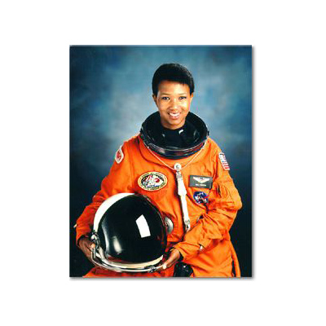
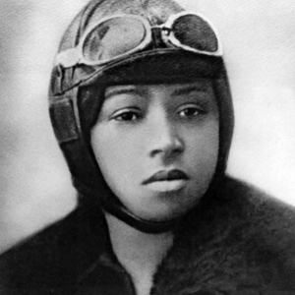
Image Description – continued from previous page
Mae Jemison
Bessie Coleman

Slide 11
Image Description
Dialogue and Manuscript Text
Page 10 (LHS)
Mom and Dad getting ready for the tea party.
It is a semi-formal affair. Dressy! They are nearly ready. They look great together.
Suit and tie for Dad. Dad pulling on his final multi-colored sock
Nice evening dress for Mom
NO SHOES!
Mom: You know she hates it when we're late.. let's go!

Slide 12
Image Description
Dialogue and Manuscript Text
Page 11 (RHS)
With the tea service setup done, Serena turns her attention to finding just the right dress to wear for her upcoming tea time with her parents.
It has to be just right, so she looks over her options carefully
None

Slide 13
Image Description
Dialogue and Manuscript Text
Spread pages 12-13
Mom and Dad in their dressy tea outfits, standing outside the door to Serena's room
Serena's just opened the door to let them in. Her dress is beautiful. She made a great choice
None

Slide 14
Image Description
Dialogue and Manuscript Text
Images p14-15
Mom and Dad and Serena are all seated
Serena pours the imaginary tea into the cups from her solar system tea set
So, lets begin..

Slide 15
Image Description
Dialogue and Manuscript Text
Images p14-15, cont
Serena's drawing of the solar system. Vertical, with the Sun on the top of the page and Saturn on the bottom.
There is an arrow that point down saying “this way to Saturn, Neptune and Uranus
We are here, on Earth. The third planet
Jupiter is number five.
It comes right after Mars.

Slide 16
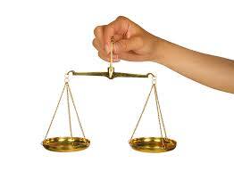
Image Description
Dialogue and Manuscript Text
Images p14-15, cont
Scale #1: A super sized Serena holds a scale with Jupiter on LHS vs other seven planets on the other. Each planets is duplicated, so 14 planets total, almost falling off the plate, and Jupiter is STILL HEAVIER
Scale #2: Serena holds another scale with the Sun on LHS versus 1000 tiny Jupiters on the other side. Balanced.
Jupiter is huge compared to all the other planets, but still small compared to the Sun

Slide 17
Image Description
Dialogue and Manuscript Text
Images p14-15, cont
Scale #3: Jupiter on one side, and 300 little Earths on the other. Scale is balanced.
Jupiter's mass is more than 300 Earths

Slide 18
Image Description
Dialogue and Manuscript Text
Images p14-15, cont
Image of Serena putting little Earth marbles inside of a “non-opaque” Jupiter-shaped container. Inside the Earths come almost all the way to the top
Jupiter is so big that more than 1000 Earths could fit inside it.

Slide 19
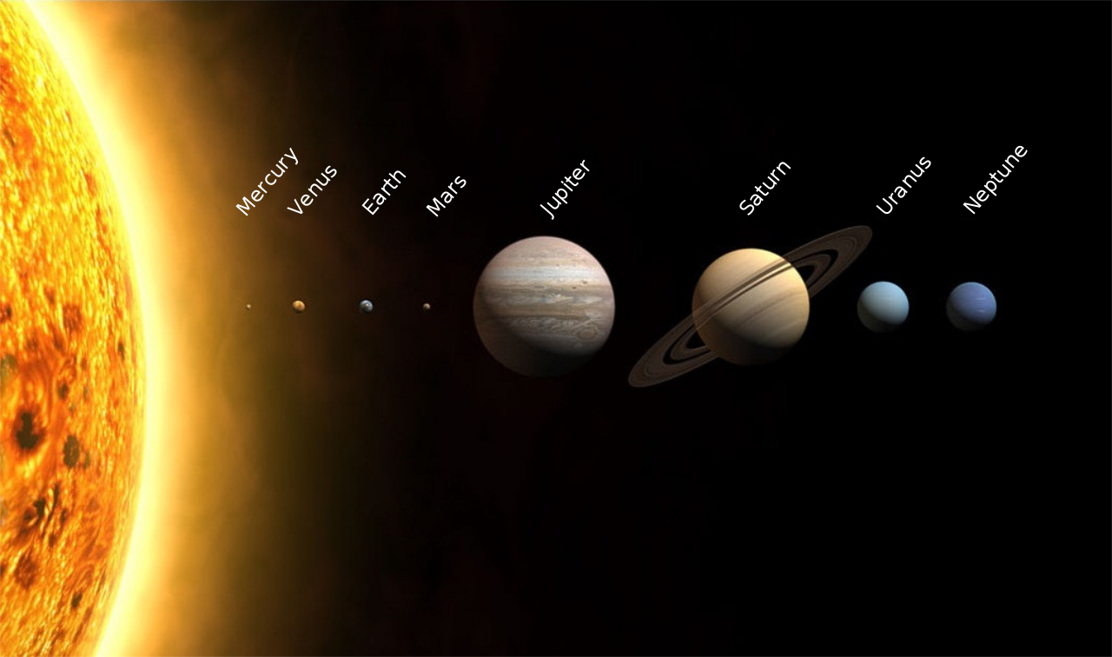
Image Description
Dialogue and Manuscript Text
Image spread p16-17
Serena's drawing of the eight inner moons of Jupiter, laid out just like our entire solar system is in the image below
Moons are all labeled
Jupiter's has eight inner moons, separated into two groups The four small satellites, and the four giant Galilean Moons.
From closest to farthest from Jupiter:
Group 1: Metis, Adrastea, Amalthea, and Thebe
Group 2: Io, Europa, Ganymede, Callisto

Slide 20
Image Description
Dialogue and Manuscript Text
Image spread, p18-19
Serena's sketch of the Jupiter system this time with Jupiter in the center and all of the moons swirling in orbit around it. Eight inner moons from previous page are seen, as well as lots of tiny and/or oddly shaped ones with crazy irregular orbits.
Jupiter has over 67 moons.
Note: I have not drawn all of the moons here because that would take too long

Slide 21
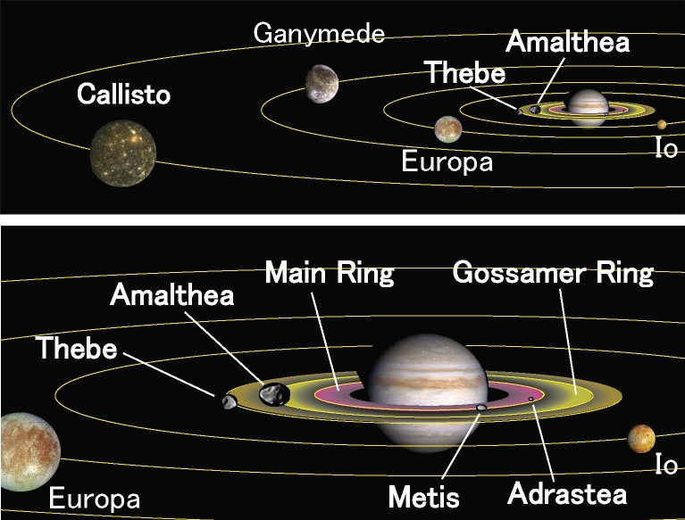
Image Description
Comments from Sean Reed
Sam: I can't find a single image for what I want here, but the combo of these two images is close! The concept is, I want to see Jupiter in the center, the eight inner moons labeled, and a few of the small, oddly orbiting outer moons, which will not necessarily be in the same 'ecliptic' as the moons shown here.
I want the kids to get that Jupiter is just like a solar system unto itself.
Image spread, 18-19 continued

Slide 22
Image Description
Dialogue and Manuscript Text
Image spread 20-21
Drawing of Voyager flyby of Jupiter, showing the rings
Here's something scientists didn't find out until we sent the Voyager probe to take pictures of Jupiter: Jupiter has rings!
The rings are made of material pulled from Jupiter's moons by the Jupiter's strong gravity.
Jupiter's rings are made of dust and rock. They are not shiny like Saturn's rings, which are mostly ice. So we couldn't see them from Earth.

Slide 23
Image Description
Dialogue and Manuscript Text
Image p 22
Full page image of Jupiter showing its full disk, with all its multicolored bands of clouds (called Zones and Belts) labeled along with Great Red Spot
Jupiter spins once in 10 hours. For a planet the size of Jupiter, this spin creates a powerful force.
The upper ammonia clouds visible at Jupiter's surface are organized in a dozen zonal bands parallel to the equator and are bounded by powerful zonal atmospheric flows (winds) known as jets.
The bands alternate in color: the dark bands are called belts, while light ones are called zones. Zones, which are colder than belts, correspond to upwellings, while belts mark descending air.[5] The zones' lighter color is believed to result from ammonia ice; what gives the belts their darker colors is not known with certainty.[5]

Slide 24
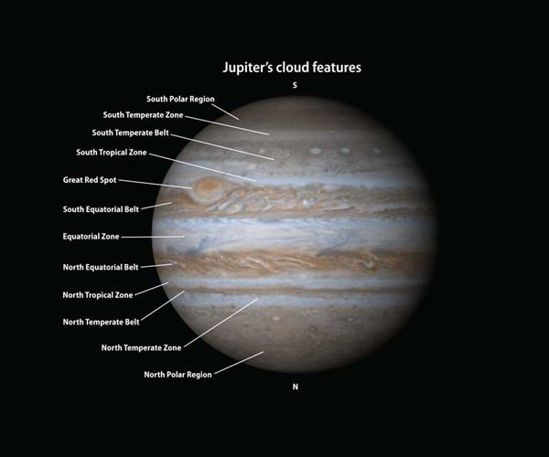
Notes
Image p 22 continued
Sam, this is almost the image I want, with the following modifications:
Flip so North Polar Region is on top, South Polar on bottom
relabel so Zones on LHS of planet and Belts on RHS
For each Zone, put two small arrows pointing right within the layer to show its direction of rotation
For each Belt, put two arrows pointing left within the layer to show its direction of rotation (arrows can go down the middle, for example, between an imaginary line connecting the north and south poles

Slide 25
Image Description
Dialogue and Manuscript Text
Image page 23
Weather on Jupiter
Serena: The Weather on Jupiter is fierce
Jupiter has powerful storms, often accompanied by lightning strikes.
The storms form mainly in belt regions.
The lightning strikes on Jupiter are hundreds of times more powerful than those seen on Earth
The Jovian atmosphere shows a wide range of active phenomena, including cyclones, anticyclones, storms, and lightning.
.
The large amount of heat generated within the center of Jupiter contributes to the unusual motions of the atmosphere.

Slide 26
Image Description
Dialogue and Manuscript Text
Image page 24
Close up of the Great Red Spot in Jupiter's atmosphere.
Arrows suggest direction of rotation of the storm
Great Red Spot. Very high atmosphere anticyclone Storm has been raging for hundreds of years. It's color changes over time. We know because many people have looked up at it through telescopes and observed it and written down its size and color in their observing notebooks
The storms are generally ovals, and show up as either red, white or brown spots in Jupiter's atmosphere.
Located in the southern hemisphere, the GRS is the largest known vortex in the Solar System.
The GRS is two or three Earths across and has existed for at least three hundred years.

Slide 27
Image Description
Dialogue and Manuscript Text
Page 25
Diagram of the interior of Jupiter
Mom: What is Jupiter Made of?
What is going on inside of jupiter, far below the colorful clouds we can see?
Jupiter is not solid rock like Earth. It is a big ball of gas and liquids.
Jupiter is mostly hydrogen, just like the Sun. The hydrogen exists as both a gas and as the pressure gets higher, a liquid
The Source of Heat from Within Jupiter
The energy that Jupiter and Saturn make has been found be very high.Energy is given off from when a planet is in the process of shrinking together, or collapsing on itself.
The fact that Jupiter is still collapsing together indicates that the process of planet formation is still going on. This process is providing the heat from within which gives its energy to the unusual motions in the atmosphere.

Slide 28
Image Description
Dialogue and Manuscript Text
Image of two men dressed in 16th century Italian clothes looking up through telescopes toward Jupiter and its four largest moons.
Galileo and Simon Marius
They were the first people to see bodies that didn't orbit the Earth or the Sun
None

Slide 29
Image Description
Dialogue and Manuscript Text
None

Slide 30
Image Description
Dialogue and Manuscript Text
None

Slide 31
Image Description
Dialogue and Manuscript Text
None

Slide 32
Image Description
Dialogue and Manuscript Text
Serena open present from MOM and DAD: A Jupiter charm for her bracelet
None

Slide 33
Image Description
Dialogue and Manuscript Text
Serena in the middle of her mom and dad. Parents simultaneously give Serena a kiss, on opposite cheeks.
She relishes it. They really love this little girl. It shows.
Dad: That was fun baby. Our best tea party ever.

Slide 34
Image Description
Dialogue and Manuscript Text
Mom and Dad go down the hall back to their bedroom to change into their regular clothes
Serena watches them walk away. So happy to have shared the journey with them.
None

Slide 35
Image Description
Dialogue and Manuscript Text
Shot of Jupiter in the night sky, as seen for real, from Earth. A bright shiny dot.
Serena with her mom and dad, looking up at it from the back porch.
Smiling, holding hands.
THE END
None

Slide 36
FURTHER NOTES

Slide 37
Outline for the Rest of the Story
Great Red Spot. Very high atmosphere Storm has been raging for hundreds of years. It's color changes over time. We know because many people have looked up at it through telescopes and observed it and written down its size and color in their observing notebooks
Arc of Jupiter traveling through the night sky, as really seen from Earth.
Even though it is bigger than Earth, Jupiter's spins much faster. So a day on Jupiter is only 10 hours long, compared to 24 hours here on Earth.
The center spins faster than its North and South poles. In fact, the whole planet spins so fast that the middle of the planet bulges out more than its North and South Poles do.

Slide 38
Outline for the Rest of the Story
We sent space ships to study Jupiter
How far away is it?
How long did it take the spaceships to get there?
Some flew by on the way to other planets
Some stayed specifically to study Jupiter.Voyager flybys
Galileo orbit and probe
Juno Probe is there right now, sending pictures and measurements back to scientists on Earth

Slide 39
Outline for the Rest of the Story
What do we see when we look at this picture of Jupiter?
We only see colorful bands of clouds in its huge atmosphere.
Earth's atmosphere is relatively thin. If you could go five miles straight up, you'll be out of the atmosphere and into outer space.
By contrast, Jupiter's atmosphere is HUGE. (Thousands of miles thick?)
Jupiter is a great big ball of gas.
Jupiter is made of mostly hydrogen, just like our Sun It is not as hot the Sun, but Jupiter does give off a lot of heat. More heat than it receives from the Sun
Jupiter does not have a solid surface to land on. We don't know if there is anything solid even at the center of the planet, its core.

Slide 40
Outline for the Rest of the Story
Jupiter is a great big ball of gas.
Jupiter is made of mostly hydrogen, just like our Sun It is not as hot the Sun, but Jupiter does give off a lot of heat. More heat than it receives from the Sun
Jupiter does not have a solid surface to land on. We don't know if there is anything solid even at the center of the planet, its core.

