Slide 1
The larder
Sean reilly
Summative Assessment - user experience

Slide 2
overview

Slide 3
concept
The project scenario that I have chosen for our Web and UX design assessment is the “Hospitality digital ordering” option. I chose this because I liked the idea of making something that everyone would use and being able to meet the needs of a majority of people.
Project idea
A restaurant located in Miramar, Wellington named The Larder wants to improve customer engagement and sales by providing table ordering via digital devices. Customers will be able to use tablets located at their table to order their food, view their food’s progress, call over a waiter and place feedback.

Slide 4
Initial planning

Slide 5
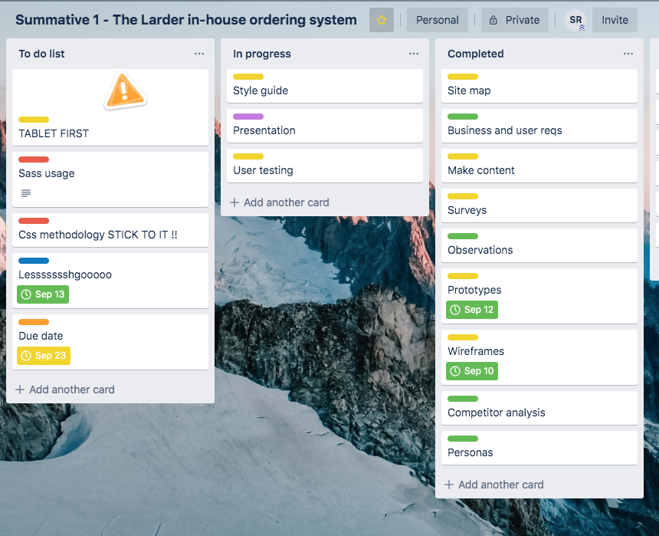
timeline
I used an online project management app called “Trello” to track and manage each of the tasks that I had assigned myself to keep on track and get tasks done on time.
The tasks were colour coded into different sections of the design and production process.
Green was research, yellow was analysis and design, red was pre-production tasks, blue was production and purple was documentation.

Slide 6
Research & analysis
I created a survey using Survey Monkey to share with the class to Slack to get and insight into a range of people’s experiences and habits at restaurants to help with some aspects of my web app design and persona build.
I staged interviews and observations of people using similar websites to get a consensus of what was good and bad experiences using ordering systems and incorporate that into my design.

Slide 7
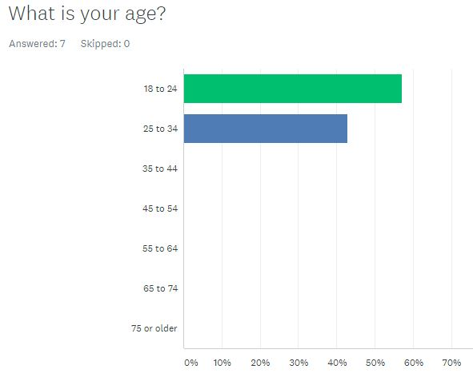
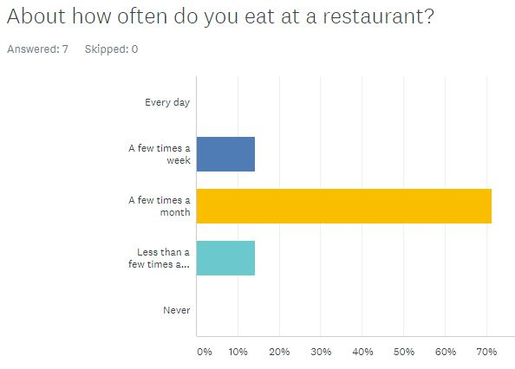
Survey
My survey consisted of seven questions and I got seven responses on it my fellow classmates using the Slack platform. The following pictures will show the questions in order as well as the results.

Slide 8
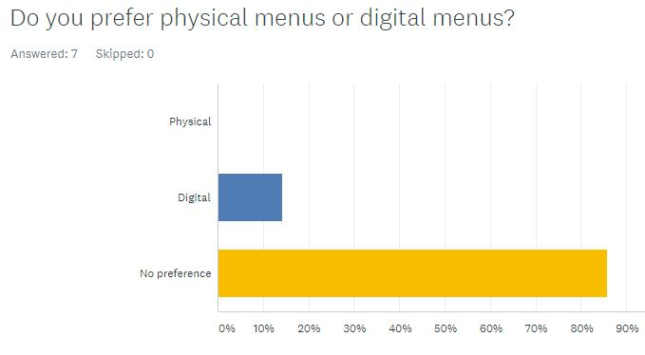
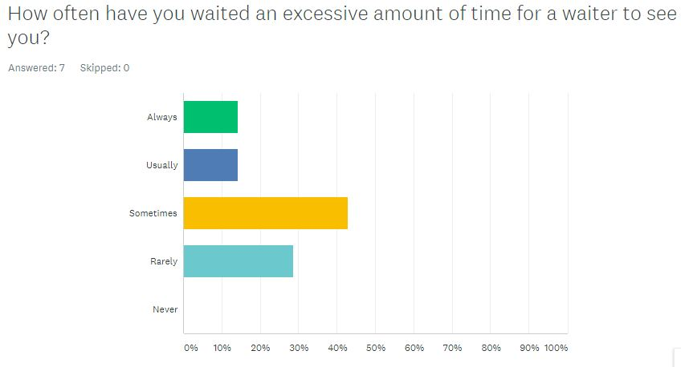
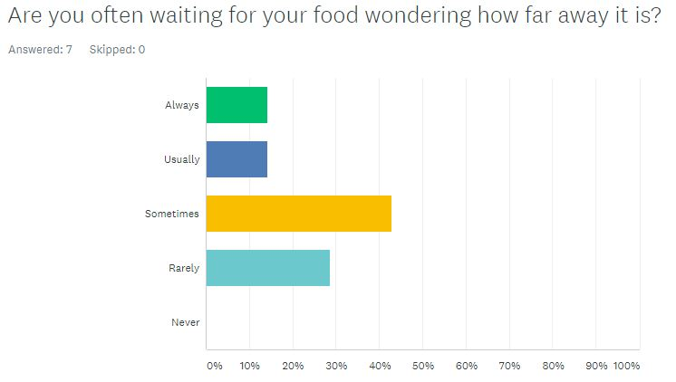
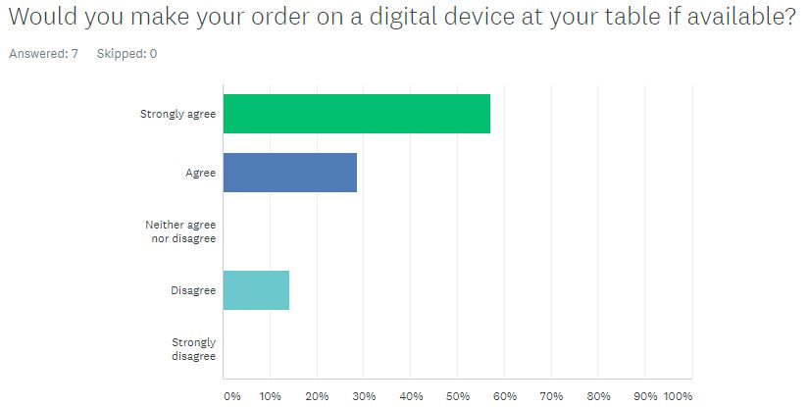
Survey

Slide 9
survey
Answers:
Check progress of order
Pay
Call waiter
Order food, check progress of order, check total price, serving time, call waiter for assistance
Change language, call waiter and see menu items available
To have a time limit on how long to wait for the waiter

Slide 10
Survey results
The results from the survey showed that people were generally waiting for waiters longer than they would like, waiting for food not knowing when it was coming for often than they should and also showed that they would be open to using digital devices to order to cure these problems.
Some features that were mentioned were checking order progress, paying and calling a waiter over for assistance. These are the features that I will focus on incorporating into my ordering system.

Slide 11
interviews
I conducted interviews with Shay and Kristine

