Slide 1
The larder
Sean reilly
Summative Assessment - user experience

Slide 2
overview

Slide 3
concept
The project scenario that I have chosen for our Web and UX design assessment is the “Hospitality digital ordering” option. I chose this because I liked the idea of making something that everyone would use and being able to meet the needs of a majority of people.
Project idea
A restaurant located in Miramar, Wellington named The Larder wants to improve customer engagement and sales by providing table ordering via digital devices. Customers will be able to use touch screens located at their table to order their food, view their food’s progress, call over a waiter and place feedback.

Slide 4
Initial planning

Slide 5
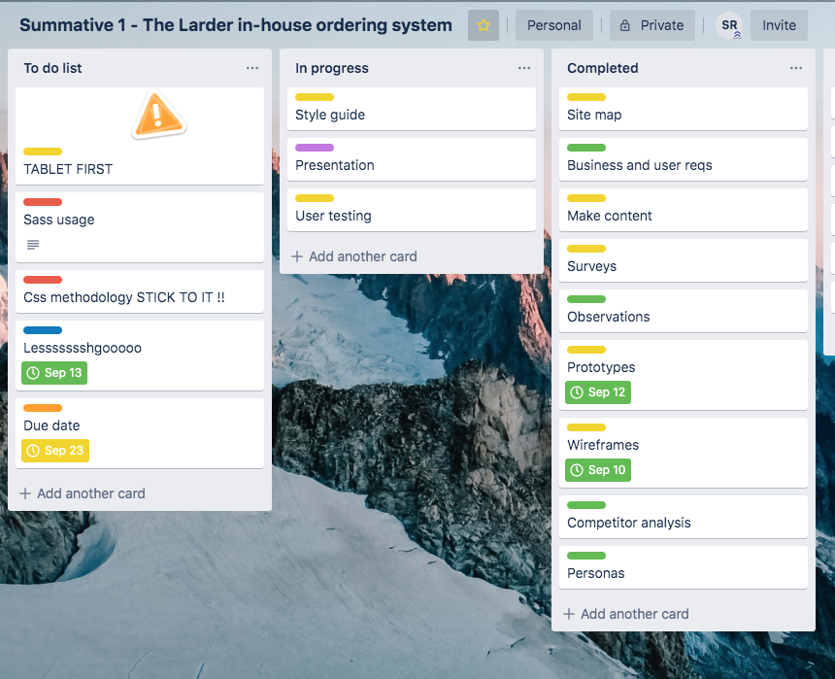
timeline
I used an online project management app called “Trello” to track and manage each of the tasks that I had assigned myself to keep on track and get tasks done on time.
The tasks were colour coded into different sections of the design and production process.
Green was research, yellow was analysis and design, red was pre-production tasks, blue was production and purple was documentation.

Slide 6
Research

