Slide 1
Facial Recognition Application
By Sean Remenyi

Slide 2
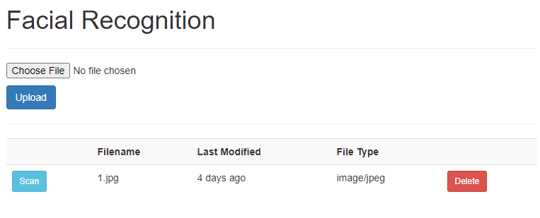
What is it
An application where:
-users can upload a picture of themselves
-pictures analyzed using AWS’ machine learning
-metrics returned

Slide 3
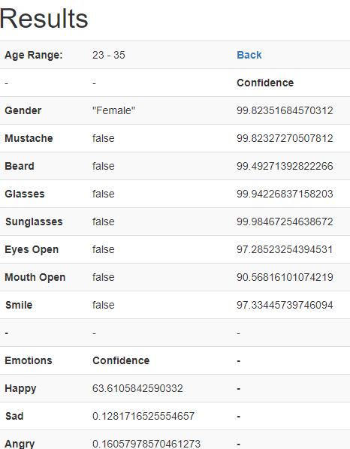

Slide 4

AWS Services
-IAM: Users/Roles to use S3 and Rekognition
-EC2: Hosting the Application
-S3: Object Storage for images
-Amazon Rekognition: AWS artificial intelligence service
-Route53: DNS web service

Slide 5
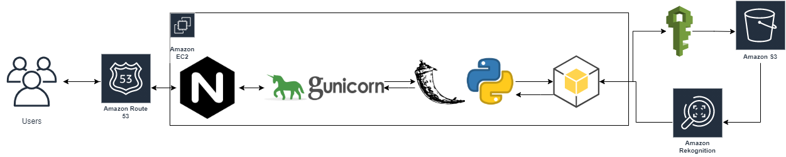
Data flow

Slide 6

Hosted:
http://nuage.technology
https://nuage.technology

Slide 7
APP RUN THROUGH

Slide 8
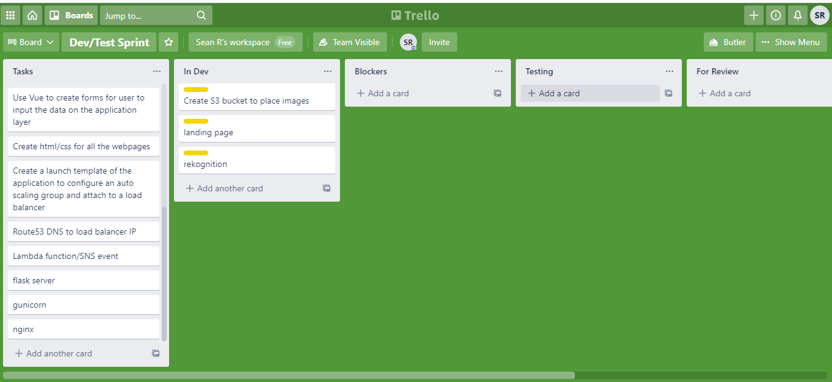
Workflow

Slide 9
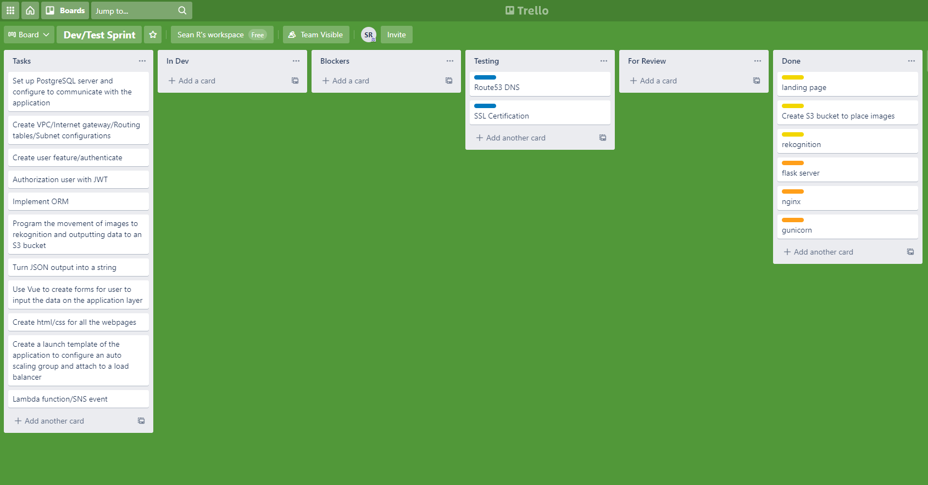
Workflow

Slide 10
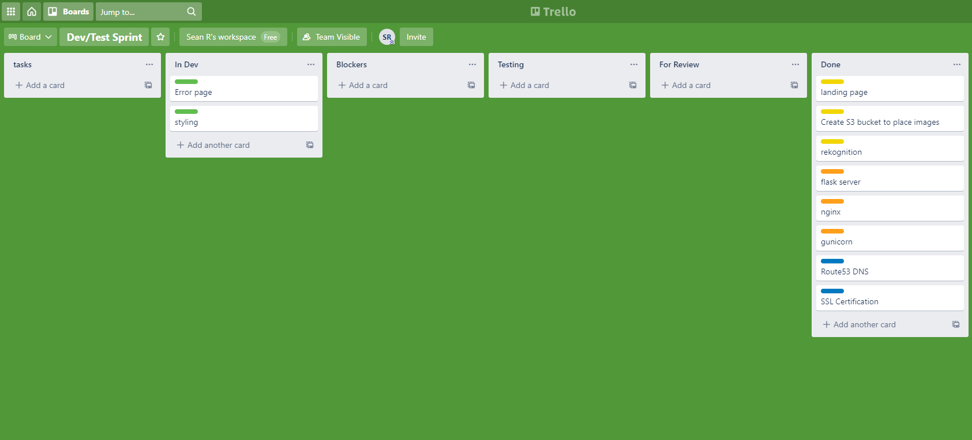
Workflow

Slide 11
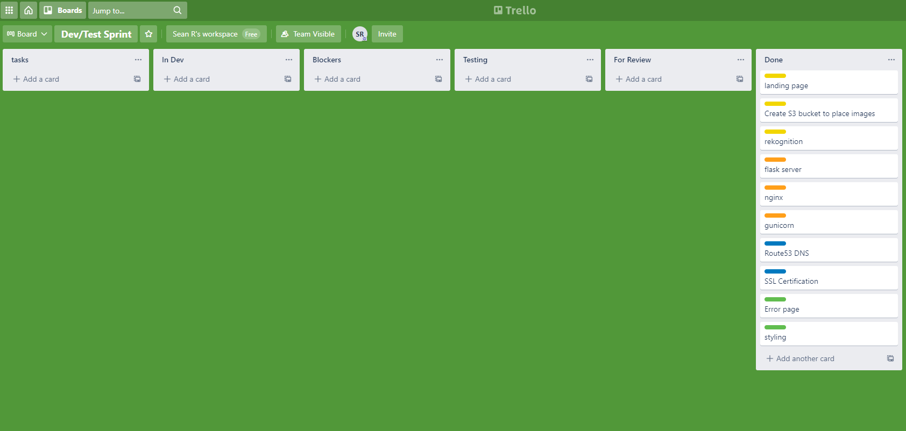
Workflow

Slide 12
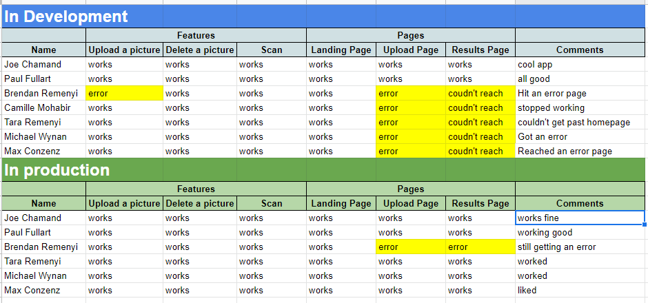
Testing

Slide 13
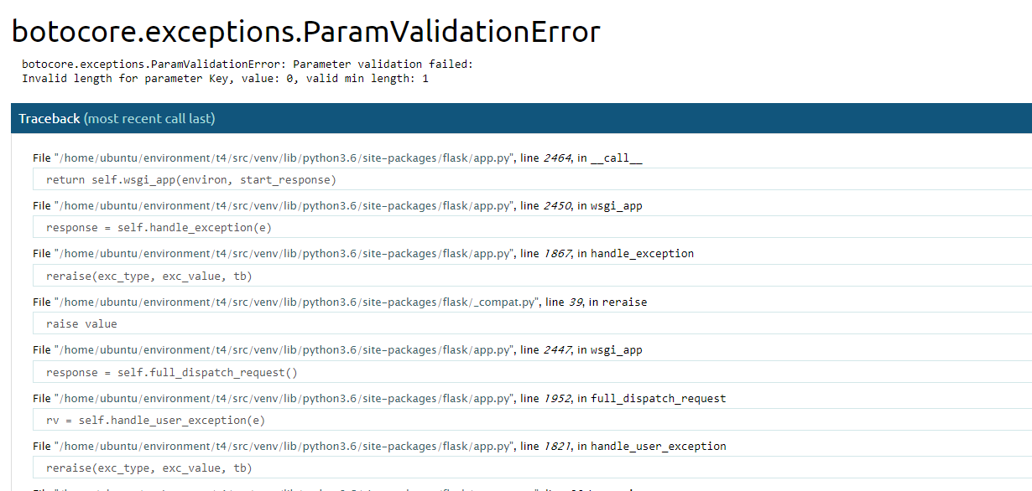
Testing

Slide 14
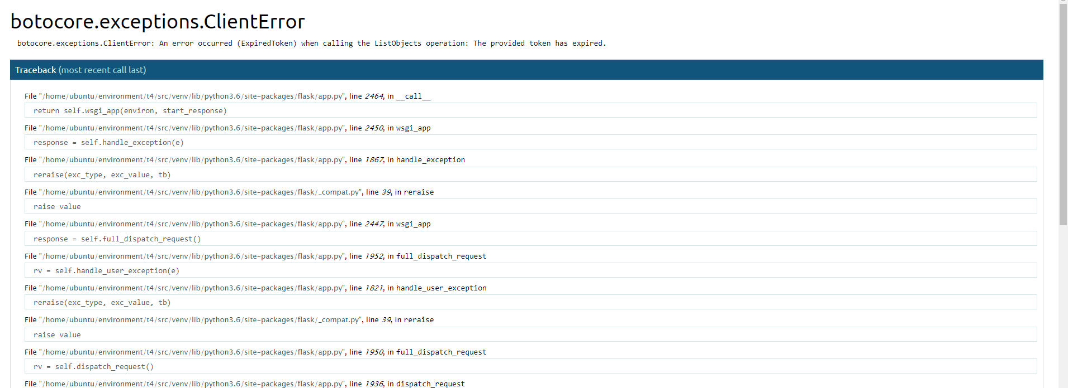
Testing

Slide 15
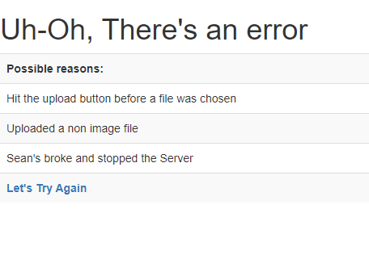
Testing

Slide 16
nuage.technology
Thank You

