Slide 1
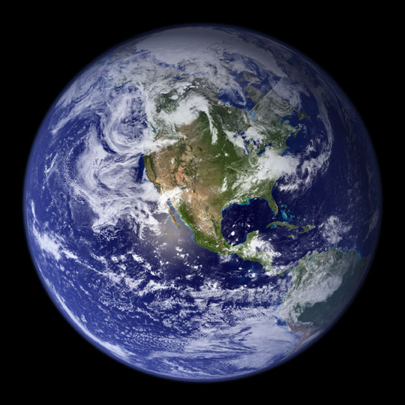
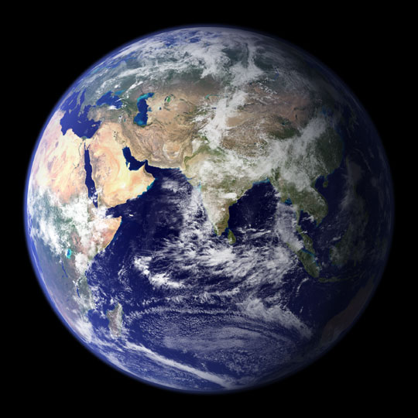
BLUE BEAUTY
Photos by Astronaut Sunita Williams

Slide 2
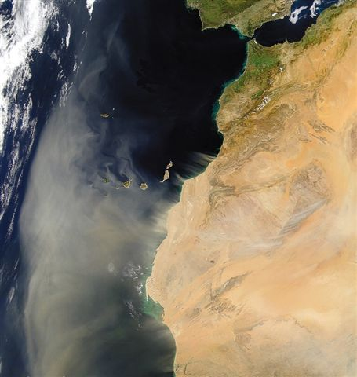
SANDSTORM LEAVING NORTH AFRICA TOWARDS THE ATLANTIC – CANARY ISLAND.

Slide 3
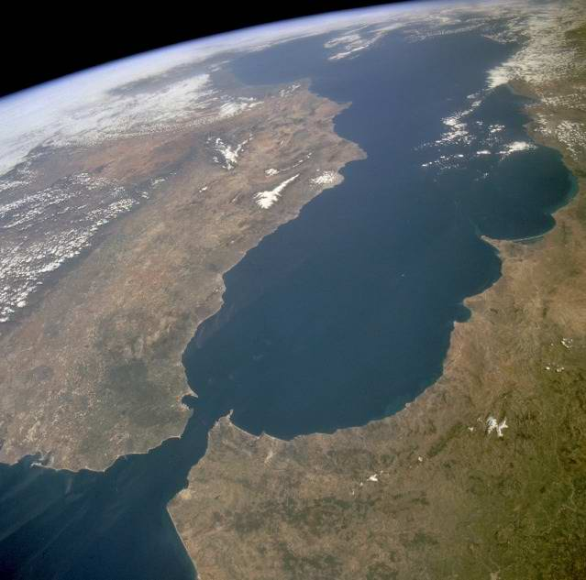
GIBRALTAR STRAITS

Slide 4
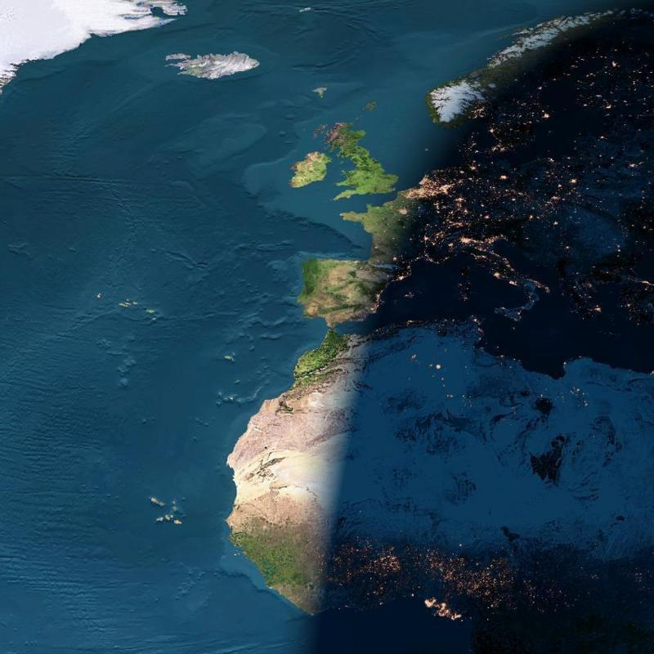
NIGHT ARRIVES
BETWEEN EUROPE & AFRICA

Slide 5
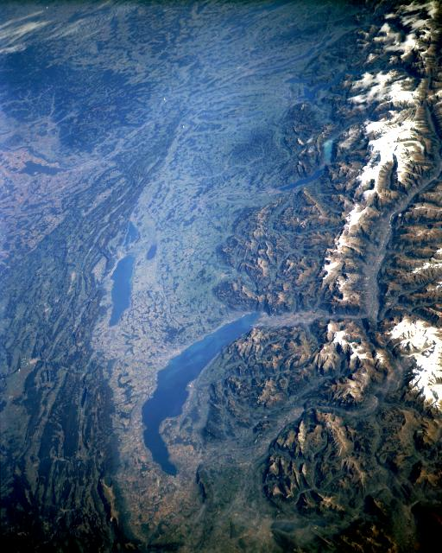
SWISS ALPS

Slide 6
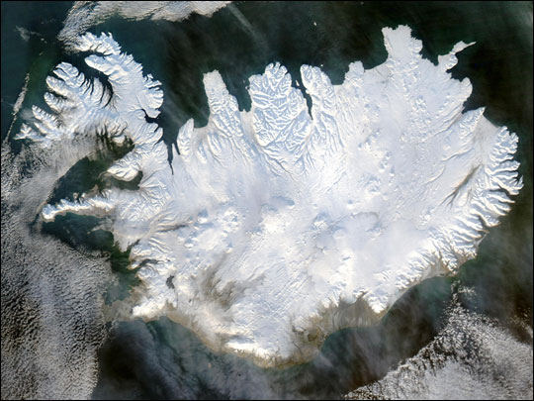
ICELAND

Slide 7
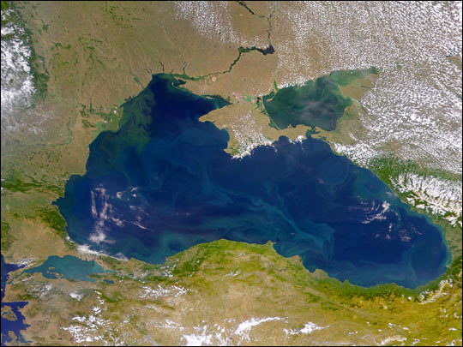
BLACK SEA

Slide 8
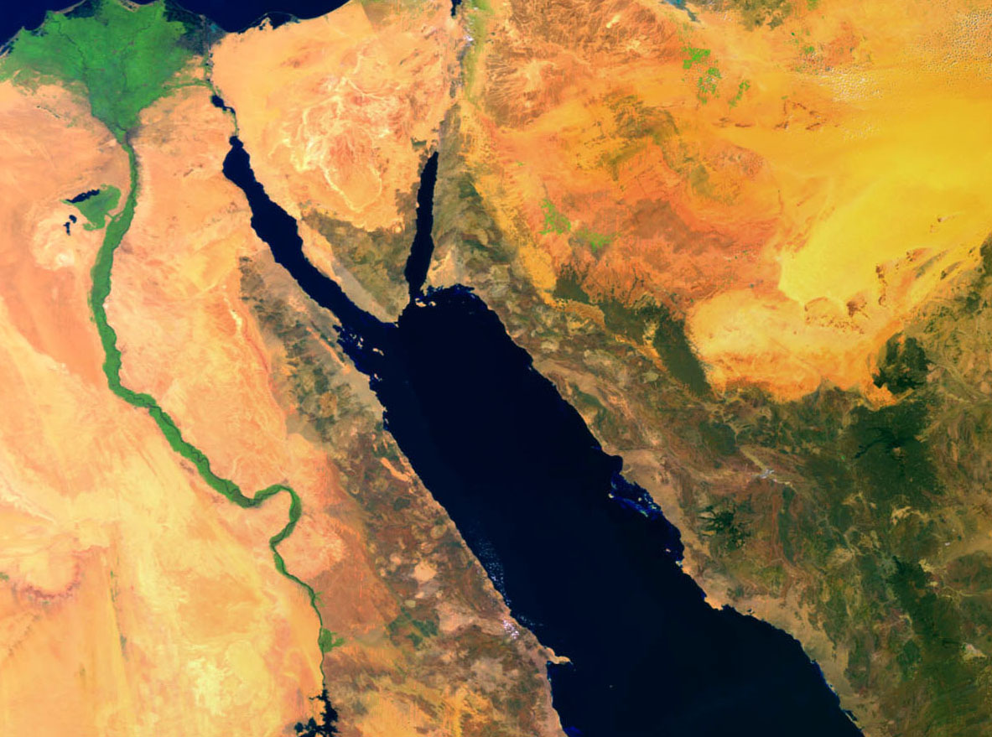
RED SEA

Slide 9
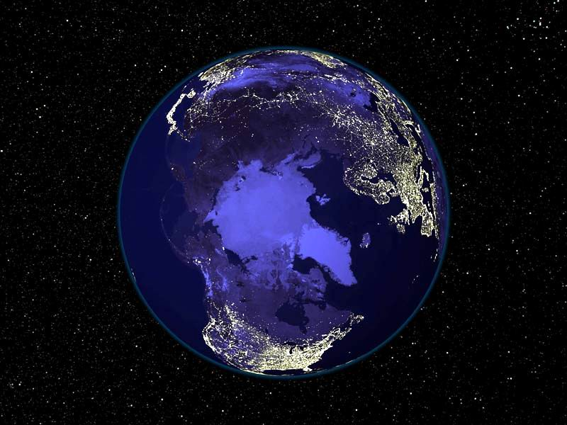
OUR PLANET IN THE MIDDLE OF THE UNIVERSE AT NIGHT

Slide 10
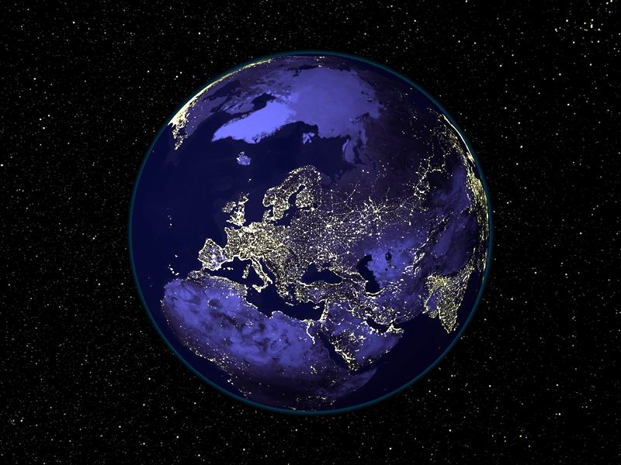

Slide 11
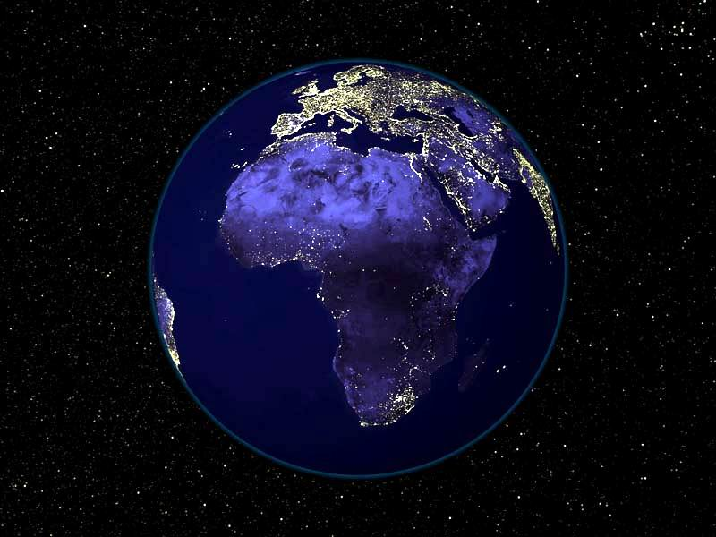

Slide 12
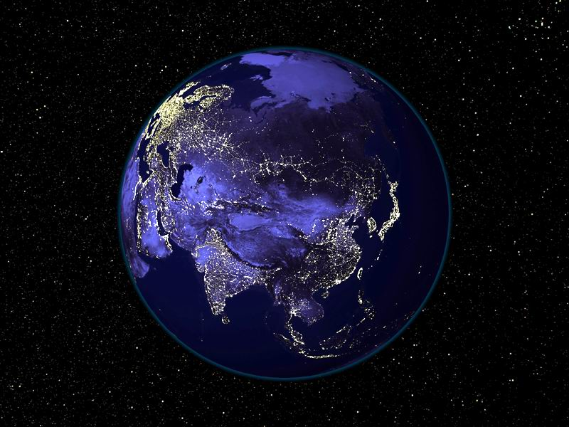

Slide 13
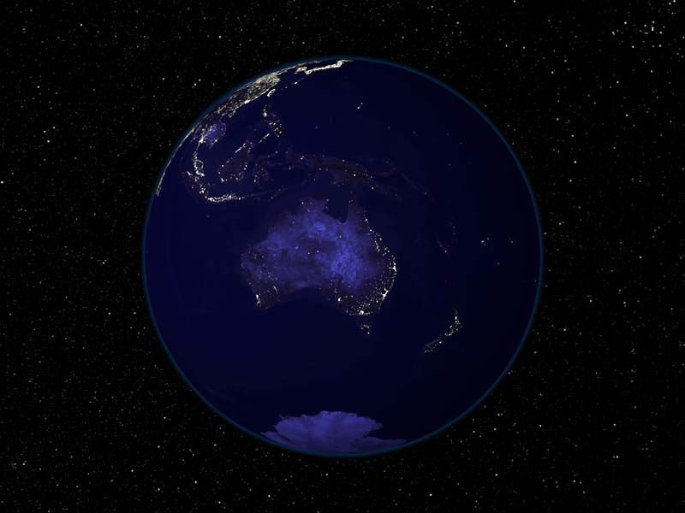

Slide 14
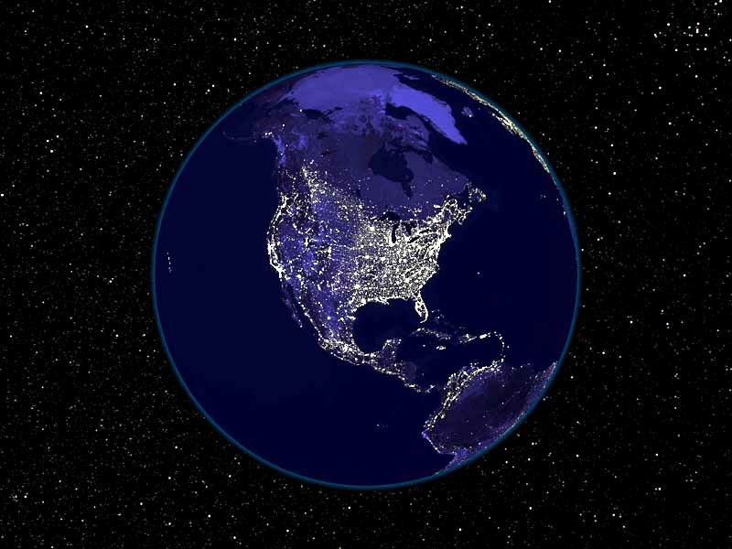

Slide 15
SPECTACULAR!
Satellite photo of Europe and Africa at night on a cloudless day.
Lights are already on in Paris, Barcelona but not in London, Lisbon or Madrid, where there is still daylight.
You can see the Azores in the middle of the ocean. A little below Madeira and further Canary Islands and Cape Verde.
You can observe the continent platforms from the British Isles to Canada and Iceland in the middle.

Slide 16
Continental
Platform
England
Iceland
Atlantic
Ocean
France
Islas de la Madera y Azores
Spain
Italy
Already night time here.
Canary Islands
ÁFRICA
Cabo Verde Island

Slide 17
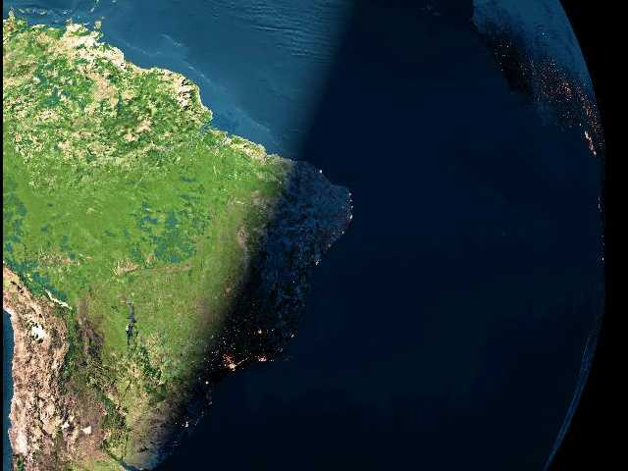
NIGHTFALL IN BRAZIL
Brazilian Continental Platform.
Atlantic Ocean
Belo Horizonte
Salvador
Rio de Janeiro
Grande São Paulo

Slide 18
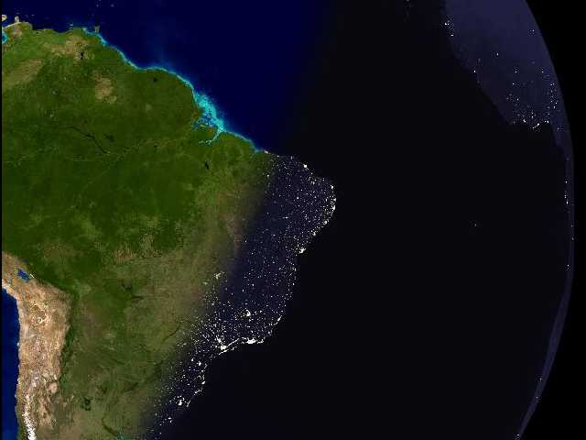
Fortaleza
Brasília
Recife
Goiânia
Salvador
Uberlândia
Belo Horizonte
Rio de Janeiro
Grande São Paulo
Florianópolis

Slide 19
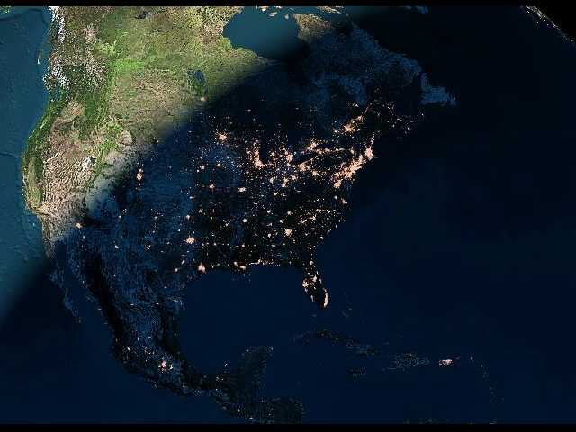
NIGHTFALL IN USA

Slide 20
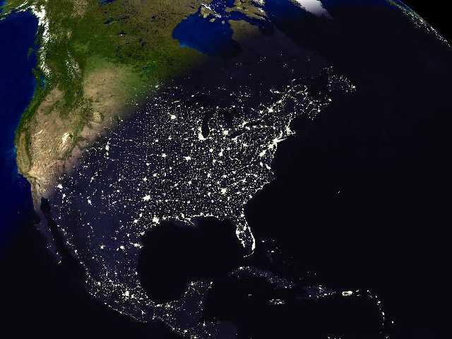
Still daylight in California.
Chicago
The biggest concentration of lights (from top to bottom) are the cities of Boston, New York, Philadelphia and Washington.
Dallas
Puerto Rico
Houston
Miami

Slide 21
THE END
Isn’t this magic ?
So our children can enjoy these spectacular views for a long time, please forward this message to as many people as possible.
TRANSLATION TO ENGLISH AND EDITED MSW 2007

