Slide 1
IPoS-Inventory and point of sale system
Members: Marco Joaquin Po
Joseph Alovera

Slide 2
AGENDA
1
ABSTRACT
2
INTRODUCTION
3
SCOPE AND LIMITATION
4
PROPOSED SOLUTION TO THE PROBLEM
5
TABLES

Slide 3
Background of the problem
The 7th of May trading hardware store manually records every process of the store they do not have any computerized or automated system that can record the transaction, products, and their daily sale, monthly sale, top selling product or even the least selling product at the store.

Slide 4
Statement of the problem
The specific problems of the 7th of May Trading's are:
-Replenishing the product.
-Problem in producing of reports.
-recording transactions.

Slide 5
Objectives
The specific objective will include the following features:
To lessen redundancy of recording transactions.
To generate reports.
To keep track items
To provide service for product replenishment

Slide 6
Significance of the study
The purpose of this study is to help the 7th of May “hardware store” have a web app inventory system and point of sale that can help them keep track of the data regarding all the needed materials or equipment for the business.
the owner will benefit from the system because they can check the sale and inventory of their hardware store.
The admin staff would easily access or record transactions and check, update and delete items in the inventory and also the staff will able to view the product availability and record the transaction.

Slide 7
Scope and limitations
This Web application aims to provide an automated inventory system and point of sale where the system can inventory all the product in the storage room of the hardware store. It should have the capabilities in generating a report like daily sale, monthly sale, top selling product and least selling product.

Slide 8
Scope and limitations
The 7th of May Trading’s Hardware store inventory and point of sale system will only limit to the following:
Two separate account for the staff and the admin staff.
No credit card transaction.
Admin can view the product and process the order.
Staff can add product in the inventory.

Slide 9
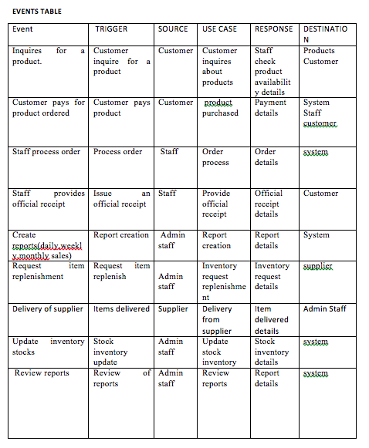
Event table

Slide 10
Event table

Slide 11
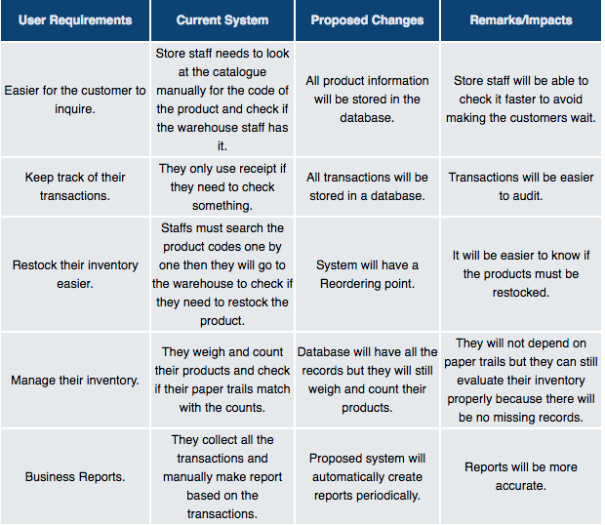
GAP Analysis

Slide 12
GAP Analysis

Slide 13
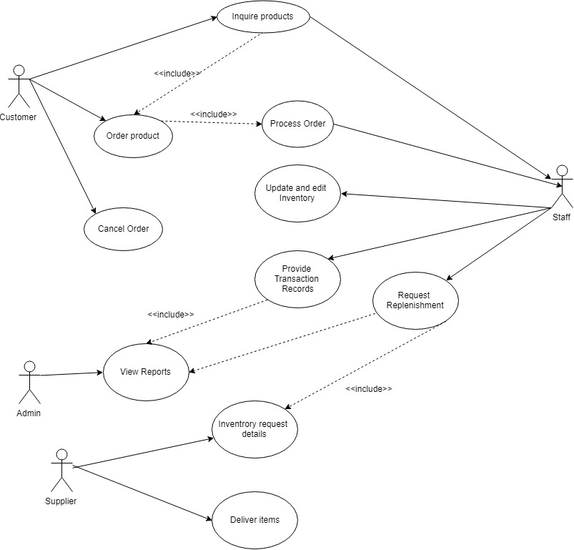
Use Case Diagram

Slide 14
Use Full Description

Slide 15
Use Full Description

Slide 16
Use Full Description

Slide 17
Use Full Description

Slide 18
Use Full Description

Slide 19
Use Full Description

Slide 20
Use Full Description

Slide 21
Use Full Description

Slide 22
Use Full Description

Slide 23
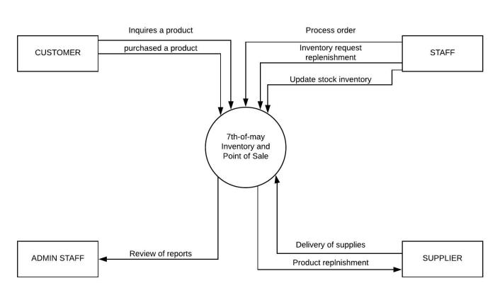
Context Flow Diagram

Slide 24
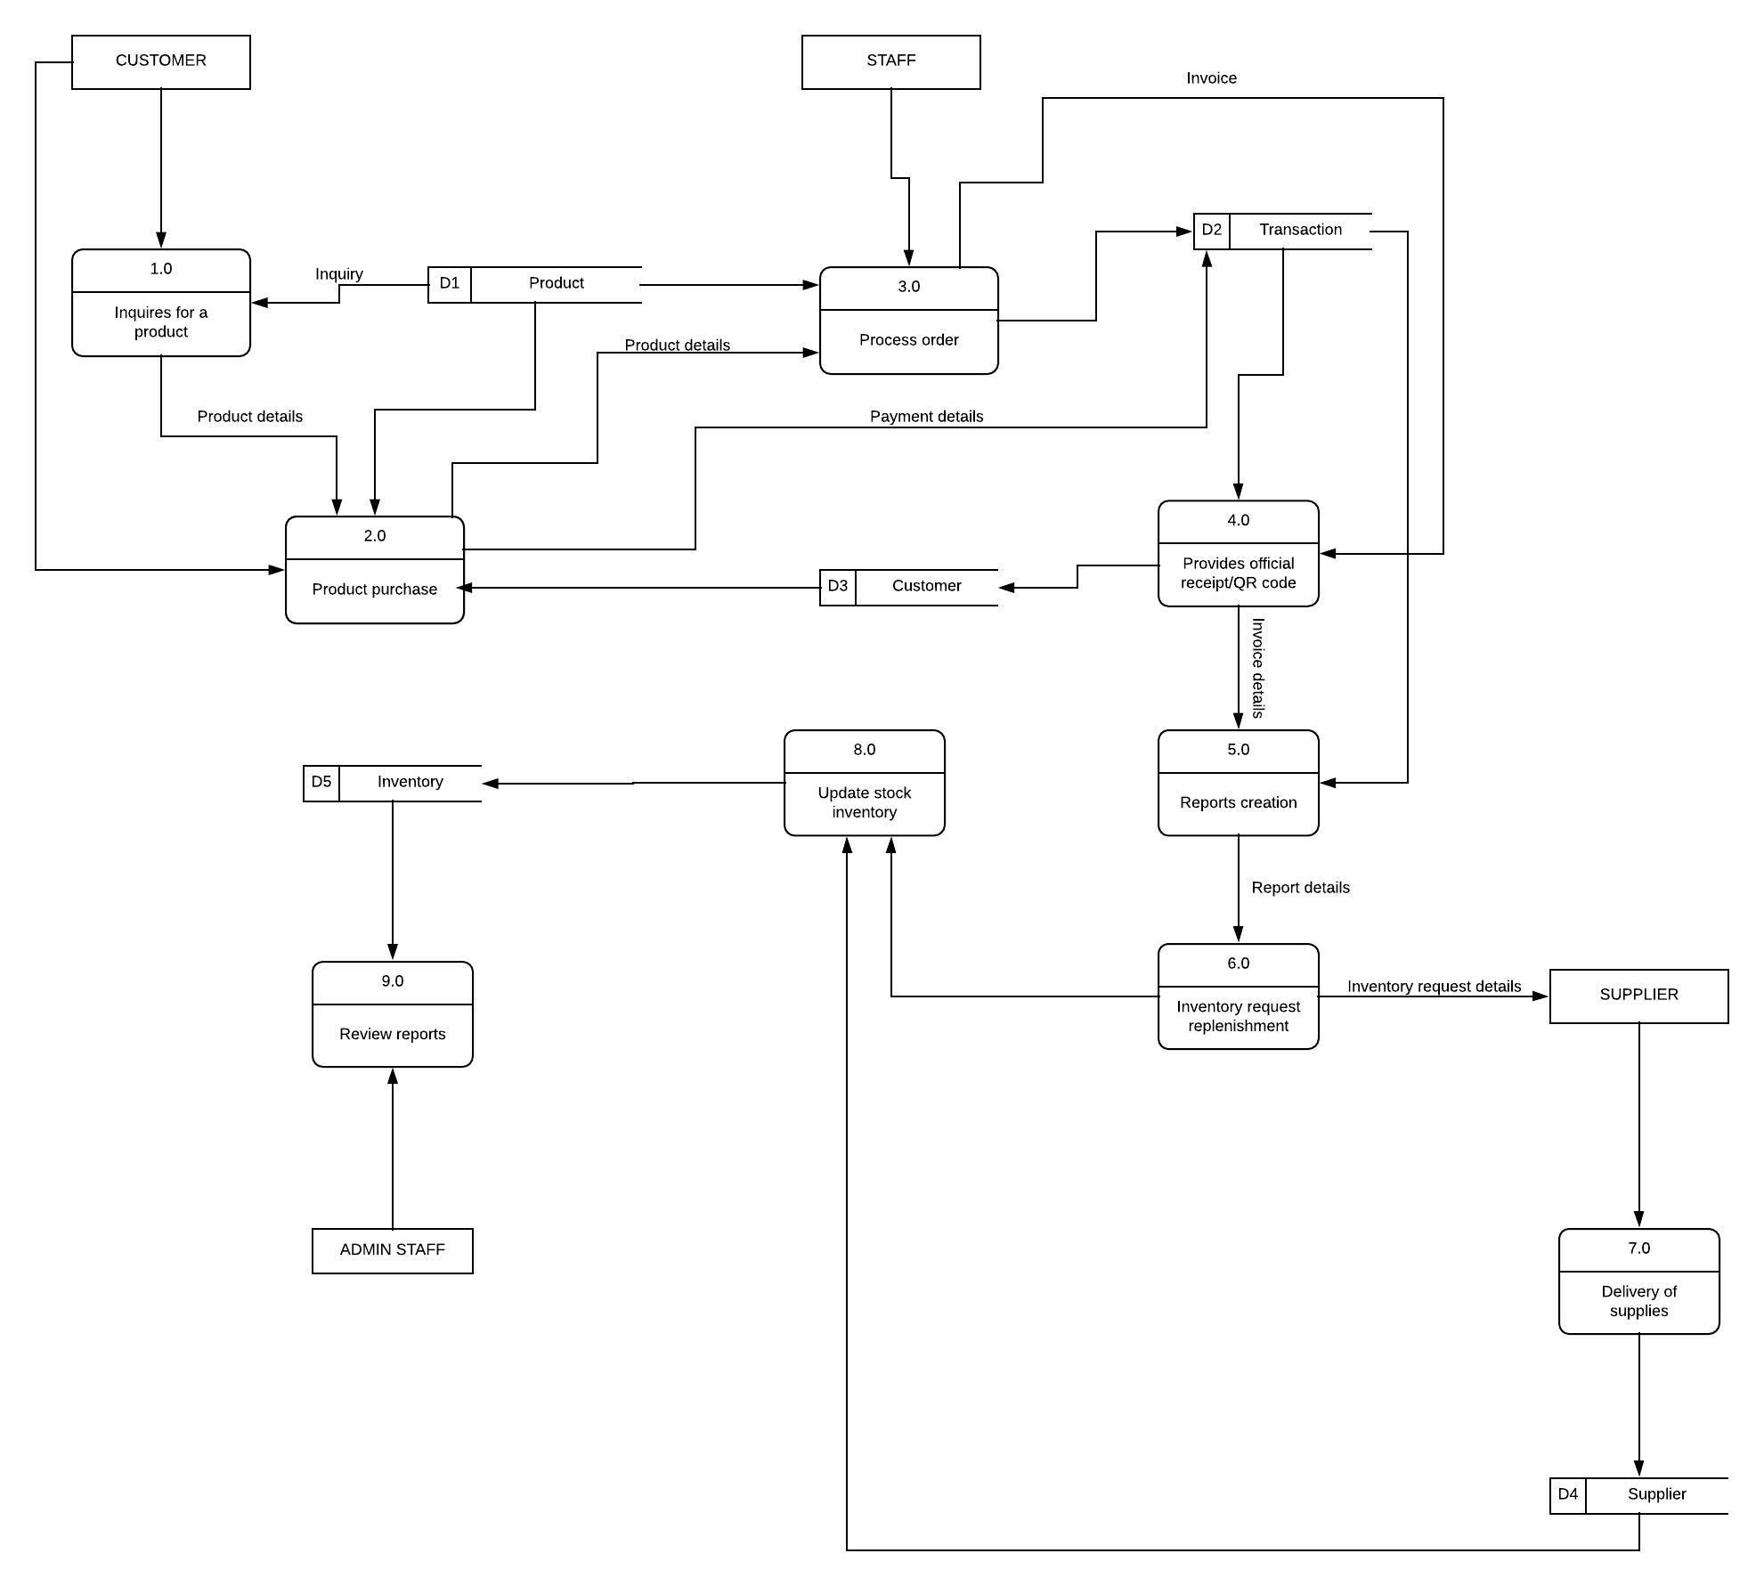
Data Flow Diagram 0

Slide 25
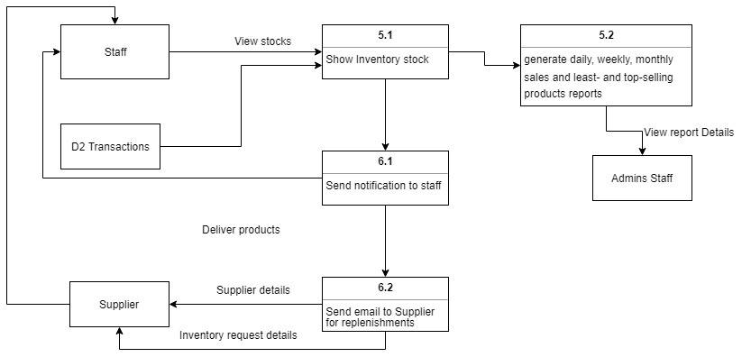
Data Flow Diagram 1

Slide 26
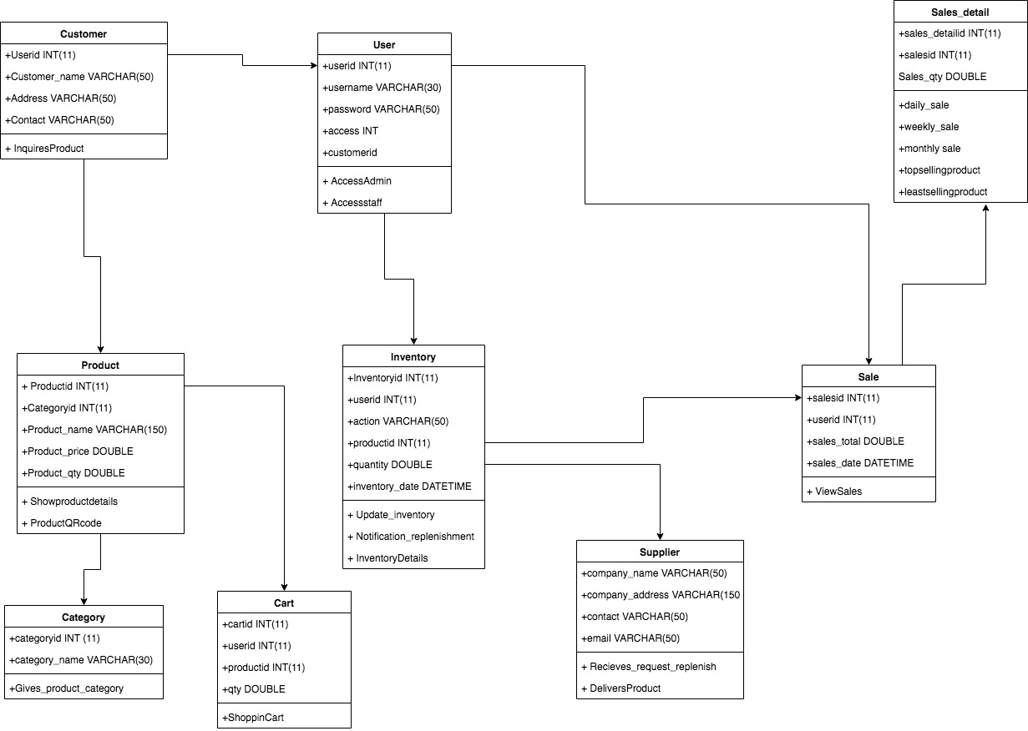
Class Diagram

Slide 27
Activity Diagram

Slide 28
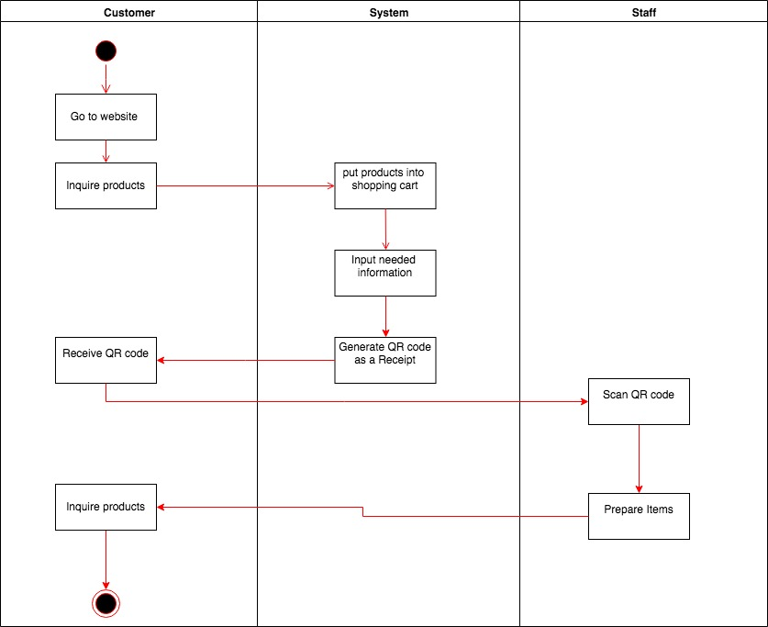

Slide 29
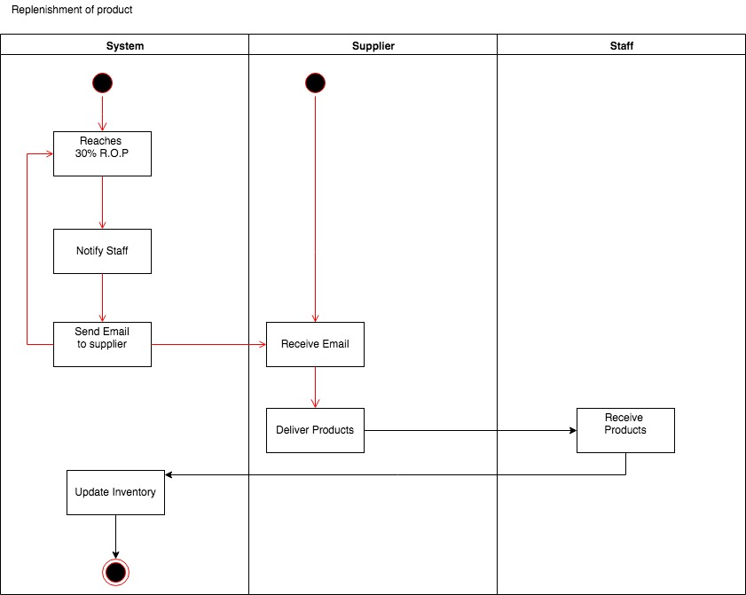

Slide 30
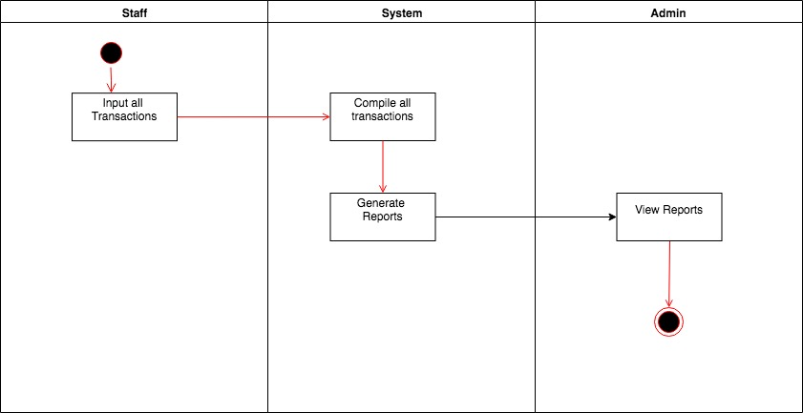

Slide 31
Sequence Diagram

Slide 32
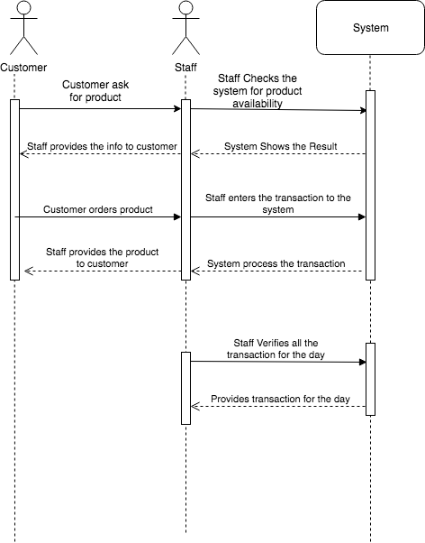

Slide 33
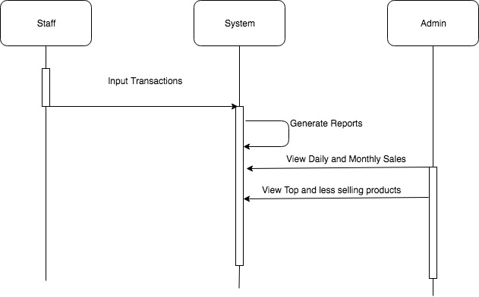

Slide 34
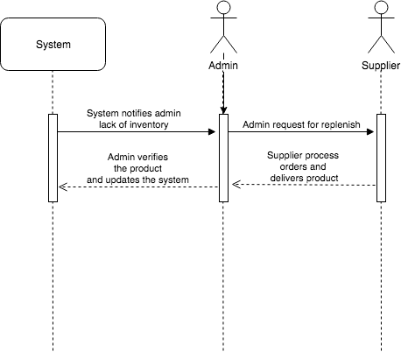

Slide 35
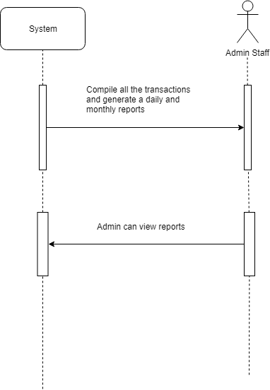

Slide 36
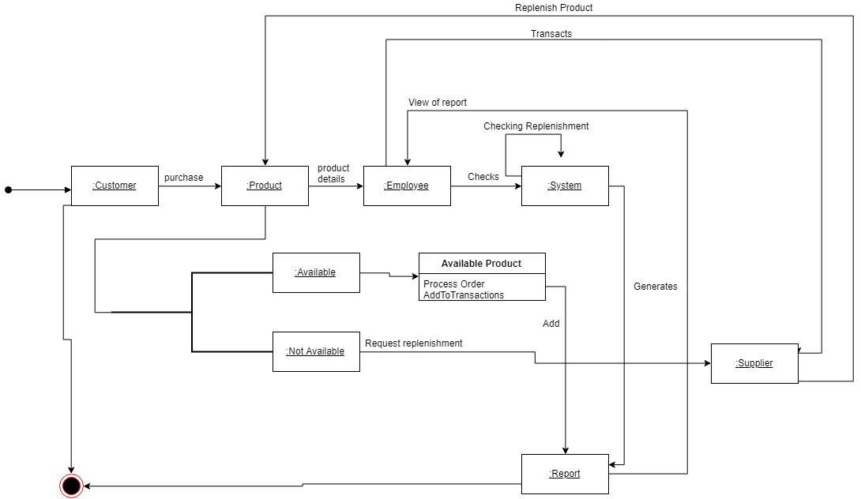
Finite State Machine Diagram

Slide 37
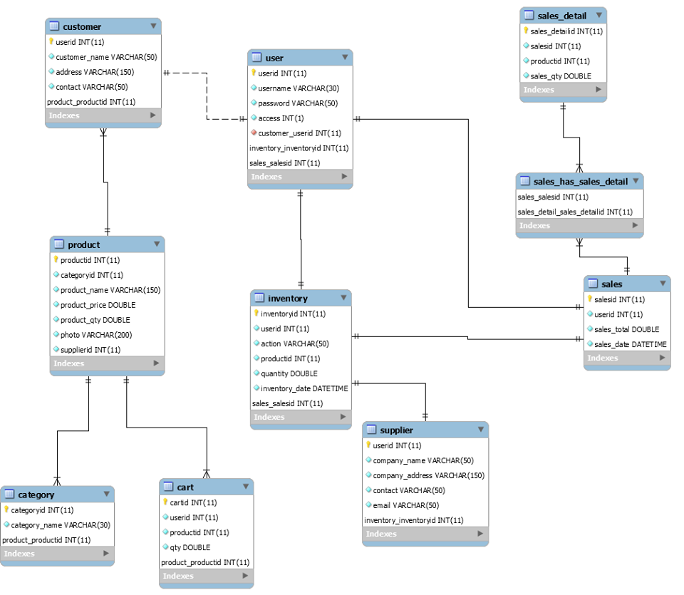
Entity Relationship Diagram

Slide 38
Prototype

