Slide 1


Academic and Curricular
Advising Management System
Academic and Curricular advising Management System

Slide 2
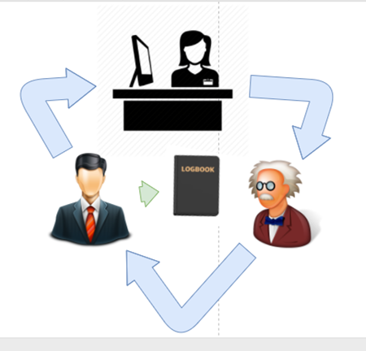
PROBLEM | CASE 1
PROBLEM
PROPOSED SOLUTION
OBJECTIVES
USER
LOG IN
USER HOMEPAGE
REGISTRATION
FORGOT PASSWORD
CASE
Academic and Curricular advising Management System

Slide 3
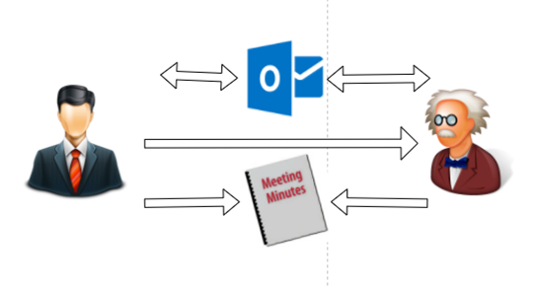
PROBLEM | CASE 2
PROBLEM
PROPOSED SOLUTION
OBJECTIVES
USER
LOG IN
USER HOMEPAGE
REGISTRATION
FORGOT PASSWORD
CASE
Academic and Curricular advising Management System

Slide 4
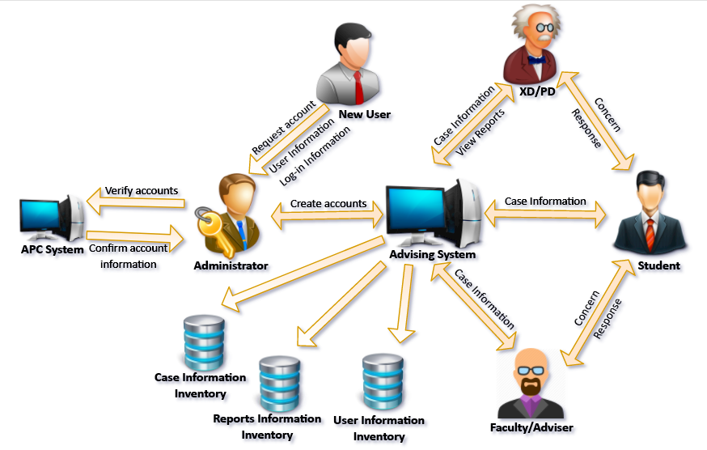
PROPOSED SOLUTION
PROBLEM
PROPOSED SOLUTION
OBJECTIVES
USER
LOG IN
USER HOMEPAGE
REGISTRATION
FORGOT PASSWORD
CASE
Academic and Curricular advising Management System

Slide 5
OBJECTIVES | GENERAL OBJECTIVE
PROBLEM
PROPOSED SOLUTION
OBJECTIVES
USER
LOG IN
USER HOMEPAGE
REGISTRATION
FORGOT PASSWORD
CASE
To develop and design a web-based intranet system for Asia Pacific College – School of Engineering that will serve as a medium of communication for student and faculty and to centralize students’ academic and curricular advising records.
Academic and Curricular advising Management System

Slide 6
OBJECTIVES | SPECIFIC OBJECTIVES
PROBLEM
PROPOSED SOLUTION
OBJECTIVES
USER
LOG IN
USER HOMEPAGE
REGISTRATION
FORGOT PASSWORD
CASE
Develop:
Registration
Log in
Case
Reports
Academic and Curricular advising Management System

Slide 7


USER | MODULE ACCESS LEVEL
PROBLEM
PROPOSED SOLUTION
OBJECTIVES
USER
LOG IN
USER HOMEPAGE
REGISTRATION
FORGOT PASSWORD
CASE
USER ROLE | LOGIN | REGISTRATION | CASE | REPORTS
Executive Dir.
Program Dir.
Adviser
Faculty
Student
Admin
Academic and Curricular advising Management System

Slide 8
USER | CASE ACCESS LEVEL
PROBLEM
PROPOSED SOLUTION
OBJECTIVES
USER
LOG IN
USER HOMEPAGE
REGISTRATION
FORGOT PASSWORD
CASE
USER ROLE | ACCESS LEVEL
Executive Dir. | All cases
Program Dir. | All cases under program handled
Adviser | All cases under cluster assigned
Faculty | All cases under subjects handled
Student | All cases under his Student ID
Admin | No access
Academic and Curricular advising Management System

Slide 9
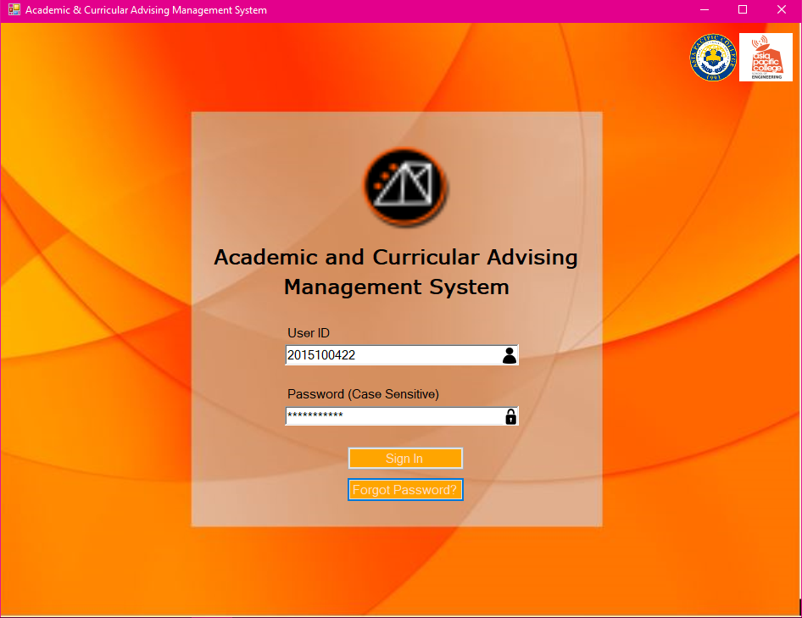
LOG IN
PROBLEM
PROPOSED SOLUTION
OBJECTIVES
USER
LOG IN
USER HOMEPAGE
REGISTRATION
FORGOT PASSWORD
CASE
Academic and Curricular advising Management System

Slide 10
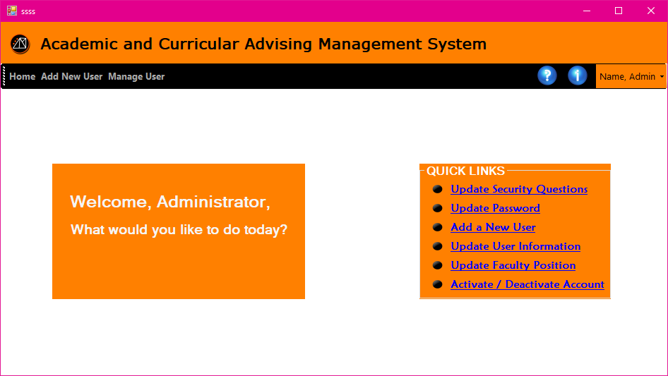
HOMEPAGE | ADMIN
PROBLEM
PROPOSED SOLUTION
OBJECTIVES
USER
LOG IN
USER HOMEPAGE
REGISTRATION
FORGOT PASSWORD
CASE
Academic and Curricular advising Management System

Slide 11
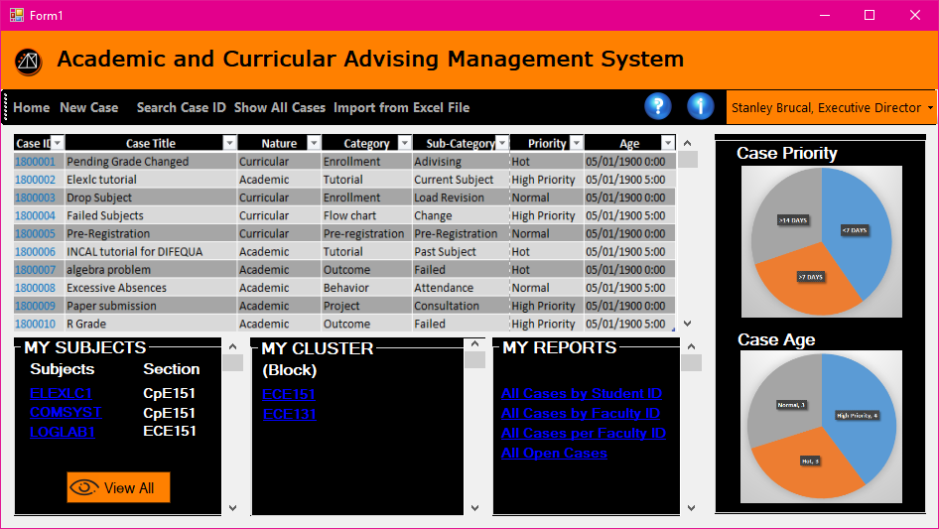
HOMEPAGE | EXECUTIVE DIRECTOR
PROBLEM
PROPOSED SOLUTION
OBJECTIVES
USER
LOG IN
USER HOMEPAGE
REGISTRATION
FORGOT PASSWORD
CASE
Academic and Curricular advising Management System

Slide 12
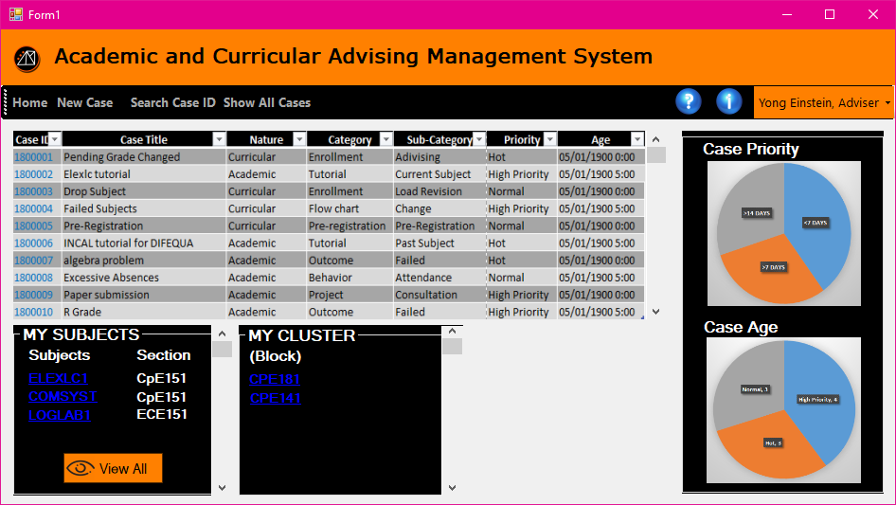
HOMEPAGE | ADVISER
PROBLEM
PROPOSED SOLUTION
OBJECTIVES
USER
LOG IN
USER HOMEPAGE
REGISTRATION
FORGOT PASSWORD
CASE
Academic and Curricular advising Management System

Slide 13
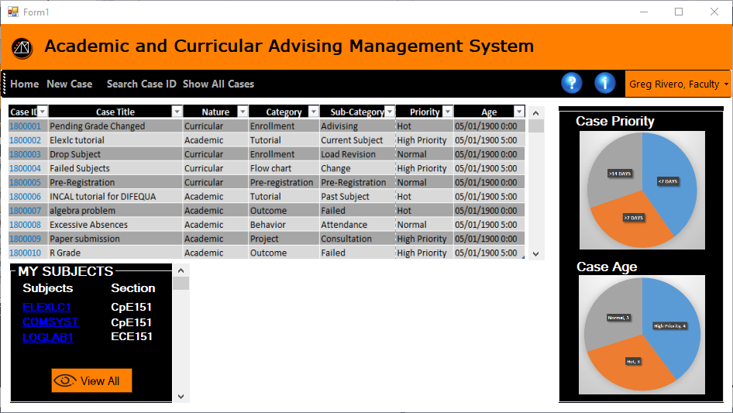
HOMEPAGE | FACULTY
PROBLEM
PROPOSED SOLUTION
OBJECTIVES
USER
LOG IN
USER HOMEPAGE
REGISTRATION
FORGOT PASSWORD
CASE
Academic and Curricular advising Management System

Slide 14
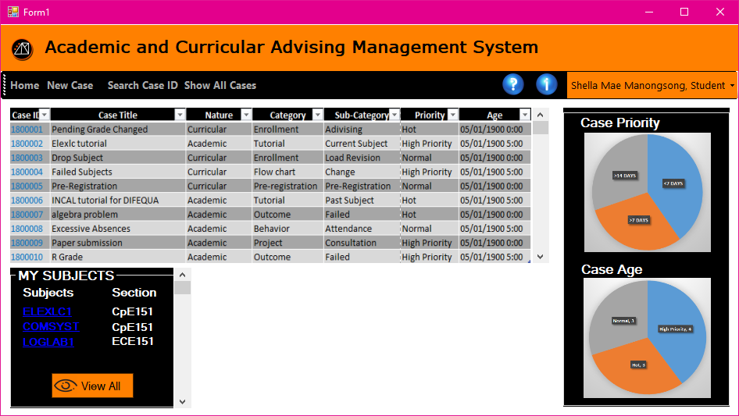
HOMEPAGE | STUDENT
PROBLEM
PROPOSED SOLUTION
OBJECTIVES
USER
LOG IN
USER HOMEPAGE
REGISTRATION
FORGOT PASSWORD
CASE
Academic and Curricular advising Management System

Slide 15
REGISTRATION | FROM ADMIN HOMEPAGE -> SELECT ADD NEW USER
PROBLEM
PROPOSED SOLUTION
OBJECTIVES
USER
LOG IN
USER HOMEPAGE
REGISTRATION
FORGOT PASSWORD
CASE
Academic and Curricular advising Management System

Slide 16
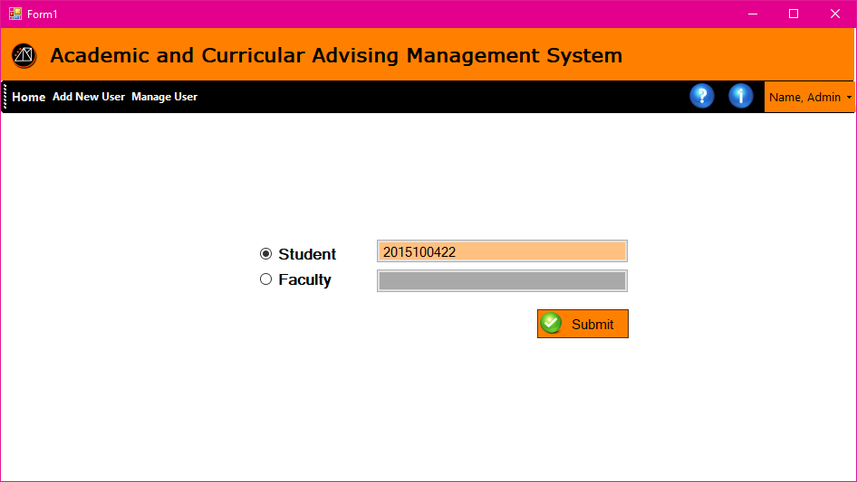
REGISTRATION | REGISTRATION ACCOUNT VERIFICATION
PROBLEM
PROPOSED SOLUTION
OBJECTIVES
USER
LOG IN
USER HOMEPAGE
REGISTRATION
FORGOT PASSWORD
CASE
Academic and Curricular advising Management System

Slide 17
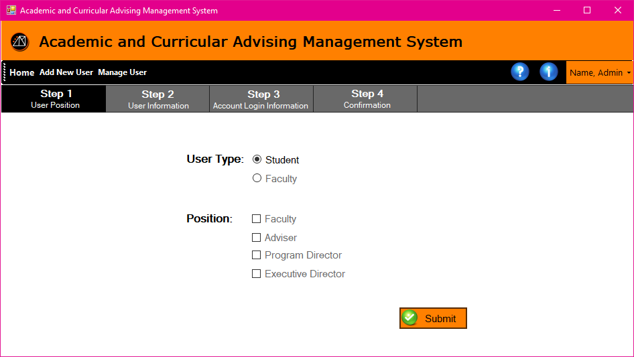
REGISTRATION | STEP 1: USER POSITION
PROBLEM
PROPOSED SOLUTION
OBJECTIVES
USER
LOG IN
USER HOMEPAGE
REGISTRATION
FORGOT PASSWORD
CASE
Academic and Curricular advising Management System

Slide 18
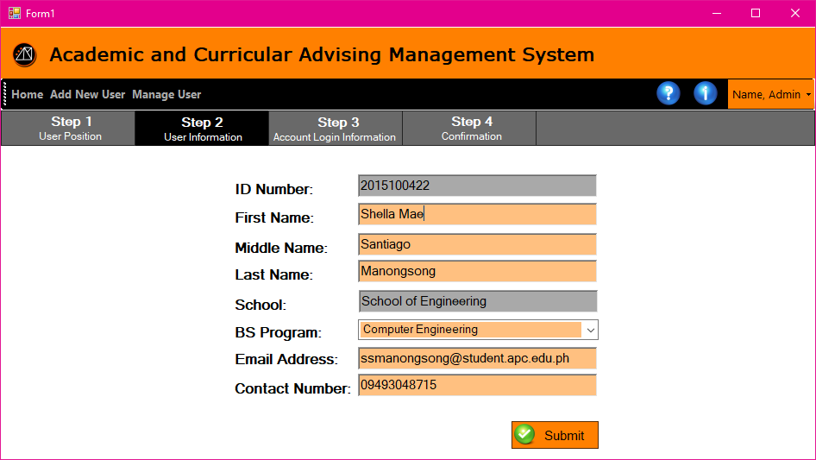
REGISTRATION | STEP 2: USER INFORMATION
PROBLEM
PROPOSED SOLUTION
OBJECTIVES
USER
LOG IN
USER HOMEPAGE
REGISTRATION
FORGOT PASSWORD
CASE
Academic and Curricular advising Management System

Slide 19
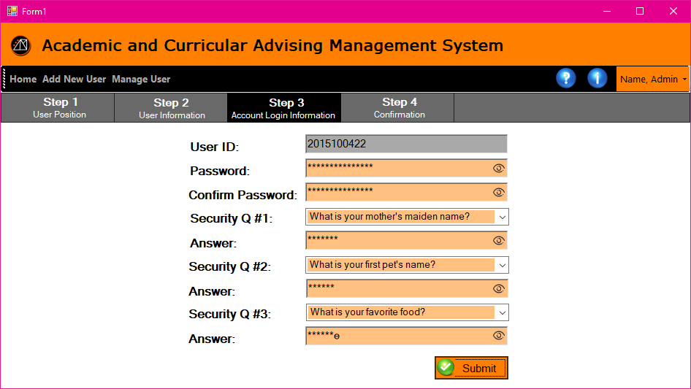
REGISTRATION | STEP 3: ACCOUNT LOG IN INFORMATION
PROBLEM
PROPOSED SOLUTION
OBJECTIVES
USER
LOG IN
USER HOMEPAGE
REGISTRATION
FORGOT PASSWORD
CASE
Academic and Curricular advising Management System

Slide 20
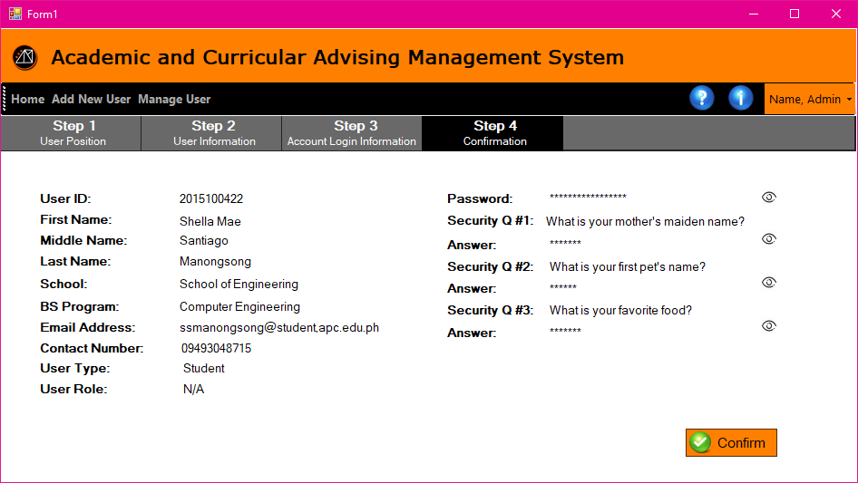
REGISTRATION | USER INFORMATION SUMMARY
PROBLEM
PROPOSED SOLUTION
OBJECTIVES
USER
LOG IN
USER HOMEPAGE
REGISTRATION
FORGOT PASSWORD
CASE
Academic and Curricular advising Management System

Slide 21
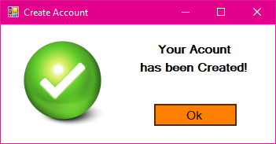
REGISTRATION | CONFIRMATION
PROBLEM
PROPOSED SOLUTION
OBJECTIVES
USER
LOG IN
USER HOMEPAGE
REGISTRATION
FORGOT PASSWORD
CASE
Academic and Curricular advising Management System

Slide 22
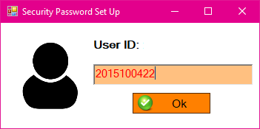
FORGOT PASSWORD | USER ID INPUT FIELD
PROBLEM
PROPOSED SOLUTION
OBJECTIVES
USER
LOG IN
USER HOMEPAGE
REGISTRATION
FORGOT PASSWORD
CASE
Academic and Curricular advising Management System

Slide 23
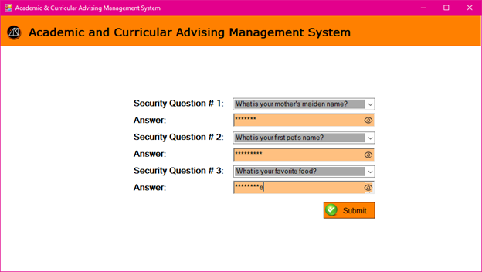
FORGOT PASSWORD | SECURITY QUESTIONS
PROBLEM
PROPOSED SOLUTION
OBJECTIVES
USER
LOG IN
USER HOMEPAGE
REGISTRATION
FORGOT PASSWORD
CASE
Academic and Curricular advising Management System

Slide 24
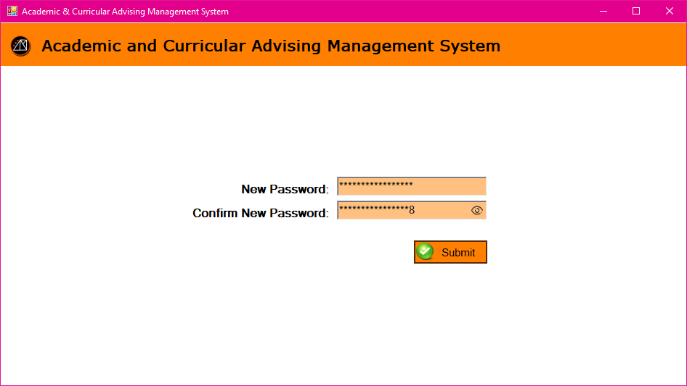
FORGOT PASSWORD | SETTING UP NEW PASSWORD
PROBLEM
PROPOSED SOLUTION
OBJECTIVES
USER
LOG IN
USER HOMEPAGE
REGISTRATION
FORGOT PASSWORD
CASE
Academic and Curricular advising Management System

Slide 25
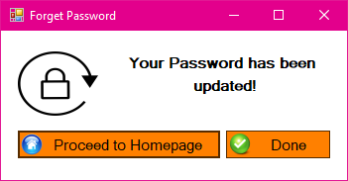
FORGOT PASSWORD | PASSWORD CHANGE CONFIRMATION
PROBLEM
PROPOSED SOLUTION
OBJECTIVES
USER
LOG IN
USER HOMEPAGE
REGISTRATION
FORGOT PASSWORD
CASE
Academic and Curricular advising Management System

Slide 26
CASE | ATTRIBUTES
PROBLEM
PROPOSED SOLUTION
OBJECTIVES
USER
LOG IN
USER HOMEPAGE
REGISTRATION
RESET PASSWORD
CASE
Age | Nature
Case Closed | Notes
Case Created | Priority
Case ID | Status
Case Owner | Sub-Category
Category | Subject
Cluster | Title
Faculty
Academic and Curricular advising Management System

Slide 27
CASE | CREATE CASE | FACULTY
PROBLEM
PROPOSED SOLUTION
OBJECTIVES
USER
LOG IN
USER HOMEPAGE
REGISTRATION
RESET PASSWORD
CASE
Academic and Curricular advising Management System

Slide 28
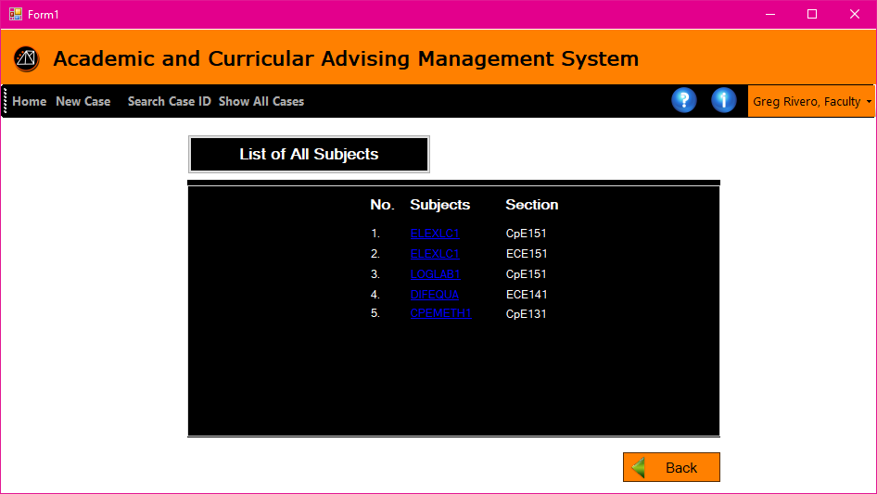
CASE | CREATE CASE | FACULTY
PROBLEM
PROPOSED SOLUTION
OBJECTIVES
USER
LOG IN
USER HOMEPAGE
REGISTRATION
RESET PASSWORD
CASE
Academic and Curricular advising Management System

Slide 29
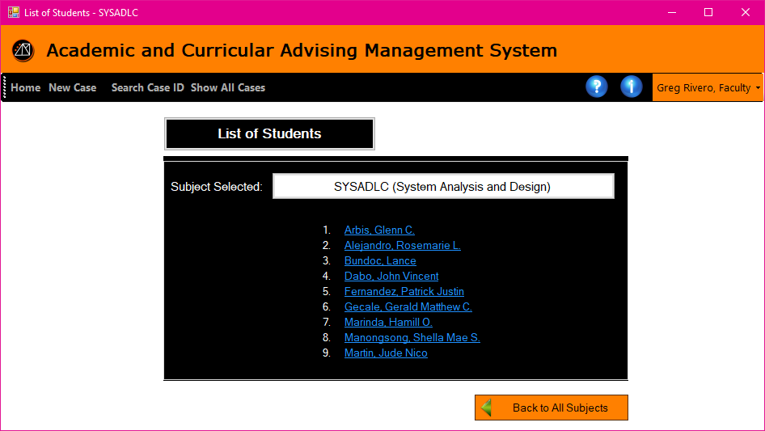
CASE | CREATE CASE | FACULTY
PROBLEM
PROPOSED SOLUTION
OBJECTIVES
USER
LOG IN
USER HOMEPAGE
REGISTRATION
RESET PASSWORD
CASE
Academic and Curricular advising Management System

Slide 30
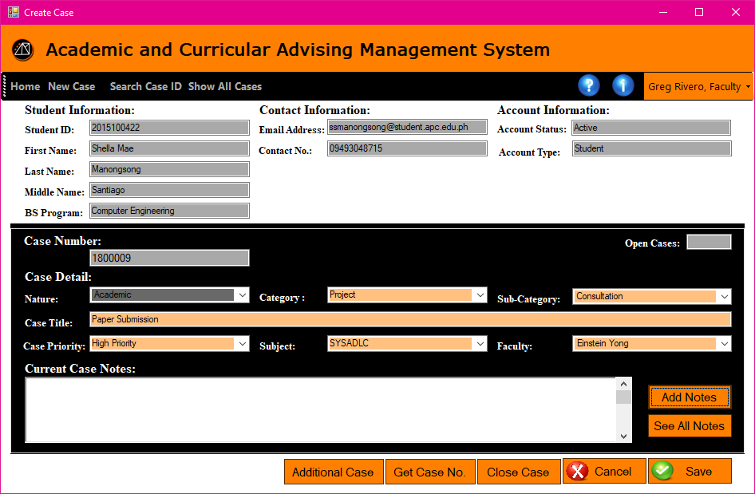
CASE | CREATE CASE | FACULTY
PROBLEM
PROPOSED SOLUTION
OBJECTIVES
USER
LOG IN
USER HOMEPAGE
REGISTRATION
RESET PASSWORD
CASE
Academic and Curricular advising Management System

Slide 31
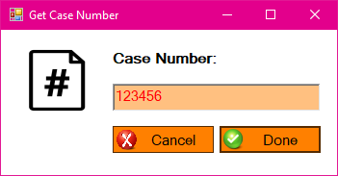
CASE | CREATE CASE | FACULTY
PROBLEM
PROPOSED SOLUTION
OBJECTIVES
USER
LOG IN
USER HOMEPAGE
REGISTRATION
RESET PASSWORD
CASE
Academic and Curricular advising Management System

Slide 32
CASE | RETRIEVE CASE | FACULTY
Academic and Curricular advising Management System

Slide 33
CASE | RETRIEVE CASE | FACULTY
Academic and Curricular advising Management System

Slide 34
After clicking a subject from the quick links from the Faculty Homepage
Academic and Curricular advising Management System

Slide 35
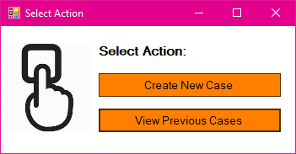
CASE | RETRIEVE CASE | FACULTY
Academic and Curricular advising Management System

Slide 36
CASE | RETRIEVE CASE | FACULTY
Academic and Curricular advising Management System

Slide 37
Faculty Home Page: Show All Cases (From the Tool strip)
Academic and Curricular advising Management System

Slide 38
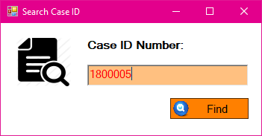
Search Case ID popup and Select Action popup
Academic and Curricular advising Management System

Slide 39
Faculty Home Page: Search Case ID
Academic and Curricular advising Management System

