Slide 1

Barangay system
Kamila Lagman
Jhonel Deluna
David Warren Arcellana
Daren Mar Cabral

Slide 2
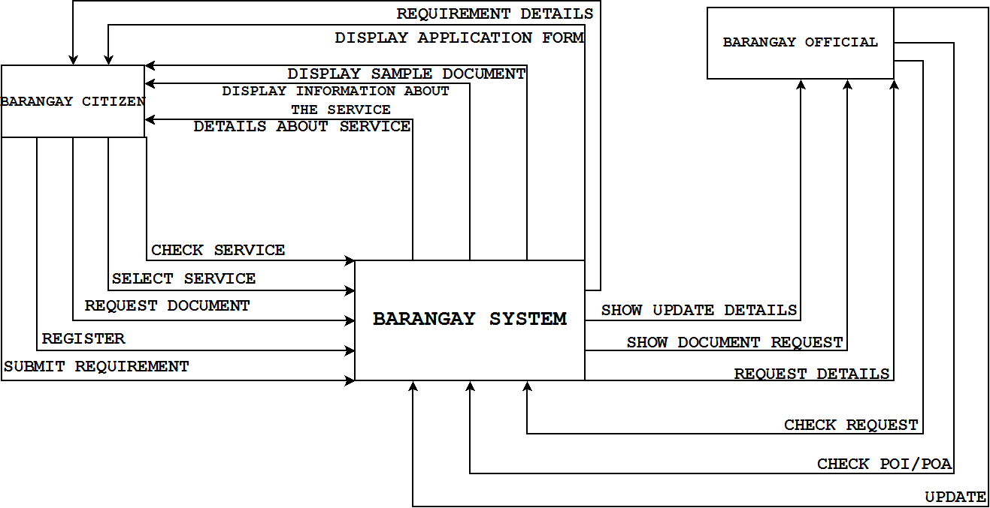
Context Level Diagram

Slide 3
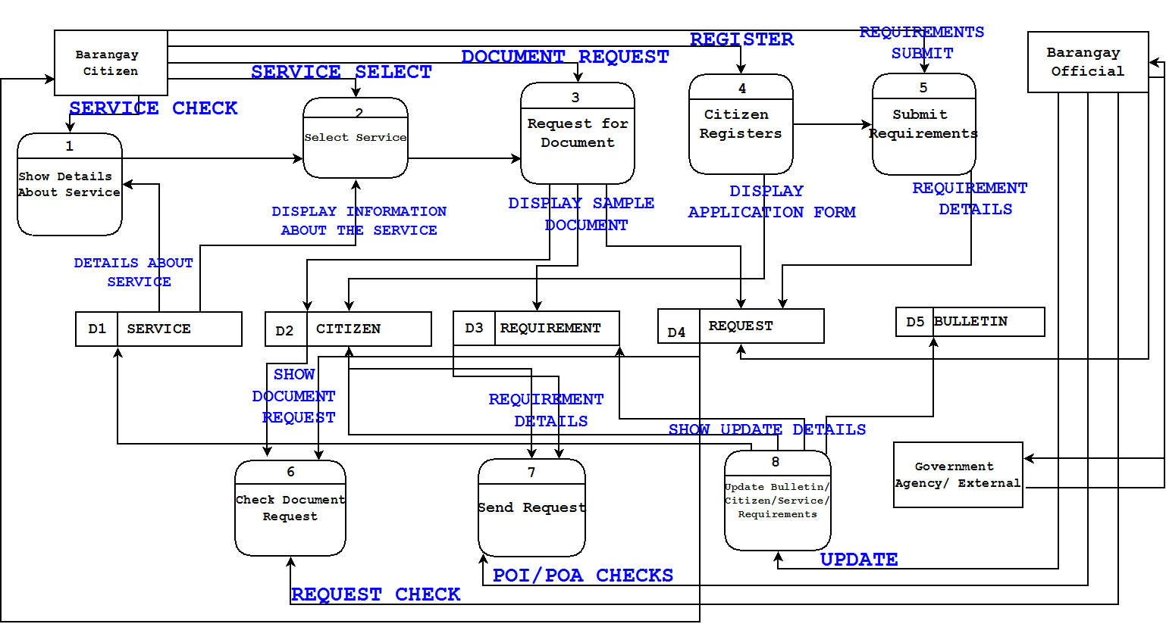
Data Flow Diagram (Level 0)

Slide 4
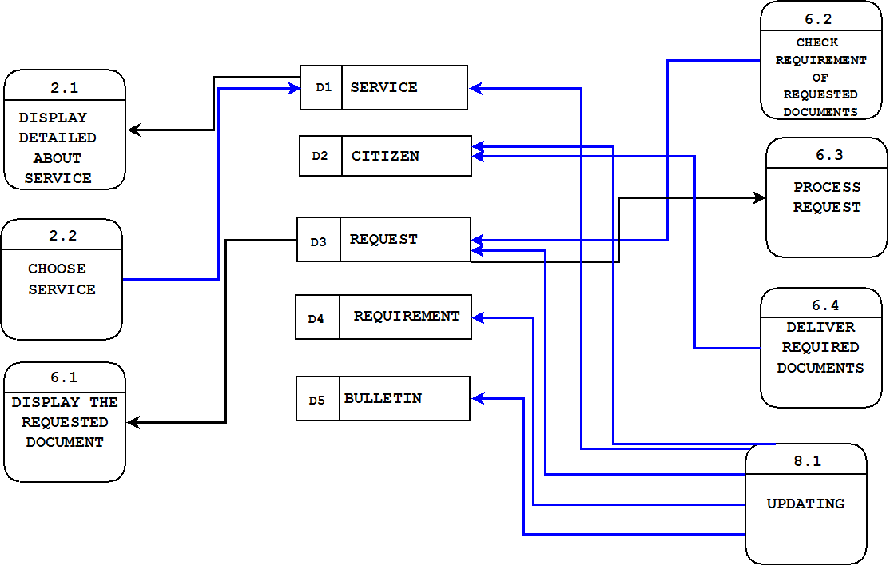
Data Flow Diagram (Level 1)

Slide 5
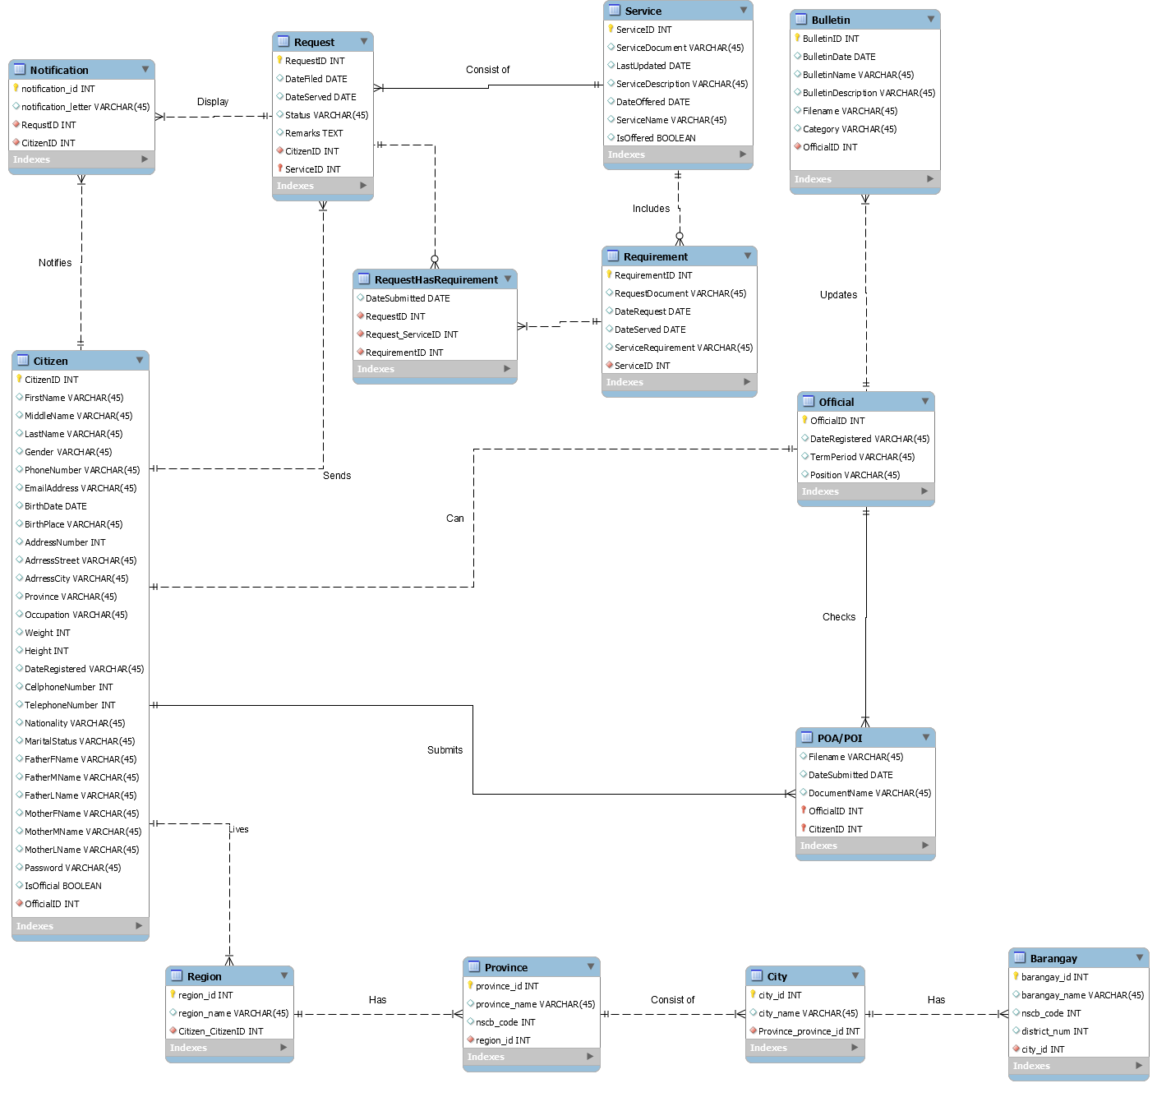
Entity Relationship Diagram

Slide 6
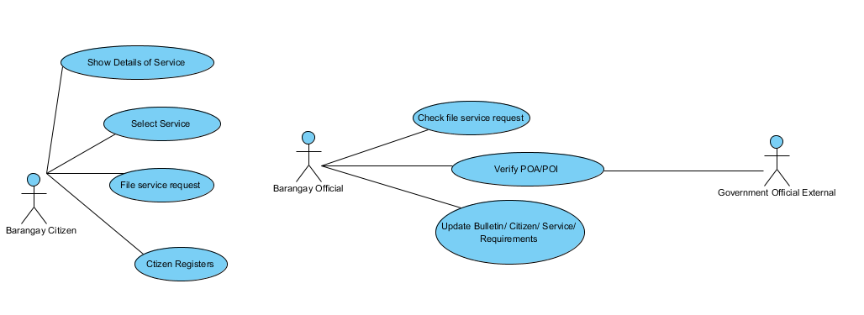
Use Case Diagrams

Slide 7
Programming Language / Software Toolkit
Framework: Cobalt
Language: PHP
Other: HTML, CSS, PHPMyAdmin, XAMPP, MySQL

