Slide 1
Event Table
Event | Trigger | Source | Use Case | Response | Destination
Citizen checks for the services available | Check Service | Barangay Citizen | Show details of services | More details about the service | Barangay Citizen
Citizen chooses available service | Select Service | Barangay Citizen | Select Service | Display detailed information about the service | Barangay Office
Citizen requests for documents | Select Service | Barangay Citizen | File Service Request | Display sample document | Barangay Citizen
Citizen wants to register to the barangay | Register | Barangay Citizen | Citizen Registers | Display application form | Barangay Citizen

Slide 2
Event Table
Event | Trigger | Source | Use Case | Response | Destination
Barangay Official check request document | Check Request | Barangay Officials | Check file service request | Show Document Requests | System
Barangay Official verifies citizen’s identity | Check POA/POI | Barangay official | Verify POA/POI | Update citizen’s record | System
Barangay official updates content of Bulletin / Citizen/ Service/ Requirements | Update | Barangay Officials | Update Bulletin / Citizen/ Service/ Requirements | Show update details | System

Slide 3
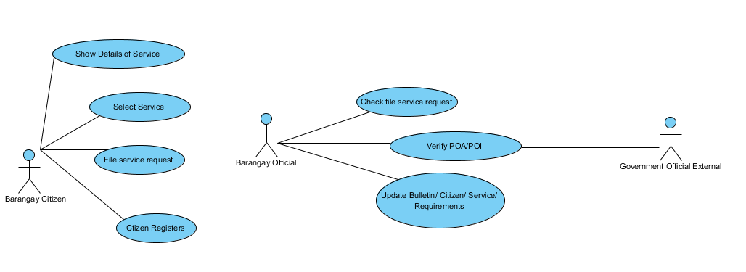
Use Case Diagram

Slide 4
Fully Developed Description
Use Case Name: | Select Service
Scenario: | User selects desired service
Trigger Event: | Select Service
Brief Description: | System displays detailed information of the service and the requirements to fulfill the service
Actors: | User
Related Use Cases: | Show details of service
Stakeholders: | Barangay Citizen
Preconditions: | Citizen must view list of services
Post conditions: | System displays more details about the selected service
Flow of Activities: | Actor | System
 | 1. User selects desired service | 1.1 System displays detailed information of the service

Slide 5
Use Case Name: | File Service Request
Scenario: | Citizen wants to avail a service
Trigger Event: | Select Service
Brief Description: | If the citizen has selected the chosen document, the system will get the information of the citizen from the database and transfer that information to the service file document.
Actors: | User, System
Stakeholders: | Barangay citizen, Barangay official
Preconditions: | Citizen must be registered to the system
Post conditions: | The request will be successfully placed
Flow of Activities: | Actor | System
 | 1. Citizen requests for a file | 1.1 System will output the requirements for the specific document to the citizen.
 | 2. Citizen submits requirements | 2.1System will get the information of the citizen from the database and use that data for the document requested 2.2 System will display the sample output of requested document
Exception Conditions: | The citizen cannot request for a document if the computer that the user is using lost or does not have connection.

Slide 6
Use Case Name: | Citizen registers
Scenario: | The user wants to register
Trigger Event: | Register
Brief Description: | The user wants to register to the barangay system to make use of the system’s services
Actors: | User, System
Stakeholders: | Barangay citizen
Preconditions: | User is not in the systems database
Post conditions: | User’s details will be stored to the system
Flow of Activities: | Actor | System
 | 1. User wants to register | 1.1 Show application form
 | 2. User fills up and submits form together with POA/POI. | 2.1 System stores data to the database.
Exception Conditions: | The citizen cannot proceed with the registration process if the computer that the user is using does not have internet connection

Slide 7
Use Case Name: | Check File Service Request
Scenario: | The barangay official checks
Trigger Event: | Check Request
Brief Description: | The barangay official checks the requests of the citizens
Actors: | Admin/Barangay officials
Related Use Cases: | Request document
Stakeholders: | Barangay official/Citizen
Preconditions: | There must be a request document from the citizen.
Post conditions: | Barangay officials can see and check requested documents.
Flow of Activities: | Actor | System
 | 1. Barangay official checks request of the citizen | 1.1 The system outputs the requested documents of the citizen
Exception Conditions: | If there is no requested document from the citizen then there is no requirements to be checked.

Slide 8
Use Case Name: | Verify POI/POA
Scenario: | Barangay official verifies submitted POA/POI of the citizen
Trigger Event: | Check POI/POA
Brief Description: | The barangay official will verify the submitted POA/POI of the citizen in order for the citizen to be successfully registered to the barangay.
Actors: | Barangay Official
Related Use Cases: | Citizen Registers
Stakeholders: | Barangay citizen, Barangay official
Preconditions: | There should be a submitted POA/POI from the citizen
Post conditions: | Request of the citizen will be verified
Flow of Activities: | Actor | System
 | Barangay official will check submitted POA/POI Barangay Official verifies the submitted POA/POI to the external agency. If verification is successful, Barangay Official will update the request in the system | 1.1 System will output the POA/POI of the citizen 3.1 System will register the citizen.
Exception Conditions: | If the submitted POA/POI is not legit then the barangay official cannot approve the citizen’s registration

Slide 9
Use Case Name: | Update Bulletin
Scenario: | The barangay official updates Bulletin / Citizen/ Service/ Requirements
Trigger Event: | Update
Brief Description: | The barangay official updates the content of Bulletin / Citizen/ Service/ Requirements
Actors: | Barangay Official
Related Use Cases:
Stakeholders: | Barangay Official, Barangay Citizen
Preconditions: | There should be a database to be updated
Post conditions: | Contents of the Bulletin / Citizen/ Service/ Requirements will be updated
Flow of Activities: | Actor | System
 | 1. Barangay official updates bulletin/citizen/service/requirements | 1.1The content of the bulletin/ citizen/service/requirements
Exception Conditions: | Barangay official cannot update if there is no database.

Slide 10
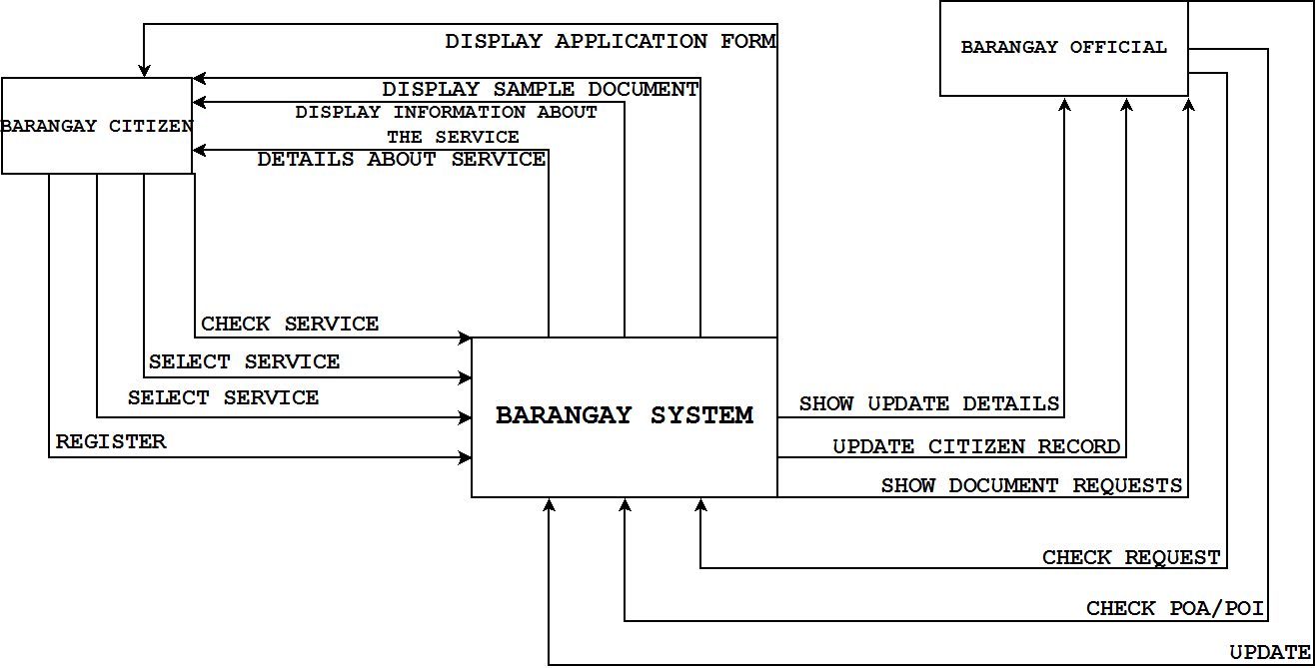
Context Diagram

Slide 11
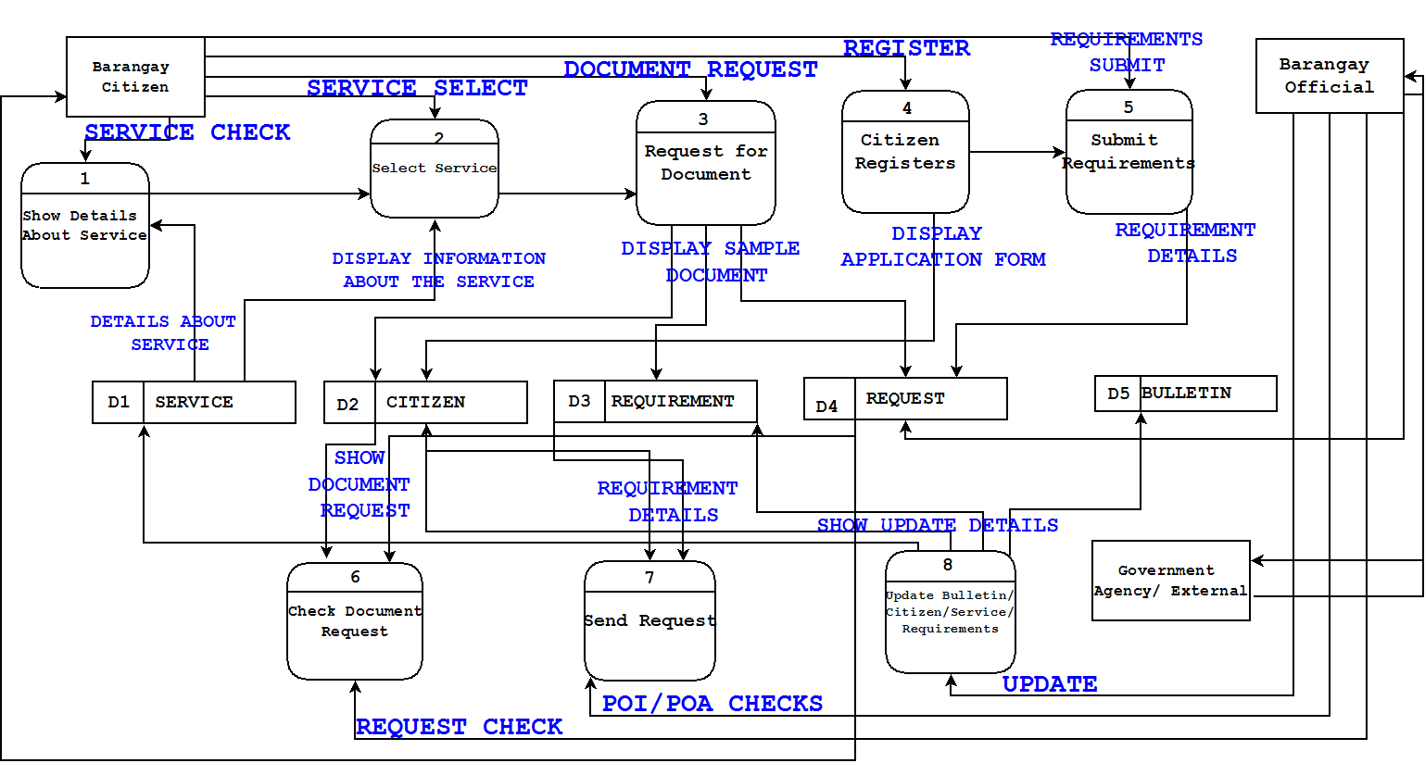
Data Flow Diagrams (level0)

Slide 12
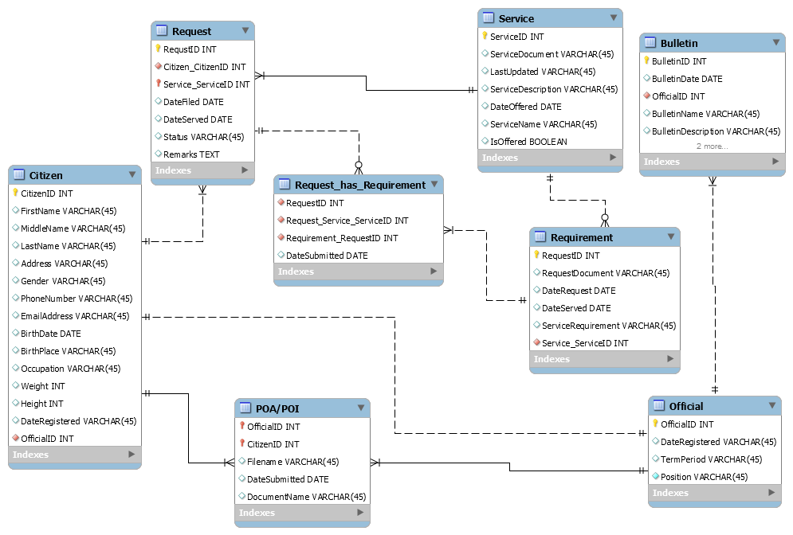
ERD

Slide 13
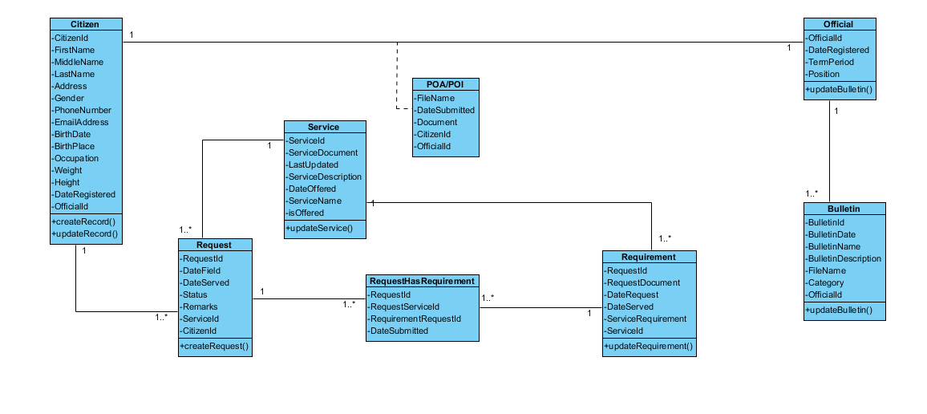
Class Diagram

Slide 14
Activity Diagram

Slide 15
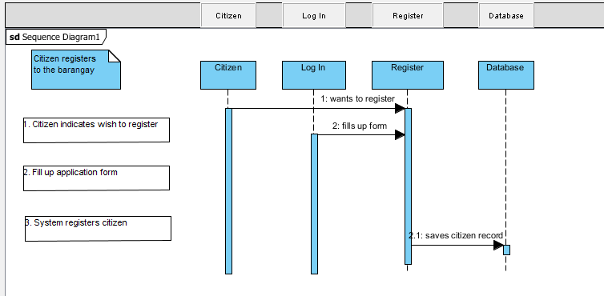
Sequence Diagram

Slide 16
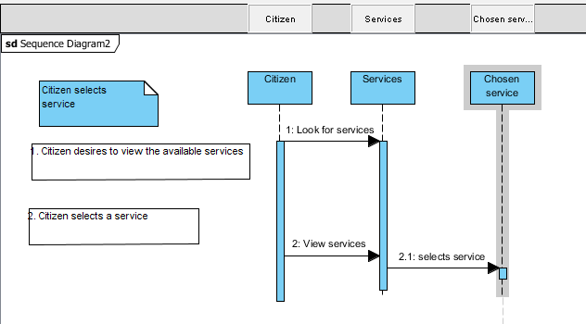
Sequence Diagram

Slide 17
Collaboration Diagram

