Slide 1
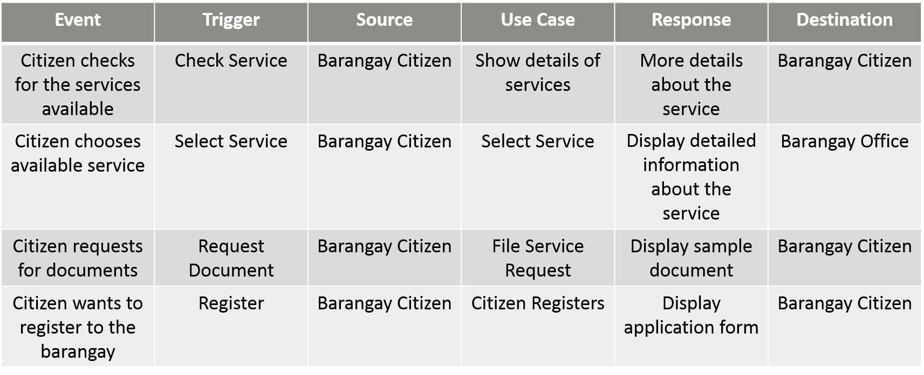
EVENT TABLE

Slide 2
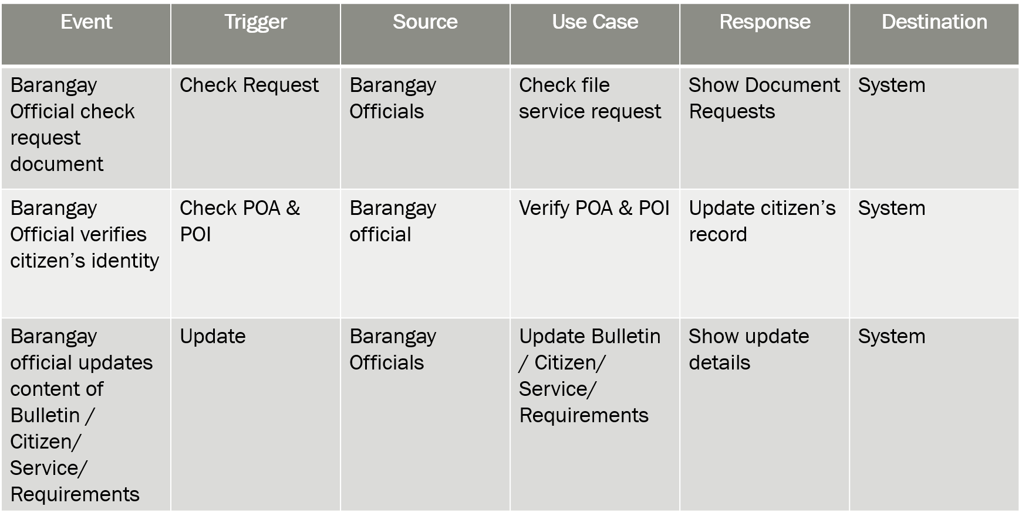
EVENT TABLE

Slide 3
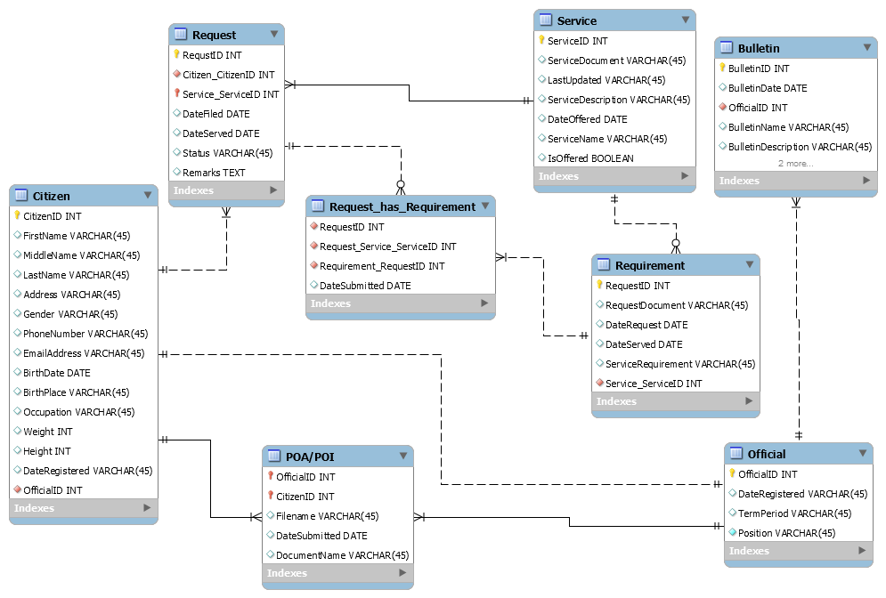
ERD

Slide 4
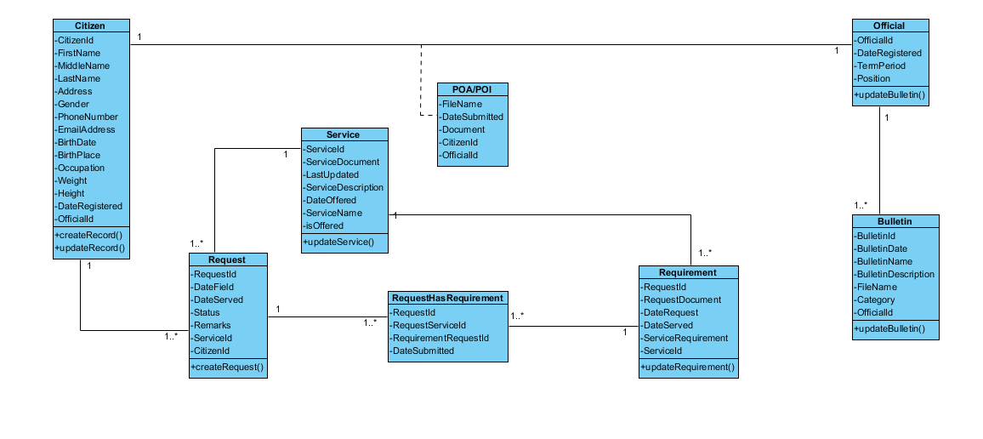
Class Diagram

Slide 5
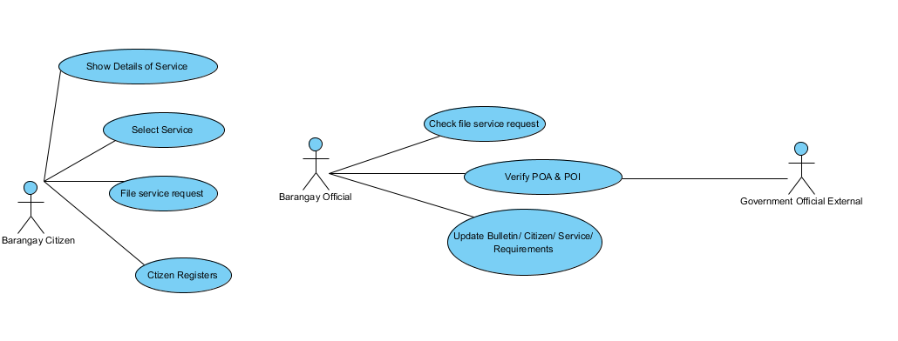
Use Case Diagram

Slide 6
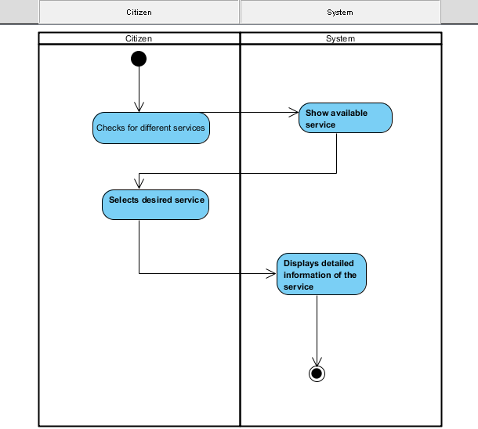
Activity Diagram
Select Service

Slide 7
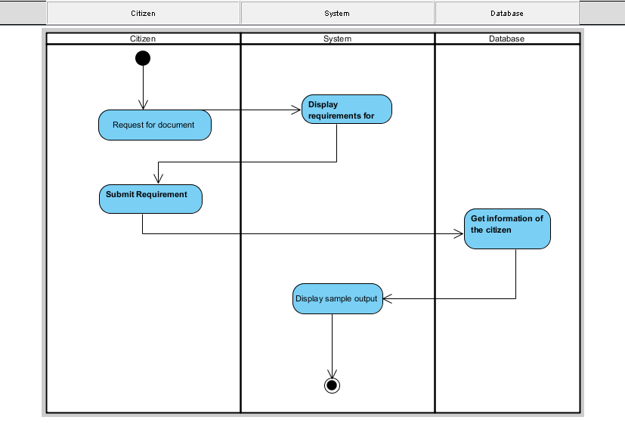
File Service Request

Slide 8
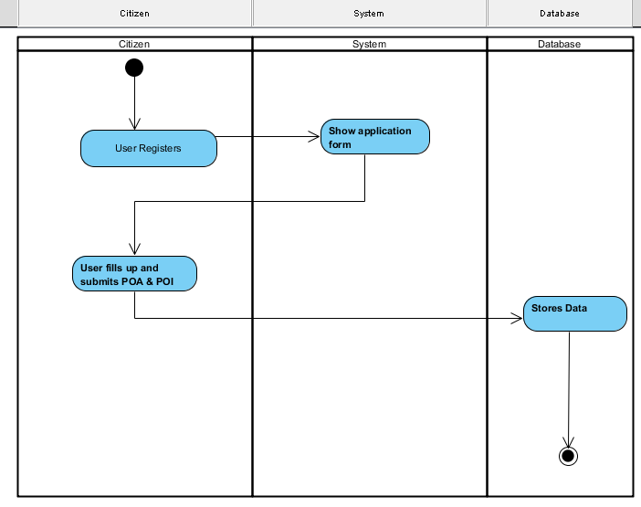
Citizen Registers

Slide 9
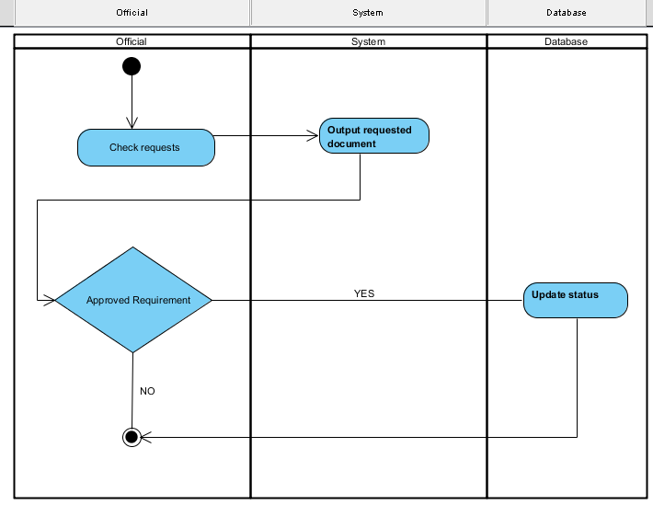
Check file service request

Slide 10
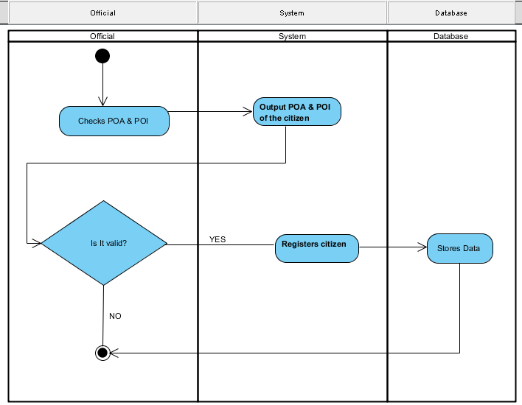
Verify POA & POI

Slide 11
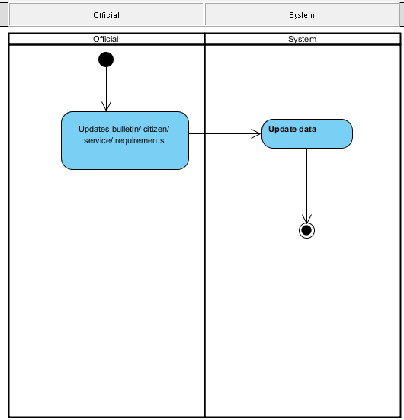
Update Bulletin

Slide 12
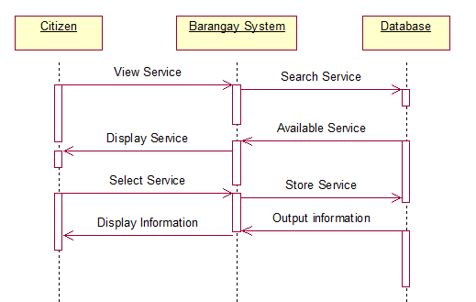
Sequence Diagram
Select Service

Slide 13
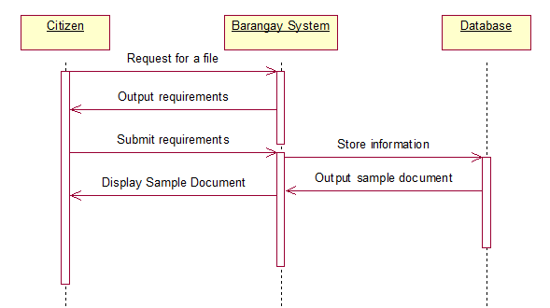
File Service Request

Slide 14
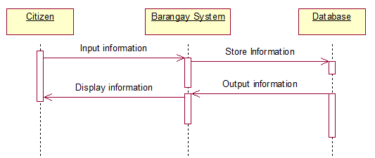
Citizen Registers

Slide 15
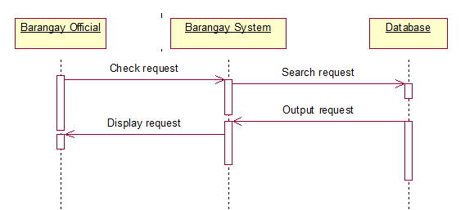
Check file service request

Slide 16
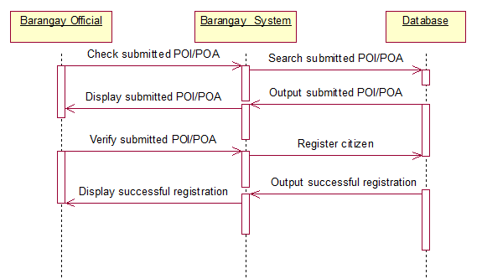
Verify POA & POI

Slide 17
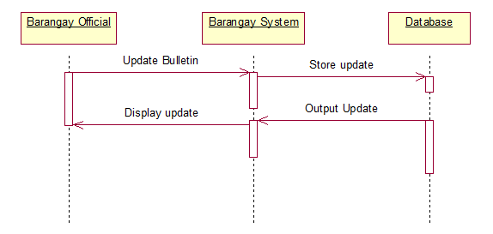
Update Bulletin

Slide 18
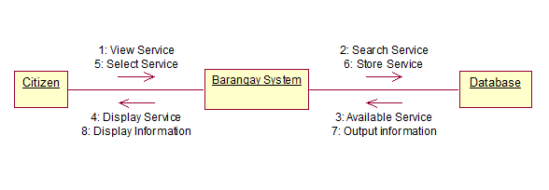
Collaboration Diagram
Select service

Slide 19

File Service Request

Slide 20

Citizen Registers

Slide 21

Check file service request

Slide 22

Verify POA & POI

Slide 23

Update Bulletin

