Slide 1

Blood Findr
CSPROJ MIDTERM
PRESENTATION

Slide 2
Introduction
Blood Findr is basically a web-based and mobile-based application that eases the reservation of blood and the handling of clients alike.
The application only requires an account so that administrators can verify each client.
Our team deems it necessary that our system or our study be utilized for the development of blood availing in our country.

Slide 3
Problem Statement
The process of availing of blood at Red Cross is through making a call or e-mail. This method has been inefficient and time consuming for everyone who wants to avail blood from Red Cross.
The availability of the blood group requested is not always guaranteed. This is a problem because it could only cost more time for the recipient to receive the blood.

Slide 4
Solution
Our team imagined a feasible project to improve the convenience of people searching for blood. Blood Findr, a web and mobile based application wherein people can find the nearest desired blood available, reserve the blood, and claim it as soon as possible.
It will require the user to have an account. Upon registration, the system will ask for user’s information.
The system will also require a photo or scanned document of user’s government issued ID upon registering. This is to ensure that the user is a legitimate client. Registration is mandatory for verification and security purposes. Once registered, clients can now use our system.

Slide 5
Processing of our System
First step - Client logs in to the system. If the clients still don’t have an account he/she should register for an account.
Second step - Client inquires for the type of blood needed. A list of red cross blood facility and its location will be shown, along with the availability of the client’s desired blood type.
Third step - Client chooses the nearest desired blood available. Once chosen, a request for reservation will be sent to the red cross blood facility – which the admin will receive.
Fourth step – Admin confirms blood reservation and will send a code to the user through the app, prompting the desired blood group is reserved and ready for pick up.
Fifth step – The system will display amount to be paid and the client can now pick up the blood. Note that upon claiming

Slide 6
Purpose and Description
The purpose of this project is to utilize our technology and use it to ease the process of availing of blood. It will be free for everyone to use. Furthermore, the project will be user-friendly guaranteed so that even those who are not in to technology can easily use the application.
Blood Findr aims to change the way we get blood. While adding convenience to the overall process

Slide 7
Objectives
The application aims to improve the way people avail blood from Red Cross. This can be made possible through the use of today’s technology.
To introduce a much easier and faster way of availing blood at Red Cross, because when it comes to blood, time is gold.
Innovate the way people avail blood from Red Cross. Innovate the way people avail blood from Red Cross.
To replace the traditional process of having to make a call or e-mail to inquire about a specific blood and have it reserved with a much convenient and reliable way

Slide 8
Scope and Limitations
The application is easily accessible by everyone. Clients can use the application through any browser and operating system available. Internet connection will be one of its non-functional requirement.
The system is only limited to blood recipients. The application cannot address blood donors or people who wishes to donate blood. This is due to the fact that blood donation needs a more comprehensive and complex process, in which the application cannot handle.

Slide 9
SWOT Analysis
Strengths:
- Strong mission, vision as well as guiding principle
- High level of accountability and trust
- Large blood supplier here in the Philippines
Weaknesses:
- Lack of online presence
- Lack of innovation
Opportunities:
- Innovation
- Expansion of products and services
Threats:
-Competition (Philippine Blood Center)

Slide 10
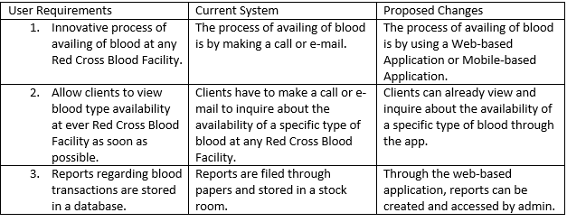
GAP Analysis

