Slide 1

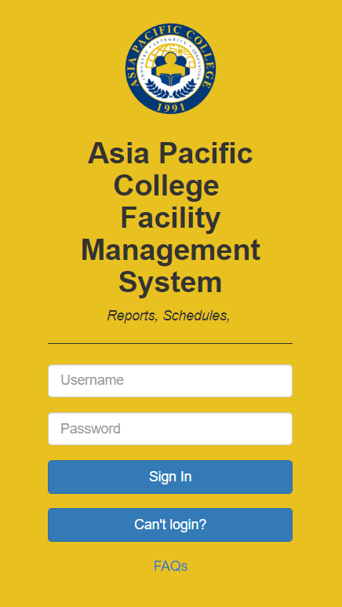

Slide 2

Invalid Credentials

Slide 3





ADMIN
Welcome to Asia Pacific Management portal
Welcome To Administrator
Class Schedules
Reports
Check class schedules for the term and status
Check Facility Reports, Facility Equipment’s and Facility status

Slide 4
ADMIN
Welcome to Asia Pacific Management portal
Class Schedules
Reports
Check class schedules for the term and status
Check Facility Reports, Facility Equipment’s and Facility status

Slide 5
Professor
Welcome to Asia Pacific Management portal
Room | Section | Report | Scheduled time | Name of Professor
305 | CSIT01 | No working pc | 7:30-9:30 | Ivan Jasper Evangelista
Submit

Slide 6


Class schedules
7:43 PM
17/07/2019
Scheduled Class | Room | Time Start | Time End | Status
CSITO1 | 305 | 1:30 | 3:30 | ACTIVE
ABM121 | 608 | 7:30 | 9:30 | DEACTIVATED
MI123 | 601 | 1:30 | 5:30 | ACTIVE
GD124 | 603 | 5:30 | 7:30 | ACTIVE
ABMA128 | 605 | 3:30 | 5:30 | ACTIVE
GD334 | 608 | 11:30 | 1:30 | ACTIVE
CSITO1 | 608 | 1:30 | 3:30 | ACTIVE

Slide 7
Reports
7:43 PM
17/07/2019
Room | Section | Report | Time reported | Scheduled time | Name of Professor
305 | CSIT01 | No working pc | 7:30 | 7:30-9:30 | Ivan Jasper Evangelista
307 | CSIT01 | Closed rooms | 5:30 | 5:30-7:30 | Marco Butalid
605 | ABMA121 | Projectors | 4:30 | 4:30-5:30 | John Mattew Fonacier
607 | GD123 | Programs | 7:30 | 7:30-5:30 | Luis Gino
608 | CSIT01 | Aircon | 8:30 | 8:30-9:30 | Marco Butalid

Slide 8
USER
Welcome to Asia Pacific Management portal
Welcome USER
Create Report
Create Facility Report

Slide 9
USER
Welcome to Asia Pacific Management portal
Create Report
Create Facility Report

Slide 10

Create Report
7:43 PM
17/07/2019
Name | Room | Time | Equipment
Aircon
Projector
Lights
Others
Type Text Here:
Send

