Slide 1


Event Table
Event | Trigger | Source | Use Case | Response | Destination
CCS, Central Server and Transparency Server sends encrypted data to VCM using the VCM’s public key | End of voting period | CCS, Central Server, and Transparency Server | Sends encrypted data | Sent encrypted data | VCM
VCM decrypts the data using its private keys | Received encrypted data | Private Key | Decrypts the data | Decrypted the data | CCS, Central Server, and Transparency Server
VCM & 3 Servers create key exchange using the Diffie-Hellman algorithm | Succesfully decrypted data | VCm & 3 Servers | Creates key exchange | Generated Key | VCM
VCM sends encrypted election returns using the generated key | Generated Key | Key exchange | Sends encrypted ERs | Sent encrypted ERs | CCS, Central Server, and Transparency Server
CCS, Central Server and, Transparency Server verify hash value of the received election returns | Received encrypted election returns | VCM | Verifies hash value | Verified hash value | CCS, Central Server, and Transparency Server

Slide 2
Context Diagram
Transparency Server
Encrypted data
Encrypted data
Encrypted data
VCM
Automated Election System
Encrypted data
Central Server
Encrypted data
Encrypted data
Encrypted data
Encrypted data
CCS

Slide 3
DFD DIAGRAM 0
votes
2
Store votes in database
5
Transmit election returns to Municipal BOC
Precinct
ERs
Votes
Municipal
BOC
1
Cast ballots
summary of votes
stored votes
6
Transmit election returns to Provincial BOC
4
Accumulates votes
votes
3
Print receipt
Voter
Municipal ERs
Accumulated
votes
Election Returns
ProvincialBOC
receipt
digital signature
BEI
8
Transmit election returns to National BOC
7
Transmit election returns to Regional BOC
Regional ERs
Provincial ERs
NationalBOC
RegionalBOC

Slide 4
DFD DIAGRAM 1

Slide 5
Activity Diagram
Servers(CSS,Central and Transparency) | VCM
Sends encrypted data
Decrypts the data
Sends encrypted ERs
Creates key exchange
Verifies hash value

Slide 6
Communication Diagram
1.1:DecryptData()
1:sendEncryptedData()
2:CreateKeyExchange()
3:SendEncryptedERs()
:Servers
(CCS, Central and Transparency)
:VCM
4:verifiesHashValue()
2:CreateKeyExchange()

Slide 7
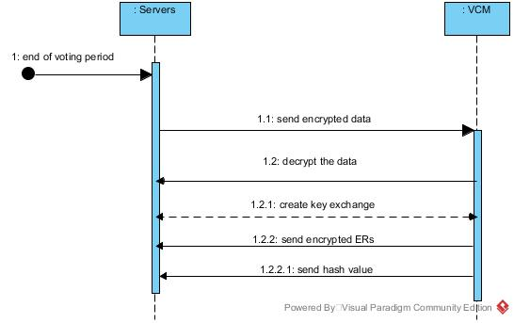
Sequence Diagram

Slide 8
State Diagram
VCM public key
Send encrypted data
Private key
Decrypt data
Verify hash value
Encrypted ERs
Create key exchange
Generated key
Send encrypted ERs

Slide 9
Timing Diagram
Encrypt data
Decrypt data
Create key exchange
Send encrypted ERs
Verify hash value
|--------30s--------|-----------30s------------|----------30s----------|----------30s----------|---------30s---------|

Slide 10
Interaction Overview Diagram
Sd VoteTransmission

Slide 11
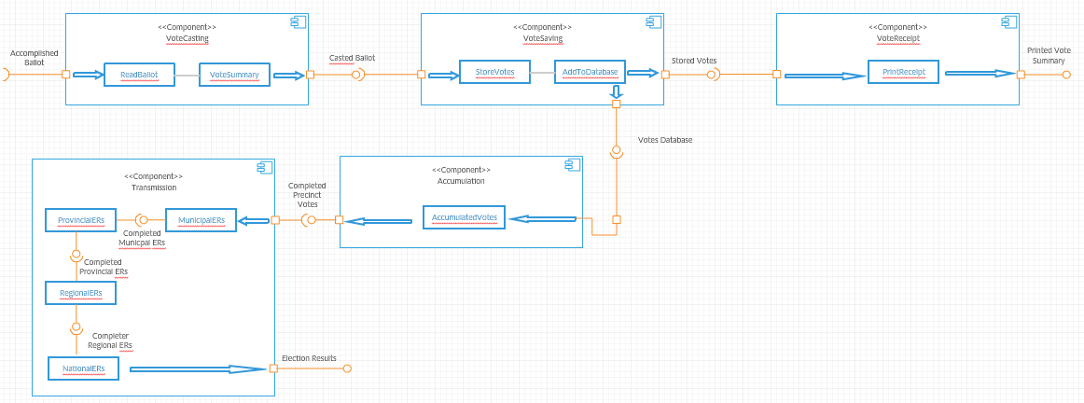
Component Diagram

Slide 12
Composite Diagram
TransmissionVotes
Central Server
VCM
Transparency Server
Hybrid Cryptography of AES
Transparency Server

Slide 13
Use Case Diagram
CCS, Central, Transparency Server
Send encrypted data
VCM

Slide 14
Use Case Diagram
VCM
Decrypt data
CCS, Central, Transparency Server

Slide 15
Use Case Diagram
CCS, Central, Transparency Server
Create key exchange
VCM

Slide 16
Use Case Diagram
VCM
Send encrypted ERs
CCS, Central, Transparency Server

Slide 17
Use Case Diagram
CCS, Central, Transparency Server
Verify hash value

Slide 18
Use Case Diagram w Full Description
Use Case Name: | Send encrypted data
Scenario: | The Voter casts the accomplished ballot in the VCM
Triggering Event: | Accomplished Ballot
Brief Description: | The voter proceeds to the VCM machine to cast their ballot containing te votes
Actor(s): | BEI, Voter
Related Use Cases: | ---
Stakeholders: | The BEI ensures that the voter will proceed to the VCM machine after accomplishing the ballot
Precondition: | Ballot is accomplished
Postcondition: | Ballot is casted
Basic Flow: | Actor: 1. The Voter fills the ballot sheet 2. The Voter proceeds to the VCM 3. The Voter enters the accomplished ballot sheet inside the VCM 4. The BEI checks if the machine is processing the ballot sheet 5. The Voter and BEI will wait for the VCM to print a receipt containing the vote summary | System Response: 3.1 The System reads the ballot 3.2 The System will check for anomalies
Exceptions: | 1.1 Person should be a confirmed registered voter 3.1.1 If the system rejects the ballot, voter is allowed to insert the ballot in the VCM again.

Slide 19
Use Case Diagram w Full Description
Use Case Name: | Decrypt the data
Scenario: | The System stores the votes in a database
Triggering Event: | Scanned Ballot
Brief Description: | The System stores the votes that was read when the voter casts the ballot
Actor(s): | BEI, Voter
Related Use Cases: | ----
Stakeholders: | The BEI checks whether the VCM is properly functioning The Voter check from the screen if their votes are being stored
Precondition: | Ballot is casted
Postcondition: | Votes in the ballot are stored in a database
Basic Flow: | Actor: 1. The Voter waits for the system to accomplish the saving of the votes | System Response: 1.1 The System stores the votes in a database
Exceptions: | 1.1.1 If votes are not equal to the number of votes, system will display error message.

Slide 20
Use Case Diagram w Full Description
Use Case Name: | Create key exchange
Scenario: | The System prints a copy of the receipt
Triggering Event: | Successfully stored votes
Brief Description: | The System prints a copy of the receipt containing the corresponding votes of the voter
Actor(s): | BEI, Voter
Related Use Cases: | ----
Stakeholders: | The BEI ensures that the voters are following the procedures and guides them throughout the process The Voter verifies what the VCM read
Precondition: | Votes in the ballot are stored in a database
Postcondition: | Receipt is printed
Basic Flow: | Actor: 1. The BEI checks whether the VCM is already generating a copy of the receipt 2. The BEI gets the receipt from the VCM and is given to the voter 3. The Voter checks whether the VCM read the ballot correctly 4. The Voter surrenders the receipt by placing it inside a box 5. The BEI ensures that the voter surrenders the receipt before exiting the polling area | System Response: 1.1 The system will display a signal if it is ready to generate a receipt
Exceptions: | 1.1.1 If there is a miscalculations of votes , system will display error message.

Slide 21
Use Case Diagram w Full Description
Use Case Name: | Send encrypted ERs
Scenario: | The System accumulates the votes inside the database
Triggering Event: | Successfully stored votes
Brief Description: | The System accumulates the votes that were successfully stored inside the database
Actor(s): | BEI
Related Use Cases: | ----
Stakeholders: | The BEI ensures that no anomalies are being done when accumulating the votes
Precondition: | Votes in the ballot are stored in a database
Postcondition: | Votes are accumulated
Basic Flow: | Actor: 1. The BEI checks whether the VCM is accumulating the votes | System Response: 1.1 The system will display a signal if it is or has accumulated the votes
Exceptions: | 1.1.1 If there is a miscalculations of votes , system will display error message.

Slide 22
Use Case Diagram w Full Description
Use Case Name: | Verify hash value
Scenario: | The BEI transmits the votes to MBOC
Triggering Event: | Completion of Precinct Votes
Brief Description: | The BEI transmits the votes of the accumulated precinct level votes to the MBOC of the municipal level through the transmitting function of the VCM
Actor(s): | BEI, MBOC
Related Use Cases: | ----
Stakeholders: | The BEI ensures that no anomalies are being done The MBOC is the receiving party of the transmission
Precondition: | Precinct votes are accumulated
Postcondition: | Transmitted Precinct votes
Basic Flow: | Actor: 1. The BEI prompts the system to transmit the votes to the MBOC 2. The BEI checks whether the VCM is capable of transmitting the votes 3. The BEI checks the status of the transmission and reports to the MBOC 4. MBOC receives the transmitted precinct votes 5. MBOC Confirms the BEI that they had already received the votes of the precinct where the BEI is assigned | System Response: 2.1 The system displays a message that it is ready for transmission 3.1 The system displays the percentage of the already successful transmission 4.1 The system displays a message that says transmission is 100% complete 5.1 Confirms that the recipient already received the votes
Exceptions: | 1.1 Digital signature should be present

Slide 23
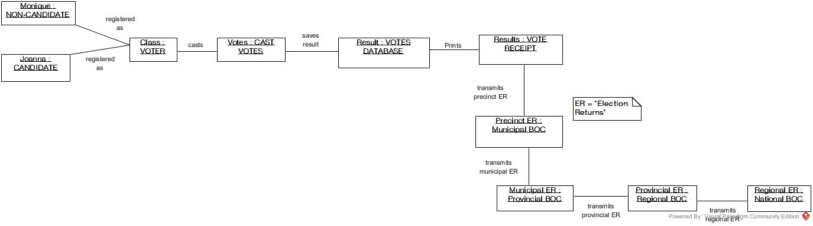
Object Diagram

Slide 24
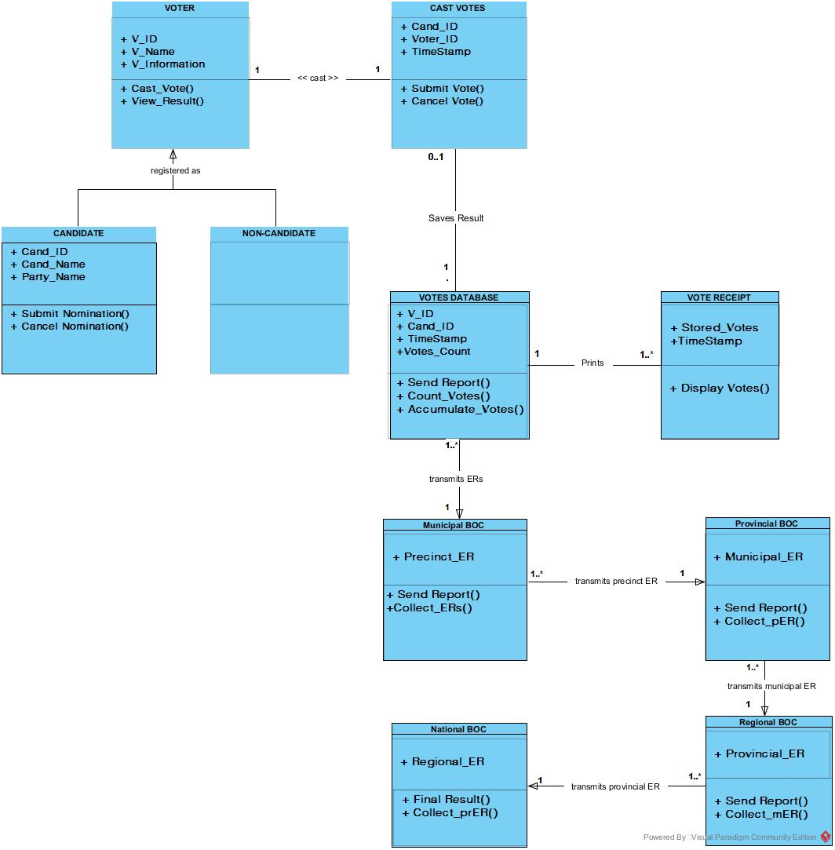
Class Diagram

Slide 25
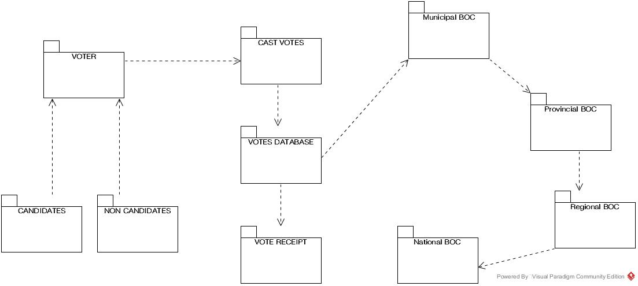
Package Diagram

Slide 26
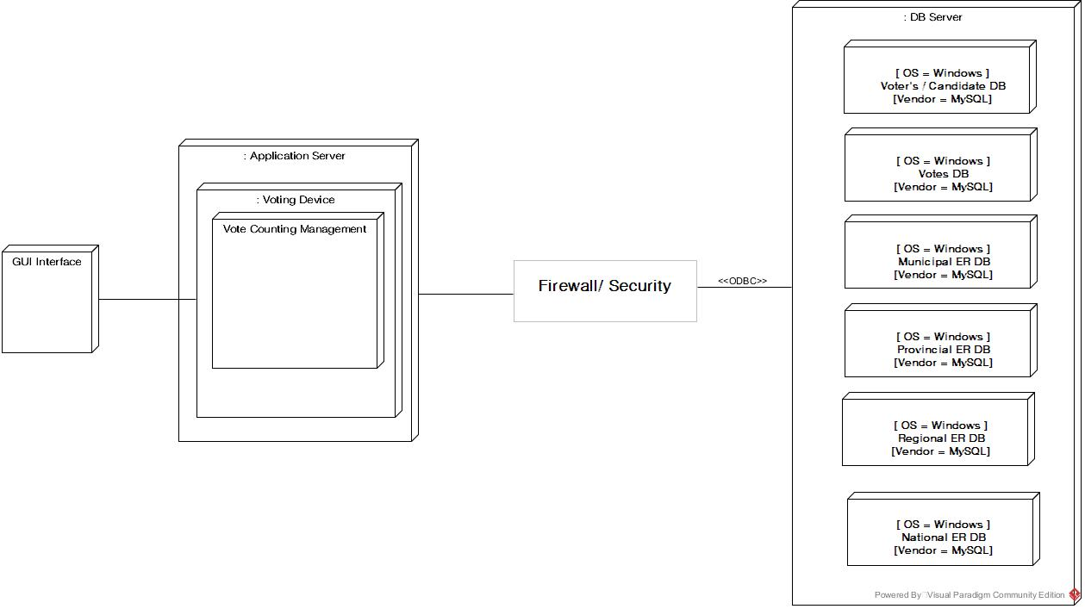
Deployment Diagram

