Slide 1


Event Table
Event | Trigger | Source | Use Case | Response | Destination
Voter casts ballot | Accomplished ballot | Voter | Casts ballot | Casted ballot | System
System stores votes in the database | Scanned ballot | Ballot | Stores votes in the database | Stored votes in the database | System
System prints receipt | Successfully stored votes | Database | Prints receipt | Printed receipt | Voter
System accumulates votes | Successfully stored votes | Database | Accumulate votes | Accumulated votes | System
Board of Election Inspectors (BEI) transmits Election Returns (ERs) to the Municipal Board of Canvassers | Completion of precinct votes | BEI | Transmits election returns to the Municipal Board of Canvassers | Transmitted ERs to the Municipal Board of Canvassers | Municipal BOC
Municipal Board of Canvassers (MBOC) transmits ERs to the Provincial Board of Canvassers | Completion of municipal election returns | MBOC | Transmits election returns to the Provincial Board of Canvassers | Transmitted ERs to the Provincial Board of Canvassers | Provincial BOC
Provincial Board of Canvassers (PBOC) transmits ERs to the Regional Board of Canvassers | Completion of provincial election returns | PBOC | Transmits election returns to Regional Board of Canvassers | Transmitted ERs to the Regional Board of Canvassers | Regional BOC
Regional Board of Canvassers (RBOC) transmits ERs to the National Board of Canvassers | Completion of regional election returns | RBOC | Transmits election returns to the National Board of Canvassers | Transmitted ERs to the National Board of Canvassers | National BOC

Slide 2
Context Diagram
BEI
digital signature
Automated Election System
election returns
Voter
votes
BOC
receipt
ERs

Slide 3
DFD DIAGRAM 0
votes
2
Store votes in database
5
Transmit election returns to Municipal BOC
Precinct
ERs
Votes
Municipal
BOC
1
Cast ballots
summary of votes
stored votes
6
Transmit election returns to Provincial BOC
4
Accumulates votes
votes
3
Print receipt
Voter
Municipal ERs
Accumulated
votes
Election Returns
ProvincialBOC
receipt
digital signature
BEI
8
Transmit election returns to National BOC
7
Transmit election returns to Regional BOC
Regional ERs
Provincial ERs
NationalBOC
RegionalBOC

Slide 4
DFD DIAGRAM 1
1.1
Enter ballot in the system
1.2
Store votes in the database
Voter
votes
Votes

Slide 5
DFD DIAGRAM 3
3.1
Incorporate digital signature
3.2
Transmit to Municipal Board of Canvassers (BOC)
3.3
Transmit to Provincial Board of Canvassers (BOC)
3.4
Transmit to Regional Board of Canvassers (BOC)
Election Return
3.5
Transmit to National Board of Canvassers (BOC)

Slide 6
Activity Diagram
Voter | System | BEI | BOC
Incorporate digital signature
ER for Provincial
Cast ballots
Store votes in the database
Yes
ER for Municipal
No
Transmit election returns to Provincial BOC
No
Print receipt
Yes
Transmit election returns to Regional BOC
ER for Regional
Yes
Transmit election returns to Municipal BOC
Accumulate votes
No
Transmit election returns to National BOC

Slide 7
Communication Diagram
1:storeVote()
2:printReceipt()
3:getSummary()
2.1:getReceipt()
:System
:Database
:Voter
3.1:getElectionReturn()
:BEI
1.1:accumulateVote()
4:provideDigitalSignature()
:BOC
5:transmitElectionReturn()

Slide 8
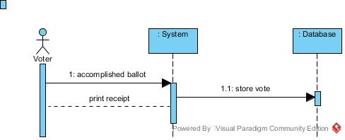
Sequence Diagram
Casting

Slide 9
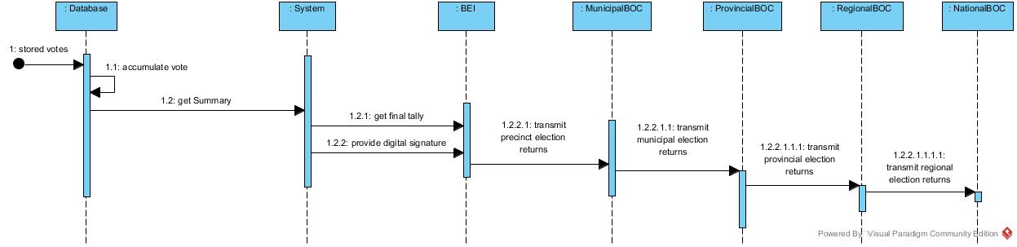
Sequence Diagram
Transmission

Slide 10
State Diagram
Accomplished ballot
Cast ballots
Complete Provincial ERs
Scanned ballot
Store votes in the database
ok
Print receipt
Transmit election returns to Provincial BOC
Transmit election returns to Regional BOC
Complete Municipal ERs
Complete Regional ERs
Complete ERs
ok
Provide BEI digital signature
Transmit election returns to Municipal BOC
Transmit election returns to National BOC
Complete National ERs

Slide 11
Timing Diagram
Cast ballots
Store votes
Print receipt
Provide
digital signature
Transmit to MBOC
Transmit to PBOC
Transmit to RBOC
Transmit to NBOC
|-----3mins-----|-------30s-------|-----30s-----|-------30s------|-----25mins-----|----25mins----|----25mins----|----25mins---|

Slide 12
Interaction Overview Diagram
Sd VoteCasting
ref
ref
ref
Cast ballots
Store votes in the database
Print receipt

Slide 13
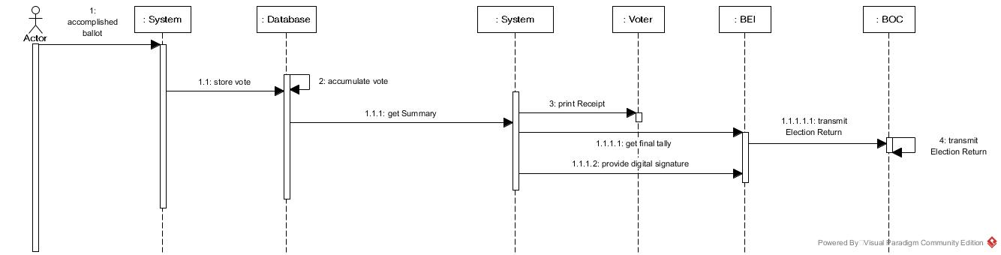
Interaction Overview Diagram
sd VoteTransmission
ref
Casted Vote
Yes
No

Slide 14
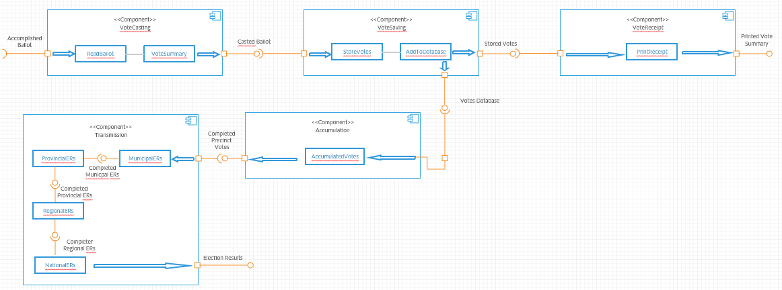
Component Diagram

Slide 15
Composite Diagram
CanvassedVotes
BEI
Voter
BOC
AES

Slide 16
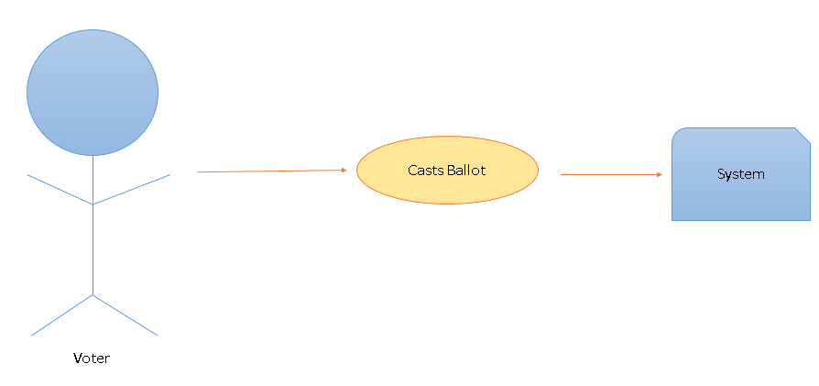
Use Case Diagram

Slide 17
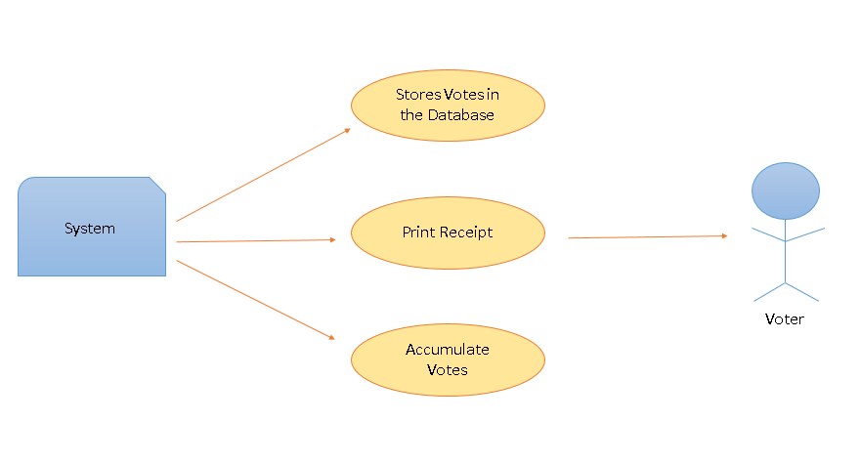
Use Case Diagram

Slide 18
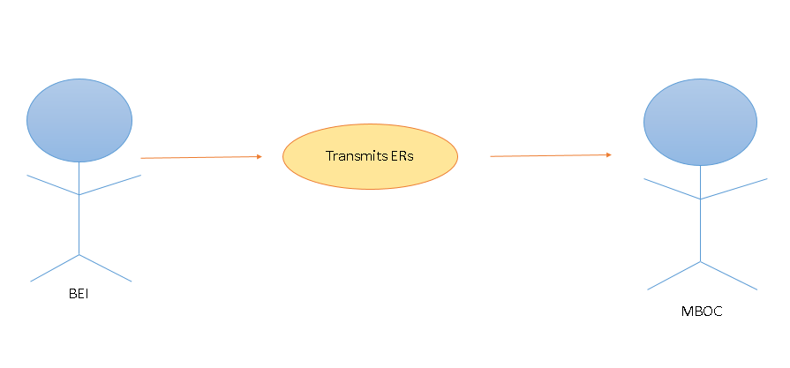
Use Case Diagram

Slide 19
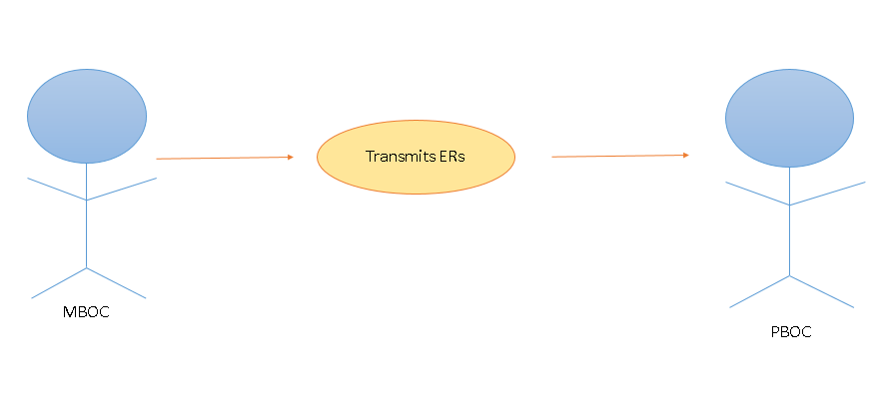
Use Case Diagram

Slide 20
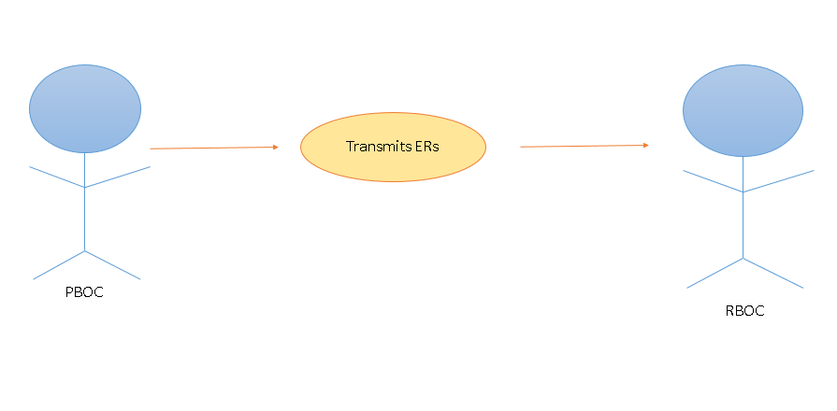
Use Case Diagram

Slide 21
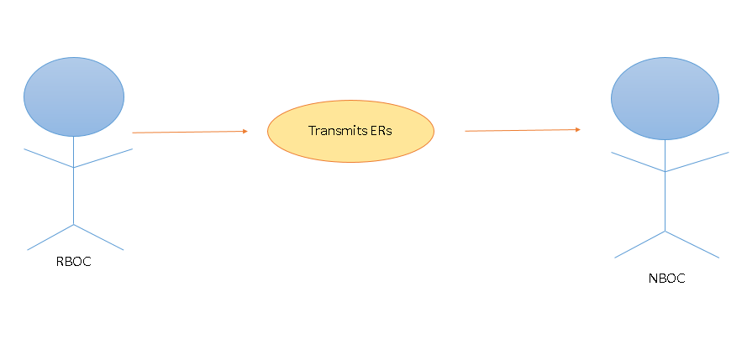
Use Case Diagram

Slide 22
Use Case Diagram w Full Description
Use Case Name: | Cast Ballot
Scenario: | The Voter casts the accomplished ballot in the VCM
Triggering Event: | Accomplished Ballot
Brief Description: | The voter proceeds to the VCM machine to cast their ballot containing te votes
Actor(s): | BEI, Voter
Related Use Cases: | ---
Stakeholders: | The BEI ensures that the voter will proceed to the VCM machine after accomplishing the ballot
Precondition: | Ballot is accomplished
Postcondition: | Ballot is casted
Basic Flow: | Actor: 1. The Voter fills the ballot sheet 2. The Voter proceeds to the VCM 3. The Voter enters the accomplished ballot sheet inside the VCM 4. The BEI checks if the machine is processing the ballot sheet 5. The Voter and BEI will wait for the VCM to print a receipt containing the vote summary | System Response: 3.1 The System reads the ballot 3.2 The System will check for anomalies
Exceptions: | 1.1 Person should be a confirmed registered voter 3.1.1 If the system rejects the ballot, voter is allowed to insert the ballot in the VCM again.

Slide 23
Use Case Diagram w Full Description
Use Case Name: | Vote Storing
Scenario: | The System stores the votes in a database
Triggering Event: | Scanned Ballot
Brief Description: | The System stores the votes that was read when the voter casts the ballot
Actor(s): | BEI, Voter
Related Use Cases: | ----
Stakeholders: | The BEI checks whether the VCM is properly functioning The Voter check from the screen if their votes are being stored
Precondition: | Ballot is casted
Postcondition: | Votes in the ballot are stored in a database
Basic Flow: | Actor: 1. The Voter waits for the system to accomplish the saving of the votes | System Response: 1.1 The System stores the votes in a database
Exceptions: | 1.1.1 If votes are not equal to the number of votes, system will display error message.

Slide 24
Use Case Diagram w Full Description
Use Case Name: | Printing of Receipt
Scenario: | The System prints a copy of the receipt
Triggering Event: | Successfully stored votes
Brief Description: | The System prints a copy of the receipt containing the corresponding votes of the voter
Actor(s): | BEI, Voter
Related Use Cases: | ----
Stakeholders: | The BEI ensures that the voters are following the procedures and guides them throughout the process The Voter verifies what the VCM read
Precondition: | Votes in the ballot are stored in a database
Postcondition: | Receipt is printed
Basic Flow: | Actor: 1. The BEI checks whether the VCM is already generating a copy of the receipt 2. The BEI gets the receipt from the VCM and is given to the voter 3. The Voter checks whether the VCM read the ballot correctly 4. The Voter surrenders the receipt by placing it inside a box 5. The BEI ensures that the voter surrenders the receipt before exiting the polling area | System Response: 1.1 The system will display a signal if it is ready to generate a receipt
Exceptions: | 1.1.1 If there is a miscalculations of votes , system will display error message.

Slide 25
Use Case Diagram w Full Description
Use Case Name: | Vote Accumulation
Scenario: | The System accumulates the votes inside the database
Triggering Event: | Successfully stored votes
Brief Description: | The System accumulates the votes that were successfully stored inside the database
Actor(s): | BEI
Related Use Cases: | ----
Stakeholders: | The BEI ensures that no anomalies are being done when accumulating the votes
Precondition: | Votes in the ballot are stored in a database
Postcondition: | Votes are accumulated
Basic Flow: | Actor: 1. The BEI checks whether the VCM is accumulating the votes | System Response: 1.1 The system will display a signal if it is or has accumulated the votes
Exceptions: | 1.1.1 If there is a miscalculations of votes , system will display error message.

Slide 26
Use Case Diagram w Full Description
Use Case Name: | Precinct Level to Municipal Level Transmission
Scenario: | The BEI transmits the votes to MBOC
Triggering Event: | Completion of Precinct Votes
Brief Description: | The BEI transmits the votes of the accumulated precinct level votes to the MBOC of the municipal level through the transmitting function of the VCM
Actor(s): | BEI, MBOC
Related Use Cases: | ----
Stakeholders: | The BEI ensures that no anomalies are being done The MBOC is the receiving party of the transmission
Precondition: | Precinct votes are accumulated
Postcondition: | Transmitted Precinct votes
Basic Flow: | Actor: 1. The BEI prompts the system to transmit the votes to the MBOC 2. The BEI checks whether the VCM is capable of transmitting the votes 3. The BEI checks the status of the transmission and reports to the MBOC 4. MBOC receives the transmitted precinct votes 5. MBOC Confirms the BEI that they had already received the votes of the precinct where the BEI is assigned | System Response: 2.1 The system displays a message that it is ready for transmission 3.1 The system displays the percentage of the already successful transmission 4.1 The system displays a message that says transmission is 100% complete 5.1 Confirms that the recipient already received the votes
Exceptions: | 1.1 Digital signature should be present

Slide 27
Use Case Diagram w Full Description
Use Case Name: | Municipal Level to Provincial Level Transmission
Scenario: | The MBOC transmits the votes to PBOC
Triggering Event: | Completion of Municipal Votes
Brief Description: | The MBOC transmits the votes of the accumulated municipal level votes to the PBOC of the provincial level through the transmitting device
Actor(s): | PBOC, MBOC
Related Use Cases: | ----
Stakeholders: | The MBOC ensures that no anomalies are being done The PBOC is the receiving party of the transmission
Precondition: | Municipal votes are accumulated
Postcondition: | Transmitted Municipal votes
Basic Flow: | Actor: 1. The MBOC prompts the system to transmit the votes to the PBOC 2. The MBOC checks whether the device is capable of transmitting the votes 3. The MBOC checks the status of the transmission and reports to the PBOC 4. PBOC receives the transmitted precinct votes 5. PBOC Confirms the MBOC that they had already received the votes of the municipal where the MBOC is assigned | System Response: 2.1 The system displays a message that it is ready for transmission 3.1 The system displays the percentage of the already successful transmission 4.1 The system displays a message that says transmission is 100% complete 5.1 Confirms that the recipient already received the votes
Exceptions: | 1.1 Digital signature should be present

Slide 28
Use Case Diagram w Full Description
Use Case Name: | Provincial Level to Regional Level Transmission
Scenario: | The PBOC transmits the votes to RBOC
Triggering Event: | Completion of Provincial Votes
Brief Description: | The PBOC transmits the votes of the accumulated provincial level votes to the RBOC of the regional level through the transmitting device
Actor(s): | RBOC, PBOC
Related Use Cases: | ----
Stakeholders: | The PBOC ensures that no anomalies are being done The RBOC is the receiving party of the transmission
Precondition: | Provincial votes are accumulated
Postcondition: | Transmitted Provincial votes
Basic Flow: | Actor: 1. The PBOC prompts the system to transmit the votes to the RBOC 2. The PBOC checks whether the device is capable of transmitting the votes 3. The PBOC checks the status of the transmission and reports to the RBOC 4. RBOC receives the transmitted precinct votes 5. RBOC Confirms the PBOC that they had already received the votes of the municipal where the PBOC is assigned | System Response: 2.1 The system displays a message that it is ready for transmission 3.1 The system displays the percentage of the already successful transmission 4.1 The system displays a message that says transmission is 100% complete 5.1 Confirms that the recipient already received the votes
Exceptions: | 1.1 Digital signature should be present

Slide 29
Use Case Diagram w Full Description
Use Case Name: | Regional Level to National Level Transmission
Scenario: | The RBOC transmits the votes to NBOC
Triggering Event: | Completion of Regional Votes
Brief Description: | The RBOC transmits the votes of the accumulated regional votes to the NBOC of the national level through the transmitting device
Actor(s): | RBOC, NBOC
Related Use Cases: | ----
Stakeholders: | The RBOC ensures that no anomalies are being done The NBOC is the receiving party of the transmission
Precondition: | Regional votes are accumulated
Postcondition: | Transmitted Regional votes
Basic Flow: | Actor: 1. The RBOC prompts the system to transmit the votes to the NBOC 2. The RBOC checks whether the device is capable of transmitting the votes 3. The RBOC checks the status of the transmission and reports to the NBOC 4. NBOC receives the transmitted precinct votes 5. NBOC Confirms the RBOC that they had already received the votes of the municipal where the RBOC is assigned | System Response: 2.1 The system displays a message that it is ready for transmission 3.1 The system displays the percentage of the already successful transmission 4.1 The system displays a message that says transmission is 100% complete 5.1 Confirms that the recipient already received the votes
Exceptions: | 1.1 Digital signature should be present

Slide 30
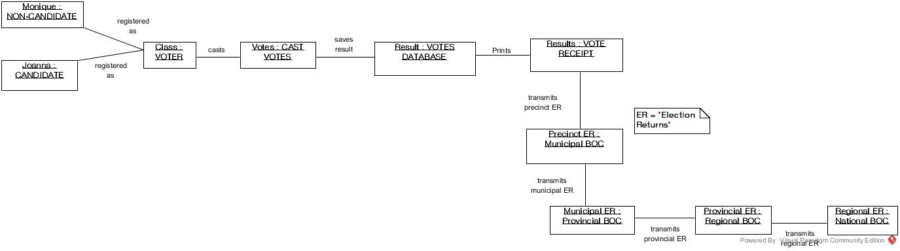
Object Diagram

Slide 31
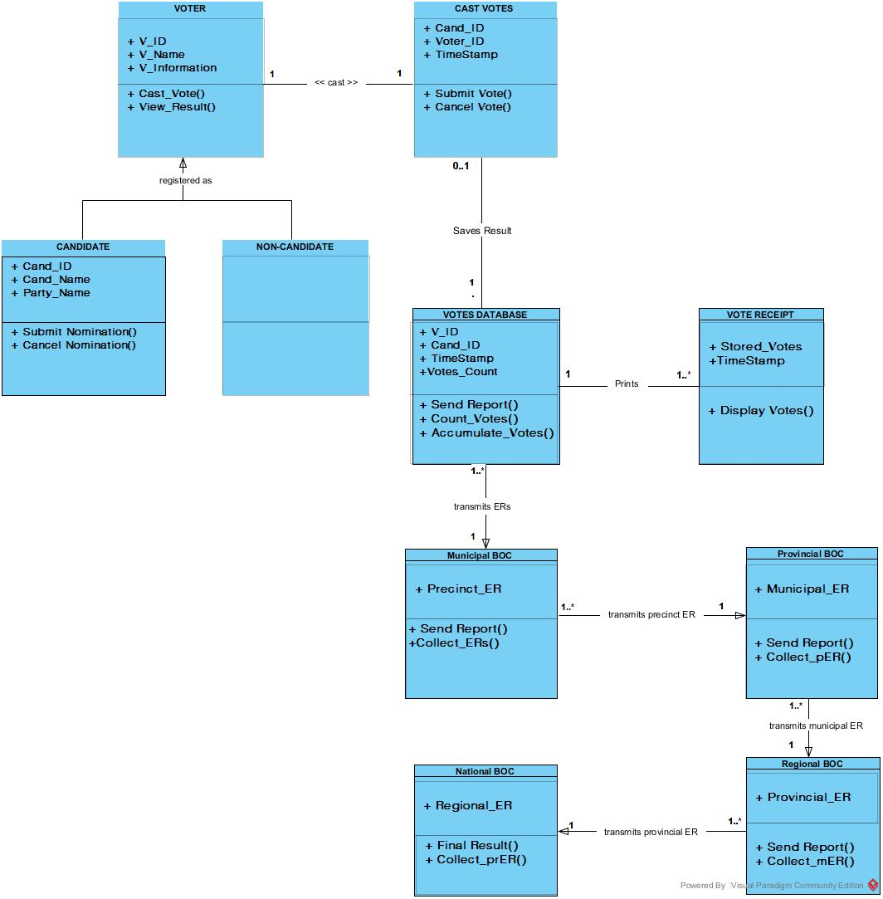
Class Diagram

Slide 32
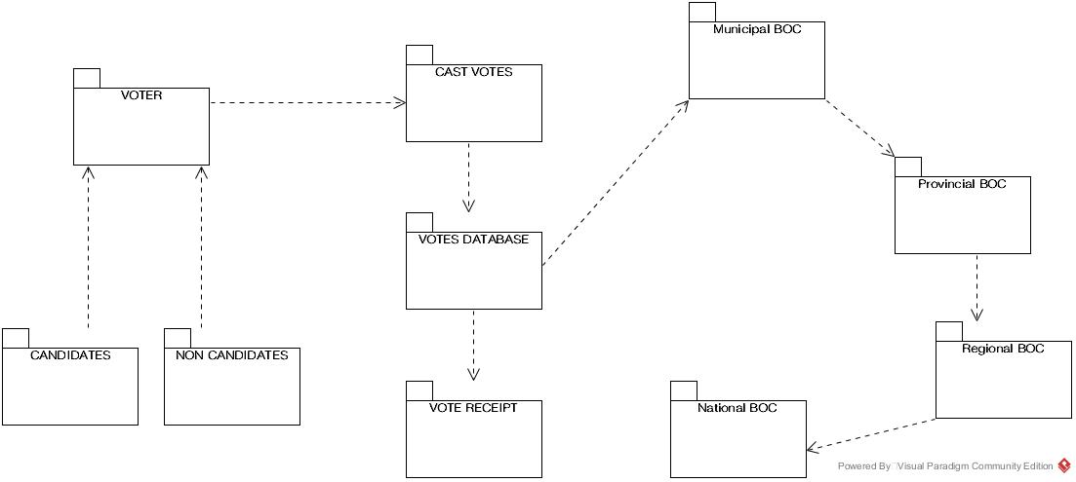
Package Diagram

Slide 33
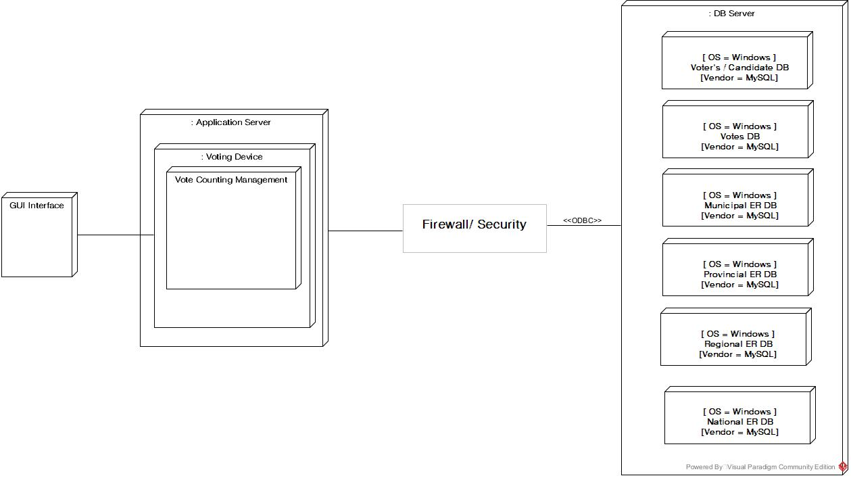
Deployment Diagram

