Slide 1
Enhancing Customer Service Through Refined Restaurant Workflow Provided by a Mobile POS System
Presented by:
Jesus P. Brugada
Denzel F. Oribiana
Manuel Victor P. Serrano

Slide 2
Introduction

Slide 3
A. Background of the problem
MP Megapro Plus Marketing Corporation
The establishment has 2 floors. The mess hall, multi-purpose hall and karaoke rooms is located at the ground floor, while the 2nd floor is all karaoke rooms.
Has 8 waiters and 1 cashier that handles the POS (point of sale)
Experiencing delays due to waiter mobility

Slide 4
B. Statement of the Problem
In what ways would a POS system be helpful in increasing the efficiency of the current workflow of the restaurant to satisfy the customer's requirements/needs?

Slide 5
C. Objectives
To find a system that suits the needs of the client's restaurant
To identify the cause of delays in taking an order
To lessen the time it takes for the cycle of order taking to complete

Slide 6
D. Significance
The result of this study will be beneficial to the following stakeholders:
To the client
The researchers decided to conduct a research about the client's restaurant to find a solution to the problem that they are having. It will help them find the real problem they are not aware of and have the best possible solution to the problem. The client cares for the satisfaction of its customers, and the study will be beneficial for the client.
To the customers
This research will significantly contribute to the satisfaction of the customers regarding their experiences in the client's restaurant.
To the future researchers
As the technology that can improve the system of a restaurant as well as the satisfaction of the customers are evolving, this study could be a reference for other researchers who would like to conduct a research in a similar field with that of the researchers.

Slide 7
E. Scope and Limitations
The scope of the study will only be about what a POS system can do to solve the current workflow problem of the restaurant. Further in-depth analyses about how the systems are developed will no longer be part of the research. The team will only focus on three examples of existing POS systems, what they can offer for the restaurant, and will be judged based on how efficient the app will be considering the context of the client. The team will closely look on their minimum device version requirement, printer compatibility, file size, and additional features to determine the best system the researchers can offer to their client

Slide 8
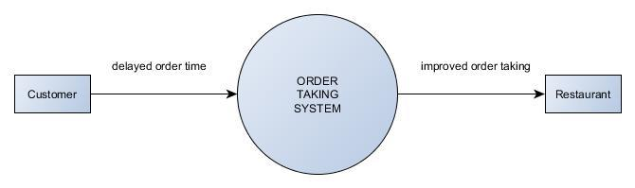
F. Context Diagram

Slide 9
II. Related Literature
A Point of Sale system in a restaurant is very important for the owner, having this will be beneficial for the business in so many ways. The website shopkeep.com listed down five most important features of a restaurant Point of Sale system. The most important advantage you can get by having a POS system is the speed and ease of use it provides. Second most important is that it can track your inventory, to keep the establishment competitive as it can help you make good decisions regarding the restaurant. Same logic can be applied to the third feature of a POS system - Reporting. The fourth feature to be considered is the Marketing while Technical support feature will be the last thing the owner must consider in choosing a POS system.
Koladiya, B. (2015, April 30). 5 restaurant POS features designed to serve up success. Retrieved August 22, 2016, from Point of Sale & Payments, http://www.shopkeep.com/blog/5-features-that-define-superior-restaurant-pos-software

Slide 10
Related Literature (cont.)
An article by Lorri Mealy stated that having an efficient POS system inside your restaurant simplifies the communication between the kitchen(cooks) and the wait staff(waiters and cashiers). Not only it can make transactions faster but is also cost-effective especially when you are previously running a bookkeeping department, as it gets the job done.
Mealey, L. (2016, August 11). Pros and cons of restaurant POS systems. Retrieved August 22, 2016, from The Balance, https://www.thebalance.com/why-you-need-a-pos-system-2888877

Slide 11
So by having a POS system that will make things right, it will most likely result into a restaurant with satisfied customers, and having satisfied customer can lead to better things for the restaurant. Once having a large number of satisfied customers can be an indicator of repurchases, an advantage over a competition, can reduce customer churn, and build up good business reputation. It can be attained in just having a fast customer service which is provided by a POS system.
Beard, R. (2014, January 20). Why customer satisfaction is important (6 reasons). Retrieved August 22, 2016, from http://blog.clientheartbeat.com/why-customer-satisfaction-is-important/

Slide 12
III. Theoretical Background
Comparing the processes involved in the current system of our client and the emerging new technologies by other competitors, there has been a clear indication on why the new technologies are better than the current system. In the current system, when someone ordered a food, it must be passed first through the cashier, needs it to be encoded before handing it over to the cook for the preparation of the food. On the other hand, the new technology promotes unification between the two entity, when someone ordered a food, the details will be transferred onto the cashier and also the cook at the same given time. With this kind of integration, the minutes wasted from the cashier handling the order slip to the cook will be eliminated, thus having a short time to deliver the food to the customer. The other advantage of advanced restaurants is that they promote customer satisfaction by letting them order by themselves without the interference of the waiter, that's why ordering platforms like tablets and touchpads are being deployed in tables for customer use.

Slide 13
IV. Proposed Solution to the Problem
The team's proposed solution to the problem is to find the best existing mobile POS that has the needed features for the client's restaurant. The best mobile POS system will be chosen according to the scope the team had elaborated in the scope and limitations.
The team compared some features of the three chosen POS using a table which is placed in the Results and Discussion: ● The first parameter is the least android version required to run each certain POS.. If an app can run in lower versions of android then it can be used by more people because some people doesnt have yet the higher versions of android in their phones. ● The second parameter is the least IOS version required for each POS to run. It is the same thing with Android, but iOS compatibility needs to be taken in account because other restaurant prefers using Apple devices, the lower the number the better. ● The third parameter is the compatibility of the mobile POS to printers. A mobile POS app must be compatible with wide ranges of receipt printers to be able to use greatly. ● The fourth parameter is the file size,the file size of the three POS is not too far way from each other but it is still better to use the app which has smaller file size. The smaller the file size, the efficient the app is, it has also a drawback small file size can be equated to small numbers of features the certain app can offer. ● The last parameter is the pricing of each Mobile POS. It will determine if the app is really cost-effective or not, a free app is preferred by most owners that is just starting with their business but free apps can have limited features.

Slide 14
Proposed Solutions
● The third parameter is the compatibility of the mobile POS to printers. A mobile POS app must be compatible with wide ranges of receipt printers to be able to use greatly. ● The fourth parameter is the file size, the file size of the three POS is not too far way from each other but it is still better to use the app which has smaller file size. The smaller the file size, the efficient the app is, it has also a drawback small file size can be equated to small numbers of features the certain app can offer. ● The last parameter is the pricing of each Mobile POS. It will determine if the app is really cost-effective or not, a free app is preferred by most owners that is just starting with their business but free apps can have limited features.

Slide 15
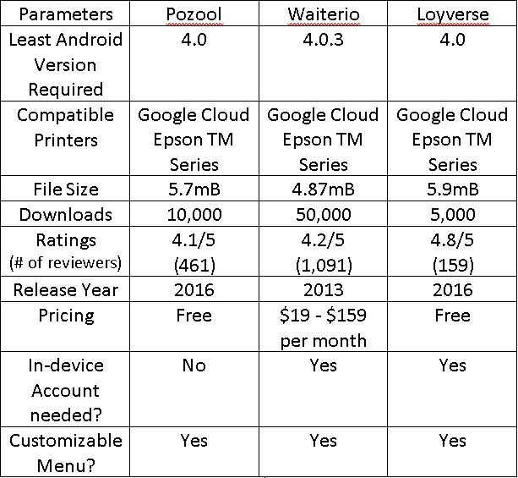
V. Results and Discussion
The researchers found three mobile Point of Sale (POS) systems that can help the cause of the client's restaurant, all of them having their own kind of unique features but one of them will be an effective tool to aid the problem the client is having with his restaurant.

Slide 16
VI. Conclusion and Recommendation
Based on initial research, it turned out that Pozool is the best among the three.
It has 4.1/5 rating on Google Play out of 459 users as of August 26, 2016.
It solves the problem by making the transactions electronic
Has a good billing feature, prints receipt with complete details (taxes, tips, discounts)
Can help owners in tracking the health of their business by monitoring sales record
All of its features at free price, and you will enjoy full privilege of Pozool, unlike the other two
Lastly, it doesn’t require an account unlike the other, so the identity of the user is safe.
Advantages aside, the restaurant needs to build a server to accompany messages of printing receipts from the POS devices, but it will be the same case with the other two as well.
Notes:
Of the three POS systems, the team thought that Pozool POS App is the best system they can offer for the client's restaurant. It has a good reputation from Android users, having 10,000 downloads and gained a rating of 4.1/5 out of 459 users. It has the features that the restaurant needs. One of the needs Pozool can provide is the mobility of giving the restaurant's workflow an online gist by having the order be taken electronically and be sent to the kitchen the same way. With its customizable settings, you can modify menus to the client's liking. It also offers an efficient billing module with its bill splitting feature, which makes a very informative receipt that can involve taxes and discounts, all according to how the client wants it. It also involves a feature that can help owners track their sales record

Slide 17
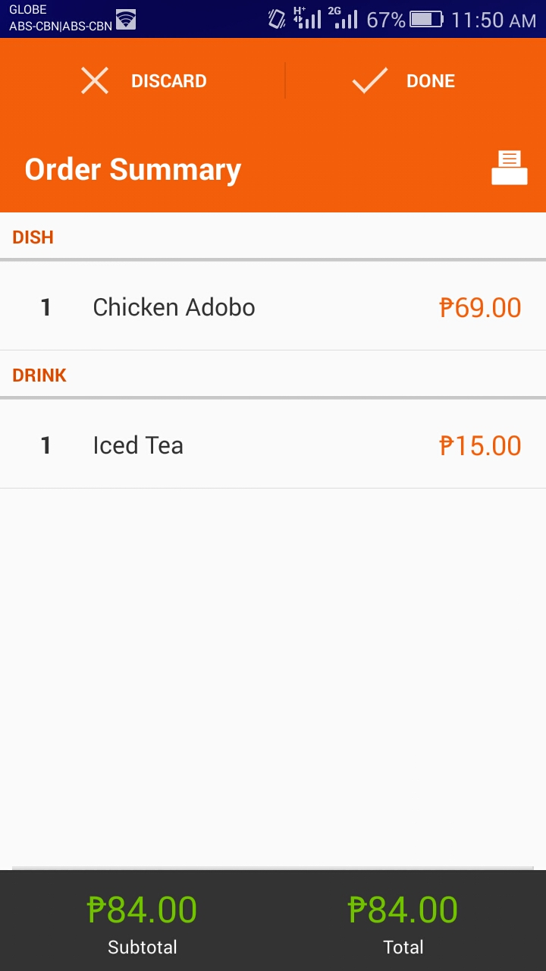
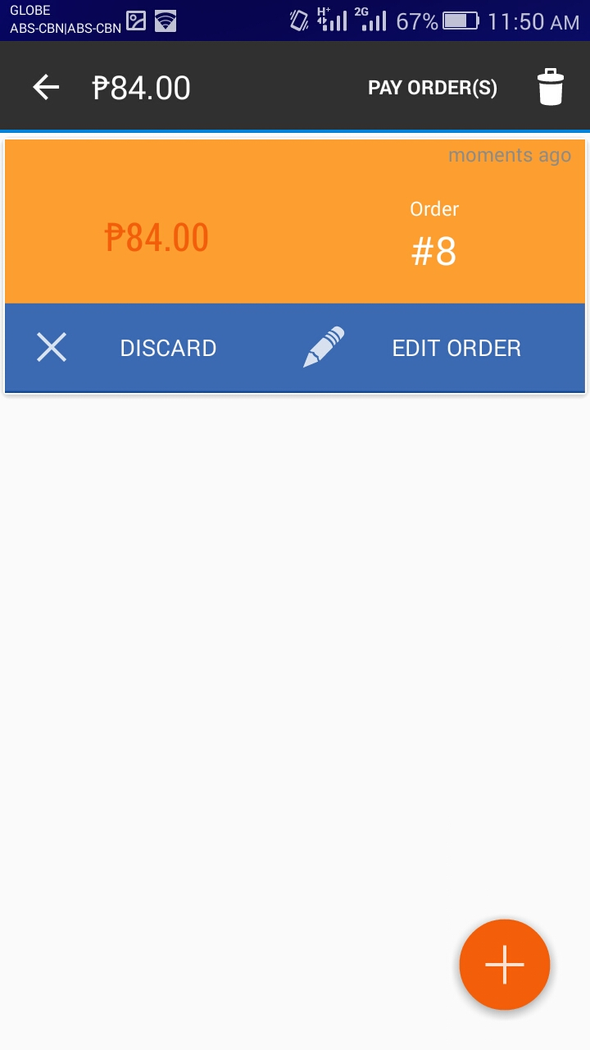
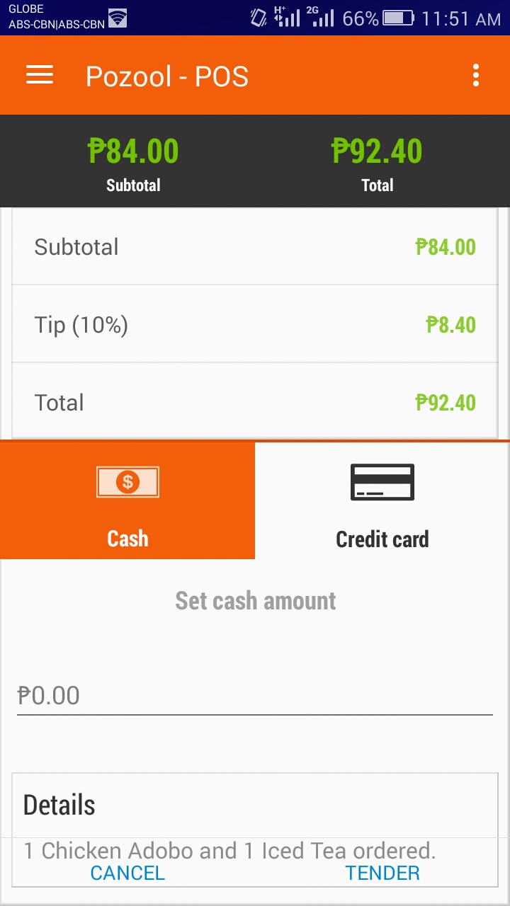

Slide 18
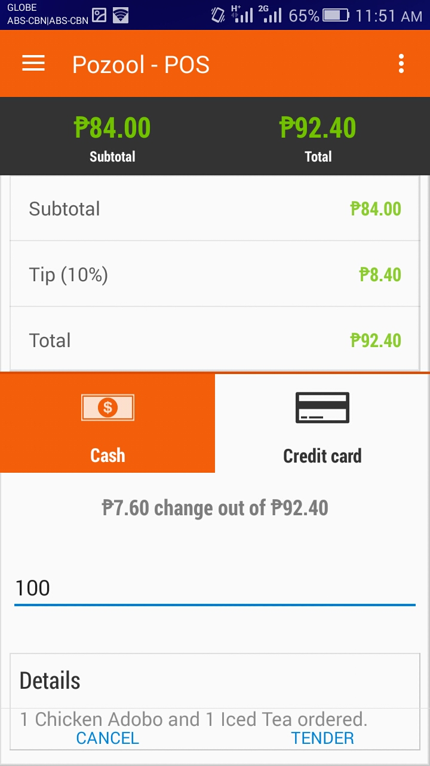
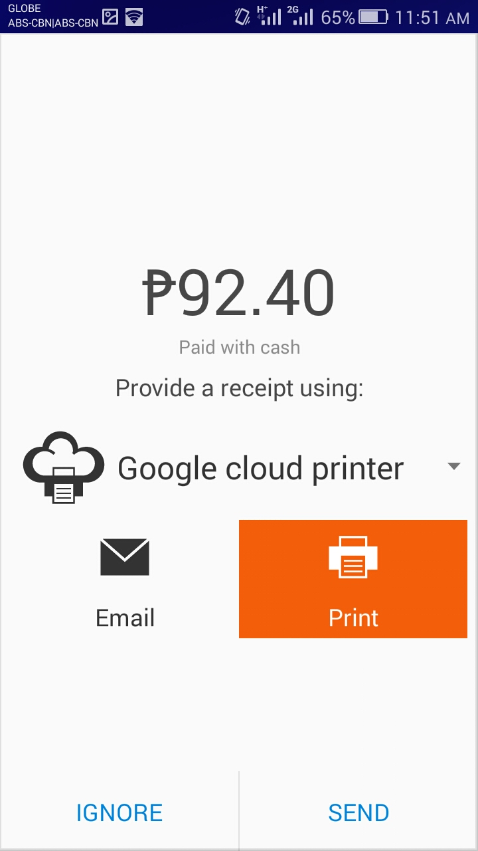
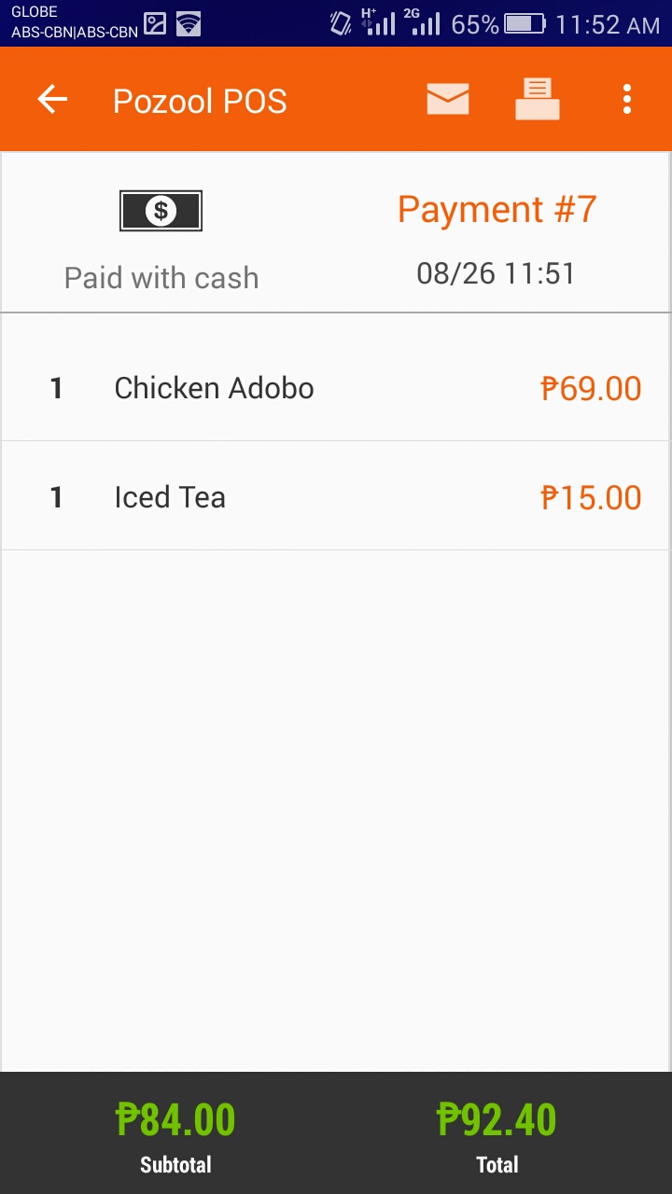

Slide 19
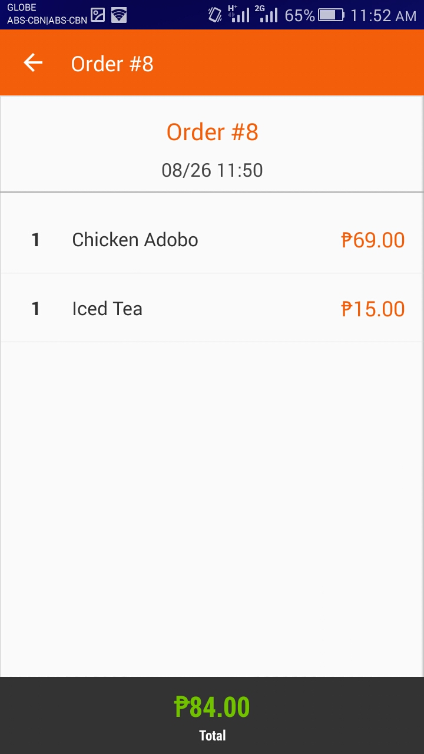
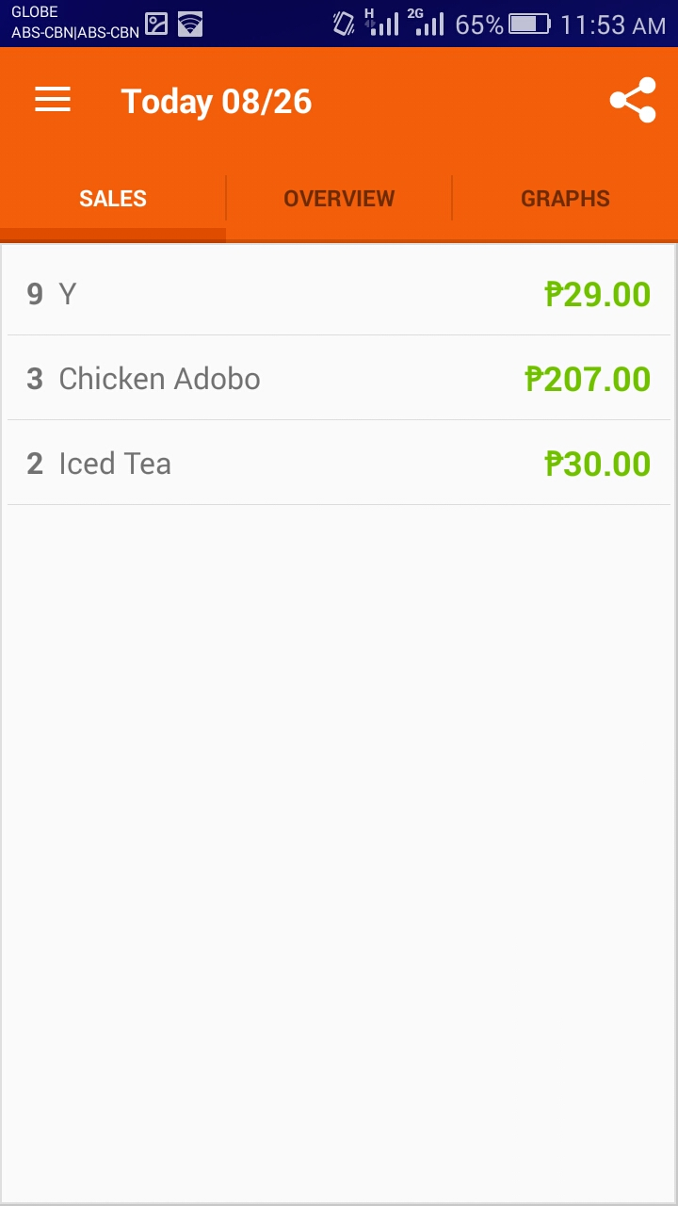

Slide 20
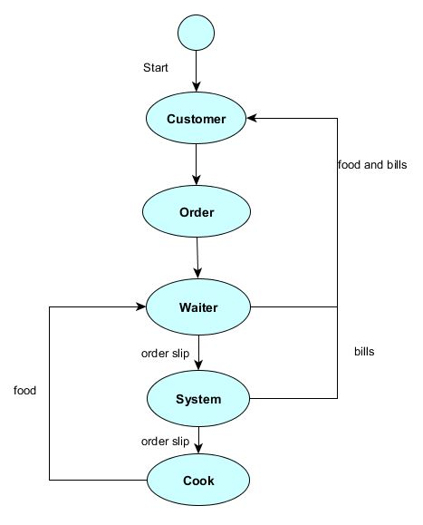
VII. Appendices
State Diagram

Slide 21
VII. Appendices
Activity Diagram

Slide 22
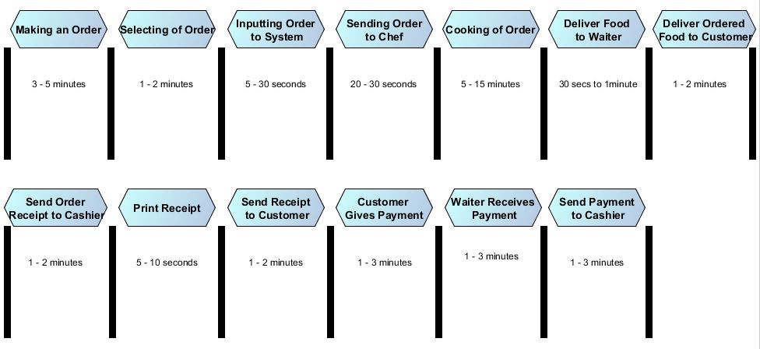
VII. Appendices
Timing Diagram

Slide 23
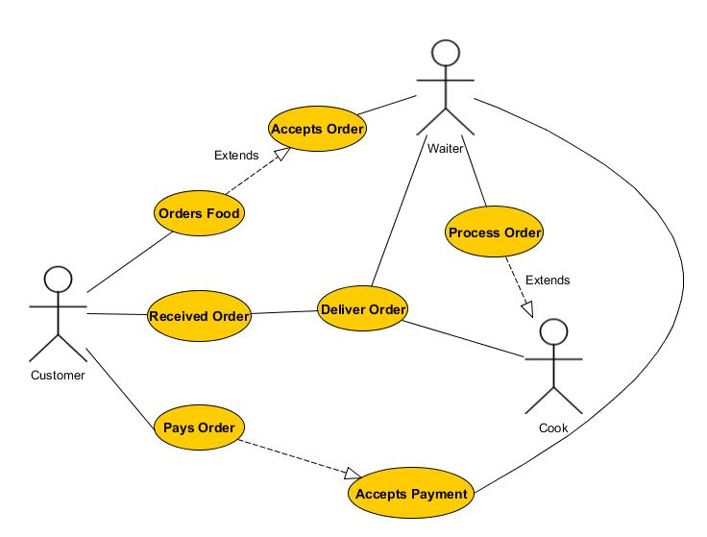
VII. Appendices
Use Case Diagram

Slide 24
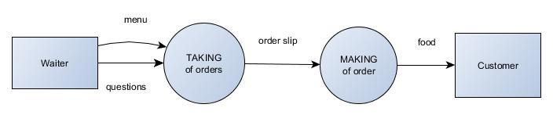
VII. Appendices
DFD

