Slide 1
Utilizing technology to improve Customer service
JESUS P. BRUGADA JR.
DENZEL F. ORIBIANA
VICTOR P. SERRANO

Slide 2
Background of the Problem
MP Megapro Plus Marketing Corporation
Approximately 12 rooms on 2 floors
8 waiters
1 cashier with POS
Structural limits causes delays despite average number of customers

Slide 3
Statement of the Problem
How to minimize delay time and meet the preferred service time of order taking from the client?

Slide 4
Objectives
● To decrease the waiting time of customers ● To speed up the transactions of customer service ● To identify the cause of delays in taking an order ● To lessen the time it takes for the cycle of order taking to complete

Slide 5
Significance
The project can be useful for restaurants that encounter delays from the moment the waiter records the order to the time where he/she will handle it to the cook, due to various reasons such as staff incompetence, structural limitations and unusual large number of customers. With the project aiming to lessen the time it takes for the cycle of order taking to complete, it will be beneficial for restaurants and alike.

Slide 6
Scope and limitations
MP Megapro KTV Bar and Restaurant
Will only focus on the cycle of order taking, food processing and billing
One year time frame

Slide 7
Related literature
1. Customer satisfaction in the restaurant industry: An examination of the transaction-specific model 2. Are highly satisfied restaurant customers really different? A quality perception
3. Singapore Mobile App ordering for restaurants, cafes, bars. http://bigspoon.sg/
4. Eatsa Restaurant https://www.eatsa.com/
5. OTG Netwark http://otgmanagement.com/
6. Breadcrumb https://breadcrumb.com/
7. McDonalds Create Your Taste https://mcdonalds.com.au/create-your-taste

Slide 8
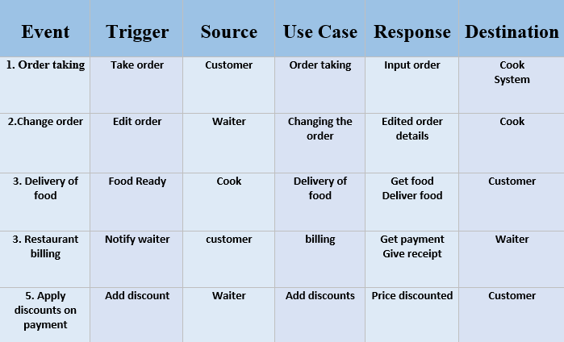
Event table

Slide 9
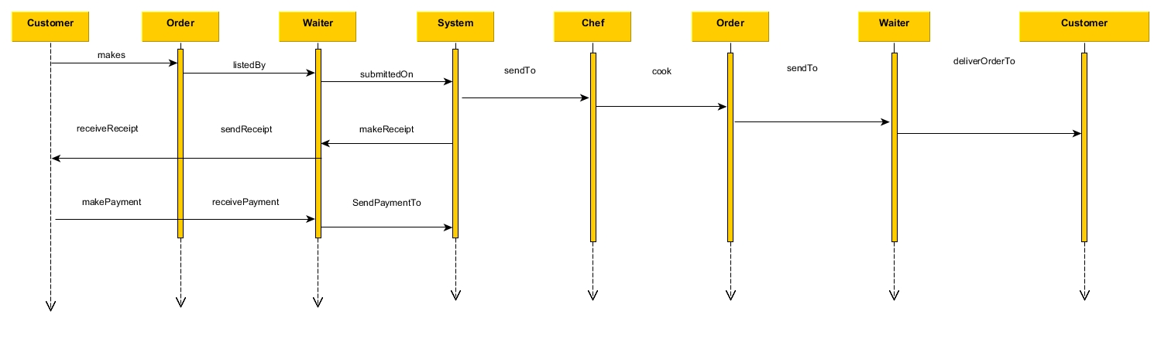
Sequence Diagram

Slide 10
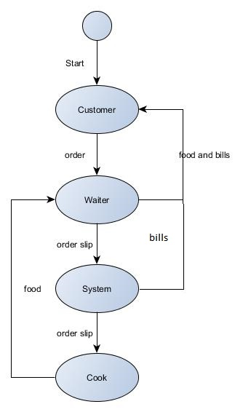
State Diagram

Slide 11
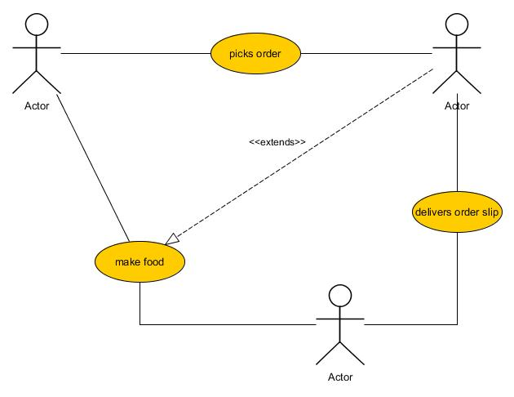
Use Case

Slide 12
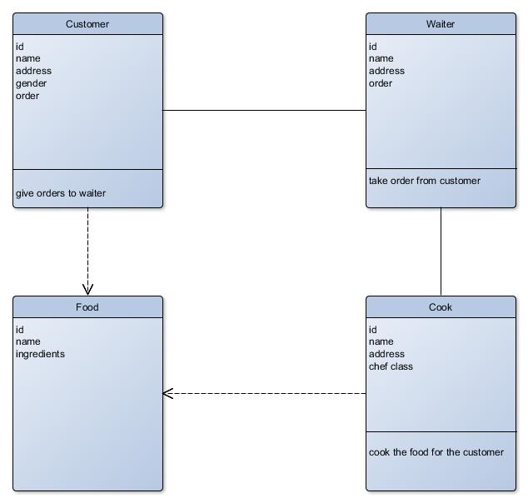
Class Diagram

Slide 13
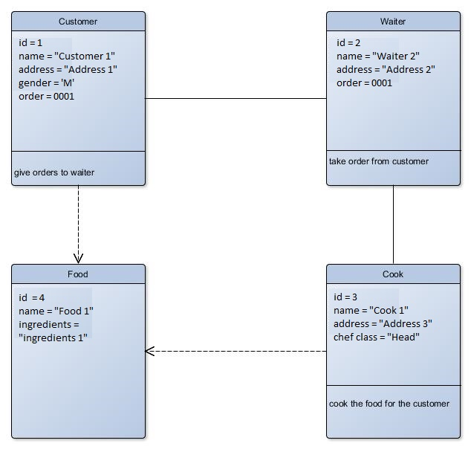
Object Diagram

Slide 14
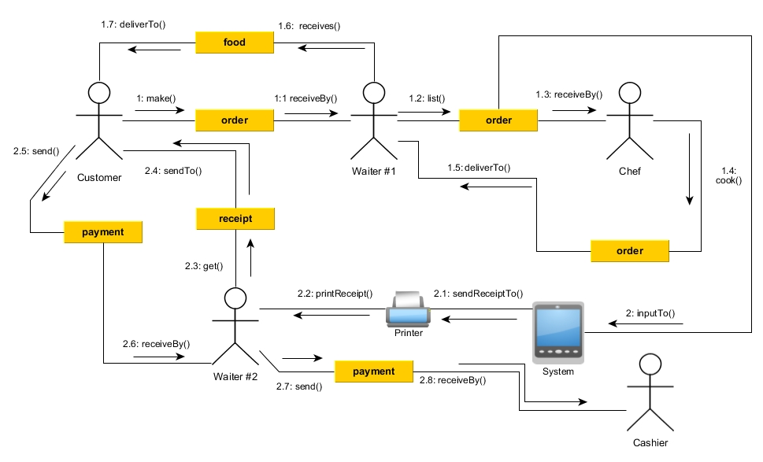
Communication Diagram

Slide 15
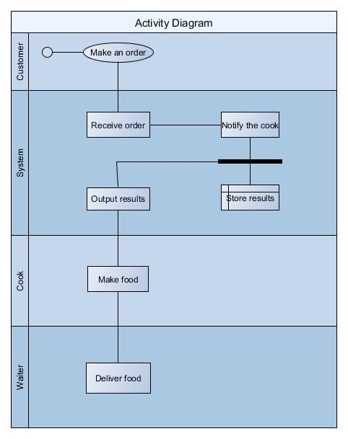
Activity Diagram

Slide 16
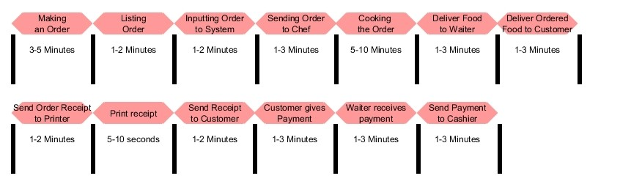
Timing Diagram

Slide 17
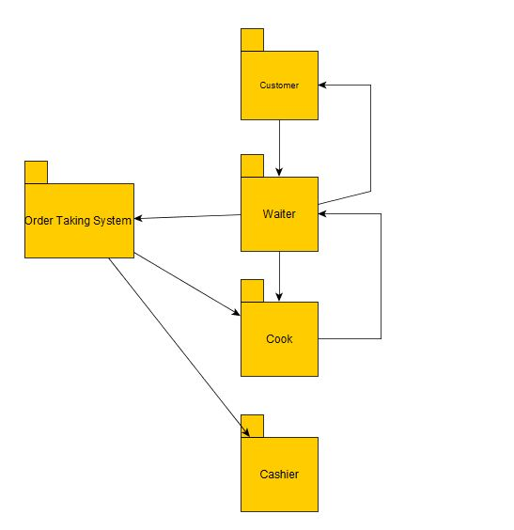
Package Diagram

Slide 18
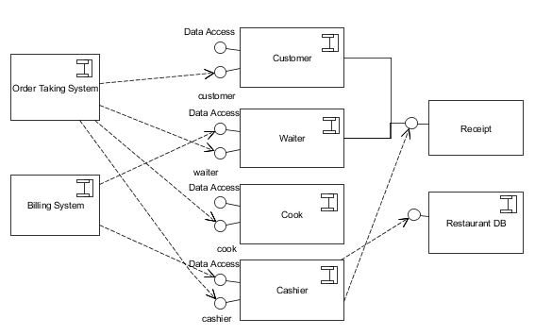
Component Diagram

Slide 19
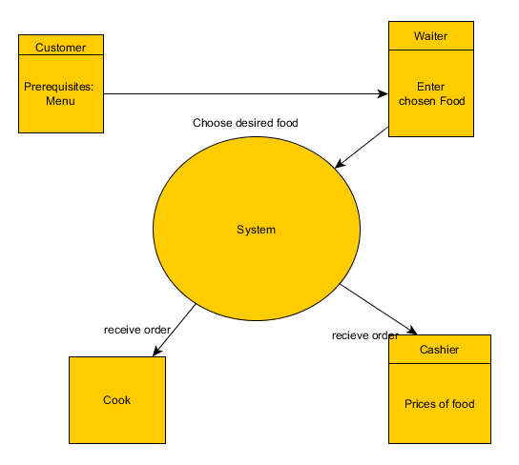
Composite Diagram

