Slide 1
Lightweight Easily-deployable Inexpensive Nodes for Temporary Wireless Mesh Networks
Members:
Rivera, Benjamin
Tonoike, Tomio
Tison, Alfonsin
Ellana, Allen
Project Adviser:
Mr. Paolo Oblepias
Project Professor:
Mr. Manuel Sebastian

Slide 2
I. Introduction
Project Context
Mobile phones as main tool for communication
Phones rely on telecommunication networks to send and receive messages
Ad-hoc networks do not rely on telco networks
Bluetooth and Wi-Fi can be used to connect devices in an Ad-hoc
Bluetooth and Wi-Fi range is limited
Use Raspberry Pis to extend range and effectiveness

Slide 3
I. Introduction
Objective:
General Objective
This study aims to find a cost efficient and easily deployable method to improve the communication among users of Wi-Fi capable mobile devices who are situated in a place where there is no currently available network infrastructure to connect to.

Slide 4
I. Introduction
Objective:
Specific Objectives:
To connect multiple microcomputers as intermediary nodes of a mesh network;
To enable data transfer between microcomputers;
To connect mobile devices as end nodes of the network;
To relay a message to and from endpoints of the network(mobile devices);
To enable the network nodes to automatically detect and connect to nearby nodes;
To know and use the fastest path between nodes to maintain efficient reliable data transfer.(self healing)
To create a solution that will be inexpensive and cost effective.

Slide 5
I. Introduction
Significance
Applications such as:
helping emergency response teams' coordination with the local population
helping workers in remote mining operations
helping users that want to deploy own personal network
The project will be easily implemented and will not require any additional instructions for the user

Slide 6
I. Introduction
Significance
In events of a network failure or a power outage after a natural calamity for example, real-time connections are preserved by creating a reliable network infrastructure that can be easily established and removed as needed.

Slide 7
I. Introduction
Scope & Limitations
Develop nodes that can be used to establish a network using mesh topology for areas without available network service
Raise the nodes in the air with the use of balloons which is anchored to the ground using heavy boxes for increased effectiveness

Slide 8
I. Introduction
Scope & Limitations
Specify how the nodes should be used and positioned based on different scenarios
Only scenarios that are likely to happen in the Philippines will be considered
Measure the specifications of the node created
Compare the node with other existing technology
Validate the study by applying it to simulated real world scenarios

Slide 9

I. Introduction
Planned Design

Slide 10
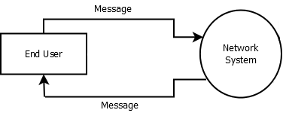
I. Introduction
Context Diagram

Slide 11
II. Related Literature
Topics
Microcontrollers
Microcomputers
Wi-Fi Peer to Peer Networking
Mesh Network
Routing protocols

Slide 12
II. Related Literature
Microcontrollers (Arduino)
PROS
Cheap
Lightweight / easily replaceable
Easily available
Wide range of modules can be added

Slide 13
II. Related Literature
Microcontrollers (Arduino)
CONS
Very low memory
Operating system
Inefficient data transfer

Slide 14
II. Related Literature
Microcomputer (Raspberry Pi)
PROS
Lightweight / easily replaceable
Has built in 802.11 and Bluetooth modules(Rasberry Pi 3)
Wide range of modules can be added
Has high memory

Slide 15
II. Related Literature
Microcomputer (Raspberry Pi)
CONS
More expensive than microcontroller
No official distributor in the Philippines

Slide 16
II. Related Literature
Wi-Fi Peer to Peer and Ad-hoc network
Fire Chat
-peer to peer chat app
-uses Bluetooth and Wi-Fi to send messages
-no platform dependent
Greenstone
-being developed by the same company behind Fire Chat
-extends Fire Chat range
-save messages of nearby people
-very limited range

Slide 17
II. Related Literature
Wi-Fi Peer to Peer and Ad-hoc network
Byzantium
-connects multiple devices using 802.11 wireless interface
-can be run on Raspberry Pi

Slide 18
II. Related Literature
Wi-Fi Peer to Peer and Ad-hoc network
Serval Mesh
-currently in development project
-created their own mesh network by placing devices at strategic places
-users can send messages, call, and send files to people within their network
-limited location

Slide 19
III. Theoretical Background
OSI Model
- the research revolves around the implementation of Layers 1 and 2
- Layer 1(Physical layer)
- Layer 2(Data Link layer)
- developed node can be connected to any existing device that use Layers 3 and above.

Slide 20

III. Theoretical Background
MANET Routing Protocols
Dynamic Source Routing (DSR)
- fast in small networks
- too much overhead in big networks

Slide 21
III. Theoretical Background
MANET Routing Protocols
Destination Sequenced Distance Vector(DSDV)
- proactive
- each node has a routing table that is updated regularly
- high delivery rate
- low mobility
Dest | Seq | Hop

Slide 22
III. Theoretical Background
MANET Routing Protocols
Ad-hoc On-demand Distance Vector (AODV)
- each node has a routing table
- sends requests first
- reactive
- based on DSDV
- scalable to large networks
Seq | Dest | Next | hop

Slide 23
DIAGRAMS

Slide 24
EVENT TABLE
EVENT | TRIGGER | SOURCE | USE CASE | RESPONSE | DESTINATION
Broadcast message | Node broadcasts a message | Smart phone or dedicated node | Broadcast | Message is broadcasted | Nearby nodes
Receive repeated message | Node discards redundant message | Nearby nodes | Discard | Message is discarded | Smart phone or dedicated node
Receive message | Node receives a message | Nearby node | Receive | Message is received | Smart phone or dedicated node

Slide 25
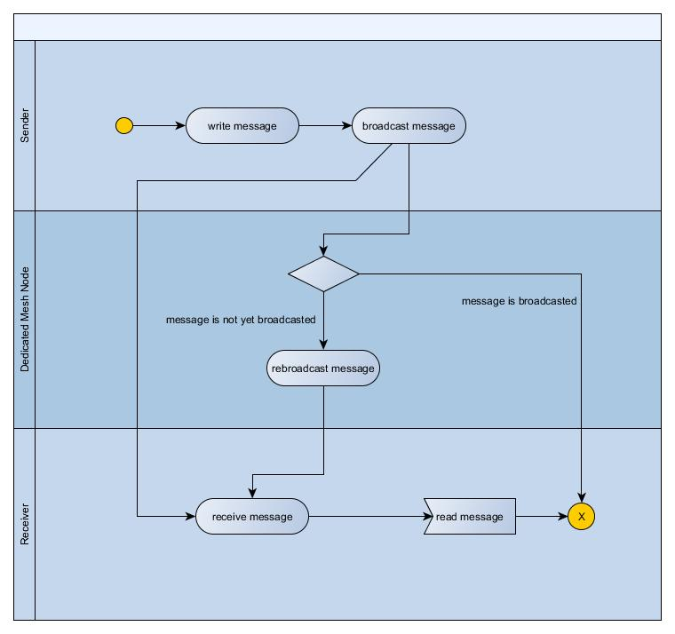
Activity Diagram

Slide 26
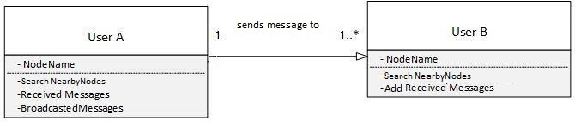
Class Diagram

Slide 27
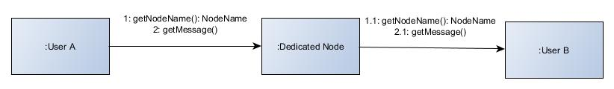
Communication Diagram

Slide 28
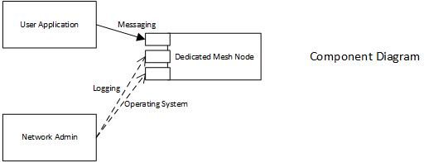
Component Diagram

Slide 29
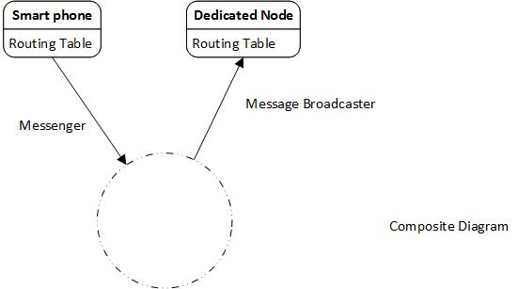
Composite Diagram

Slide 30
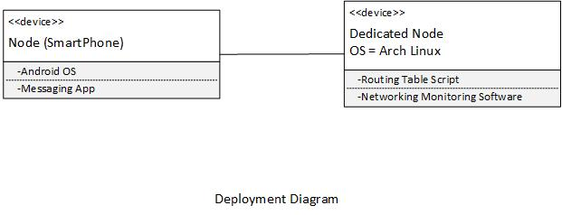
Deployment Diagram

Slide 31
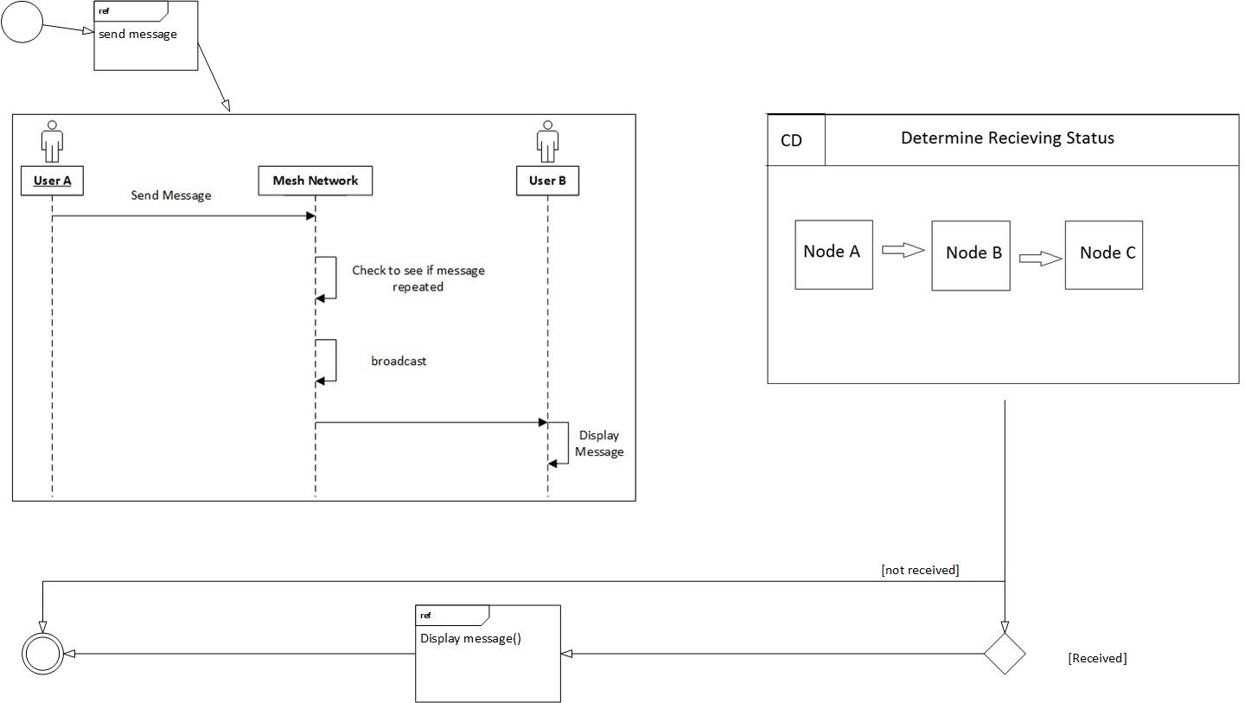
Interaction Overview Diagram

Slide 32
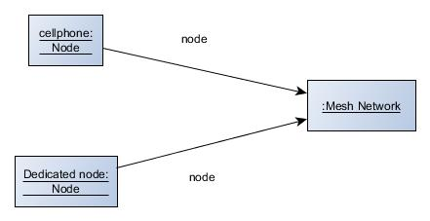
Object Diagram

Slide 33
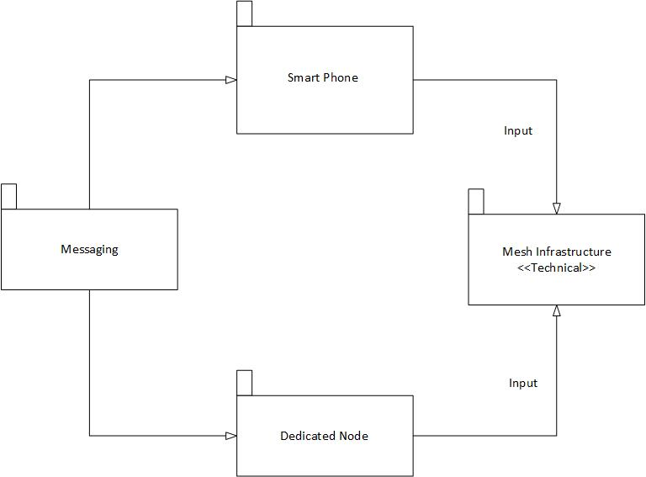
Package Diagram

Slide 34
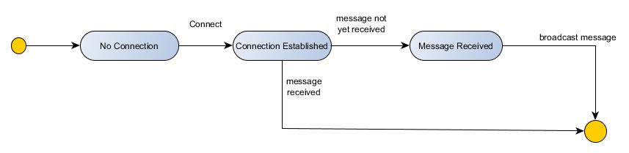
State Diagram

Slide 35
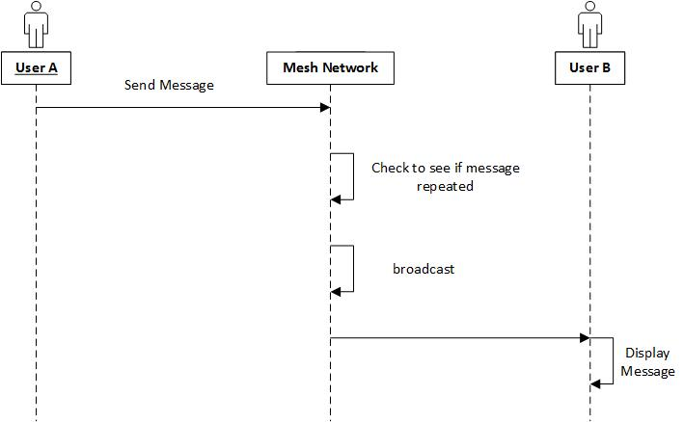
Sequence Diagram

Slide 36
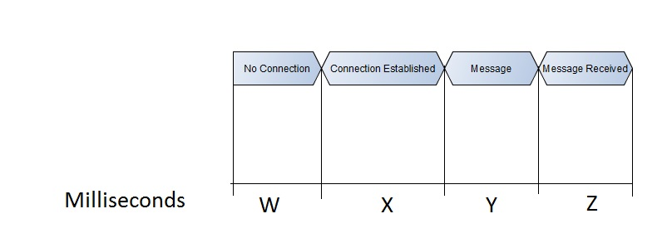
Timing Diagram

Slide 37
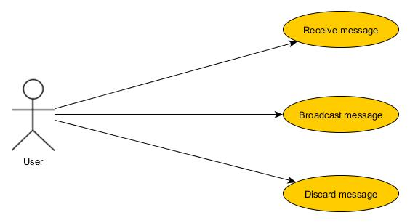
Use Case Diagram

Slide 38
References
http://www.digitaltrends.com/computing/arduino-vs-raspberry-pi/ https://learn.sparkfun.com/tutorials/what-is-an-arduino https://www.raspberrypi.org/help/faqs/#introWhatIs http://www.wi-fi.org/discover-wi-fi/wi-fi-direct http://stackoverflow.com/questions/29018122/android-pure-p2p-chat-application http://info.hummingbirdnetworks.com/blog/wireless-mesh-networking-recommended-maximum-distances http://archive.oreilly.com/pub/a/wireless/2004/01/22/wirelessmesh.html http://www.idosi.org/wasj/wasj29(3)14/14.pdf http://robot-kingdom.com/best-flight-controller-for-quadcopter-and-multicopter/ http://quadcoptergarage.com/quadcopter-parts-list-what-you-need-to-build-a-diy-quadcopter/ http://diydrones.com/profiles/blogs/basic-sonar-based-collision-avoidance-for-a-quadcopter http://www.gizmag.com/solarcopter-solar-helicopter/26645/ http://sts.bwk.tue.nl/7y500/readers/InstellingenRegelaars.pdf https://www.techopedia.com/definition/575/at-command-set http://makezine.com/2015/04/01/esp8266-5-microcontroller-wi-fi-now-arduino-compatible/ https://gsmaintelligence.com/research/?file=141201-philippines.pdf&download http://www.mgb.gov.ph/images/stories/RA_7942.pdf http://pluto.ksi.edu/~cyh/cis370/ebook/ch05b.htm

