Slide 1

Hello!
SISCODE
Aira Joyce Carpio
Danya Balcena Florence Gail Haboc

Slide 2

LSC Enrollment System

Slide 3

ABOUT LSC
It started early 1980’s
Started by group of faculty members from the University of the Philippines and the Ateneo de Manila University
In 1986, a tutorial and review was established in Katipunan Avenue.
Solomon’s Ark Computer & Tutorial Services Center then became Loyola Student Center

Slide 4

PROBLEM
PAPER BASED SYSTEM
Lack of storage space
Prone to damage
Supply costs
Limited collaboration
Editing problems

Slide 5

OBJECTIVES
GENERAL OBJECTIVES
To create a web and mobile enrollment system for Loyola Student Center
To ease the problem in managing records on enrolling old and new students

Slide 6
OBJECTIVES
SPECIFIC OBJECTIVES
To provide the client with a web and mobile application and a database system
To make it easier for the students of Loyola Student center to enroll and avail services LSC offers
To have a fast and accurate access to the records
To easily manage records
To prevent records on getting damaged by natural calamities
To avoid mishandling and redundancy of records

Slide 7

TARGET AUDIENCE
•Loyola Student Center Management
•Students of Loyola Student Center

Slide 8
EVENT TABLE
EVENT | TRIGGER | SOURCE | USE CASE | RESPONSE | DESTINATION
1. Student checks availability of services offered | Service Inquiry | Student | Inquire services | Services offered details | Student
2. Student places a reservation | Slot reservation | Student | Create reservation for a review class | Reserved slot | Generic employee Student
3. Student enrolls a session | Avail of services | Student | Enroll a review class | Schedule | Generic employee Student Instructor

Slide 9
EVENT TABLE
EVENT | TRIGGER | SOURCE | USE CASE | RESPONSE | DESTINATION
4. Student pays for services | Payment | Student | Pay services | Receipt | Accounting Student Generic Employee
5. Instructor views class list | Receives class list | Generic employee | View class list | Class list details | Instructor
6. Student reschedule a class | Reschedule of review class | Student | Reschedule a review class | Rescheduled class | Generic employee Instructor Student

Slide 10
EVENT TABLE
EVENT | TRIGGER | SOURCE | USE CASE | RESPONSE | DESTINATION
7. Student cancels the transaction | Cancellation of transaction | Student | Cancel Transaction | Cancelled Transactions | Generic employee Student
8. Produce daily transaction | Daily transaction record | Generic employee | Produce daily transaction record | Summary of daily transaction record | Generic employee
9. Summary of monthly transaction | Generate monthly transaction report | Generic employee | Produce monthly transaction summary report | Summary of monthly transaction report | Accounting

Slide 11





USE CASE DIAGRAM
Reserves slot
Pays Services
View class list
Inquires Services
STUDENT
INSTRUCTOR
Cancels Enrollment
Reschedule review class
Enrolls Students
Receives Payments and Monthly Transaction Summary Reports
Produces Daily Transaction Summary Records
GENERIC EMPLOYEE
ACCOUNTING

Slide 12
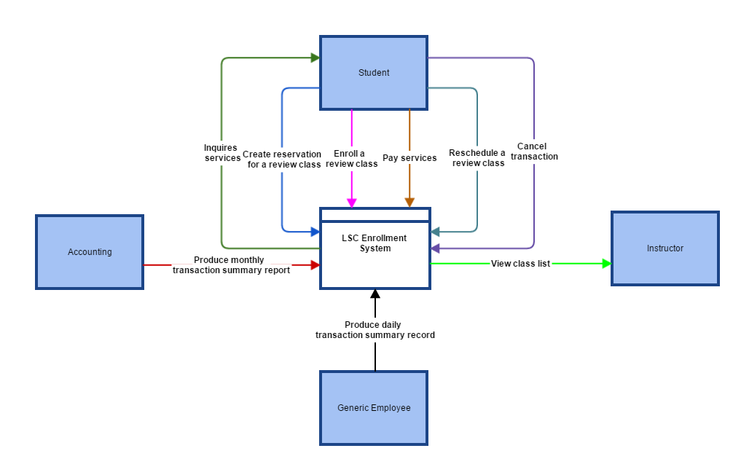
CONTEXT FLOW DIAGRAM

Slide 13
Data Flow Diagram
Level 0

Slide 14
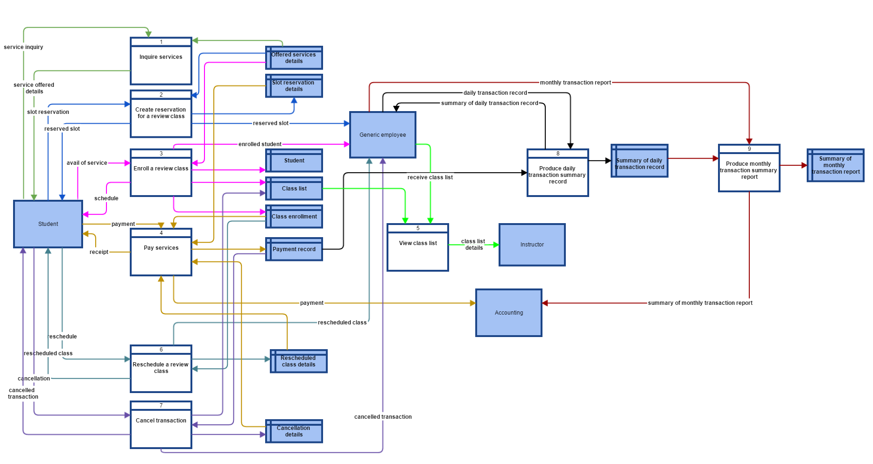
DATA FLOW DIAGRAM

Slide 15
Data Flow Diagram
Level 1

Slide 16
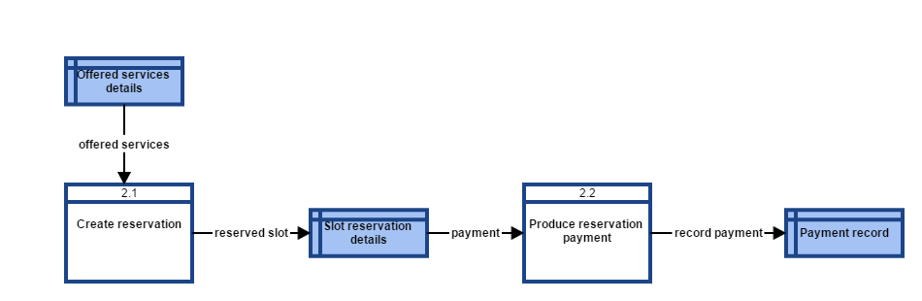

Slide 17
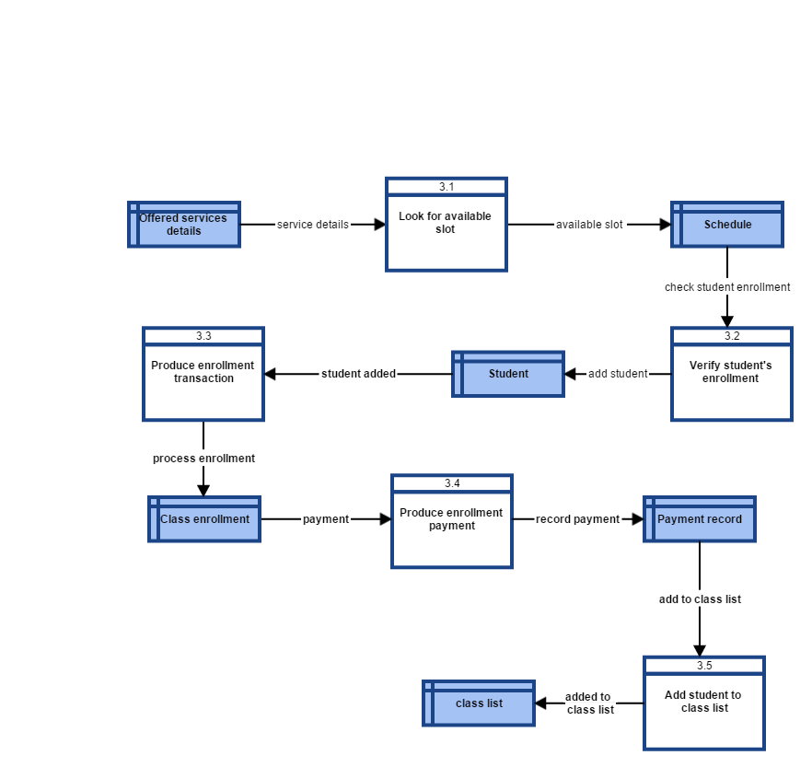

Slide 18
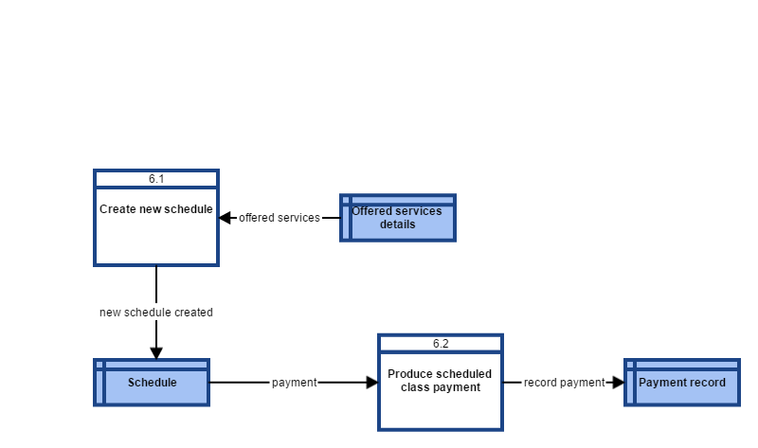

Slide 19
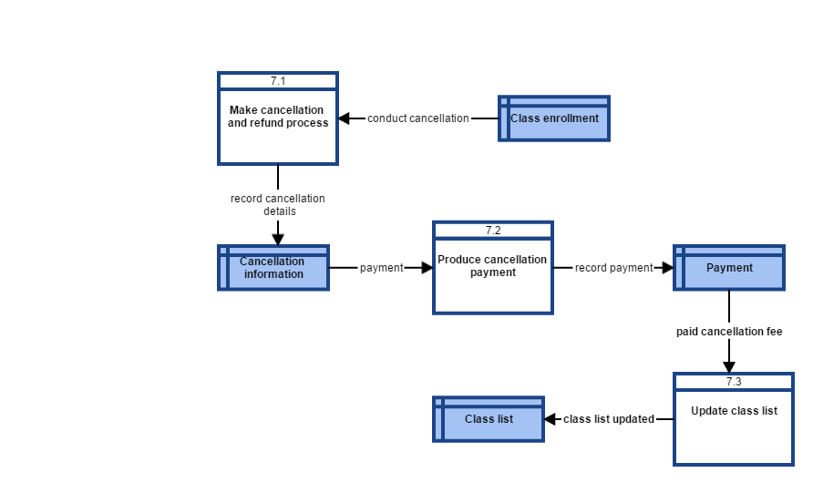

Slide 20
Entity Relationship Diagram

Slide 21

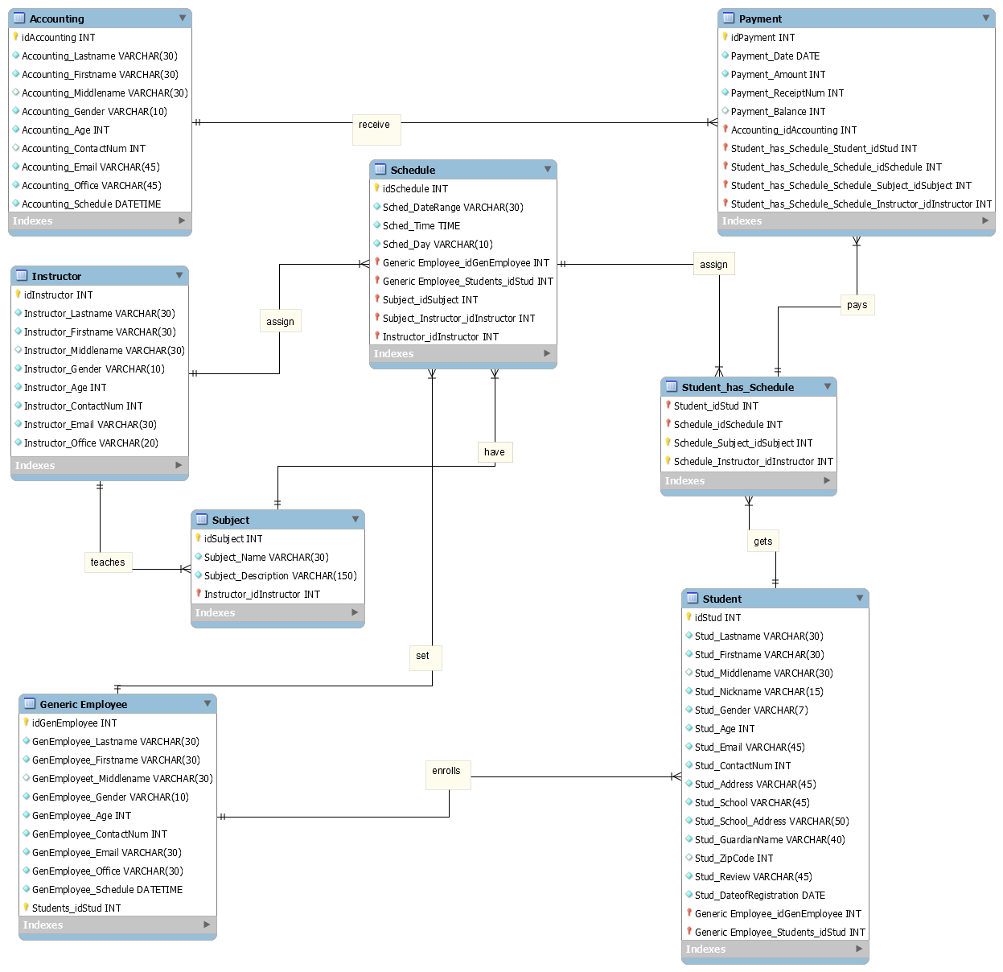
ENTITY RELATIONSHIP DIAGRAM

Slide 22
Data Dictionary

Slide 23
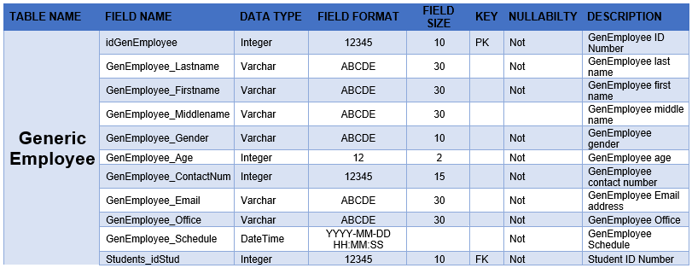
Generic Employee

Slide 24
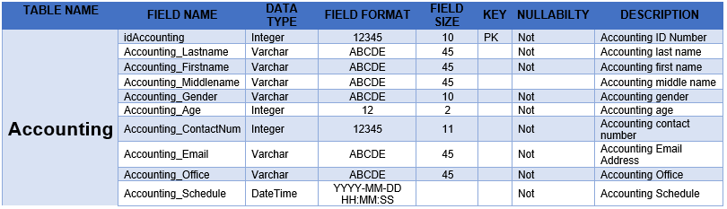
Accounting

Slide 25
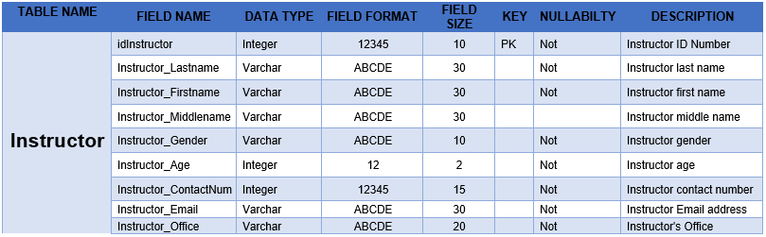
Instructor

Slide 26
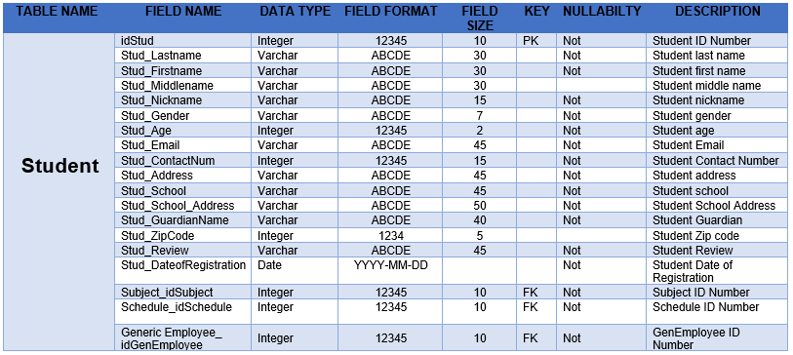
Student

Slide 27

Subject

Slide 28
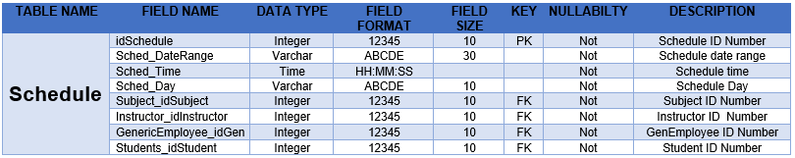
Schedule

Slide 29
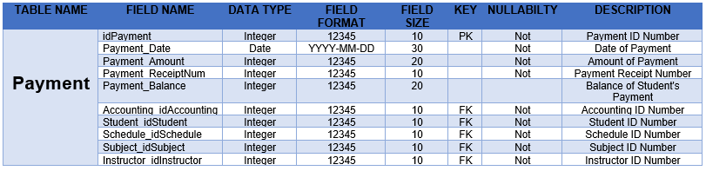
Payment

Slide 30
Activity Diagram

Slide 31
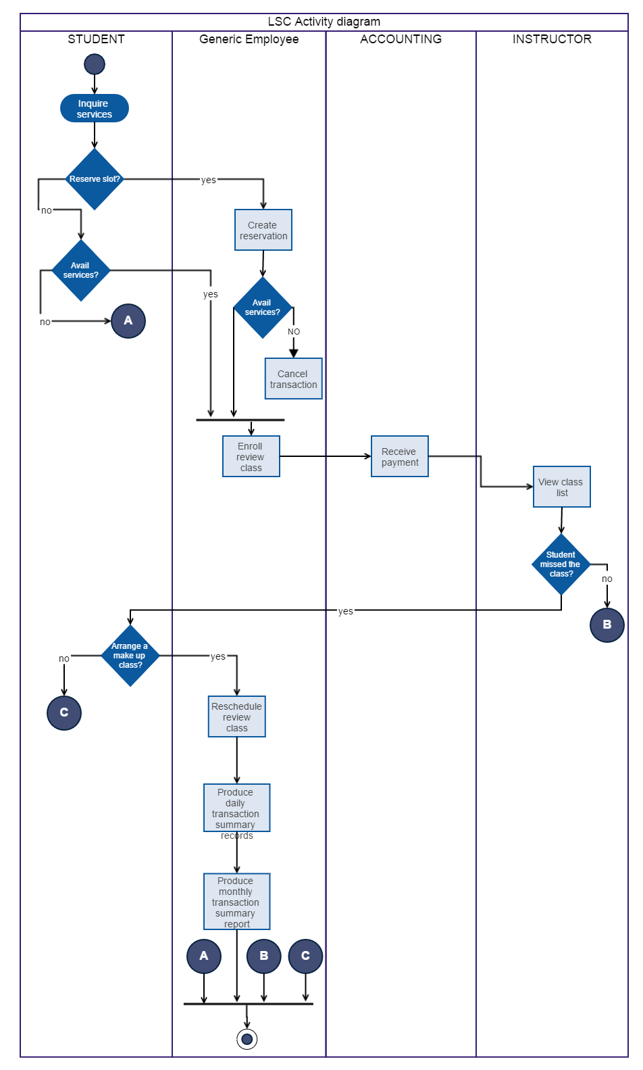
ACTIVITY DIAGRAM

Slide 32
Gantt Chart/Activity List/WBS

Slide 33
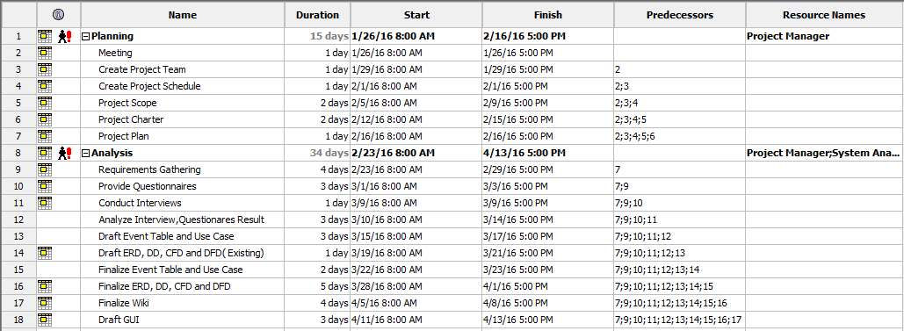
Gantt Chart

Slide 34
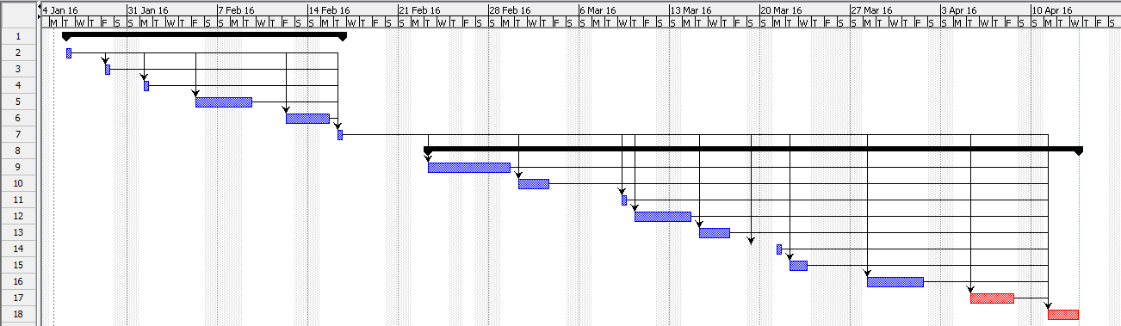
Gantt Chart

Slide 35
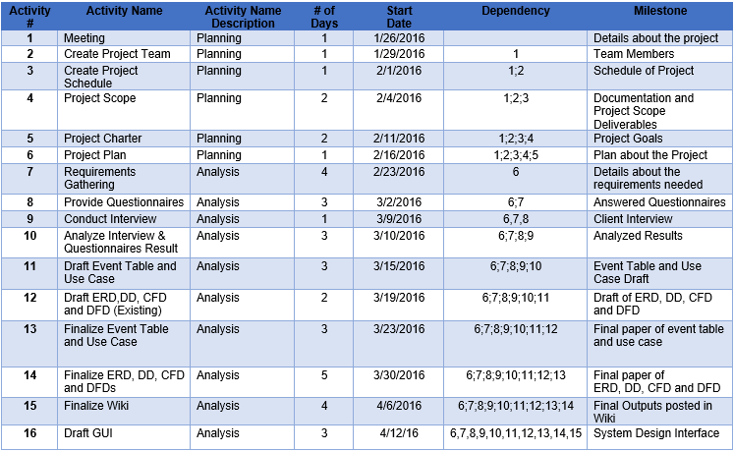
Activity List

Slide 36
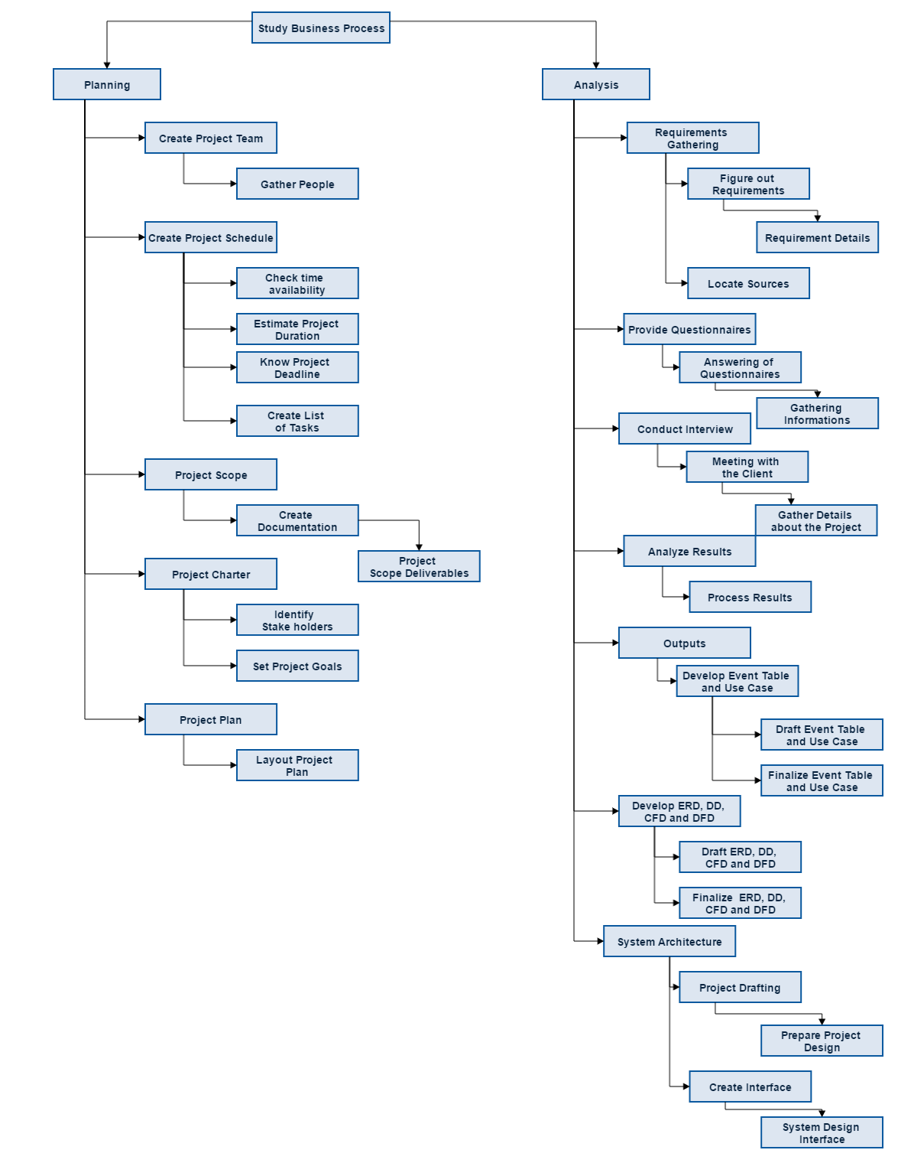
WBS

Slide 37
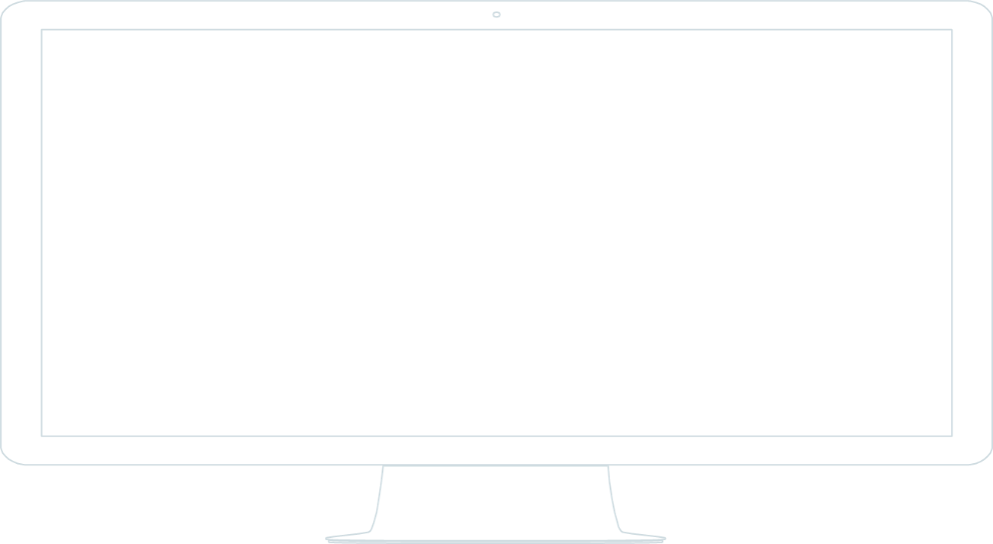
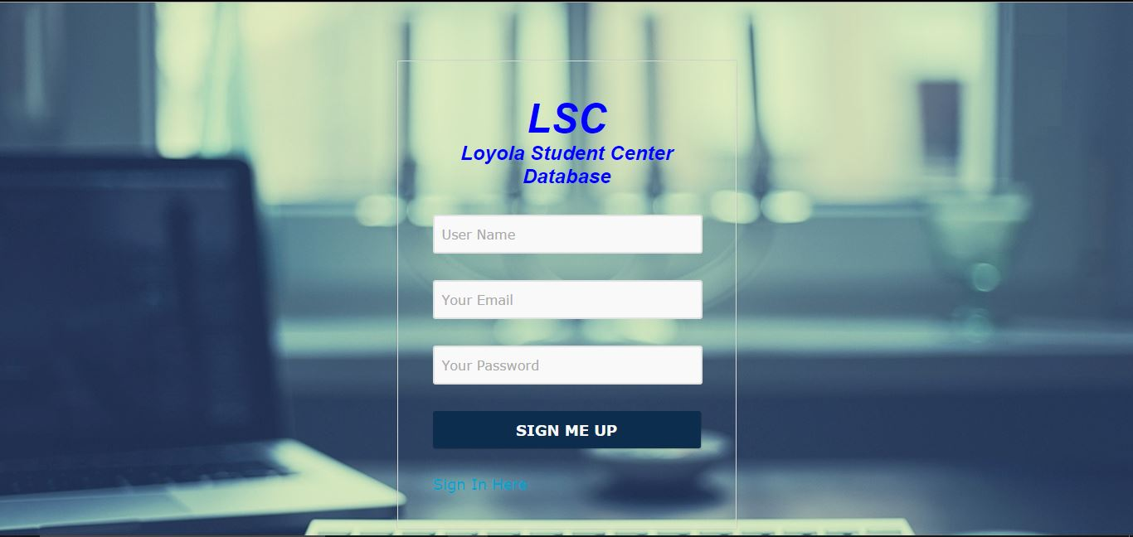
Screenshots of Proposed System

Slide 38
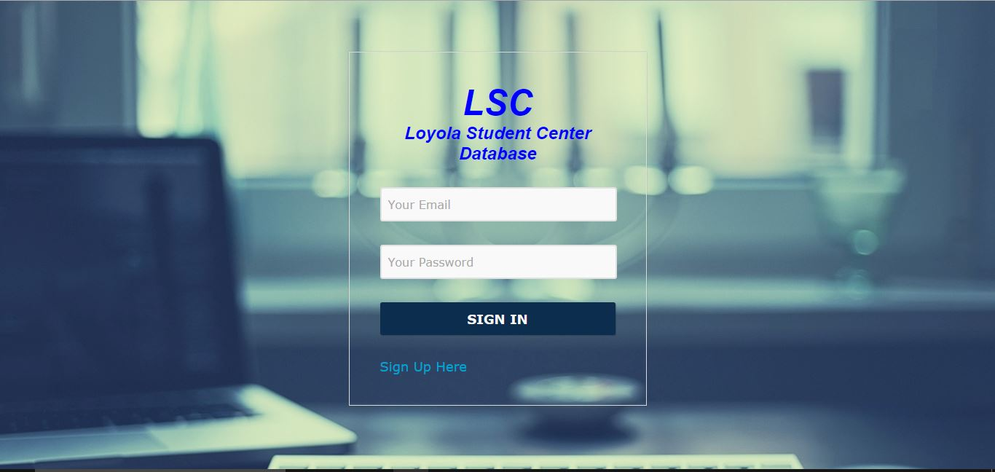
Screenshots of Proposed System

Slide 39
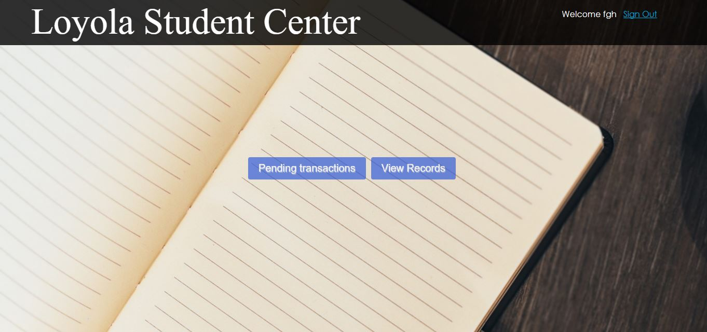
Screenshots of Proposed System

Slide 40

Screenshots of Proposed System

Slide 41
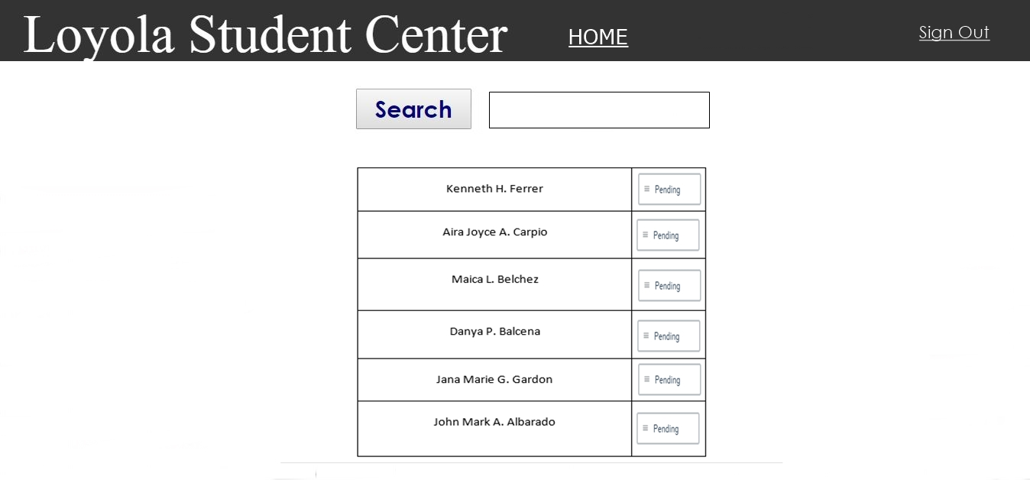
Screenshots of Proposed System

Slide 42
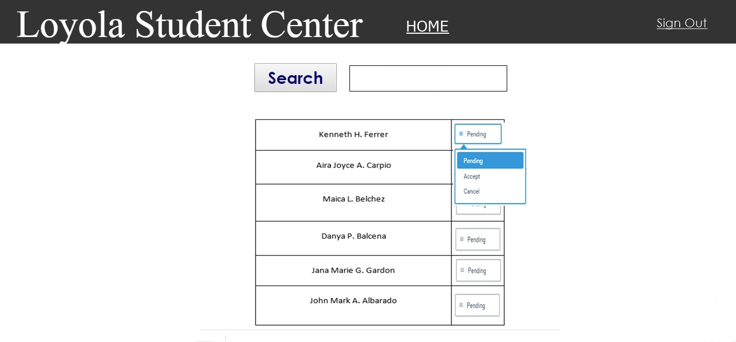
Screenshots of Proposed System

Slide 43
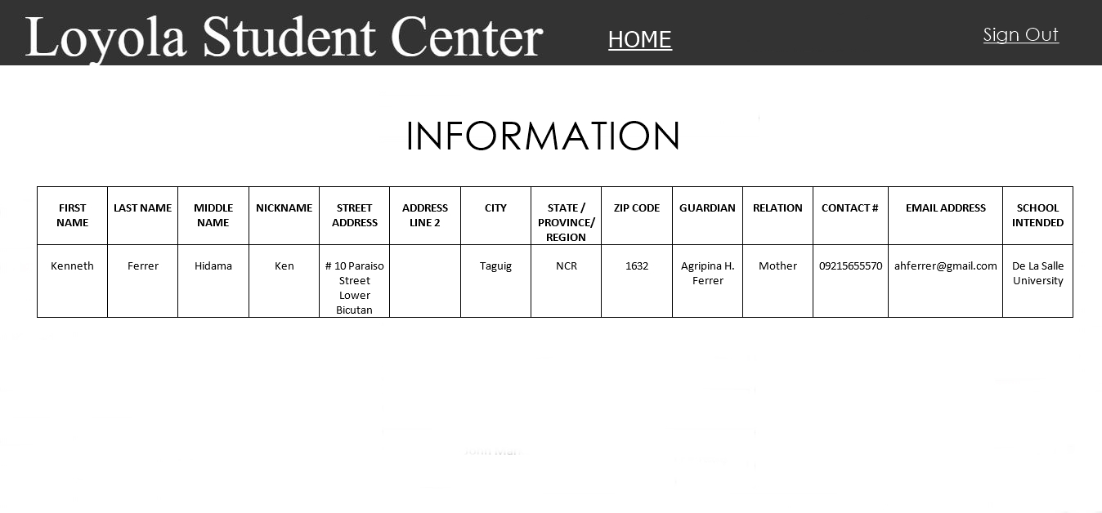
Screenshots of Proposed System

Slide 44
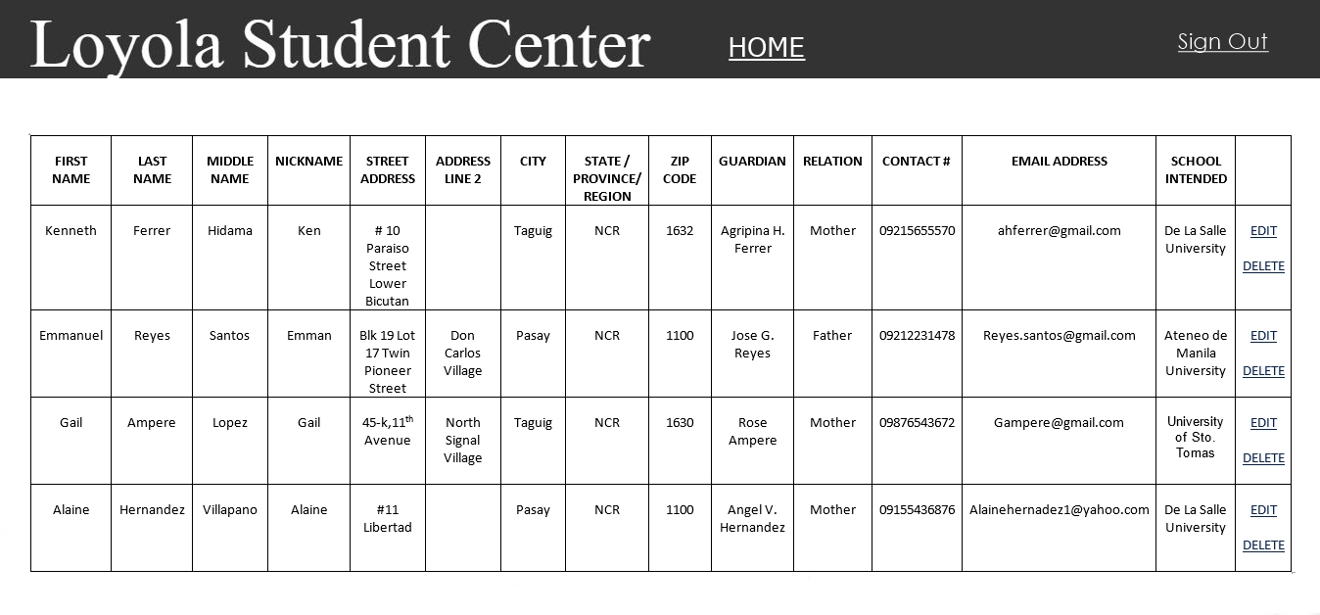
Screenshots of Proposed System

Slide 45
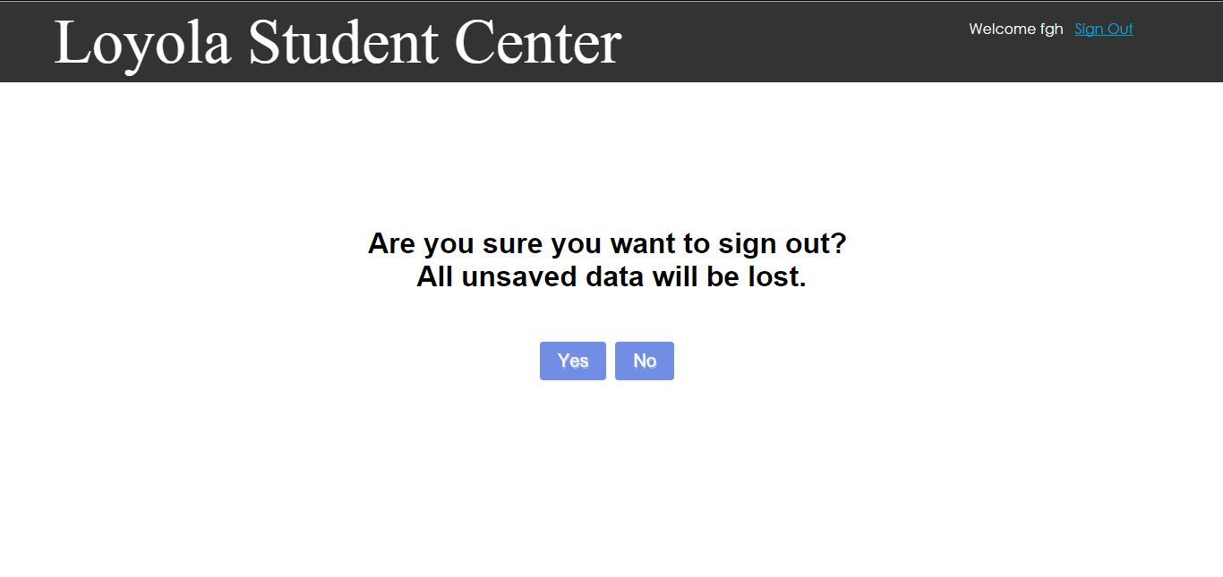
Screenshots of Proposed System

Slide 46
Thanks!

