Slide 1
Protection Identification of Corrupted data security
Project Team: Kent Michael Miculob Maria Letty Laureta Reginald John Steven Alberca

Slide 2
Project Context
Data corruption has always been a problem in computing. With the imminent implementation of internet of things, solutions on data corruption must be address to avoid future complications regarding data loss.

Slide 3
Purpose and Description
technology advances rapidly, this also means that security issues such as data corruption are evolving as well and we need to address this issue since huge consequences are at risk. We may not be able to prevent data corruption but we might able to minimize or neglect the impact by being prepared for it.

Slide 4
Objective
General Objectives:
This Project aims to create a security algorithm that could save critical information from data loss.
Specific Objectives:
To be able to provide an algorithm that could save someone’s information.
To be able to give confidentiality control on the user’s information.
To be able to create a low-learning curve security algorithm that are applicable to most people.

Slide 5
Scope and Limitations
This Project aims to help students and/or office-workers to secure their information or data on availability issues, whom are using windows based OS- 7 and higher. The project primarily focuses on data corruption and prevention. It also assumes that the interaction are just between the players of the system such as the admin, system, and user interactions and no other irrelevant factors are included.

Slide 6
Related Literature
Causes of Data Corruption
Checksum
File System
RAID Technology
Assembly Language
An Analysis of Data Corruption in the Storage Stack

Slide 7
Technical Background

Slide 8
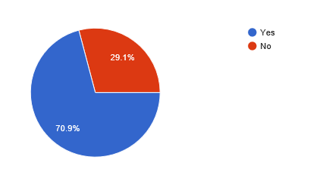
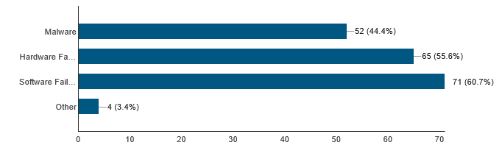
Survey Result.
Percentage of people Experienced data corruption.
Frequency of the causes.

Slide 9
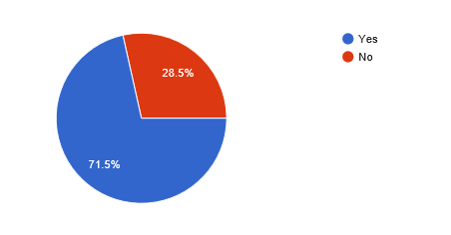
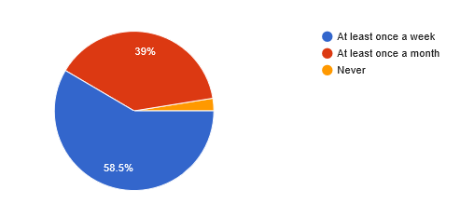
Percentage of population of who does back up.
How often they do back up

