Slide 1
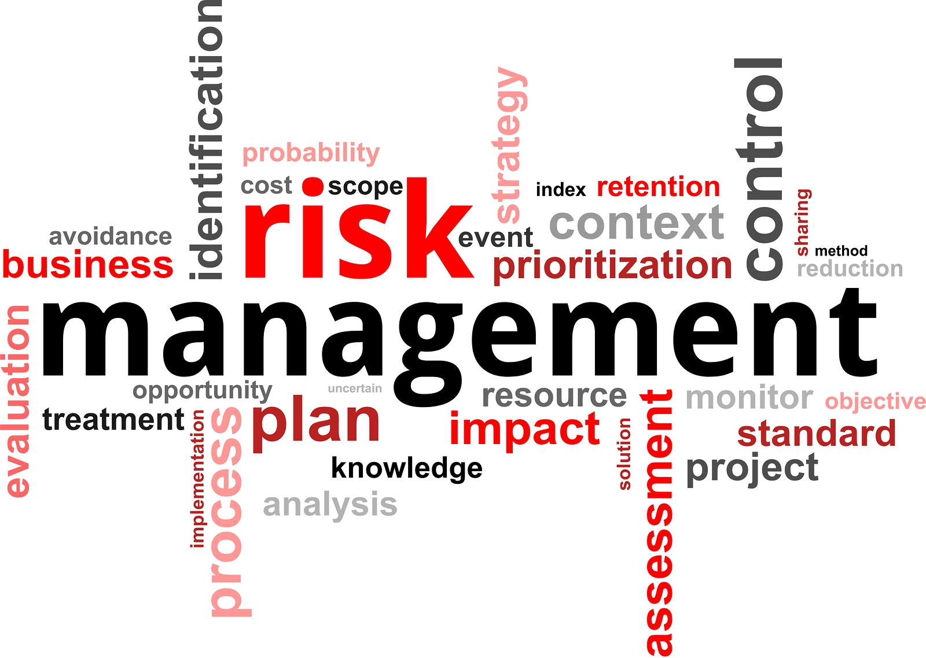

Slide 2
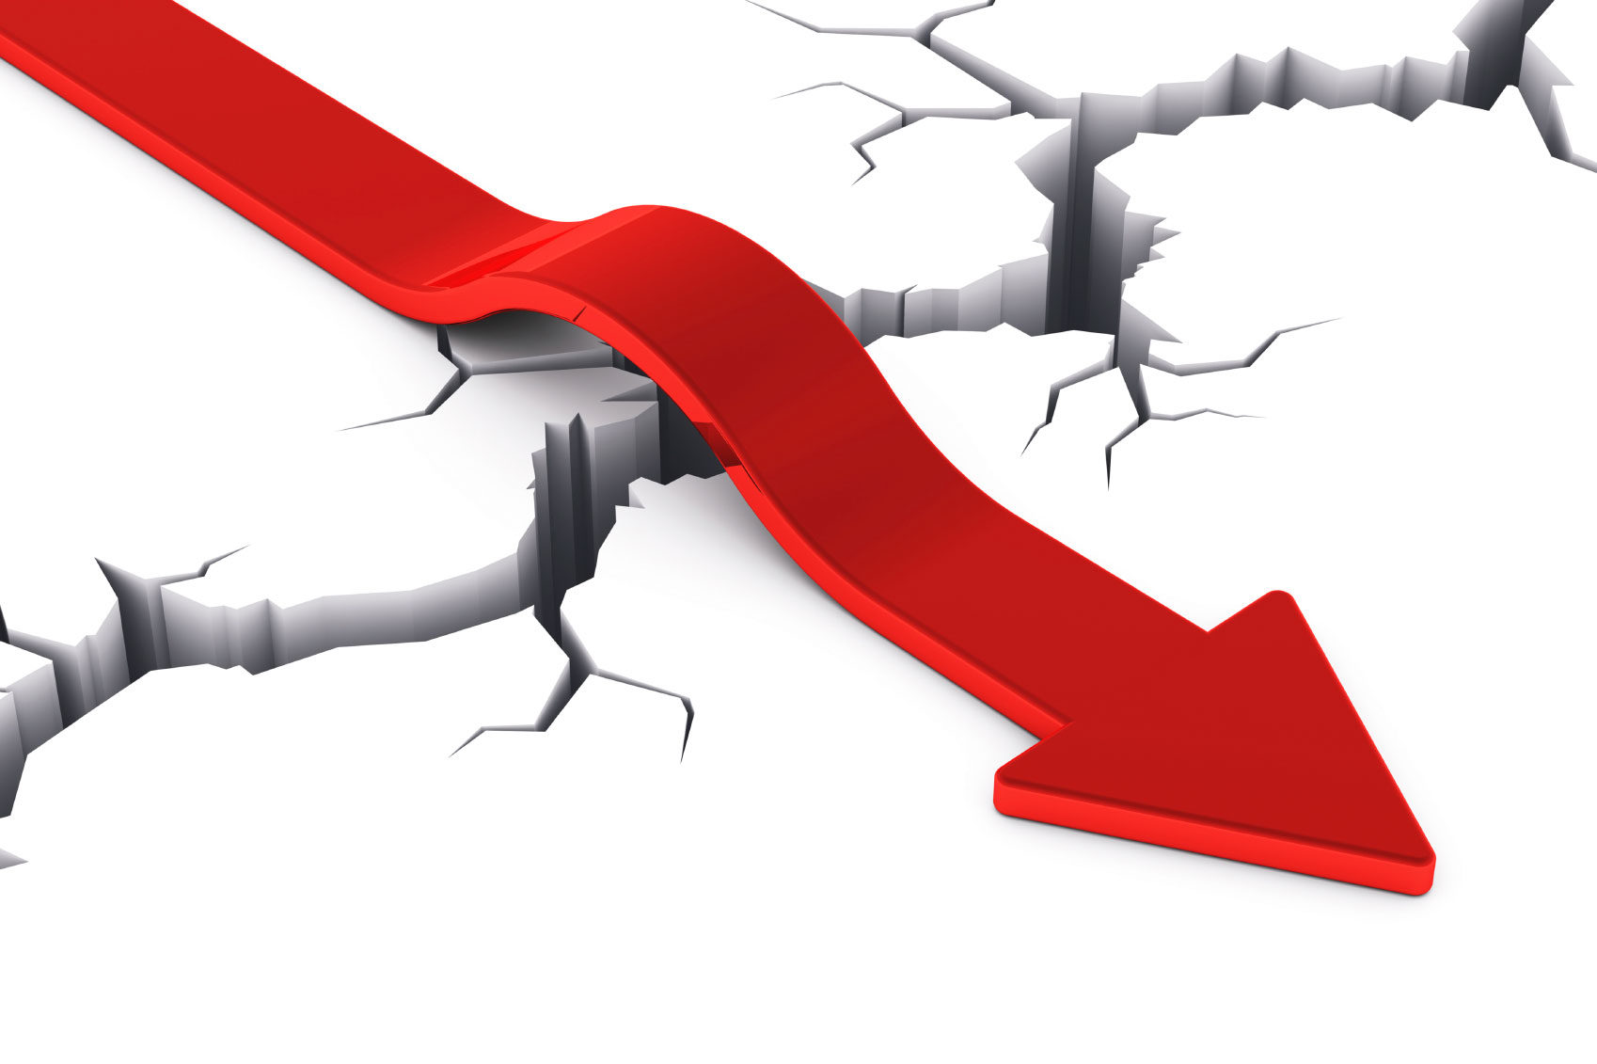

Implementing NIST 800-30 to APC’s ITRO
Lazaro, Louise Gabrielle D.
Miculob, Kent Michael P.
Siccion, Justine Mark D.
Tomas, Gener Joseph G.

Slide 3

ABSTRACT
Management
NIST 800-30
Risk Management Methodology

Slide 4
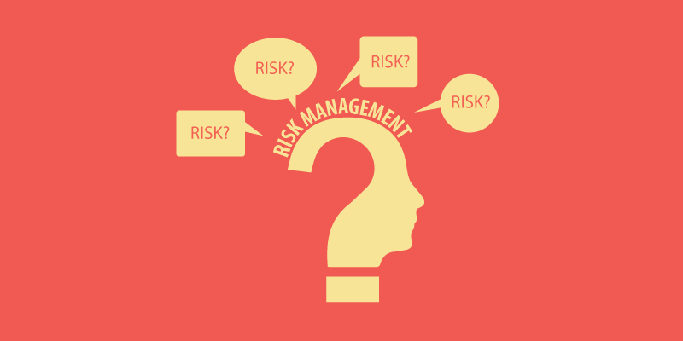
INTRODUCTION
Risk Management
APC’s ITRO
NIST 800-30
Risk Assessment

Slide 5
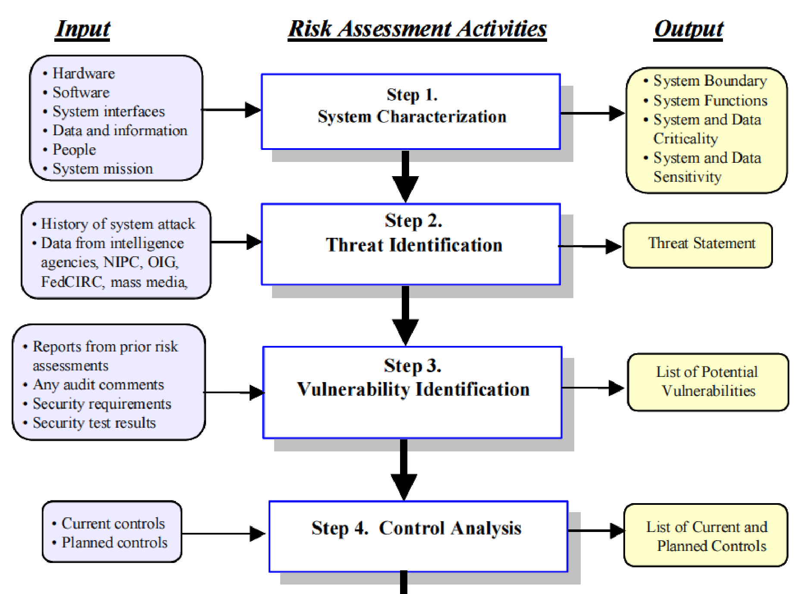

Slide 6
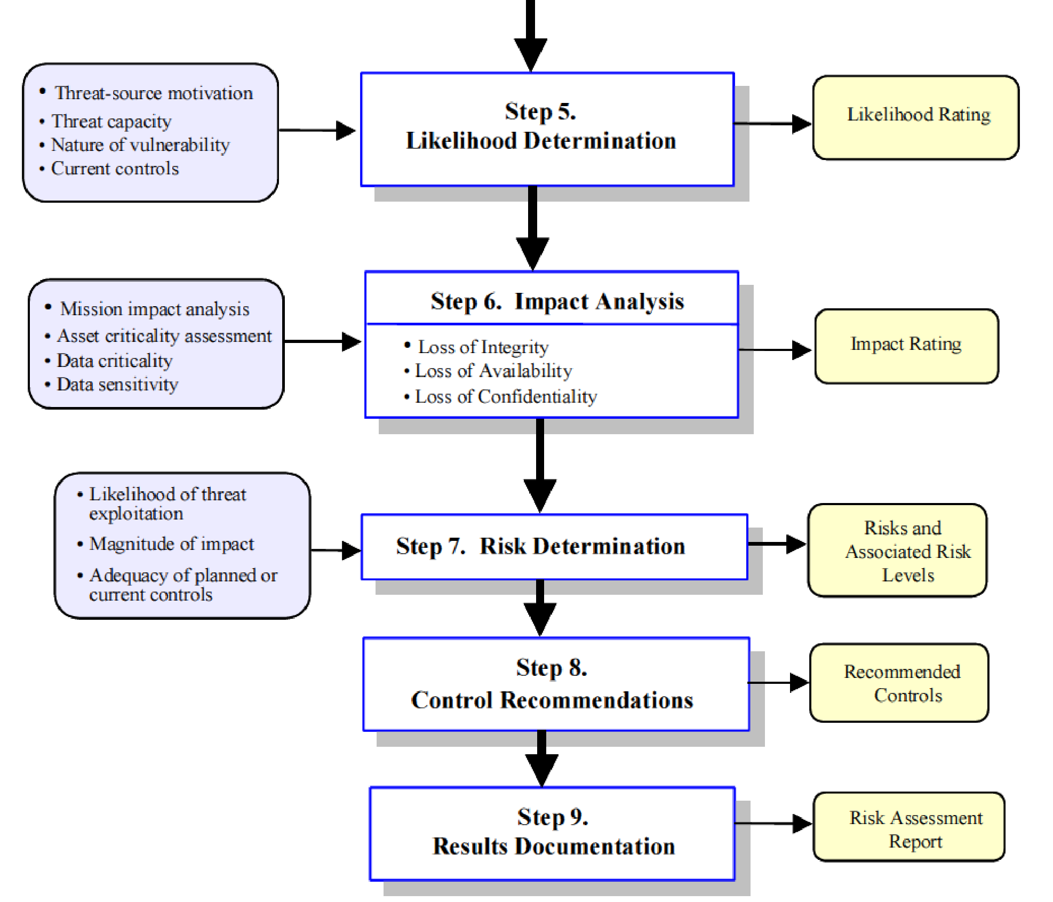

Slide 7
PROBLEM STATEMENT
How do schools implement their risk management?
What factors to consider in managing risks in a school?
How to incorporate NIST 800-30 to APC’s ITRO?
Can NIST 800-30 really help ITRO in minimizing risks?

Slide 8
RESULTS AND DISCUSSION
1. System Characterization
Hardware found inside ITRO
Software used by ITRO
Network of APC
Data and information that are found inside ITRO
People who work inside ITRO
Notes:
In this step, researchers identified all information that must be established in the system. To identify all information, researchers went to ITRO to ask and collect all system-related information

Slide 9
RESULTS AND DISCUSSION
1. System Characterization
People who use the system of ITRO
Security Policies of ITRO
Physical security of ITRO
Environmental security implemented in ITRO

Slide 10
RESULTS AND DISCUSSION
Type of Threat | Threats
Natural Threats | Earthquake Floods Lightning that can interrupt services of APC
Human Threats | Unauthorized access of any person in the restricted place inside ITRO Theft Script injection or Cross site scripting on school’s website. Network attacks causing availability issues such as Denial of service. Destruction of ITRO’s equipment caused by students. Students messing desktops causing confusion to other users. Students installing other software in computers that can cause computer to be slow Students unplugging LAN Cables Students who installed viruses on computers.
Environmental Threats | Fire or Explosion Car accident Power Outage.
2. Threat Identification
Notes:
So first, what is a threat? A threat is the potential danger found in the system. In NIST 800-30, threat-sources such as natural threats, human threats, and environmental threats are identified.

Slide 11
RESULTS AND DISCUSSION
Threat | Vulnerability
Earthquake | Destruction of sensitive and confidential data | ITRO would not be operational if an earthquake happens. All information inside can be accessible if the building collapses.
Network Attacks such as denial of service. | Unavailability of the school’s servers which are used by students and professors in a daily basis. | Operational Disruption may occur causing delay to the students and professors daily activities.
Fire or Explosion | Computers, servers and etc. would be destroyed. | Data located in computers, servers cannot be accessible unless ITRO would have a back- up location for the information.
3. Vulnerability Identification
Notes:
So next is the vulnerability identification. A vulnerability is a weakness found in the system. The aim of this step is to come up with a list of system vulnerabilities that can be exploited by the given threats. Us the researchers, have chosen our top 3 threats

Slide 12
RESULTS AND DISCUSSION
Administrative | Deterrent
Earthquake | None
Network Attacks such as denial of service | Create policies and proper sanction for violators.
Fire or Explosion | Put signage for rooms that is restricted
4. Control Analysis
Physical | Preventive
Earthquake | Mandate earthquake drills, safety precautions
Network Attacks such as denial of service | Implement Firewall specifically Stateful inspection Firewalls Or an Intrusion Detection System
Fire or Explosion | Implement non-flammable materials in the area
Notes:
The aim of this step is to identify controls that could be implemented by the administrative, physical, and technical aspects. Researchers have classified controls that can minimize risks from happening.

Slide 13
RESULTS AND DISCUSSION
Technical | Detective
Earthquake | Be updated to the news forecast
Network Attacks such as denial of service | Honeypot Implementation
Fire or Explosion | Implement fire alarms
4. Control Analysis
Technical | Recovery
Earthquake | Back up data in another location in case an earthquake happens
Network Attacks such as denial of service | None ?
Fire or Explosion | Back up data in another location in case an earthquake happens

Slide 14
RESULTS AND DISCUSSION
5. Likelihood Determination
Risks must be classified as high, medium or low
Notes:
When a risk is identified as high, chances are, all information can be exposed when such things happen. When a risk is identified as medium, information can also be exposed but not that much. When a risk is identified as low, information that can be leaked is not really sensitive and confidential. Chances are, you can ignore it.

Slide 15
RESULTS AND DISCUSSION
Risk | Risk Level
Earthquake | High
Floods | Medium
Lightning | Medium
Unauthorized access of any person in the restricted place inside ITRO | Medium
Unauthorized network access | High
Infiltration of students who have knowledge on attacks that can be made through the network | Medium
Destruction of ITRO equipment | Medium
Theft | Medium
Students messing with the desktops | Low
Students installing other software in computers that can be harmful and that can cause computer to be slow | Medium
Students unplugging LAN cables | Low
6. Impact Analysis

Slide 16
RESULTS AND DISCUSSION
Threat Likelihood | Threat Level | Vulnerability | Impact Level
Earthquake | 3 | 2 | 3 | 18
Floods | 3 | 1 | 2 | 6
Lightning | 2 | 1 | 2 | 4
Unauthorized network access | 3 | 3 | 3 | 27
Infiltration of students who have knowledge on attacks that can be made through the network | 2 | 3 | 2 | 12
Destruction of ITRO Equipment | 2 | 2 | 2 | 8
Theft | 3 | 2 | 3 | 18
Fire or Explosions | 3 | 3 | 3 | 27
Students messing with the desktops | 1 | 1 | 1 | 1
Students installing other software in computers | 2 | 2 | 2 | 8
Students unplugging LAN Cables | 1 | 1 | 1 | 1
7. Risk Determination

Slide 17
RESULTS AND DISCUSSION
8. Control Recommendation
Earthquake
Risk mitigation - Backup data in another location in case an earthquake happens
Unauthorized Network Access
Risk mitigation - Monitor network traffic frequently
Fire or Explosion
Risk mitigation - Back up data in another location in case an earthquake happens

Slide 18
RESULTS AND DISCUSSION
9. Results and Documentation
Official Report

Slide 19
CONCLUSION & RECOMMENDATION
Backup servers are ready and maintained
Specific person to be in-charge of IT functions – network & security
Computer labs must have least privilege to students
The Professor’s computer should’ve administrative rights to monitor students browsing activity.

