Slide 1
Touch Screen Adaptation: User Calibration based Touch Screen Responsiveness
Coronel | Dela Cruz | Jimenez | Llantos
Notes:
Wider scope compared to the previous title “The Effect of Palmar Hyperhidrosis on Smartphone Usage in Metro Manila”

Slide 2
Project Context
The Challenges
Incompatibility
Root Cause?
The Opportunity
User Satisfaction
Purpose and Description
Develop
Inaccuracies?
Notes:
The Challenges
Incompatibility of touch registers in the device to varying users; Incompatibility in a way that users with large hands find it extremely difficult to utilize their smartphones their phone size must scale to their hand size. Also, the differences on the mistakes on touch typing factors per Operating System or Phone Brand; the varying hardware quality and algorithm efficiency differences.
The Opportunity
This research can help smartphone manufacturers on improving their devices by increasing the satisfaction experienced by their customers through the custom-calibrated touch registers.
Purpose and Description This research serves as a possible solution for smartphone manufacturers to increase the consumer satisfaction rate of their products. This research aims to develop an android application that will calibrate the touch screen registering algorithms depending on the user to further increase accuracy and precision of future touch registers; after performing different evaluating tests. Also, this research aims to know the causes of the malfunctions and the inaccuracies of android touch registers; especially in using virtual keyboards.

Slide 3
Objectives
Increase User Satisfaction
Touch Calibrating Software
Root Cause
Notes:
To increase user satisfaction upon product consumption; to help the system satisfy the varying users when it comes to the touch screen display.
To produce a touch calibrating software wherein the system will adapt on the users usage, increasing touch accuracy and precision.
To determine the causes of the inaccuracy of touch registers on a touch screen smartphone.

Slide 4
Scope and Limitation
Touch Calibration → Android only
Touch Screen HCI

Slide 5
13 DIAGRAMS WHY?

Slide 6
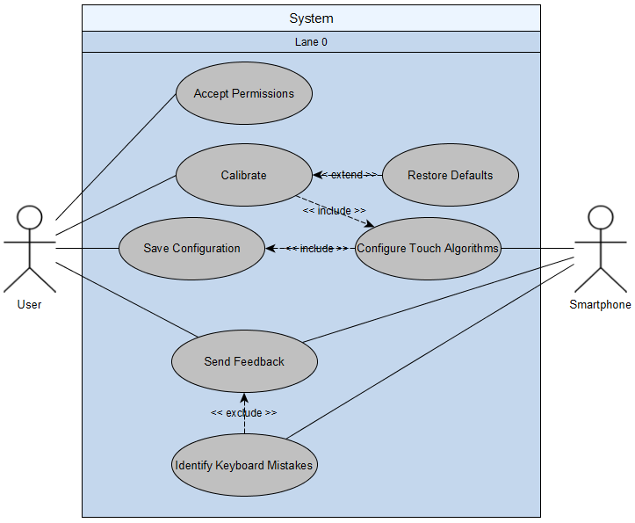
Use Case Diagram

Slide 7
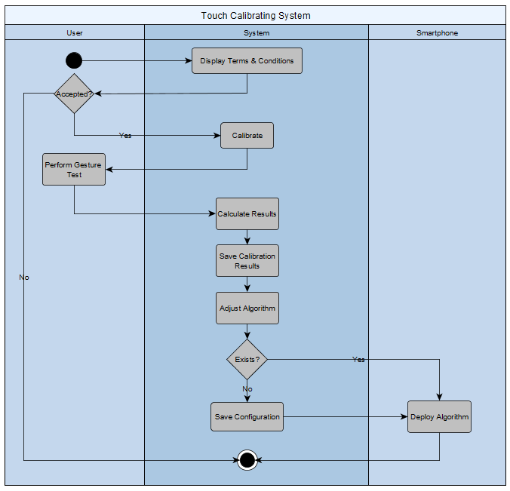
Activity Diagram

Slide 8
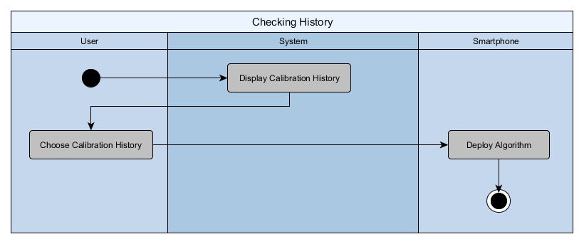
Activity Diagram

Slide 9
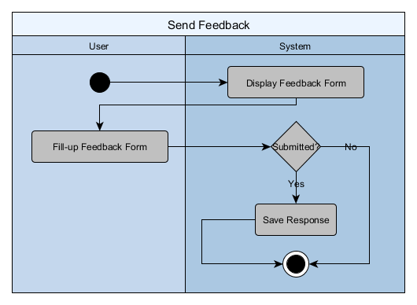
Activity Diagram

Slide 10
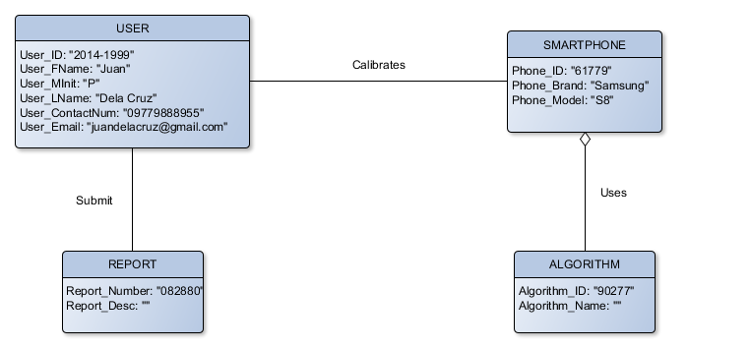
Object Diagram

Slide 11
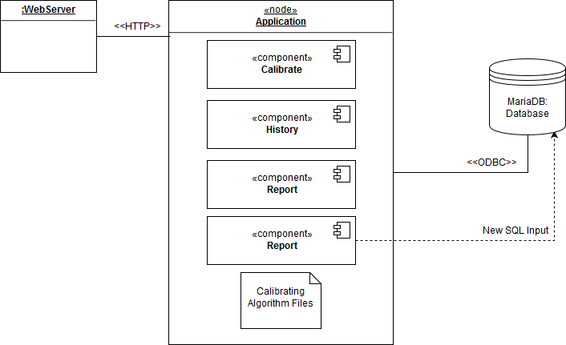
Deployment Diagram

Slide 12
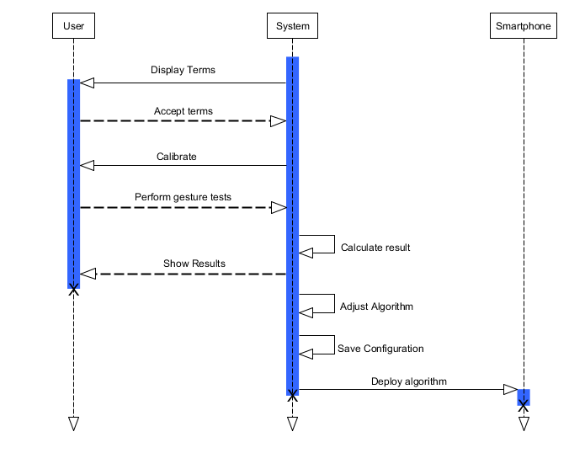
Sequence Diagram
Touch Calibration

Slide 13
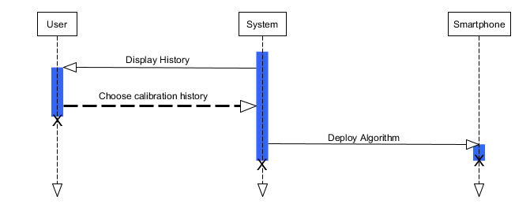
Sequence Diagram
History

Slide 14
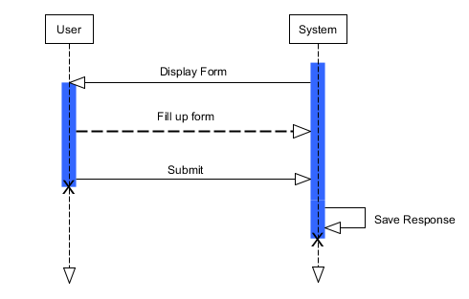
Sequence Diagram
Feedback

Slide 15
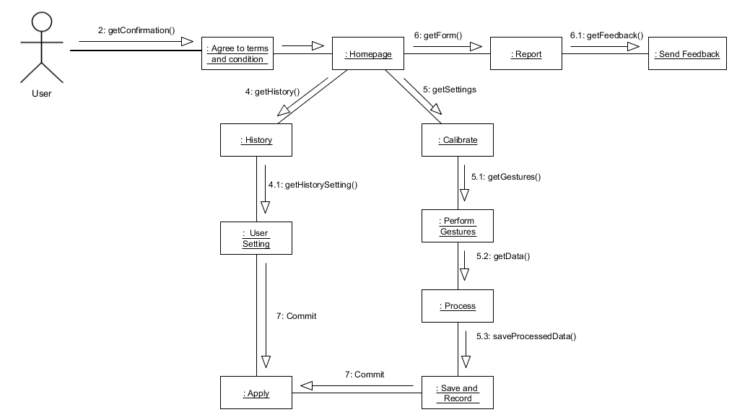
Communication Diagram

Slide 16
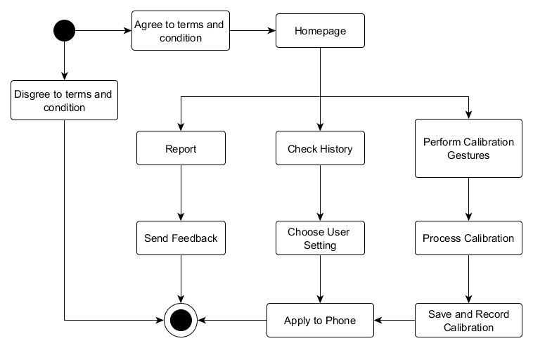
State Diagram

Slide 17
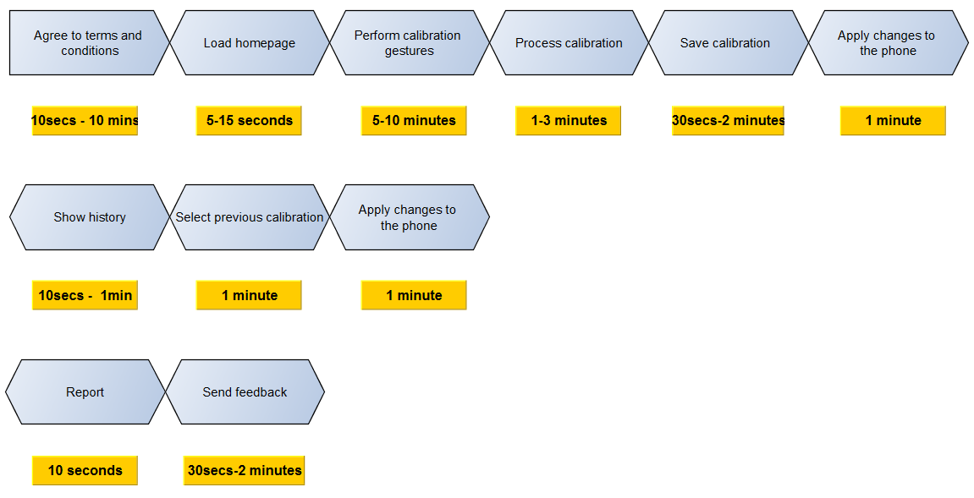
Timing Diagram

Slide 18
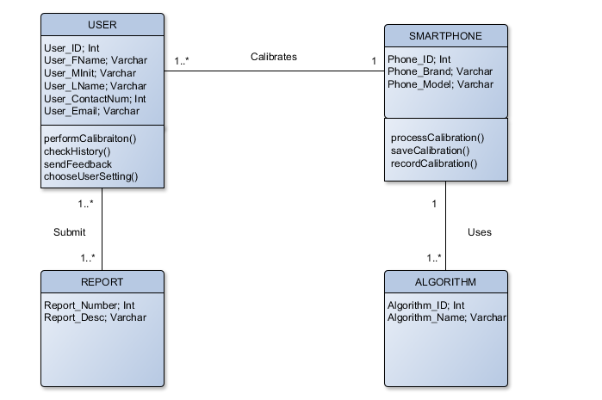
Class Diagram

Slide 19
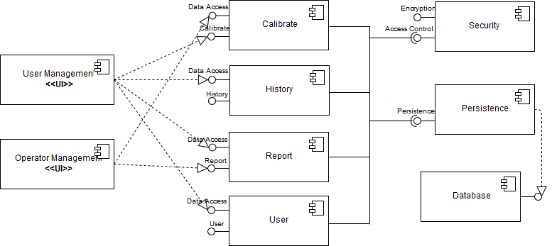
Component Diagram

Slide 20
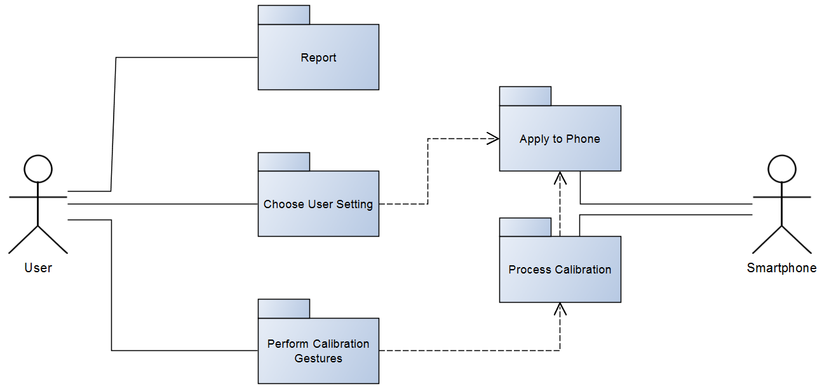
Package Diagram

Slide 21
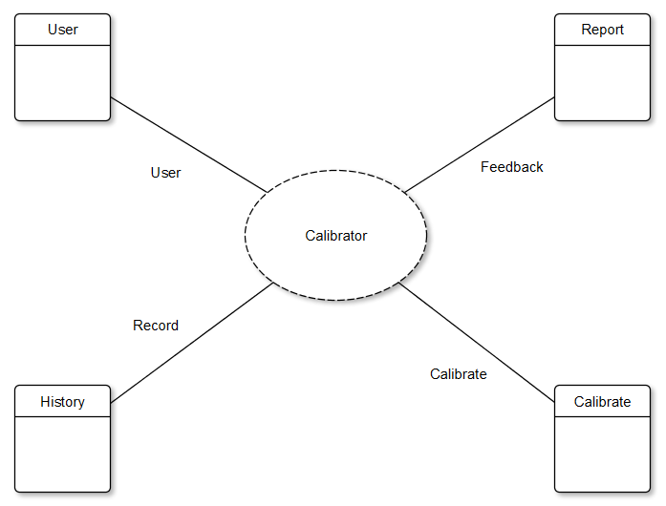
Composite Diagram

Slide 22
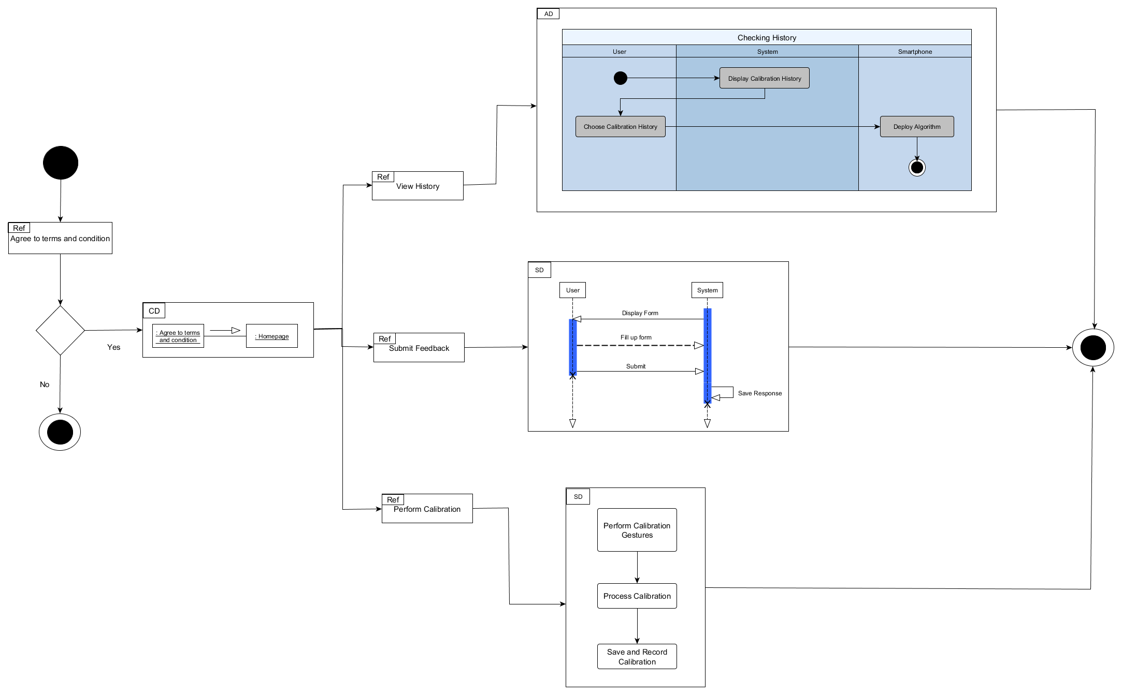
Interaction Overview

