Slide 1

Asia Pacific College

Slide 2
Aruga at Kalinga Foundation Inc. Crowd Funding Site

Slide 3
Project Context
Aruga at Kalinga Foundation Inc. is a group of people who were aiming for a million dollars to help their beneficiaries, like giving scholars, feeding the street children, helping the poor and many more. The charity wants to build a house for them to stay and live. Children and oldies from the street who doesn’t have permanent place to stay, they will adopt and support all their needs like sending children to school, feeding them, giving clothes and give them a place to stay. For the students who are eager to learn and study but they don’t have enough money to support their studies a scholarship will be given.

Slide 4
Purpose and Description
For the charity to gain their goal, they want to create a website wherein all the activities, needs, and the online donation will be found so that the person who is a far and willing to donate will have an easy access thru it. And so our client wants our group to create a crowd funding site.

Slide 5
Objectives
The main objective of this project is to build a website that can advertise the foundation’s campaign, display progress of every activity, easiest way of donating and a regular update of the system for transparency of funds.

Slide 6
Scope and Limitations
The purpose of this project is to help them to establish the Aruga and Kalinga Foundation Inc. by creating a crowd funding site thru online donation. All donations will be used for helping people in needs.

Slide 7
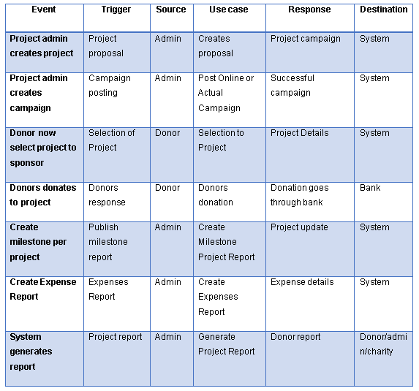
Event Table

Slide 8
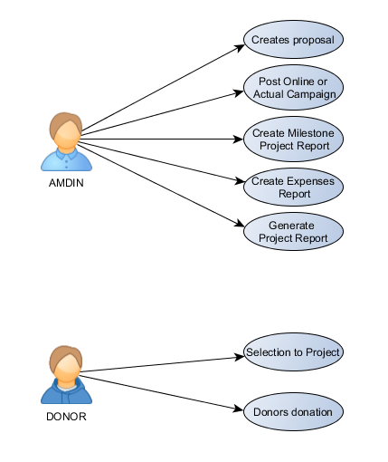
Use Case Diagram

Slide 9
Use Case Full description
Use Case: | Creates proposal
Scenario: | Creating and planning a project proposal
Triggering Events: | Project proposal
Actor: | Admin
Related Use Case: | None
Stakeholders: | Admin
Pre-Conditions: | There must be a subject for a project
Post-Conditions:
Flow of Events:
Actor | System
1.Project admin will gather information for the project 2. The project admin will propose a project 3. Other admins will make decision if it’s okay 4. Post it in website | 4.1 The Website will display the project
Except Conditions: | The project may not proceed if the admin disapproves the proposal

Slide 10
Use Case: | Post Online or Actual Campaign
Scenario: | Advertising by social media and giving flyers
Triggering Events: | Campaign posting
Actor: | Admin
Related Use Case: | None
Stakeholders: | Admin/Donor
Pre-Conditions: | A person that is willing to spend a day posting it in websites.
Post-Conditions:
Flow of Events:
Actor | System
1. video clip advertising 2. giving flyers 3. posting our project in street 4. social website campaign | 1.1 The Website will display the video clips 4.1 The website will be linked in social media sites
Except Conditions:

Slide 11
Use Case: | Selection to Project
Scenario: | Donating money, supplies and even services.
Triggering Events: | Donors response
Actor: | Donor
Related Use Case: | none
Stakeholders: | Donor/Admin
Pre-Conditions: | A person that is willing to help is a must
Post-Conditions:
Flow of Events:
Actor | System
1. visits the website 2. browse project gallery 3. reading the project description 4. ask the admins for further information about the project | 2.1 the website will show the video clips and pictures about the project 3.1 this explains who/what will be the projects subject, mission and vision
Except Conditions: | We do not force anyone to donate

Slide 12
Use Case: | Donors donation
Scenario: | Building what the project is all about.
Triggering Events: | Proceed to project
Actor: | Admin
Related Use Case: | None
Stakeholders: | Donor
Pre-Conditions: | Depends on amount of donation receive
Post-Conditions:
Flow of Events:
Actor | System
1. click the donate button 2. fill up the donation form 3. check the important information 4. select the what to donate 5. donate | 1.1 the website will direct to the donation form 2.1 will display the full information details of the donor 4.1 will prompt the donor to contact the admin
Except Conditions:

Slide 13
Use Case: | Create Milestone Project Report
Scenario: | Showing the project progress for donors to see where the donations go.
Triggering Events: | Accomplishment report
Actor: | Admin
Related Use Case: | None
Stakeholders: | Admin
Pre-Conditions: | Create Expenses Report
Post-Conditions: | The project will proceed
Flow of Events:
Actor | System
1. taking pictures about the project 2. showing the project documentation 3. video clip in gallery | 1.1 the website will display the projects milestones 2.1 will display the full information when it was started and the current situation 3.1 will display the video summary of the undergoing project
Except Conditions: | The project may not proceed if the admin did not meet the defined project milestone.

Slide 14
Use Case: | Create Expenses Report
Scenario: | Showing the donations did take place.
Triggering Events: | Money spreading report
Actor: | Admin
Related Use Case: | Profile of the project
Stakeholders: | Admin
Pre-Conditions:
Post-Conditions:
Flow of Events:
Actor | System
1. computes all the expenses 2. shows where the donations take place 3. summary of all expenses | 3.1 the website will the display the summary of all expenses paid for the project
Except Conditions:

Slide 15
Use Case: | Generate Project Report
Scenario: | Showing the donations did take place.
Triggering Events: | Money spreading report
Actor: | Admin
Related Use Case: | Profile of the project
Stakeholders: | Admin
Pre-Conditions:
Post-Conditions:
Flow of Events:
Actor | System
1. computes the total cost 2. creates a summary of the whole project | 1.1 displays the cost of the project 2.1 displays the whole project status to show where the donations go
Except Conditions:

Slide 16
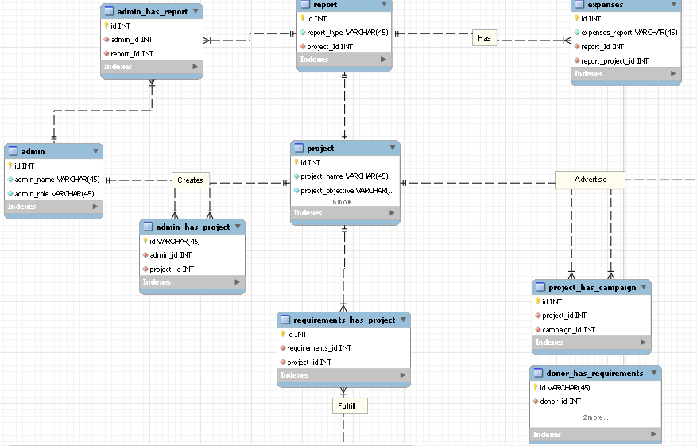
Entity Relationship Diagram

Slide 17
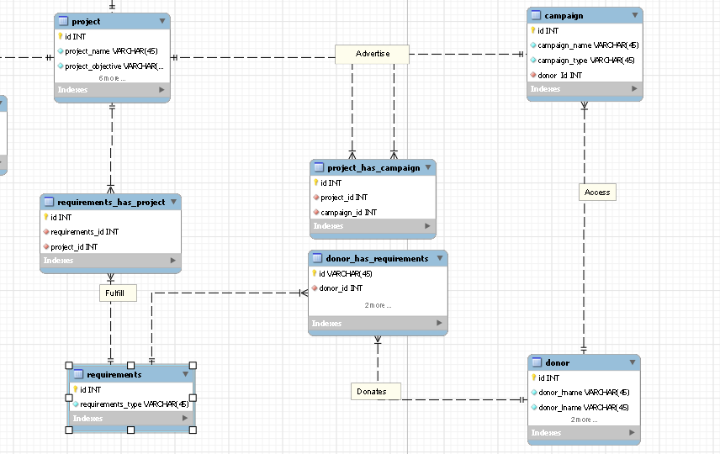

Slide 18
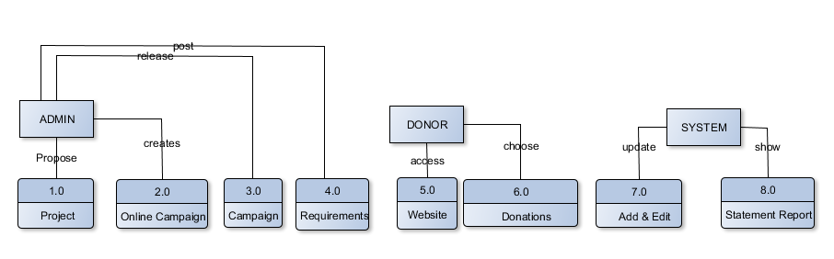
Data Flow Diagram

Slide 19
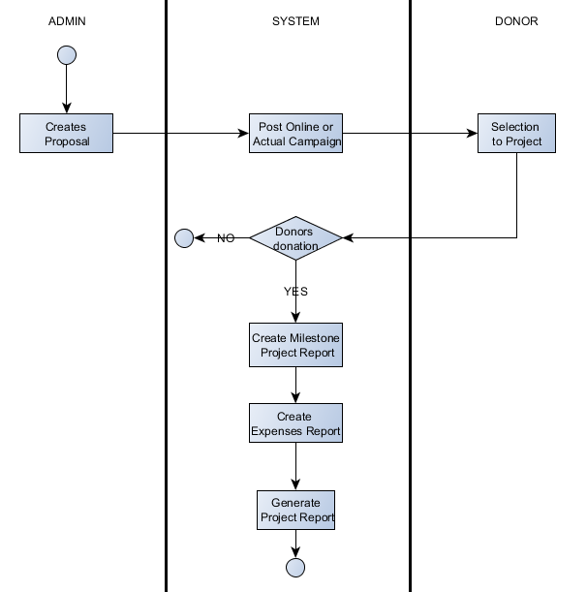
Activity Diagram

