Slide 1
CSPROJ
Hurley Evangelista
Emmanuel Devera
Alyssa Fernandez
Miguel Matawaran

Slide 2
Objectives
To expand the scope of Barangay Magallanes services in terms of receiving incident reports.
To provide evidence or supporting details when reporting an incident to the client.

Slide 3
Scope and Limitations

Slide 4
Application’s Features
Login system feature to authenticate the user and to avoid fake reporters.
A video cutter feature to reduce the file size and data that will be consumed.
Take a snap feature that allows user to send only a picture of an event.
DashCamBlue feature that allows user to transfer the video footage of the incident from the dashboard camera to the android device

Slide 5
Software Requirements
Android Studio –
Firebase Database
Firebase Authentication
Firebase Cloud

Slide 6
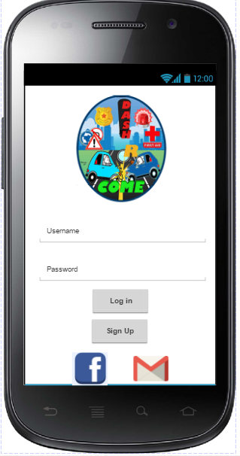
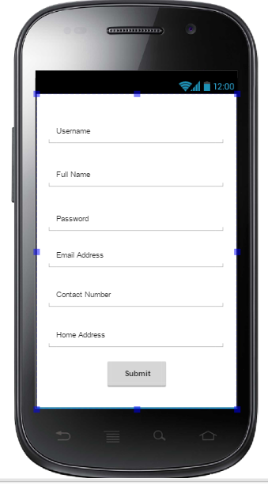
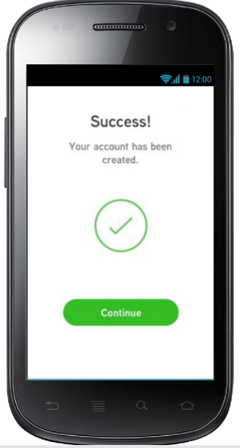
Screen Layouts

Slide 7
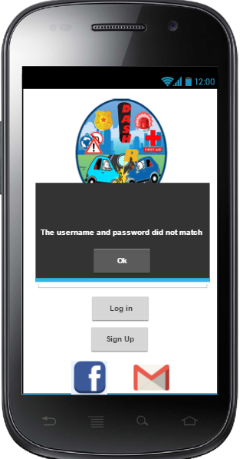
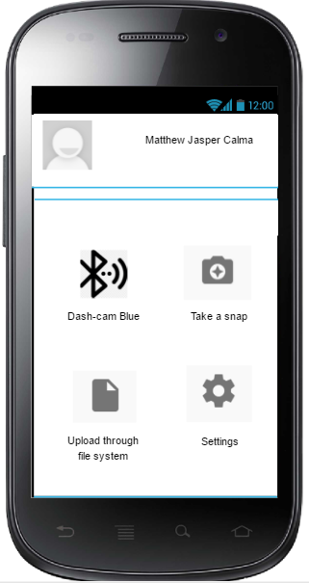
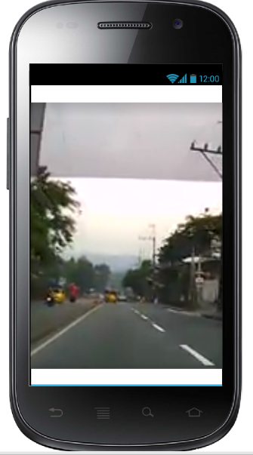

Slide 8
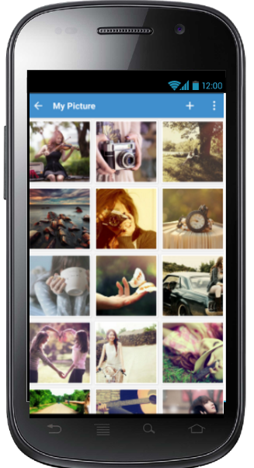
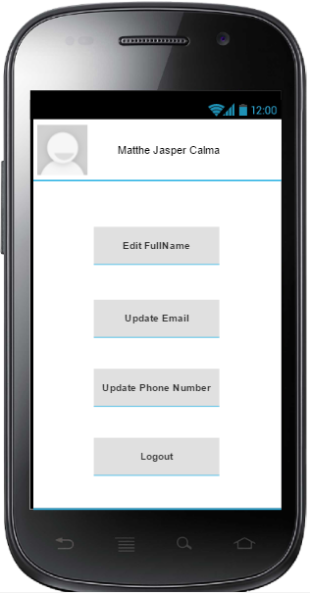
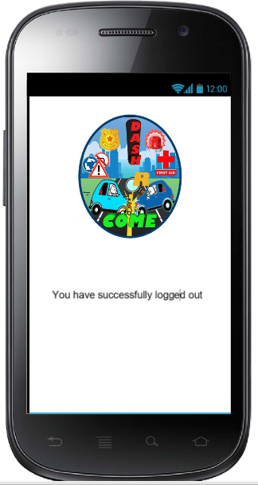

Slide 9
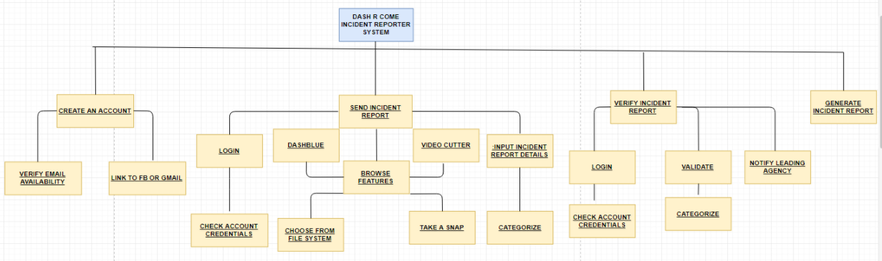
FDD

Slide 10
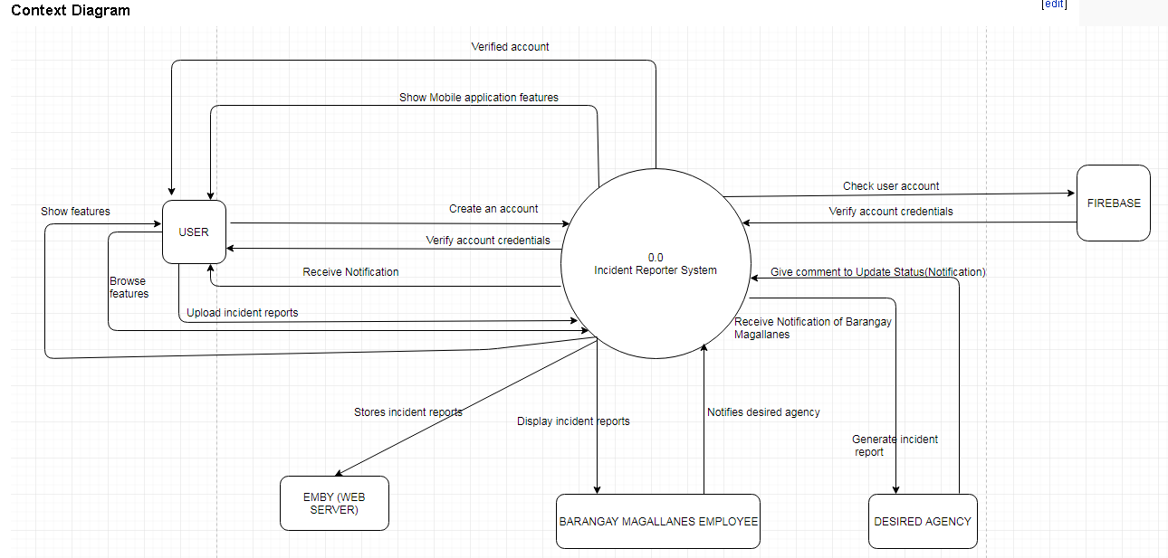
Context Diagram

Slide 11
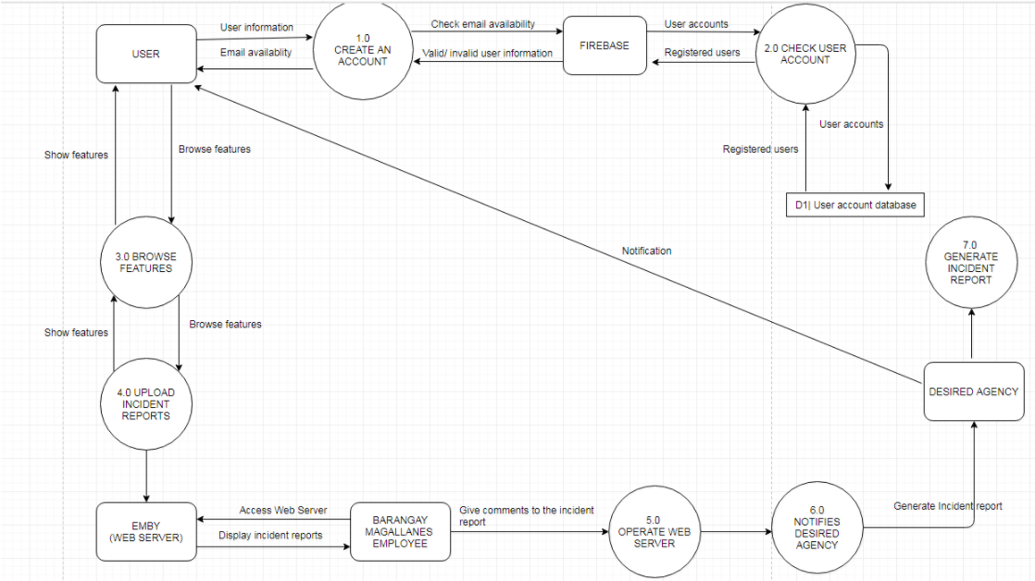
Diagram 0

Slide 12
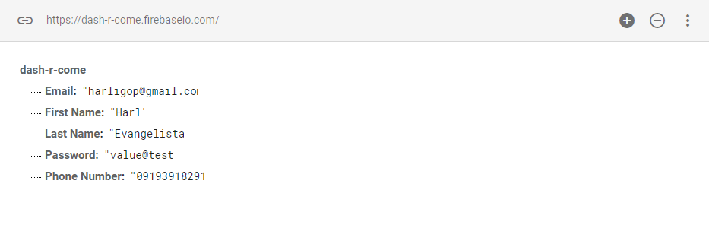
User ID String (UID / Database)

Slide 13
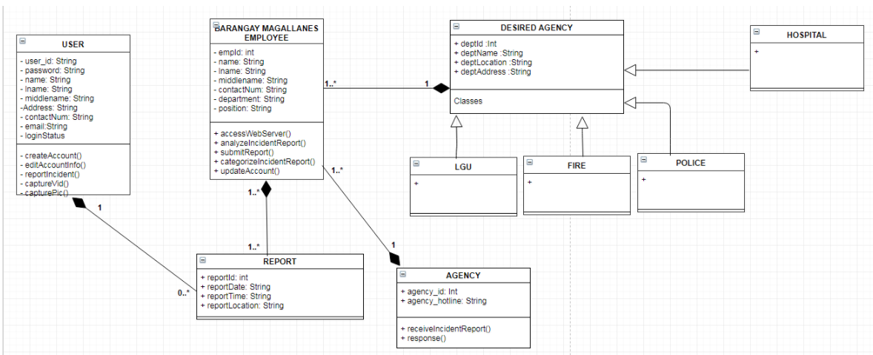
Class Diagram

Slide 14
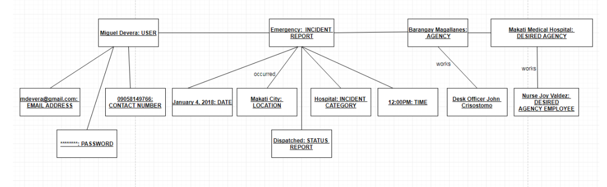
Object Diagram

Slide 15
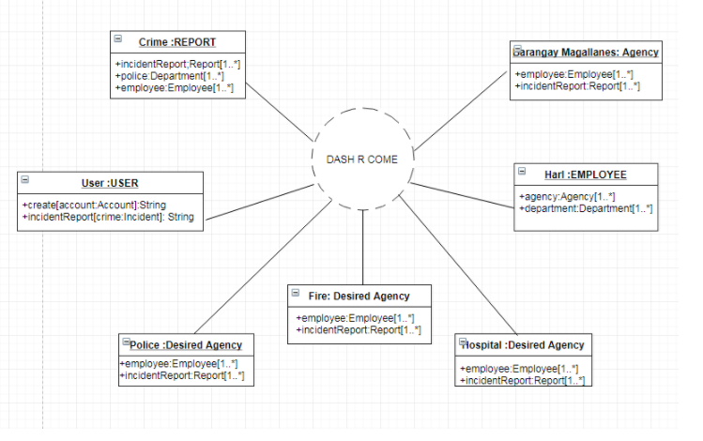
Composite Diagram

Slide 16
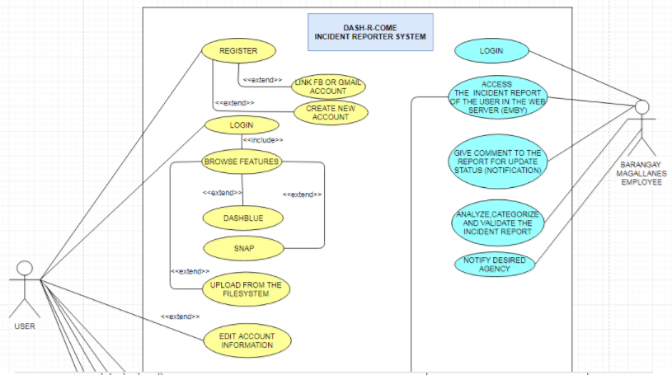
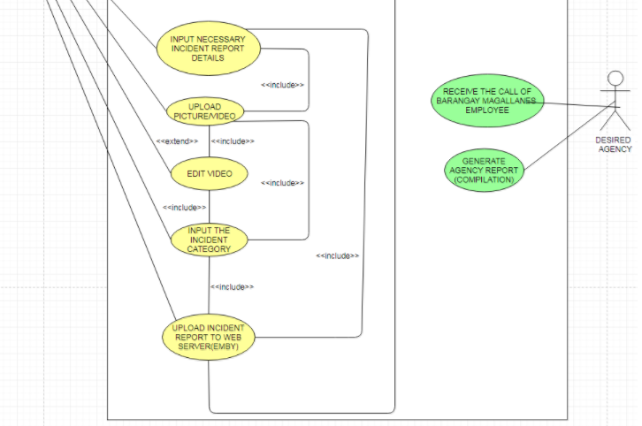
Use Case Diagram

Slide 17
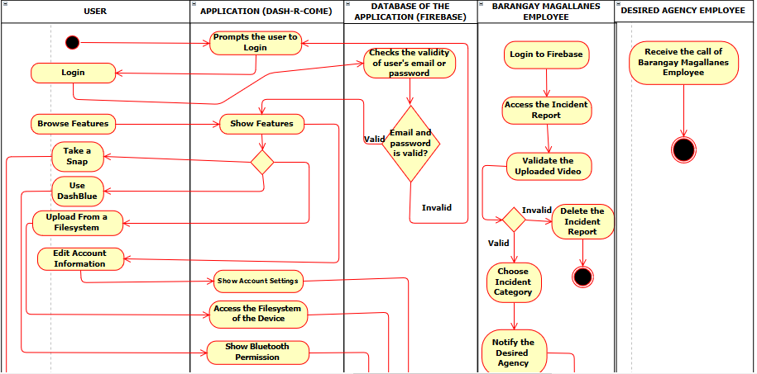
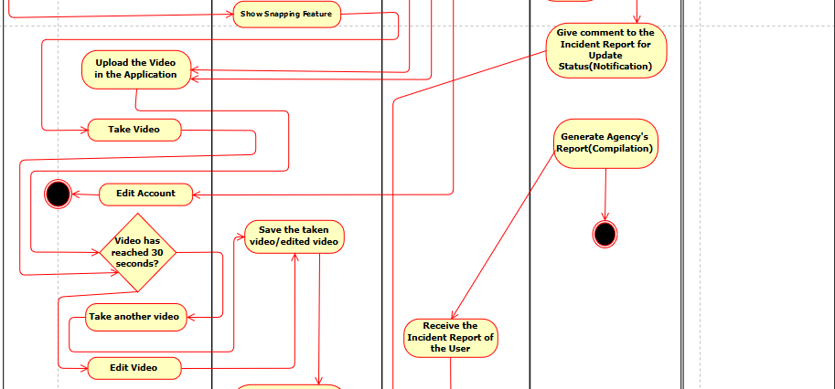
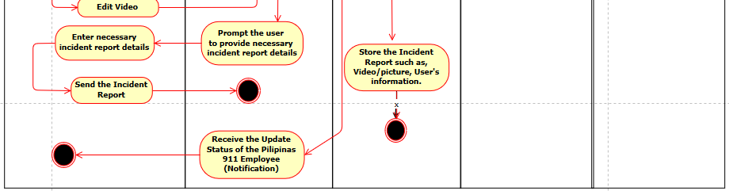

Slide 18
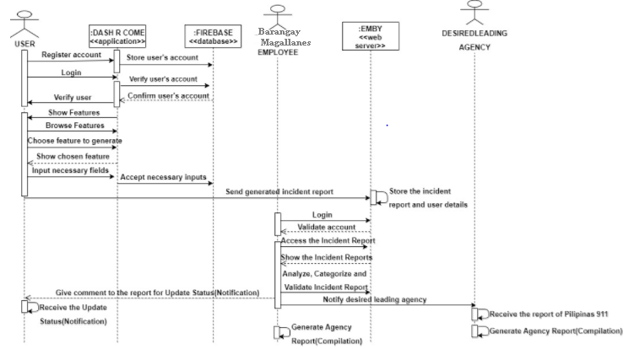
Sequence Diagram

Slide 19
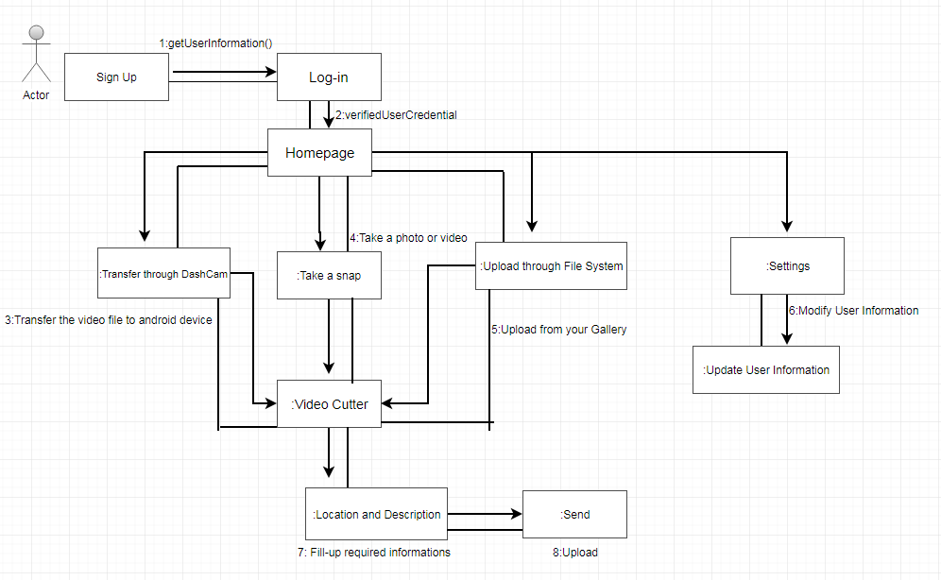
Communication Diagram

Slide 20
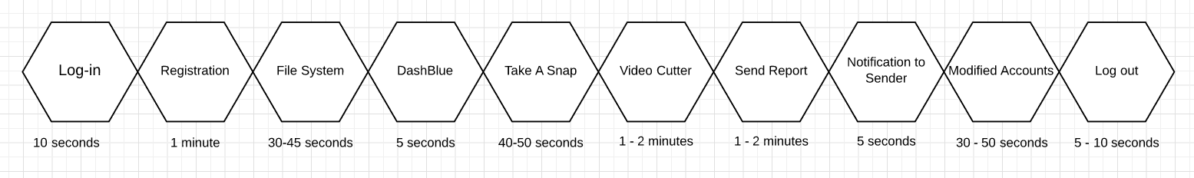
Timing Diagram

Slide 21
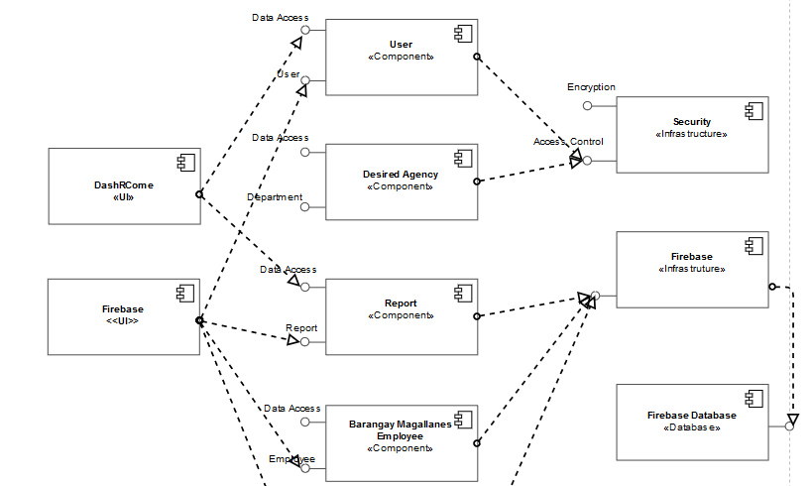
Component Diagram

Slide 22
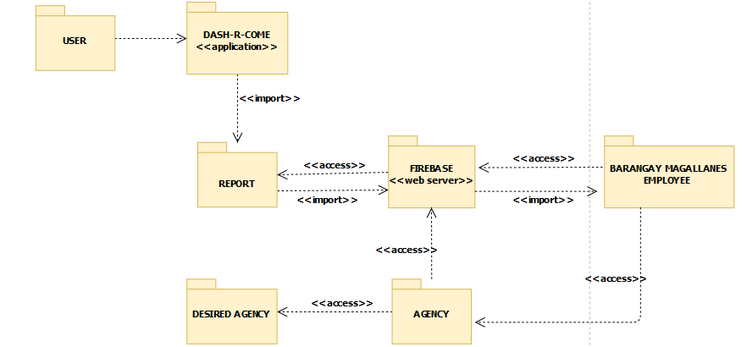
Package Diagram

