Slide 1
Bus Queuing System
Serra, Vincent Franklin T. Magcayang, Aaron Jester
Gomez, Raxell

Slide 2

Project Context
Because of the growing population of Asia Pacific College,
surely there will be a lot of students/staffs that needs to line up in order to ride the shuttle.
The problem is, due to fear of not falling in line early, even though the shuttle’s not there, students/staffs will fall in line early as they can and won’t have the time to do the things that they need (eg. Eat, appointments with professors, projects meetings).

Slide 3
Project DESCRIPTION
Bus Queue Monitoring System will provide hassle-free, convenient application
so students can use the time for other important things to be done rather than queuing. Not only students have the benefits in this project but also the staffs/professors for they can use the time on their appointments with their students. They can buy food at the cafeteria instead of queueing. This project may also come to use. In addition, to obtain new knowledge of what/when is the most students that will queue will do their best to follow schedule in-case of emergency maintenance of other buses. To provide data of when are the most students/staffs queue in a specific time

Slide 4
Objectives
To develop and create a convenient queuing system for Asia Pacific College students and staff
To develop and create an application where students/staff can fall in line to ride the shuttle without going down.
To lessen the students who fall in line to ride the bus.

Slide 5
Scope and limitations
It gives reservation number to users who are to use the bus services
Asia Pacific College has the limited area of internet connectivity making the application not accessible (only for the students/staffs that doesn’t have mobile data) anywhere/anytime at the said school.
The Internet Connection will only be available in Cafeteria & 7th floor (library)
In order for the tracker to work, the driver must always open the "send location" feature
Limitations of the project (as of now)
Account Error Checking
Messy list of queue (not sorted)
Limit of queue is only applicable per account

Slide 6
Features
Admin
Change schedule
Change driver
View list of queued students/staffs (pending)
Driver
Send Location
View list of queued students/staffs per schedule
Users
View the whereabouts of the shuttle
Queue for a specific schedule
View available schedule for the day

Slide 7
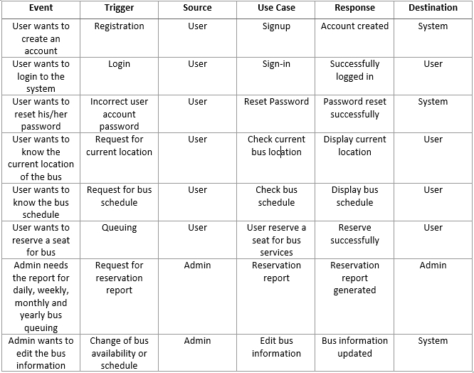
Event table

Slide 8
List of Diagrams

Slide 9
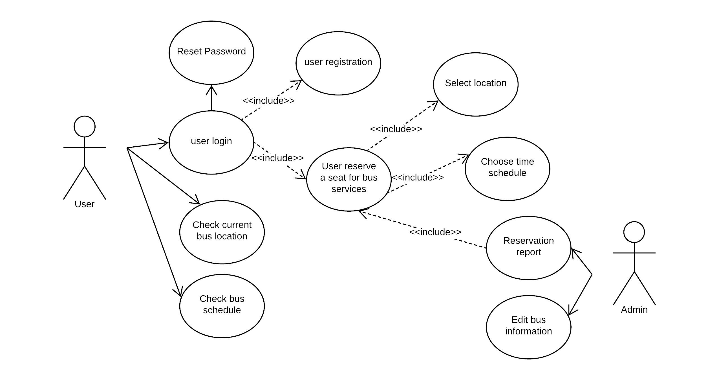
Use Case Diagram

Slide 10
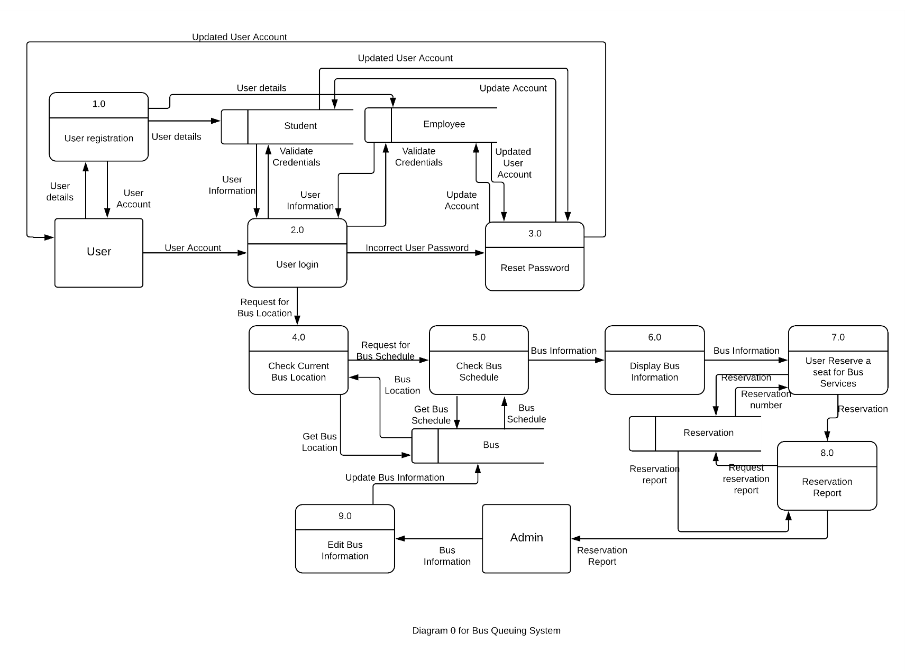
Data Flow Diagram

Slide 11
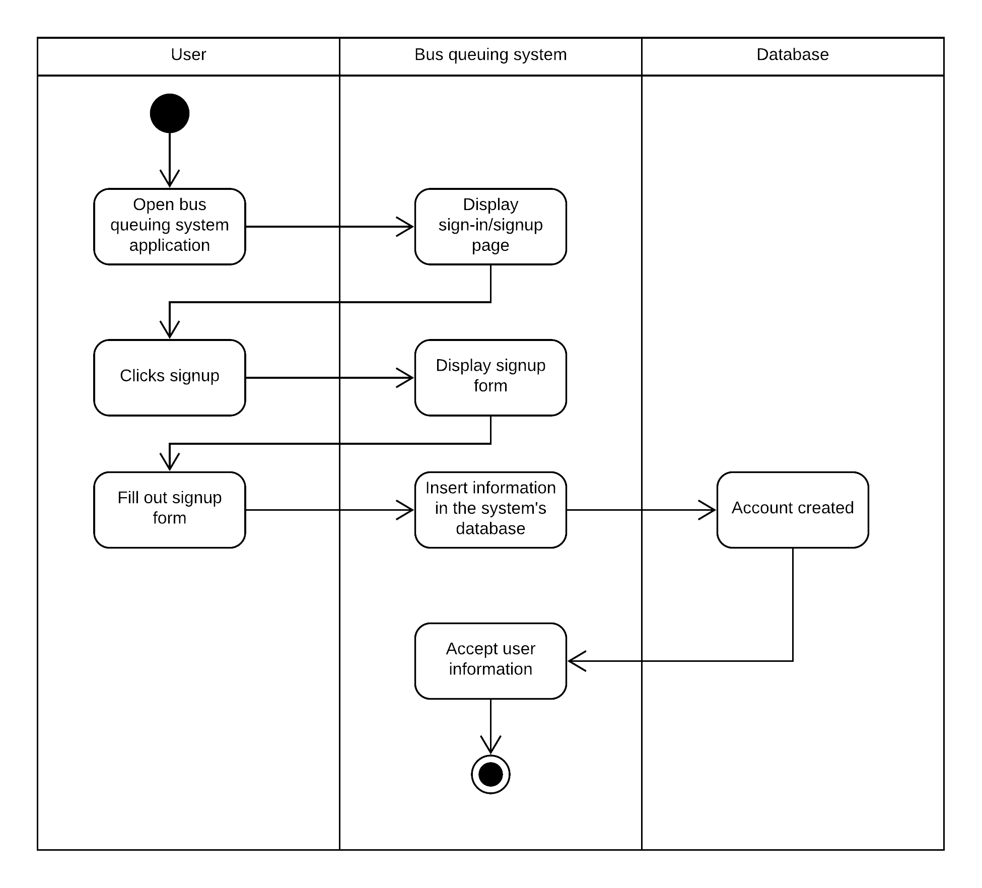
User Registration

Slide 12
Activity Diagram

Slide 13
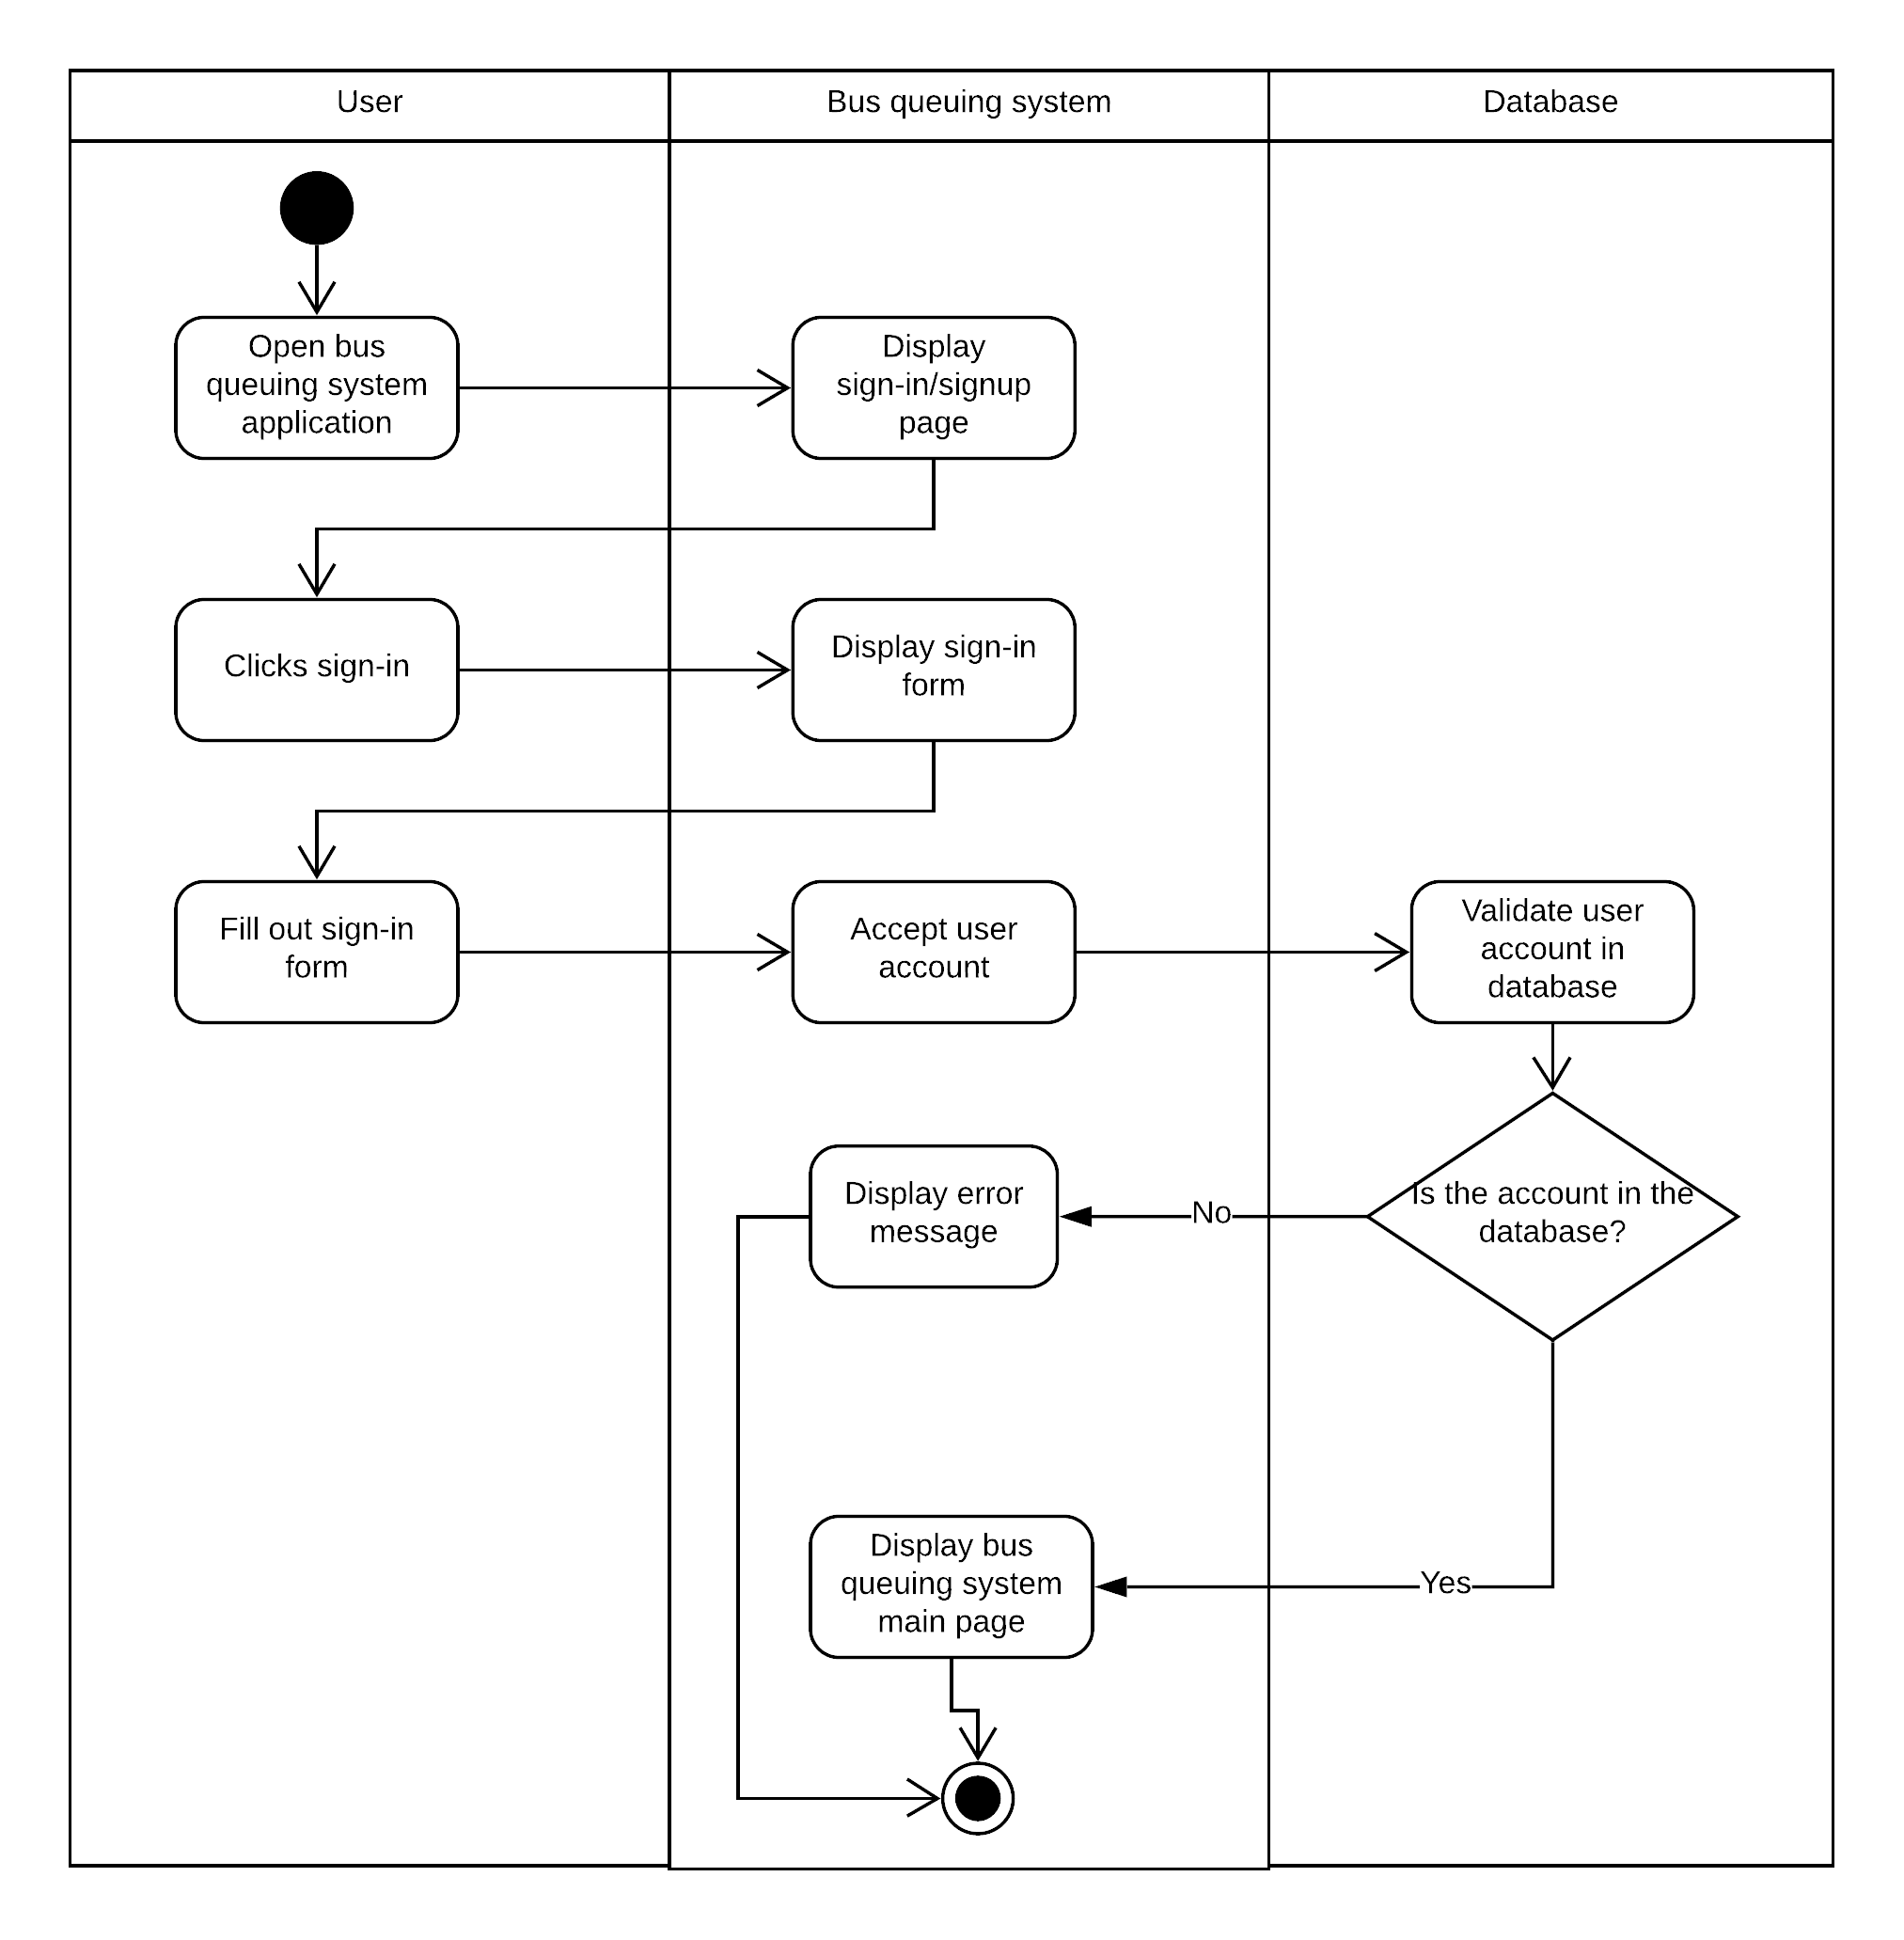
User Login

Slide 14
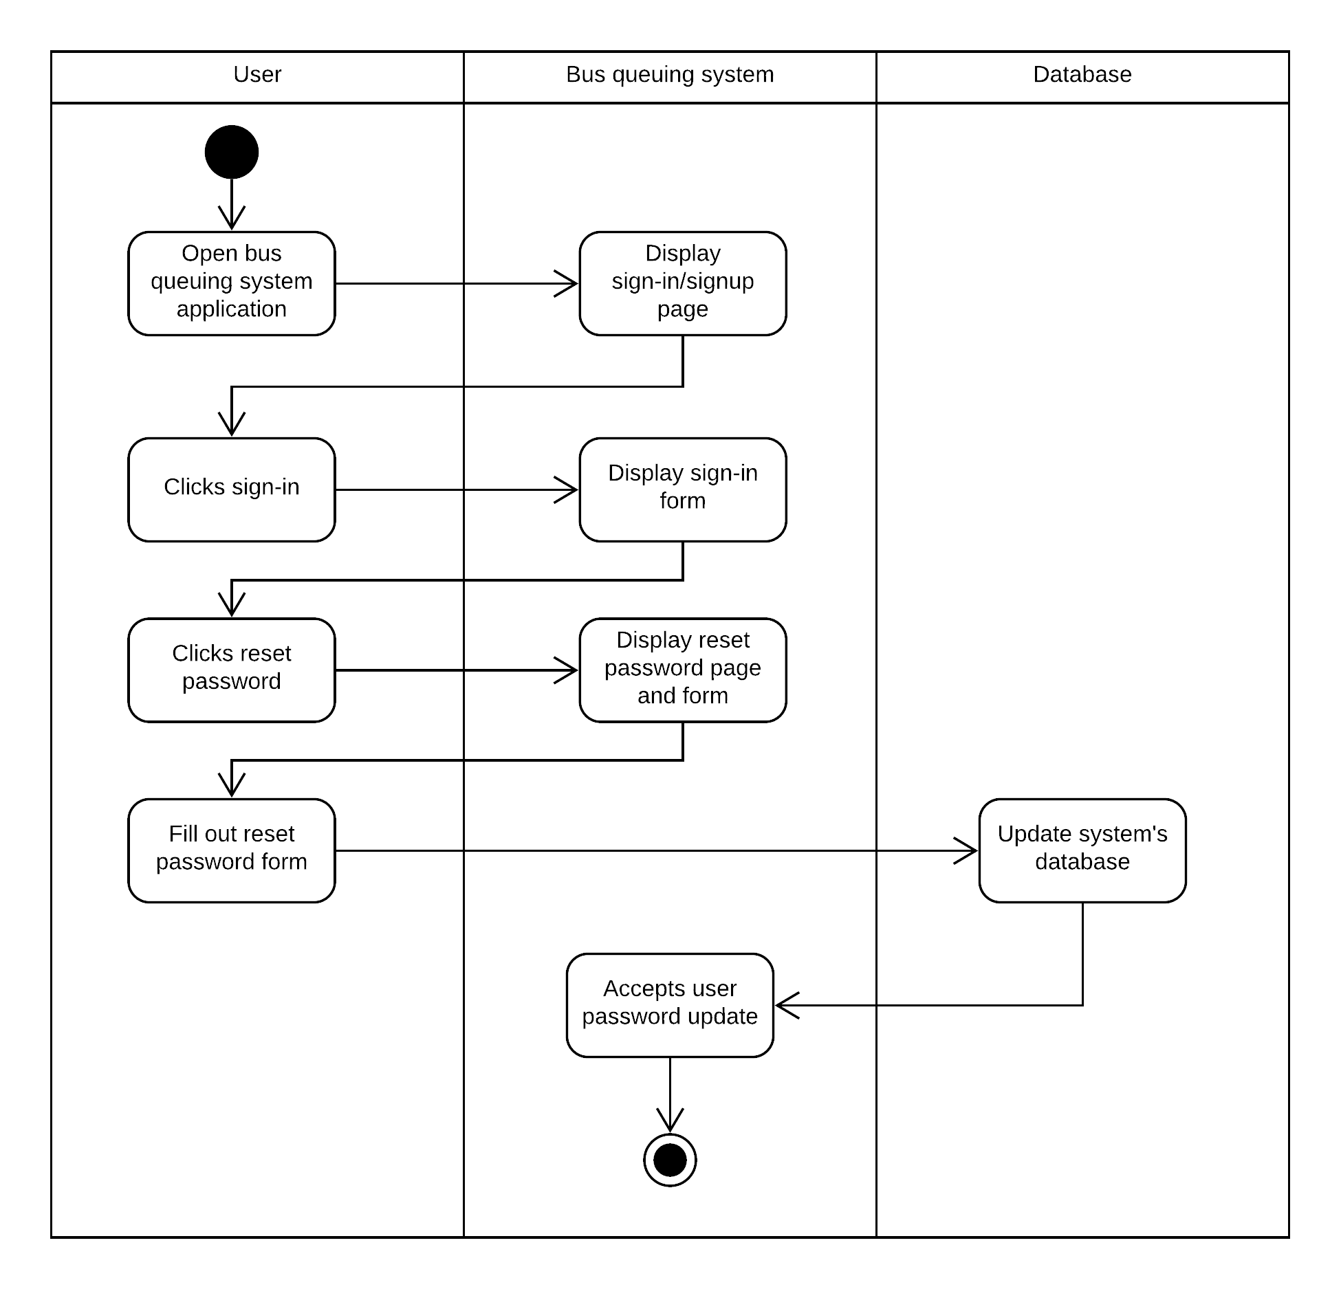
Reset Password

Slide 15
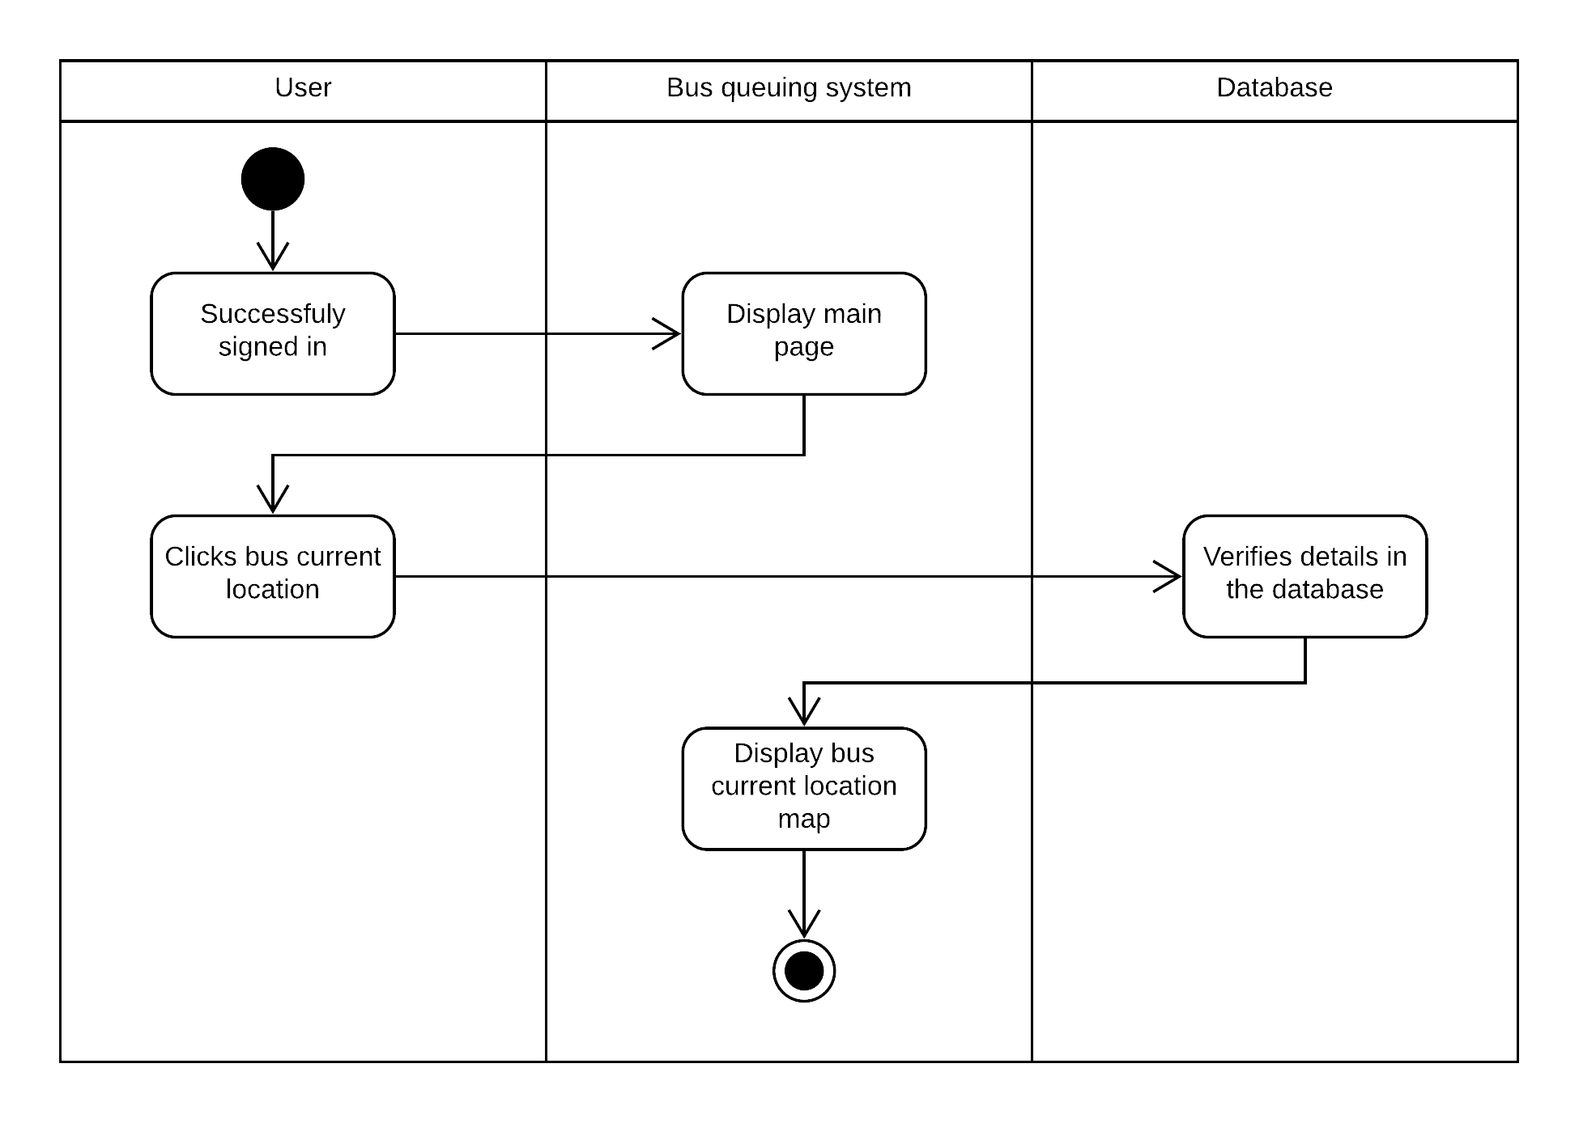
Bus Location

Slide 16

Bus Schedule

Slide 17
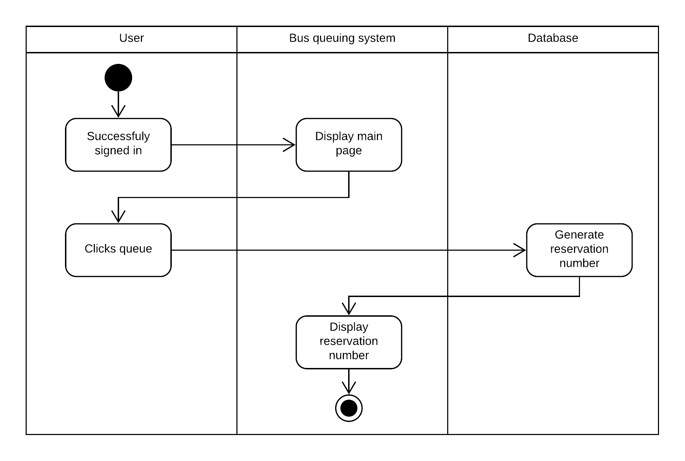
Reserve

Slide 18
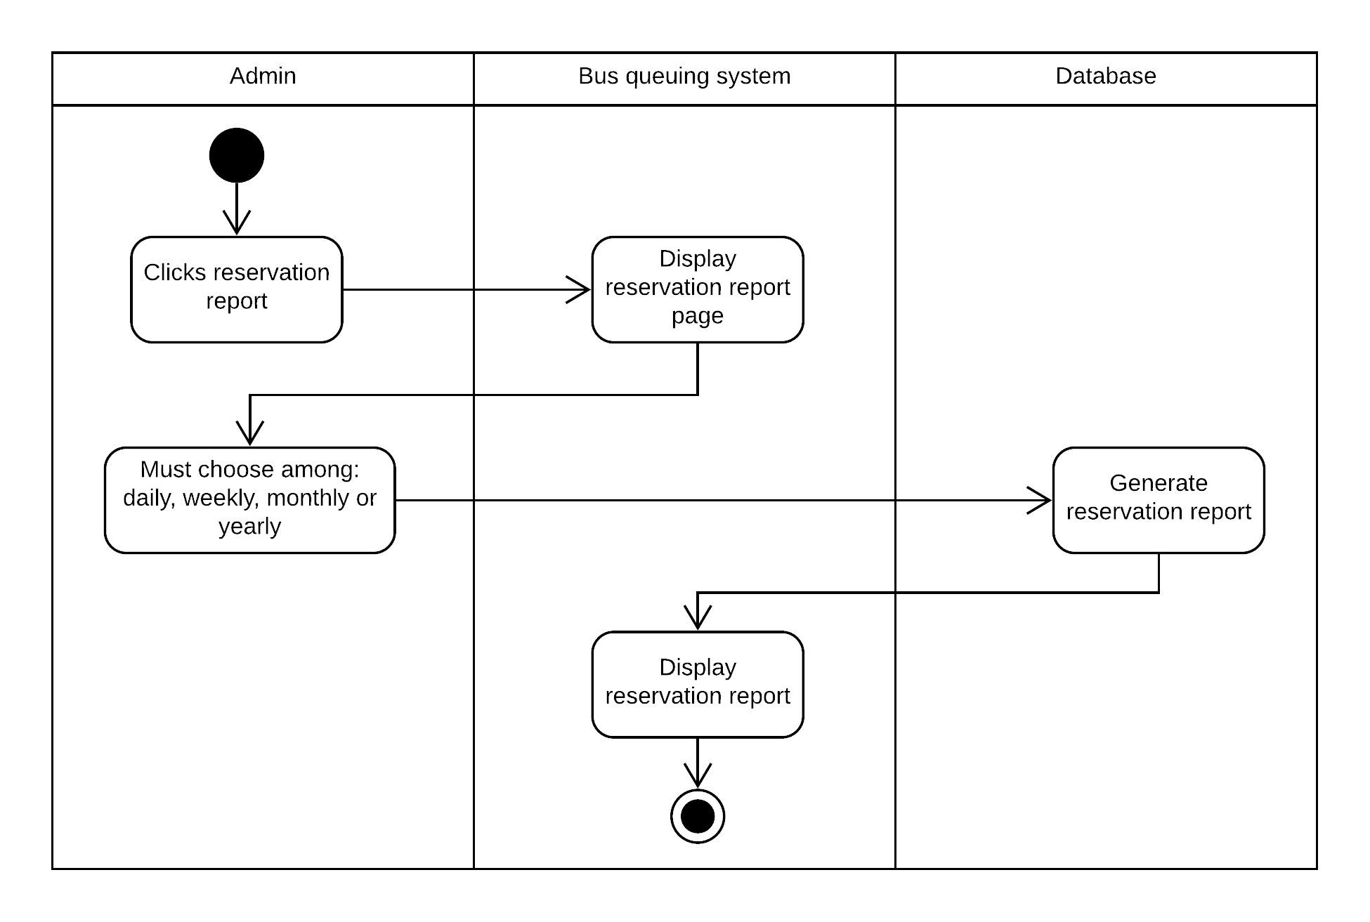
Reservation Report

Slide 19
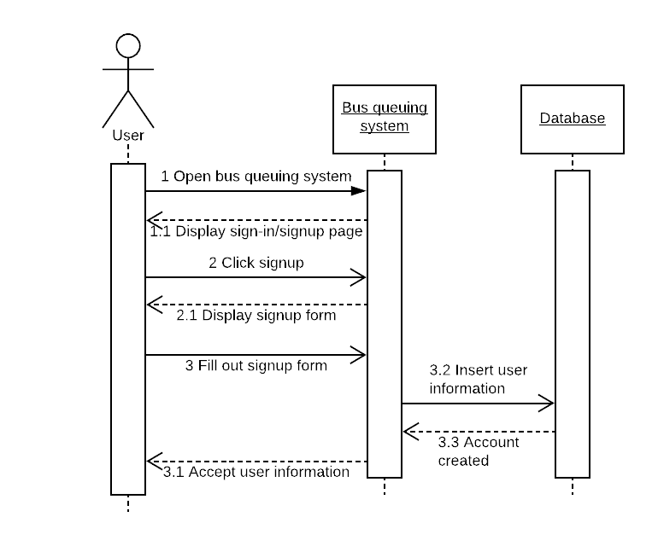
User Registration

Slide 20
Sequence Diagram

Slide 21
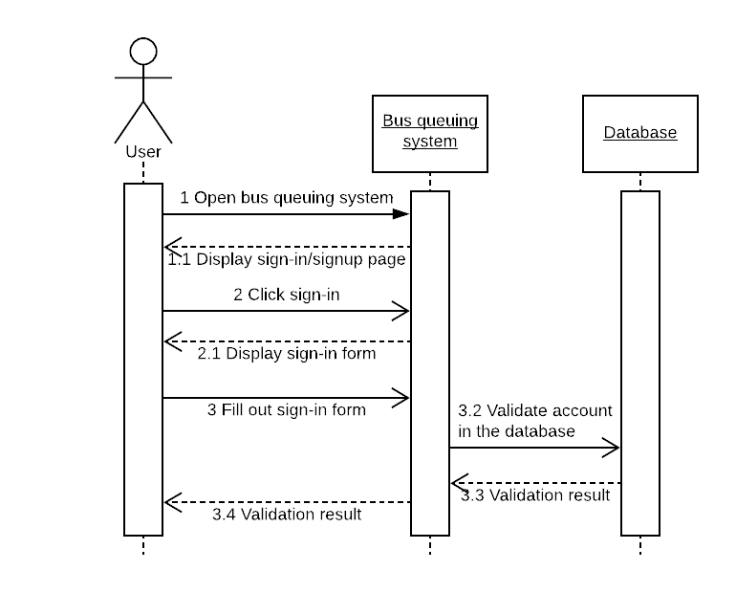
User Login

Slide 22
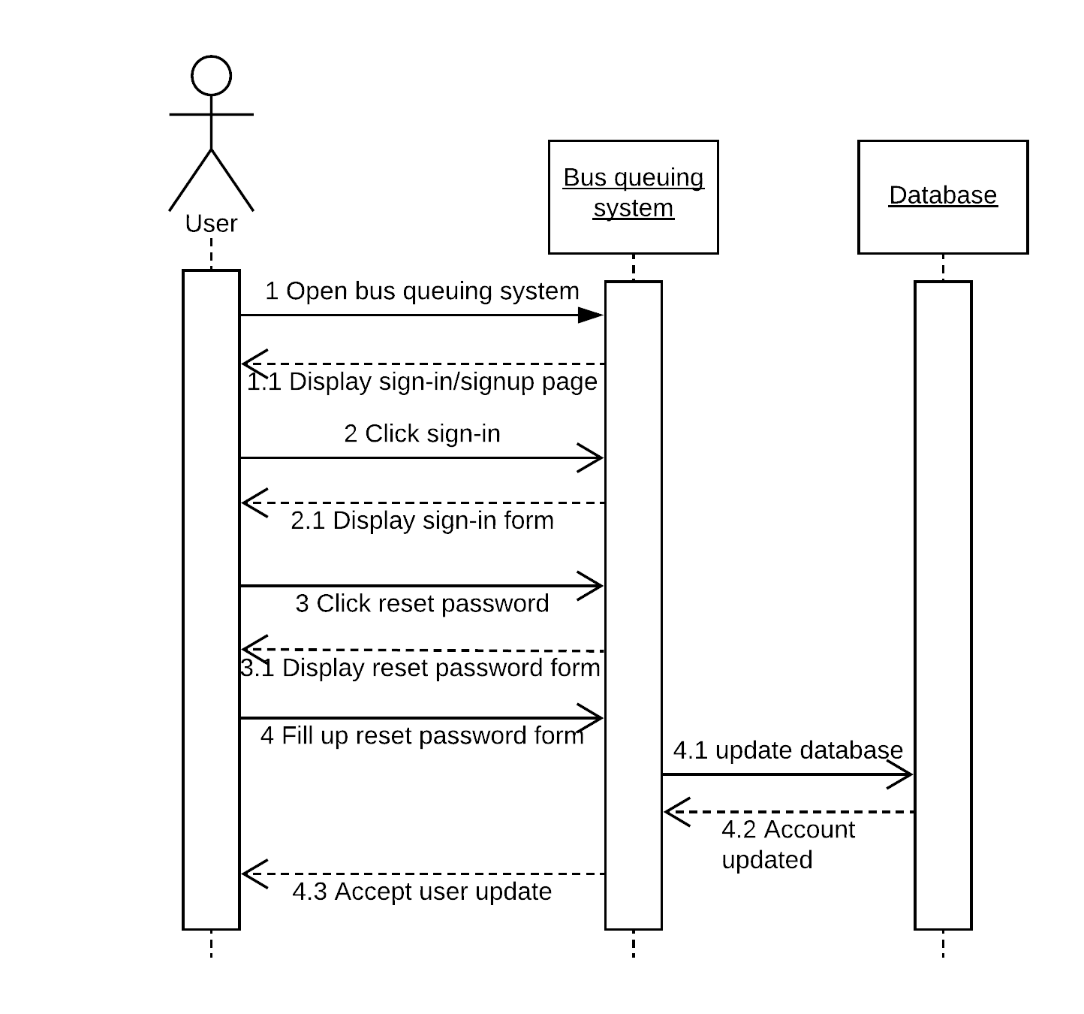
Reset Password

Slide 23
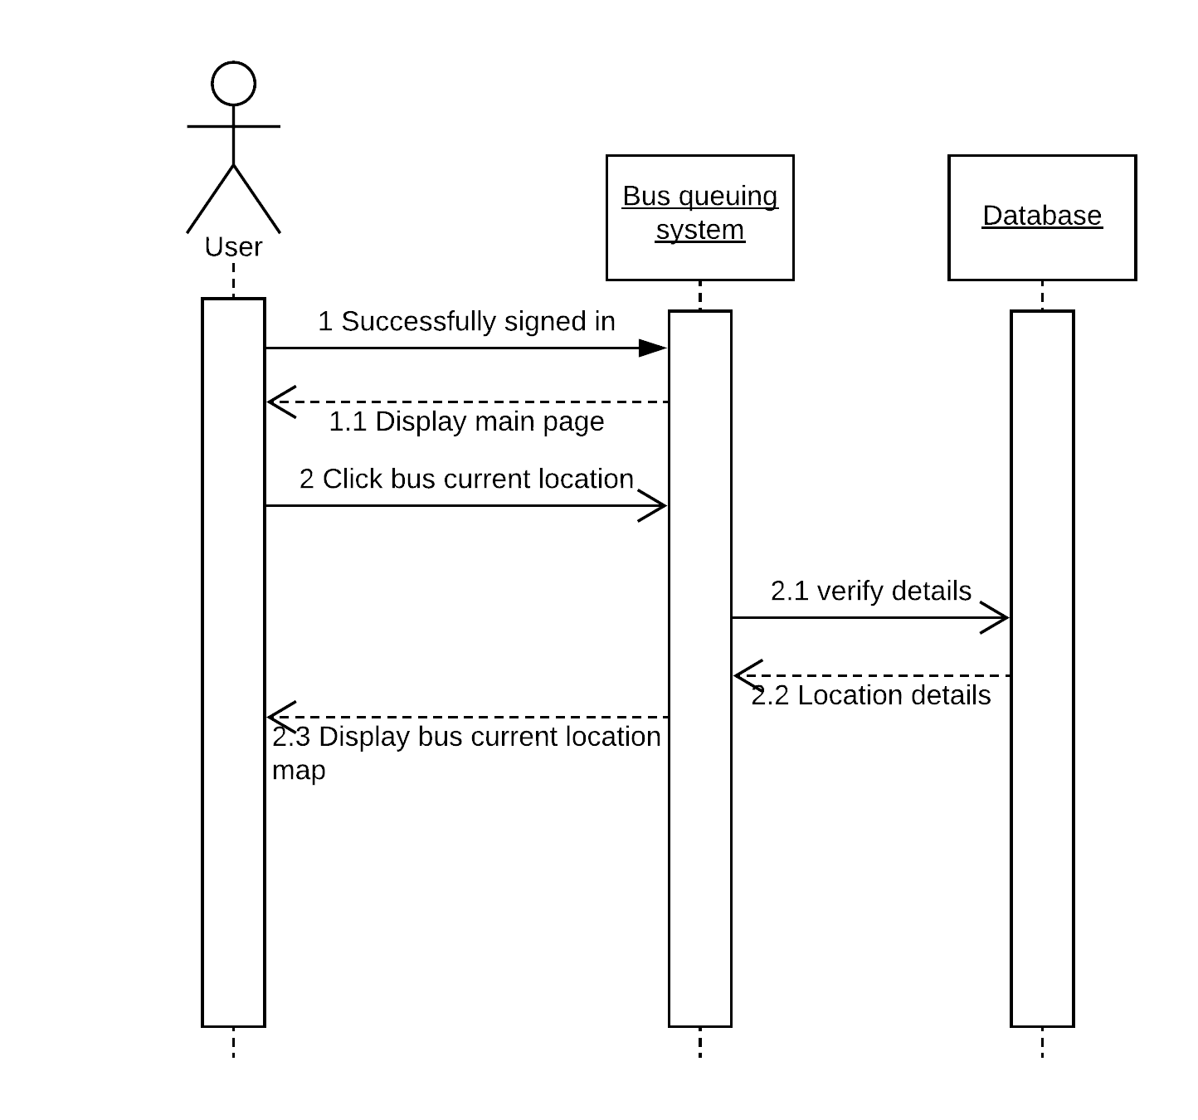
Bus Location

Slide 24

Bus Schedule

Slide 25
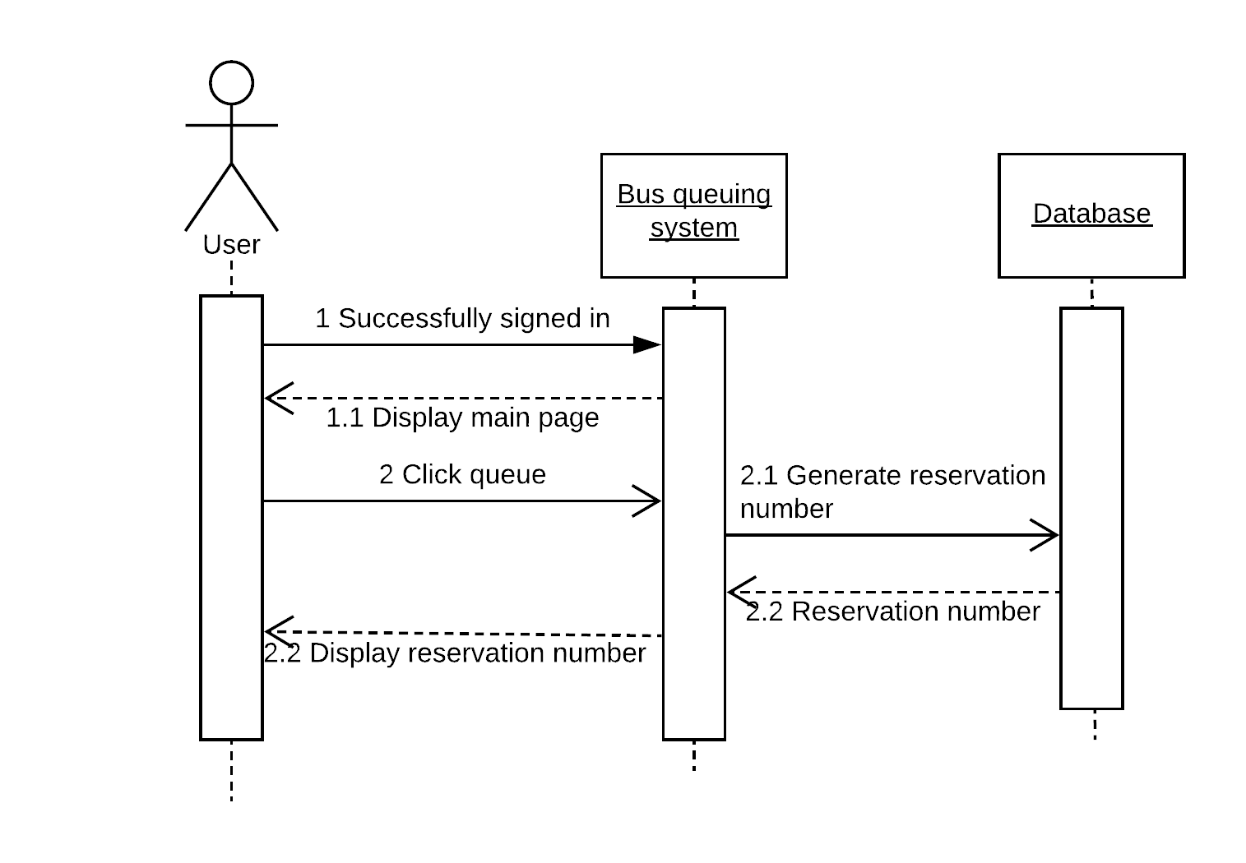
Reserve

Slide 26
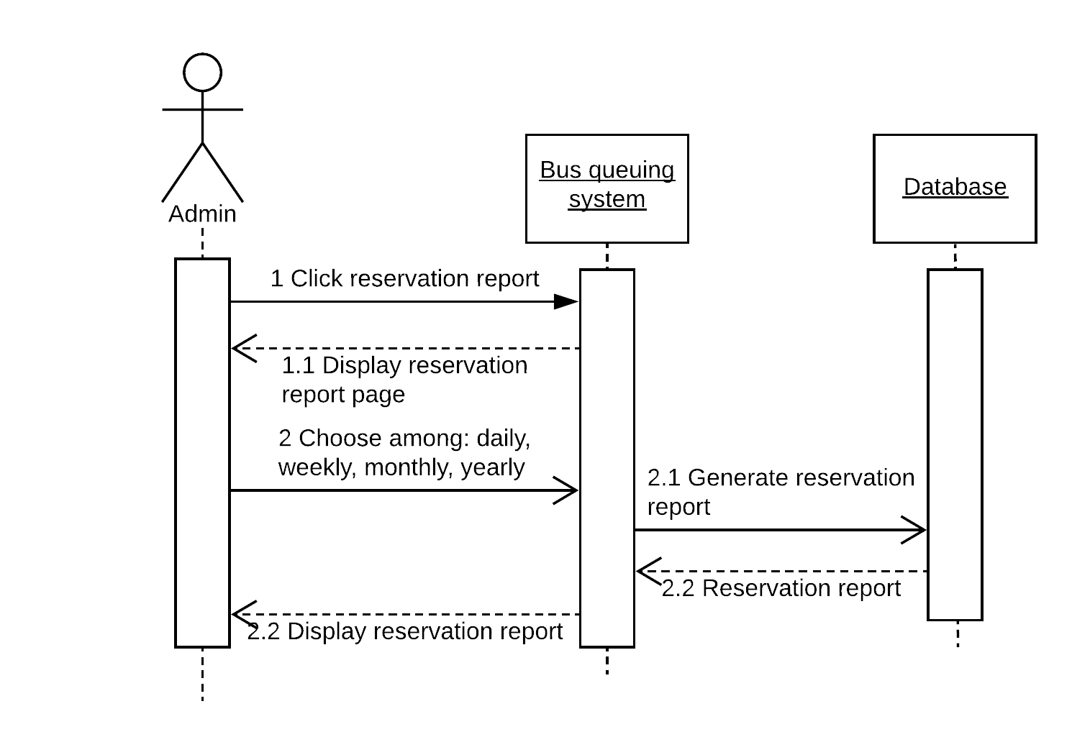
Reservation Report

Slide 27
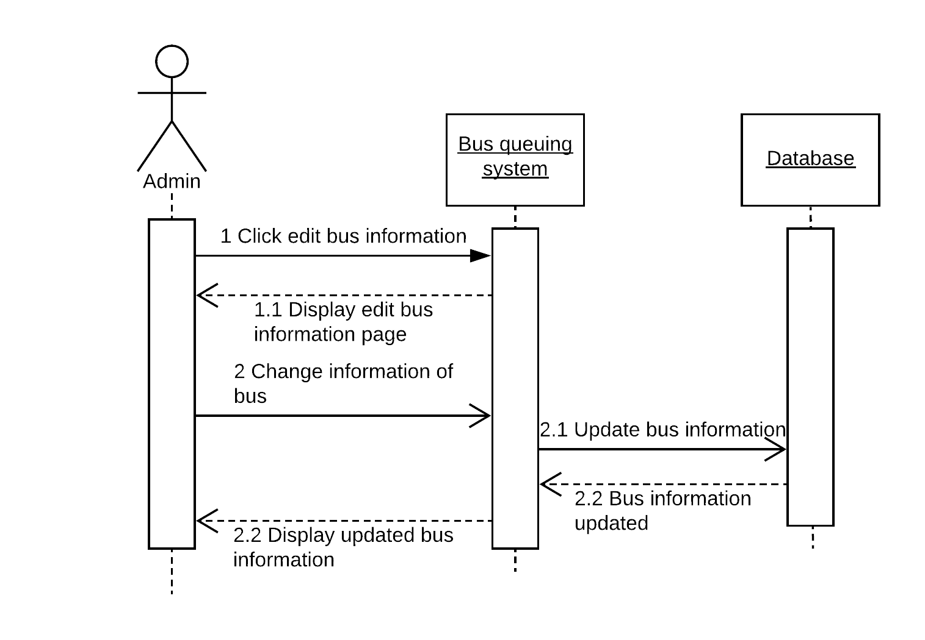
Edit Bus

Slide 28
Entity Relationship Diagram

Slide 29
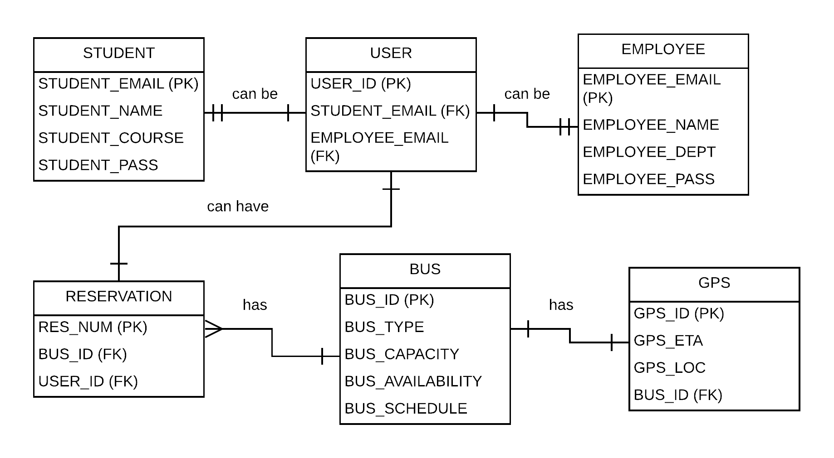

Slide 30
State-Machine Diagram

Slide 31
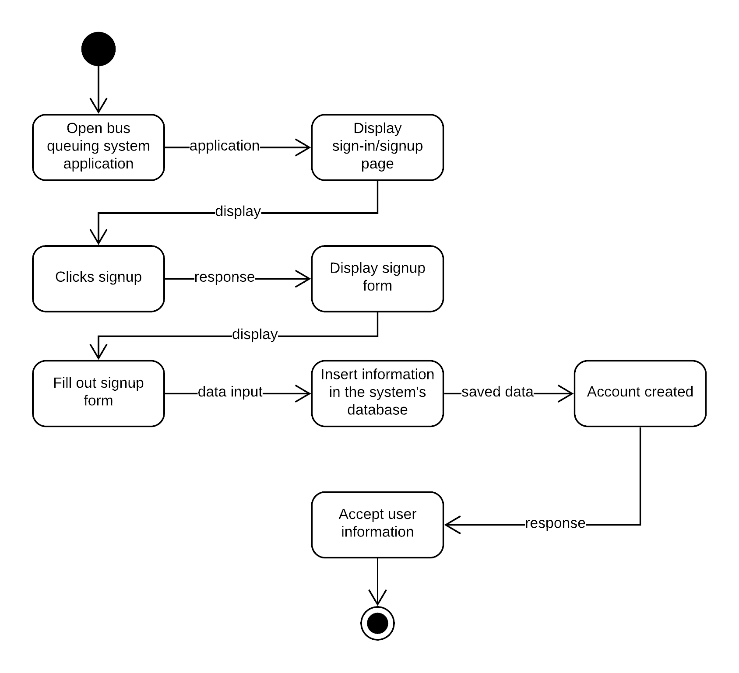
User Registration

Slide 32
User Login

Slide 33
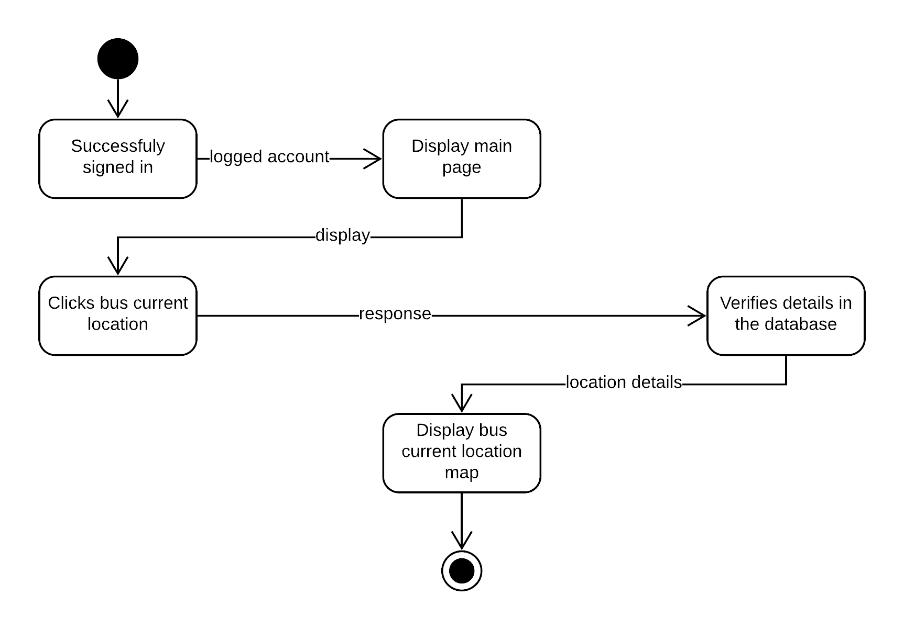
Bus Location

Slide 34

Bus Schedule

Slide 35
Reserve

Slide 36
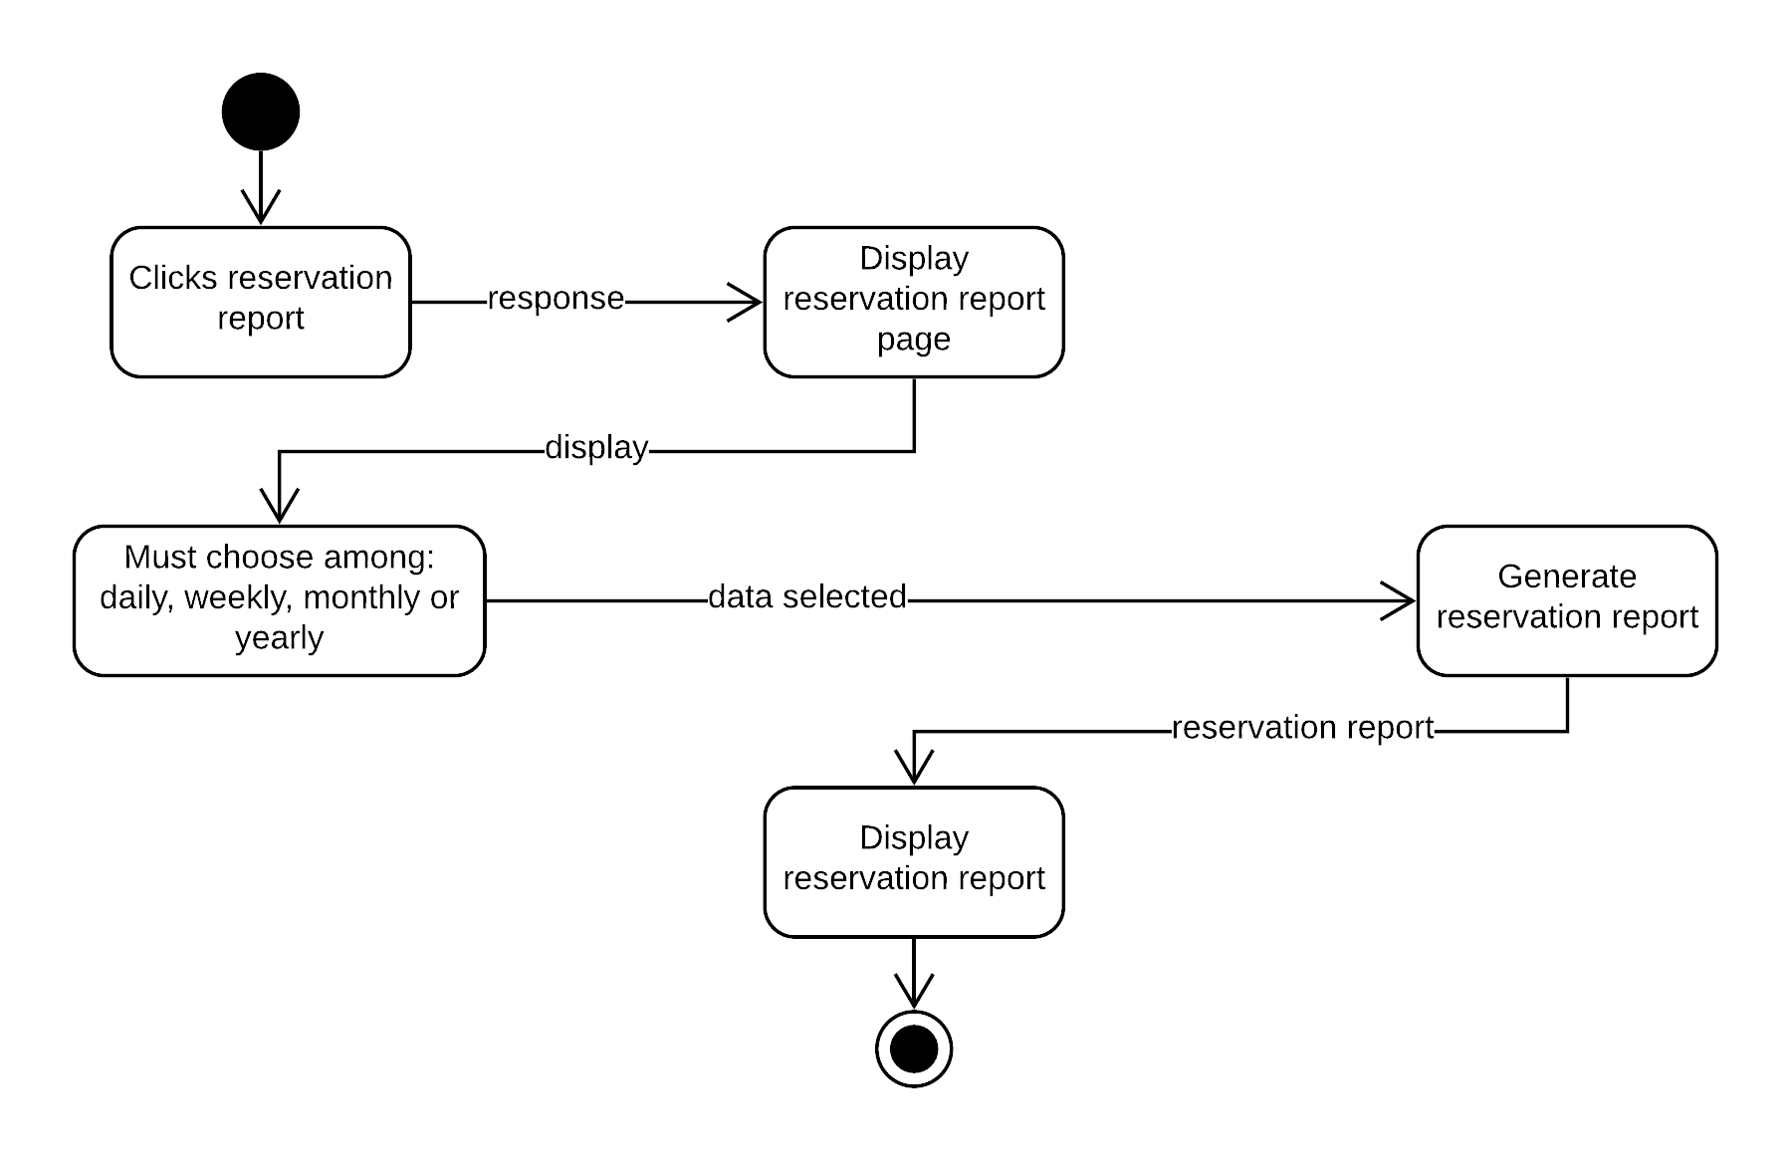
Reservation Report

Slide 37
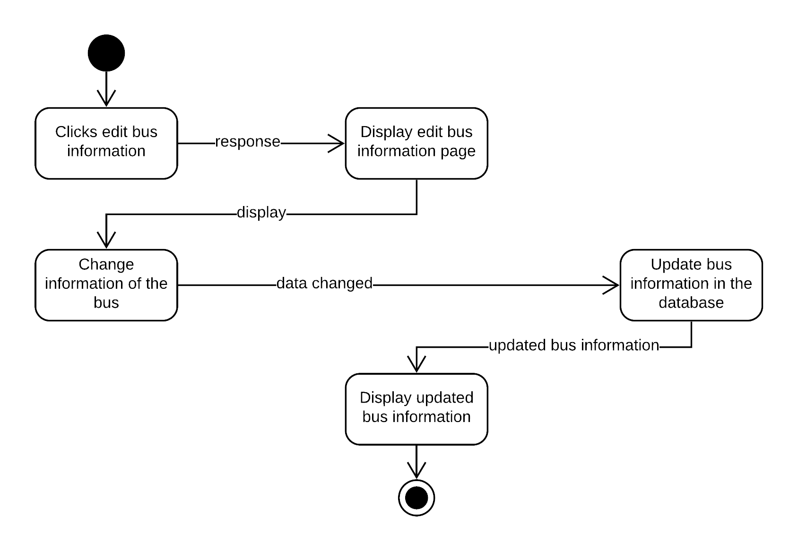
Edit Bus

Slide 38

User Registration

Slide 39
Timing Diagram

Slide 40
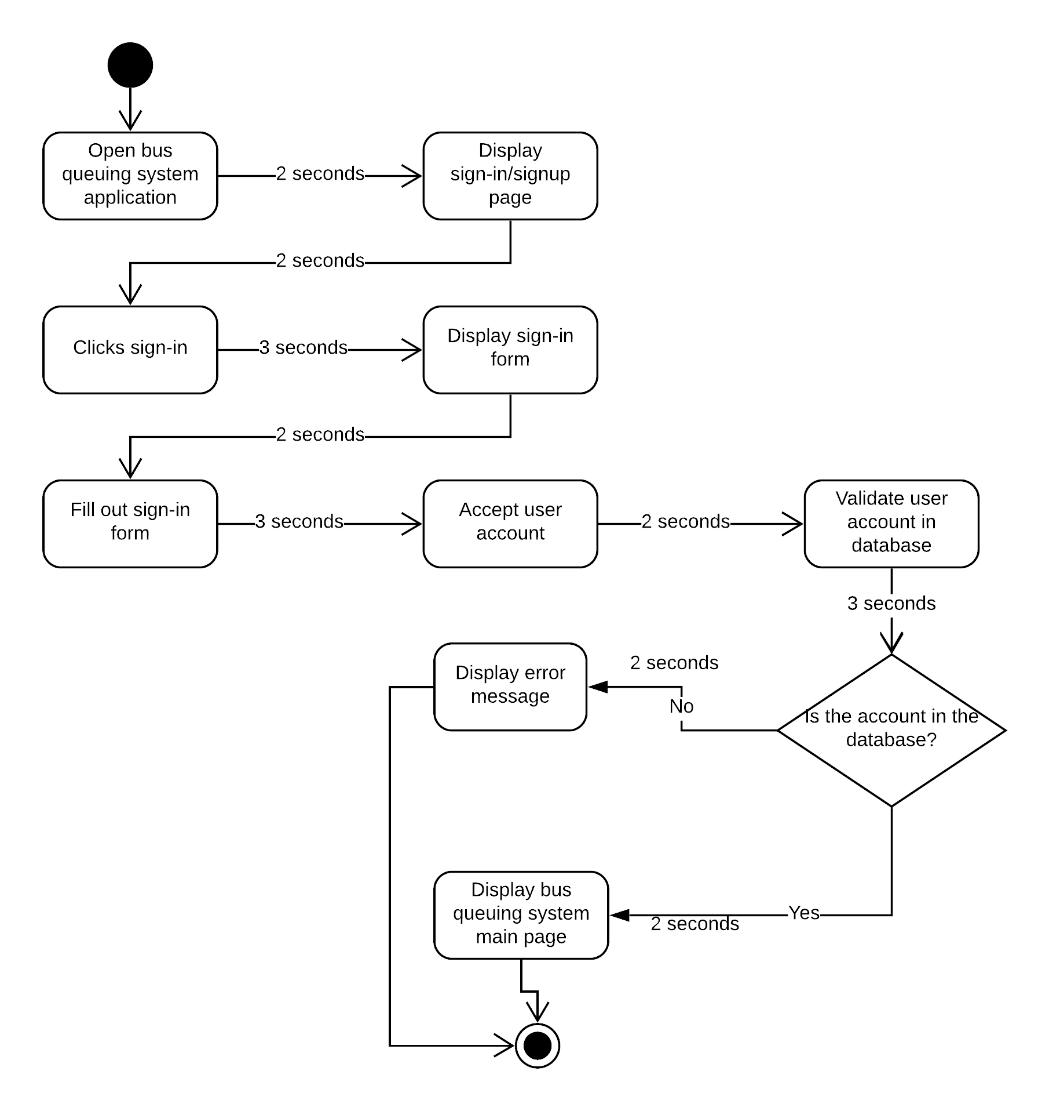
User Login

Slide 41
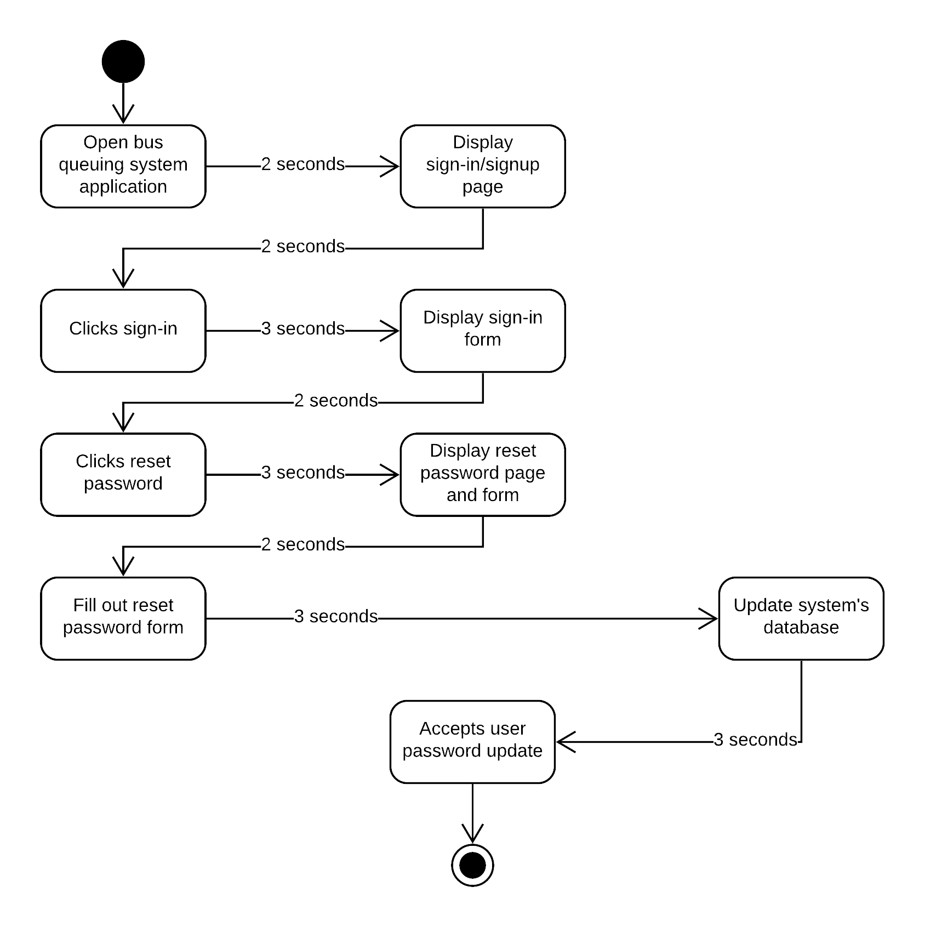
Reset Password

Slide 42

Bus Location

Slide 43

Bus Schedule

Slide 44
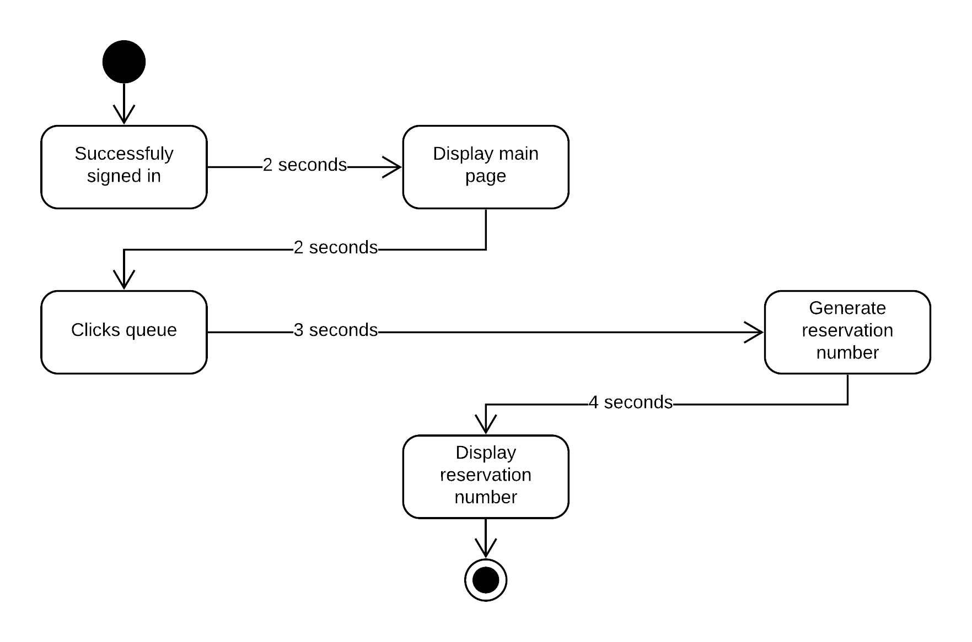
Reserve

Slide 45

Reservation Report

Slide 46

Edit Bus

Slide 47
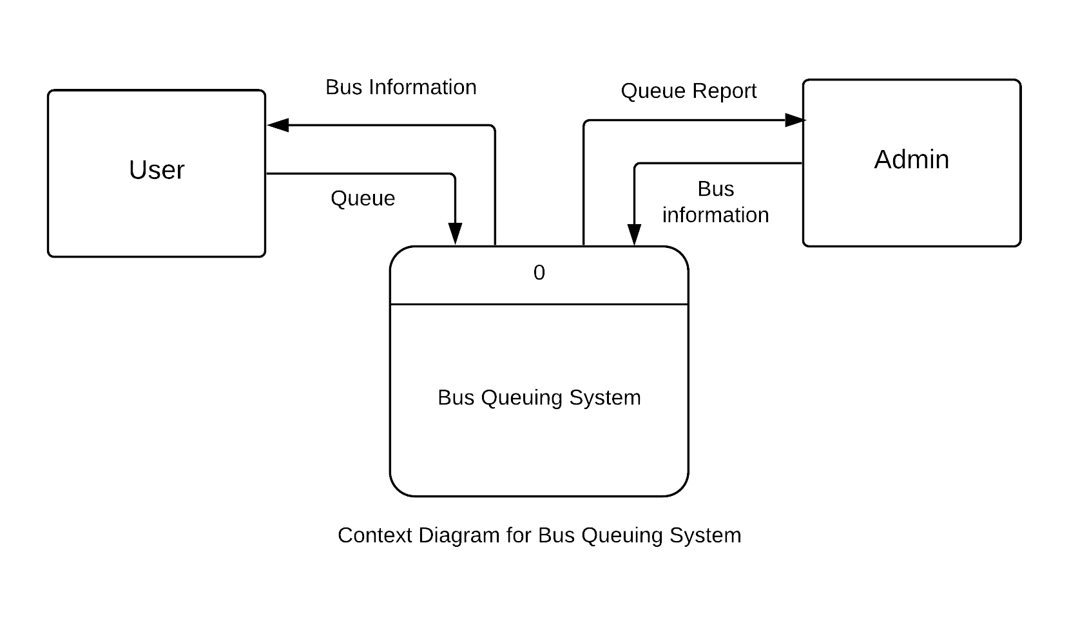
Context Diagram

Slide 48
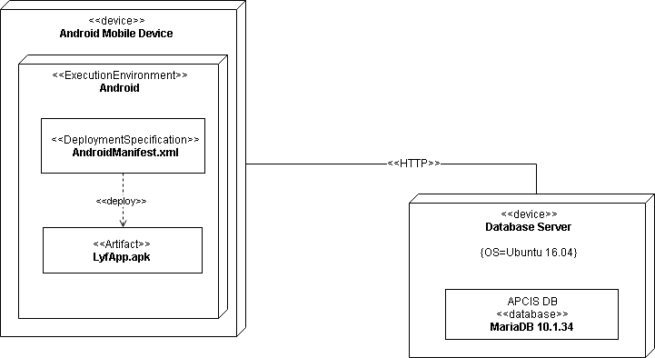
Deployment Diagram

Slide 49
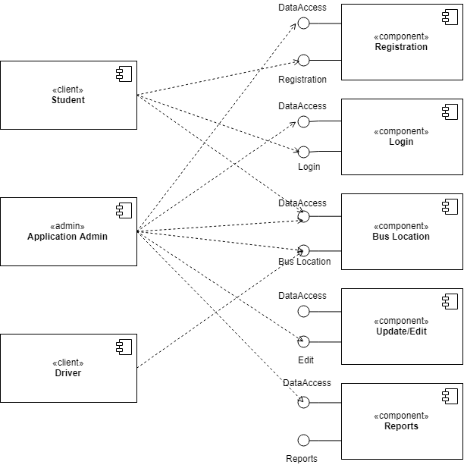
Component Diagram

Slide 50
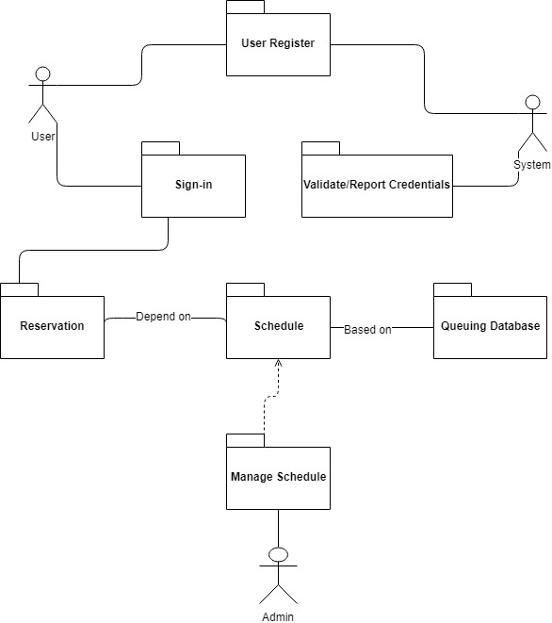
Package Diagram

Slide 51
Gap Analysis
User Requirements | Current System | Proposed Changes
The user needs to have an Android phone and bus queuing system application The user requires to have WIFI or data connection to use the application The user requires to click queue through app to be able to ride a bus | User queue to use bus services Users are not aware of the exact location and schedule of the bus Admins are not aware of the number of passengers riding the bus daily, weekly, monthly and/or yearly Users can cut in line | The proposed application lets the user to create an account to be able to use the application The user must have WIFI or data connection to be able to catch data in the database The proposed application gives each user their corresponding queuing/reservation number to avoid cutting in line The proposed application provide reports for the administrator in order to monitor the number of bus users

Slide 52
SWOT Analysis
Strength | Weakness | Opportunities | Threats
Provides high level of convenience Strongly acknowledge the rules and regulation | Nonconformity with the current bus system Limited support from hardware/software providers Lack of Internet connection | Demand for use of bus services Innovation | Competition Users that are unengaged to the application

Slide 53
Conclusion & Recommendation
Conclusion
This system provides a hassle-free bus queuing system for Asia Pacific College. With this kind of technology, it serves as an answer to the lessen long lines and avoid waiting times of students and faculty.
Recommendation
With the evolution of technology, it is more convenient and time less process to do something if we, people, are to enhance and adopt it. Students and Employees of Asia Pacific College can be able to use their time effectively for the application provides technology-based queuing system which practice and value the rules and regulation of the institution. For anyone who wants to upgrade our system. We highly recommend developing a web based application so students who doesn’t have access to the internet can also use the application.

Slide 54
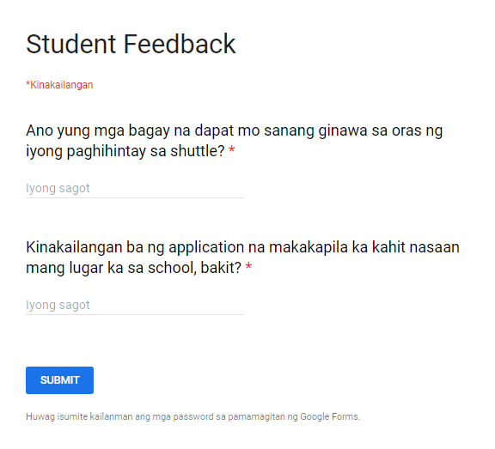
Data Gathering (Online) (50 recipients)

Slide 55
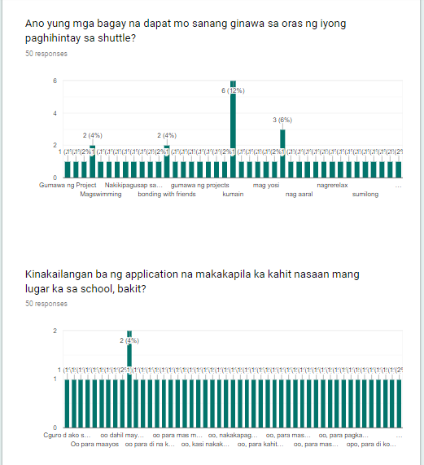
Results

Slide 56
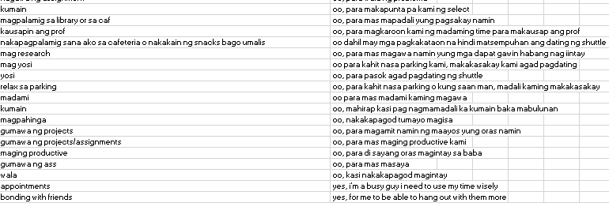
Results

Slide 57
Prototype (Screenshots)

Slide 58
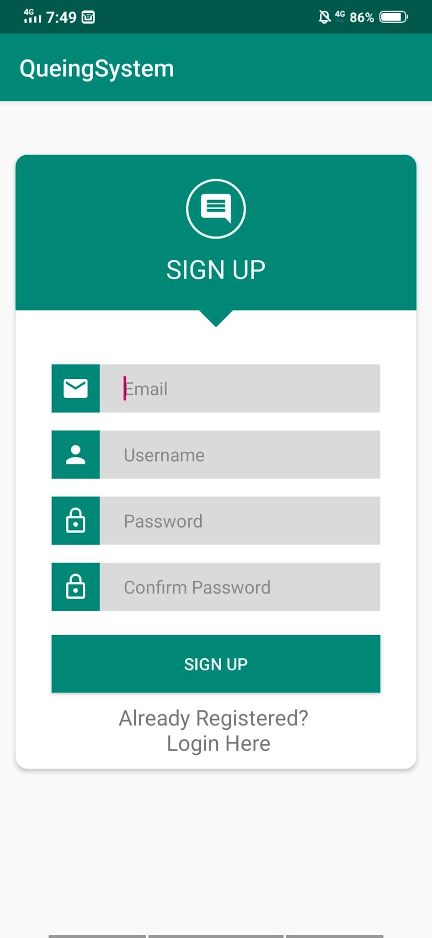
Sign up

Slide 59
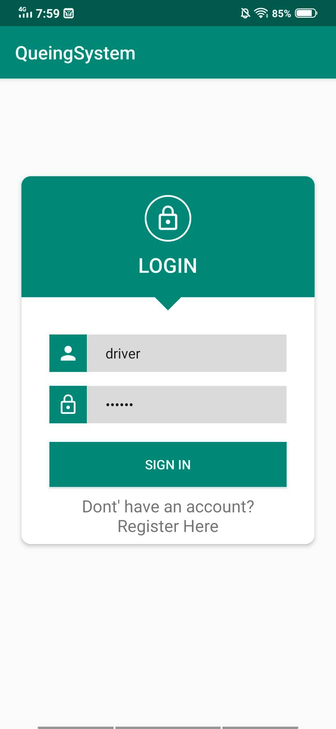
Driver

Slide 60
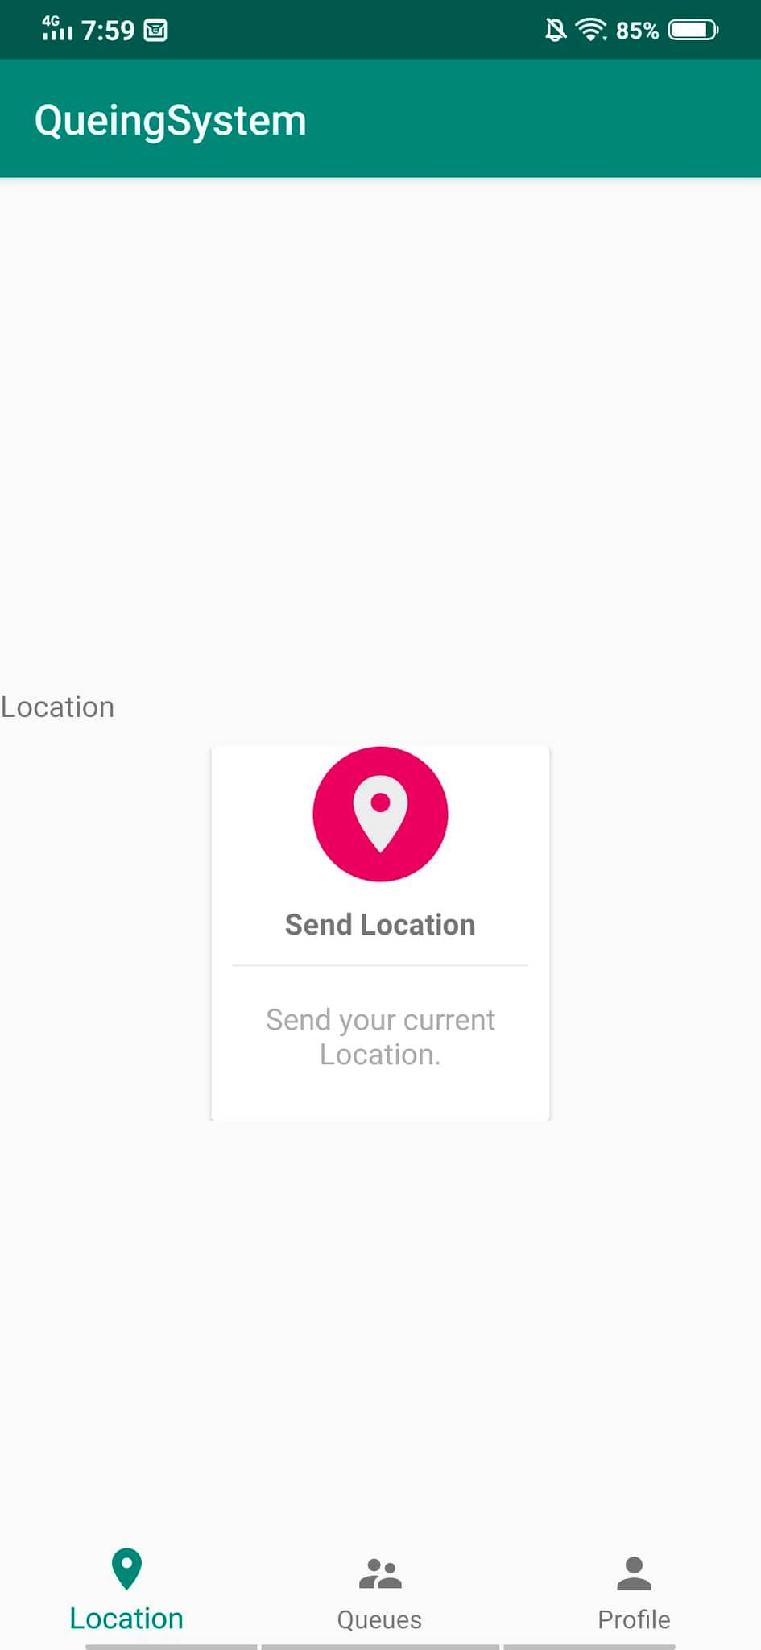
Driver

Slide 61

Student

Slide 62
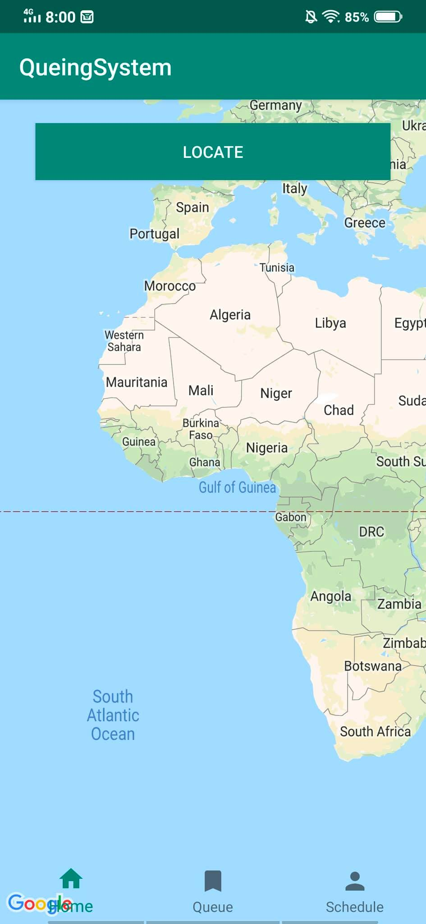
Student

Slide 63
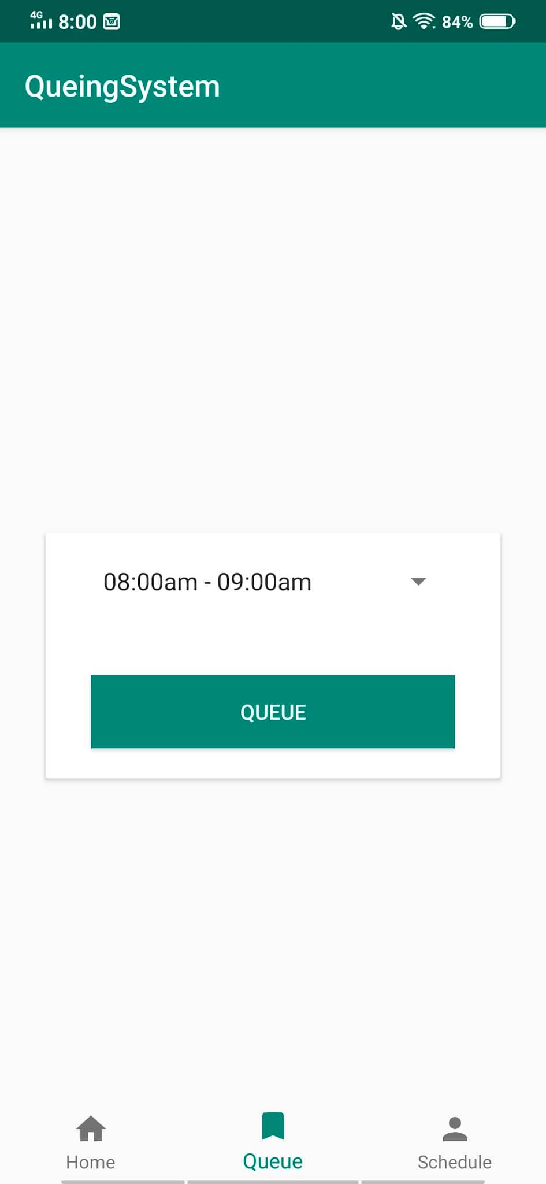
Student

Slide 64
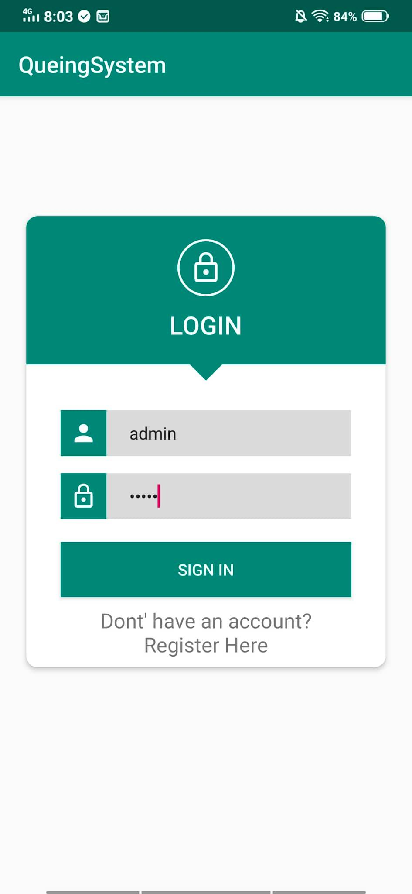
Admin

Slide 65
