Slide 1

Members:
Jamie Therese Gahallon
John David Solomon
Adviser:
Engr. Marielet Guillermo
Notes:
Jamie (Greetings)

Slide 2
Introduction
Notes:
Jamie

Slide 3
Philippine Institute of Traditional Health Care
PITAHC
Created through R.A. 8423 (Traditional and Alternative Medicine Act)
VISION “People’s health through traditional and alternative health care”
MISSION “We lead in the research and development, promotion and advocacy, and development of standards on traditional and complementary medicine (T&CM); and we ensure its accessibility, availability, sustainability and integration into the national health care. system.”
Notes:
Jamie

Slide 4
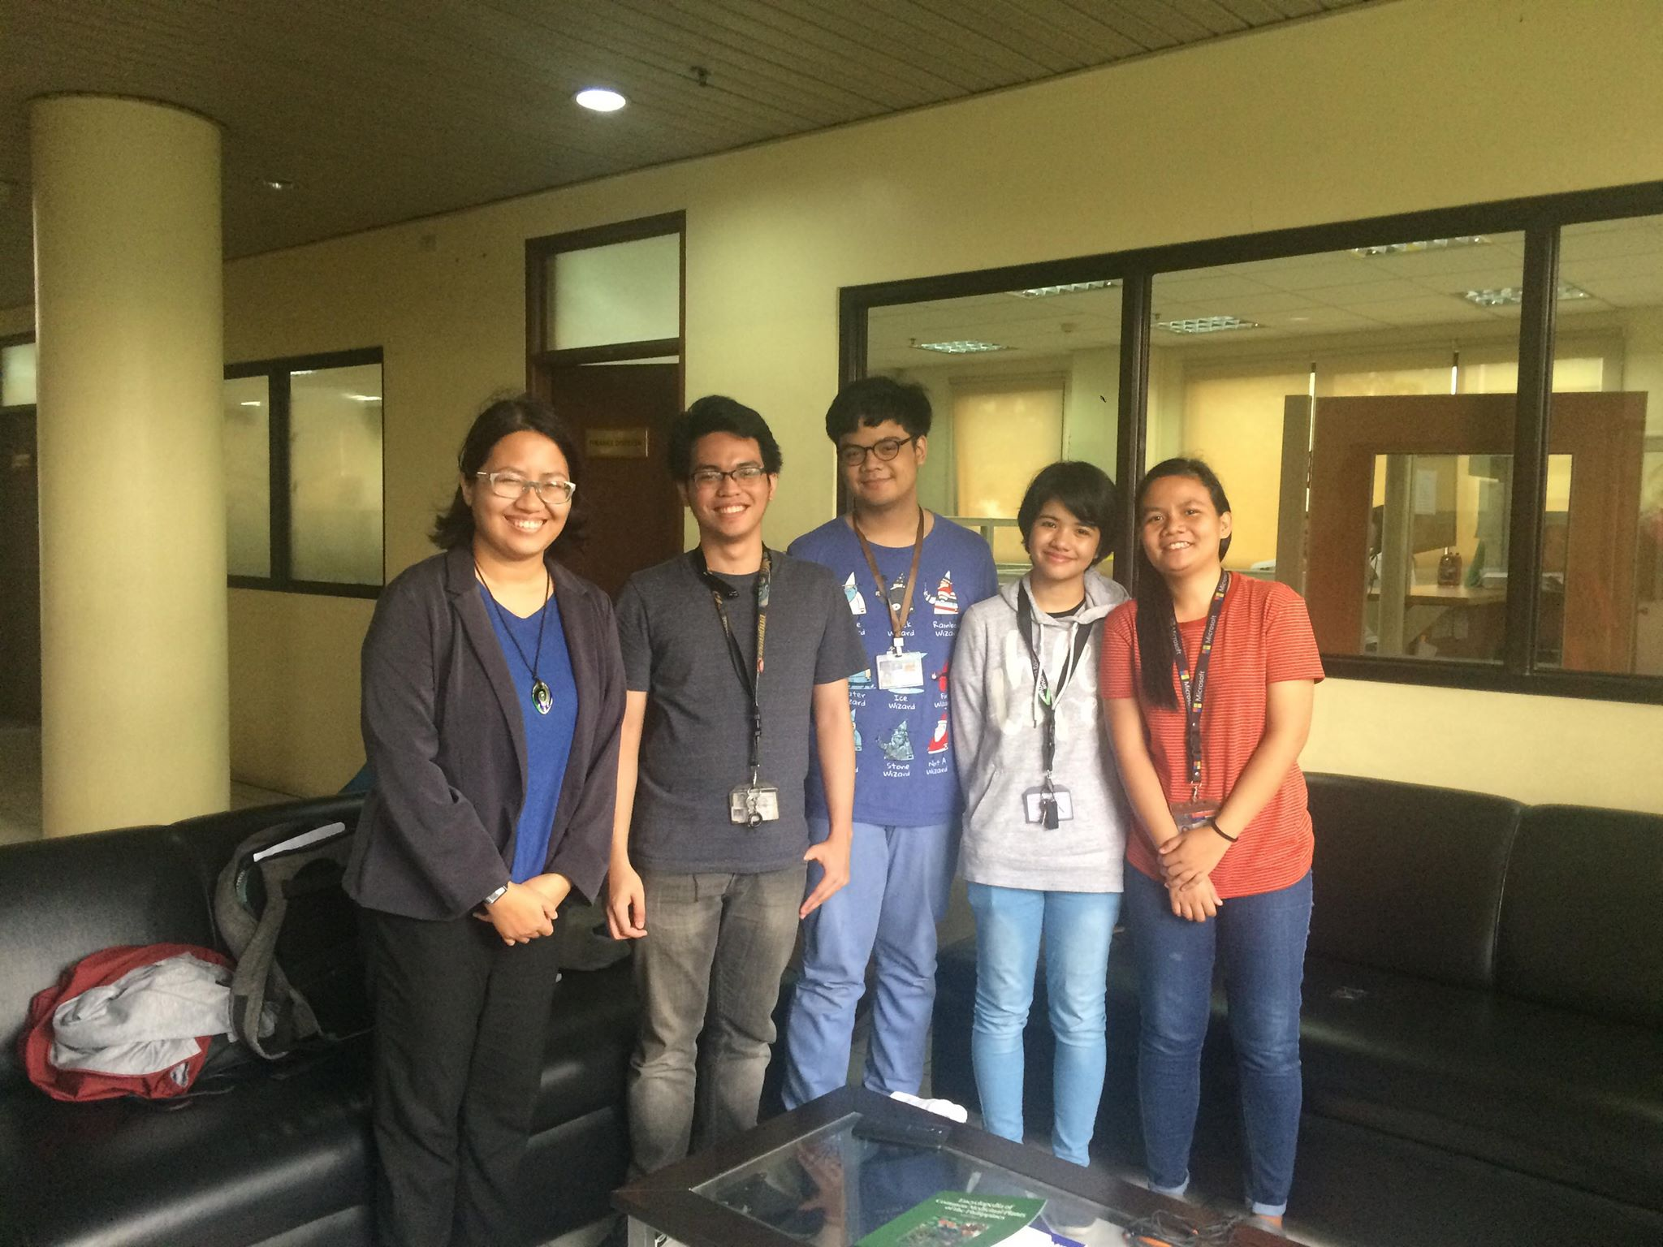
Ms. Ma. Teresa M. Torres
Science Research Specialist II
Notes:
Jamie

Slide 5
User Requirement | Current Standing | Proposed Action
Improve information dissemination by accessing more platforms to reach users. | Information is currently just being posted on PITAHC’s site | Aside from the web, info can now be viewed, accessed via Lyf app.
Encourage sharing of information with PITAHC and other citizens/researchers through easy and uncomplicated process of submission | People who want to share their research and have them released through PITAHC has to schedule a meeting with a PITAHC representative. | Information can be submitted through the Lyf app. Users are notified upon verification and approval of PITAHC. Information will then be disseminated and available on the Lyf app.
Allow users to identify plants easily | Specimen/plant has to be brought to PITAHC or Bureau of Plant Industry for identiciation | Specimen/plant is identified through the Image Recognition feature of the Lyf app.
Gather information on plant population or abundance on locations | PITAHC performs field research, sends representatives to location, and manually keep track of plant population | Location of the identified plants are automatically recorded, available to other Lyf app users and data source of system report for the admin.
Notes:
Mixed

Slide 6
Objectives
Notes:
David

Slide 7
General Objective
Create a system that will allow identification, information exchange, and location sharing of traditional and contemporary medicinal plant and generate reports for the use of PITAHC.
Notes:
David

Slide 8
Specific Objectives
• Create an Android application that will allow users to
o Register and Login
o Identify plants through Image Recognition
o Share the location of identified plants
o View all plant locations
o Report plant mislocation or incorrect location.
o Access, add and edit information and researches on traditional and contemporary medicinal plants
Notes:
David

Slide 9
Specific Objectives
• Create a web-based system that will allow admin to
o Login
o Respond to plant mislocation report
o Respond to user requests to add and edit information
o Access, add and edit information and researches on traditional and contemporary medicinal plants
o Access all result of plant identification through image recognition – including not found results.
o Generate reports such as reports on plants species identified over period of time, and/or confined in specific area, and plants not identified by the system.
Notes:
David

Slide 10
Scope
Notes:
Mixed

Slide 11
Admin
Create an account by providing:
Name
Username
Password
Email
Position
Access the Lyf Web Admin Panel
Assign Admin role to registered account.
Edit account.
David
Notes:
Jamie

Slide 12
Admin
View all result of image recognition, both successful and failed results.
Address mislocation report and remove plant location from Maps.
View all admins response to mislocation report.
View all plant information shown in plant glossary.
Add/Edit plant information in plant glossary.
View all requests for add and edit plant information.
Change request status to Verified.
Delete requests.
David
Notes:
Jamie

Slide 13
Users
Create an account by providing:
Name
Username
Password
Email
Access the Lyf App.
Edit account.
Notes:
David

Slide 14
Users
View all locations of successful image recognitions through Maps.
Report mislocation or missing in location of plant in Maps.
Identify plants by isolating the leaf and capturing an image of it.
View the plant glossary and information verified by the admin.
Create requests to add information/plant in the plant glossary.
Create requests to edit information in the plant glossary.
Notified upon verification of requests.
David
Notes:
David

Slide 15
Limitations
David
Notes:
David

Slide 16
The Lyf Web Admin Panel is the responsibility of the client, PITAHC. Admin roles are granted by PITAHC.
System can only recognized plants which has undergone match training.
Plants can only be recognized by capturing an image of its leaf.
Notes:
David

Slide 17
Event Table
Notes:
Mixed

Slide 18
Event | Trigger | Source | Use Case | Response | Destination
A registration form will be shown if the user hasn’t created an account for the app yet (or wants to create a new account for the app) | User registration | User | User Registers | Display Register form | User/System
User has photographed a plant for identification | User wants to identify a certain plant | User | Captures Plant Image | System prepares image for identification | System
System compares image with training data set | System receives photo | System | Process Image | System displays identified plant match | User
System creates report if plant match is not found | Plant cannot be identified by system | System | Create Not Found report | System generates Plant Not Found report | User/System
Notes:
Jamie

Slide 19
Event | Trigger | Source | Use Case | Response | Destination
User reports incorrect/missing location | Report from user | User | Create Mislocation report | System generates Mislocation report | User/System
User wants to add or edit plant information in the plant glossary | User adds/edits plant information in the plant glossary | User | Create Add/Edit Plant Information Request | System generates Add/Edit Plant Information Request for the admin | Admin/System
Admin responds to requests and reports | Requests and reports from user | Admin | Validate Report and Request | Admin validates reports and requests | User/System
Admin updates plant glossary | Admin updates plant details in the system | Admin | Update Plant Glossary | System updates plant glossary | System
System generates reports | Admin requests for System Reports | Admin | Generate System Reports | System displays reports | Admin/System
Notes:
David

