Slide 1

Members:
Jamie Therese Gahallon
John David Solomon
Adviser:
Engr. Marielet Guillermo
Development of Mobile Application for Plant Recognition and Location Documentation
Notes:
Jamie (Greetings)

Slide 2
Midterm Revisions:
Problem Statement
Objectives
Scope and Limitations
Methodology
Notes:
Jamie – Problem Statement / Objectives / Scope and Limitations / Methodology

Slide 3
Introduction
Notes:
Jamie

Slide 4
Philippine Institute of Traditional Health Care
PITAHC
Created through R.A. 8423 (Traditional and Alternative Medicine Act)
Notes:
Jamie - Created through R.A. 8423 (Traditional and Alternative Medicine Act)

Slide 5
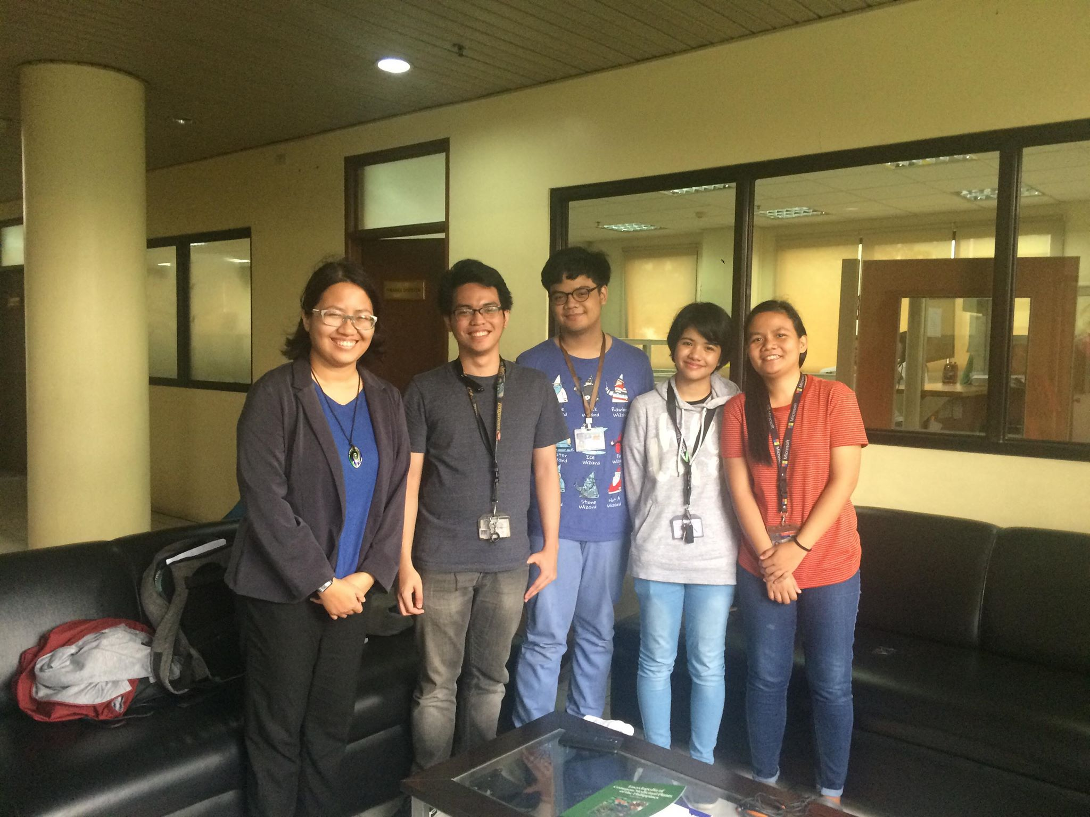
It is difficult for PITAHC to advocate use of medicinal plants because some Filipinos can’t recognize them.
Tedious task of sending representatives to locations for monitoring of plant abundance.
Ms. Ma. Teresa M. Torres
Science Research Specialist II
Notes:
David / Ms. Ma. Teresa M. Torres - Science Research Specialist II / It is difficult for PITAHC to support the idea of using of medicinal plants because some Filipinos can’t recognize them. / If they were to do this manually it be a very difficult and costly task as they will have to send out some representatives to locations for monitoring of plant abundance

Slide 6
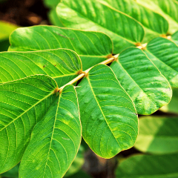
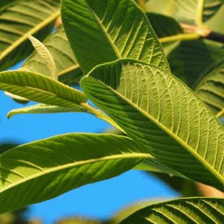
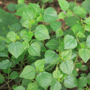
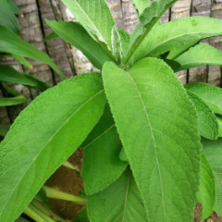
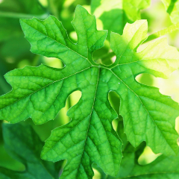

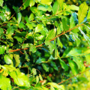
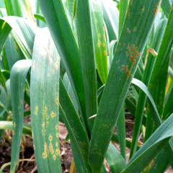
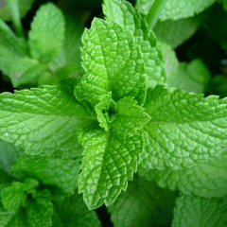
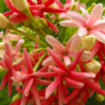
Survey
Respondents are presented pictures of DOH-approved “Common Medicinal Plants”
32%
34%
24%
16%
16%
Akapulko
Bayabas
Pansit Pansitan
Sambong
Ampalaya
10%
20%
8%
5%
34%
Lagundi
Tsaang Gubat
Bawang
Yerba Buena
Niyog-niyogan
There is a difficulty in identifying these plants.
Notes:
David

Slide 7
User Requirement | Current Standing | Proposed Action
Allow users to identify plants easily | Specimen/plant has to be brought to PITAHC or Bureau of Plant Industry for identiciation | Specimen/plant is identified through the Image Recognition feature of the Lyf app.
Improve information dissemination by accessing more platforms to reach users. | Information is currently just being posted on PITAHC’s site | Aside from the web, info can now be viewed, accessed via Lyf app.
Encourage sharing of information with PITAHC and other citizens/researchers through easy and uncomplicated process of submission | People who want to share their research and have them released through PITAHC has to schedule a meeting with a PITAHC representative. | Information can be submitted through the Lyf app. Users are notified upon verification and approval of PITAHC. Information will then be disseminated and available on the Lyf app.
Gather information on plant population or abundance on locations | PITAHC performs field research, sends representatives to location, and manually keep track of plant population | Location of the identified plants are automatically recorded, available to other Lyf app users and data source of system report for the admin.
Notes:
David

Slide 8
Objectives
Notes:
David

Slide 9
General Objective
Create a system that will allow identification, information exchange, and location sharing of traditional and contemporary medicinal plant and generate reports for the use of PITAHC.
Notes:
David

Slide 10
Specific Objectives
To classify plant by its leaf using an image classifier developed on TensorFlow
To create a collection of data on medicinal plants and its benefits
To gather data on location and abundance of plants
Notes:
David

Slide 11
Scope
Notes:
Mixed

Slide 12
Admin
Create an account by providing:
Name
Username
Password
Email
Position
Access the Lyf Web Admin Panel
Assign Admin role to registered account.
Edit account.
Notes:
Jamie

Slide 13
Admin
View all result of image recognition, both successful and failed results.
Address incorrect location report and remove plant location from Maps.
View all admins response to incorrect location report.
View all plant information shown in plant glossary.
Add/Edit plant information in plant glossary.
View all requests for add and edit plant information.
Change request status to Verified.
Delete requests.
Notes:
Jamie

Slide 14
Users
Create an account by providing:
Name
Username
Password
Email
Access the Lyf App.
Edit account.
Notes:
David

Slide 15
Users
View all locations of successful image recognitions through Maps.
Report incorrect location of plant in Maps.
Identify plants by isolating the leaf and capturing an image of it.
View the plant glossary and information verified by the admin.
Create requests to add information/plant in the plant glossary.
Create requests to edit information in the plant glossary.
Notified upon verification of requests.
Notes:
jamie

Slide 16
Limitations
Notes:
David

Slide 17
The Android app is developed using SDK for Android 8.1.
The image quality is dependent on the camera specifications of the device and its effect on the result of image recognition is not considered.
Researchers used TensorFlow for image recognition and training.
Training model are limited to classification of Bayabas, Pansit-pansitan.
The Lyf Web Admin Panel is the responsibility of the client, PITAHC. Admin roles are granted by PITAHC.
System can only recognized plants which has undergone match training.
Plants can only be recognized by capturing an image of its leaf.
Notes:
David

Slide 18
Technical Background

Slide 19
Image Recognition
Technology that can detect and recognize subjects such as people, animals or objects through algorithms and machine learning.
Approach
Machine Learning
Deep Learning
Notes:
David - Technology that can detect and recognize subjects such as people, animals or objects through algorithms and machine learning.

Slide 20

Convolutional Neural Network
Notes:
Jamie

Slide 21
TensorFlow
open source library created by the Google Brain Team
used for numerical computation and large-scale machine learning.
Notes:
Jamie

Slide 22
Google Maps
Used to create a custom map, a searchable map, check-in functions, display live data syncing with location, plan routes, or create a mashup just to name a few.
Notes:
David

Slide 23
Development
Notes:
Jamie

Slide 24

FFmpeg

Slide 25
Labeled Images for Training

Slide 26

https://codelabs.developers.google.com/codelabs/tensorflow-for-poets/
.pb
.txt
Notes:
David

Slide 27


Android
Web
Notes:
David

Slide 28
Project

Slide 29
Event | Trigger | Source | Use Case | Response | Destination
A registration form will be shown if the user hasn’t created an account for the app yet (or wants to create a new account for the app) | User registration | User | User Registers | Display Register form | User/System
User has photographed a plant for identification | User wants to identify a certain plant | User | Captures Plant Image | System prepares image for identification | System
System compares image with training data set | System receives photo | System | Process Image | System displays identified plant match | User
System creates report if plant match is not found | Plant cannot be identified by system | System | Create Unidentified Plant report | System generates Unidentified Plant report | User/System
Notes:
Jamie

Slide 30
Event | Trigger | Source | Use Case | Response | Destination
User reports incorrect/missing location | Report from user | User | Create Incorrect Location report | System generates Incorrect Location report | User/System
User wants to add or edit plant information in the plant glossary | User adds/edits plant information in the plant glossary | User | Create Add/Edit Plant Information Request | System generates Add/Edit Plant Information Request for the admin | Admin/System
Admin responds to requests and reports | Requests and reports from user | Admin | Validate Report and Request | Admin validates reports and requests | User/System
Admin updates plant glossary | Admin updates plant details in the system | Admin | Update Plant Glossary | System updates plant glossary | System
System generates reports | Admin requests for System Reports | Admin | Generate System Reports | System displays reports | Admin/System
Notes:
David

Slide 31
Demo

Slide 32
Future Development/Plans
Notes:
Mixed

Slide 33
Image Recognition
More training data
Include diverse plants
Android Application
Improve interface
Allow sharing to social media platforms
Web
Improve interface
Improve report generation
Allow admin to add/edit information of plants
Notes:
David

Slide 34
Thank you
For
Listening!
Development of Mobile Application for Plant Recognition and Location Documentation
Notes:
Mixed (Closing)

