Slide 1
JIT Ordering System

Slide 2
Project Context
use of mobile phones to order and receiving orders from customers
Client can’t answer the phone sometimes
time-consuming process, inaccurate reports, unorganized business, and misunderstanding between client and customer
The team would develop web based application for efficiency of ordering process

Slide 3
Purpose and Description
improve the ordering process
improve the operation of the company
helps to generate reports accurately
enhance productivity, and effective online ordering.

Slide 4
Objectives
To increase efficiency and improve services
To improve the service, sales, and customer satisfaction
To have a convenient way to order of items.
To create a web based application that is easy to use.

Slide 5
Scope and Limitations
provide a web based application using PHP
aims to improve the efficiency of ordering process
Customer will be able to view the product, price, and description visually
There will be 2 users for the system
It requires a computer and internet connection to use the system.

Slide 6
Review of Related Literature
Toyota Inventory Management
HP (Hewlett-Packard)
Dell
Harley Davidson

Slide 7
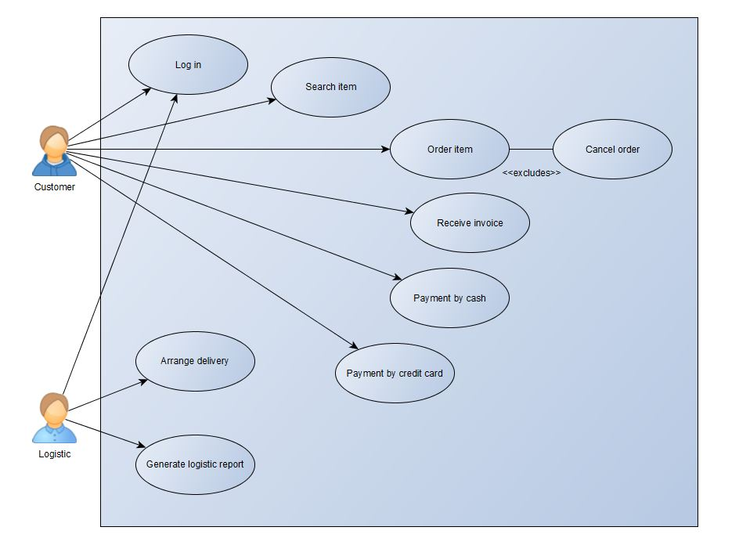
Use Case Diagram

Slide 8
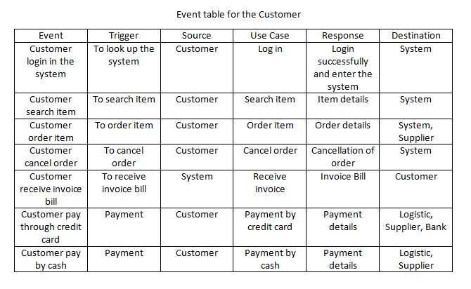
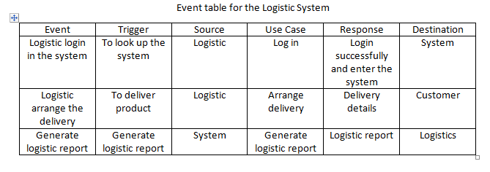
Event Table

Slide 9
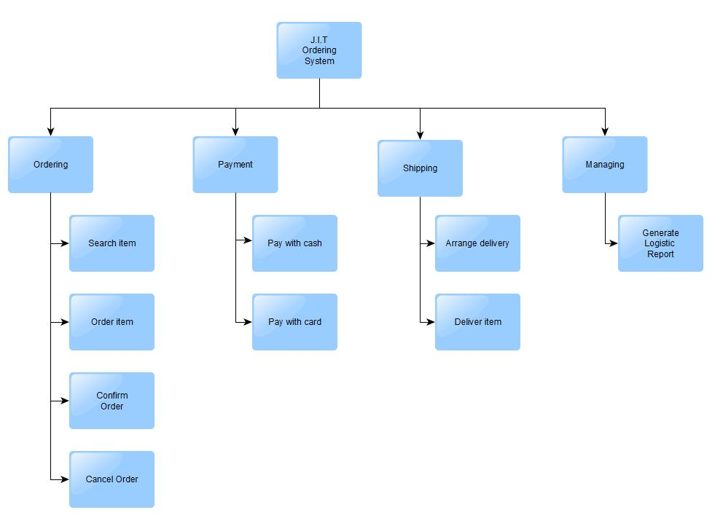
Functional Decomposition Diagram

Slide 10
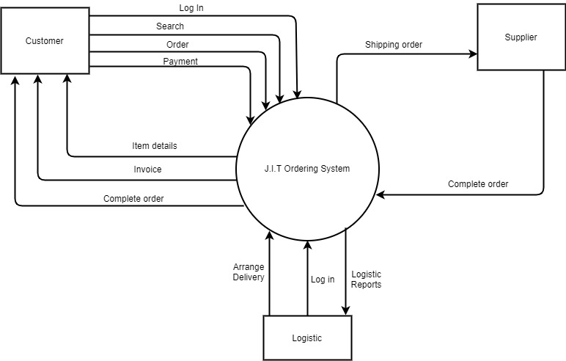
Context Flow Diagram

Slide 11
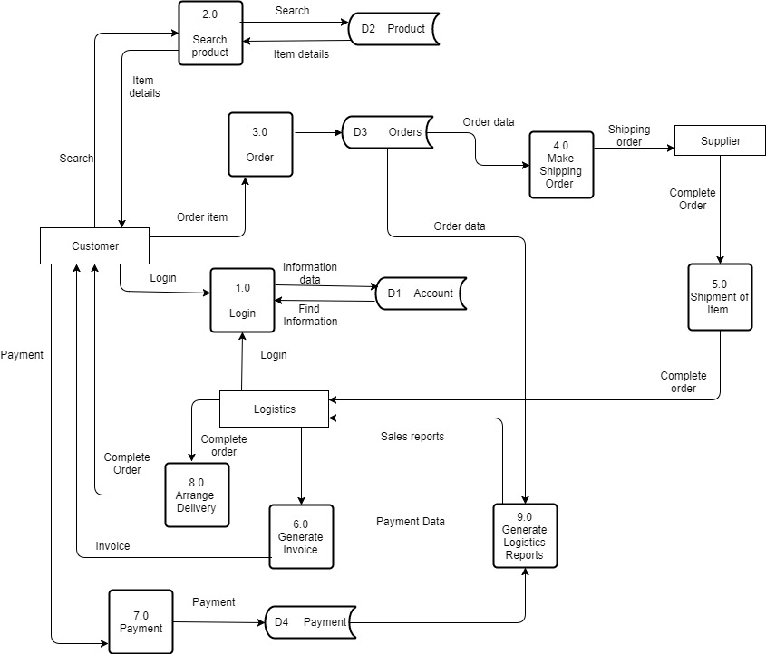
Data Flow Diagram

Slide 12
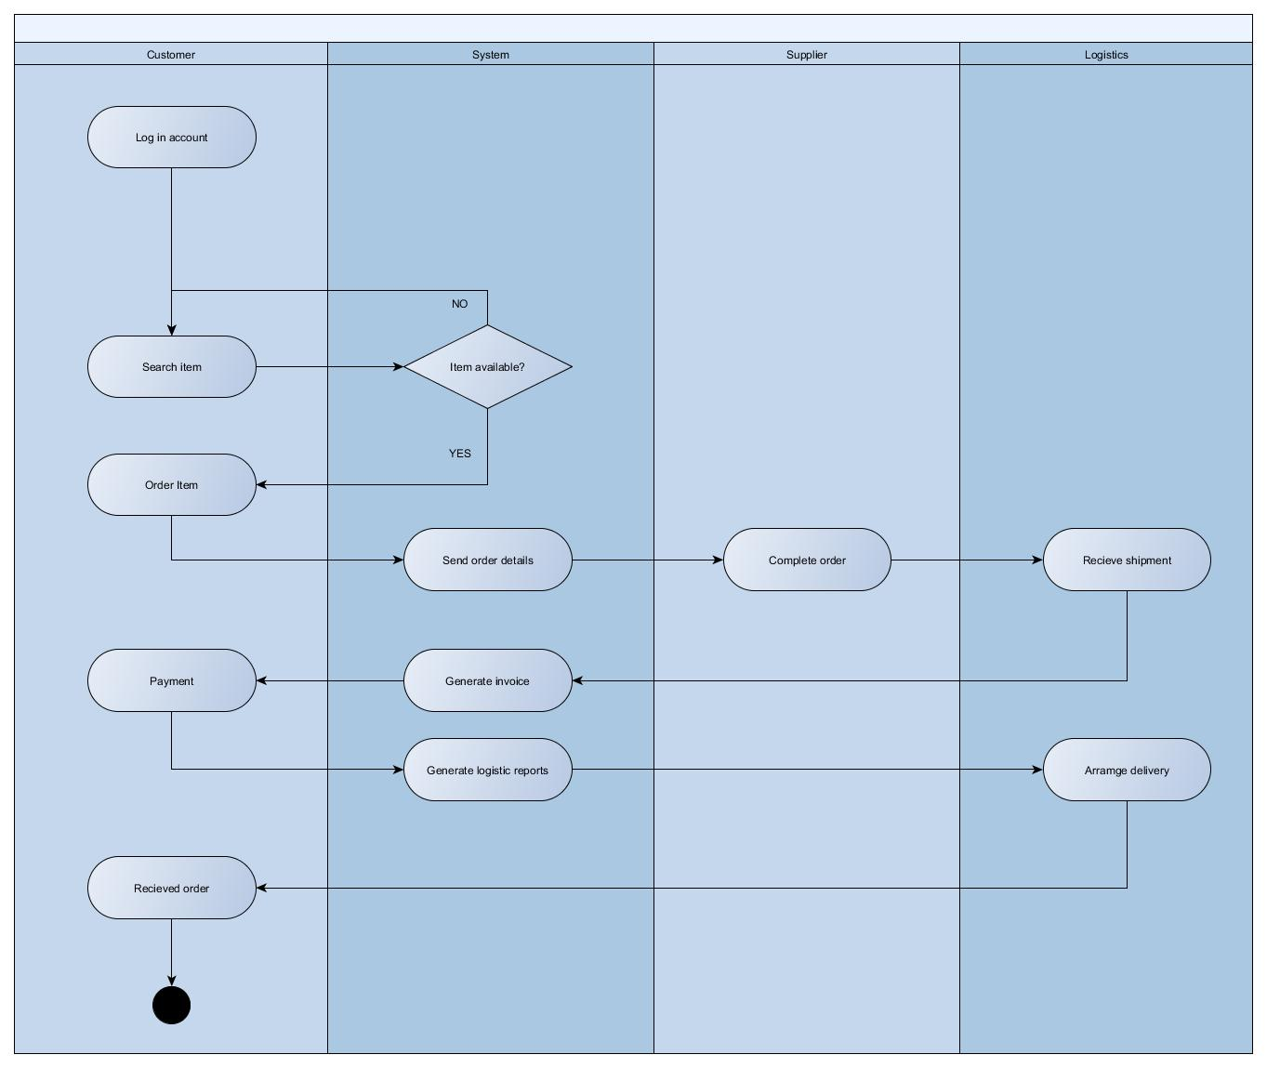
Activity Diagram

Slide 13
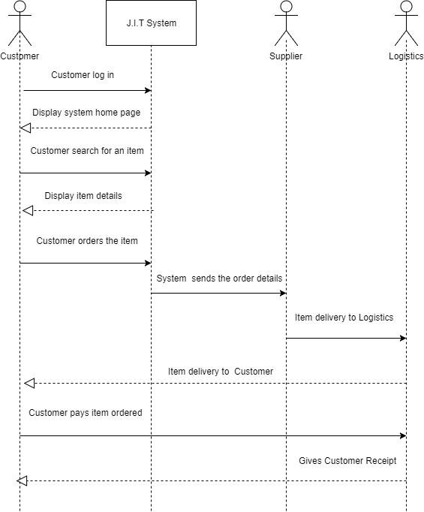
Sequence Diagram

Slide 14
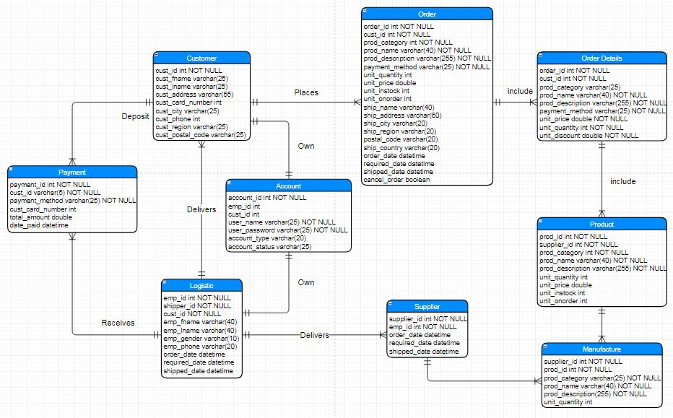
Entity Relationship Diagram

