Slide 1
Tapsibog inventory system
Owen Ylaya Kenneth Romero Ron Legaspi

Slide 2
Introduction

Slide 3
Purpose and Description
A database used for storing and administering all types of data required for efficient and accurate warehouse inventory management. This may include modules or fields for keeping track of all items and locations, requisitions, back orders, required levels of inventory on hand, reorder points, lead times, inventory error tracking, and more. This type of system may interface with an ERP and other applications.

Slide 4
Objectives
To ensure that the supply of raw material & finished goods will remain continuous so that production process is not halted and demands of customers are duly met.
To minimize carrying cost of inventory.
To minimize inventory ordering costs

Slide 5
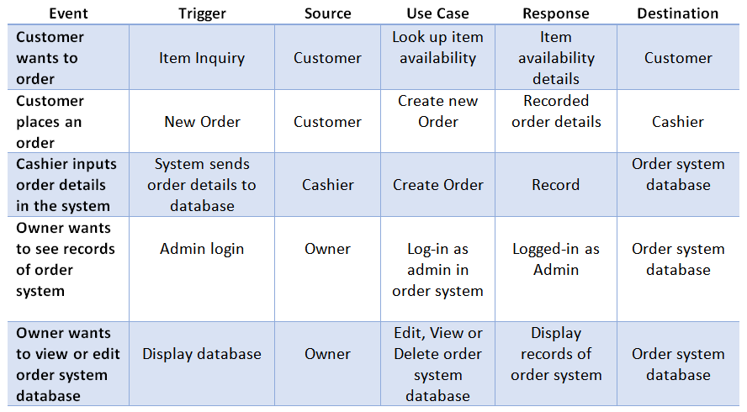
Event Table (Order)

Slide 6
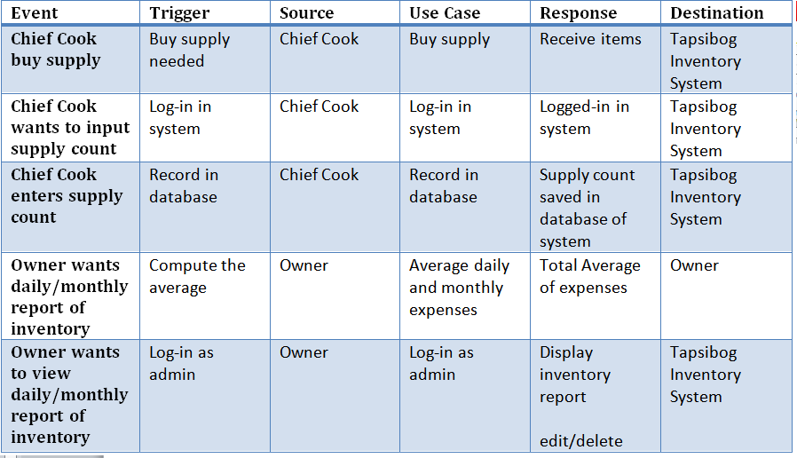
Event Table (Inventory)

Slide 7
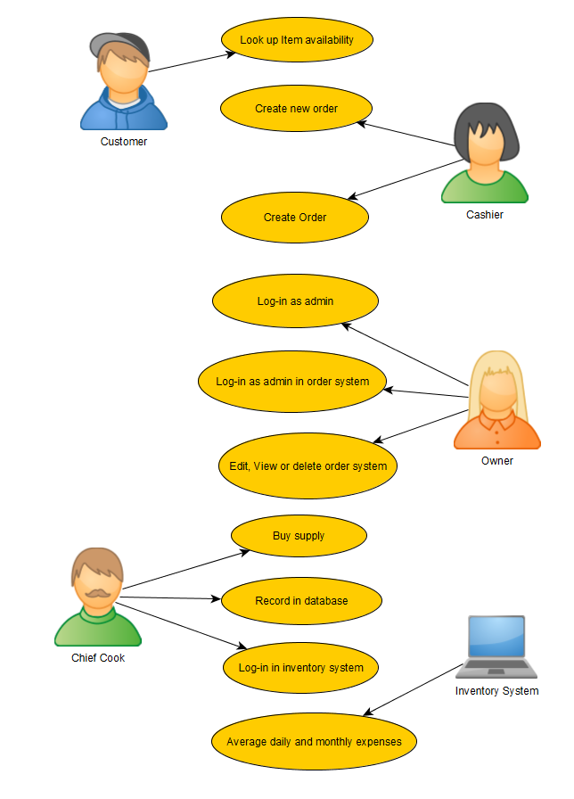
Use Case Diagram

Slide 8
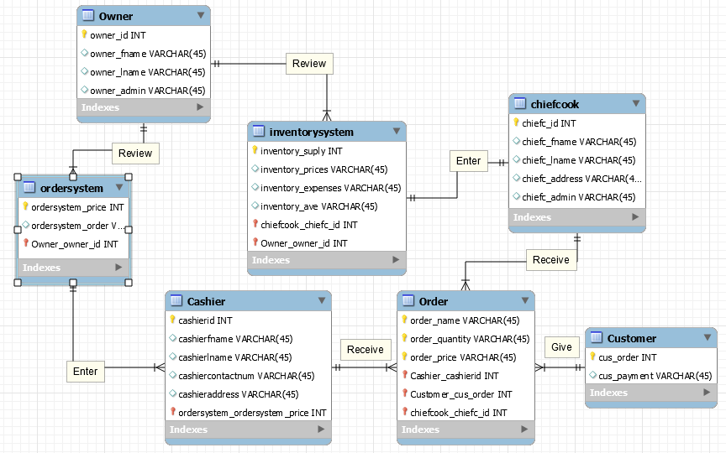
ERD

Slide 9
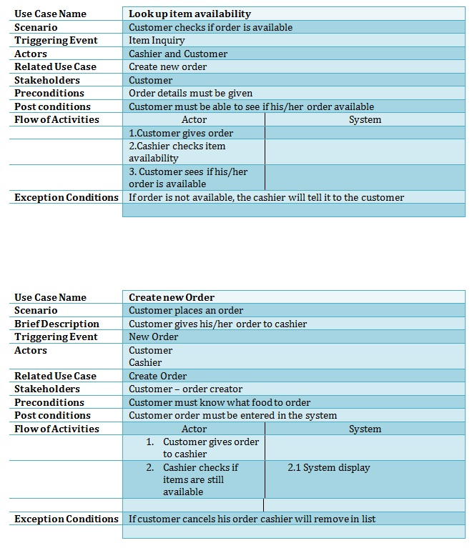
Use Case Full Description (Order)

Slide 10
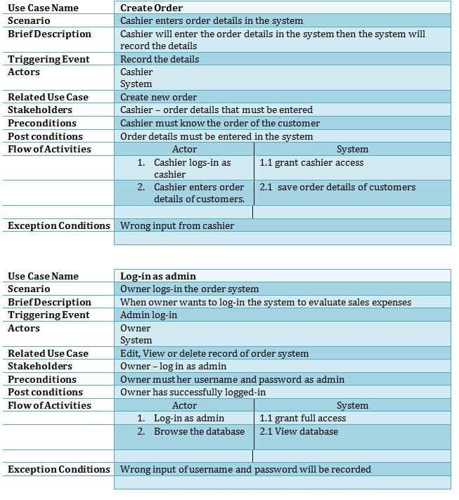

Slide 11
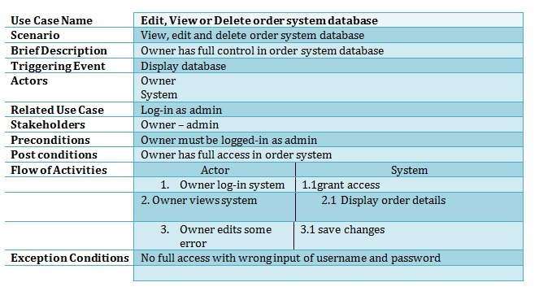

Slide 12
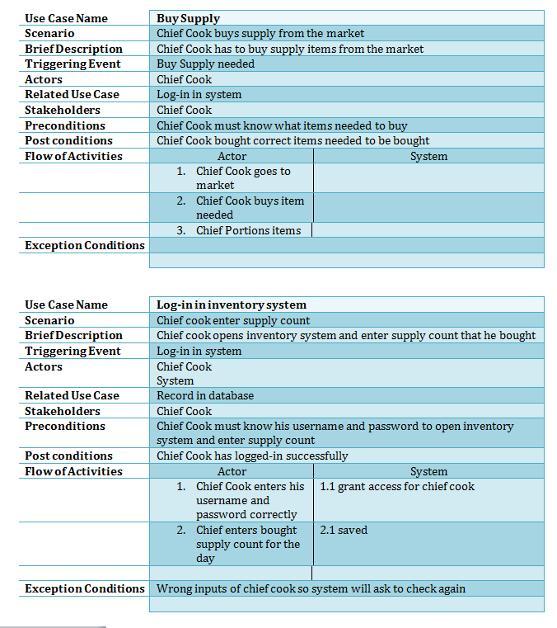
Use Case Full Description (Inventory)

Slide 13
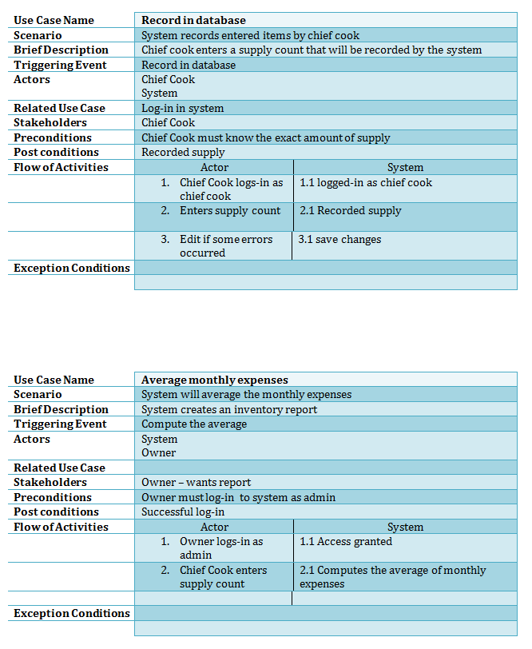

Slide 14
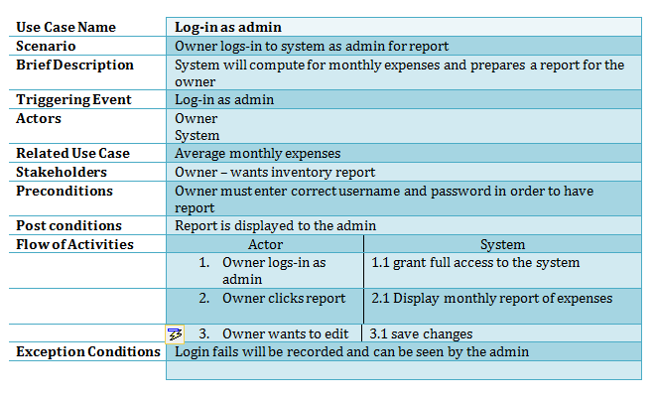

Slide 15
Timing Diagram - Order

Slide 16
Timing Diagram - Inventory

Slide 17
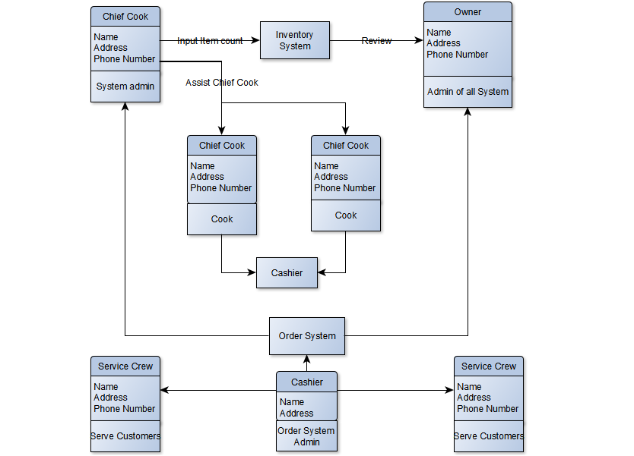
Class Diagram

Slide 18
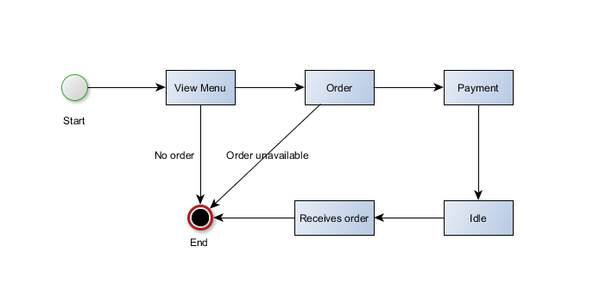
State Diagram - Order

Slide 19
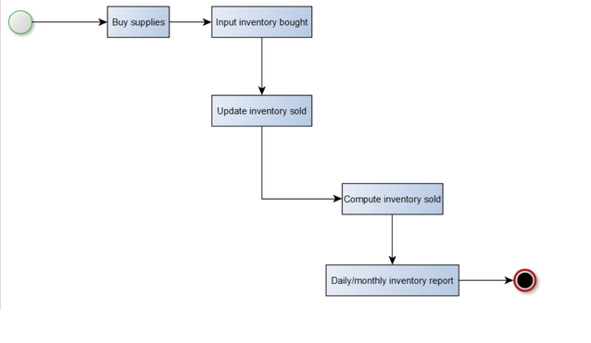
State Diagram - Inventory

Slide 20
Object Diagram

Slide 21
Object Diagram - Inventory

Slide 22
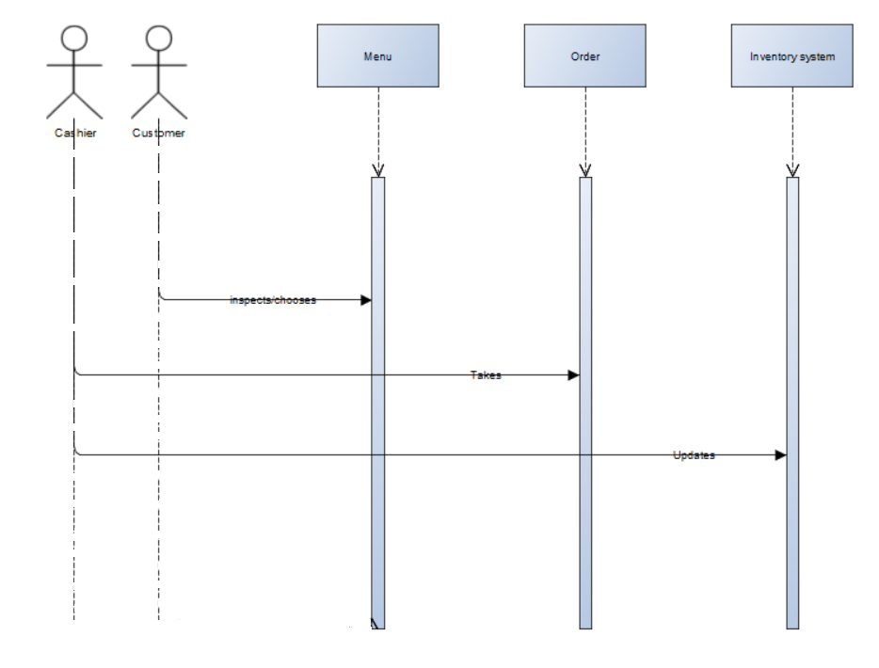
Sequence Diagram - Order

Slide 23
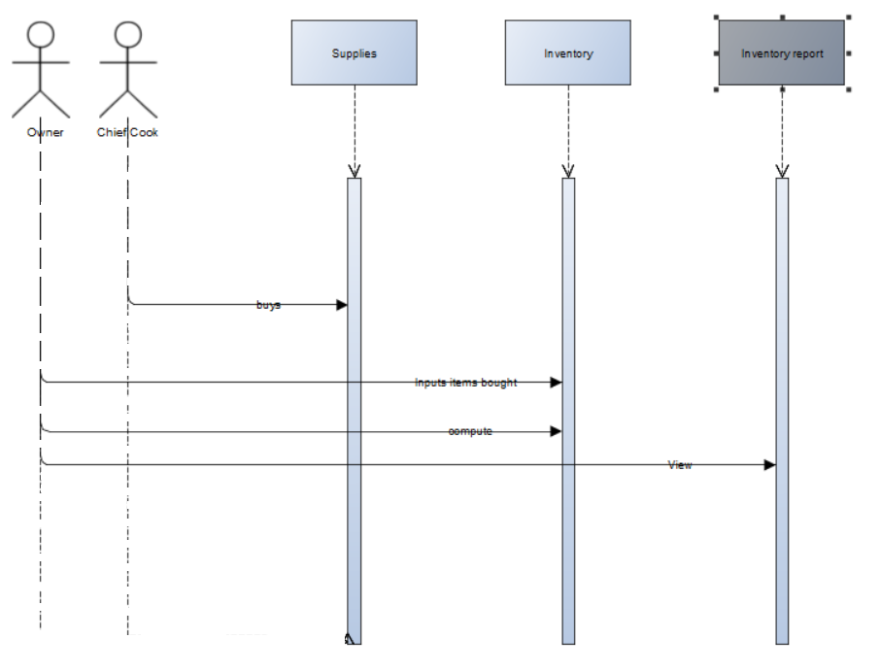
Sequence Diagram - Inventory

Slide 24
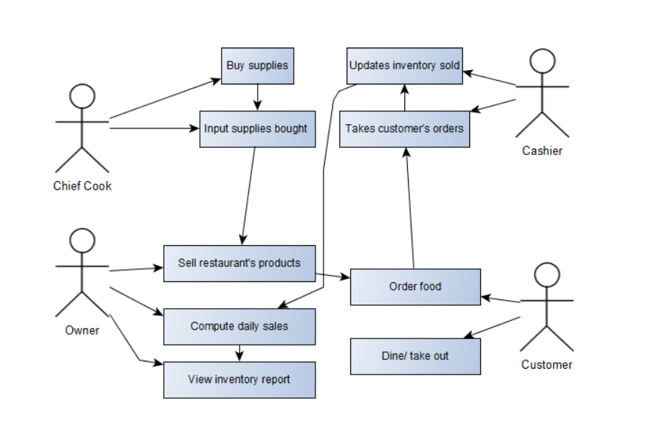
Package Diagram

Slide 25
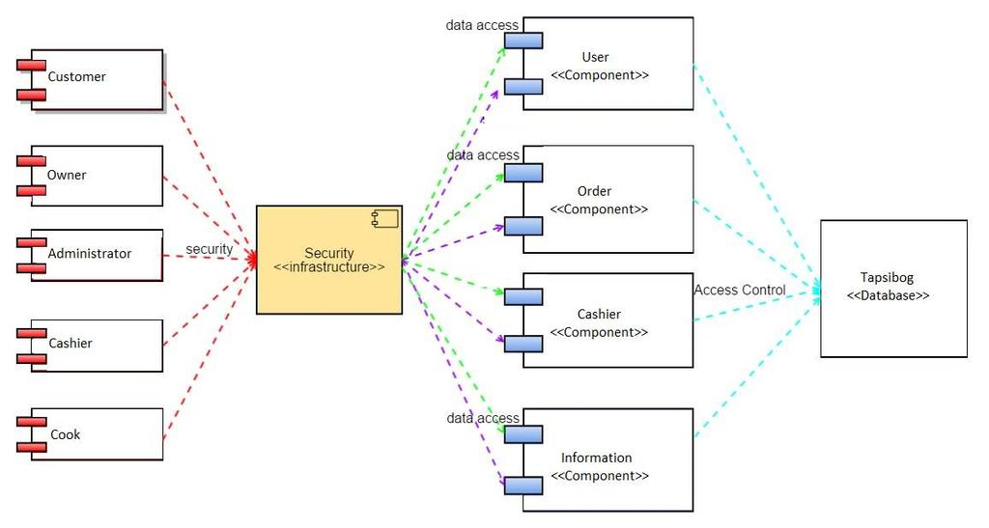
Component Diagram

Slide 26
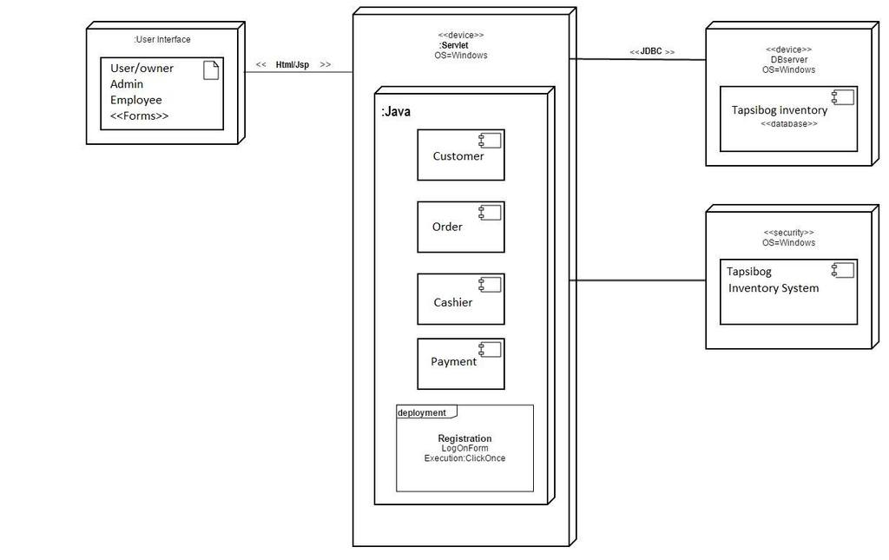
Deployment Diagram

Slide 27
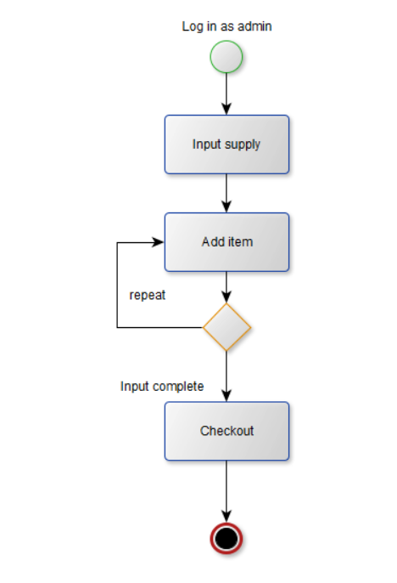
Interaction Overview Diagram - Inventory - Chief Cook

Slide 28
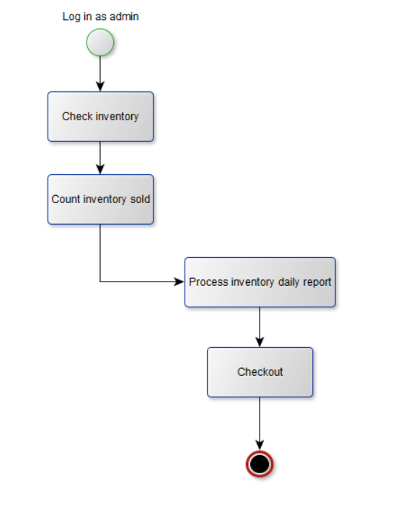
Interaction Overview Diagram - Inventory - Owner

Slide 29
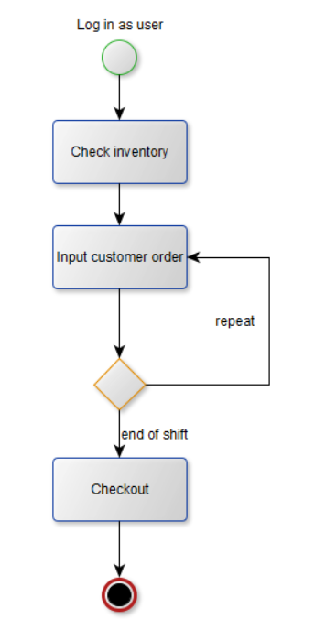
Interaction Overview Diagram - Order - Cashier

