Slide 1
Business Rules with BPMS6
Sal Elrahal
Red Hat Consulting
09/01/2015

Slide 2
Business logic vs Technical logic
Business logic is processes or decisions for which the domain experts are business analysts.
Examples of Business logic:
What makes an invoice for an order invalid?
What are the steps in processing a defective railcar?
Technical logic is processes or decisions for which the domain experts are technical in nature.
Examples of Technical logic:
What makes an email address invalid?
What are the steps in processing a GET request?

Slide 3
What is BPMS6
Red Hat JBoss BPM Suite is the JBoss platform for Business Process Management (BPM). It enables enterprise business and IT users to document, simulate, manage, automate and monitor business processes and policies.
Components:
Business process management
Complex event processing and rules execution
Business activity monitoring
Upstream Projects:
jBPM
Drools
http://www.jboss.org/products/bpmsuite/overview/

Slide 4
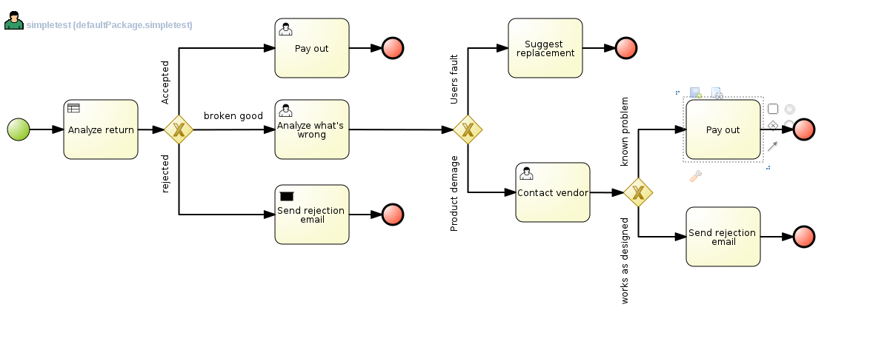
Business Process Management
The Business Process Model and Notation (BPMN) is a graphical notation that depicts the steps in a business process. BPMN depicts the end to end flow of a business process. The notation has been specifically designed to coordinate the sequence of processes and the messages that flow between different process participants in a related set of activities.
http://www.bpmn.org/
http://1.bp.blogspot.com/-msMi1NYsjbY/UCAEIIch_HI/AAAAAAAAAf0/r3DVzyHKu98/s1600/simulation-sample.png

Slide 5
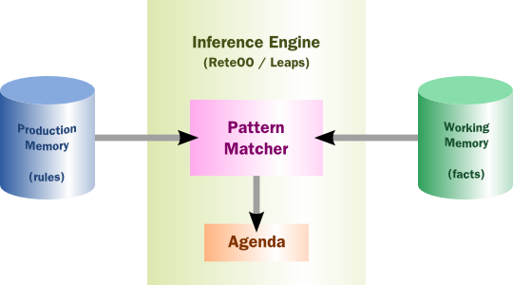
Complex Event and Rules Processing
Complex event and rules processing allows businesses to separate the logic driving business decisions from application code. A rule engine can be used to execute production rules against a set of facts and then reach a business conclusion. These rules can include temporal constraints and be evaluated in real time.
http://docs.jboss.org/drools/release/6.0.0.Final/drools-docs/html/

Slide 6
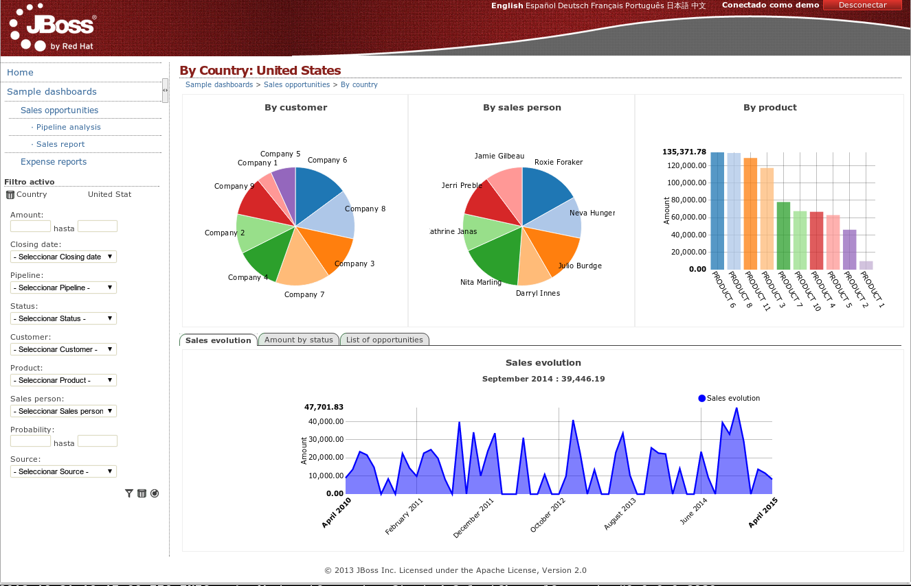
Business Activity Monitoring
Business activity monitoring allows business analysts to collect real time data about their business processes and decisions. This includes audit logs, performance optimizations, and potential resource inefficiencies.
http://docs.jboss.org/jbpm/v6.0/userguide/chap-bam.html

Slide 7
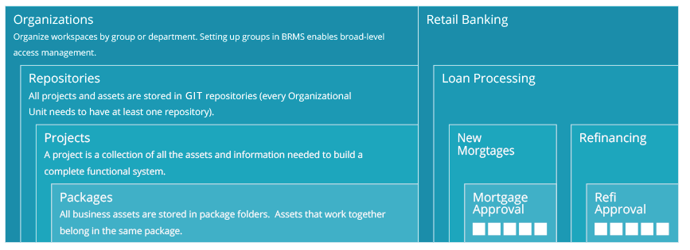
Business Central
Business Rules Manager
Repository of rules
Provides tools for authoring processes and rules
Has functionality to build deploy-able rules units
Includes Process Simulation tools
Built in mechanism for executing tests

Slide 8
Drools Expert
Rule Engine
The core of the Jboss Drools project.
Operates using Facts and Rules
Facts are pieces of information (POJO)
Rules are inferences that can be made with information
Working Memory is the space in the application where the Facts are stored
Production Memory is the space in the application where the Rules are stored
JSR 94

Slide 9
Fact
Java objects
Model can be uploaded to BPMS6 or created in BPMS6
Let's create a Person() object with String:name , int:age, and boolean:canDrink fields.
JSR 94

Slide 10
Rules Syntax
Conditions and Consequences
Example:
Rule "Underage drinking"
When
exists Person(age < 21)
Then
System.out.println("Dont buy a drink!");
End

Slide 11
Rules Syntax
Conditions and Consequences
Example:
Rule "Underage drinking"
When
Person(age < 21)
Then
System.out.println("Dont buy a drink!");
End

Slide 12
Rules Syntax cont.
Variable bindings, collections, and modifying facts
Example:
Rule "Underage Drinker"
When
person : Person(age < 21)
Then
modify (person) {canDrink = false}
End
Rule "Shutdown bar"
When
bar : Bar()
person : Person(!canDrink) from bar.patrons
Then
System.out.println("Closing bar " + bar.getName());
modify (bar) {closed = true}
End

Slide 13
Rules Syntax cont.
Variable bindings, collections, and modifying facts
Example:
Rule "Underage Drinker"
When
person : Person(age < 21)
Then
modify (person) {canDrink = false}
End
Rule "Shutdown bar"
When
bar : Bar(!closed)
person : Person(!canDrink) from bar.patrons
Then
System.out.println("Closing bar " + bar.getName());
modify (bar) {closed = true}
End

Slide 14
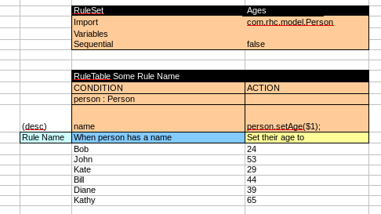
Decision Tables
Spreadsheet used to generate rules from template
Metadata at the start
Condition/Consequences are columns
Rows are parameters used, one rule generated per row
Rule "row1"
When
person : Person(name == "Bob")
Then
person.setAge(24);
End

Slide 15
Rete Algorithm
Rete Node
Rules get compiled into Rete tree.
Facts are inserted at entry points.
Propagation occurs when facts match node conditions.
Leaves of the tree are Terminal Nodes.
Terminal nodes result in rule activation.
Entry Point Node
Object Type Node
Alpha Node
Left Input Adapter
Beta Node
Terminal Node

Slide 16
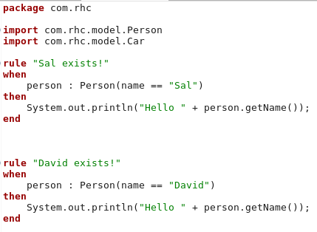
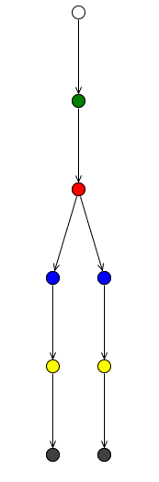
Rete Tree
Rete Node
Default entry point
Object Type (Person)
Alpha Node (name == "David")
Alpha Node (name == "Sal")
Left Input Adapter
Left Input Adapter
Terminal node ("David exists!")
Terminal node ("Sal exists!")

Slide 17
Phreak
Three layers of contextual memory; Node, Segment and Rule memories.
Rule, segment and node based linking.
Lazy (delayed) rule evaluation.
Isolated rule evaluation.
Set oriented propagations.
Stack based evaluations, with pause and resume.

Slide 18
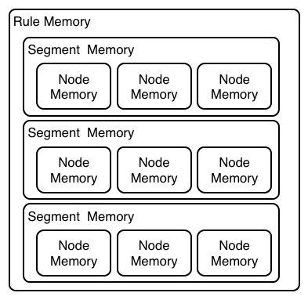
Phreak (Layered Memory)

Slide 19
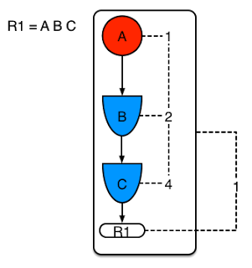
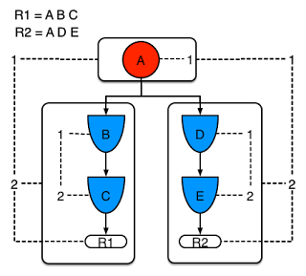
Phreak (Node Sharing)

Slide 20
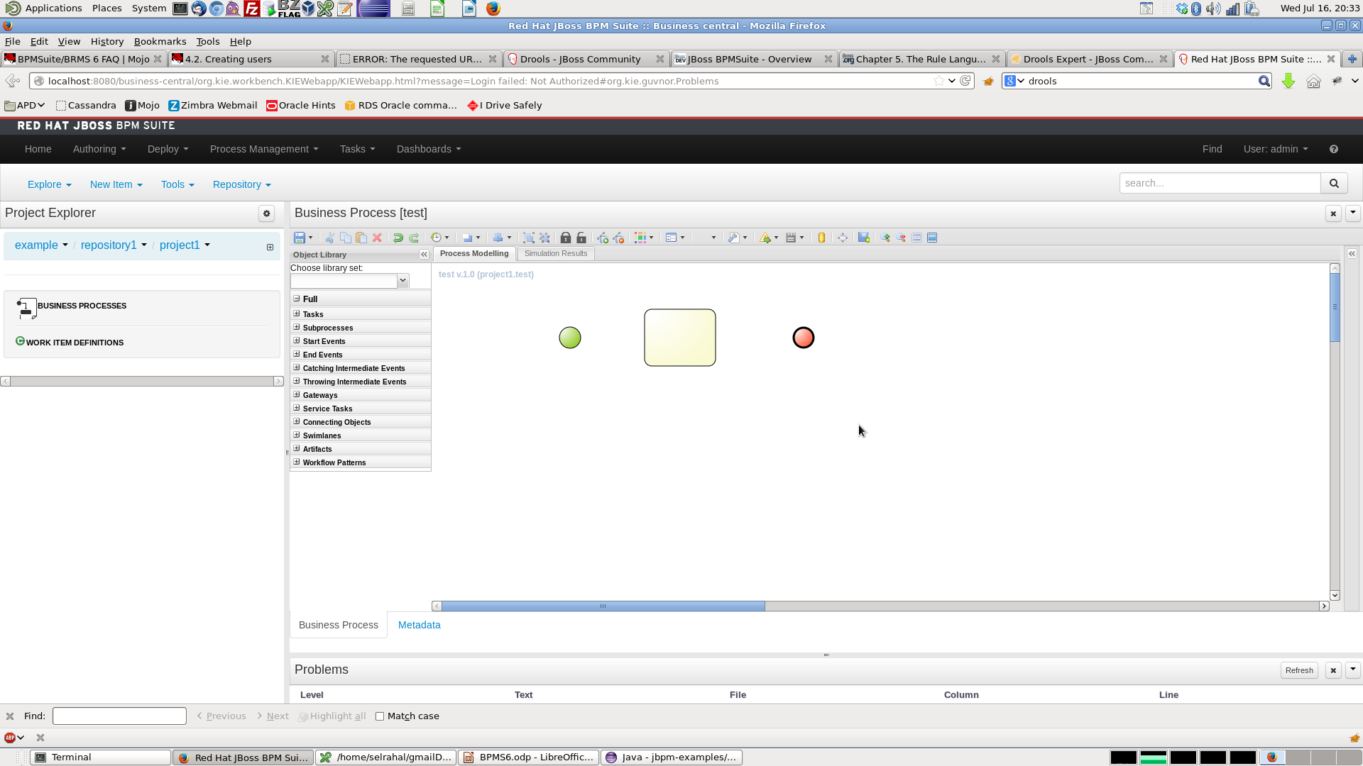
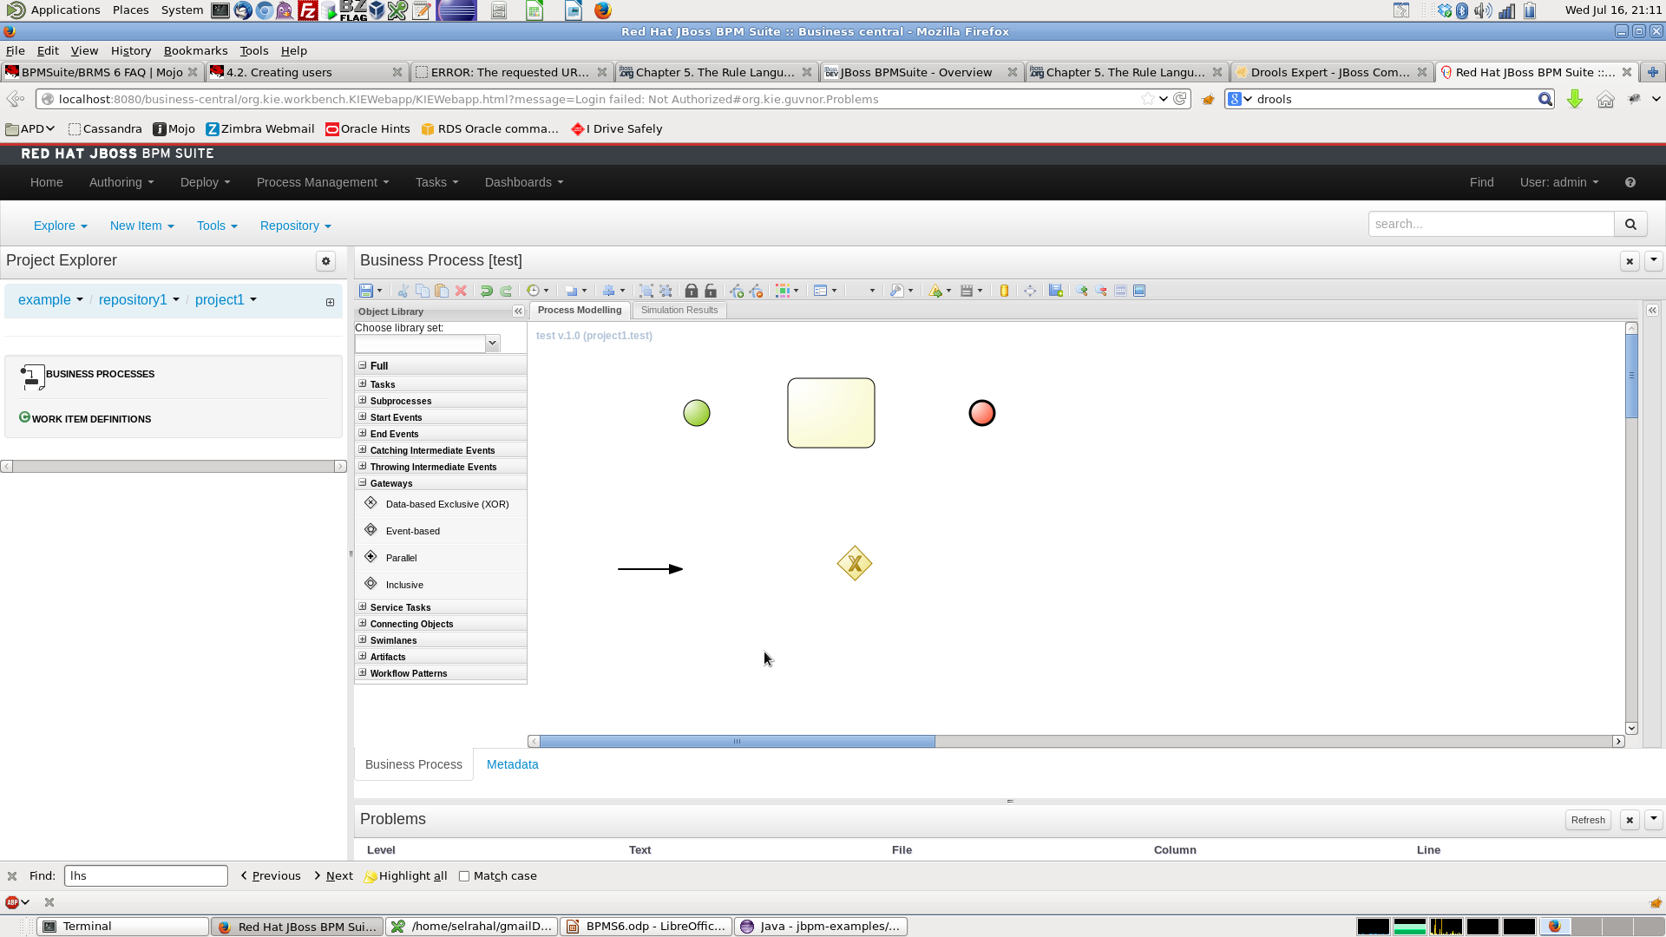
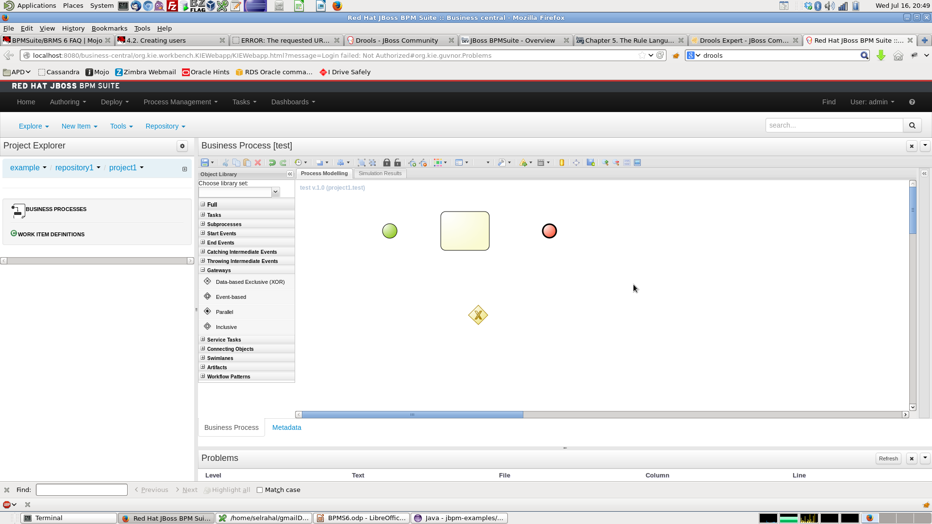
jBPM
Process/Workflow
Start Event
Work Item Node
Sequence flow
Exclusive Gateway
End Event

Slide 21
Try It!
Start Event
Sequence flow
Script Task
Sequence flow
End Event

Slide 22
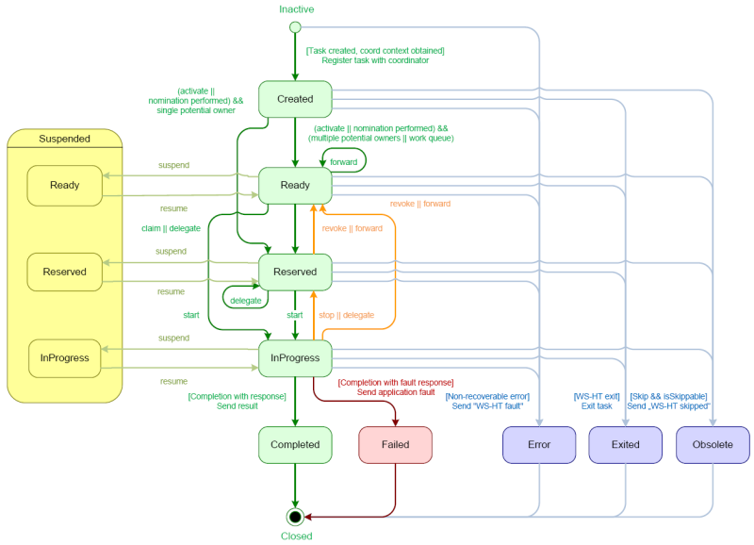
Human Tasks
Subset of work item node
Default implementation follows WS Human Task Lifecycle
Use the TaskService for all operations
http://docs.jboss.org/jbpm/v6.0/userguide/jBPMTaskService.html#jBPMTaskLifecycle

Slide 23
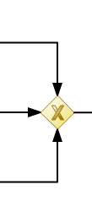
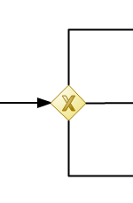
Exclusive Gateways
Can either be converging or diverging.
Diverging gateways have conditions placed on all outgoing sequence flows
At least one condition must be true
Conditions can either be rules or java code
Java code has access to all process variables
Rules have access to facts that have been inserted into the working memory
First sequence flow evaluated that is true will be taken (order of evaluation can be enforced)

Slide 24
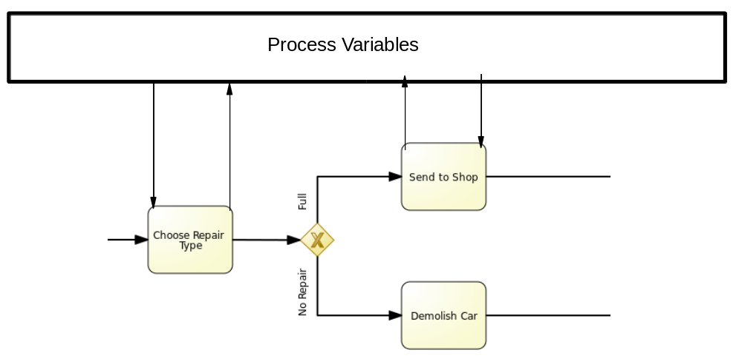
Process Variables

Slide 25
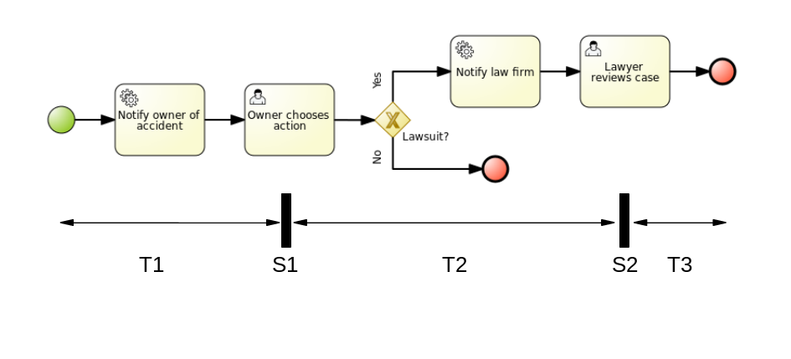
Asynchronous tasks, Safe states, and Transactions

Slide 26
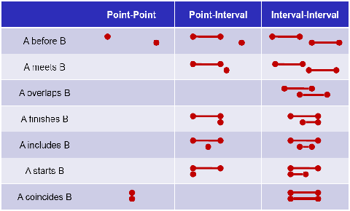
Drools Fusion
Event Processing/Temporal Reasoning
Introduces Events as a subset of Facts
Events are strongly linked with temporal data, often immutable
Can reason over event relationships including absence of events
Useful for real-time inferences around the state of a system
Multiple entrypoints can be used to process streams of facts

Slide 27
OptaPlanner
Automated planning
Uses a domain and score function to model planning
Resources are provided as a dataset
Optaplanner provides the solution to the dataset with the highest score
Can specify domain with facts and scores using DRL

Slide 28
Business Activity Monitoring and Simulations
Data providers are used to retrieve information
External connections define the connection parameters
Use data providers in reports for business analysts
Simulations use probabilities provided on gateways
Can input resource availability and average running time to identify bottlenecks in processes
Use BAM and Simulation to put business users in control of efficiency

Slide 29
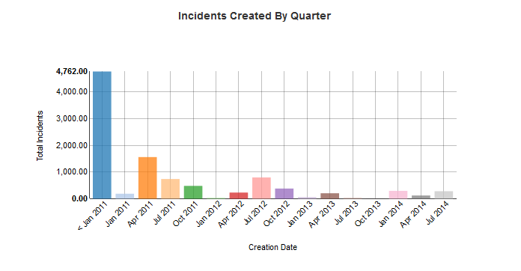
Business Activity Monitoring and Simulations

Slide 30
KIE API
KieBase
  Compiled rules and processes
RuntimeEnvironment
  Configuration object (Datasource/persistence, transaction manager)
RuntimeManager
  Uses RuntimeEnvironment to create RuntimeEngine
RuntimeEngine
  Holds a KieSession and TaskService
KieSession
  Rule/Process API (insert, delete, fireAllRules, startProcess)
TaskService
  Task API (claim, start, complete, delegate, fail...)

Slide 31
THANK YOU
https://github.com/selrahal/drools-playground
Questions? selrahal@redhat.com

