Slide 1
Mini-Project 1 ECE 471 Fall 2022
Sean Lee (sl84), Dante Howard (danteah2), Guifu Liu (guiful2)

Slide 2
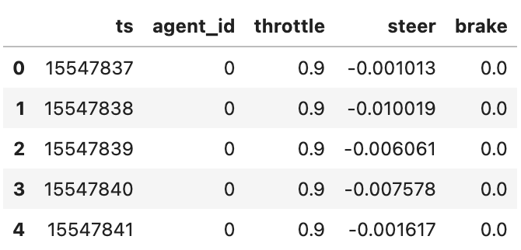
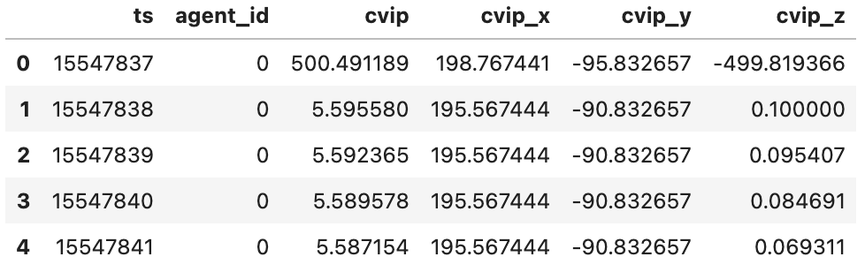
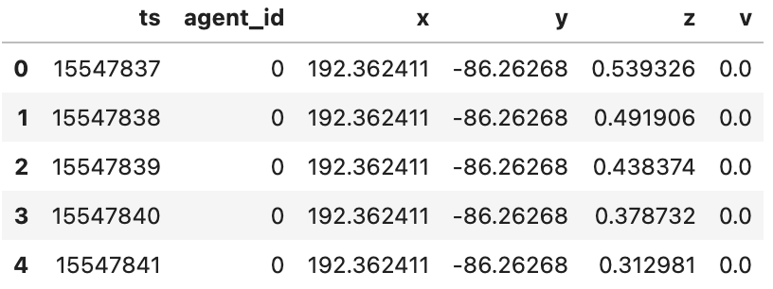
Task 1
Q1: Overview of the .csv files
ctl.csv
cvip.csv
traj.csv

Slide 3
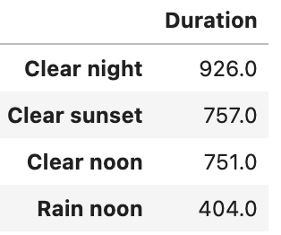
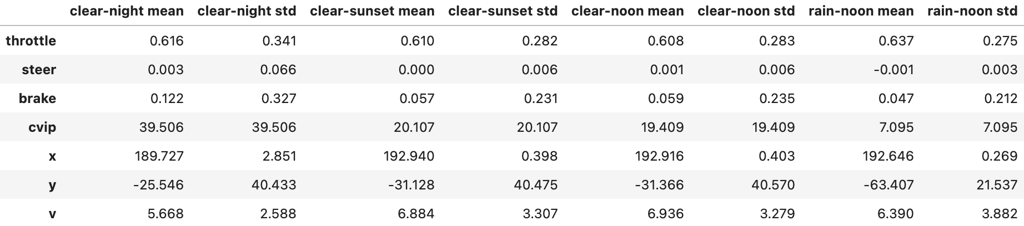
Task 1
Q2:
The duration of the scene is: frames (The ‘ts’ column is in the unit of frames).
Mean and std of the features:

Slide 4
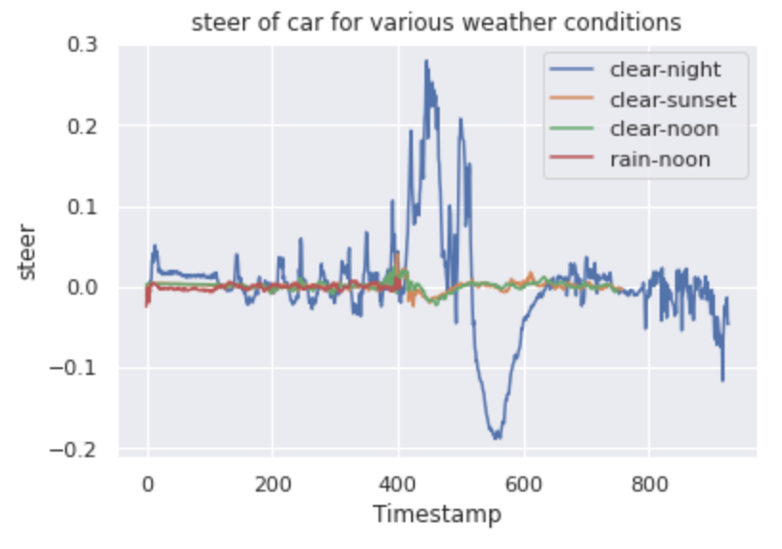
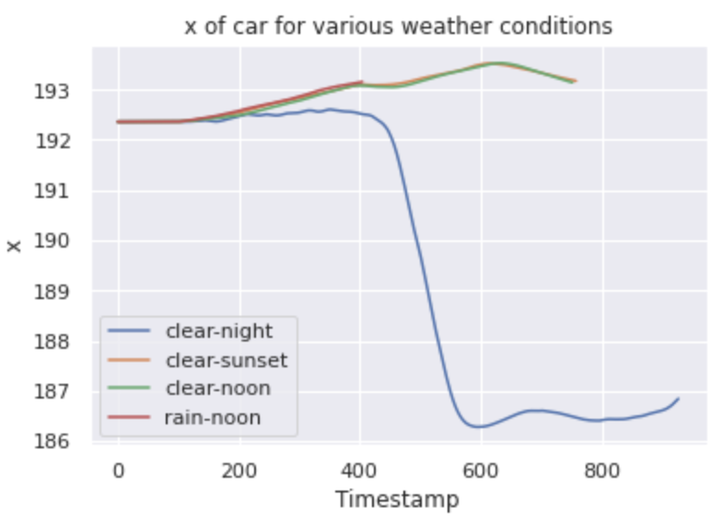
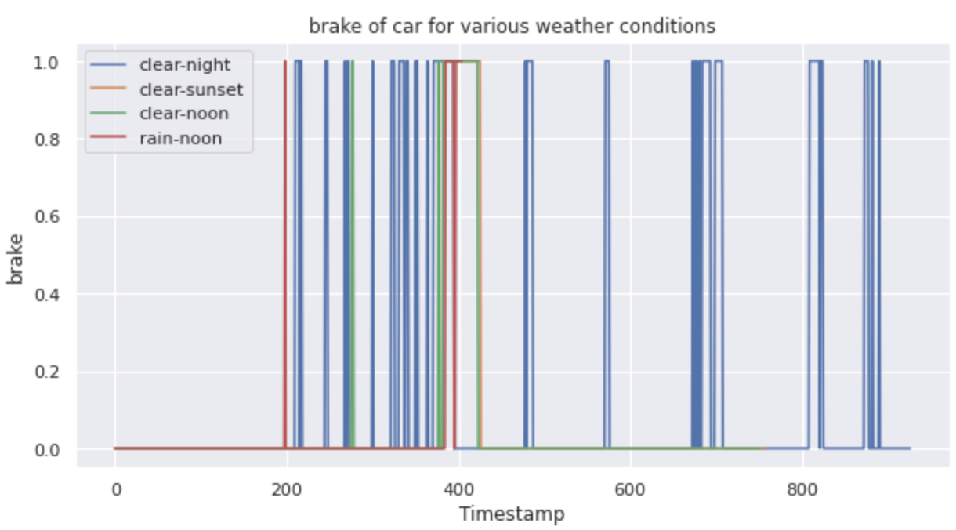
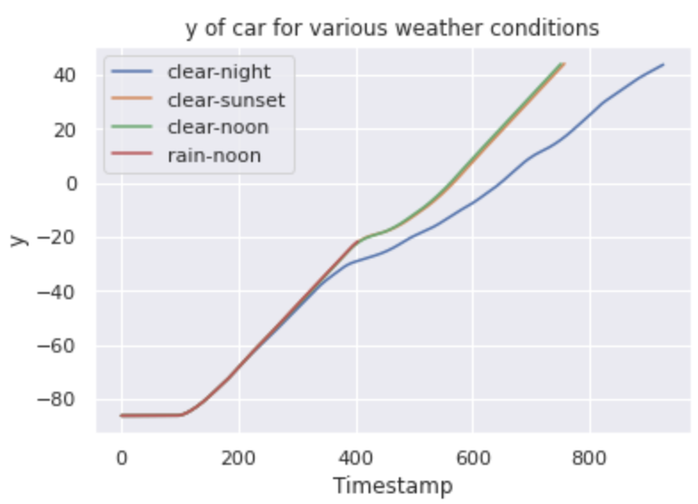
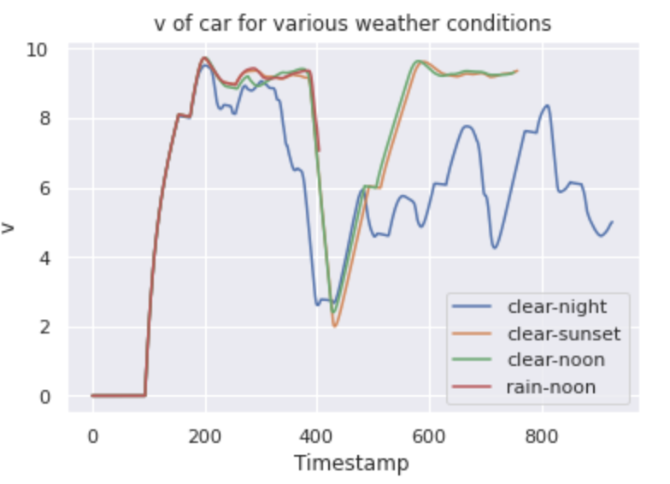
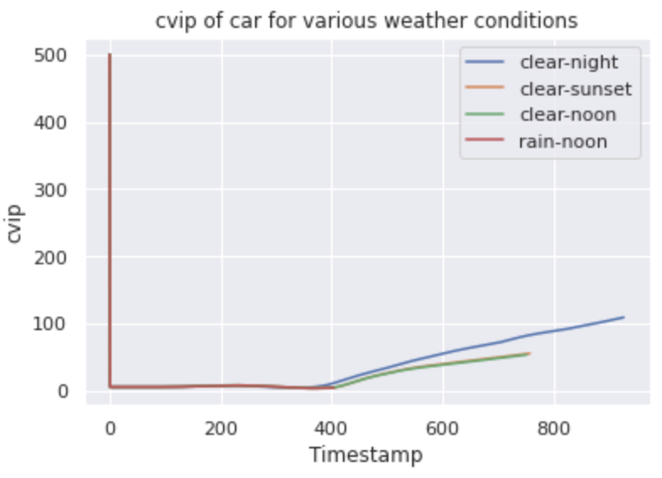
Task 1
Q3: Campaign result visualization
steer
brake
cvip
x
y
v

Slide 5
Task 1
Q4: Based on your intuition and life experience, which of the features do you think will change during an accident? How will the feature(s) change? By looking at the plots you generated in Task 1.3, combined with your reasoning (without looking at ‘route_highway.txt’), which weather condition(s) has an accident?
Based on my intuition, when an accident occurs there is initially a sudden push on the breaks and a sharp decrease in speed as the driver makes an attempt to not have a collision. There could also be erratic movement of the steering wheel from side to side as the car tries to evade the accident.
From the visualization of the data it seems that an accident occurs during the rain-noon weather condition as there are two sudden pressings of the break and a decrease in speed. One of the brake pressing takes much more time than those in clear sunset or clear noon. The data also stops before the other weather conditions such that the car was in an accident and stopped collecting data.
It also looks like an accident, or a near miss occurs in the clear-night weather conditon do to the erratic steering data. It seems as if the AV started swerving back and forth to avoid an accident.

Slide 6
Task 2
Q1: The probability of accident is .2 .
From the 5 simulated scenarios only 1 resulted in an accident. Therefore, the marginal probability of an accident occurring is 0.2.

Slide 7
Task 2
Q2: By looking at the completion records, and the plots you generated in Task 1, under which weather condition(s) did the accident happen? Does that match your guess in Task 1? When did the accident happen? Why do you think the accident happened at that time? .
From the completion records the accident happened during the rain-noon weather condition. This was what we predicted from the simulation data. It makes sense that the accident occurs during the weather event of rain as it lowers visibility. While we would expect noon to have the most visibility time wise, since it was the only rain simulation in the data it seems the weather has a larger effect than time.

Slide 8
Task 2
Q3: From the plots you generated in Task 1.3, do you observe any other abnormal behavior? If so, what do you think is(are) the cause(s) of this behavior?
We also see that the clear-night has abnormality, particularly by looking at its ‘brake’ plot, where its frequency of braking is much higher than that of other weather/light conditions. This could be since at night, the AV is visually restricted from less sunlight.

Slide 9
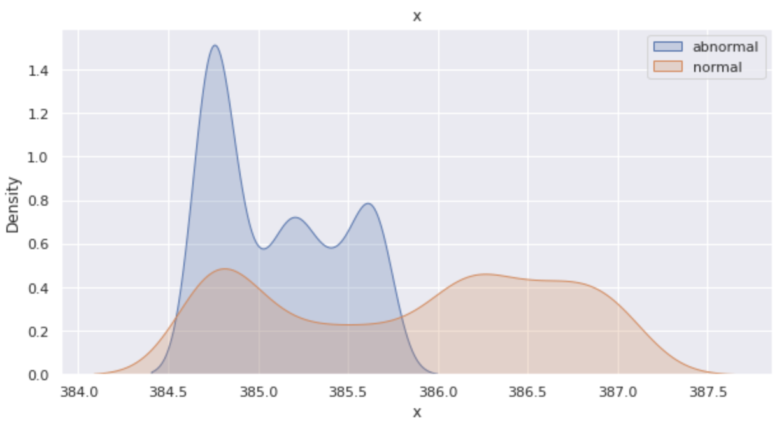
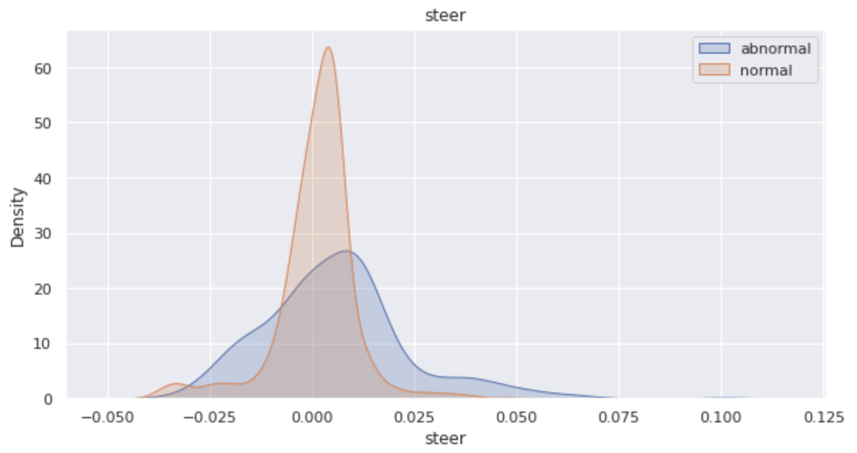
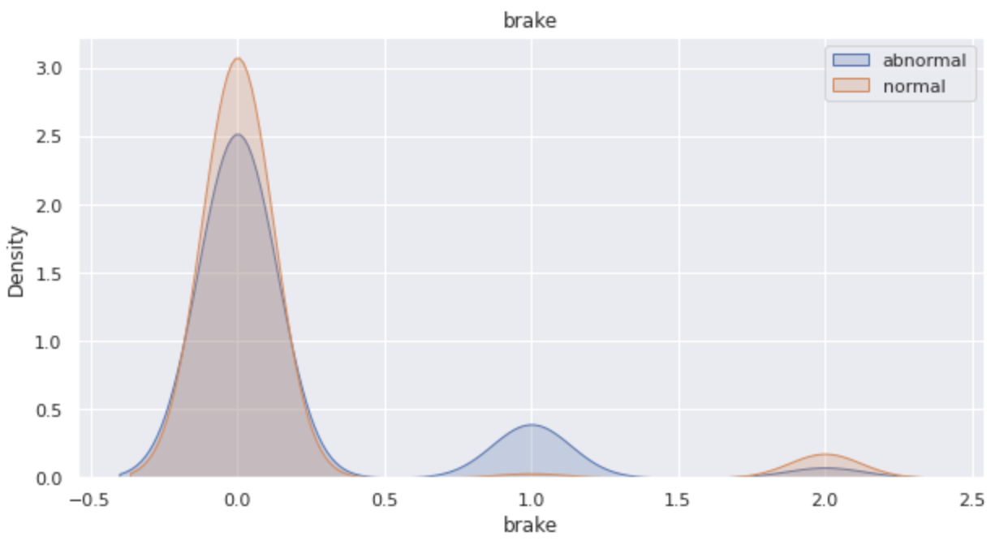
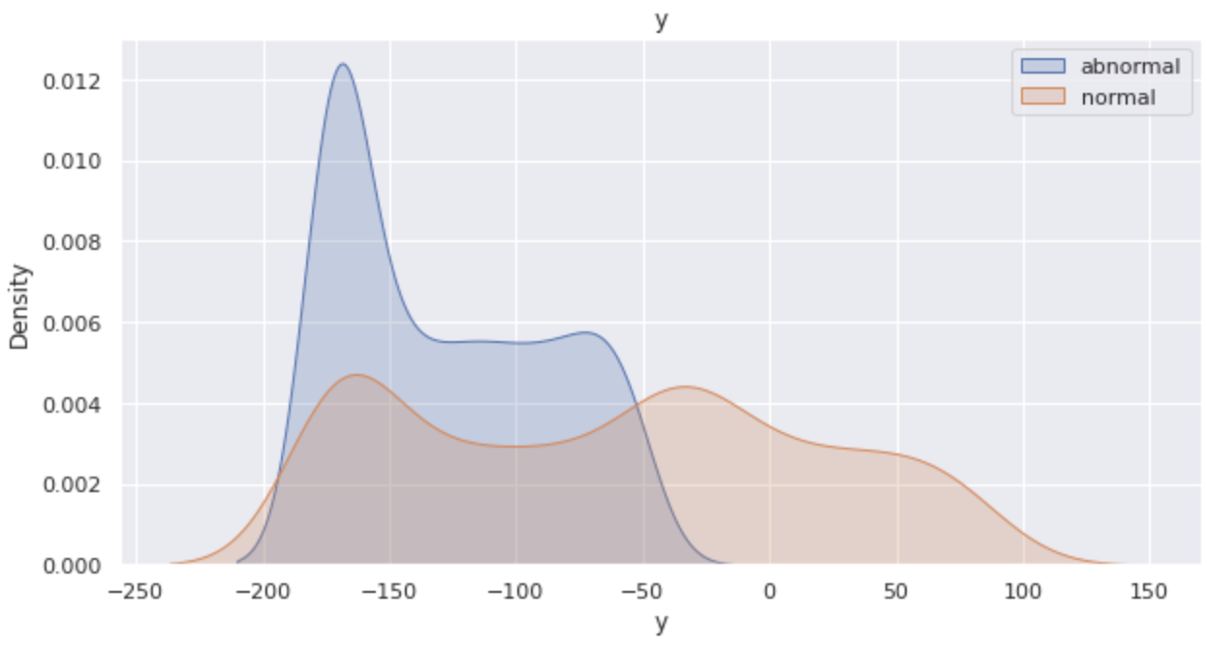
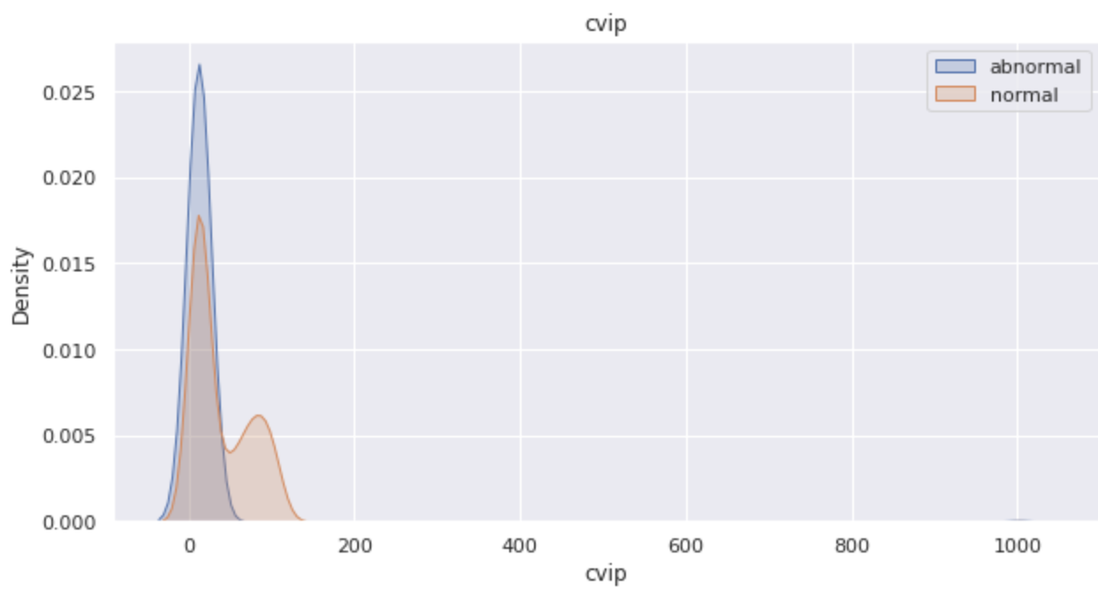
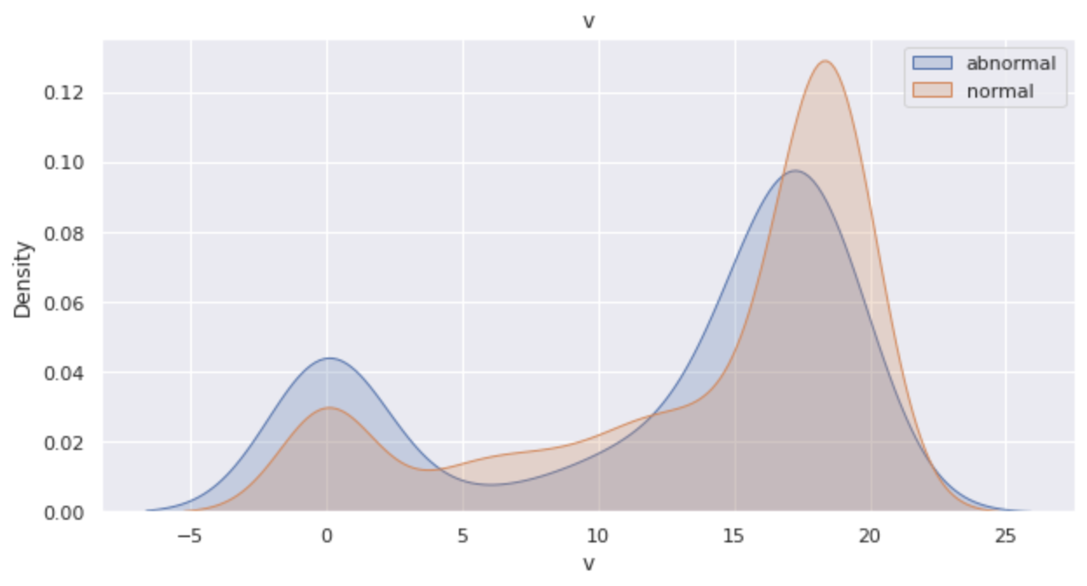
Task 2
Q3.a: Distribution of the features: abnormal (including accidents) vs normal
steer
brake
cvip
x
y
v

Slide 10
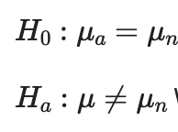
Task 2
Q3.b: Use 2-sample t-test to test on the ‘steer’ values of abnormal runs vs normal runs.
State the null and alternative hypotheses
H0:
H1:
Perform the test and calculate test statistics
Assume a significance level of 0.05, what is your conclusion
Q3.c: Does the testing result contradict your observation? Why?
The t-test gives a p-value of 0.263 which is greater than the significance level of 0.05. Thus, we fail to reject the null hypothesis and conclude that the population means for steering under normal and abnormal conditions are equal.
This results does not contradict our observation because while the variances of steering data under normal and abnormal weather conditions differ, for the normal case, the steering data is trends at 0 with little variance. On the other hand, for abnormal conditions, the steering data varies greatly, but is symmetric about 0. Thus we expect the means for both conditions to be roughly equal.

Slide 11
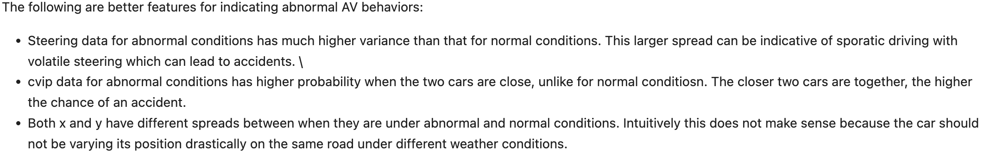
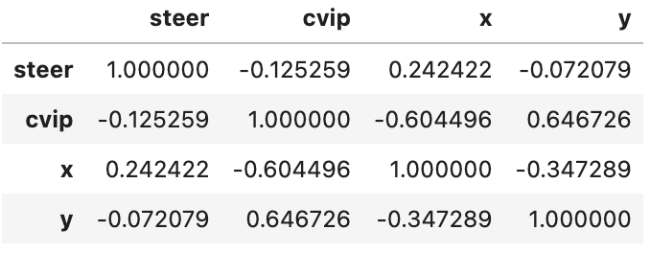
Task 2
Q4: Some of the features are better indicators of abnormal AV behavior, can you identify them?
By looking at the distribution plots of the features in Task 2.3, explain your choice of indicators.
For the fields you identified as good accident indicators above, are they related (Calculate the Pearson correlation coefficient between each pair of the indicators)? If so, how does that affect the predicting power of using one field versus using all of them?
Since there is relatively strong correlation between x and cvip or y and cvip, we can simply use less fields to predict abnormal AV behavior while keeping most of the predicting power while using all the features.

Slide 12
Task 2
Q5: Suppose we want to use hypothesis testing to test whether the field you choose in Task2.4 is indeed a good indicator of abnormal AV behavior, using the Kolmogorov–Smirnov two-sample test.
Construct the null and the alternative hypothesis and state them below
H0:
H1:
Perform the KS two-sample test using the python package (report the statistics)
‘steer’: 3.216072714961863e-41, ‘cvip’: 6.542134262242544e-38, ‘x’: 1.0606363957036516e-199, ‘y’: 1.5569290301442607e-10
Assume a significance level of 0.05, what is your conclusion?
Since our p-values are much less than the significance level of 0.05, we reject the null hypothesis and conclude that the probability distributions between the indicator values for normal and abnormal conditions are different.

Slide 13
Task 2
Q5: Suppose we want to use hypothesis testing to test whether the field you choose in Task2.4 is indeed a good indicator of abnormal AV behavior, using the Kolmogorov–Smirnov two-sample test.
d. Repeat the same test on an UNSELECTED field in Task 2.4 and repeat the test, what is your conclusion?
‘brake’: 0.16863859937978443, ‘throttle’: 4.108169360250713e-11, ‘v’: 7.068817815005532e-64
Since our p-value for ’brake’ is greater than the significance level of 0.05, we fail to reject the null hypothesis and conclude that the probability distributions between the brake data for normal and abnormal conditions are equal.
Since our p-value for ‘throttle’ and ‘v’ are much less than the significance level of 0.05, we reject the null hypothesis and conclude that the probability distributions between the ‘throttle’ data for normal and abnormal conditions are different and likewise for ‘v’.
What are the major differences between the KS test and the t-test?
The major difference between KS test and t-test is that t-test tests on whether the means of two distributions are equal or not, while KS-test catches difference of distance between two distributions, in both shape and mean. Two sample t-test may assume the distribution is approximately normal and variability of two distributions is similar. KS-tests does not assume similarity between two distributions. To conclude, KS test can find more types of discrepancy between two distributions than the t-test can.

Slide 14
Task 2
Q6: Keeping in mind that this experiment is executed over a period of time, what assumption did you make when using the KS two-sample test on the distributions in Task2.4? Are you able to come up with one situation where the assumption fails? If there is any, please explain. What are the assumptions underlying the test? How does that match your samples (data generation)?
We assumed that all the features are independent from when they were measured. V for example, could have its current value be dependent on its previous values. This assumption is shown to fail for both v and throttle, since they were initially not predicted to be indicator variables but failed the KS test showing that their distributions under normal and abnormal conditions differ. Thus, suggesting that both v and throttle are dependent on time.

Slide 15
Task 2
Q7: The dynamic-time-wrapper (DTW) is a method to compare two time-series data (such as the control and the trajectory data collected in our simulation). Use the DTW package in python (dtaidistance · PyPI), and apply the DTW distance on the two time-series dataset: (1) steering data of clear-night and (2) steering data of clear-sunset, using steering data of clear-noon as a reference. What can you say about the DTW distance for (1) and (2) with respect to the reference?
Temporally, the steering data between clear-night and clear-noon are less similar than the steering data between clear-sunset and clear-noon.

Slide 16
Task 3
Q1: Based on the above assumptions, answer the following questions on basic probability
The assumption of at most one disengagement per mile allows us to treat the occurrence of a disengagement in a mile as a random variable with a Bernoulli distribution
The probability of disengagement per mile on a cloudy day is 0.005903.
The probability of disengagement per mile on a clear day is 0.000520.
The probability of an automatic disengagement per mile on a cloudy day is 0.002806.
The probability of an automatic disengagement per mile on a clear day is 0.000264.
How likely is it that, under cloudy conditions, in 10,000 miles, there are 100 or more disengagements? (hint: use Central Limit Theorem) 4.304439E-08

Slide 17
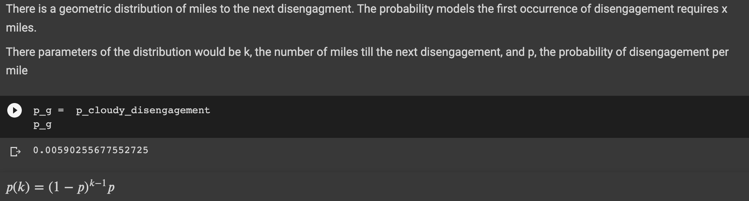
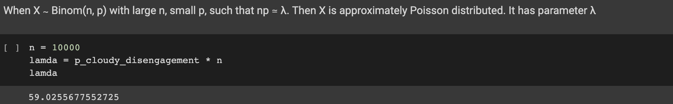
Task 3
Q2: Assuming that the disengagement per mile is a random variable with the distribution you answered in Task 3.1.a, and the weather condition is cloudy.
What is the distribution of miles to the next disengagement? Explain your reasoning. Calculate and state the values of the parameters of the distribution.
What is the distribution of the number of disengagements in 10,000 miles? (hint: this is equivalent to drawing n=10,000 independent trials from the distribution of disengagement per mile you calculated from Task 3.1.a) Calculate and state the values of the parameters of the distribution.
Notice that the n in Task 3.2.b is large while the probability p of disengagement per mile is very small, what distribution does your answer in Task 3.2.b approximate? Calculate and state the values of the parameters of the distribution.

Slide 18
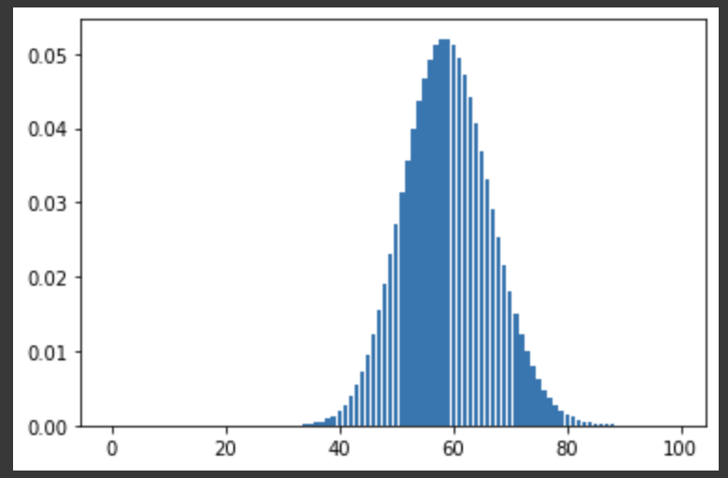
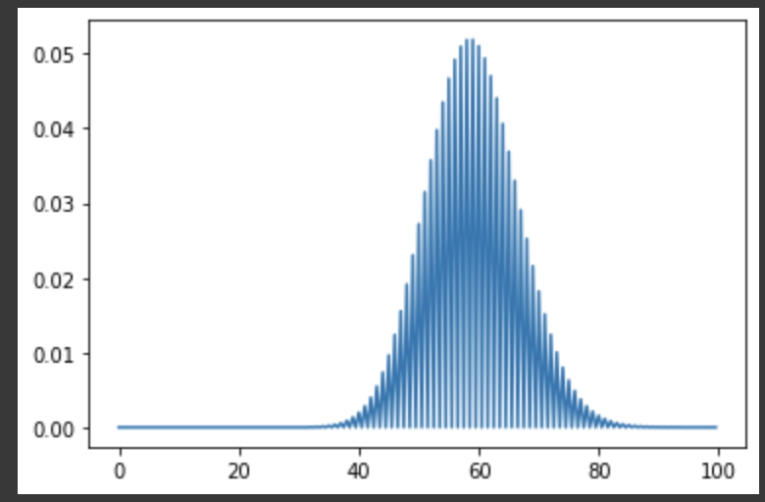

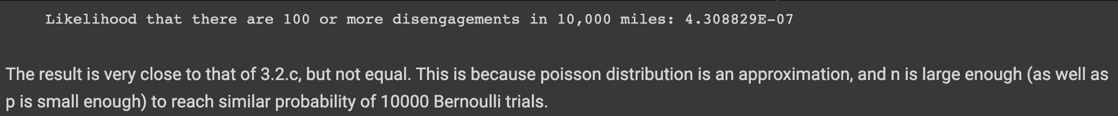
Task 3
plot the probability mass function (PMF) of the distribution in Task 3.2.b and Task 3.2.c. What do the 2 plots look like?
Solve Task 3.1.e by using the cumulative distribution function (CDF) of the distribution you computed in Task 3.2.c and compare the results. Discuss your findings.

Slide 19
Task 3
Q3: What’s the conditional probability that the reaction time is (Reaction time is measured only in cases where there was an automatic disengagement):
Greater than 0.4s given that the weather was cloudy?
Greater than 0.7s given that the weather was clear?

Slide 20
Task 3
Q4: A study found that an automatic AV disengagement will result in an accident if the human driver is slow in reacting. Following reactions are considered slow: (i) a reaction time greater than 0.4s under cloudy conditions and, (ii) a reaction time greater than 0.7s under clear conditions. Find the probability of an accident per mile due to automatic AV disengagement and slow reaction.

Slide 21
Task 3
Q5: Next, you will investigate how to diagnose the cause of an AV disengagement based on new observations
An AV had a disengagement with a reaction time greater than 0.4s on a cloudy day. What is the posterior probability that the root cause of the disengagement was “Software Froze”?
How do your conclusions in Task 3.5.a change if the disengagement happened on a clear day with reaction time greater than 0.7s?

Slide 22
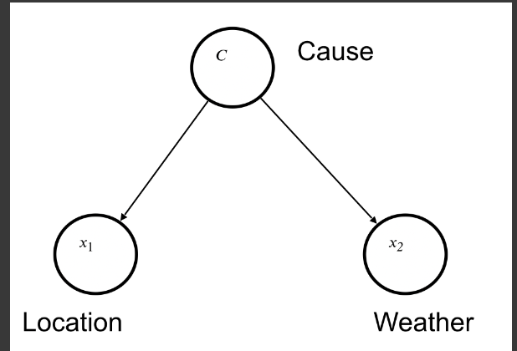
Task 3
Q6: In this question, you will construct a Naive Bayes model to infer the root cause of disengagement scenarios of AVs. Naive Bayes assumes that the factors are class conditionally independent. We assume that both Location (urban-street or highway) and Weather (cloudy or clear) are factors related to the Cause (consider the Cause has 3 different values, “Software Froze”, “Hardware Fault” or “Other”), and Location and Weather are independent given the Cause. Infer: What is the Cause of the disengagement given that we can observe the Location and Weather?
Draw a graph for the Naive Bayes model described in the question.

Slide 23
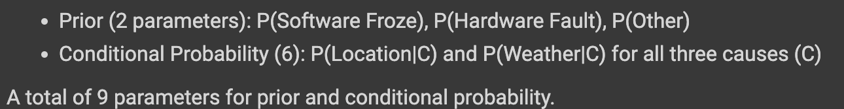
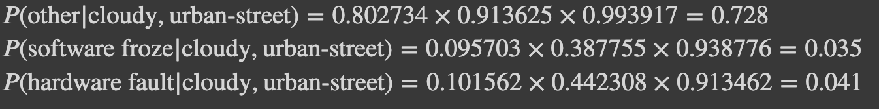
Task 3
Count the number of parameters needed to define the Naive Bayes model (including the prior and the conditional probability distributions).
Based on the number of parameters needed, derive and show the conditional probability tables and prior probability from the given dataset in order to infer the Cause.
According to the conditional probability tables you derived, what is the most possible root cause given the day was cloudy and the Location was urban-street.

Slide 24
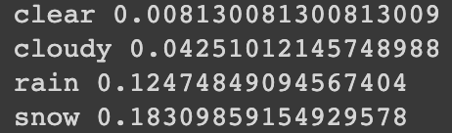
Task 4
Q1: Parse the provided Carla simulation dataset and calculate the following probabilities for the cut-in scenario (you need to filter our invalid data points before doing the analysis):
The probability of accident P(acc=1) across all weather conditions.
The probability of accident conditioned on the weather, P(acc=1 | weather=?), for each weather condition

Slide 25
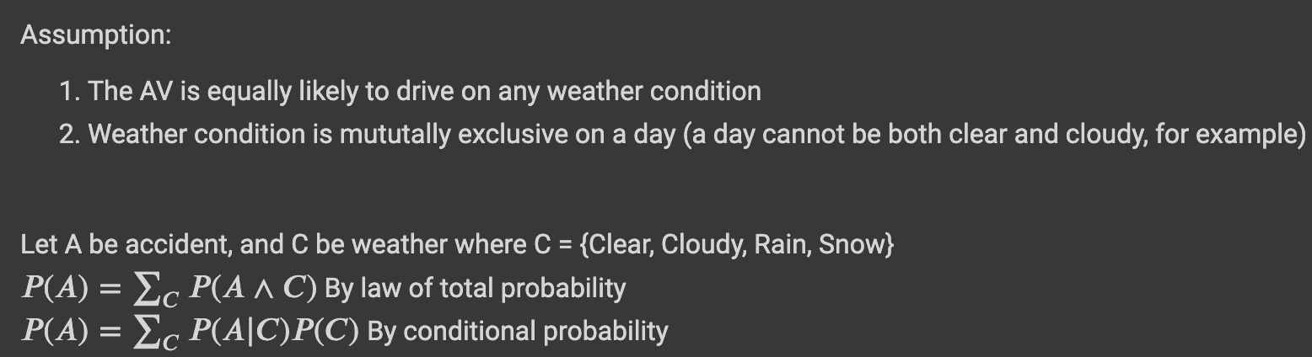
Task 4
Q2:The baseline simulated dataset contains the accident information under snowy conditions and under rainy conditions. In California it is sunny 72% of the time, rainy 10% of the time, snowy 3% of the time and the rest of the time it is cloudy. In Chicago, it is sunny 56% of the time, it rains 25% and it is snowy 9% of the time, and the rest of the time it is cloudy.
Can you use the baseline data to project the probability of accident in the cut-in scenario to California and Chicago, respectively? Clearly state your assumption and your method.

Slide 26
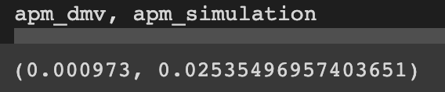
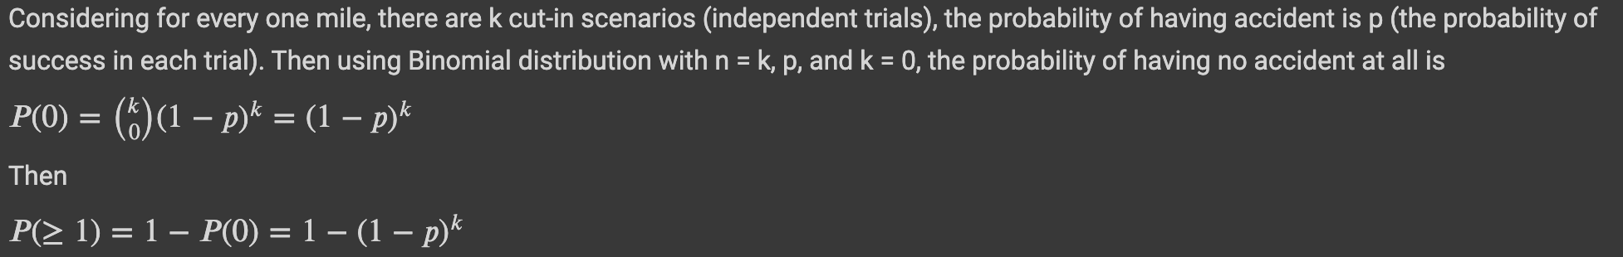
Task 4
Q3:
Unfortunately, the real DMV only has sunny and cloudy weather, how would you make a reasonable comparison between the probability of an accident of the simulated dataset and the real dataset in this case? What do you observe?
Suppose that there are k cut-in scenarios per one mile, and the probability of having an accident in one cut-in scenario is p. Starting with the Bernoulli trial, what is the probability to have at least one accident per one mile? State your reasoning in detail
Simulation has higher accident per mile than real DMV data

Slide 27
Task 4
Can you provide some explanations on the observation? Why do you think the probabilities are so different?
What are the pros and cons of simulation given the discrepancy between probability of accident in simulation and the real-world data?

Slide 28
Task 4
Q4: Given that this is the first time that the course offers an MP that involves complex simulation together with comparison with real data, what are your suggestions to improve the MP? What difficulties did you encounter? Please list your suggestions for improvement.

