Slide 1
A Machine Learning Approach to Identifying DDoS Attacks
Sean Sica
DATASCI 207
07-Mar-2024

Slide 2
Agenda
Overview
Exploratory Data Analysis
Feature Engineering
Baselines (WIP)

Slide 3
Overview
Objective: To develop a machine learning–based system capable of accurately identifying DDoS attacks in network traffic, with potential scalability towards distinguishing DDoS subtypes and other cyber threat profiles.
Deliverable: Implement a ML system for DDoS attack detection
Baselines: KNN, RF, LR
Target: Bi-LSTM CNN
Dataset: CIC-IDS2017

Slide 4
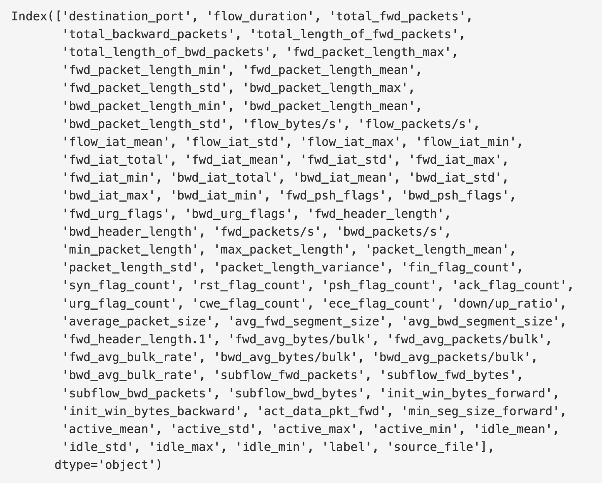
Dataset
Format:
CSV (880 MB)
PCAP (52.25 GB)
Samples: 2,830,743
Features: 80
dtypes: int64 + float64

Slide 5
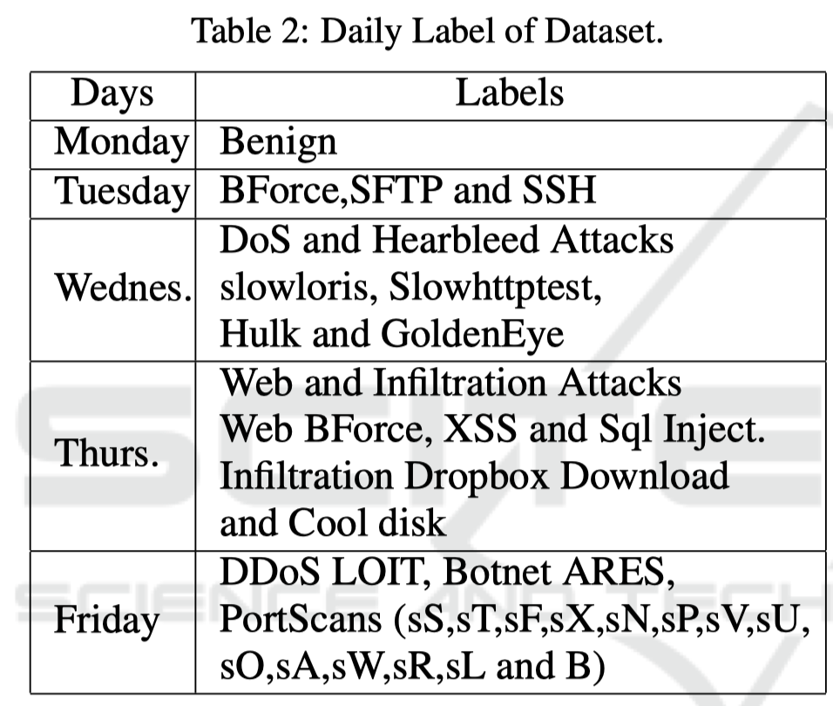
Labels
Benign
DoS GoldenEye
Heartbleed
DoS Hulk
DoS Slowhttp
DoS sloworis
SSH-Patator
FTP-Patator
Web-Attack
Infiltration
Bot
PortScan
DDoS

Slide 6
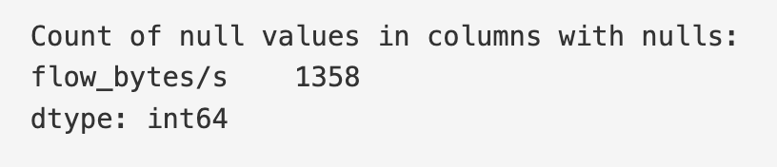
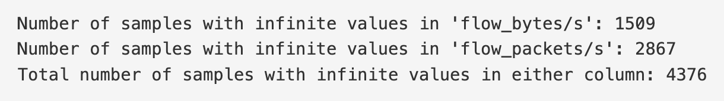
Data Sanitization
NaN values (Mean vs Zero vs Drop)
1HE the ‘label’ feature

Slide 7
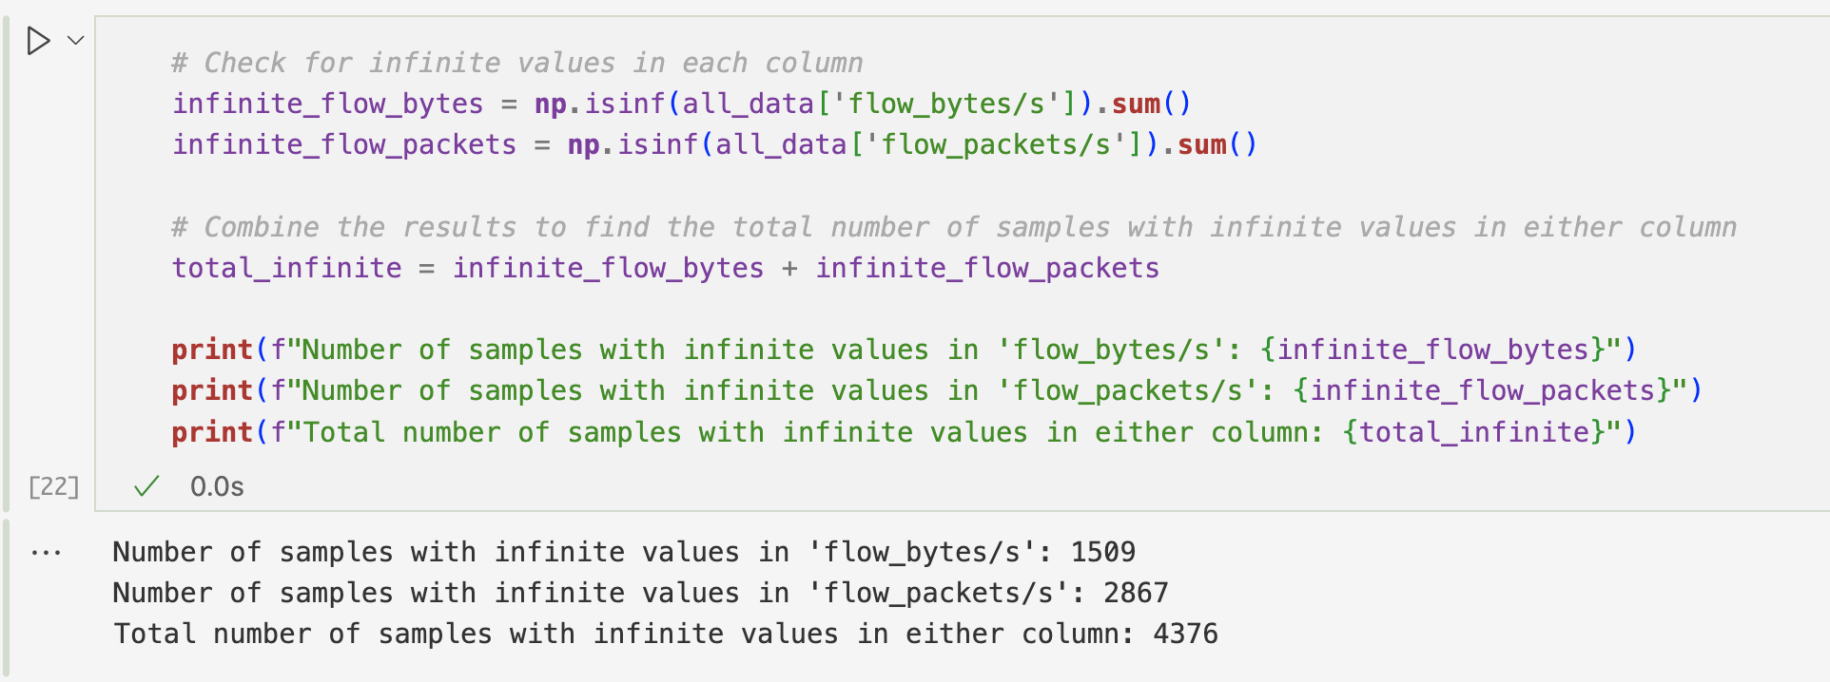
NaN Values
flow_bytes/s and flow_packets/s will prevent the models from running. These infinite values likely occur when the flow duration is 0, leading to division by zero when calculating the bytes/second and packets/second.
Theory: When the flow duration is 0, these features become undefined (division by zero).
Notes:
There are several ways to handle infinite values in these features:
* Set to 0: This is a simple approach, but it might not be the most accurate representation of the data. Setting these features to 0 implies that there was no data transmitted during the flow, which might not be true.
* Set to median/mean: Replacing infinite values with the median or mean of the respective feature can be a better option than setting them to 0. However, this approach can be sensitive to outliers and might not accurately represent the true distribution of the data.
* Drop samples: You could drop the samples with infinite values. However, this might lead to information loss, especially if a significant portion of your data contains these values.

Slide 8
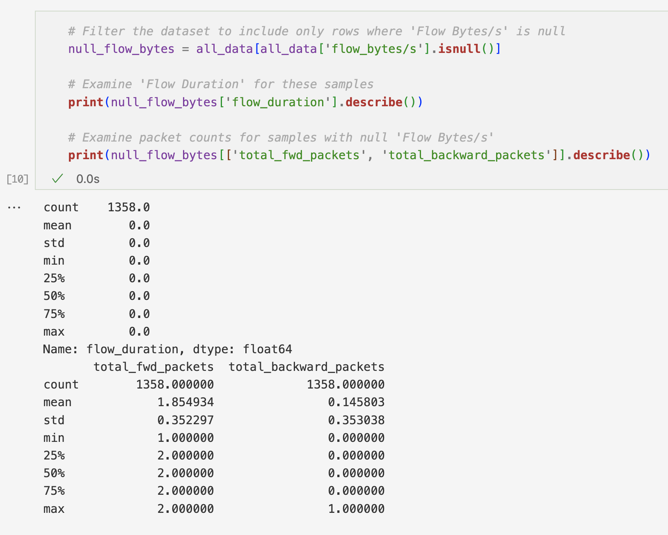
NaN Values (Cont.)
All samples with NaN flow_bytes/s have a flow_duration of zero.
Instantaneous/burst traffic.
Few ACKs.
Notes:
All samples with null flow_bytes/s have a flow_duration of 0. This suggests that these flows are instantaneous and do not last any measurable amount of time. In the context of network traffic, a flow_duration of 0 could mean that the flow was initiated and terminated within the same timestamp unit used for measurement, thus not allowing for a rate (flow_bytes/s) to be calculated.
The total_fwd_packets and total_backward_packets statistics show that, on average, there are about 1-2 forward packets and very few (if any) backward packets. This suggests minimal to no response or acknowledgment packets in these flows, which aligns with the instantaneous nature of these flows.

Slide 9
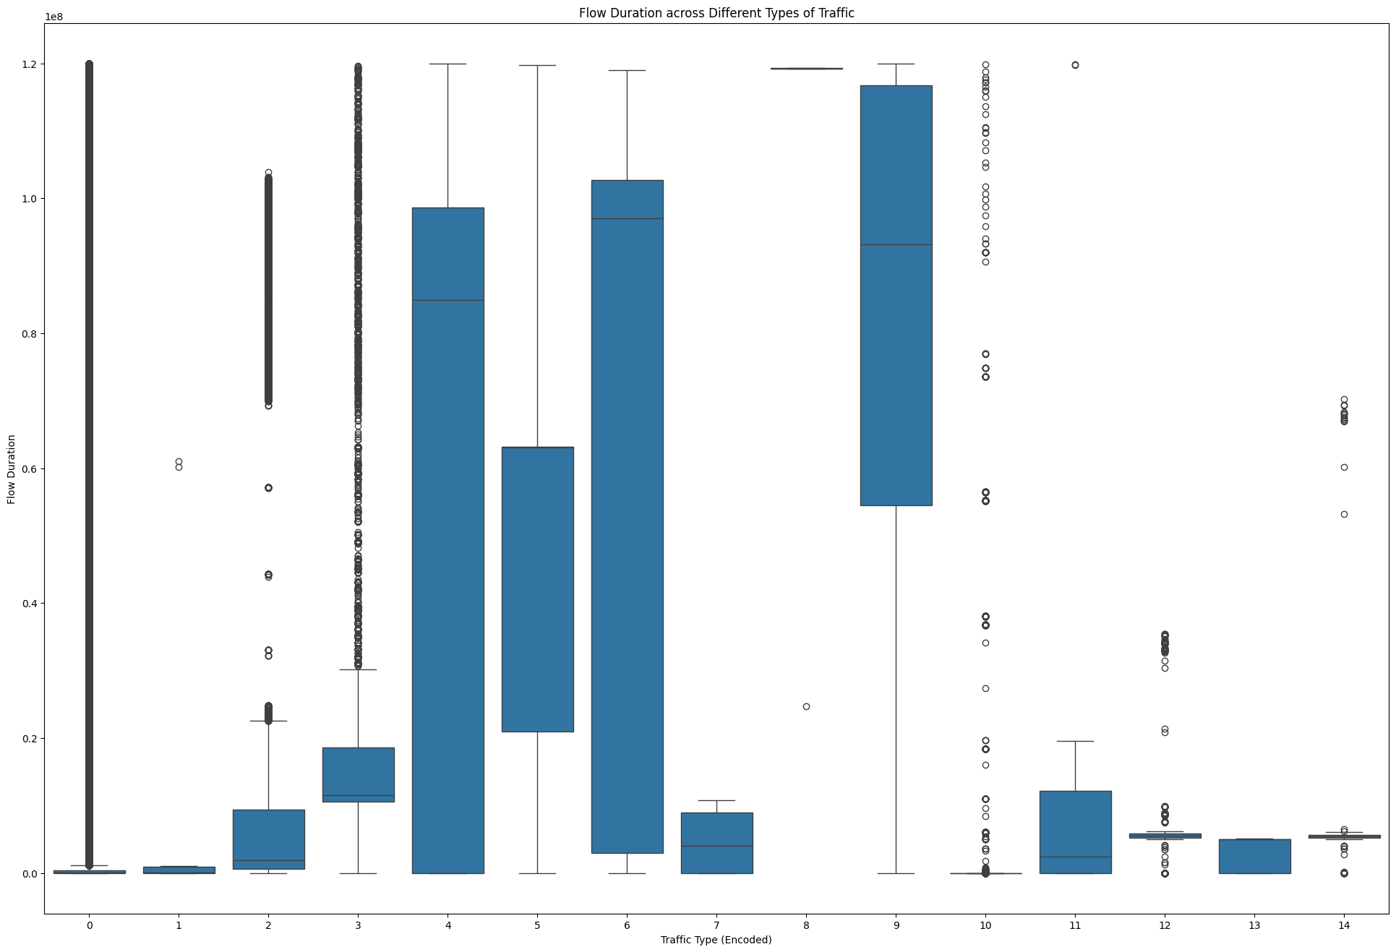
Flow Duration
Notes:
Categories like DoS Hulk and Heartbleed show a larger range of flow durations, including some extremely high values, which could indicate prolonged attack activities.
Categories such as BENIGN, Infiltration, and various Web Attacks have shorter flow durations, as indicated by the lower median and IQR, which might be typical of regular traffic or more stealthy attacks.
There are a bunch of outliers in almost all categories, especially in DoS Hulk and DDoS. This could indicate the presence of exceptionally long flows that could be due to either malicious activities or non-malicious but unusual network behavior.

Slide 10
Multicollinearity
90% Threshold → {'subflow_bwd_packets', 'bwd_packet_length_mean', 'fwd_iat_mean', 'idle_mean', 'avg_bwd_segment_size', 'bwd_packet_length_std', 'fwd_iat_max', 'avg_fwd_segment_size', 'packet_length_mean', 'ece_flag_count', 'subflow_bwd_bytes', 'packet_length_variance', 'subflow_fwd_packets', 'idle_min', 'active_min', 'fwd_packet_length_std', 'fwd_iat_std', 'total_length_of_bwd_packets', 'fwd_header_length.1', 'fwd_iat_total', 'flow_iat_max', 'average_packet_size', 'cwe_flag_count', 'fwd_packets/s', 'total_backward_packets', 'subflow_fwd_bytes', 'max_packet_length', 'idle_max', 'bwd_iat_min', 'packet_length_std', 'syn_flag_count’}
31 total!

Slide 12
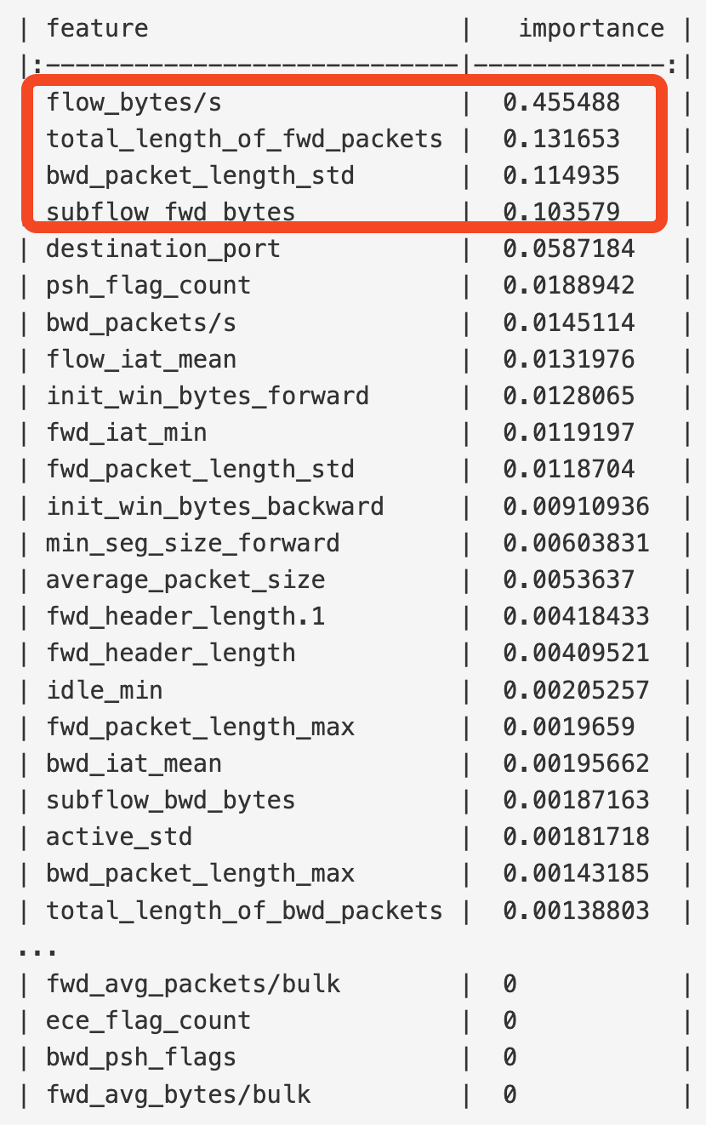
Feature Importance
RandomForestRegressor
Inspired by the researchers who created the CIC-IDS2017 dataset.
Features relating to packet length, flow duration, and sub-flow characteristics may be important

Slide 13
Baseline Models

Slide 14
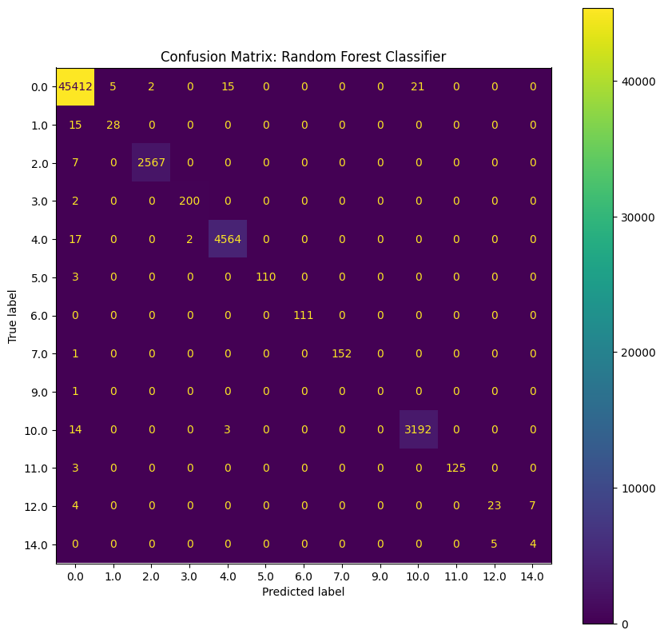
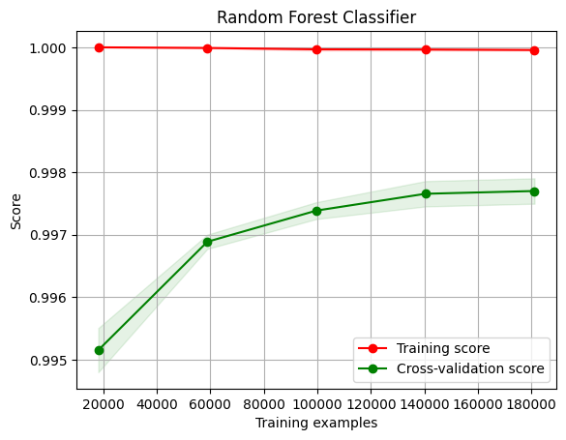
Random Forest
80/20 train test split on 10% stratified sample
n_estimators=100
max_depth=10
Test Accuracy: 0.997
Notes:
The Random Forest model has a high training score.
The cross-validation score is also high and converges towards the training score as more data is used, indicating good generalization.
The model's performance appears stable across different training set sizes, as indicated by the small variance in scores.
The model might not benefit much from more data, as the scores are already converging and plateauing.

Slide 15
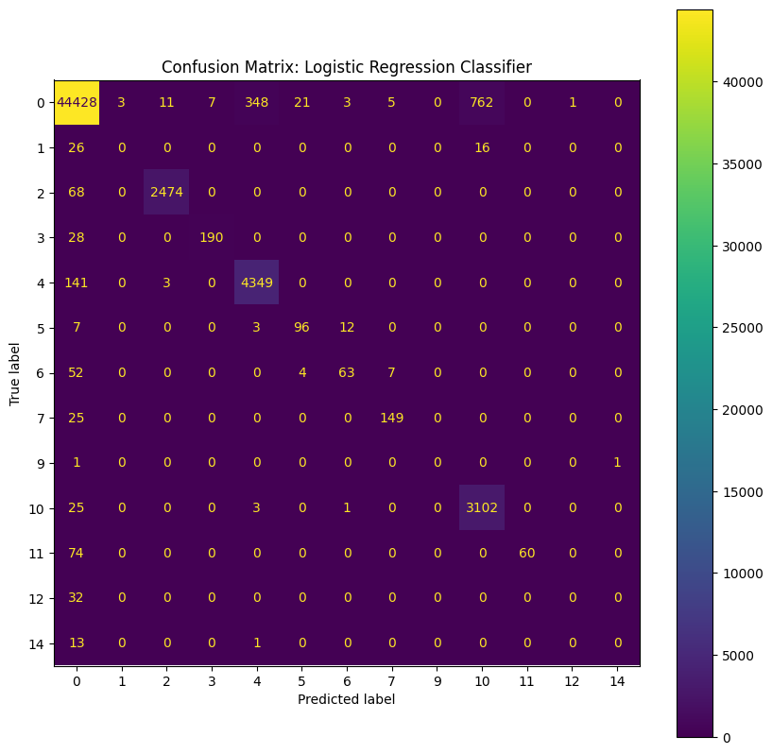
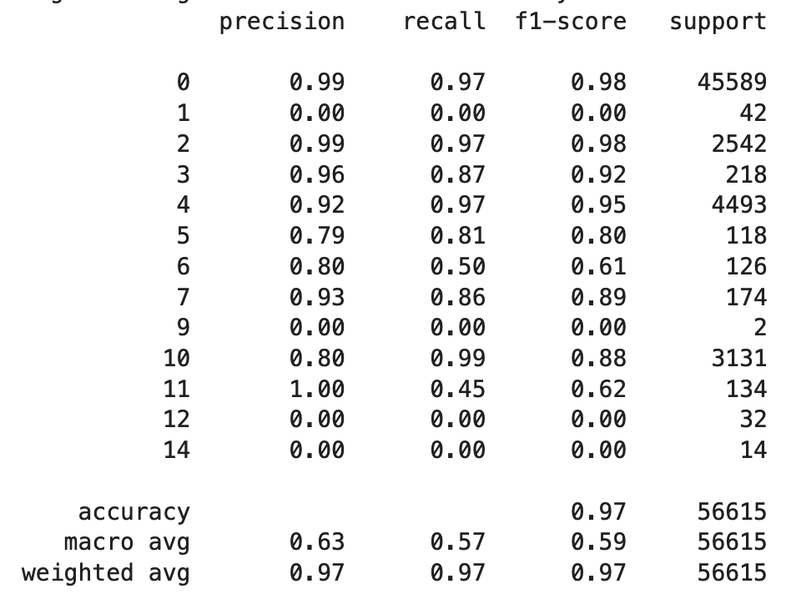
Logistic Regression
80/20 train test split on 10% stratified sample
n_estimators=100
max_depth=10
Test Accuracy: 0.969
Notes:
1. 'BENIGN' (0): The classifier did an excellent job classifying benign traffic, with 44,428 true positives and relatively few false positives and false negatives. The majority of the errors came from confusing benign traffic with 'DoS Hulk' (class 4) and 'PortScan' (class 10), with 348 and 762 instances, respectively.
2. 'Bot' (1): The classifier did not correctly identify any traffic as 'Bot', which is a concern. There were 26 instances classified as benign, and a few instances confused with other classes.
3. 'DDoS' (2): The classifier correctly identified 2,474 instances of DDoS, with 68 instances incorrectly labeled as benign. The classification of DDoS traffic is quite good but not perfect, as there are some confusions with other classes.
4. 'DoS GoldenEye' (3): There were 190 true positives with some confusion with 'BENIGN', 'DoS Hulk', and 'DoS Slowhttptest'.
5. 'DoS Hulk' (4): This class has a high number of true positives (4,349) and is the second-most frequent source of confusion for the 'BENIGN' class.
6. 'DoS Slowhttptest' (5): This class is mostly correctly identified, with some confusion with 'FTP-Patator' and 'DoS slowloris'.
7. 'DoS slowloris' (6): The classifier identified 63 instances correctly but also confused this class with 'DoS Hulk' and 'FTP-Patator'.
8. 'FTP-Patator' (7): Most instances were correctly classified, with some confusion with 'DoS Slowhttptest' and 'DoS slowloris'.
9. 'Heartbleed' (8): This is likely a class with very few instances in the dataset, indicated by the single instance misclassified as 'BENIGN' and one instance as 'PortScan'.
10. 'Infiltration' (9): With only two instances, both were misclassified.
11. 'PortScan' (10): This class has a high number of true positives (3,102), showing the classifier is quite adept at identifying port scanning activity.
12. 'SSH-Patator' (11): This class was partially correctly identified, with a significant number of misclassifications.
13. 'Web Attack – Brute Force' (12), 'Web Attack – Sql Injection' (13), and 'Web Attack – XSS' (14): All instances were misclassified, which is concerning if these are critical attack vectors you want to detect.

Slide 16
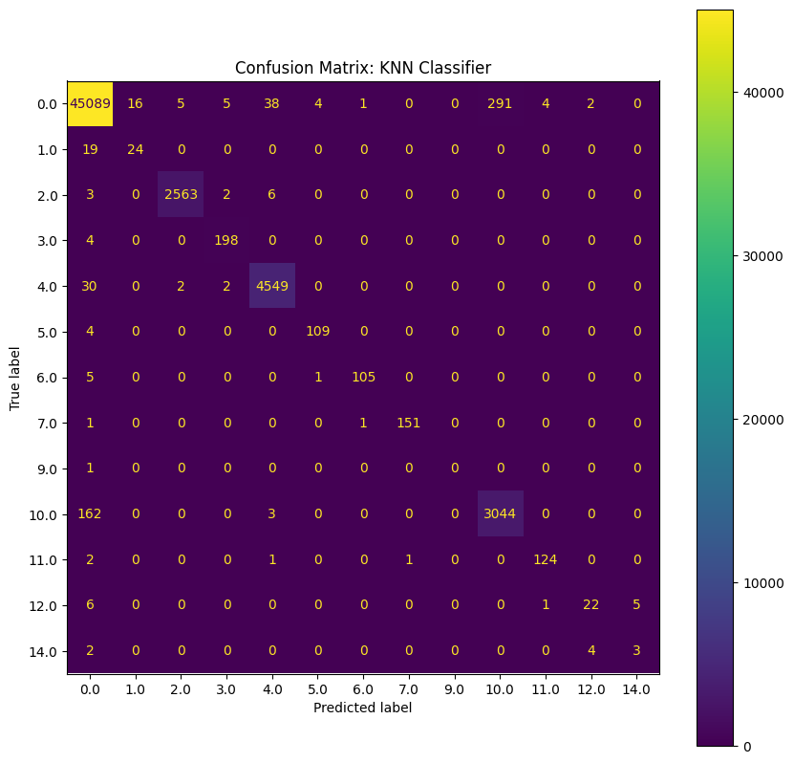
KNN
80/20 train test split on 10% stratified sample
n_neighbors = 5
StandardScaler + Mean Simple Imputer
Accuracy: 0.9888

Slide 17
Next Steps
Feature Reduction w/ PCA
Need speed!
More baselines
PCAP file format as input
Sequential Backward Selection (SBS)

