Slide 1
Customer Churn Prediction Using Machine Learning Models
AI Mini Project
Group 3:
1.Henry mumo - BDSA/MK/4398/09/25
2.Sean Simiyu - BDSA/MK/3667/09/25
3.Shannel Kerebi BDSA/MK/4424/09/25
4.Gilmer kipkoech BDSA/MK/3023/09/25
5.Juliet Gitonga - BDSA/MK/4197/09/25
6.Justus Lemik - BDSA/MK/4049/09/25
7.Wilig Leleruk - BDSA/MK/3427/09/25
8.Hassan- BDSA/MK4318/09/25
9.Brian Muriithi - BDSA/M/5054/09/25

Slide 2
Problem Statement
Predict customer churn using machine learning.
Compare Logistic Regression, Decision Tree and Random Forest.
Identify the best-performing model.
Background
Customer churn occurs when customers stop using a company's products or services. High customer churn leads to reduced revenue, increased marketing costs, and lower customer loyalty. Businesses need a way to identify customers who are likely to leave before it happens.
Problem
Many companies struggle to accurately predict which customers are at risk of churning, making it difficult to take timely action to retain them.
Project Objectives
• Predict customer churn using machine learning techniques.
• Compare the performance of Logistic Regression, Decision Tree, and Random Forest models.
• Identify the model that provides the most accurate predictions.
• Provide insights that can help businesses improve customer retention.

Slide 3
DATASET OVERVIEW Dataset
This project uses the Telco Customer Churn dataset, which contains customer information and their churn status. The dataset is used to train machine learning models to predict whether a customer is likely to leave the company's services.
Dataset Information:
~7,043 customer records
Target: Churn (Yes/No)
Features include Tenure, Contract Type, Internet Service, Monthly Charges.
Why this Dataset?
• It contains real customer behaviour data.
• It is suitable for binary classification problems.
• It helps identify customers who are likely to churn, enabling businesses to improve customer retention strategies.

Slide 4
Data Preprocessing
Before training the machine learning models, the dataset was prepared through several preprocessing steps to improve data quality and model performance.
Data Preprocessing Steps:
Data cleaning
Handled missing values
Encoded categorical variables
Train-test split
Proper preprocessing improves data quality, reduces errors, and helps machine learning models learn more effectively, resulting in better prediction accuracy.

Slide 5
Methods
Models: Logistic Regression, Decision Tree, Random Forest
To determine the best-performing model, each machine learning algorithm was evaluated using four performance metrics: Accuracy, Precision, Recall, and F1 Score.
Evaluation Metrics
• Accuracy – Measures the overall percentage of correct predictions.
• Precision – Measures how many customers predicted to churn actually churned.
• Recall – Measures how many actual churning customers were correctly identified.
• F1 Score – A balanced measure that combines Precision and Recall

Slide 6
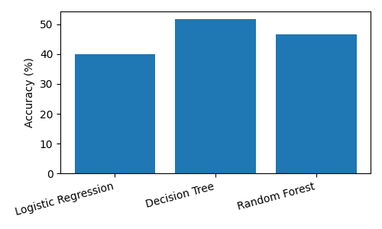
Results
Decision Tree achieved the best overall performance.
Accuracy: LR 40.00% | DT 51.67% | RF 46.67%
F1 Score: LR 28.00% | DT 47.27% | RF 33.33%

Slide 7
DEMONSTRATION
The trained machine learning model was tested using customer information to predict whether a customer is likely to churn.
Prediction Workflow:
Customer Information
↓
Data Preprocessing
↓
Selected Machine Learning Model
↓
Prediction
↓
Churn (Yes/No)
Input:
• Contract Type:
• Tenure:
• Monthly Charges:
• Internet Service:
Output:
Prediction: Churn = Yes
This demonstrates how the model can identify customers who are at risk of leaving, allowing businesses to take preventive action.

Slide 8
LEARNINGS
Throughout this project, we learnt:
• How to collect, clean, and preprocess data for machine learning.
• How to train and compare multiple classification models.
• How to evaluate model performance using Accuracy, Precision, Recall, and F1 Score.
• The importance of selecting the most suitable model based on evaluation metrics.
• How machine learning can support real-world business decision-making,

Slide 9
Conclusion
This project successfully developed and evaluated three machine learning models for predicting customer churn.
After comparing the models using Accuracy, Precision, Recall, and F1 Score, the Decision Tree model achieved the best overall performance with:
• Accuracy: 51.67%
• Precision: 44.83%
• Recall: 50.00%
• F1 Score: 47.27%

Slide 10
Thank You

